Slide 1


PY2021 LI Evaluation of California Capacity Bidding Programs
Date: May 4, 2022
Prepared for: 2022 DRMEC Load Impact Workshop

Slide 2
Agenda
Program Descriptions
Program Results by IOU
Key Findings
Overall Description
Ex-Post Load Impacts
Statewide Summaries
Descriptions by IOU
Monthly Nominations
Dispatch Summary
Ex-Ante Forecast Assumptions
Ex-Ante Load Impacts

Slide 3


Program Descriptions
3

Slide 4

Program Basics
Statewide aggregator-managed DR program offered by PG&E, SCE, and SDG&E
Aggregator Responsibilities
Recruitment and contracting with eligible customers,
Capacity Payments
Aggregators receive monthly capacity payments based on nominated load + energy payments based on kWh delivered reductions during events.
Capacity payments may be adjusted based on performance.
Aggregators receive the full monthly capacity payment according to their nominations if no events are dispatched for that month.
Monthly resource nominations to IOU programs,
Customer/resource delivery to dispatched events,
Customer disbursement of program incentives.
Report definition of “program” is IOU + Customer Class + Notification Type
Program Description
Applied Energy Group, Inc. | appliedenergygroup.com

Slide 5
Program Descriptions by IOU
 | PG&E | SCE | SDG&E
Active Programs | Residential Day Ahead Non-Residential Day Ahead | Non-Residential Day Ahead Non-Residential Day Of | Non-Residential Day Ahead Non-Residential Day Of
Products | Prescribed DA Elect DA Elect+ DA | DA 1-6 Hour DO 1-6 Hour | DA 11-7 Hour DA 1-9 Hour DO 11-7 Hour DO 1-9 Hour
Dispatch Window | 1 PM – 9 PM | 3 PM – 9 PM | 11 AM – 7 PM or 1 PM – 9 PM
Event Trigger | CAISO Market Awards | CAISO Market Awards | CAISO Market Awards
Eligible Days | May – October non-holiday weekdays, option for weekends | Year-Round non-holiday weekdays | May – October non-holiday weekdays
Event duration | 1-4 hours, 2-6 hours, 1-8 hours or 1-24 hours | 1-6 hours | 2-4 hours
Event day limit | 6 events per month | 5 events per month | 6 events per month
Event hour limit | 30 hours per month | 30 hours per month | 24 hours per month

Slide 6
PG&E
Programs
6

Slide 7
Month | Residential DA |  | Non-Residential DA
 | Enrolled Accounts | Nominated Capacity (MW) | Enrolled Accounts | Nominated Capacity (MW)
May | - | - | 701 | 34.2
June | - | - | 750 | 41.6
July | - | - | 938 | 61.3
August | - | - | 942 | 60.8
September | 23 | XXX | 980 | 56.0
October | 19 | XXX | 960 | 47.0
Avg. Summer | 21 | XXX | 879 | 50.1
PG&E
Monthly Nominations
Applied Energy Group, Inc. | appliedenergygroup.com

Slide 8
Key Definitions: Nomination v. Dispatch
 | Nomination (July) | Dispatch (July Event 1) SubLAP 2; HE20 | Dispatch (July Event 2) SubLAP 1 & 3; HE20-HE21
Aggregator 1 | Resource 1 (SubLAP 1) |  | Resource 1 (SubLAP 1)
 | Resource 2 (SubLAP 2) | Resource 2 (SubLAP 2)
 | Resource 3 (SubLAP 3) |  | Resource 3 (SubLAP 3)
Aggregator 2 | Resource 4 (SubLAP 2) | Resource 4 (SubLAP 2)
 | Resource 5 (SubLAP 3) |  | Resource 5 (SubLAP 3)
Aggregator 3 | Resource 6 (SubLAP 2) | Resource 6 (SubLAP 2)
Aggregator 4 | Resource 7 (SubLAP 1) |  | Resource 7 (SubLAP 1)
 | Resource 8 (SubLAP 2) | Resource 8 (SubLAP 2)
 | Resource 9 (SubLAP 3) |  | Resource 9 (SubLAP 3)

Slide 9
PG&E
Dispatch Summary
Month | Residential DA |  | Non-Residential DA
 | Total Event Days | Total Event Hours | Total Event Days | Total Event Hours
May |  |  | 3 | 3
June |  |  | 3 | 5
July |  |  | 13 | 31
August |  |  | 7 | 16
September | 6 | 18 | 7 | 22
October | 6 | 13 | 9 | 18
Total Summer | 12 | 31 | 42 | 95
Applied Energy Group, Inc. | appliedenergygroup.com

Slide 10
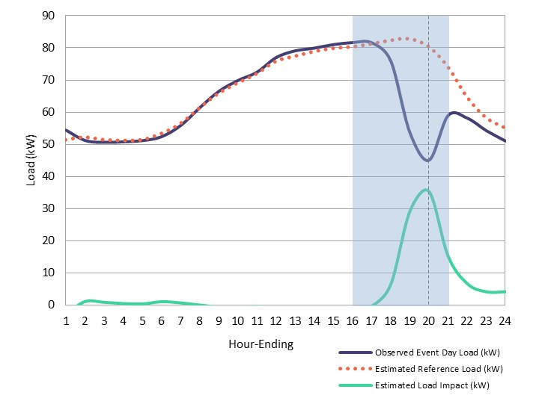
Average Event Day
PG&E
Non-Res DA
 | HE14 | HE15 | HE16 | HE17 | HE18 | HE19 | HE20 | HE21
Event 1
Event 2
Event 3
Event 4
Event 5
Event 6
Event 7
Event 8
Event 9
Event 10
Event 11
Event 12
Event 13
Event 14
Event 15
*Shaded blocks represent event hours dispatched.
**HE20 is the reporting hour.

Slide 11
Key Definitions: Delivery Performance v. Adjusted Delivery Performance
 | Dispatched MW | HE20 Dispatched | HE14 | HE15 | HE16 | HE17 | HE18 | HE19 | HE20 | HE21
Event 1 | 7.0 | Yes
Event 2 | 24.4 | Yes
Event 3 | 24.7 | Yes
Event 4 | 0.9 | Yes
Event 5 | 10.5
Event 6 | 11.0
Event 7 | 11.0
Event 8 | 9.3 | Yes
Event 9 | 11.0 | Yes
Event 10 | 11.0
Event 11 | 2.3
Event 12 | 0.1 | Yes
Event 13 | 5.8 | Yes
Event 14 | 9.3 | Yes
Event 15 | 0.1 | Yes
Total Dispatch MW | 138.5
HE20 Dispatch MW | 92.6

Slide 12
PG&E
Ex-Post Load Impacts
Program | Month | Ex-Post Estimate (MW) | Dispatched |  | HE20 Dispatched
 |  |  | MW | % Delivered | MW | Adj % Delivered
Res DA | Avg. Event (2021) | XX | XX | XX | XX | XX
 | Avg. Event (2020) | XX | XX | XX | - | -
 | Avg. Event (2019) | XX | XX | XX | - | -
Non-Res DA | Avg. Event (2021) | 13.0 | 13.5 | 96% | 12.4 | 105%
 | Avg. Event (2020) | 10.0 | 15.6 | 64% | - | -
 | Avg. Event (2019) | 9.8 | 9.2 | 106% | - | -
Applied Energy Group, Inc. | appliedenergygroup.com

Slide 13
 | Res DA | Non-Res DA
Program Changes | No program changes impacting forecast assumptions | No program changes impacting forecast assumptions
Nomination Forecast | 4 MW for August 2023 2.5 MW for 2022 Flat forecast from 2023-2032 | 55 MW for August 2022 Flat forecast from 2023-2032
Delivery Performance | 61% min delivery threshold for penalties | 100% based on PY2021 Ex-Post
Impact Degradation Rate* | N/A due to absence of historical performance data | Based on PY2020-2021 historical data.
Max Load Impact | Used % impacts from HE20 results due to solar customers with less available load during earlier hours of the RA window | HE20 per-customer impacts from Ex-Post
RA Window Response | 4-hour max response based on historical preference to the 1-4-hour event duration option; assume no response in HE21 (5th hour) | 4-hour max response based on historical preference to the 1-4-hour event duration option; assume no response in HE21 (5th hour)
PG&E
Ex-Ante Forecast Assumptions
*Represents how customers maintain impacts through events called for longer durations, similar to the 5-hour RA Window.
Applied Energy Group, Inc. | appliedenergygroup.com

Slide 14
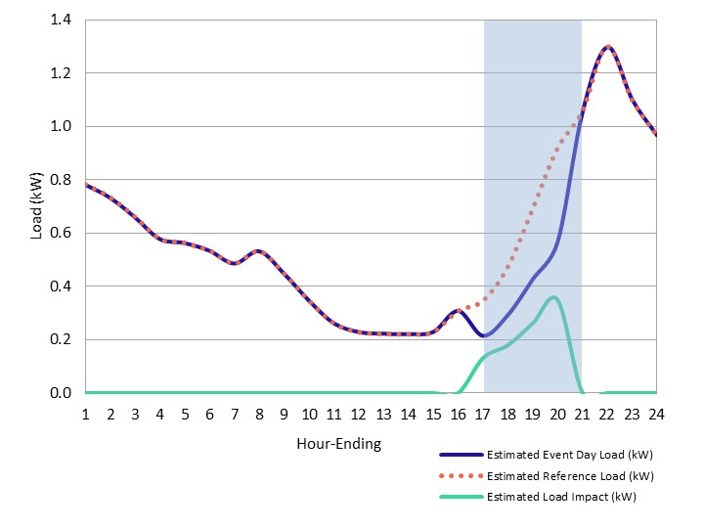
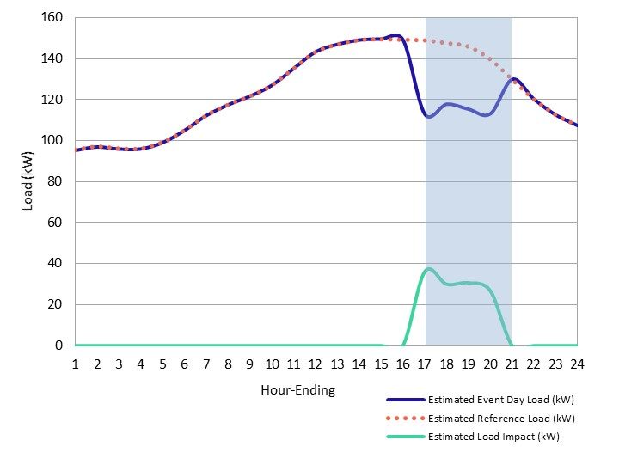
Ex-Ante Hourly Load Profiles
PG&E
Res DA
PG&E 1-in-2, August Peak Day, 2023
Non-Res DA
PG&E 1-in-2, August Peak Day, 2022

Slide 15
PG&E 1-in-2, August Peak Day
PG&E
Ex-Ante Load Impact Forecast
Program | Estimate | # of Accounts | Aggregate (MW) |  | Per-Customer (kW) |  | % Impact
 |  |  | Impact | Ref. Load | Impact | Ref. Load
Res DA* | PY2021 Forecast | 4,357 | 0.9 | 2.7 | 0.2 | 0.6 | 32%
 | PY2020 Forecast | 16,494 | 4.9 | 23.6 | 0.3 | 1.4 | 21%
Non-Res DA | PY2021 Forecast | 1,505 | 37.1 | 214.5 | 24.6 | 142.5 | 17%
 | PY2020 Forecast | 2,258 | 44.7 | 292.8 | 19.8 | 129.7 | 15%
*Shown for 2022 Typical event day due to zero forecasted August 2022 enrollments.
Applied Energy Group, Inc. | appliedenergygroup.com

Slide 16
SCE
Programs
16

Slide 17
Month | Non-Residential DA |  | Non-Residential DO
 | Enrolled Accounts | Nominated Capacity (MW) | Enrolled Accounts | Nominated Capacity (MW)
May | 416 | 10.2 | 278 | 4.2
June | 414 | 9.9 | 279 | 4.4
July | 403 | 10.6 | 266 | 4.1
August | 379 | 8.7 | 265 | 3.4
September | 373 | 9.0 | 270 | 3.6
October | 364 | 7.2 | 259 | 3.3
Avg. Summer | 392 | 9.3 | 270 | 3.8
SCE
Monthly Nominations
Applied Energy Group, Inc. | appliedenergygroup.com

Slide 18
SCE
Dispatch Summary
Month | Non-Residential DA |  | Non-Residential DO
 | Total Event Days | Total Event Hours | Total Event Days | Total Event Hours
May | 5 | 7 | 5 | 7
June | 5 | 20 | 8 | 38
July | 7 | 21 | 7 | 23
August | 5 | 26 | 6 | 28
September | 5 | 30 | 1 | 4
October | 5 | 22 | 0 | 0
Total Summer | 32 | 126 | 27 | 100
Applied Energy Group, Inc. | appliedenergygroup.com

Slide 19
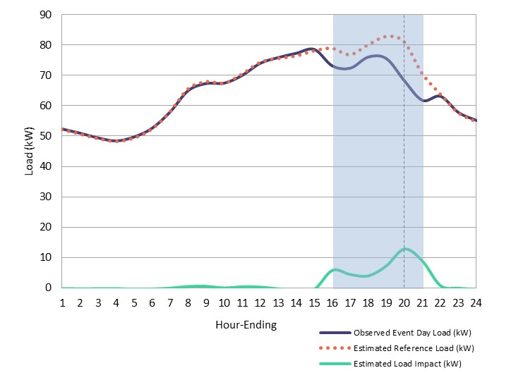
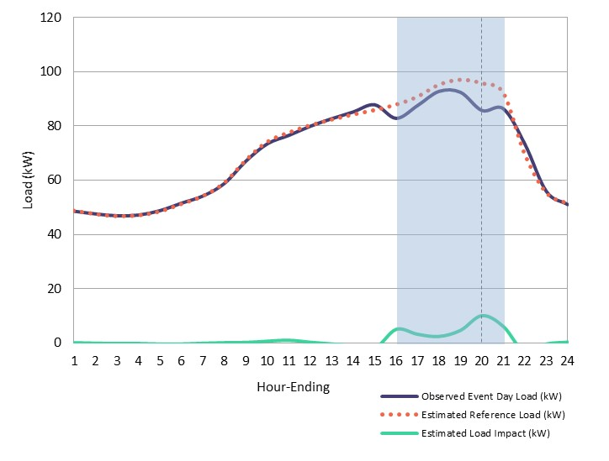
Average Event Day
Non-Res DA
SCE
 | HE16 | HE17 | HE18 | HE19 | HE20 | HE21
Event 1
Event 2
Event 3
Event 4
Event 5
Event 6
Event 7
Event 8
Event 9
Event 10
Event 11
Event 12
Event 13
Event 14
Event 15
Non-Res DO
*Shaded blocks represent event hours dispatched.
**HE20 is the reporting hour.

Slide 20
SCE
Ex-Post Load Impacts
Program | Month | Ex-Post Estimate (MW) | Dispatched |  | HE19 Dispatched
 |  |  | MW | % Delivered | MW | Adj % Delivered
Non-Res DA | Avg. Event (2021) | 4.0 | 7.6 | 53% | 7.5 | 53%
 | Avg. Event (2020) | 3.9 | 6.0 | 65% | - | -
 | Avg. Event (2019) | 2.7 | 3.8 | 72% | - | -
Non-Res DO | Avg. Event (2021) | 2.0 | 2.9 | 70% | 2.8 | 71%
 | Avg. Event (2020) | 2.9 | 4.4 | 67% | - | -
 | Avg. Event (2019) | 2.4 | 4.6 | 52% | - | -
Applied Energy Group, Inc. | appliedenergygroup.com

Slide 21
 | Non-Residential Day Ahead & Day Of
Program Changes | No program changes impacting forecast assumptions
Enrollment Forecast | Flat enrollment forecast based on average PY2021 summer enrollment
Delivery Performance | 53% for DA summer; 71% for DO summer 0% delivery performance for non-summer months Based on PY2021 findings
Impact Degradation Rate* | Based on PY2019-2021 historical data.
Max Load Impact | HE20 per-customer impacts from Ex-Post
SCE
Ex-Ante Forecast Assumptions
*Represents how customers maintain impacts through events called for longer durations, similar to the 5-hour RA Window.
Applied Energy Group, Inc. | appliedenergygroup.com

Slide 22
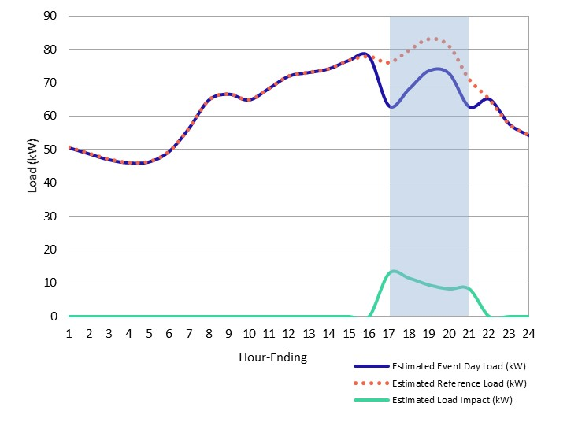
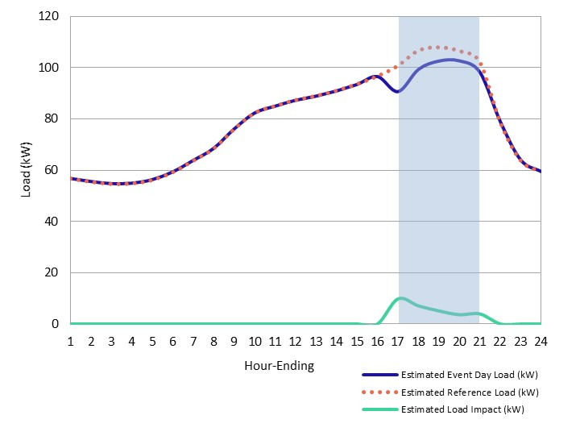
Ex-Ante Hourly Load Profiles
SCE
Non-Res DA
SCE 1-in-2, August Peak Day, 2022
Non-Res DO
SCE 1-in-2, August Peak Day, 2022

Slide 23
SCE 1-in-2, August Peak Day
SCE
Ex-Ante Load Impact Forecast
Program | Estimate | # of Accounts | Aggregate (MW) |  | Per-Customer (kW) |  | % Impact
 |  |  | Impact | Ref. Load | Impact | Ref. Load
Non-Res DA | PY2021 Forecast | 410 | 4.2 | 32.1 | 10.1 | 78.3 | 13%
 | PY2020 Forecast | 410 | 2.6 | 36.2 | 6.2 | 88.3 | 7%
Non-Res DO | PY2021 Forecast | 290 | 1.7 | 30.4 | 6.0 | 104.7 | 6%
 | PY2020 Forecast | 380 | XXX | XXX | XXX | XXX | XXX
Applied Energy Group, Inc. | appliedenergygroup.com

Slide 24
SDG&E
Programs
24

Slide 25
Month | Non-Residential DA |  | Non-Residential DO
 | Enrolled Accounts | Nominated Capacity (MW) | Enrolled Accounts | Nominated Capacity (MW)
May | 40 | 1.4 | 134 | 2.9
June | 48 | 1.2 | 126 | 3.2
July | 36 | 1.0 | 133 | 3.3
August | 48 | 1.0 | 133 | 3.3
September | 35 | 0.8 | 130 | 3.4
October | 48 | 1.0 | 131 | 3.1
Avg. Summer | 43 | 1.1 | 131 | 3.2
SDG&E
Monthly Nominations
Applied Energy Group, Inc. | appliedenergygroup.com

Slide 26
SDG&E
Dispatch Summary
Month | Non-Residential DA |  | Non-Residential DO
 | Total Event Days | Total Event Hours | Total Event Days | Total Event Hours
May | 0 | 0 | 0 | 0
June | 6 | 25 | 5 | 13
July | 7 | 16 | 5 | 12
August | 3 | 8 | 2 | 6
September | 6 | 17 | 6 | 19
October | 6 | 18 | 5 | 11
Total Summer | 28 | 84 | 23 | 61
Applied Energy Group, Inc. | appliedenergygroup.com

Slide 27
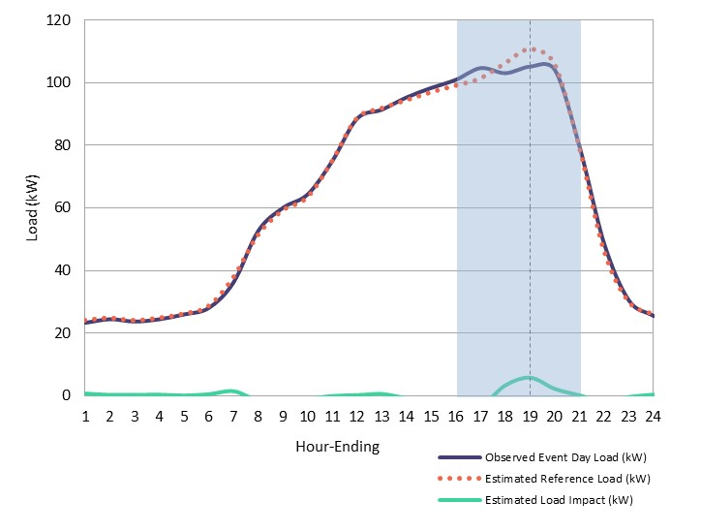
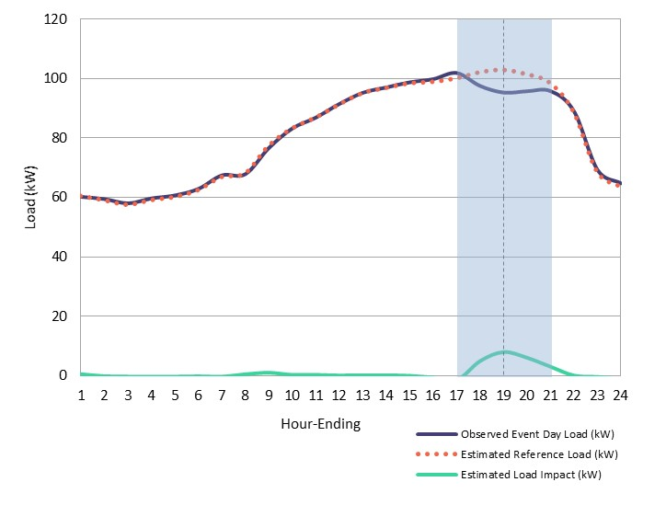
Average Event Day
Non-Res DA
SDG&E
 | HE12 | HE13 | HE14 | HE15 | HE16 | HE17 | HE18 | HE19 | HE20 | HE21
Event 1
Event 2
Event 3
Event 4
Event 5
Event 6
Event 7
Event 8
Event 9
Event 10
Event 11
Event 12
Event 13
Event 14
Event 15
Non-Res DO
*Shaded blocks represent event hours dispatched.
**HE19 is the reporting hour.

Slide 28
SDG&E
Ex-Post Load Impacts
Program | Month | Ex-Post Estimate (MW) | Dispatched |  | HE19 Dispatched
 |  |  | MW | % Delivered | MW | Adj % Delivered
Non-Res DA | Avg. Event (2021) | 0.3 | 1.1 | 25% | 1.0 | 26%
 | Avg. Event (2020) | 0.4 | 0.6 | 71% | - | -
 | Avg. Event (2019) | 0.4 | 0.7 | 54% | - | -
Non-Res DO | Avg. Event (2021) | 1.0 | 3.4 | 30% | 3.4 | 30%
 | Avg. Event (2020) | 2.2 | 2.9 | 74% | - | -
 | Avg. Event (2019) | 3.6 | 3.6 | 101% | - | -
Applied Energy Group, Inc. | appliedenergygroup.com

Slide 29
 | Non-Residential Day Ahead & Day Of
Program Changes** | Adding new Elect product options for the 1-9 PM dispatch window
Nomination Forecast | Solicited aggregator feedback on participation outlook for new Elect options and existing Prescribed options; this included current participants in other DR programs that will likely shift to CBP Elect options.
Enrollment Forecast | 2% growth from 2022-2027 1% DO+TI growth from 2022-2023
Delivery Performance | 48% based on PY2020-21 Ex-Post
Impact Degradation Rate* | Based on PY2019-2021 historical data.
Max Load Impact | HE19 per-customer impacts from Ex-Post
SDG&E
Ex-Ante Forecast Assumptions
*Represents how customers maintain impacts through events called for longer durations, similar to the 5-hour RA Window.
** Currently assumes existing Prescribed options are offered until 2032
Applied Energy Group, Inc. | appliedenergygroup.com

Slide 30
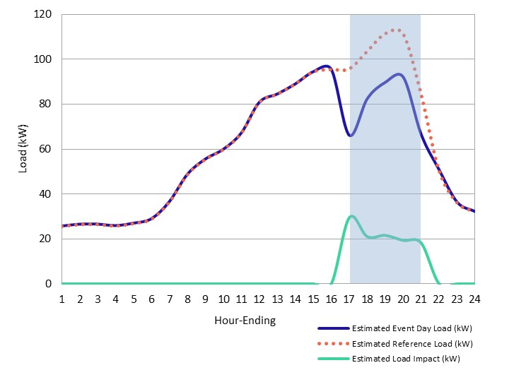
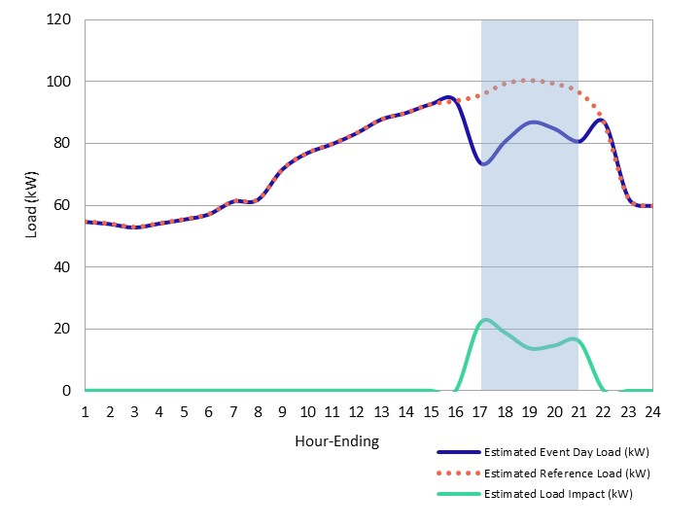
Ex-Ante Hourly Load Profiles
SDG&E
Non-Res DA
SDG&E 1-in-2, August Peak Day, 2022
Non-Res DO
SDG&E 1-in-2, August Peak Day, 2022

Slide 31
SDG&E 1-in-2, August Peak Day
SDG&E
Ex-Ante Load Impact Forecast
Program | Estimate | # of Accounts | Aggregate (MW) |  | Per-Customer (kW) |  | % Impact
 |  |  | Impact | Ref. Load | Impact | Ref. Load
Non-Res DA | PY2021 Forecast | 105 | 2.3 | 10.6 | 22.0 | 101.4 | 22%
 | PY2020 Forecast | 19 | 0.2 | 2.3 | 11.8 | 120.0 | 10%
Non-Res DO | PY2021 Forecast | 208 | 3.5 | 20.4 | 16.9 | 98.3 | 17%
 | PY2020 Forecast | 167 | 1.5 | 16.0 | 9.1 | 95.8 | 9%
Applied Energy Group, Inc. | appliedenergygroup.com

Slide 32
Key Findings
32

Slide 33
Program |  | Nominations |  | Overall Dispatched |  | Reporting Hour Dispatched |  | Ex-Post Analysis
 |  | # Accts | Capacity (MW) | # Accts | Capacity (MW) | # Accts | Capacity (MW) | Impact (MW) | % Delivered | Adj. % Delivered
PG&E | Res DA | 21 | XXX | 21 | XXX | 14 | XXX | XXX | XXX | XXX
 | Non-res DA | 879 | 50.1 | 365 | 13.5 | 345 | 12.4 | 13.0 | 96% | 105%
SCE | Non-res DA | 392 | 9.3 | 312 | 7.6 | 308 | 7.5 | 4.0 | 53% | 53%
 | Non-res DO | 270 | 3.8 | 203 | 2.9 | 198 | 2.8 | 2.0 | 70% | 71%
SDG&E | Non-res DA | 43 | 1.1 | 46 | 1.1 | 43 | 1.0 | 0.3 | 25% | 26%
 | Non-res DO | 131 | 3.2 | 133 | 3.4 | 133 | 3.4 | 1.0 | 30% | 30%
Statewide Ex-Post Impacts
  *Results shown for summer months only (May through October)
Applied Energy Group, Inc. | appliedenergygroup.com

Slide 34
Program |  | Dispatched Accounts | Dispatched MW | Ex-Post Impact MW | Ex-Post % Delivered | Event Temp (F)
PG&E | Res DA | 23 | XX | XX | XX | 76
 | Non-res DA | 9 | XX | XX | XX | 71
SCE | Non-res DA | 269 | 6.5 | 2.9 | 45% | 85
 | Non-res DO | - | - | - |  | -
SDG&E | Non-res DA | 18 | 0.5 | 0.7 | 140% | 85
 | Non-res DO | 11 | 0.3 | 0.2 | 66% | 77
Statewide System Peak Hour Sep 8, 2021 (HE18)
Applied Energy Group, Inc. | appliedenergygroup.com

Slide 35
Program |  | Enrollment Forecast |  |  | Aggregate Impact Forecast (MW)
 |  | 2022 | 2023 | 2027-2032 (Each Year) | 2022 | 2023 | 2027-2032 (Each Year)
PG&E | Res DA | 0 | 6,972 | 6,972 | 0.0 | 1.3 | 1.3
 | Non-res DA | 1,505 | 1,505 | 1,505 | 37.1 | 37.1 | 37.1
SCE | Non-res DA | 410 | 410 | 410 | 4.2 | 4.2 | 4.2
 | Non-res DO | 290 | 290 | 290 | 1.7 | 1.7 | 1.7
SDG&E | Non-res DA | 105 | 107 | 116 | 2.3 | 2.4 | 2.6
 | Non-res DO | 208 | 212 | 227 | 3.5 | 3.6 | 3.8
Statewide Ex-Ante Impacts
  *Results shown for summer months only (May through October)
Applied Energy Group, Inc. | appliedenergygroup.com

Slide 36





AEG Team
Kelly Marrin
Project Director
Maggie Buffum
Analysis Support
Abigail Nguyen
Project Manager
Dexter Luu
Analysis Support
Xijun Zhang
Analysis Lead

Slide 37


Thank You.

