Slide 1
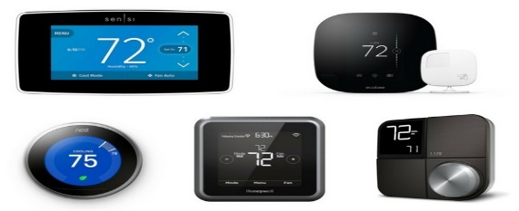
Southern California Edison
Smart Energy Program:
2021 Load Impact Evaluation
May 4, 2022

Slide 2
SEP Program Description
Overview
Participant Make-Up
SEP operates through temporary thermostat adjustments which reduce AC usage and lower electric demand.
Events can be called year-round, though customers only receive bill credits for June through September participation.
One-time $75 bill credit for enrolling and a daily bill credit of $0.3275 per day June to September.
SCE can call multiple events in a single day, but cannot exceed 6 hours of control per event day
SEP includes multiple vendors and smart thermostat manufacturers (OEMs)
Segmentation Variable | Segment Description | Participants
All Customers |  | 49,929
LCA | Big Creek/Ventura | 5,793
 | LA Basin | 42,750
 | Outside | 1,386
Low Income | CARE | 10,608
 | Non-CARE | 39,321
NEM | NEM Customer | 11,145
 | Non-NEM Customer | 38,784
Size | Less than 1.88 kW during RA window | 24,964
 | Greater than 1.88 kW during RA window | 24,965
SubLAP | SCEC | 20,370
 | SCEN | 5,037
 | SCEW | 22,381
 | SCHD | 1,338
 | SCLD | 47
 | SCNW | 755
Tariff | Dynamic | 15,990
 | Flat | 33,939
Thermostats | 1 Thermostat | 43,584
 | 2 Thermostats | 5,848
 | 3+ Thermostats | 497
Zone | South Orange County | 10,678
 | Remainder of System | 20,882
 | South of Lugo | 18,368

Slide 3
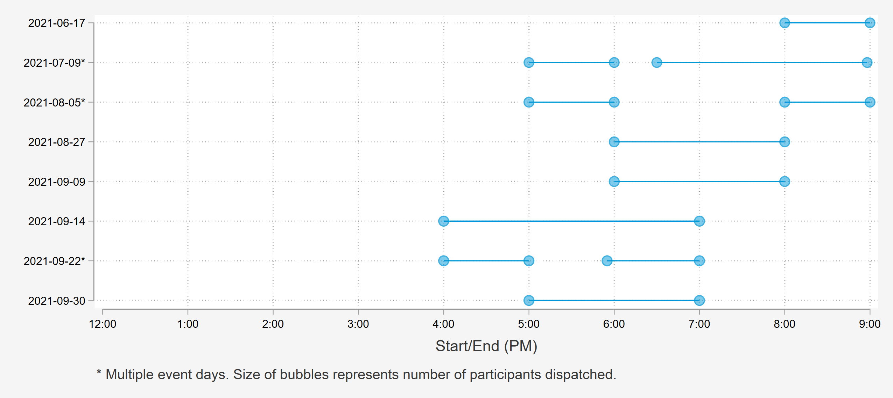
2021 Events varied in timing and duration; Three Multi-event days and generally shorter events when compared Previous Years
2nd Event: Reliability
M&V

Slide 4
SEP Ex Post Methodology
Proxy Day Selection
Three proxy days were selected for each event day based on SCE system load
Matched Controls
A single control customer was chosen for each participant based on individual load during all proxy days
Regression Analysis
Difference-in-differences panel regression
Hourly event impacts estimated by subcategory and across all customers
Separate regression for each event day hour using event day and it’s 3 proxy days
Hard matched within NEM status, climate zone, and CDD bin groups
Propensity score matching model with replacement
2021 estimates were developed separately using both delivered and net customer loads. Net loads are used for all reporting.

Slide 5
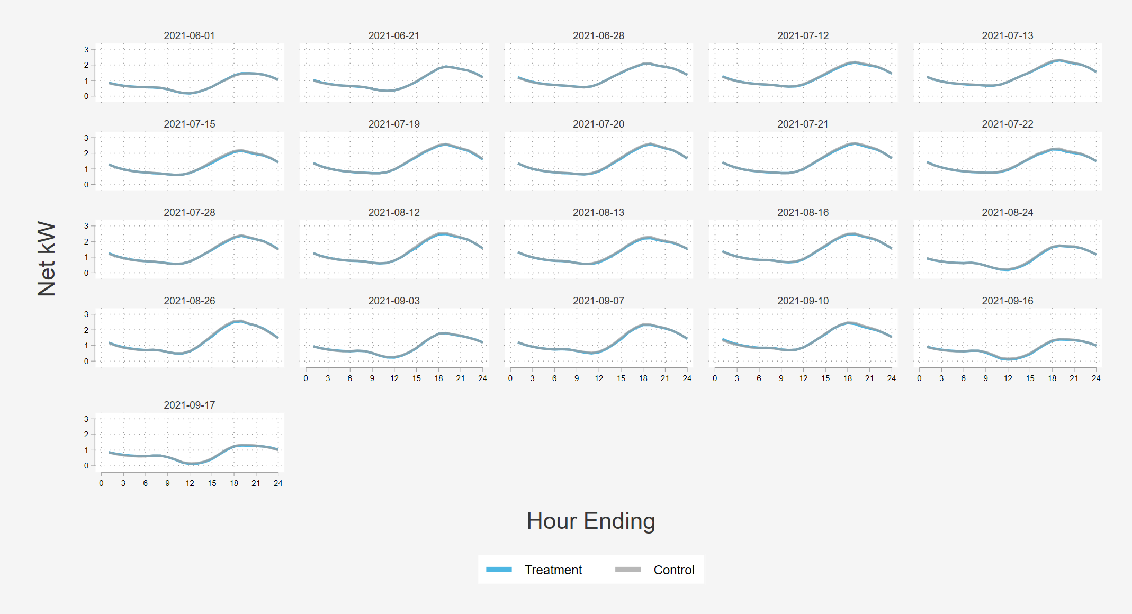
Treatment and Matched Control Group
Average Hourly kW on Proxy Days
Control matches were assigned characteristics (including sub-LAPs and vendor) from their treated counterpart
Matches are done with replacement
In 2021, 4% of participants were unable to be matched
  This may be due to missing data or usage values that do not match any controls in our sample

Slide 6
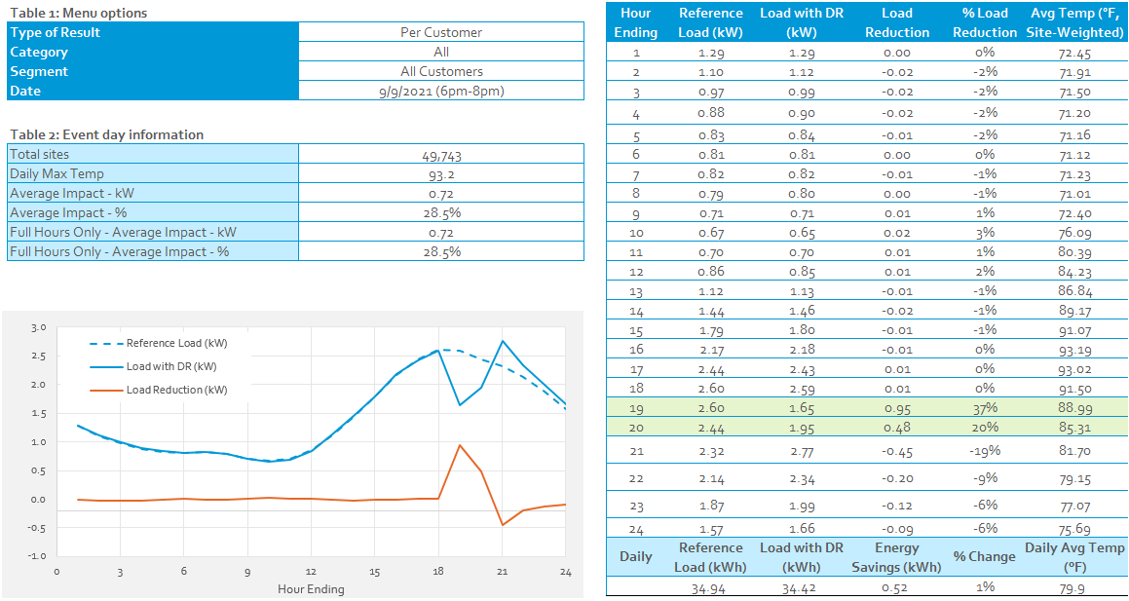
System Peak day – 9/9/2021
Two hour dispatch
  Economic/M&V event
  Average per-customer impact of 0.95 kW per in hour 1
Maximum daily temperature of 93.2°F
  Event hours were cooler

Slide 7
Ex Post Results
All events we called territory wide
Events marked with an asterisk (*) include partial event hours which are not shown here
Program participation grew over the summer
Impacts decay over each event hour

Slide 8
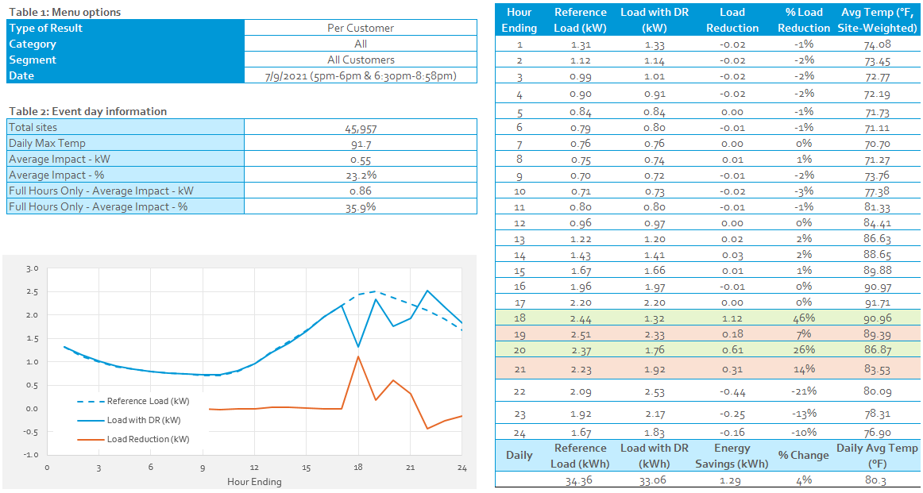
Double Event day with partial event hours (July 9th)

Slide 9
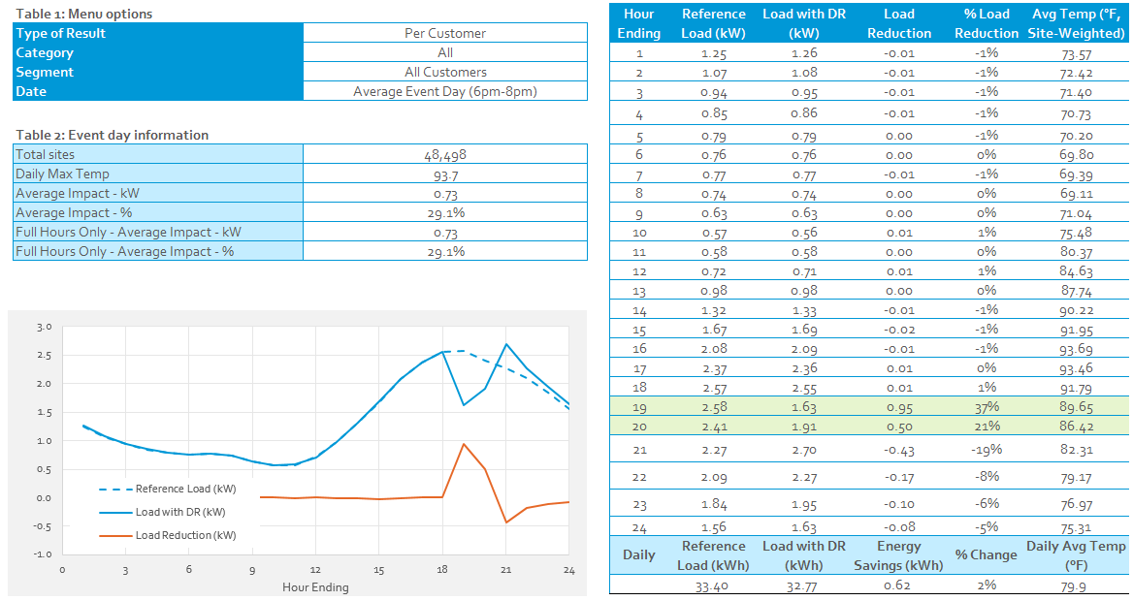
Average Event Day (6 PM – 8PM)

Slide 10
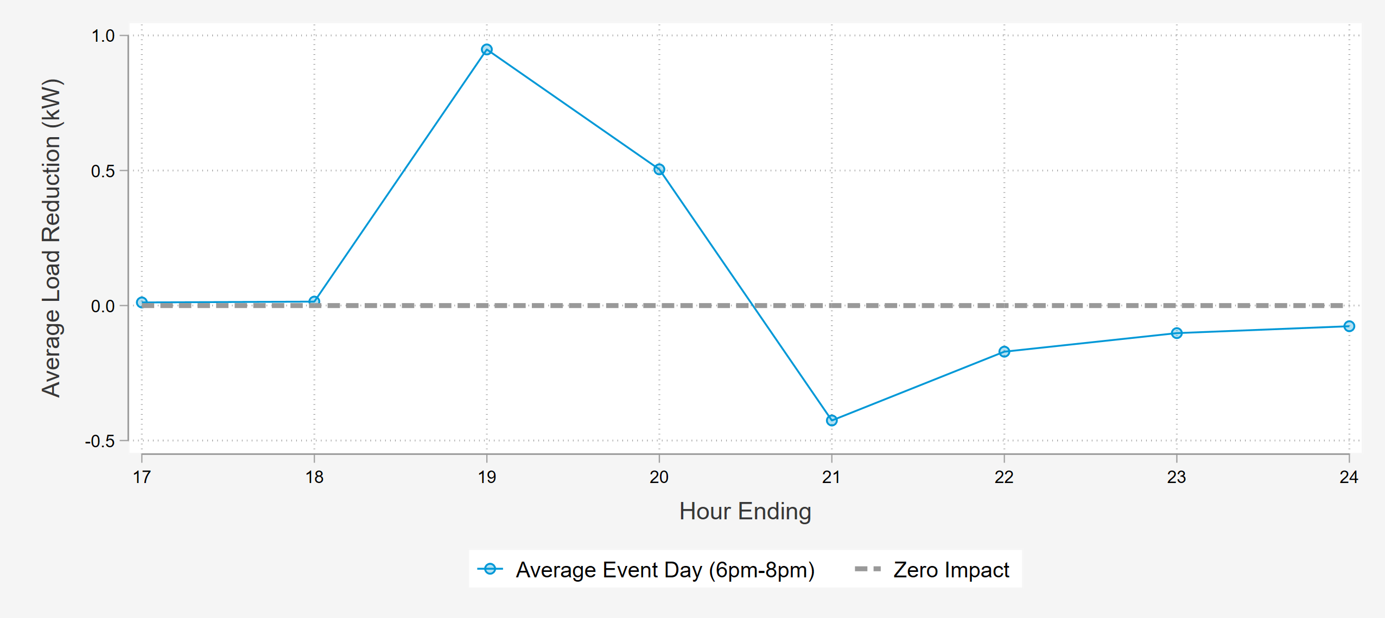
Event Impacts Are Largest During the first Hour of Dispatch and fade in subsequent hours

Slide 11
Ex Post Comparison to Prior years – Average Event Days
2021 and 2019 impacts and reference loads were very similar
In 2020, we produced two average event days
  5pm-9pm (four hours)
  7pm-8pm (one hour)
  Approximately 15% of devices were unavailable for dispatch
Lower enrollment in 2021 also means that aggregate impacts were lower.
Performance Metric | 2019 (6-8PM) | 2020 (7-8 PM) | 2021 (6-8 PM)
Avg. Reference Load (kW) | 2.48 | 2.45 | 2.49
Avg. Load Impact (kW) | 0.74 | 0.75 | 0.73
% Load Impact | 29.84% | 30.61% | 29.32%
Avg. Event Temperature | 83.8 | 88.6 | 88.0
Event Hours | 6-8PM | 7-8PM | 6-8PM
Heat Buildup (Avg. F, 12 AM to 5 PM) | 80.6 | 77.3 | 78.5
Enrollment | 52,139 | 51,437 | 48,498

Slide 12
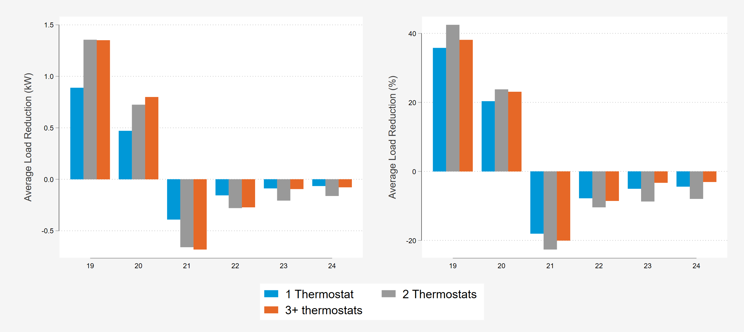
Average Event Day Impacts Segmented by Number of Thermostats
Average load reductions increase about 50% for homes with more than one thermostat
  There is minimal increase in 3+ thermostats
Average load reduction percentages do not vary much by number of thermostats
  Most of the increase in savings for 2+ thermostats is driven by increased customer load size

Slide 13
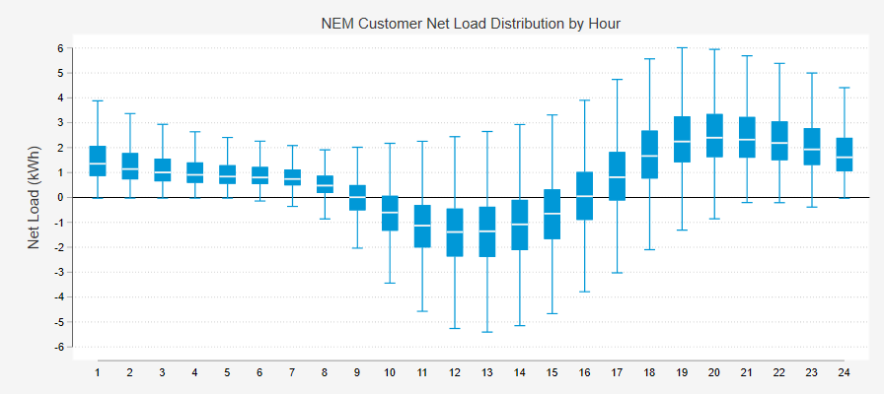
Load Impacts Estimated with Net vs. Delivered
Any sites exporting to the grid will have delivered load of zero and a net load less than zero.
CAISO settlement is done on a delivered basis, but all analysis of the SEP program was done with net.
Events are typically called during hours when some customers have negative loads
  SEP dispatch can make their loads negative or more negative

Slide 14
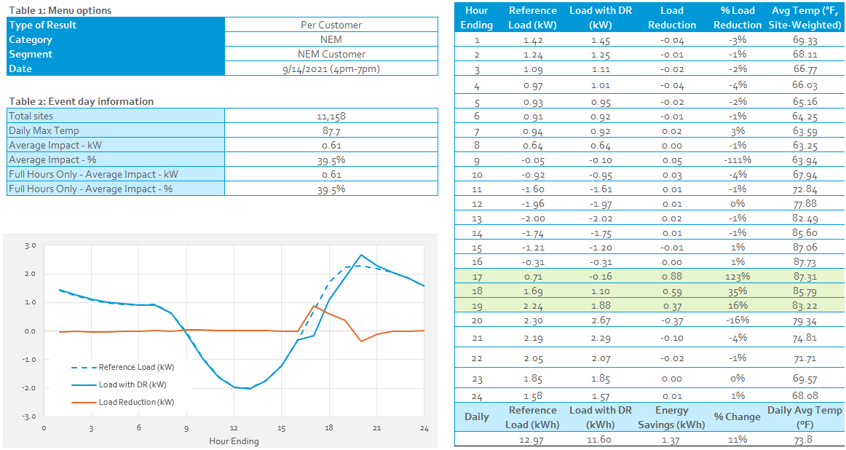
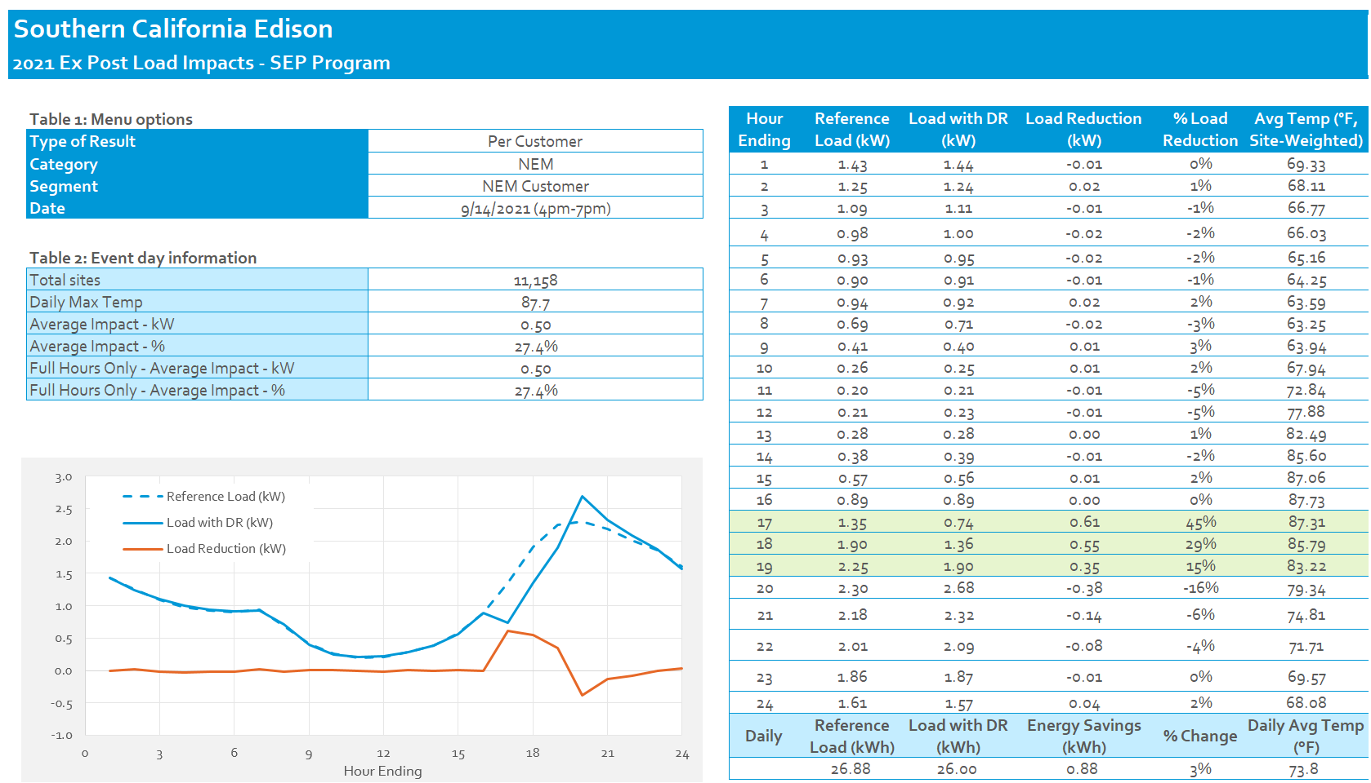
Net vs. Delivered Impacts for NEM Customers
Net
Delivered

Slide 15
2021 Ex-Post vs 2020 Ex-ante, how did we do?
These comparisons use the first four hours of the 2020 ex ante predictions
  Ex Ante predictions assume a 4pm to 9pm dispatch
July 9th was a double event day that was cooler than SCE 1-in-2 weather
August 27th was warmer than SCE 1-in-2 weather for the average event day, but started at 6 pm rather than 4 pm
September 9 was the system peak day, but was still cooler than SCE 1-in-2 weather
7/9/2021 (5-6 PM) &(6:30-8:58 PM) |  |  | Per-Customer Impact (kW)
Results | Daily Max Temp (F) | Customers | Hour 1 | Hour 2* | Hour 3 | Hour 4*
SCE 1-in-2 July Peak Day | 92.4 | 58,796 | 1.01 | 0.60 | 0.36 | 0.26
(2020 Ex Ante Predictions for 2021)
Ex Post | 91.7 | 45,957 | 1.12 | 0.18 | 0.61 | 0.31
8/27/2021 (6:00-8:00 PM) |  |  | Per-Customer Impact (kW)
Results | Daily Max Temp (F) | Customers | Hour 1 | Hour 2 | Hour 3 | Hour 4
SCE 1-in-2 Typical Event Day | 91.5 | 59,498 | 0.99 | 0.58 | 0.35 | 0.25
(2020 Ex Ante Predictions for 2021)
Ex Post | 94.2 | 47,185 | 0.95 | 0.52
9/9/2021 (6:00-8:00 PM) |  |  | Per-Customer Impact (kW)
Results | Daily Max Temp (F) | Customers | Hour 1 | Hour 2 | Hour 3 | Hour 4
SCE 1-in-2 September Peak Day | 95.5 | 61,017 | 1.06 | 0.66 | 0.43 | 0.30
(2020 Ex-Ante Predictions for 2021)
Ex-Post | 93.2 | 49,743 | 0.95 | 0.48

Slide 16
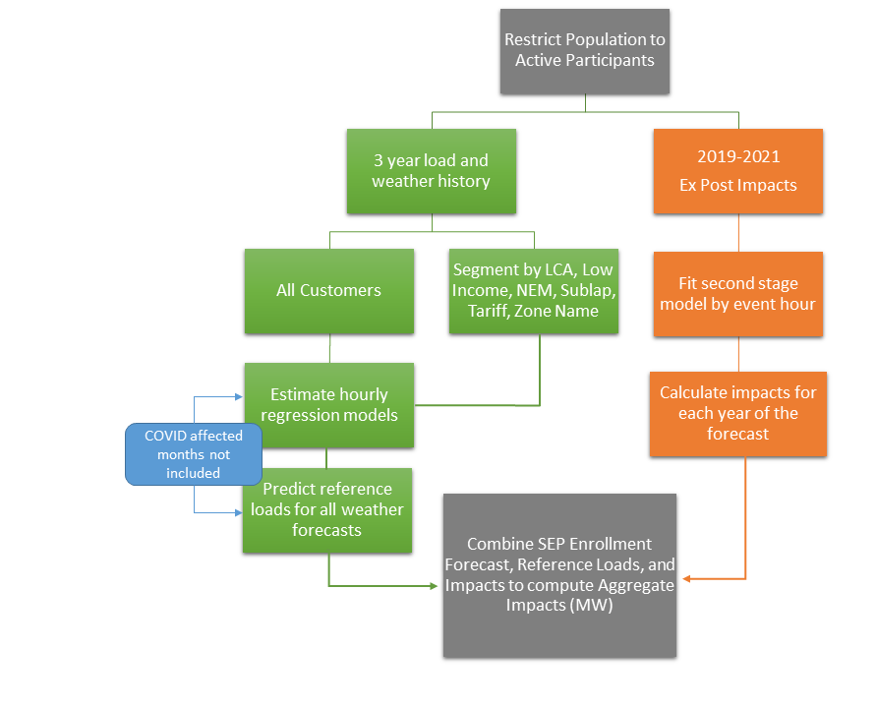
SEP Ex Ante Methodology
Estimate hourly average customer reference loads
  Estimate loads for all weather forecasts
Use the past three years of events in a second stage model to estimate impacts in varying conditions
In 2021, we did not include any COVID affected months. We assume that load levels in 2021 are the “new normal”
  March 2020-Dec 2020 were not included

Slide 17
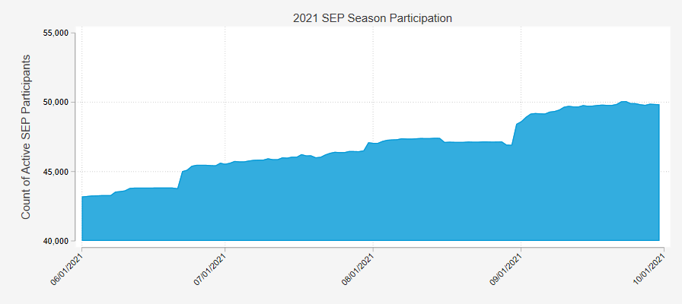
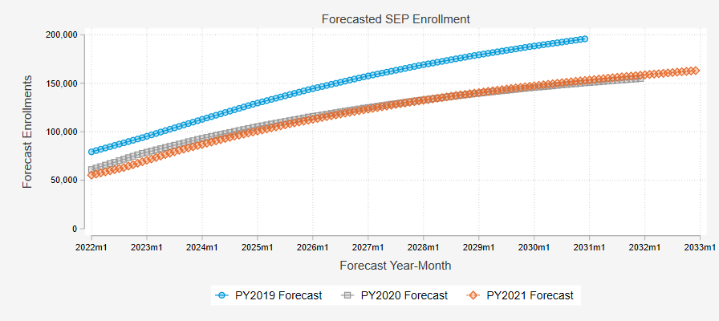
Enrollment Forecast
Enrollment in 2021 was lower than projected in previous years, but rose over the course of the summer
Future enrollment, which plays a major part in program potential, is expected to grow to over 150,000 participants by 2032.

Slide 18
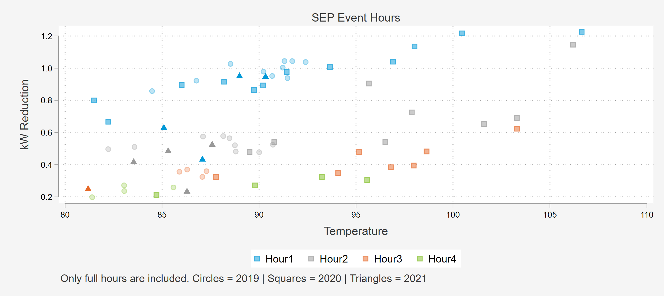
Relationship between Load Impacts, Temperature, and Event Hour
Models are run separately for each event hour and snapback hour
2019, 2020, and 2021 impacts are used
Models are run separately for each customer category
Second stage model regresses kW impact on temperature (°F)
  Event hour is the most important factor in impact
  Temperature increases magnitude of impact

Slide 19
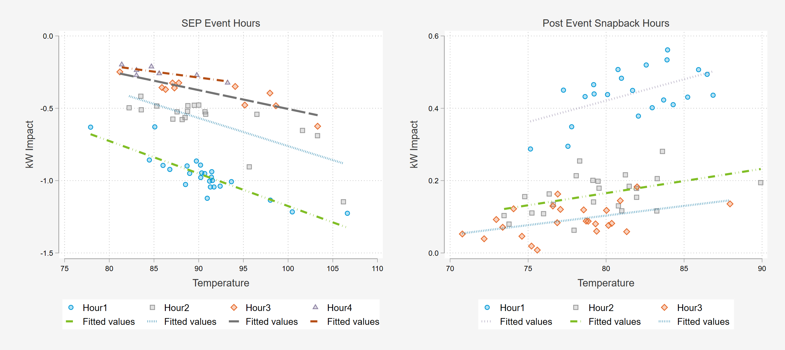
Approach to Second Stage Modeling of kW Impacts in 2021
Seven different regression models by hour run for each subcategory

Slide 20
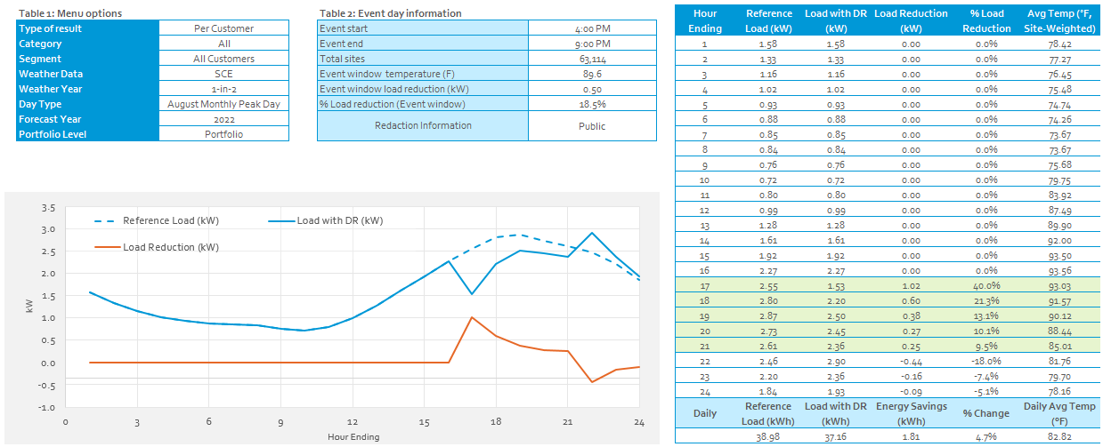
2022 Average Customer SCE 1-in-2 Conditions (August Peak Day)

Slide 21
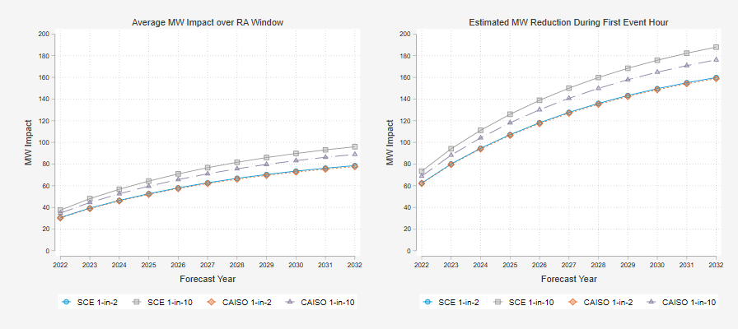
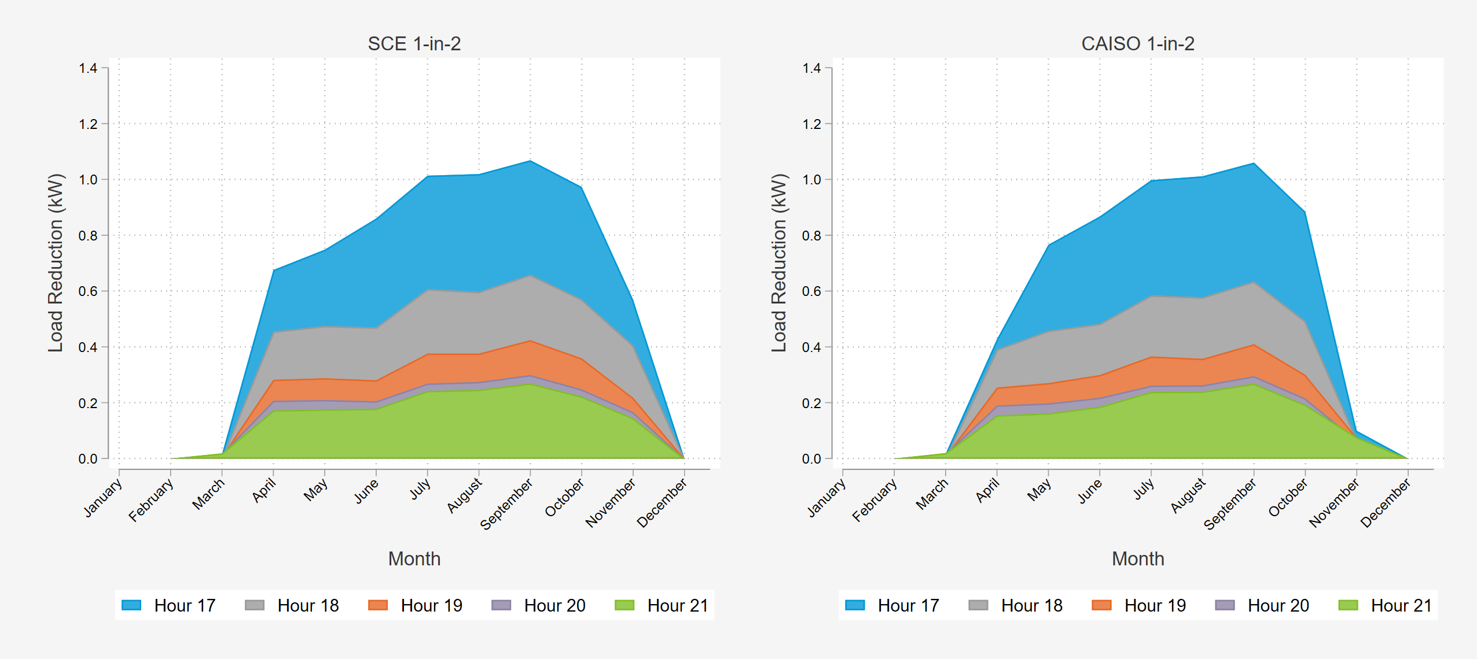
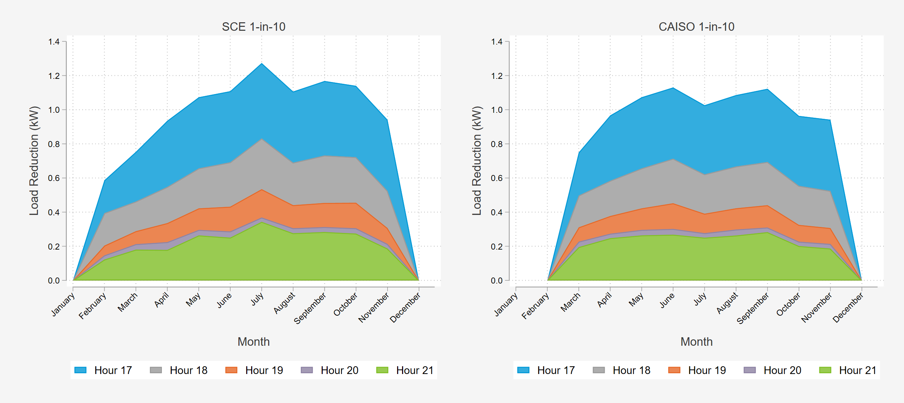
Ex Ante Impacts
Aggregate Impacts – Typical Event Day
Per Customer Impacts by Month
By 2032 SEP is expected to be a ~ 180 MW resource during the first hour of dispatch. ~ 90 MW average over RA window
Event impacts peak in warmer months but decline with each event hour in all months

Slide 22
Discussion
Recommendations
For the third consecutive year, actual participation in SEP fell short of SCE’s forecasted enrollment.
  The number of enrolled customers has a direct effect on the projected MW capability of the program.
Weather conditions in 2021 were relatively mild. The system peak day (9/9/2021) at 93.2 degrees (F) maximum daily temperature was actually milder than 1-in-2 weather conditions, which are projected to be 95.6 degrees (F).
SEP does not hold a consistent load shed under the current event profile.
  Variable impact profile across an event creates considerations for dispatch and valuation.
Our parallel ex post evaluation using delivered loads rather than net loads shows that the use of delivered loads for settlement systematically understates the performance of SEP due to the prevalence of NEM customers in the program
  DSA recommends SCE discuss these findings with CAISO and the other IOUs and recommend net loads as the basis for economic settlements of programs like SEP.
By Summer 2022 default TOU pricing will be in effect in SCE territory. Nearly 28% of SEP participants faced time-varying pricing during PY2021.
  Continue to monitor the effect of TOU on SEP participant reference loads and load impacts.
The evaluation team was not furnished any information on the curtailment strategies used by the thermostat vendors in 2021.
  This information should be shared in the future for more transparent evaluations and accurate ex ante predictions.

Slide 23

Questions?
Jesse Smith
Partner & Principal Consultant
Demand Side Analytics, LLC
jsmith@demandsideanalytics.com
770.401.9018

