Slide 1
OhmConnect 2021 LIP Evaluation
Presented at the Demand Response Providers’
2022 Load Impact Protocol Final Report Workshop
hosted by the California Public Utilities Commission
May 18, 2022
Co-authors:
Sam Borgeson
Phil Price
Jenn Mitchell-Jackson

Slide 2
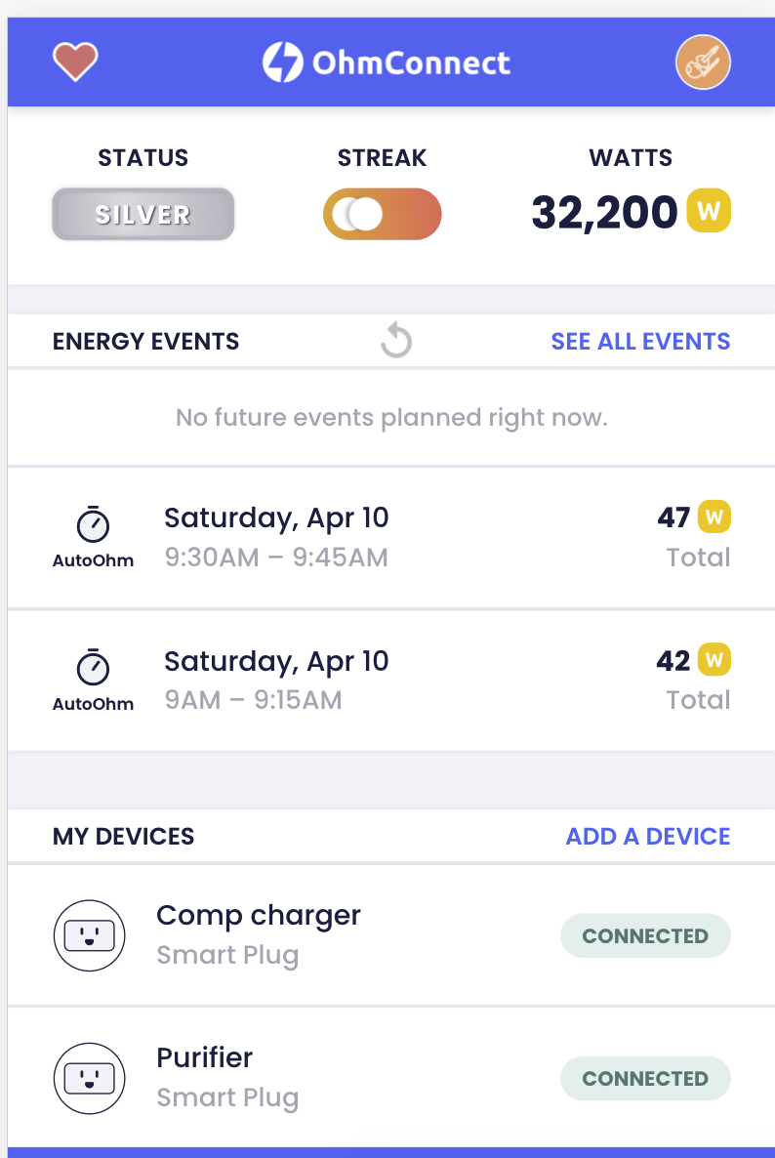
About OhmConnect
OhmConnect is a free service that rewards residential customers for saving energy when it matters most to the grid and the environment: “Save Energy. Get Paid”
Demand response events, which vary between one and four hours, are called OhmHours
Users are typically notified a full day ahead that an OhmHour is scheduled—OhmConnect notifies users once it receives notice of a DAM award
Rewards are proportional to the amount of energy saved
Users participate in OhmHours automatically, through devices controlled by OhmConnect (their focus going forward) and behaviorally, by shutting off devices inside the home
OhmConnect users receive a different status—Bronze, Silver, Gold, Platinum, or Diamond—based on how much energy they’ve saved, on average, during their OhmHours

Slide 3
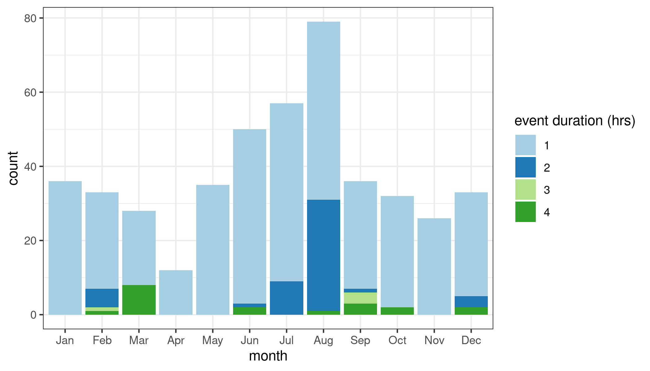
Events called in 2021
Events are defined by a unique combination of date, utility, event types, and start and end times.
In 2021, 457 events occurred on 119 days, with multiple events being called on the same day.
SCE and SDGE
Smart Meter
Data outages
start | count
4 pm | 4
5 pm | 54
6 pm | 158
7 pm | 159
8 pm | 82
Total | 457

Slide 4
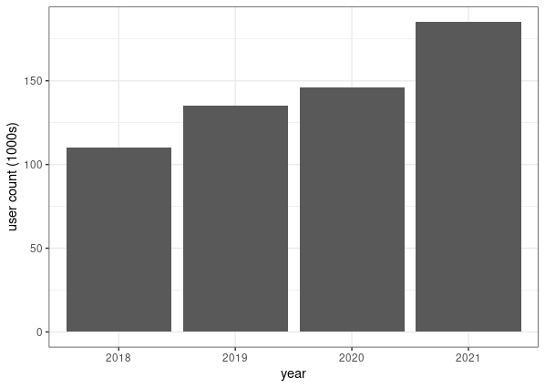
Annual unique participants

Slide 5
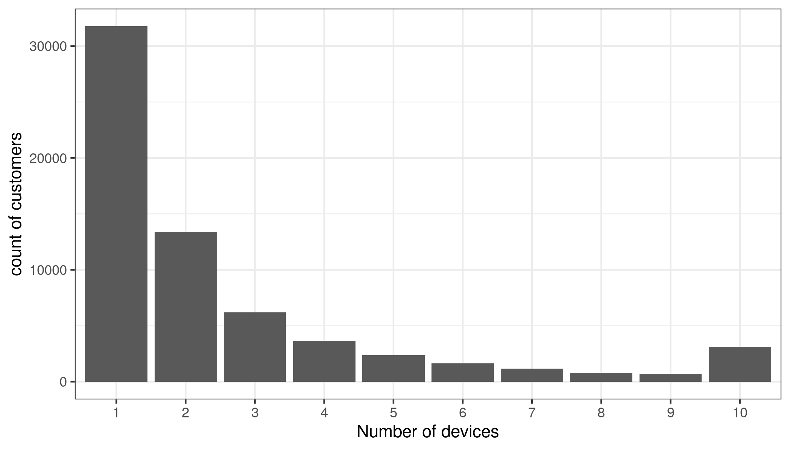
Controllable devices and tiers
tier | % of customers in tier | % of tier with devices | % of devices in tier
Silver (and below) | 41% | 29% | 38%
Gold | 36% | 30% | 35%
Platinum (and above) | 22% | 37.5% | 27%

Slide 6
Ex post

Slide 7
Ex post methods
5 of 10 baselines
Adaptive additive same day adjustments

Slide 8
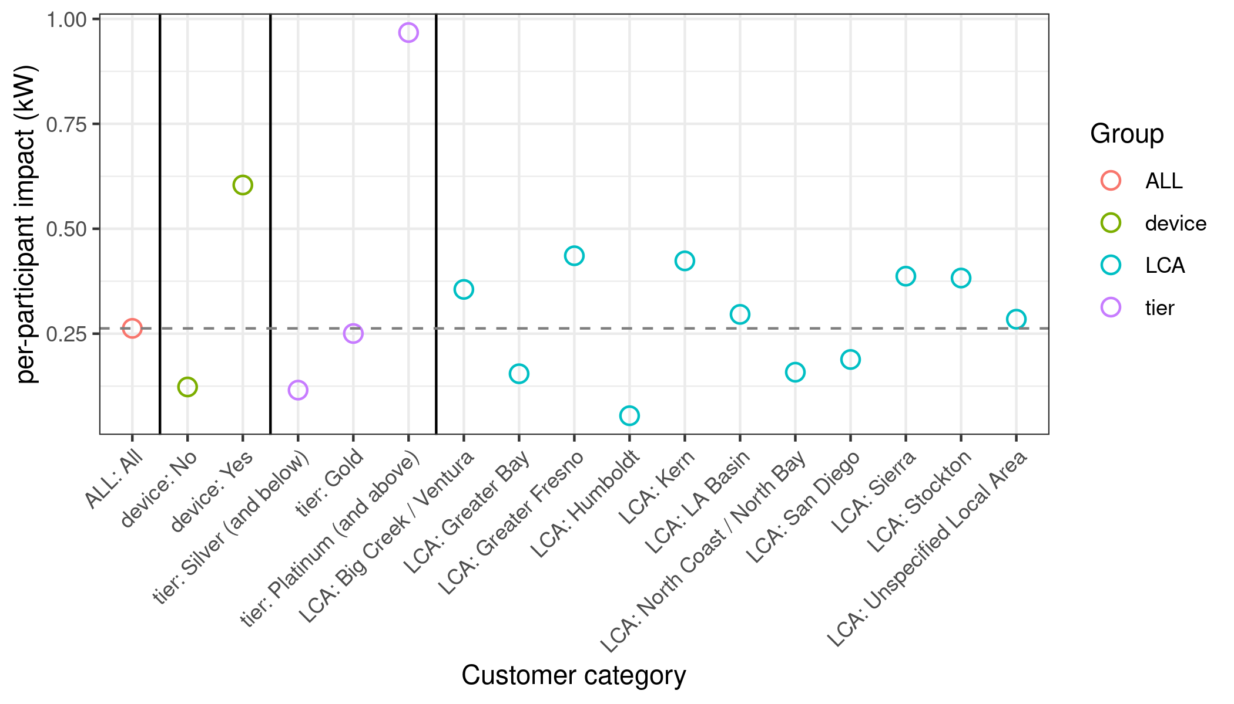
Ex post summary
Group | Category | # Jun-Sept unique participants | Average temperature (F) | per-participant ref. load (kW) | per-participant impact (kW) | Impact % (of ref)
ALL | All | 161,535 | 79.6 | 1.68 | 0.26 | 15.6
device | No | 118,666 | 80.1 | 1.68 | 0.12 | 7.3
 | Yes | 53,158 | 78.6 | 1.68 | 0.60 | 36.0
tier | Silver (and below) | 148,046 | 80.3 | 1.77 | 0.12 | 6.5
 | Gold | 116,165 | 76.8 | 1.36 | 0.25 | 18.4
 | Platinum (and above) | 66,239 | 80.2 | 1.67 | 0.97 | 57.9

Slide 9
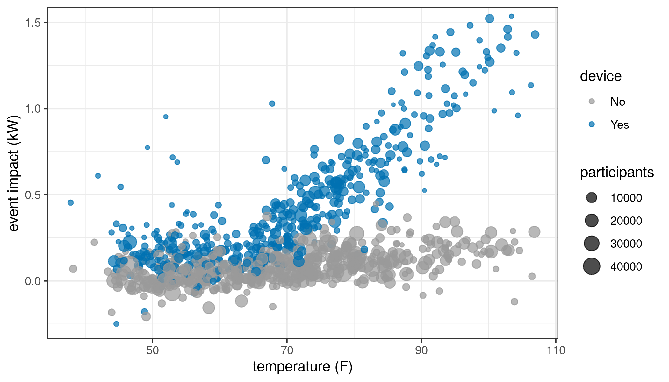
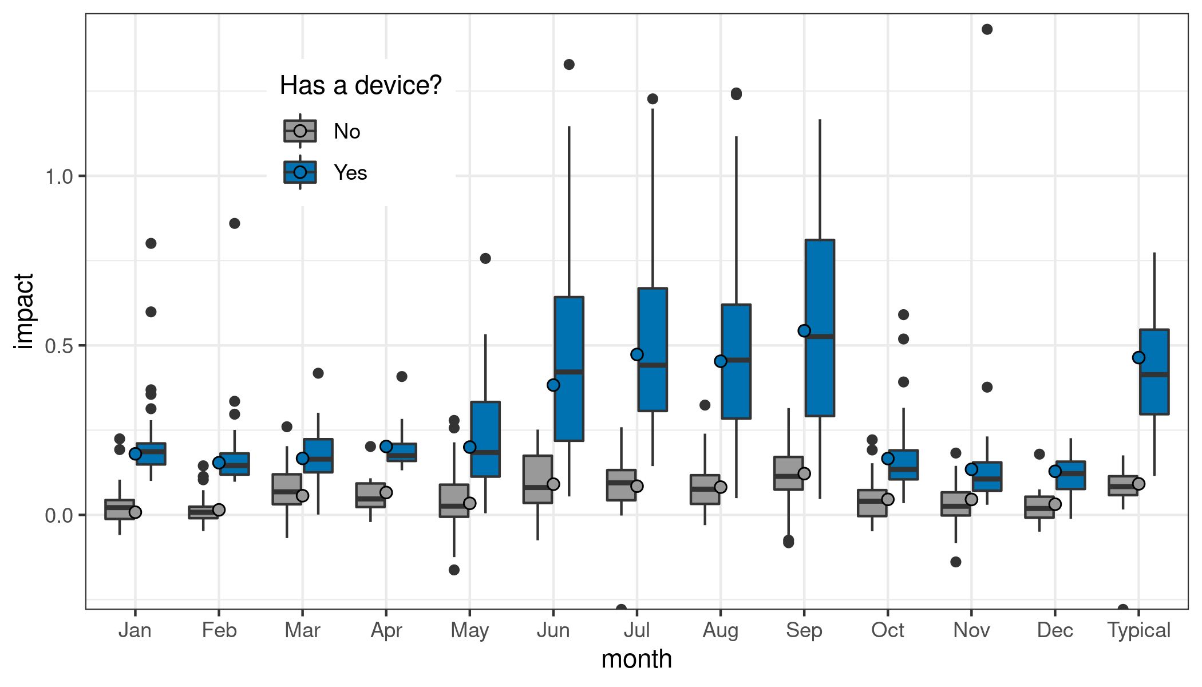
Device owner performance

Slide 10
Ex ante

Slide 11
Ex ante methods
Ex post events as inputs into ex ante regression model
Primary explanatory variables: temperature, hour of day, device, tier, sub-LAP
Also, indicator variables for (May or October) and (June or September), interacted with sub-LAP

Slide 12
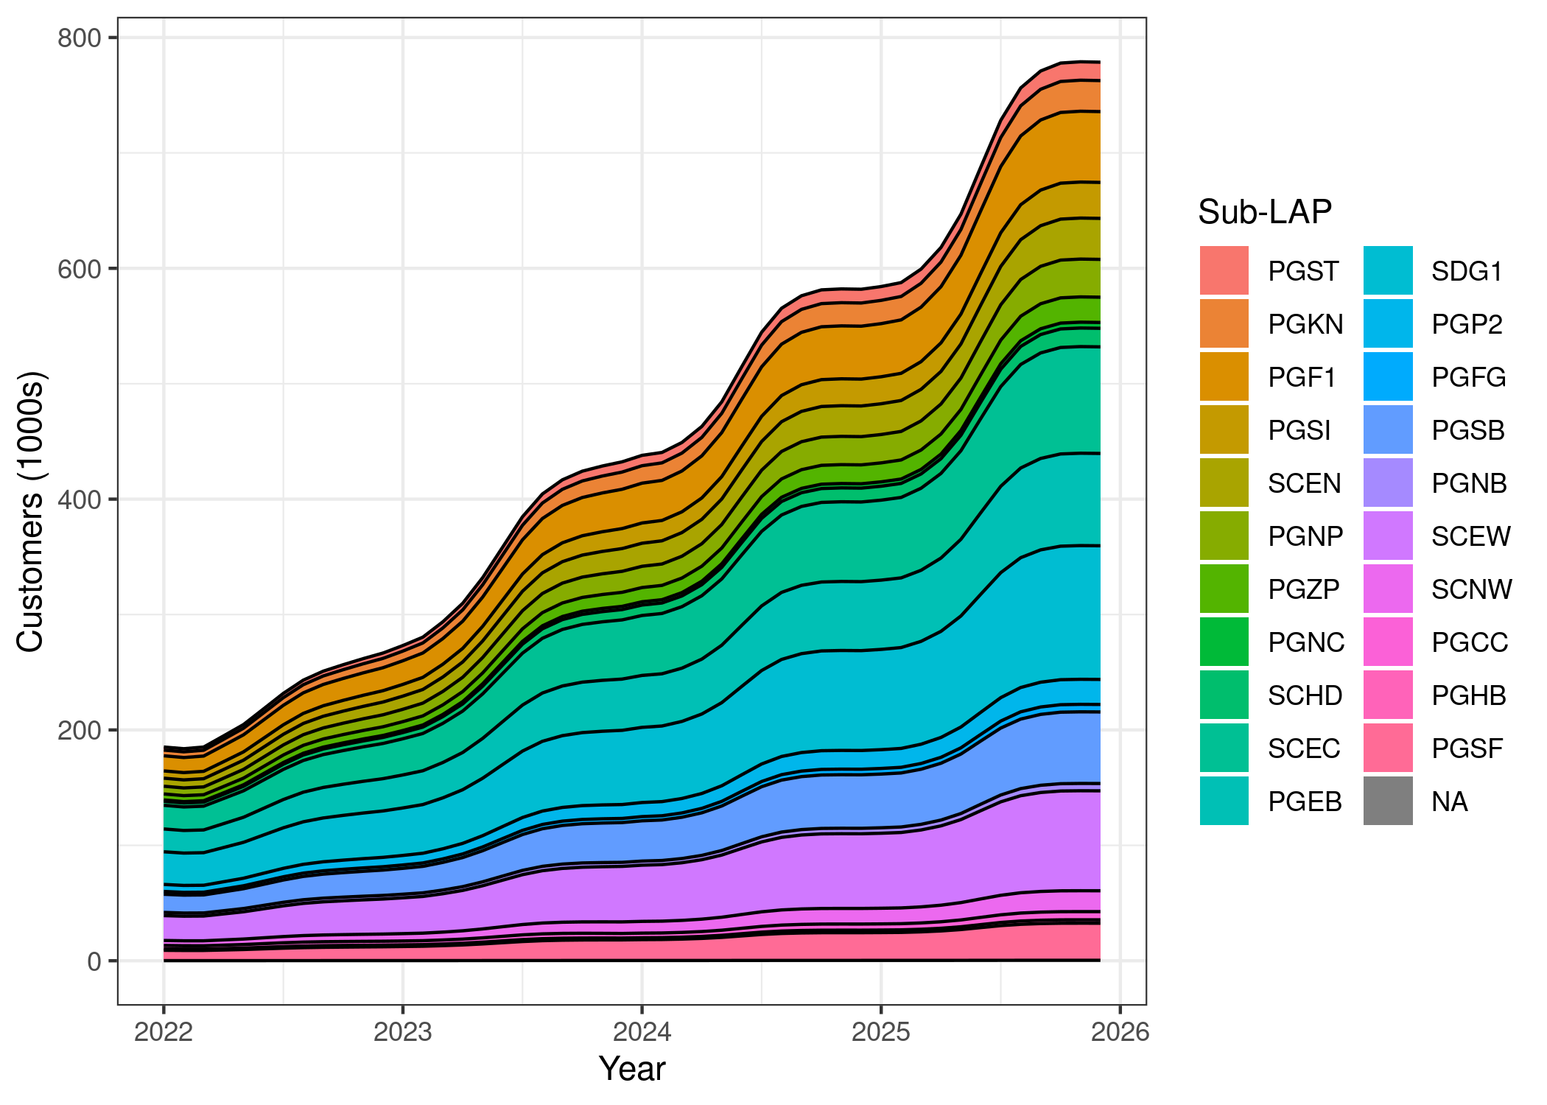
Projected enrollment - Medium scenario

Slide 13
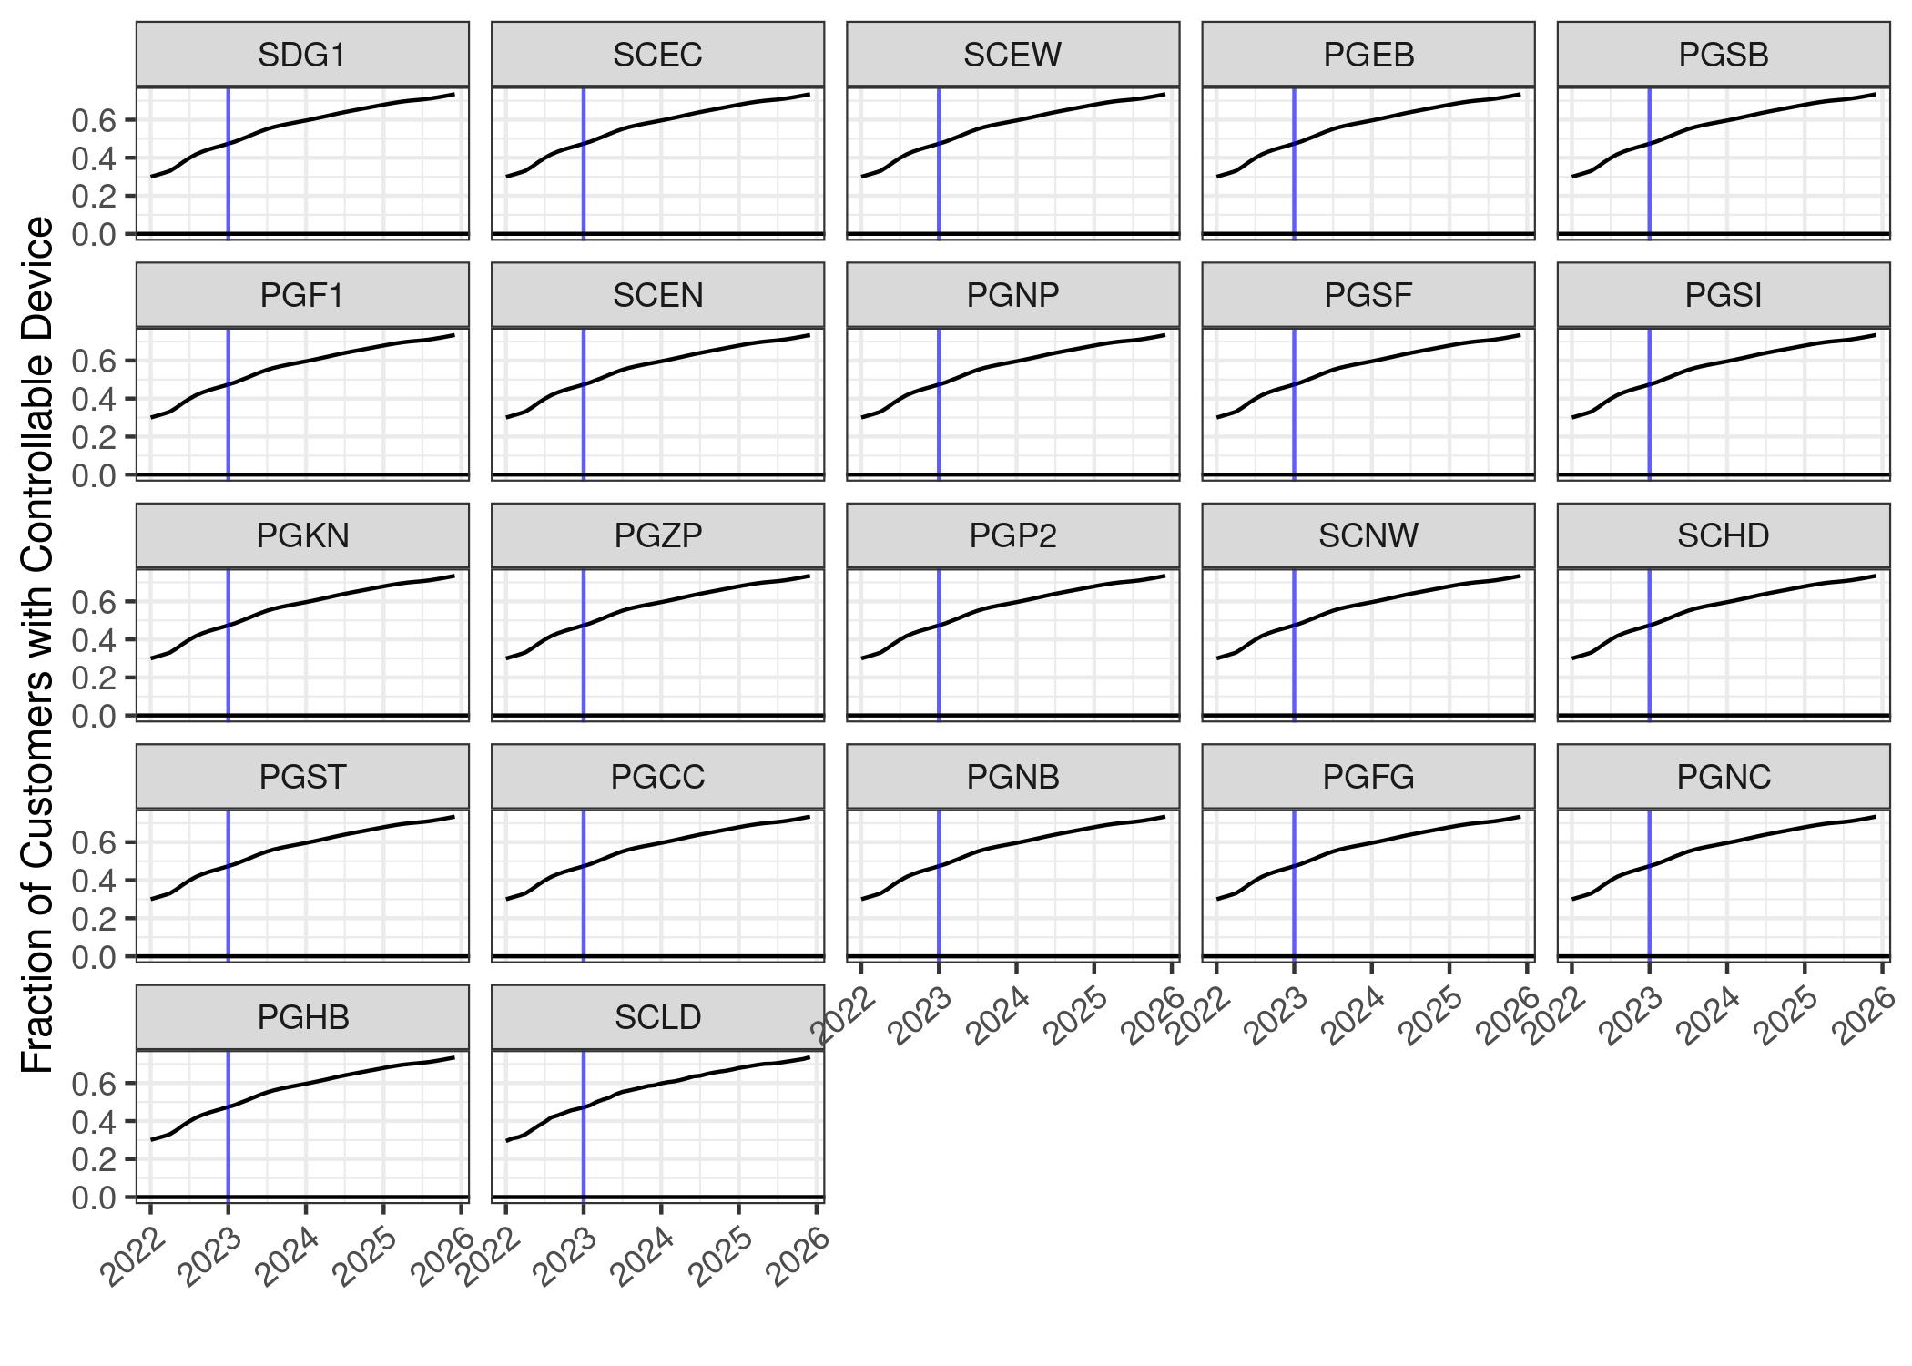
Projected fraction of device customers

Slide 14
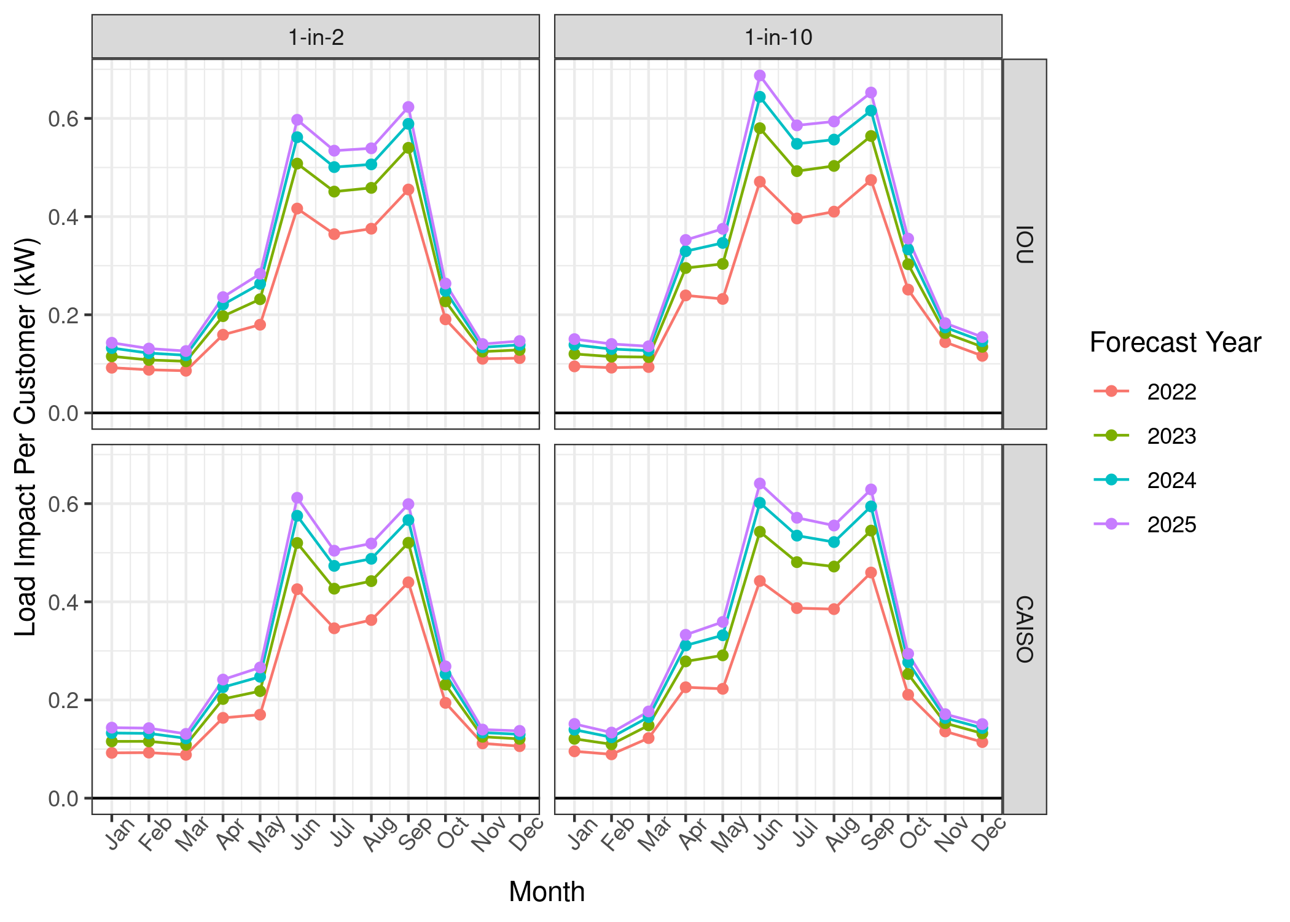
Per-customer predicted monthly load impact (4-hour QC window)
Increases primarily due to increasing fraction of device customers
Resi-station funding requires a focus on device-owning customers

Slide 15
Ex post to ex ante load impact predictions, for events in hours 17-20 (2021)
Month | Ex post (kW) | Ex ante 2020 weather (kW) | Ex ante IOU 1-in-2 weather (kW)
January | 0.04 | 0.05 | 0.05
February | 0.01 | 0.05 | 0.05
March | 0.13 | 0.07 | 0.06
April | 0.09 | 0.11 | 0.11
May | 0.10 | 0.10 | 0.11
June | 0.27 | 0.32 | 0.32
July | 0.25 | 0.24 | 0.25
August | 0.28 | 0.29 | 0.30
September | 0.35 | 0.35 | 0.36
October | 0.12 | 0.11 | 0.14
November | 0.13 | 0.10 | 0.08
December | 0.07 | 0.06 | 0.07

Slide 16
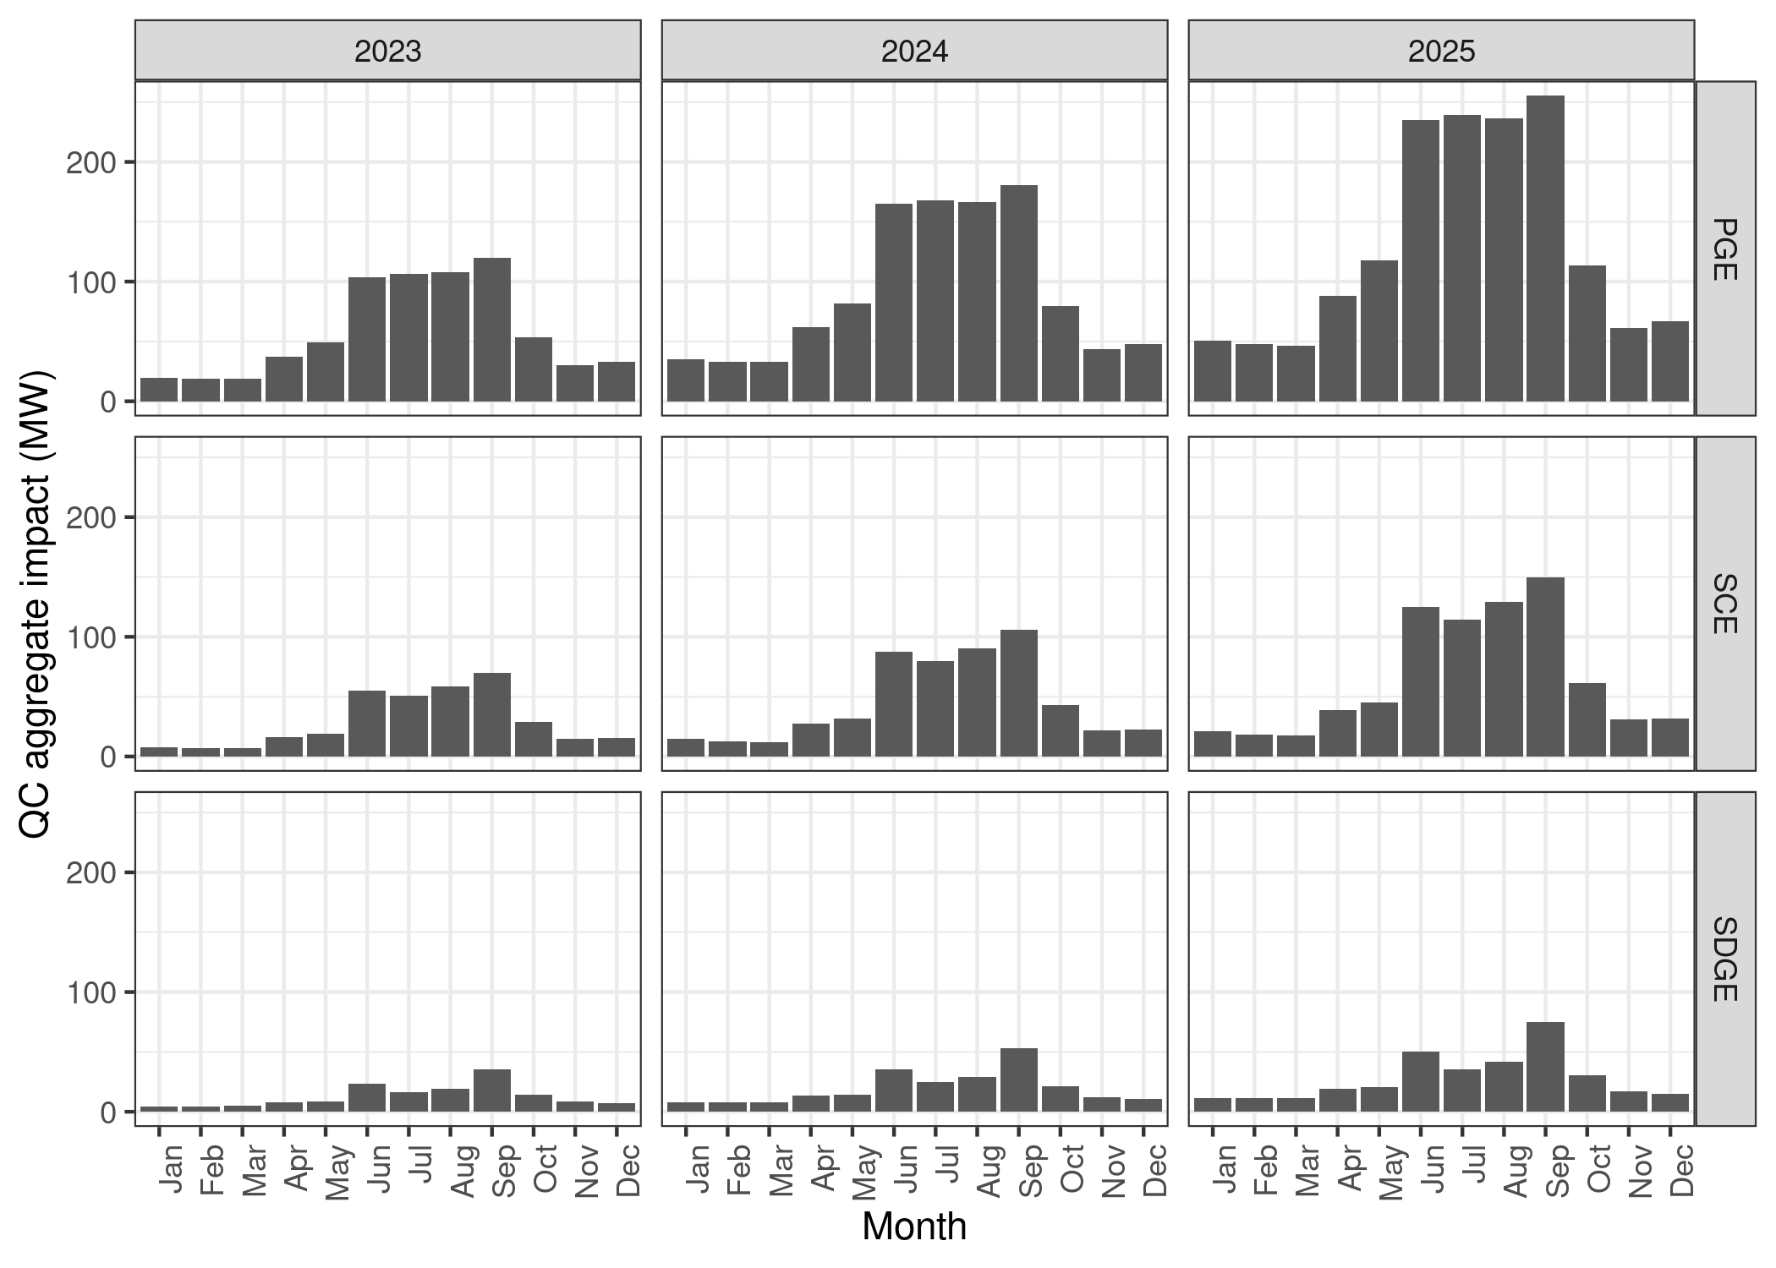
Monthly IOU 1-in-2 (4-hour QC window)
Year | Temp (F) | Enrollment (August) | Aggregate Impact (MW)
2022 | 85.6 | 243,169 | 91.3
2023 | 86.1 | 404,492 | 185.5
2024 | 86.2 | 565,403 | 286.4
2025 | 86.2 | 756,306 | 407.9

Slide 17
Questions?
sam@convergenceda.com

Slide 18
Ex post month by month summary
 |  | Average Event-based Data (by Month, i.e., “monthly roll-ups”) Individual events in appendix |  |  |  |  |  |  |  | Coincident Aggregate (using per-participant impacts)
month | ave temp (F) | # of unique events | total # participants (not unique) |  | average # of parts | reference load (kW) | per-part. impact (kW) | Agg. reference load (MW) | Agg. impact (MW) | # monthly unique parts. |  | coincident reference load (MW) | coincident aggregate impact (MW) | impact %
Jan | 52.5 | 36 | 271,634 |  | 7,544 | 1.01 | 0.04 | 7.64 | 0.27 | 99,594 |  | 94.99 | 3.5 | 3.6
Feb | 55.3 | 33 | 344,983 |  | 10,451 | 0.87 | 0.02 | 9.09 | 0.17 | 115,638 |  | 97.01 | 4.3 | 1.9
Mar | 58.5 | 28 | 137,566 |  | 4,913 | 0.89 | 0.07 | 4.36 | 0.36 | 107,929 |  | 91.19 | 8.01 | 8.2
Apr | 67.4 | 12 | 126,876 |  | 10,573 | 0.97 | 0.11 | 10.28 | 1.20 | 63,076 |  | 57.18 | 5.86 | 11.7
May | 68.6 | 35 | 453,479 |  | 12,942 | 1.01 | 0.09 | 13.04 | 1.23 | 122,730 |  | 114.58 | 8.73 | 9.4
Jun | 76.3 | 50 | 558,554 |  | 11,141 | 1.47 | 0.21 | 16.42 | 2.37 | 129,153 |  | 173.46 | 20.88 | 14.4
Jul | 81.7 | 57 | 804,226 |  | 14,098 | 1.76 | 0.25 | 24.88 | 3.49 | 134,117 |  | 214.46 | 25.16 | 14.0
Aug | 79.4 | 79 | 989,235 |  | 12,514 | 1.66 | 0.26 | 20.72 | 3.20 | 143,957 |  | 215.3 | 27.1 | 15.5
Sep | 80.6 | 36 | 526,810 |  | 14,626 | 1.82 | 0.35 | 26.64 | 5.13 | 145,290 |  | 234.67 | 35.66 | 19.3
Oct | 68.4 | 32 | 448,294 |  | 14,000 | 0.98 | 0.13 | 13.70 | 1.76 | 148,810 |  | 130.31 | 12.27 | 12.9
Nov | 62.3 | 26 | 283,017 |  | 10,884 | 0.96 | 0.13 | 10.43 | 1.39 | 146,470 |  | 123.34 | 10.71 | 13.4
Dec | 49.6 | 33 | 606,676 |  | 18,384 | 1.11 | 0.07 | 20.45 | 1.30 | 147,337 |  | 151.47 | 9.15 | 6.3

Slide 19
Ex ante monthly predictions (2022, IOU 1-in-2)
 |  | Day type
 |  |  | Temp (F) | Impact Per Participant | Impact Per Customer | Agg Impact (MW) | Participants | Enrollment
IOU | 1-in-2 | Typical Event Day | 84.9 | 0.49 | 0.45 | 180.4 | 367,756 | 404,492
 |  | January Peak | 48.6 | 0.13 | 0.12 | 31.5 | 244,132 | 273,174
 |  | February Peak | 52.8 | 0.12 | 0.11 | 30.3 | 250,587 | 280,404
 |  | March Peak | 55.1 | 0.12 | 0.11 | 30.9 | 259,668 | 293,663
 |  | April Peak | 73.6 | 0.22 | 0.20 | 61.1 | 271,997 | 309,767
 |  | May Peak | 79.0 | 0.26 | 0.23 | 77.0 | 300,392 | 331,959
 |  | June Peak | 82.4 | 0.55 | 0.51 | 182.1 | 330,639 | 358,311
 |  | July Peak | 85.3 | 0.49 | 0.45 | 173.5 | 351,733 | 384,749
 |  | August Peak | 86.1 | 0.50 | 0.46 | 185.5 | 367,756 | 404,492
 |  | September Peak | 85.9 | 0.60 | 0.54 | 225.1 | 377,380 | 416,731
 |  | October Peak | 78.5 | 0.25 | 0.23 | 96.5 | 386,149 | 424,231
 |  | November Peak | 60.0 | 0.14 | 0.12 | 53.6 | 388,829 | 428,681
 |  | December Peak | 48.7 | 0.14 | 0.13 | 55.5 | 389,054 | 432,339

Slide 20
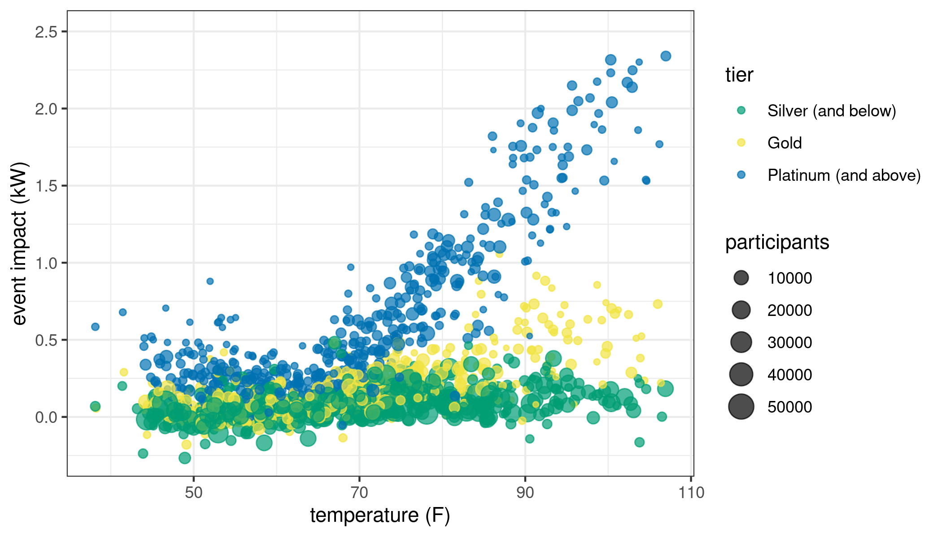
Performance by tier / temperature

Slide 21
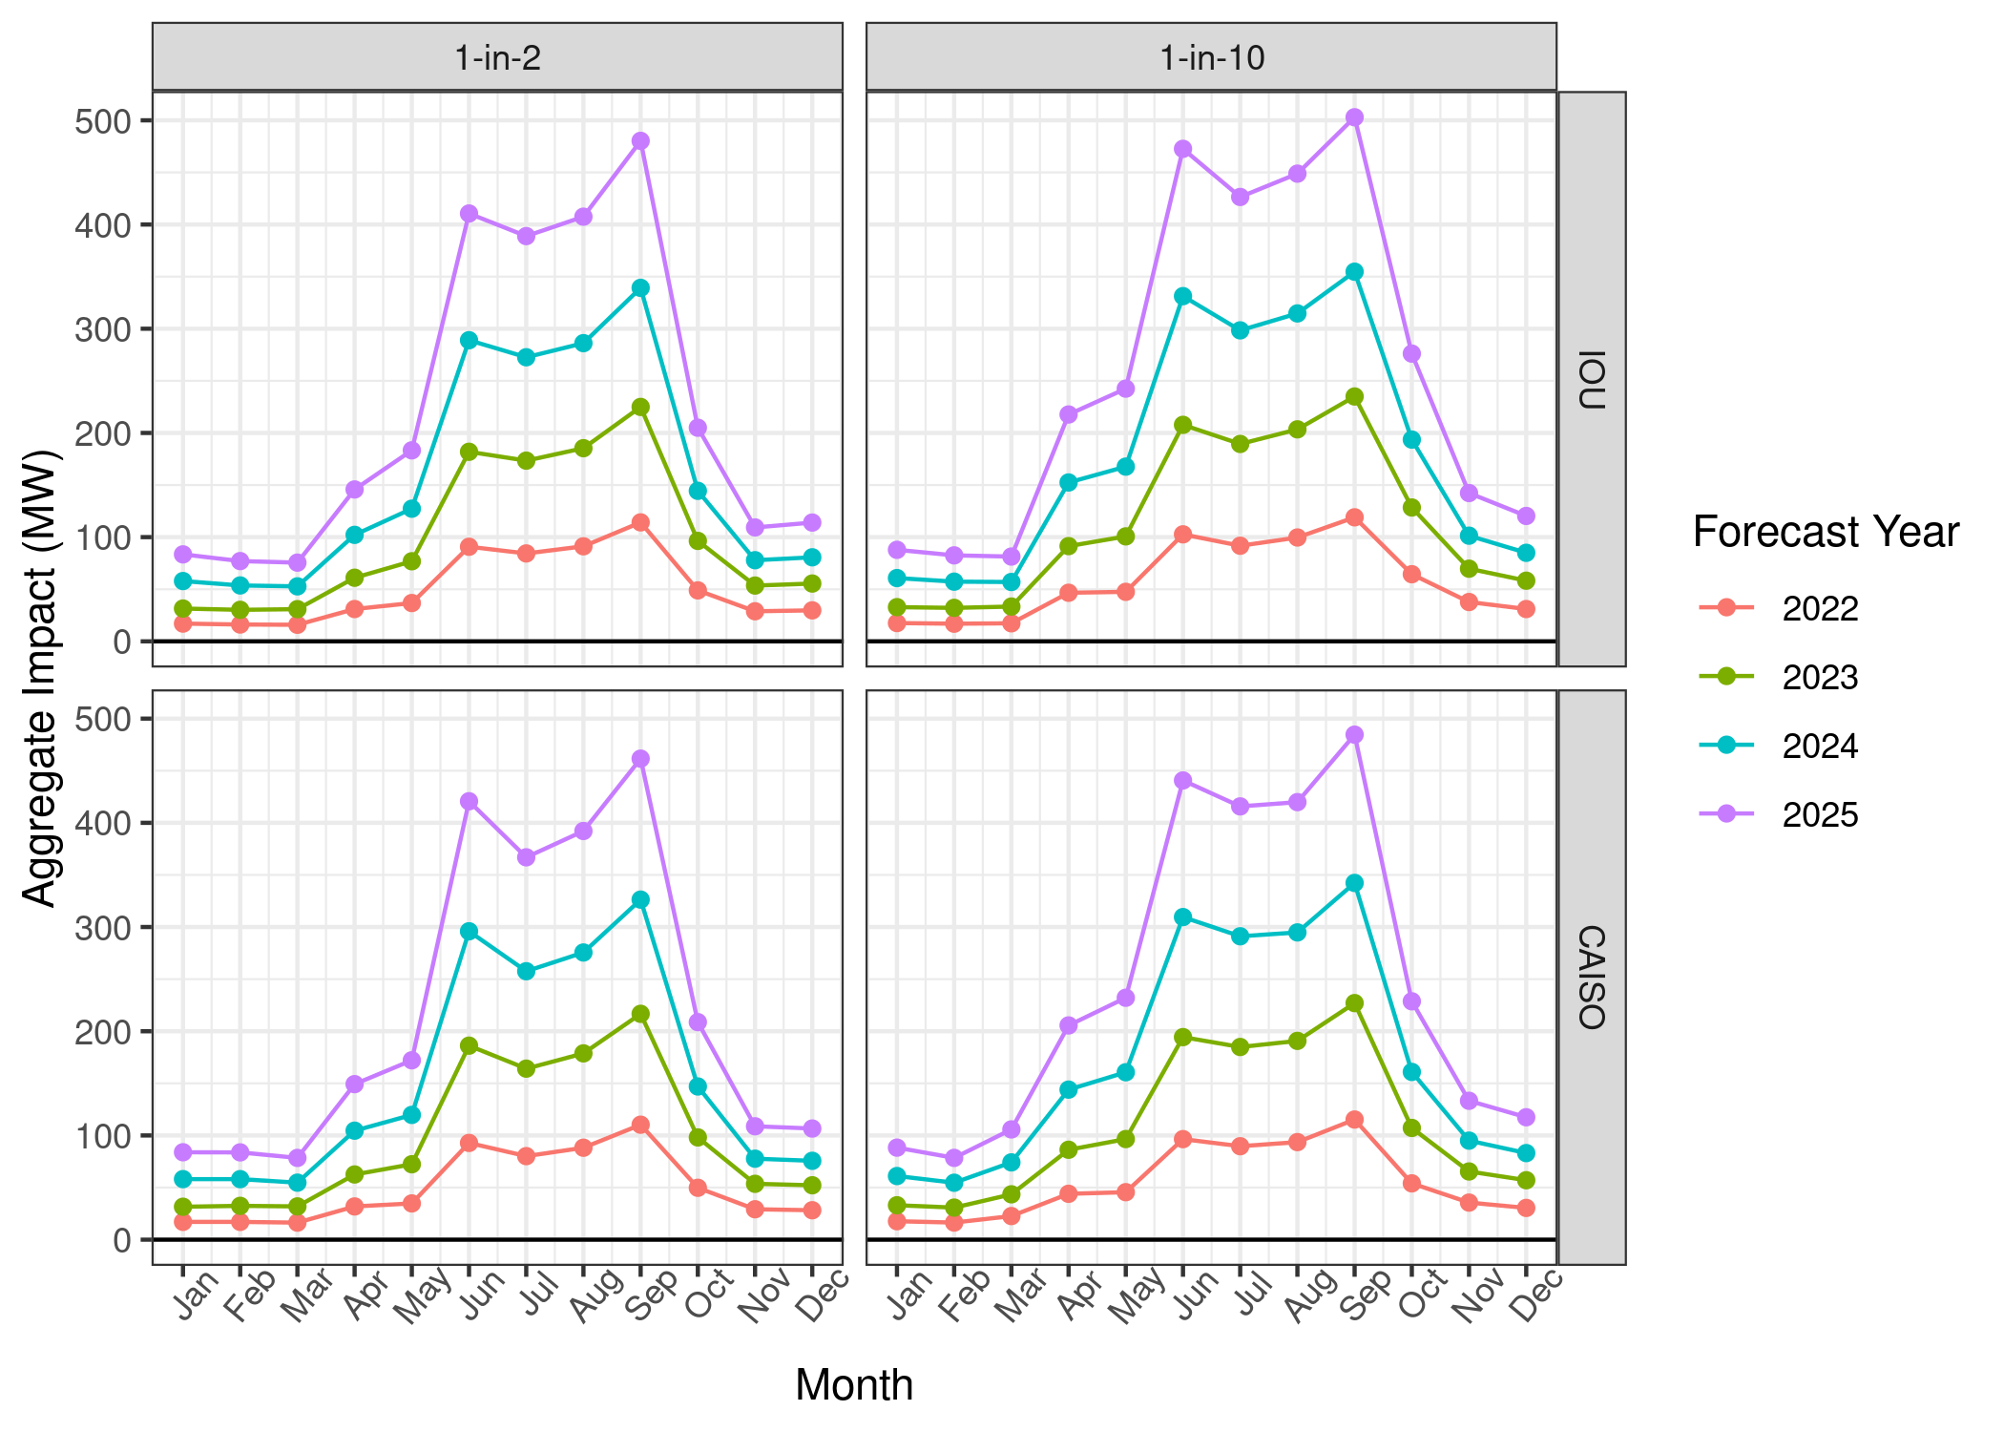
Ex ante performance by weather day

Slide 22
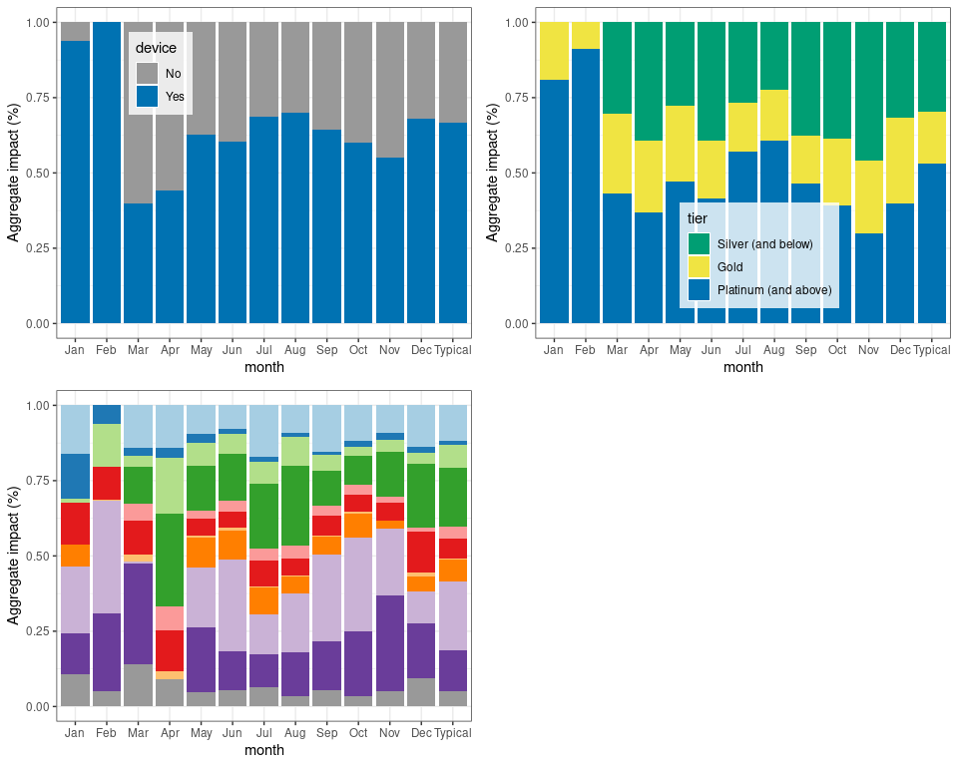
Ex post fraction of aggregate impact by device, event type, tier, and LCA

Slide 23
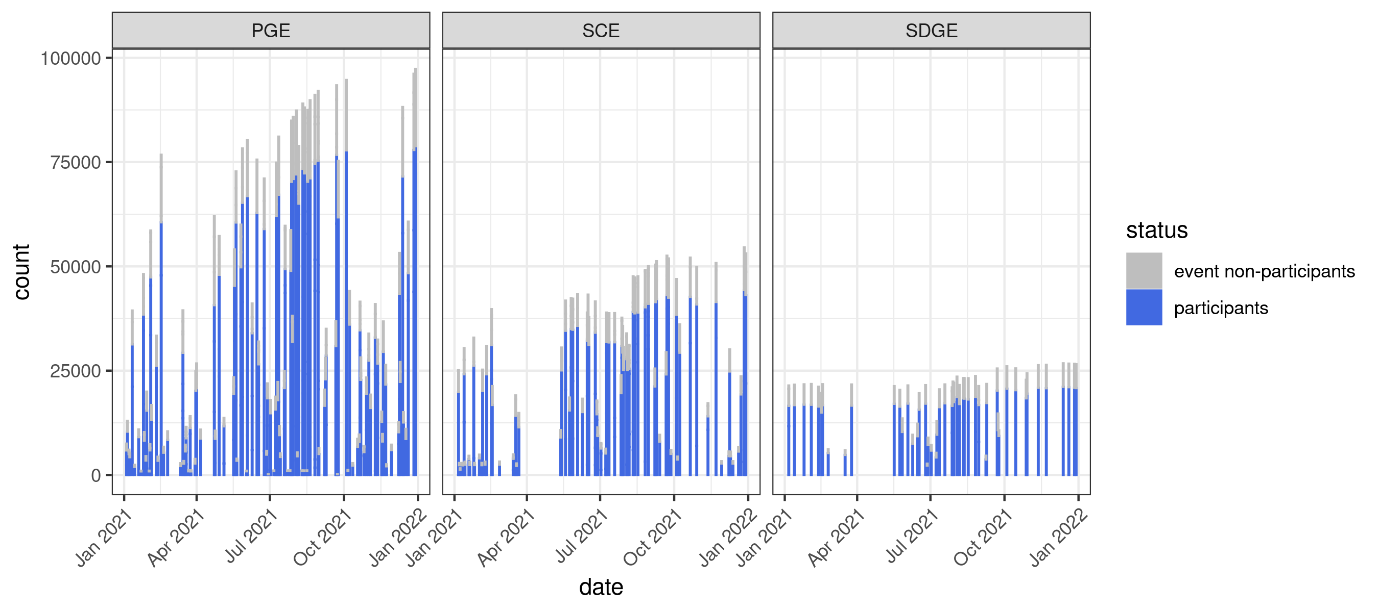
Participation rates

Slide 24
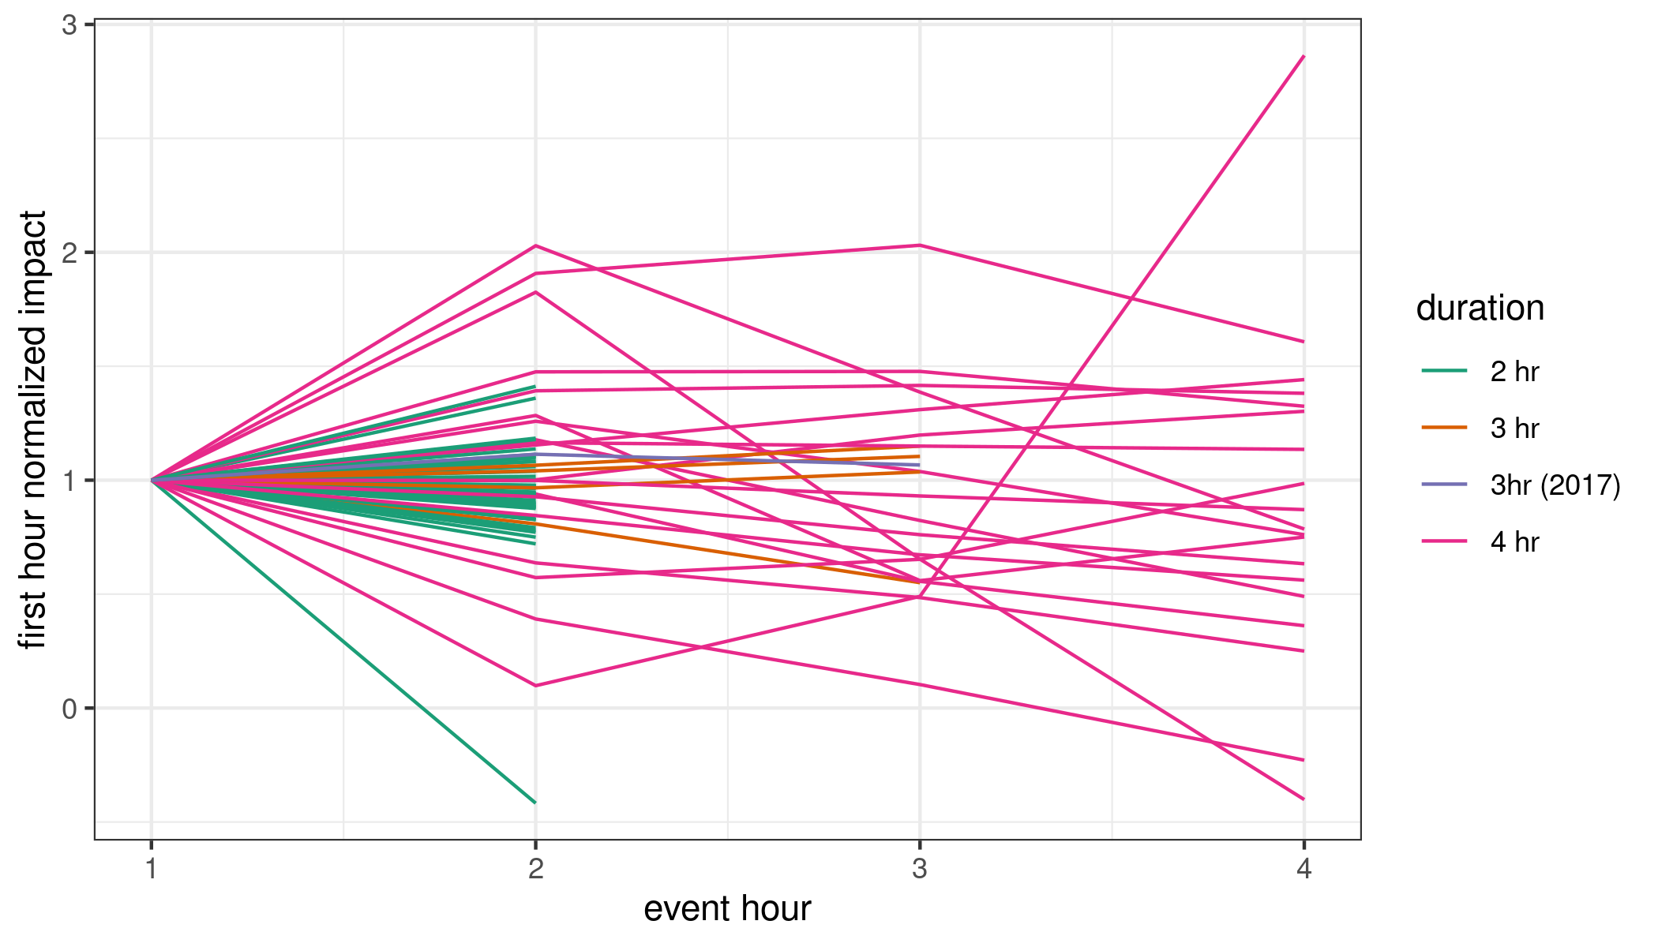
Sustained savings hour to hour

Slide 25
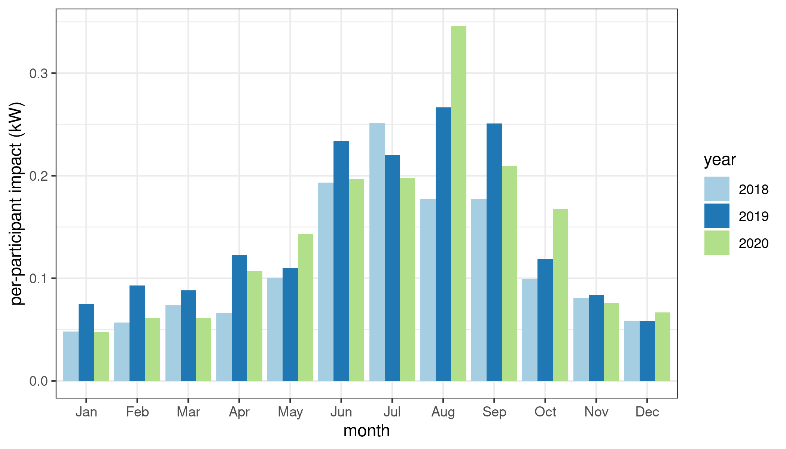
Year to year ex post monthly performance

