Slide 1
LIP Simplification Workshop
August 8, 2023

Slide 2
Enersponse Overview
LIP Objectives
Simplified LIP Approach
Incentive-based QC Approach
Approach Comparison
Additional CEC WG Recommendations
Agenda
Agenda

Slide 3
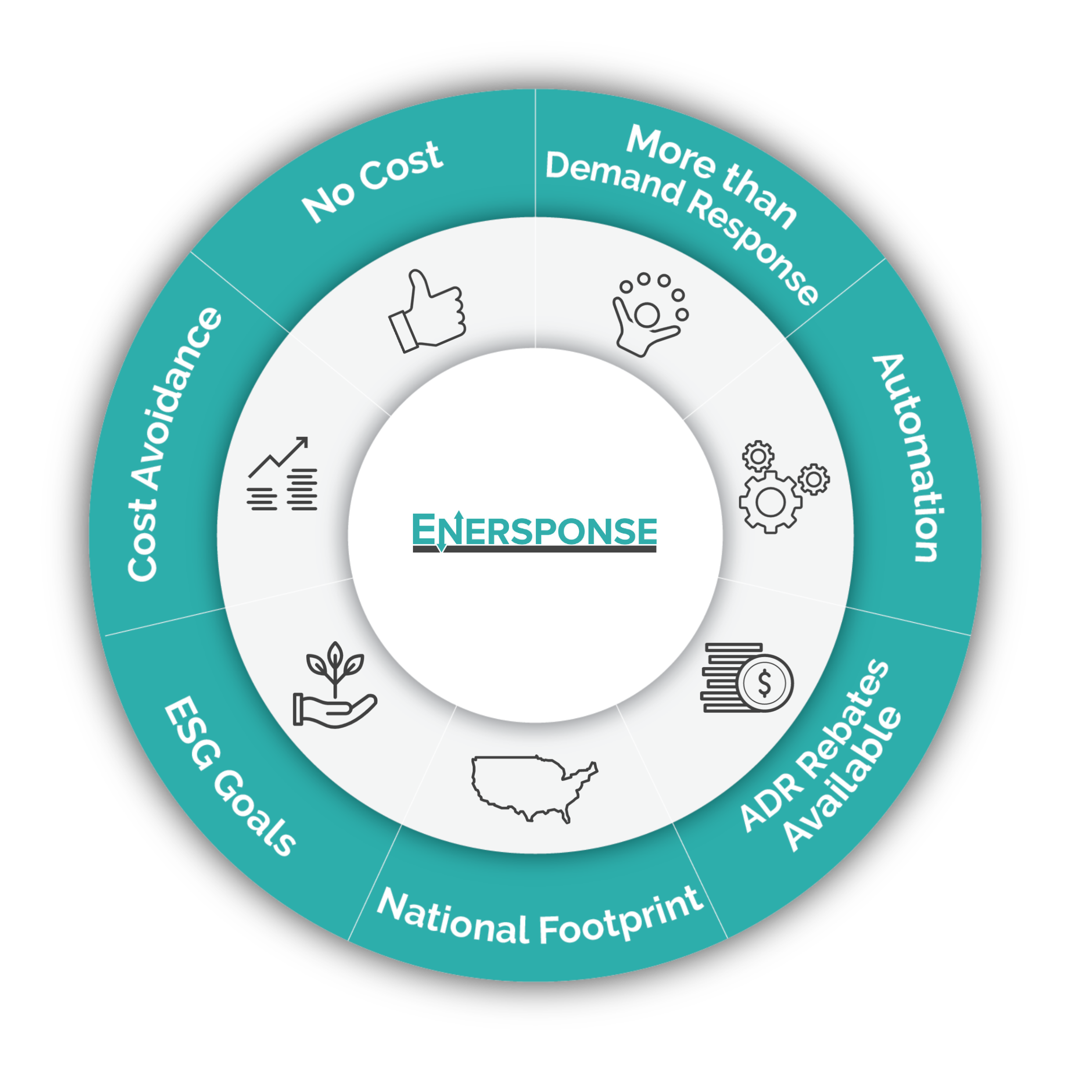
Who We Are

Slide 4
LIP Objectives – Are they aligned with outcomes?
Uncertainty Estimates
Resource Planning
QC Awards
Do the current uncertainty estimates contribute to cost-effectiveness evaluation, resource planning, or QC certainty?
What are the essential components to award QC?
Do the LIP results provide a consistent measure of DR that can be compared to other resources?

Slide 5
Simplified LIP Approach
Problems with the current LIP Approach:
Inconsistent
Time-consuming and costly for DRPs
Is not aligned with the desired outcomes (resource planning, load reductions that are close to the expected values)
Supported Initiatives
Two LIPs – one for IOUs, one for DRPs
Centralize standard reporting requirements
Standardize report and presentation requirements (DSA)
Employ a central planning authority to align with resource planning (DSA)
Remove requirement for LIP presentation for DRPs or limit discussion to required items/questions/issues with the report
Penalty structure for under-performance (CEDMC); align with CAISO reporting and settlement requirements to enforce (deadlines, repercussions, etc.)
Determine ex-post using prescribed analysis per customer type; use same baseline for settlement and ex post evaluation (CEC WG)
Determine ex-ante using hourly capability profile (CEC Staff)
Objectives of the Simplified LIP Approach
Align with resource planning
Reduce the time and cost burden for each DRP
Produce standard reports that allow for meaningful comparison and data transparency
Notes:
D.23-06-029

Slide 6
Incentive-based QC Approach
Problems with a proposed QC Approach:
Does not account for the complexity of IOUs
Untested; does not guarantee the desired outcomes
Requirements (e.g. hourly capability profile) are not fully defined
Supported Initiatives
Centralize standard reporting requirements
Pay less up front; pay more for delivered capacity
Determine ex-ante forecast based on hourly capability profile (CEC Staff)
Determine ex-post using demonstrated capacity calculations using bid-normalized load impacts (CEC Staff)
Penalty structure for under-performance (CEDMC) - penalty cliff could be lower than PG&E CBP if “pay less up front; pay more for delivered capacity” is adopted
Objectives of the Incentive-based QC Approach
Provides some price certainty for DRPs
Reduce the time and cost burden for each DRP
Produce standard reports that allow for meaningful comparison and data transparency
Notes:
D.23-06-029

Slide 7
Proposed Approaches Comparison
Simplified LIP Approach:
Incentive-Based QC Approach:
Use the same baseline for settlement and ex post evaluation (CEC WG)
Standardize report and presentation requirements (DSA)
Penalty structure for under-performance (CEDMC)
Central planning authority (DSA)
Provide more transparency for DRPs to align with grid needs
Centralize standard reporting
Use a third-party as a central repository for data and some reporting components to remove some of the reporting burden and cost from DRPs
Move away from the LIP approach (CEC Staff)
Pay less up front
This reserves funds to cover costs of other resources as needed
De-incentivizes over-commitments
Pay more for delivery
If delivered, the capacity is worth more, incentivizing better performance
Implement a penalty structure for shortfalls (CEDMC)
De-incentivizes overcommitments
Notes:
D.23-06-029

Slide 8
Additional CEC WG Recommendations
In addition to the aforementioned recommendations, the following CEC WG recommendations are supported.
Supported Initiatives
Reduce reporting requirements for QC determination
Streamline QC approval criteria; check-list of items required (data and/or tables)
Consistent QC framework and methodology; above check-list, plus standard reporting
Reduce the threshold for mid-year QC updates; template to complete with hourly capability profiles
Objectives of the WC Recommendations
Provide benefits for DRPs while also ensuring reliability
Reduces cost and time burden for both DRPs and CPUC
Provides opportunity and incentives for DRPs to acquire new customers and for additional DR customers to participate after the initial QC award
Notes:
D.23-06-029

