Slide 1
NEMA Land Review and Engineering Timing Interconnection Discussion Forum June 24, 2020

Slide 2
NEMA Review Timing
For a NEM-Aggregation project, utilities currently wait until Land Review is completed before starting Engineering Review
Land Review can take a long time if leases need to be created or addresses have mismatches in different databases
Customers could move projects forward if they had the results of Engineering Review and were confident they would eventually pass Land Review

Slide 3
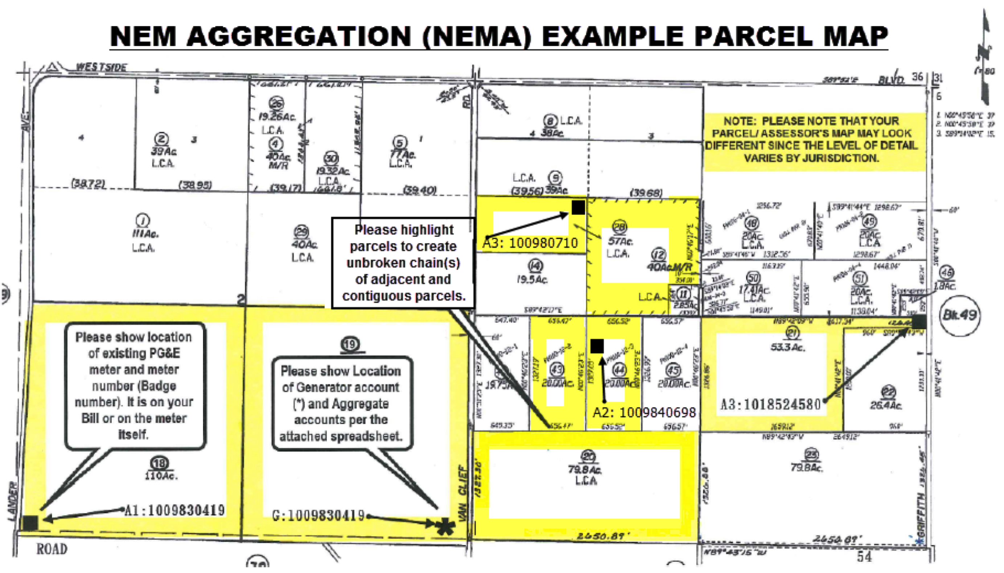
NEMA Land Review Can Be Complex

Slide 4
Thank You!
Brad Heavner
Policy Director
California Solar & Storage Association
brad@calssa.org

