Slide 1
San Joaquin Valley Pilots Bill Protection Principles & Recommendations
2/25/19
Presented by:
Elise Hunter
Policy & Regulatory Affairs Director ehunter@gridalternatives.org

Slide 2
Bill Protection – Analysis Findings
Post-Pilot Savings Analysis – Community Solar Customers
 | CARE | Non-CARE
Savings % w/o 20% Bill Protection | 25 Pcntl: 19% or $399 | 25 Pcntl: -8% or -$176
 | Median: 19% or $459 | Median: -3% or -$76
 | 75 Pcntl: 19% or $532 | 75 Pcntl: 2% or $95
Savings % w/ 20% Bill Protection | 25 Pcntl: 35% or $733 | 25 Pcntl: 13% or $286
 | Median: 35% or $839 | Median: 18% or $518
 | 75 Pcntl: 35% or $974 | 75 Pcntl: 22% or $835
An additional bill discount ensures that both CARE and non-CARE customers will receive energy bill savings
Every customer receives a 20% community solar discount before any other discounts
Customers are on EL-1 and E-1 tiered all-electric baseline rates, Region R

Slide 3
Bill Protection – Analysis Findings
Post-Pilot Savings Analysis – Non-Community Solar Customers
Several communities have either CSGT or GT-DAC as community solar options
GT-DAC is restricted to only CARE/FERA eligible customers; other customers will be excluded
The SJV pilots will allow participation up to 400% Federal Poverty Level (FPL), and FERA eligibility is 250% FPL
While CSGT allows for a broader swath of customers, non-CARE/FERA customers may have to wait, or may be turned away if the CARE/FERA subscription % is too low
 | Non-CARE/FERA
Savings % w/o 20% Bill Protection | 25 Pcntl: -35% or -$746
 | Median: -28% or -$808
 | 75 Pcntl: -22% or -$821
Savings % w/ 20% Bill Protection | 25 Pcntl: -8% or -$176
 | Median: -3% or -$76
 | 75 Pcntl: 2% or $95
Non-CARE/FERA customers risk higher bills as a result of the pilot if they are not enrolled in community solar, and do not receive additional bill protection

Slide 4
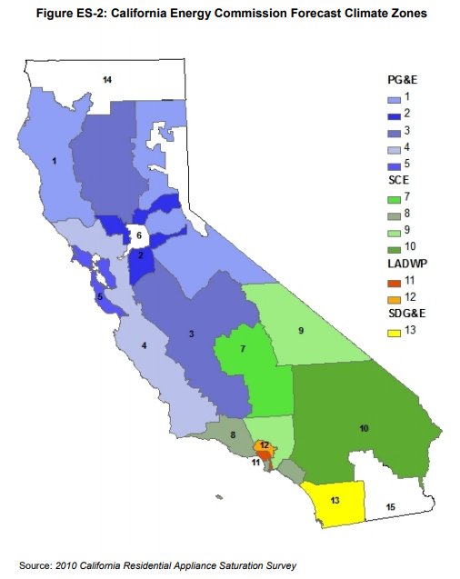
Bill Protection –Analysis Methodology
Assumed post-pilot electric loads were adjusted based on regional averages
The pilots in SJV fall into two main CEC forecast zones, 3 (PG&E) and 7 (SCE)
The 2009 CEC California Residential Appliance Saturation Study (RASS) has estimates for space heating loads in forecast zones
FZ 7 is likely more representative of the southern pilot communities than FZ 3, especially since RASS is 10 years old, and climate change is already affecting local temperatures
Assigned Communities in Madera, Fresno and Tulare Counties to FZ 7, and assigned Merced county to FZ 3
This creates a weighted average where 10 out of 11 PA communities are assigned a higher space conditioning load
Region | # Communities | HP Space Conditioning Load (Annual kWh)
FZ 3 | 1 | 831 kWh
FZ 7 | 10 | 5,509 kWh
Weighted Avrg. | N/A | 5,084 kWh

Slide 5
Bill Protection –Analysis Methodology
Accounted for the “rebound effect” of increased usage of energy post-pilot to reach greater health and comfort
In SCE’s October 2018 proposal, SCE compared actual 2017 electricity consumption in the summer and winter, and found 30% more consumption in the summer, likely due to air conditioning.
To account for this, SCE increased its heat pump space conditioning post-pilot load by 30%.
GRID replicates this approach for the 5 PA/PI communities:
5,084 kWh *1.3 = 6,609 kWh for HP Space Conditioning
Total Adjusted Added Electric Load = 8,489 kWh*
Using this adjusted value, median CARE customers see average loads increase by 117% and median non-CARE customers see average loads increase by 121%
*The remainder of electric loads are taken from the CEC RASS analysis for other appliances
719 kWh for electric dryer from table 2-5
310 kWh for radiant cooktop from table 2-5
1,004 kWh for heat pump water heater from table 2-5, adjusted for 300% efficiency rather than 95%

Slide 6
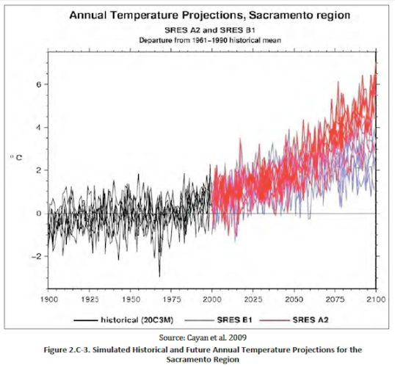
Climate Change in the SJV
https://www.energy.ca.gov/2009publications/CEC-500-2009-014/CEC-500-2009-014-F.PDF

