Slide 1
626 Area Code Region
California Public Utilities Commission

Slide 2
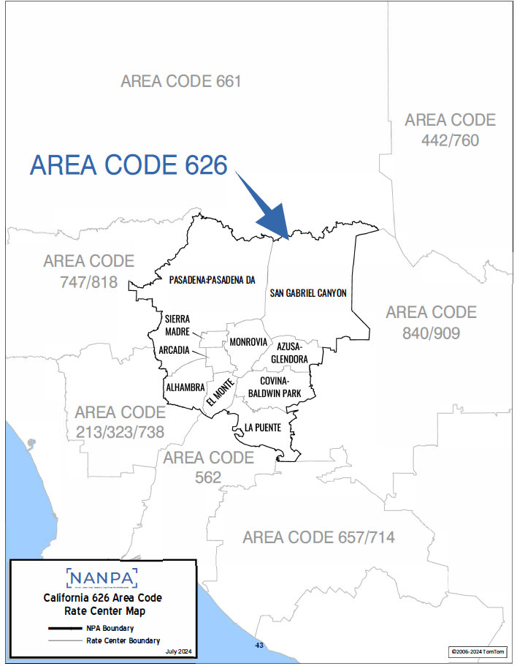

Slide 3
California Public Utilities Commission’s Role
FCC holds full jurisdiction over the telephone numbering system and area code administration.
FCC has delegated area code relief responsibilities to each state.
The CPUC conducts area code relief and determines method to introduce a new area code in accordance with Public Utilities Code Sections 7930-7943.
Area codes are managed and assigned by the North American Numbering Plan Administrator (NANPA).

Slide 4
Purpose and Objectives
Present
Area code relief plan
Provide
Provide estimated implementation schedule of new area code
Solicit
Solicit opinions and feedback
Effects of an overlay

Slide 5
626 Area Code History
1997
The 818 area code was split and the 626 area code was established.
1999
NANPA initiated relief planning for the 626 area code.
1999
The CPUC instituted a rationing and lottery allocation plan for the 626 area code that permitted up to five Central Office codes to be assigned monthly.
2002
Thousands-block number pooling was implemented, a number conservation method.
2010
The CPUC eliminated rationing in the 626 area code.
2024
NANPA notified the CPUC that a new area code is needed.

Slide 6
NANPA’s Responsibilities
Assigns area codes and prefixes
Tracks number usage, receives numbering reports from the service providers
Forecasts when area codes will run out of available prefixes, or “exhaust”
Coordinates planning to introduce a new area code which starts 36 months before the forecasted exhaust

Slide 7
Factors to Consider in Area Code Exhaust Forecast
Assignment history of prefixes
Current growth in the telecommunications industry
Annual increase in the demand for prefixes in the area code

Slide 8
Rate Centers
Area codes are geographically specific.
Each area code is divided into local serving area called rate centers.
There are 10 rate centers in the 626 area code.
ALHAMBRA | ARCADIA | AZUSA-GLENDORA | COVINA | EL MONTE
LA PUENTE | MONROVIA | PASADENA: PASADENA DA | SIERRA MADRE | SAN GABRIEL CANYON

Slide 9
626 Area Code Background
The 626 area code encompasses a large portion of the San Gabriel Valley containing the eastern portion of Los Angeles County.
51 service providers provide phone service within the 626 area code.

Slide 10
Number of Prefixes Remaining
As of March 2025, the 626 area code has 61 available prefixes or about 8% remaining. The available prefixes are expected to run out or “exhaust” by 4th Quarter 2027.
A new area code, or relief, is needed to replenish the supply of prefixes.
Each prefix is uniquely assigned to a rate center.

Slide 11
626 Area Code Overlay Relief Method
An additional area code is the only relief option for the 626 area code overlay.
California has introduced seventeen new area codes using the overlay method.
The 530 area code geographic area is already an overlay region.

Slide 12
Impacts of the Proposed Overlay
All current customers will keep their existing area code and telephone number.
Customers in this area may be assigned a number in the new area code when the 626 area code prefixes are no longer available for assignment.

Slide 13
Impacts of the Proposed Overlay
Dialing ‘1+ an area code’ does not change what a call costs and does not mean that a call is a toll or long-distance call.
Calling areas and rates will NOT change.
What is a local call before the introduction of a new area code will remain a local call after the new area code is implemented.
Calls to 911 and 988 as well as 211, 311, 411, 511, 611, 711 and 811 will not be affected, and will continue to be dialed with three digits.

Slide 14
Estimated Implementation Schedule of the Proposed Overlay
Estimated Implementation Intervals:
NANPA Filed Application with CPUC
1st Quarter 2025
CPUC Decision
1st Quarter 2026
Introduction of the New Area Code
2nd Quarter 2027

Slide 15
Questions & Comments
Questions and comments concerning the information in this presentation may be submitted to the Public Advisor’s Office no later than June 13, 2025.
Email: public.advisor@cpuc.ca.gov
Postal mail: CPUC Public Advisor’s Office 320 W. 4th Street, Suite 500 Los Angeles, CA 90013
Phone: (866) 849-8390

