Slide 1

California Teleconnect Fund (CTF) Program
Participant Recertification Process
Presented by CTF Staff

Slide 2
The program aims to bring every Californian direct access to advanced communications services in their local communities, particularly those with lower rates of internet adoption and greater financial need. – California Teleconnect Fund

Slide 3
California Teleconnect Fund Application Recertification
To conform with program rules
To ensure that participants have updated their contact information and are still active in CTF
To ensure all participants are eligible to receive the CTF discount

Slide 4
Recertification Webinar Objectives
To explain and clarify the rules for Recertification
The Recertification process
Recertification timelines
Documentation required for Recertification
Live demonstration

Slide 5
Agenda Items
Introduction
Rules of Recertification
Live eCAP Demonstration
Documentation required for Recertification
Importance of updated contact information
Deficiencies, incomplete Recertification applications
Determinations
Conclusion

Slide 6
Recertification Background

Slide 7
Why do I need to Recertify?
The Caifornia Teleconnect Fund was established by the CPUC in 1996 as a result of the Telco Act of 1996 and deregulation by the Federal Communications Commission in Decision 96-10-066. The Decision states that the fund must undergo review every three years. Since than there have been changes to technology and program rules in 2008, 2015, 2016, and 2018.
In Decision 18-01-066 (2018) the Commission ordered the implementation and documentation specifics for a three-year eligibility verification requirement.
Major changes to the California Teleconnect Fund since inception in 1996:
  In 2015, reinstatement of CTF Goals, elimination of support for voice services, eligible services list.
  In 2016, establishment of e-rate cap.
  In 2018, updated eligibility rules for Community Based Organizations.
  In 2019, implementation of the 50% of mission rule and Qualifying Services Worksheet.

Slide 8
Who needs to Recertify?
Because there are over 15,000 participants in the California Teleconnect Fund, the recertification process will be done by category.
Community Based Organizations must recertify every three years from the eligibility date. They will be the first category undergoing recertification since they are the largest and have had the most changes in eligibility criteria. This process should take around three years.
The next categories will undergo Recertification every five years from their eligibility date.
  Public and Private schools
  Libraries
  Government Owned and Operated hospitals
  California Telehealth Network members

Slide 9
How will I know when to Recertify?
The California Teleconnect Fund will notify participants through E-CAP when they need to Recertify. Notices will go out to participants through e-mail.
First Notice will be sent 120 days prior to the expiration of eligibility.
A Second Notice will be sent 60 days prior to the expiration of eligibility.
A Third and Final Notice will be sent 30 days prior to the expiration of eligibility.
Notices will also be sent to the California Teleconnect Fund service providers with the expectation they will reach out to their CTF customers so there is no gap in discounts.

Slide 10
How do I Recertify?
Participants will recertify through the E-Cap portal:
Log into your E-Cap account and find your account.
Once you verified your account basic information, check the locations on file.
You will see the application number of the location, and the approval and expiration dates.
You will see a tab to “Recertify”. Click on the tab and complete your application.

Slide 11
How do I Recertify (2)?
For Community Based Organizations, you will need the following required documents necessary to Recertify:
  IRS 501 (c)(3) Determination
  Most recent IRS Form 990
  List of Board of Directors
  Qualifying Services Worksheet
For Healthcare Community Based Organizations in addition:
  Medicare-Medi Cal, fee structure documentation
  List of state licensed practitioners
  Facility state licenses
  .

Slide 12
CTF- Live Demonstration
Objectives:
View ECAP Portal Queues
View recertification process

Slide 13

RECERTIFICATIONS IN ECAP
The following will be CTF staff presenting live demonstrations for participants submitting CTF recertification applications.
eCAP Web Portal:
https://ecap.cpuc.ca.gov/
Community-Based Organizations (CBOs)
CTF staff will provide a live demonstration
Public and Private Schools
CTF staff will provide a live demonstration for Public Schools
Libraries, Community Colleges, Government Hospitals, 2-1-1 Service Providers
For these remaining entities, the process is similar to the live demonstrations that will be provided for CBO’s, HCBO’s, and schools.
Healthcare Community-Based Organizations (HCBOs)
CTF staff provide instruction regarding HCBO’s
Organizations must utilize eCAP to manage their participation in the CTF program, including for submitting applications, maintaining contact information, and completing eligibility recertifications.

Slide 14
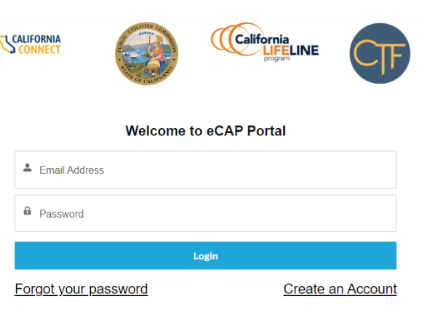
General Information

Slide 15
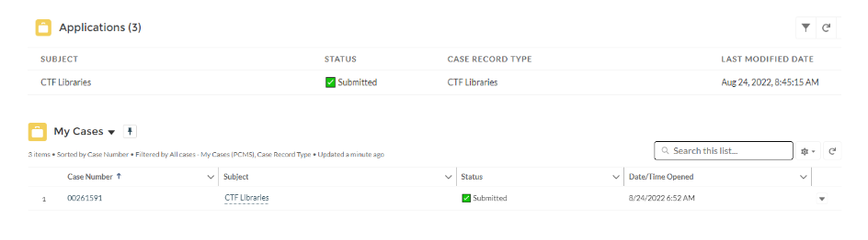
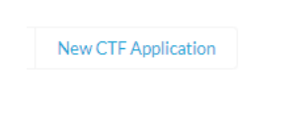
List of submitted applications/cases
Applications in applicant queue are called “cases”
Each application is assigned a case number
To begin a new application, applicant will click “New CTF Application” button.

Slide 16
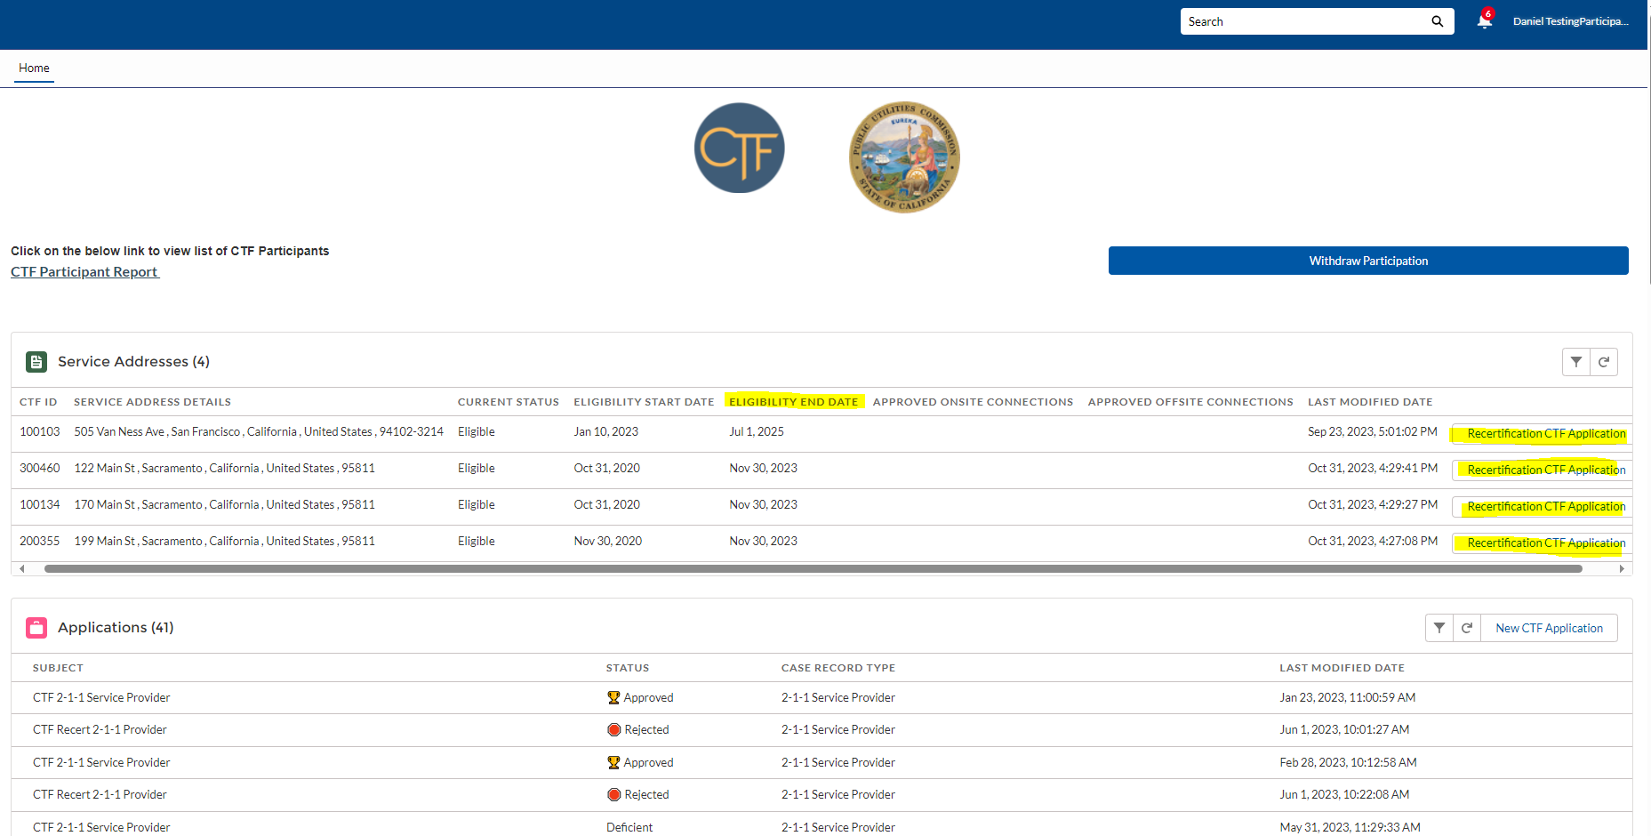

Slide 17
LIVE DEMONSTRATION

Slide 18
CTF Required Documentation for Recertification & Contact Information for Participants

Slide 19
Documentation and Information
Documentation and Information that applicants need to provide when submitting their recertification
Log in to your eCAP account
Schools, Libraries, Community Colleges, Government Hospitals/ Clinics, Community-Based Organizations , 2-1-1 providers and Healthcare Community-Based Organization needs to click “recertifications CTF applications” when they submit the document in eCAP
Current Form 990 and 501c(3) letter

Slide 20
The Importance of Accuracy and Completeness in Documentation
All documents submitted through eCAP must be most recent and accurate
All required documentation must be completed
Submit a recertification application at least 30 days before the eligibility end date
Do not create a new eCAP account

Slide 21
Highlight Importance of Keeping Contact Information updated in eCAP
Organizations must maintain current email address
Recertify eligibility through eCAP
Receive recertification notifications

Slide 22
CTF Outreach Efforts – Administrative Letter No. 31
The letter was sent out to carriers on September 1,2023.
Collect participant contact information
A template to carrier
90 calendar days to submitted to CTF

Slide 23
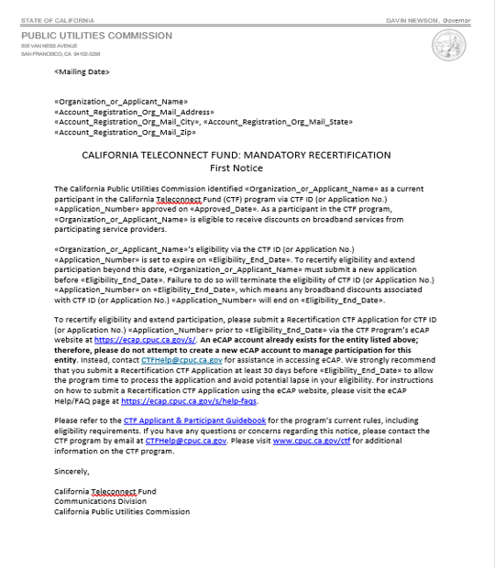
Recertification Notices
This is a sample of the first recertification notices.
The first notice is sent out to the participants 120 days prior to the eligibility end date.
A second notice is sent 60 days priors to eligibility end date.
A third and final notice is sent 30 days prior to eligibility end date.

Slide 24
CTF- Application Deficiencies

Slide 25
Deficiencies and Delays
Incomplete information
Incorrect or inaccurate information
Eligibility issues
Failure to provide supporting documents

Slide 26
Deficiencies and Delays Con’t
Service provider approval
Non-compliance
Incomplete cost details

Slide 27
Getting Ahead of CTF Application Deficiencies
Qualifying Services Worksheet

Slide 28
Purpose of Qualifying Services Worksheet
Determination of eligibility
Calculation of discounts
Application process
Compliance

Slide 29
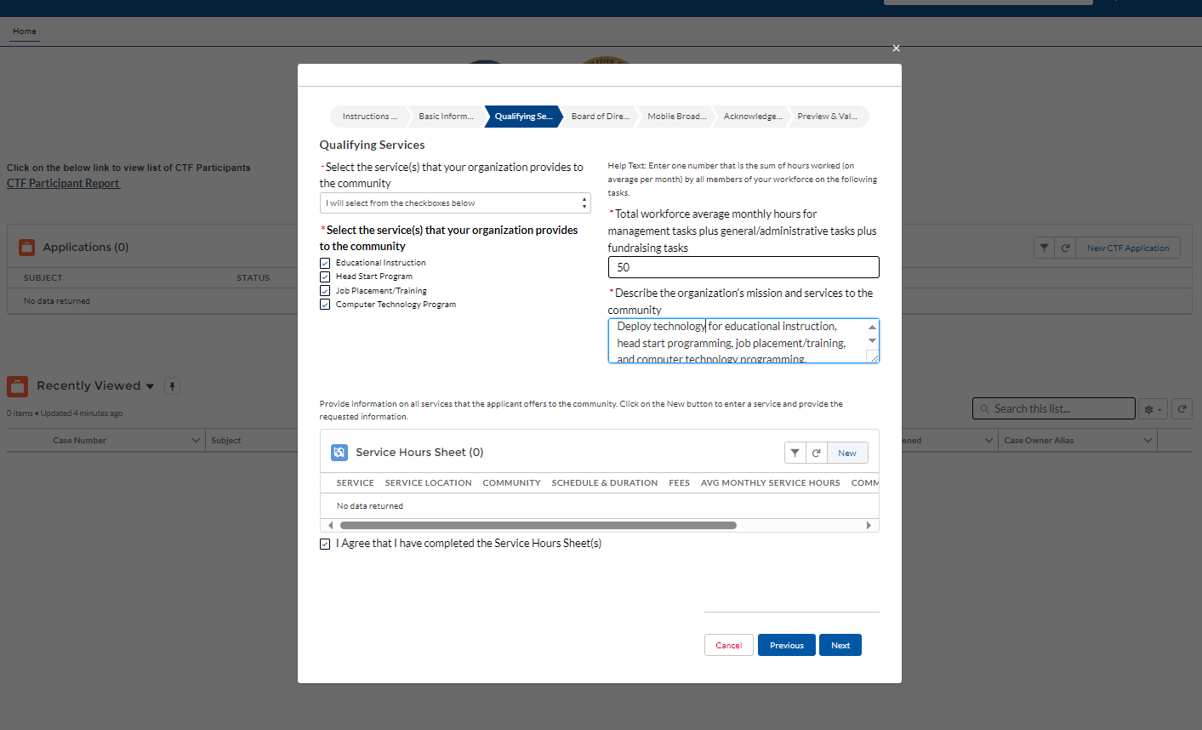
How To Fill Out The Worksheet Accurately

Slide 30
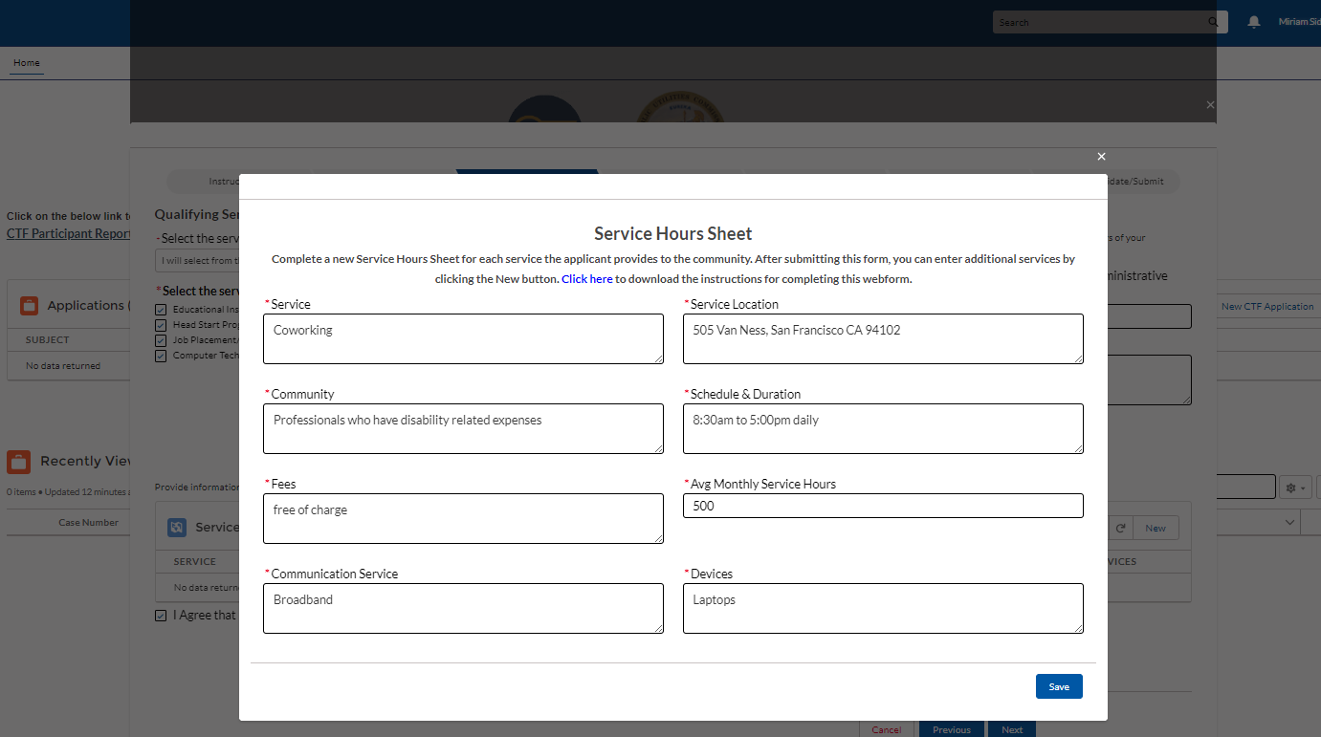
How To Fill Out The Worksheet Con’t

Slide 31
Common Qualifying Services
Data Transmission Services
Internet Access
Integrated Services Digital Network

Slide 32
CTF – Recertification Determination

Slide 33

Recertification Review Process
Recert application submission
Document verification
Eligibility assessment
Review financial information
Verify compliance with CTF Program rules
Approval/Ineligible/Rejection

Slide 34
Recertification Timeline
CTF Analyst Receives Recert Application
CTF Analyst Reviews Recert Application
CTF Analyst Issues Deficiency Notification
**If applicable
CTF Analyst Approves or Rejects Recert Application
Recert Applicant
Submits Recert Application in eCAP
Recert Applicant
Awaits During Review Process
Recert Applicant
Receives Deficiency Notices and Re-submits Recert Application
Recert Applicant
Receives Notification of Approved or Rejected Recert Application

Slide 35
Conclusion

Slide 36
How the California Teleconnect Fund bridges the Digital Divide
By providing discounts for small, Community Based Organizations to diffuse access and adoption to broadband services.
During the pandemic in 2020-21, the Distance Learning Initiative provided 413 School Districts a total of 110,630 mobile hot spots, ensuring remote access to state testing for students.
The Digital Divide Grant Program awarded nearly $1million in grant funding to provide holistic technological solutions for low income, rural and urban, small school districts.

Slide 37
In Summary
Recertification of California Teleconnect Fund participants will ensure compliance of eligibility requirements of participants, will enhance program administration and will ensure the accuracy of participant data.
Pursuant to D.18-01-006 all California Teleconnect Fund Healthcare and Community Based Organization participants must recertify their eligibility every three years.
Schools, libraries, Government Owned Hospitals and California Telehealth Network members participating in the California Teleconnect Fund must recertify their eligibility every five years.

Slide 38
In Summary
Please log in and view your account in E-CAP so you can see the locations eligible for the California Teleconnect Fund, and most important the eligibility end dates to prepare for recertification.
Be on the look out for recertification notices 120, 60 and 30 days prior to your entity’s recertification date.
Please submit your questions regarding your account and recertification to:
ctfhelp@cpuc.ca.gov.

Slide 39
Questions?

Slide 40
Resources
Information on the previous webinar is
Available at:
Program Outreach and Education
For more information:
https://www.cpuc.ca.gov/CTF
CTF Applicant & Participant Guidebook
Available on our website in English, Spanish, and Chinese
E-CAP Frequently Asked Questions:
Help - FAQs (ca.gov)

