Slide 1

California Teleconnect Fund (CTF) Program
Recap
Presented by CTF Staff

Slide 2
The program aims to bring every Californian direct access to advanced communications services in their local communities, particularly those with lower rates of internet adoption and greater financial need. – California Teleconnect Fund

Slide 3
Importance of CTF in promoting affordable telecommunications services
  Facilitates access & innovation in the delivery and use of advanced communication services
  Promotes diversity & affordability of choices among California services and providers
  Bridges the digital divide and enhanced connectivity for entities that serve the public interest and may have limited resources
  Facilitates better communication and internet access for schools, libraries, and healthcare institutions
  Promotes digital inclusion and equitable access to information and resources
  Improves access to affordable and reliable telecommunications services for eligible institutions
  Diffuses access and adoption to broadband services by providing discounts to small Community Based Organizations (CBOs)

Slide 4
Agenda Items
CTF Overview
Application Process
Recertification Process
Claims Process
Conclusion
Q&A Session

Slide 5
CTF Overview

Slide 6
Purpose & Mission of the California Teleconnect Fund
Advance universal service by providing discounted rates to libraries, hospitals, health clinics, community organizations, community colleges and qualifying schools, maintaining pre-school, kindergarten or any of the grades 1 to 12, inclusive;
Bring every Californian direct access to advanced communications services in their local communities;
Ensure high-speed internet connectivity for community CTF-eligible institutions at reasonable rates; and
Increase direct access to high-speed internet in communities with lower rates of internet adoption and greater financial need.
6

Slide 7
Background & Establishment of CTF
The California Teleconnect Fund (CTF) provides discounts of up to 50% for advanced telecommunications services to help bridge the “digital divide” to Schools, Libraries, Community Colleges, Government Owned and Operated Health Facilities, Community Based Organizations (CBOs), Healthcare Community Based Organizations, California Telehealth Network (CTN).
Since it’s inception in 1996, the CTF has supported over 14,000 participants by bridging the Digital Divide through access and adoption to broadband services at discounted rates in their community.
Prior to 2023, entities would apply for CTF by completing and filling out an application form specific to their entity and mailing the form to the Commission. Now, organizations submit applications online, utilizing eCAP.
The CTF Program is funded by ratepayer surcharges on telephone access lines. Currently the surcharge rate is $0.18 per access line. The appropriated CTF budget for 2023-2024 is $108.34 million.
7

Slide 8
Background & Establishment of CTF
Assembly Bill 3643 (1994)
Public Utilities Section 280
Decision 96-10-010 (1996)
Decision 08-06-020 (2008)
Decision 15-07-007 (2015)
Decision 16-04-021 (2016)
Decision 18-01-006 (2018)
Decision 19-04-013 (2019)

Slide 9
Entities Eligible for CTF Support
Schools
Libraries
Community Colleges
Government Owned and Operated Health Facilities
Community Based Organizations (CBOs)
Healthcare Community Based Organizations
California Telehealth Network (CTN)

Slide 10
CTF’s Role in Bridging the Digital Divide
By providing discounts for small, Community Based Organizations to diffuse access and adoption to broadband services.
During the pandemic in 2020-21, the Distance Learning Initiative provided 413 School Districts a total of 110,630 mobile hot spots, ensuring remote access to state testing for students.
The Digital Divide Grant Program awarded nearly $1million in grant funding to provide holistic technological solutions for low income, rural and urban, small school districts.

Slide 11
CTF- Application Process

Slide 12


Entities Eligible for CTF Support
Schools
Libraries
Government Hospitals & Clinics
Community Colleges
Public Schools-No requirement
Private Schools- must be a verifiable non-profit organization
Certified by the CA State Library
Operated by municipal or local government
N/A
Public Schools- None
Private Schools- $50 Million Endowment Cap
No Revenue Cap
No Revenue Cap
No Revenue Cap
Services: Elementary, pre-school, or K-12 academic instruction
Services: Direct broadband access to community members
Services: Only locations in CA that provide direct healthcare services to the community
Services: Educational services to community members
CDS Code
N/A
CDPH/ Healthcare License Number
MIS Code

Slide 13

Entities Eligible for CTF Support Cont.
Community Based Organizations (CBOs)
Healthcare CBO’s
2-1-1 Service Providers
501-c3 Organization
501-c3 Organization
501-c3 Organization
$5 Million Revenue Cap
$50 Million Revenue Cap
None
Performs Qualifying Services per CTF rules
Provides direct licensed healthcare services to public
Offers 2-1-1 services as the primary function
www.cpuc.ca.gov/ctf
Majority Board members in CA
Majority board members in CA
Majority board members in CA
Not a religious organization
Licensed Healthcare Personnel on site
Be a designated 2-1-1 service provider by the CPUC via an adopted Resolution.
CDPH/ Healthcare License Number

Slide 14

Application Review Process
Application submission
Document verification
Eligibility assessment
Review financial information
Verify compliance with CTF Program rules
Approval/Ineligible/Rejection

Slide 15
Application Timeline
CTF Analyst Receives Application
CTF Analyst Reviews Application
CTF Analyst Issues Deficiency Notification
**If applicable
CTF Analyst Approves or Rejects Application
Applicant
Submits Recert Application in eCAP
Applicant
Awaits During Review Process
Applicant
Receives Deficiency Notices and Re-submits Application
Applicant
Receives Notification of Approved or Rejected Application

Slide 16
Deficiencies and Delays
Incomplete information
Incorrect or inaccurate information
Eligibility issues
Failure to provide supporting documents
Service Provider Approval
Non-compliance

Slide 17
CTF- Recertification Process

Slide 18
Why do I need to Recertify?
The Caifornia Teleconnect Fund was established by the CPUC in 1996 as a result of the Telco Act of 1996 and deregulation by the Federal Communications Commission in Decision 96-10-066. The Decision states that the fund must undergo review every three years. Since then, there have been changes to technology and program rules in 2008, 2015, 2016, and 2018.
In Decision 18-01-066 (2018) the Commission ordered the implementation and documentation specifics for a three-year eligibility verification requirement.
Major changes to the California Teleconnect Fund since inception in 1996:
  In 2015, reinstatement of CTF Goals, elimination of support for voice services, eligible services list.
  In 2016, establishment of e-rate cap.
  In 2018, updated eligibility rules for Community Based Organizations.
  In 2019, implementation of the 50% of mission rule and Qualifying Services Worksheet.

Slide 19
Who needs to Recertify?
There are over 15,000 participants in the California Teleconnect Fund, the recertification process will be done by category.
Community Based Organizations and Health Care CBO must recertify every three years from the eligibility date. This process should take around three years.
The next categories will undergo Recertification every five years from their eligibility date.
  Public and Private schools
  Libraries
  Government Owned and Operated hospitals
  California Telehealth Network members

Slide 20
Submission of Necessary Documentation
Documentation and Information that applicants need to provide when submitting their recertification
Log in to your eCAP account
Schools, Libraries, Community Colleges, Government Hospitals/ Clinics, Community-Based Organizations , 2-1-1 providers and Healthcare Community-Based Organization needs to click “recertifications CTF applications” when they submit the document in eCAP
Current Form 990 and 501c(3) letter

Slide 21
Recertification Notification
The California Teleconnect Fund will notify participants through E-CAP when they need to Recertify. Notices will go out to participants through e-mail.
First Notice will be sent 120 days prior to the expiration of eligibility.
A Second Notice will be sent 60 days prior to the expiration of eligibility.
A Third and Final Notice will be sent 30 days prior to the expiration of eligibility.

Slide 22

Recertification Review Process
Recert application submission
Document verification
Eligibility assessment
Review financial information
Verify compliance with CTF Program rules
Approval/Ineligible/Rejection

Slide 23
Recertification Timeline
CTF Analyst Receives Recert Application
CTF Analyst Reviews Recert Application
CTF Analyst Issues Deficiency Notification
**If applicable
CTF Analyst Approves or Rejects Recert Application
Recert Applicant
Submits Recert Application in eCAP
Recert Applicant
Awaits During Review Process
Recert Applicant
Receives Deficiency Notices and Re-submits Recert Application
Recert Applicant
Receives Notification of Approved or Rejected Recert Application

Slide 24
CTF- Claims Process

Slide 25
Types of Services Eligible for CTF Reimbursement
Eligible Services are categories of advanced communication services that are eligible to receive the CTF discount. The following eligible services are
Asynchronous Transfer Mode
Broadband Over Power Lines
Cable Modem
Digital Subscriber Line
Digital Signal, DS1, DS2, etc.
Ethernet
Fiber Optics, including leased dark fiber and leased lit fiber
Fixed Wireless Internet Access

Slide 26
Telecommunications Services Eligible (Cont.)
Frame Relay
Integrated Services Digital Network
Mobile Broadband Service – with certain restrictions*
Multi-Protocol Label Switching
Optical Carrier, OC1, OC2, etc.
Satellite Internet Access
Switched Multimegabit Data Service
Trunk Level, T1, T2, etc.
Wide Area Network (WAN)¹

Slide 27
Documentation requirements for filing claims
Record retention
Please keep a copy of your submitted claim sheet for future audit purposes.
Consistent email communication
Deficient, Rejected, or Approved letters.
Ensure correct claim totals
After you have corrected all system generated errors, please double check that the total claim amount is correct.
Consider final formatting.
Data should be submitted using an Excel worksheet. Please ensure data is in the correct columns.
Excel worksheet template is provided via a link during the claim's submission process.

Slide 28
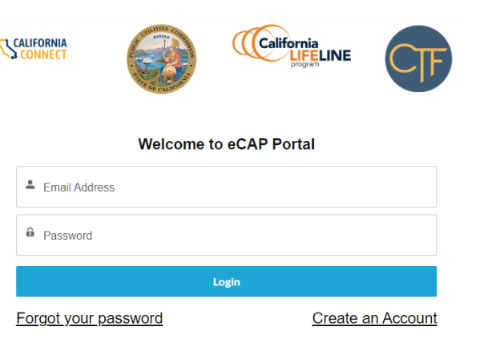
Submission process for claims

Slide 29
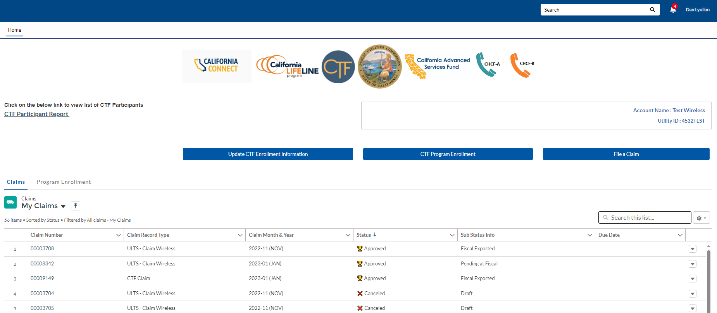
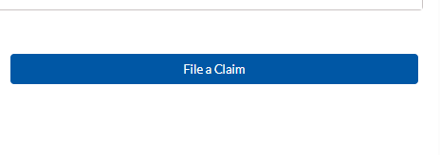
List of submitted and in-process claims
Each claim is assigned a claim number
“My Claims” queue will show all claims in various modes such as “approved, rejected, pending information, draft”
To begin a new claim, service provider will click “File a Claim” button.

Slide 30
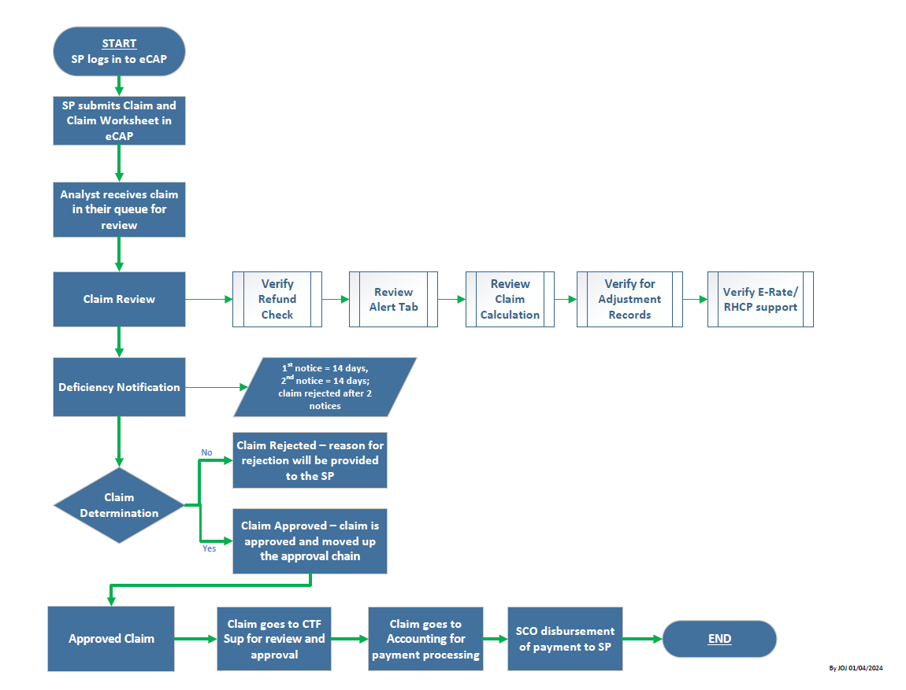
Review and approval process for claims
CTF Claims Process Workflow

Slide 31
Claim Processing Timeline
CTF Analyst Receives Claim
CTF Analyst Reviews Claim
CTF Analyst Issues Deficiency Requests
**if required
CTF Analyst Approves or Rejects Claim
Service Provider
Submits Claim in ECAP
Service Provider
Awaits During Review Process
Service Provider
Receives Deficiency Notices and Re-submits Claim
Service Provider
Receives Notification of Approved or Rejected Claim

Slide 32
Conclusion

Slide 33
Conclusion
The CTF program has a significant impact on communities in need of broadband services.
The CTF program is funded by California ratepayers through surcharges on telephone corporations' active access lines in California.
CTF accepts applications from nonprofit CBOs, schools, libraries, healthcare CBOS, government hospitals and clinics, and community colleges.
Applicants to the CTF program must login to eCAP and submit a completed application with update and accurate supporting documents

Slide 34
Conclusion
Recertification of California Teleconnect Fund participants will ensure compliance of eligibility requirements of participants, will enhance program administration and will ensure the accuracy of participant data
Be on the look out for recertification notices 120, 60 and 30 days prior to your entity’s recertification date
CTF claims ensure service providers are reimbursed for offering discounts, supporting affordable access to advanced communication services in California.
For successful claim submission, service providers need to maintain organized records, use clear and consistent email communication with CTF staff, double-check claim accuracy, and review their final excel sheet formatting.

Slide 35
Questions?

Slide 36
Resources
Information on the previous webinar is
Available at:
Program Outreach and Education
For more information:
https://www.cpuc.ca.gov/CTF
CTF Applicant & Participant Guidebook
Available on our website in English, Spanish, and Chinese
E-CAP Frequently Asked Questions:
Help - FAQs (ca.gov)

Slide 37

For questions regarding the CTF program and application process, please reach out to us at CTFHelp@cpuc.ca.gov.

