Slide 1

CTF Service Provider Webinar
Presented by CTF Staff
January 16, 2025

Slide 2
The program aims to bring every Californian direct access to advanced communications services in their local communities, particularly those with lower rates of internet adoption and greater financial need. – California Teleconnect Fund

Slide 3
Agenda Items
CTF Updates
Processes
Payments
Concepts and Best Practices
Participant Report
Audits and Compliance
Feedback/Discussion
Conclusion

Slide 4
CTF Updates

Slide 5
Legislative and Policy Updates
Federal Communications Commission Includes WiFi Hotspots for Public Schools, CTF Adapts Requirements
On July 18, 2024, the FCC, in the Wi-Fi Hotspot Report and Order, granting schools and libraries the ability to utilize E-Rate resources to loan out Wi-Fi hotspots which will provide internet access for those individuals without a reliable connection at home.
Resolution T-17848 revises CTF’s eligible services list and reflects the FCC’s adoption of the Wi-Fi Hotspot Report and Order making eligible the off-premises use of Wi-Fi hotspots and mobile wireless Internet access services.
Notes:
Please make sure you keep and retain all approval letters, invoices and billing information in the event of an audit.

Slide 6
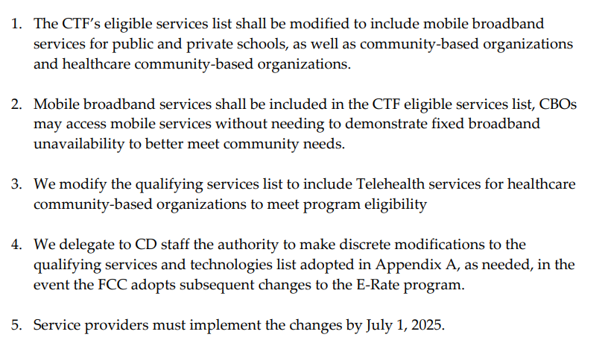
Legislative and Policy Updates
Federal Communications Commission Includes WiFi Hotspots for Public Schools, CTF Adapts Requirements
Notes:
Please make sure you keep and retain all approval letters, invoices and billing information in the event of an audit.

Slide 7


CTF Funding Sources
The CTF program is funded by California ratepayers through surcharges based on the number of active access lines that a telephone corporation operates in California
  Updated Surcharge Mechanism- Effective April 1, 2023, assessed on a per access line basis (D. 22-10-021)
  Telecommunications carriers were required to begin collecting a flat rate surcharge of $1.11 for every active access line (telephone line) in California to support California’s six Universal Service programs, known as Public Purpose Programs.
  CTF’s allocation of the $1.11 surcharge is approximately $0.25, or 22.46%.

Slide 8

CTF Funding Limits & Activities
Funding Limits
Standard Budgetary appropriation limits per year (Annual CA Budget Act)
Continuous annual Funding is based on first come, first served until funding runs out
CTF Activities
Aside from the main goal of the CTF program, which is to administer a program to advance universal service by providing 50% discounts to qualifying entities, CTF funding was also used for various sub-programs and projects such as
    Distance Learning Project
    Senate Bill (SB)1212 / 2-1-1 project
    Digital Divide Grant Program (DDGP)

Slide 10
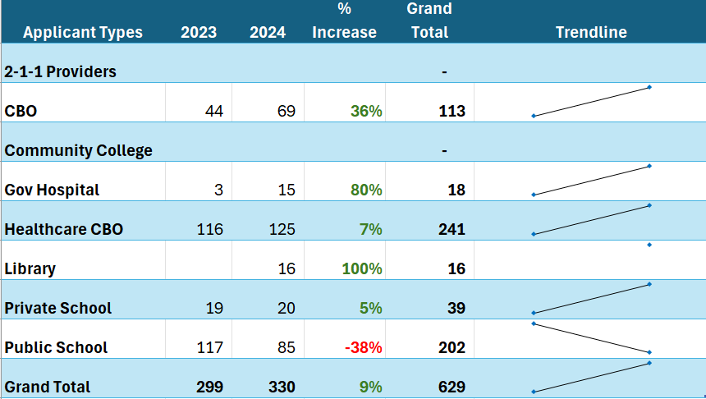
CTF Participant Trends
1

Slide 11

CTF Claims Worksheet- Update
Additional tab added for service providers to provide explanations regarding adjustment records.
Purpose of the tab is for service providers to explain various adjustments to the CTF program at the same time as submitting a claim.
  Increases review efficiency
  Reduces amount of data requests
  Ensures program compliance

Slide 12
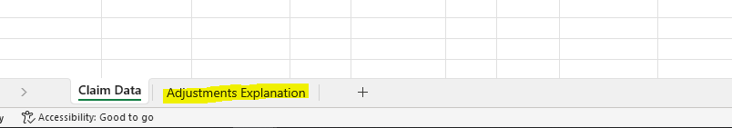
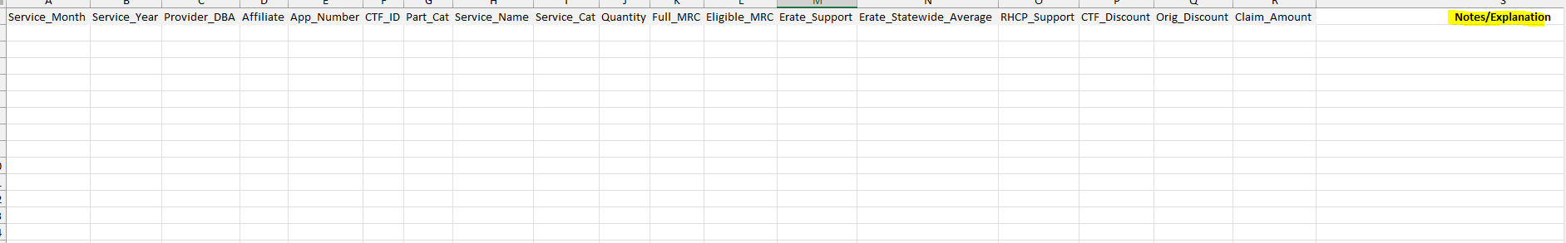
Claims Worksheet Update- Example

Slide 13

Digital Divide Grant Program
T-17842 to award CBOs and public schools' grants for reducing the digital divide in schools and communities located in low-income urban and rural areas by providing necessary resources and access to digital technology.
    $100,000 to projects for low-income rural and urban schools
    Two $50,000 awards for CBOs
  The DDGP will begin accepting applications seven days after the adoption of this Resolution.
  Applicants must submit their completed application, including all required documents, to DigitalDivideGrantProgram@cpuc.ca.gov.
    See T-17842 Appendix A for Application Instructions

Slide 14



eCAP Updates
Library Annex
School Annex
CTF Outreach

Slide 15
Processes

Slide 16
Service Provider Program Requirements
Must have a Certificate Of Public Convenience and Necessity (CPCN) on file with the Communications Division to receive reimbursements.
Service Providers that do not have a CPCN can partner with a CPCN holder to participate and to file claims for reimbursement on their behalf.
Payments are addressed to the CPCN holder and are passed on to the partner.
CTF does not arrange or facilitate partnerships.
The Service Provider filing the claim is responsible for the veracity of the entire claim, including any amounts for a partner.
Notes:
Thank you, Joy. What do Service Providers need to do to participate in CTF? It is a simple process. First, a Service Provider needs to have CPCN on file with the Commission. If not:

Slide 17
Service Provider Program Requirements (cont.)
Must maintain a public webpage that includes information on CTF, a link to www.cpuc.ca.gov/ctf, a list of eligible services and contact information.
If a Service Provider discounts tariffed services, they must have the tariffs on file with the CPUC.
Must submit and update their CTF contacts to the Communications Division with a Carrier Information Update Request Form.
Must have an accurate Payee Data Record on file with the CPUC’s Fiscal Department.
Notes:
The website must have a dedicated CTF web page that is easy to find and to navigate through. It must have basic information and contact information.

Slide 18
Service Provider Program Requirements (cont.)
Must provide any documentation or data requested by Communications Division.
Must remain compliant and current on surcharge fee collections and remittances.
Service Providers must comply with all applicable state laws, CPUC requirements and rules.
Notes:
Please make sure you keep and retain all approval letters, invoices and billing information in the event of an audit.

Slide 19

Service Provider Program Enrollment
Once a Service Provider is approved for CTF, they will receive a welcome email from e-Cap with instructions on how to log in and can add primary and additional contacts. Service Providers cannot create their own account. If you do not receive a welcome email, contact:
CTFclaims@cpuc.ca.gov.
Notes:
New Service Providers will receive a confirmation e-mail through e-Cap.

Slide 20
Before Providing CTF discounts:
Service providers must verify participant eligibility. This is done by obtaining a copy of the participants CTF Approval Letter. The Approval Letter will have the participants CTF-ID or Application number and the eligibility dates.
You can further verify participant eligibility through the Participant Report at https://ecap.cpuc.ca.gov/s/ctf-participants
Notes:
It is important that you verify eligibility and that the Approval Letter matches the information on the Participant Report. Kirsten will be going over the Report later.

Slide 21

CTF Approval Letters
New participants to the program must submit their CTF Approval Letter to the carrier to initiate their discounts. The participant must keep a copy for their records.
Existing participants do not need to submit copies of CTF Approval Letters, service provides can verify their eligibility through the Participant Report.
Participants may request a copy of their Approval Letter for their records at CTFHelp@cpuc.ca.gov.
Notes:
Copies of Approval Letters must be requested by the participant. Service Providers can verify eligibility through the e-Cap Participant report.

Slide 22
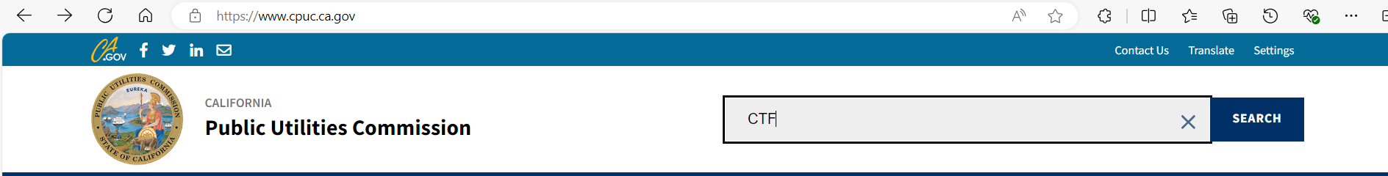
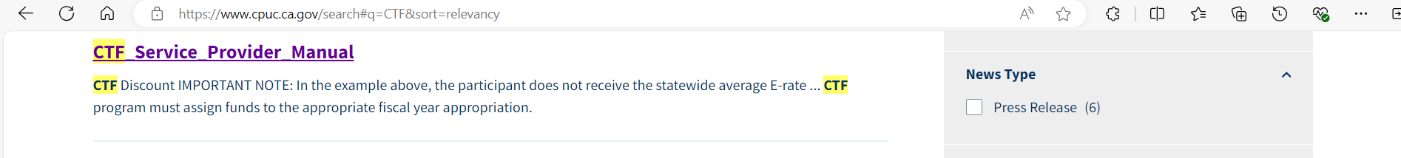
Handling Claims ---- Service Provider Manual https://www.cpuc.ca.gov/search#q=CTF&sort=relevancy
Notes:
Copies of Approval Letters must be requested by the participant. Service Providers can verify eligibility through the e-Cap Participant report.

Slide 23
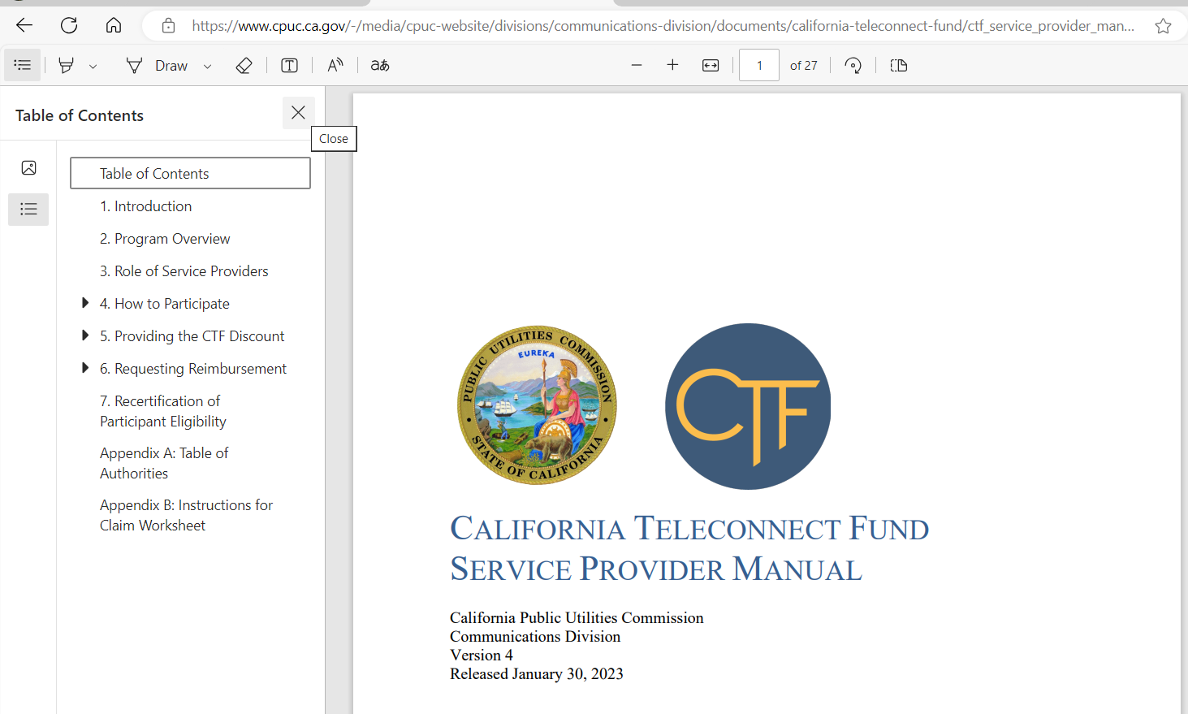
Handling Claims ---- Service Provider Manual https://www.cpuc.ca.gov/-/media/cpuc-website/divisions/communications-division/documents/california-teleconnect-fund/ctf_service_provider_manual.pdf
Notes:
Copies of Approval Letters must be requested by the participant. Service Providers can verify eligibility through the e-Cap Participant report.

Slide 24
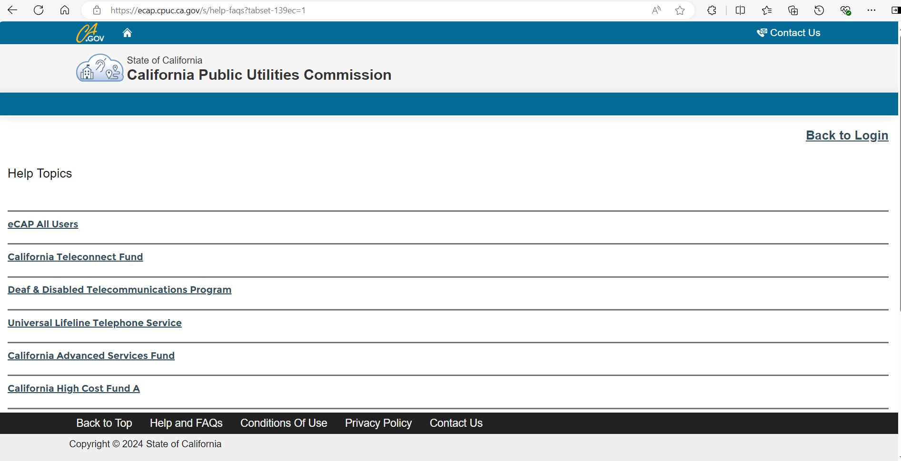
Handling Claims ---- Frequently Asked Questions https://ecap.cpuc.ca.gov/s/help-faqs
Notes:
Copies of Approval Letters must be requested by the participant. Service Providers can verify eligibility through the e-Cap Participant report.

Slide 25
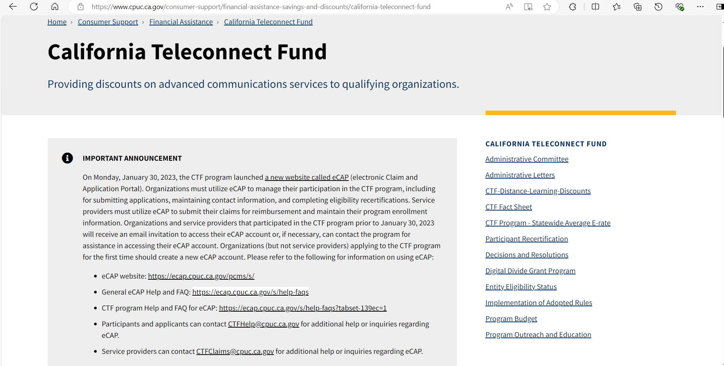
Handling Claims ----
CA Teleconnect Fund Webpage https://www.cpuc.ca.gov/consumer-support/financial-assistance-savings-and-discounts/california-teleconnect-fund
Notes:
Copies of Approval Letters must be requested by the participant. Service Providers can verify eligibility through the e-Cap Participant report.

Slide 26

When To Submit A Claim
Only submit a claim after the participant has been billed.
Claims Cannot be submitted before the participant has been billed.

Slide 27
Claim Adjustment Demo

Slide 28
Claim Adjustment Demo
Correction
Example Type |  |  |  | Srv_Month | Srv_Year | Provider_DBA | Affiliate | App_Number | CTF_ID | Part_Cat | Srv_Name | Srv_Cat | Quantity | Full_MRC | Eligible_MRC | Erate_Support | Erate_St_Avg | RHCP_Support | CTF_Discount | Orig_Discount | Claim
Correction Record A |  |  |  | 6 | 2021 | Awesome Broadband | N |  | 100099 | CBO | Fast DSL | DSL | 1 | $ 24.00 | $ 24.00 |  |  |  | $ 12.00 | $ 10.00 | $ 2.00
Record from June-2021 claim:
Previous Record A |  |  |  | 6 | 2021 | Awesome Broadband | N |  | 100099 | CBO | Fast DSL | DSL | 1 | $ $20.00 | $ 20.00 |  |  |  | $ 10.00 |  | $ 10.00

Slide 29
Claim Adjustment Demo
E-rate True-Up
Example Type |  |  |  | Srv_Month | Srv_Year | Provider_DBA | Affiliate | App Number | CTF_ID | Part_Cat | Srv_Name | Srv_Cat | Quantity | Full_MRC | Eligible_MRC | Erate_Support | Erate_St_Avg | RHCP_Support | CTF_Discount | Orig_Discount | Claim amount
E-rate True-up Entry |  |  |  | 7 | 2021 | Awesome Broadband | N |  | 400235 | Private School | Speedy Fiber | Fiber | 1 | $ 50.00 | $ 50.00 | 70% | 75% |  | $ 7.50 | $ 6.25 | $ 1.25

Slide 30
Claim Adjustment Demo
Correction with A Refunded Amount
Example Type |  |  |  | Srv_Month | Srv_Year | Provider_DBA | Affiliate | App_Number | CTF_ID | Part_Cat | Srv_Name | Srv_Cat | Quantity | Full_MRC | Eligible_MRC | Erate_Support | Erate_St_Avg | RHCP_Support | CTF_Discount | Orig_Discount | Claim Amount
Correction Record B |  |  |  | 6 | 2021 | Awesome Broadband | N |  | 102354 | CBO | Fast DSL | DSL | 1 | $ 100.00 | $ 80.00 |  |  |  | $ 40.00 | $ 50.00 | $ (10.00)
Records from June-2021 claim:
Previous Record B |  |  |  | 6 | 2021 | Awesome Broadband | N |  | 102354 | CBO | Fast DSL | DSL | 1 | $ 100.00 | $ 100.00 |  |  |  | $ 50.00 |  | $ 50.00

Slide 31
Claim Extensions
If you need more than 60 days to submit your claim, you can request an extension by contacting the CTF analyst processing the claim. You must do this within the 60-day window. The request will be forwarded to the CTF Supervisor for review and determination.
Notes:
Requests for extensions are granted on a case-by-case basis. And now Connie will go over the payment process.

Slide 32
Payments

Slide 33
Instruction on how Service Providers Need to Submit a Claim Before They Receive Payment
Service providers apply CTF discounts within participant’s monthly bills.
Submit a claim for reimbursement to eCAP.
Download the claim worksheet template, then complete and submit one claim worksheet per month.
Each claim worksheet is due 60 days from the last day of the month.

Slide 34

Timeline for SP to Receive Payment from CTF
CTF analysts reviewed the claim in eCAP and submitted to supervisor for approved within 30 days.
CTF supervisor reviewed and approved the claim.
Fiscal office processed the claim and created a voucher in FI$Cal.
State Controller Office will approve or deny the claim in FI$Cal.
The warrant check will issue approximately 30 days after a claim is approved in eCAP.

Slide 35
Returning Funds to CTF
The adjustments and corrections can sometime necessitate a service provider to return the funds.
If the subtotal for any fiscal year listed is negative, the service providers must send a refund check.
The refund check can be either a physical check or e-check.
A physical check need to mail and make payable to “California Public Utilities Commission- CTF program”.
E-check is an electronic check that can be mail to our CTF claims email.
A claim is considered incomplete if the associated check has not received.

Slide 36
Concepts and Best Practices

Slide 37
Best Practices
Multiple Locations:
  CTF discount is location-based, each location (address) must receive its own Approval Letter to be eligible for CTF discount. Verify each location's eligibility before adding the customer.
    Verify existing multiple-location customer for each location's CTF eligibility.
    Verify each CTF participant location's eligibility expiration date before submitting a claim since each location may have different CTF eligibility end date.
Record Retention:
  CTF service provider must keep claim-related records for 10 years and make them available in the event of a state audit.
Notes:
Hi, I will be going over the definitions for each of the columns in the CTF workbook and then give you a demo on how to fill out the workbook for the different types of claim corrections.

Slide 38
Common Errors and How to Avoid Them – and Get Reimbursed Faster
Location eligibility for multi-location CTF participants.
  CTF eligibility is location-based, please confirm each location's CTF eligibility before adding the location to customer account.
Confirm CTF participant eligibility for each claim month.
Name change.
  When there is a legal name change. Please submit updated Std. Form 204 and IRS letter approving the name change.
Claim Submission Deadline
  Service Providers must submit one claim for each service month. Claim is due 60 days from the end of the month and is not eligible for reimbursement if received after the due date.

Slide 39
Common Errors – cont.
CTF payments are reimbursements:
  Do not include in submitted claim prior to providing the discounted bill to the CTF participant.
eCAP claim worksheet input errors:
  Enter the appropriate information for claim worksheet columns.
    Service month vs. billed month.
    E-rate state average vs. E-rate support.
Adjusting past claim(s):
  Adjust past claims by including the adjustments in the most recent claim month instead of adjusting past claims.
  Not an error: but please include screenshot(s) when reporting eCAP errors.

Slide 40
CTF Workbook Column Title Definitions
Service_Month- The Month which the participant received the service.
Service_Year- The year which the participant received the service.
Provider DBA- The service providers “do business as” Name. This will normally be the name of the company that submitted the claim however if an affiliate provided the service then they will need to be listed here instead.
Affiliate- This is anyone except the filing carrier that provided services. Refer to chapter 6 section C of the service provider manual for additional information on submitting claims on behalf of affiliates.
App_Number- The programs identification number for CTF applicants approved before July, 2019.
CTF ID- A unique identifier for each eligible service address approved or recertified after July 1, 2019.
Part_Cat- Participant Category. This is the category of the eligible CTF participant. The eligible categories are Private School, Public School, Public School-Annex, Library, Library-Annex, Community College, Gov. Hospital, CBO, and Healthcare CBO

Slide 41
Column Title Definitions Continued
Service_Name- The marketed name of the service.
Service_Cat- The CTF eligible Category of the service. For a list of eligible services please see the eligible services list in the service provider manual appendix B.
Quantity- The quantity of the service purchased by the participant.
Full_MRC- The full and undiscounted monthly recurring cost of service without any adjustments for credits or prorations.
Eligible_MRC- The portion of the full monthly recurring cost remaining after adjustments for time-based proration, service provider credits or discounts, and/or cost allocation of bundles containing ineligible services.
Erate_Support- The participant’s support level commitment from the federal E-rate program.
Erate_ST_Avg- The E-rate statewide average.

Slide 42
Column Title Definitions Continued
RHCP_Support- The amount of Rural Healthcare Program Support the participant receives.
CTF_Discount- The CTF discount received by the participant.
Orig_Discount- The original CTF discount amount previously given to the participant on a previous claim.
Claim_Amount- The amount being reimbursed on the claim.
All of this information can be found in the CTF Service Provider Manual on our website-
https://www.cpuc.ca.gov/consumer-support/financial-assistance-savings-and-discounts/california-teleconnect-fund

Slide 43
Participant Report

Slide 44

CTF Participant Report
What is it?
A report of all CTF participants, that can be viewed in your browser or exported to Microsoft Excel, that includes:
CTF ID/Application Number
Participant Name
Eligibility Start Date
Eligibility End Date
Number of Approved Onsite & Offsite Mobile Connections
Service Address
Participant Category*
*The Participant Category field is included in the downloadable Participant Report only.

Slide 45
CTF Participant Report
How is it used?
Service Providers:
To determine if, and when, a participant is eligible to receive the CTF discount.
Participants:
To verify their eligibility dates, service addresses or other information.
Applicants:
To verify their organization does not have an existing eCAP account and avoid creating duplicate accounts.
Notes:
Service Providers may use the CTF Participant Report to determine if, and when, a participant is eligible to receive the CTF Discount. Service Providers may use the CTF Approval Letter for the same purpose. They may also use the Participant Report to verify that any organizations included in their CTF claim do not have expired eligibility end dates. If a Service Provider believes does not find a particular organization in the participant report, they may request a copy of the CTF Approval Letter from the organization directly. If the Service provider believes there is an error in the Participant Report, CTF encourages them to share this with the CTF team so that we may correct any issues.
Participants may use the CTF Participant Report to verify their eligibility start and end dates for each service location that is participating in the program. Participants may direct their service provider to the CTF Participant Report as an alternative to providing their CTF Approval Letter.
Applicants may use the CTF Participant Report if they are unsure if their organization may have participated in the CTF program in the past. If the organization has had turnover, there may not be clarity on if the organization has an eCAP account. Any organizations that had previously participated in our program will have existing eCAP accounts regardless of expired eligibility. If an applicant sees that their organization does have an account listed on the Participant Report, but they do not have access to that account, they may email CTFHelp@cpuc.ca.gov for assistance.

Slide 46
CTF Participant Report
Where is it located?
A link to the CTF Participant Report can be found on CTF’s homepage website, in the CTF Service Provider Manual and in the CTF Applicant & Participant Guidebook.
https://ecap.cpuc.ca.gov/s/ctf-participants

Slide 47
Participant Report Demonstration

Slide 48
Audits and Compliance

Slide 49


Utility Audits Branch
How to Prepare for an Audit
Common Issues
  CTF Participant’s Eligibility
    CTF Participants
  Statewide Average E-rate
  CTF Discount
  Internal Controls

Slide 50
Feedback Discussion

Slide 51

Feedback from the Service Providers
How can the CTF Program better assist you with the claims process?
Latest Technology in the Industry

Slide 52
Conclusion
The CTF Has updated the eligible services list to include mobile broadband services.
The Digital Divide Grant Program has become a permanent program.
Only submit claims after the participant has been billed
Service Providers can access the CTF Participant Report at this link Https://ecap.cpuc.ca.gov/s/ctf-participants
Thank you for being a part of the CTF program.

Slide 53

Questions and Answers

