Slide 1



California Advanced Services Fund (CASF)
Adoption Account
Rule Changes and New Application

Slide 2
This presentation is specific to the new Adoption Account rules adopted in Decision (D.) 25-11-003 on November 20, 2025, and effective for the July 1, 2026, application round.
The Adoption Account application forms have been modified consistent with the new rules and must be completed and submitted when applying for funding.
Staff's statements during the presentation express Staff's views only, and do not necessarily represent the views of the CPUC, its commissioners, or the State of California. Please follow CPUC rules adopted in Decision (D.) 25-11-003 for Broadband Adoption Account.

Slide 3

File Locations
The application can be downloaded from the CASF Broadband Adoption Account (Account) website or using the links below –
https://www.cpuc.ca.gov/industries-and-topics/internet-and-phone/california-advanced-services-fund/casf-adoption-account
Application Form and Other Required Documents (found on the website under “Applying for Funds”):
Complete and Submit the Adoption Account Application Package (Zip File). This zip files contains:
  Adoption Account Guidelines D.25-11-003: Account rules (please review before submitting an application)
  Adoption Account Application Instructions (an overview on how to apply)
  Applying for a grant from the Adoption Account (detailed instructions on using the application form).
  Folders for the eligible projects that can be applied for – digital literacy, broadband access, and call center projects. Each folder contains:
    The application form for the specific type of project.
    The affidavit form.
    Workplan templates
Oakland Tech Exchange Contra Costa County Digital Literacy Project
3

Slide 4

Program Changes in Decision
D.25-11-003
Staff proposed and implemented changes to program and administrative rules and requirements
To provide clarity and transparency
To make the program more effective
Use the following link to access the new Account Guidelines:
Adoption Account Guidelines for the July 2026 round and subsequent rounds
City of Long Beach Earn and Learn Project

Slide 5
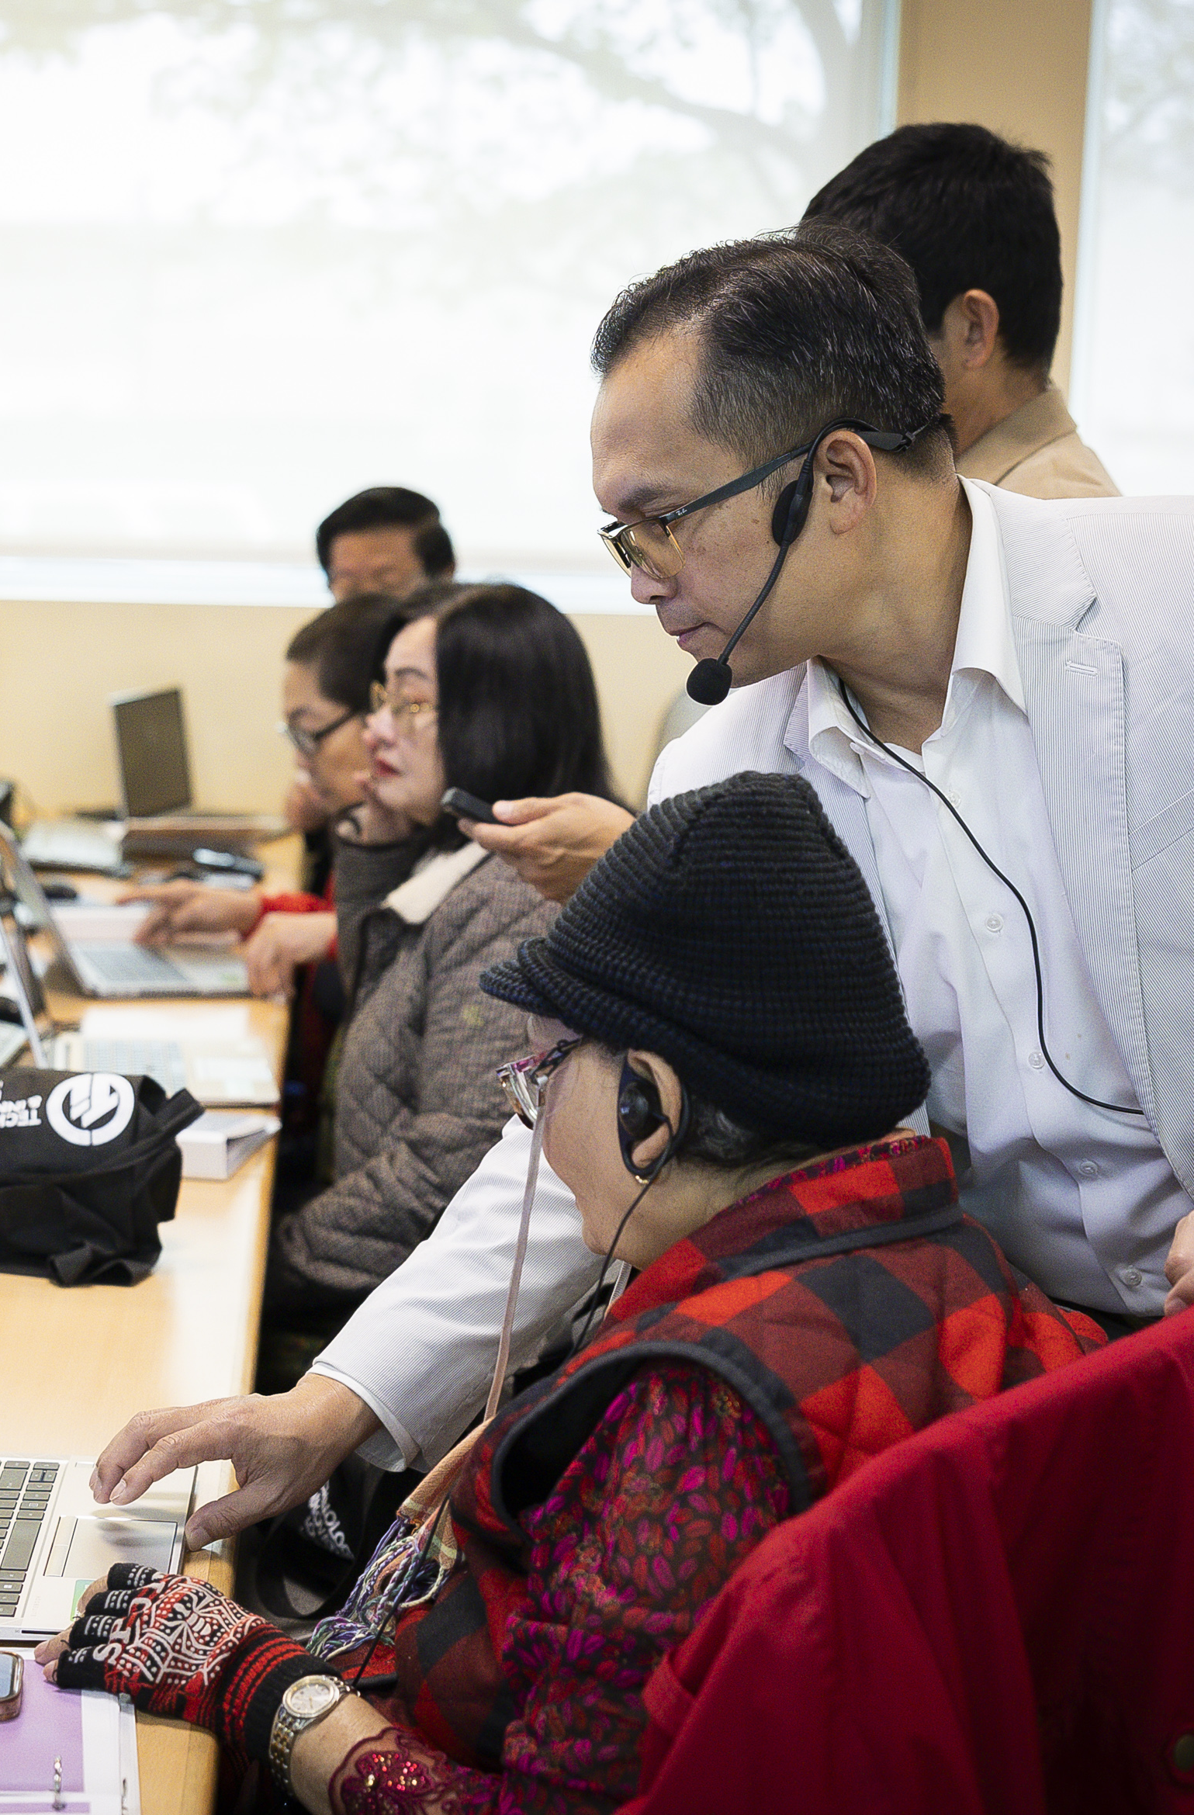
Program Changes
Organization Eligibility & Rules
•A nonprofit with gross receipts over $50,000, or a nonprofit with gross receipts at $50,000 or less and who has successfully completed a digital inclusion grant can apply under its own tax ID. Otherwise, a nonprofit must apply under a fiscal sponsor.
•Local governments can include Tribes and entities organized under Tribal law. A California Tribe may either be a California Native American Tribe with or without federal recognition.
City of Long Beach Earn and Learn Project

Slide 6
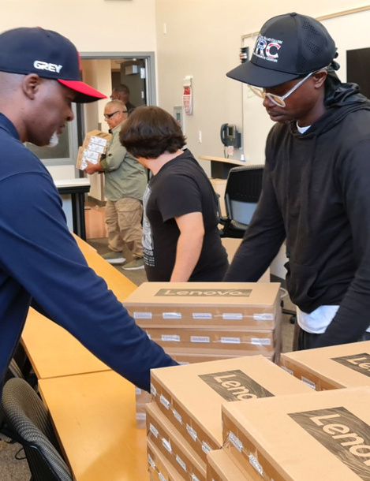
Program Changes
Project Eligibility & Eligible Program Costs
•The terms "Digital Literacy", "Broadband Access", and "Call Center" are defined. Only projects that fit into those definitions are eligible to be funded.
  •Digital literacy is defined as the measurement of an individual’s ability to use the Internet and modern technologies, such as computers and smart phones. Digital fluency is defined as the ability to discover, evaluate, and use information and technology effectively and ethically. Digital literacy projects funded through the Adoption Account program assist participants in becoming both digitally literate and fluent through short term training.
Device provision Great Harvest Community Center

Slide 7
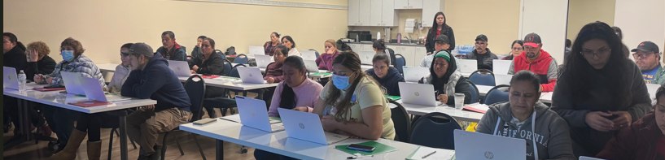
Program Changes
Project Eligibility & Eligible Program Costs
  Broadband access is defined as the availability of high-speed and reliable Internet and the equipment . . . used to access the available Internet in community institutions and/or public locations. Broadband access project participation is the number of participants provided access to the Internet through equipment funded through the grant when the project is implemented.
  A call center is defined as a centralized department that handles inbound and outbound calls from current and potential customers. Call centers are located either within an organization or outsourced to another company that specializes in handling calls. For the purposes of program eligibility, call centers must focus on broadband adoption by promoting and facilitating the adoption of broadband internet services to the household.
United Way Merced 2024

Slide 8
Program Changes
Eligible Program Costs - Labor
Digital Literacy instructors
Community outreach
Direct costs for program/project operational functions (an operational function could be for activities such as managing project deliverables, computer room monitoring, direct administration of a Call Center, etc.)
Direct costs for equipment and/or software installation
Direct costs for technical support for equipment/software subsidized through the grant not inclusive of repairs provided under warranty

Slide 9
Program Changes
Eligible Program Costs - Computer Equipment and Software
Desktop computers, laptop computers and computer pads and tablets (within budgetary limits and including warranty and device covers);
Software (inclusive of licensing for online platforms)
Printers (not inclusive of 3-D printers
Mobile hotspots (only when no inside network is available); mobile hotspots are reimbursable for use in residential locations only for the duration of the project (reimbursement does not include Internet Service Provider (ISP) service plans).
Adaptive equipment and technology (only for projects that are targeting populations with physical, developmental, and/or sensory disabilities).
Any kind of network equipment and cabling deployed inside a single building for the purpose of establishing an indoor public space for broadband access or digital literacy that connects to an already existing broadband network accessible within that building. This includes expansion of a LAN deployed inside a building and does not include site rehabilitation, demolition or construction of any kind of network expansion and/or deployment to residences/installation of network outside a building.)

Slide 10
Program Changes
Eligible Program Costs – Other Equipment and Supplies
Projectors and projector screens, televisions, or classroom displays, or touchscreen devices used for in-classroom digital literacy classes
Microphone, camera, and similar equipment needed for the provision of remote instruction but not inclusive of a conference-room AV installation
Monitors and keyboards can be supplied separately from computers
Power strips and cabling for powering a space for broadband access or digital literacy
Laptop carts/charging stations for laptops when laptops are funded as in-classroom computers
Office supplies used during the implementation of the funded project
Desks, chairs, and tables to furnish a designated space for digital literacy or broadband access

Slide 11
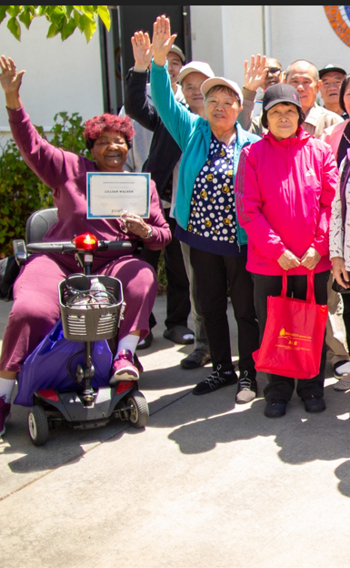
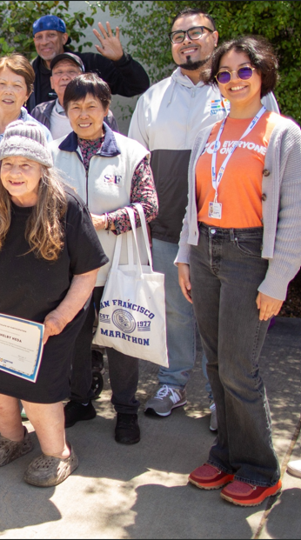
Program Changes
Ministerial Review Criteria
In addition to the current rules –
Qualification criteria:
Funding request is 50% or less of their total revenue and/or net assets.
Current assets exceed current liabilities.
Denial criteria:
An application submission is not complete as defined in the definitions section.
The application requests funding for the construction of a network of any kind outside of a building.
EveryoneON East Bay DL Project

Slide 12
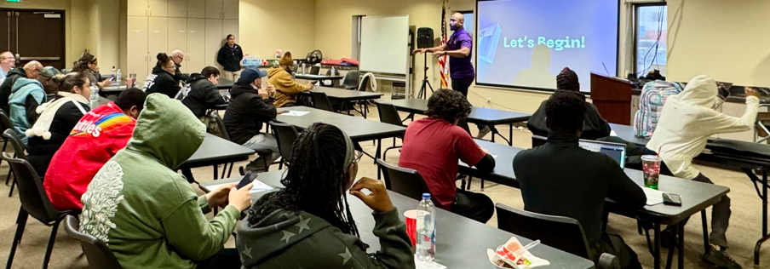
Program Changes
Reporting and Clarifications of Terms
County of Los Angeles, Internal Services Department Digital Navigator Program
A ramp up report is no longer required unless payment is requested.
A progress report must be submitted with every payment request. If a payment request is submitted without a progress report, the payment request will not be considered until the progress report is submitted.
Year 1 and Final reports are required; if not provided after six months of the reporting period grantees will be notified of the reporting deficiency and the grant may be rescinded.

Slide 13
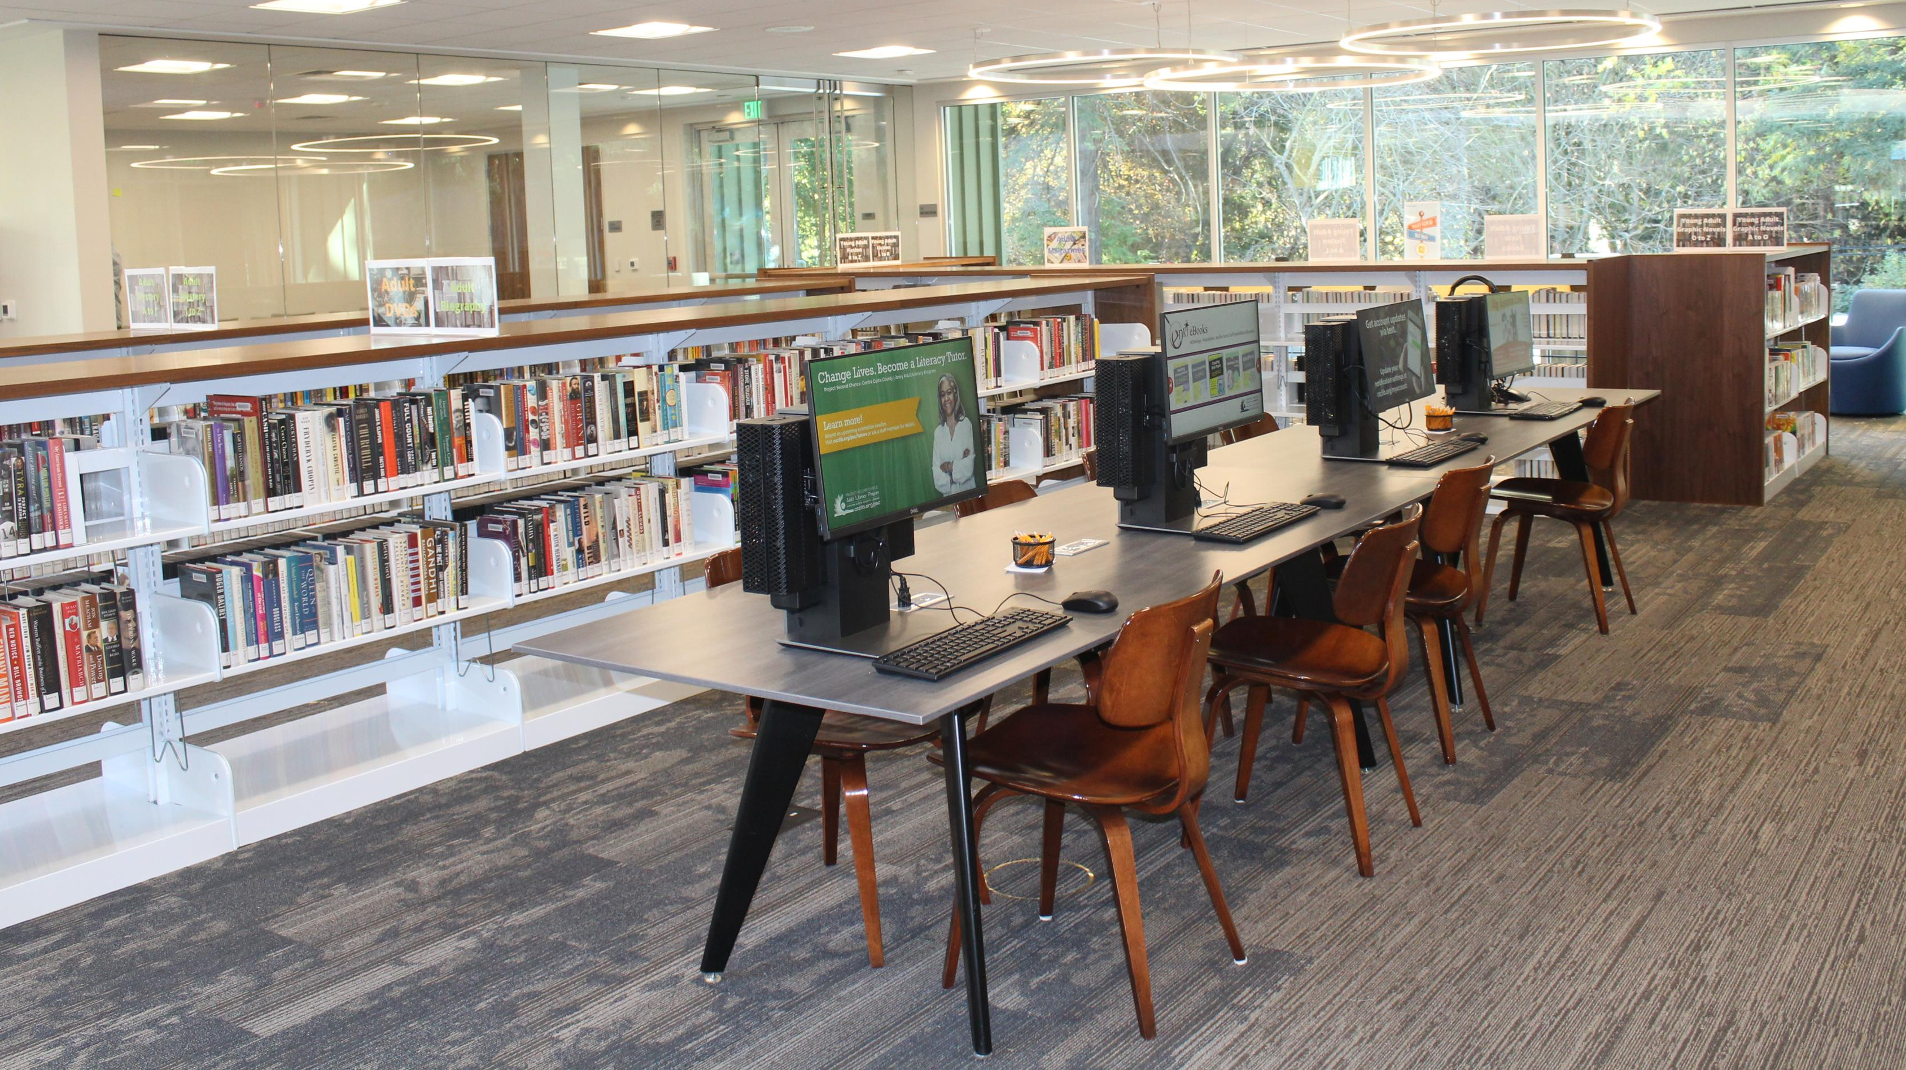
How to Apply for a Grant
Contra Costa County Library-El Sobrante Library Broadband Access Project

Slide 14
Is Your Organization Eligible?
Is your organization a local government, senior center, school, public library, nonprofit organization, or community-based organization with programs to increase publicly available or after school broadband access and digital inclusion, such as digital literacy training programs? (Note for the purpose of the Adoption Account that Tribe(s) and entities organized under Tribal law are considered local governments eligible to apply to the Adoption Account)
Is Your Proposed Project Eligible?
Is your project a digital literacy training program providing public education to communities with limited broadband adoption or a broadband access project providing free broadband access in community training rooms or other public space such as local government centers, senior centers, schools, public libraries, or other such places? Does your proposed project provide outreach to the community in order to increase broadband access and adoption? These projects and similar are eligible for funding.

Slide 15
How to Apply – Completing the Application Package
The applicant must submit the following items:
A completed adoption account application form that corresponds to they type of project being submitted.
Completed project workplan(s) using the workplan templates available in the application package.
The following attachments must be submitted (in PDF format):
  Attachment A – Cover Letter (must include organizational profile and history and detail regarding background in digital inclusion activities including the dates, locations, training content, and number of participants served as appropriate)
  Attachment B - Curriculums (both existing and proposed), brochures, outreach material, etc.
  Attachment C - Demonstration of community support: examples could include letters of endorsements obtained from Community Based Organizations (CBO), schools, hospitals, libraries, businesses and consumers, etc.
Please see the Adoption Account website for the application package and any of the required forms!
https://www.cpuc.ca.gov/industries-and-topics/internet-and-phone/california-advanced-services-fund/casf-adoption-account

Slide 16
How to Apply – Completing the Application Package
  Attachment D - For non-profits (including non-profit senior centers and CBOs), a copy of the IRS non-profit tax-exempt ruling, a copy of the most recently submitted IRS 990 form, if required to file, financial documents (if available) if submitting IRS 990N or not required to file, and documentation showing good standing with the California Secretary of State. For non-profits submitting a 990N or not required to file and no available financial documents, provide total assets, liabilities, and revenue for the past fiscal year, referencing a source document.
  Attachment D - For local government, the most recent audited financial documents, if available; if none, provide total assets, liabilities, and revenue for the past fiscal year, referencing a source document.
  Attachment E - Notarized affidavit
Please see the Adoption Account website for the application package and any of the required forms!
https://www.cpuc.ca.gov/industries-and-topics/internet-and-phone/california-advanced-services-fund/casf-adoption-account

Slide 17
Completing the Application Form
Please select the application form that corresponds with your specific project type (please note projects that have both a digital literacy and broadband access component require separate applications):
Adoption Account Application Form – Digital Literacy
Adoption Account Application Form – Broadband Access
Adoption Account Application Form – Call Center
The application form has two tabs:
  Tab 1- Applicant Information
  Tab 2- Project Information
If the applicant has more than one project of the same type, the applicant can fill out the Project Information tab for the first project and then add more tabs by copying the tab and modify it, as necessary for the next project. If more than one project is being submitted in one application, please rename the tab with unique project names.

Slide 18
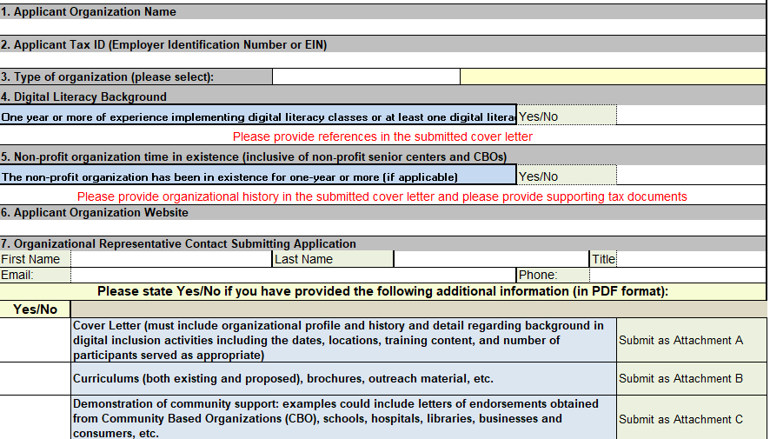
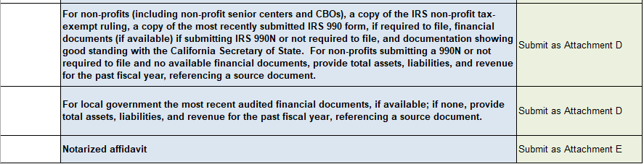
Completing the Application Form - Sample
Please enter your organization information on the Applicant Information tab
Enter your Federal Tax ID
Background and experience attested to – please include details in cover letter
Provide required documents
MODIFIED APPLICATION FORMS WILL NOT BE CONSIDERED

Slide 19
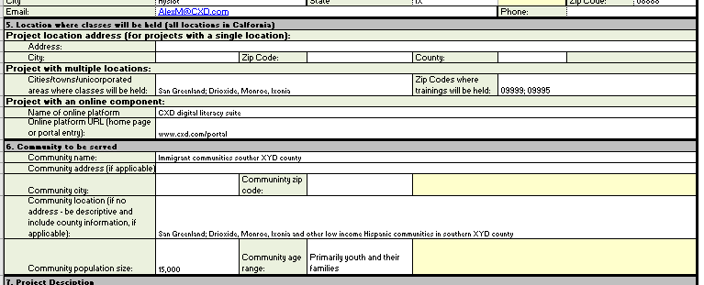
Completing the Application Form – Sample
Please enter your project
information on the Project Information tab
Note that project locations (where classes are held or broadband access provided) can be a single location or multiple locations, as well as being an online portal.
The community being served is not the same as the project location. However, the project location needs to be accessible to the community being served.
MODIFIED APPLICATION FORMS WILL NOT BE CONSIDERED

Slide 20
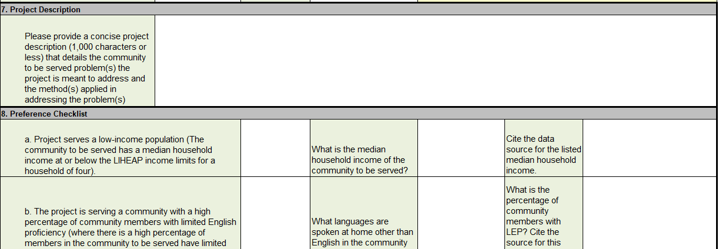
Completing the Application Form – Sample
The project description should provide a short summary of the project and the issues that the project is proposed to address and how the project will address those issues (1,000 characters or less).
The preference checklist lists various issues that impact broadband adoption in communities. Identify whether it meets the described preference and provide supporting attestations and/or evidence in support of the assertion that your project meets the preference checklist selection.
MODIFIED APPLICATION FORMS WILL NOT BE CONSIDERED

Slide 21
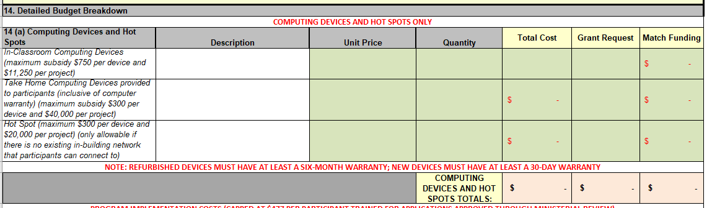
Completing the Application Form – Sample
Note that projects are funded through two categories:
Computing devices and hot spots
Program implementation costs
Please note that you need to account for matching funding.
Specific to computing devices and hot spots:
Take-home computers can only be funded for digital literacy projects.
In-classroom (or in office) computers can be funded through both digital literacy or broadband access projects (including call center projects).
Hot spot devices are only funded to provide access when there is no existing in-building network that participants
can connect to.
MODIFIED APPLICATION FORMS WILL NOT BE CONSIDERED

Slide 22
Completing the Application Form – Sample
Projects can be approved by staff by ministerial review or by the full Commission via Resolution. Please refer to the Adoption Account Guidelines for details.
The budget sheet in the application automatically calculates the per participant cost, the percentage of the grant for administrative costs and the total match. Please note the following:
To be approved by ministerial review –
  the highest amount that can be approved, per participant, specific to program implementation (not inclusive of computing devices and hot spots) is:
    $477 per participant for digital literacy projects
    $42 per participant provided access for broadband access projects
    $205 per subscription obtained for call center projects
For all projects, administrative costs cannot exceed 15% of the proposed budget for program implementation. At least 15% of the provided grant amount must be funded by other sources and provided as a match.
MODIFIED APPLICATION FORMS WILL NOT BE CONSIDERED

Slide 23
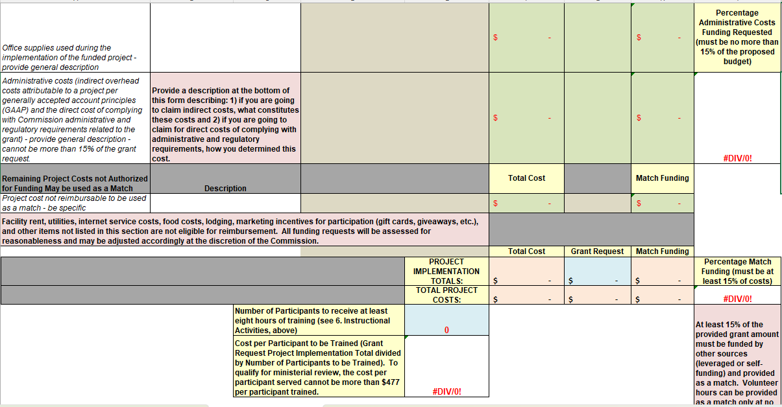
Completing the Application Form – Sample
Required percentages for administrative costs and matching funds are automatically calculated in the application form. The benchmark amount per participant is also calculated. Please adjust your budget to meet program benchmarks.
MODIFIED APPLICATION FORMS WILL NOT BE CONSIDERED

Slide 24
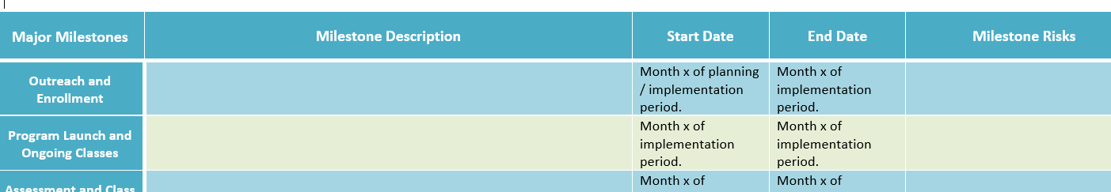
Completing the Project Workplans
Please complete the project workplans; if the workplan is the same for more than one project, then only one workplan is required (please note which projects the workplan refers to – if for all projects submitted, please note):
Ramp up workplan (if applicable)
Program implementation workplan
Please note that the project workplan templates are pre-populated with suggested milestones. Modify as necessary, but keep in mind we would like to see items listed that cover similar topics (such as outreach or program launch and ongoing classes).

Slide 25
Submit the Application
Ensure that Attachments A-E are in PDF format and the Adoption Account Application Form in Excel format. Place all files into a compressed (zipped) folder.
Log into your Commission FTP account. If you do not have an existing Commission FTP account, please follow instructions below:
  Go to https://kwftp.cpuc.ca.gov
  Click on “Create account”
  An email will be sent to the email account you just entered. Click on ‘ACTIVATE’ to enter a password.
  Your registration process is now complete.
  Create a new message to be sent to: CASF_Adoption@cpuc.ca.gov, with CC to: ORA_CommunicationsEnotice@cpuc.ca.gov
  Upload your zipped application package & click “send” to complete the upload request

Slide 26
Reviews and Approvals
The Commission will evaluate each application based on the criteria established for the CASF Broadband Adoption Account adopted in D.25-11-003.
Applicants of projects approved via ministerial review will be notified by an approval letter. Projects not meeting ministerial review may be approved via Resolution. Successful applicants will be provided a consent form through which the applicant can accept the grant. If the applicant fails to sign and return the consent form, the Commission may deem the grant null and void.
All approved applications will be listed on the Commission website.

Slide 27
Rejected Applications
The Commission staff will notify an applicant by letter specifying reasons for rejection should an application fail to meet the Commission criteria or other factors including:
Reasons for rejection include:
An application submission is not complete (as defined on the next slide)
The applicant submitted an incomplete application specific to other items than above and does not respond, by a stated deadline, to follow-up requests for clarification and/or supplemental materials, sent to the designated contact on the application.
The application requests funding for the construction of a network of any kind outside of a building.
The applicant has previously had a Commission grant award rescinded for violation of Commission or program rule.
The applicant has made false statements to the Commission or to the Federal Communications Commission (FCC)

Slide 28
What is a “Complete” Application Submission?
An application submission will be considered complete if:
the application is submitted to the Commission FTP site (https://kwftp.cpuc.ca.gov ) (see “Submit the application”, above)
the application is submitted using application forms provided by the Commission for the specific project proposed (digital literacy, broadband access, or call center)
the applicant provides a contact name with contact information (an email and/or phone number) in the application
the application is submitted with the following required documents:
  a signed and notarized affidavit
  a cover letter
  if the applicant is a nonprofit organization, submitted with the organization’s IRS form 990 (if required to file).

Slide 29
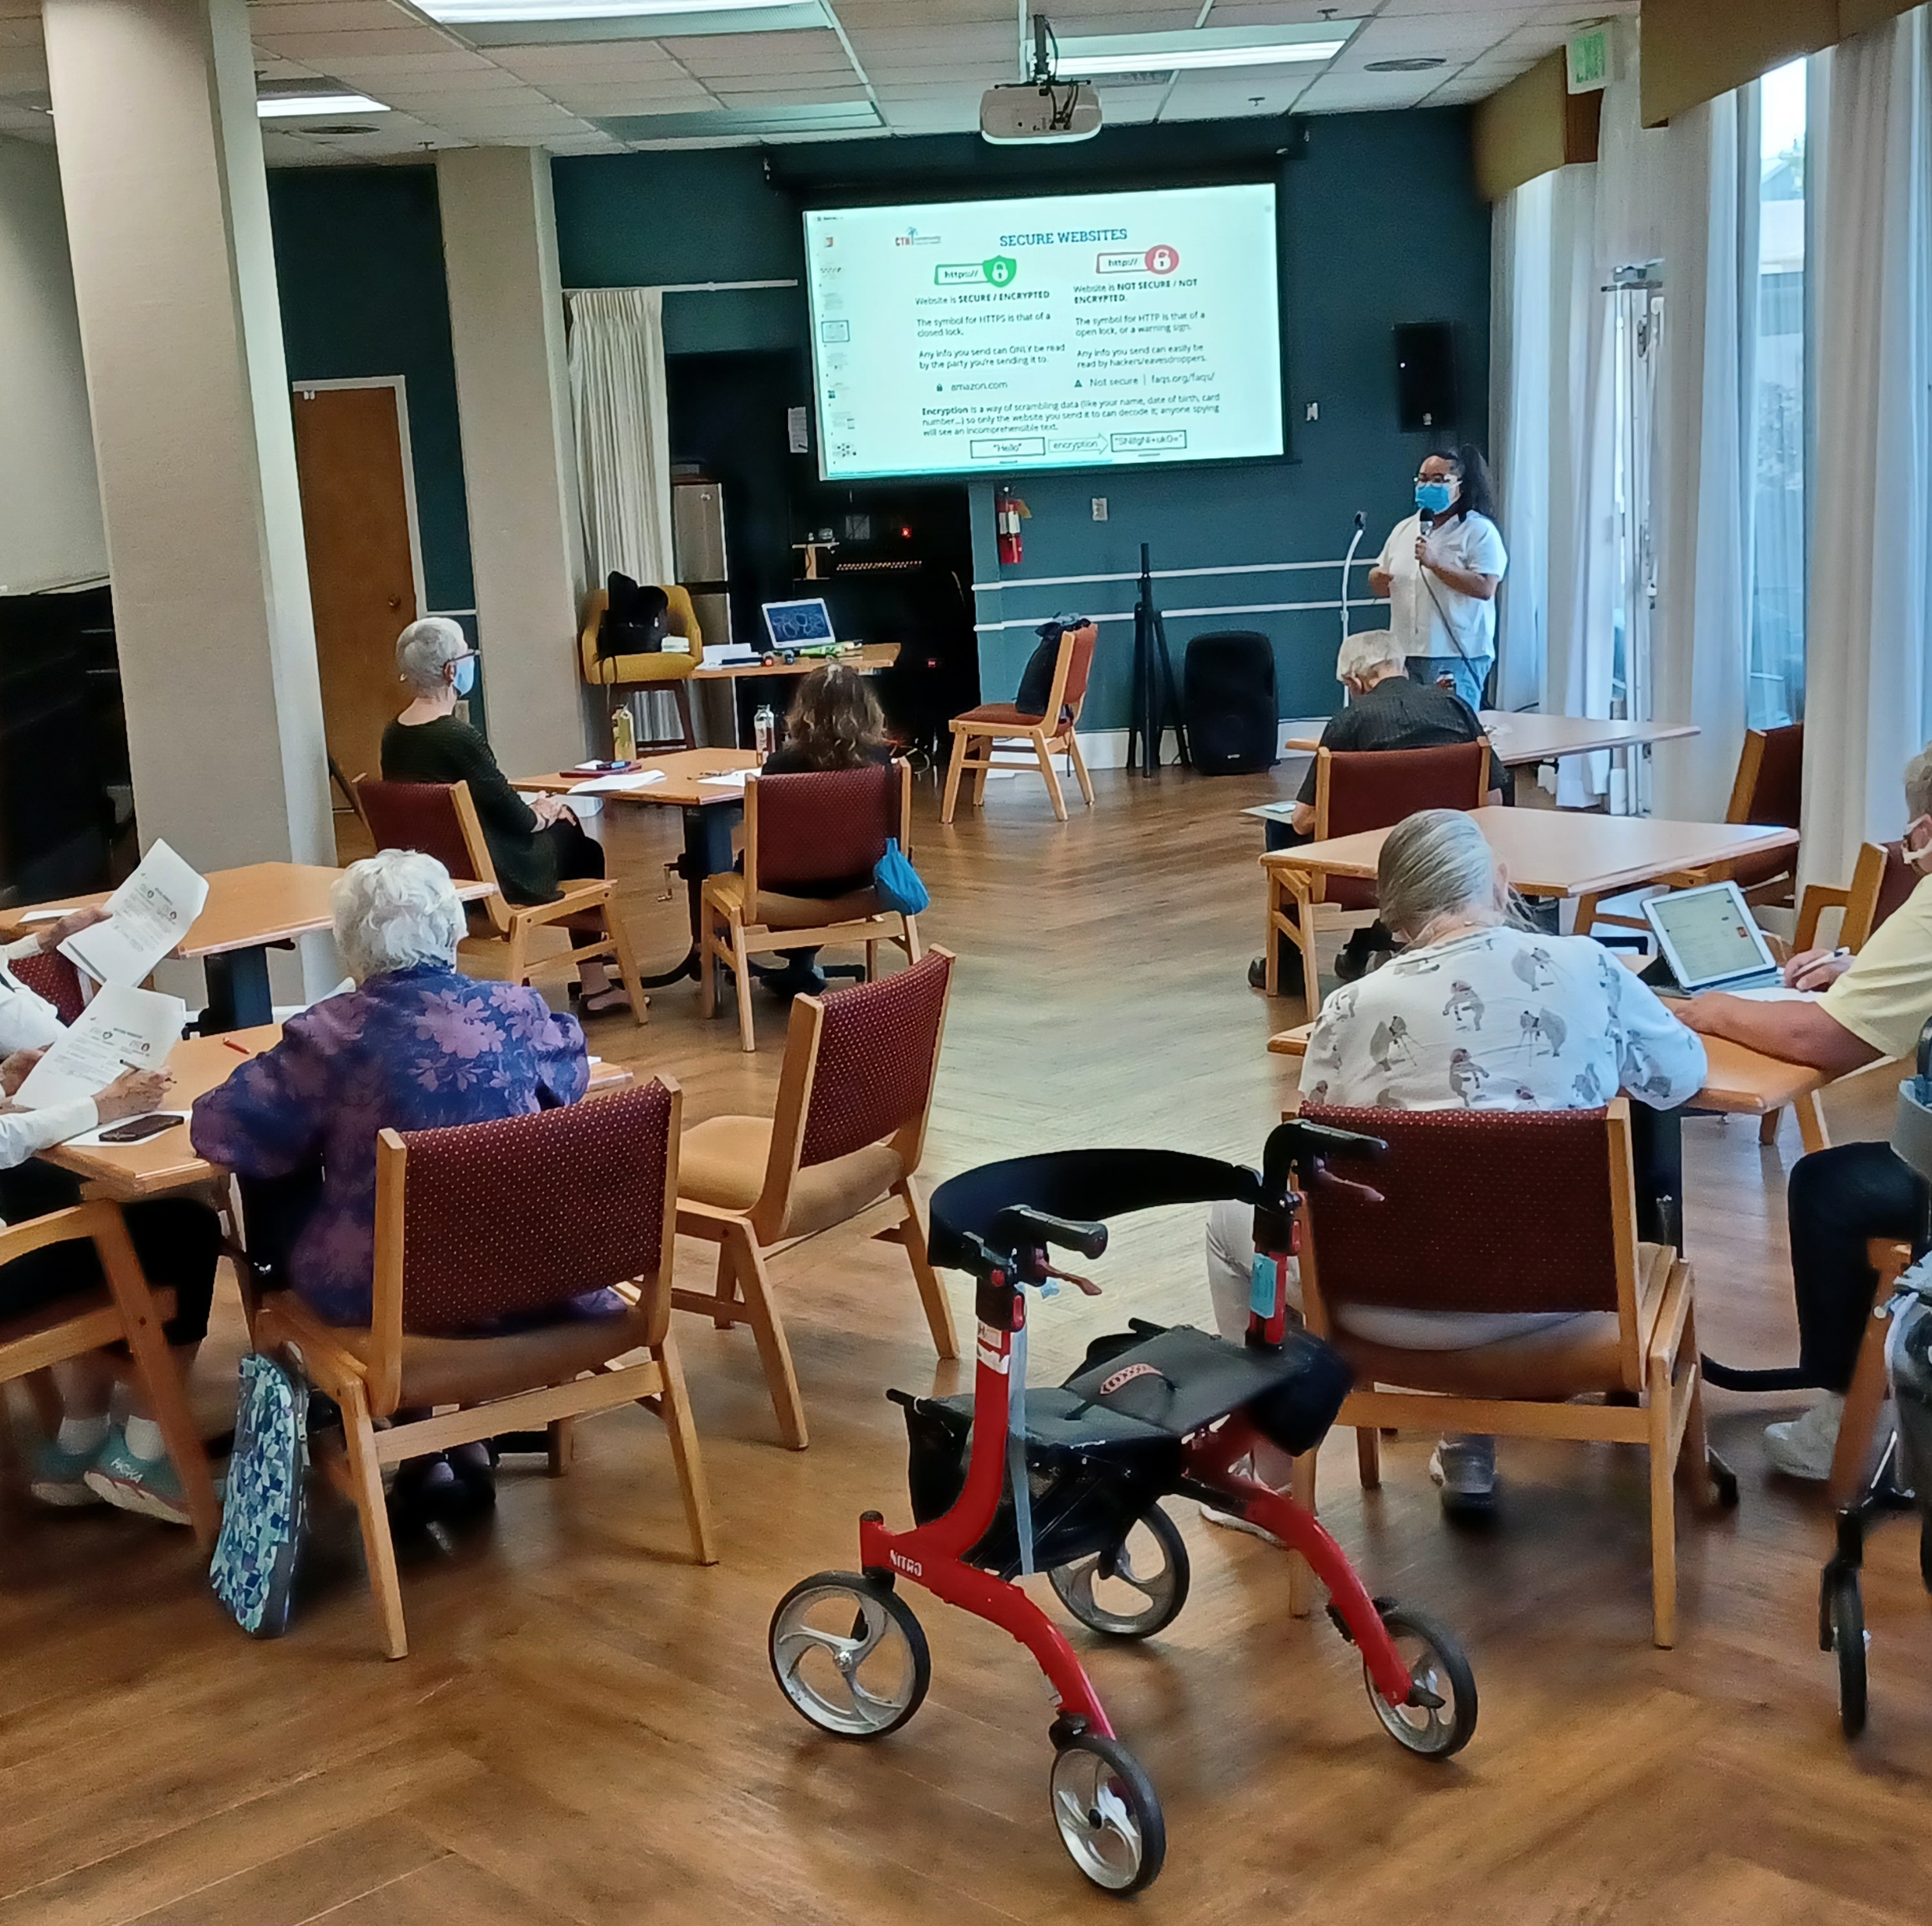
For additional information please review the
Adoption Account Guidelines,
and the
Administrative Manual
Piedmont Gardens Digital Literacy project

Slide 30
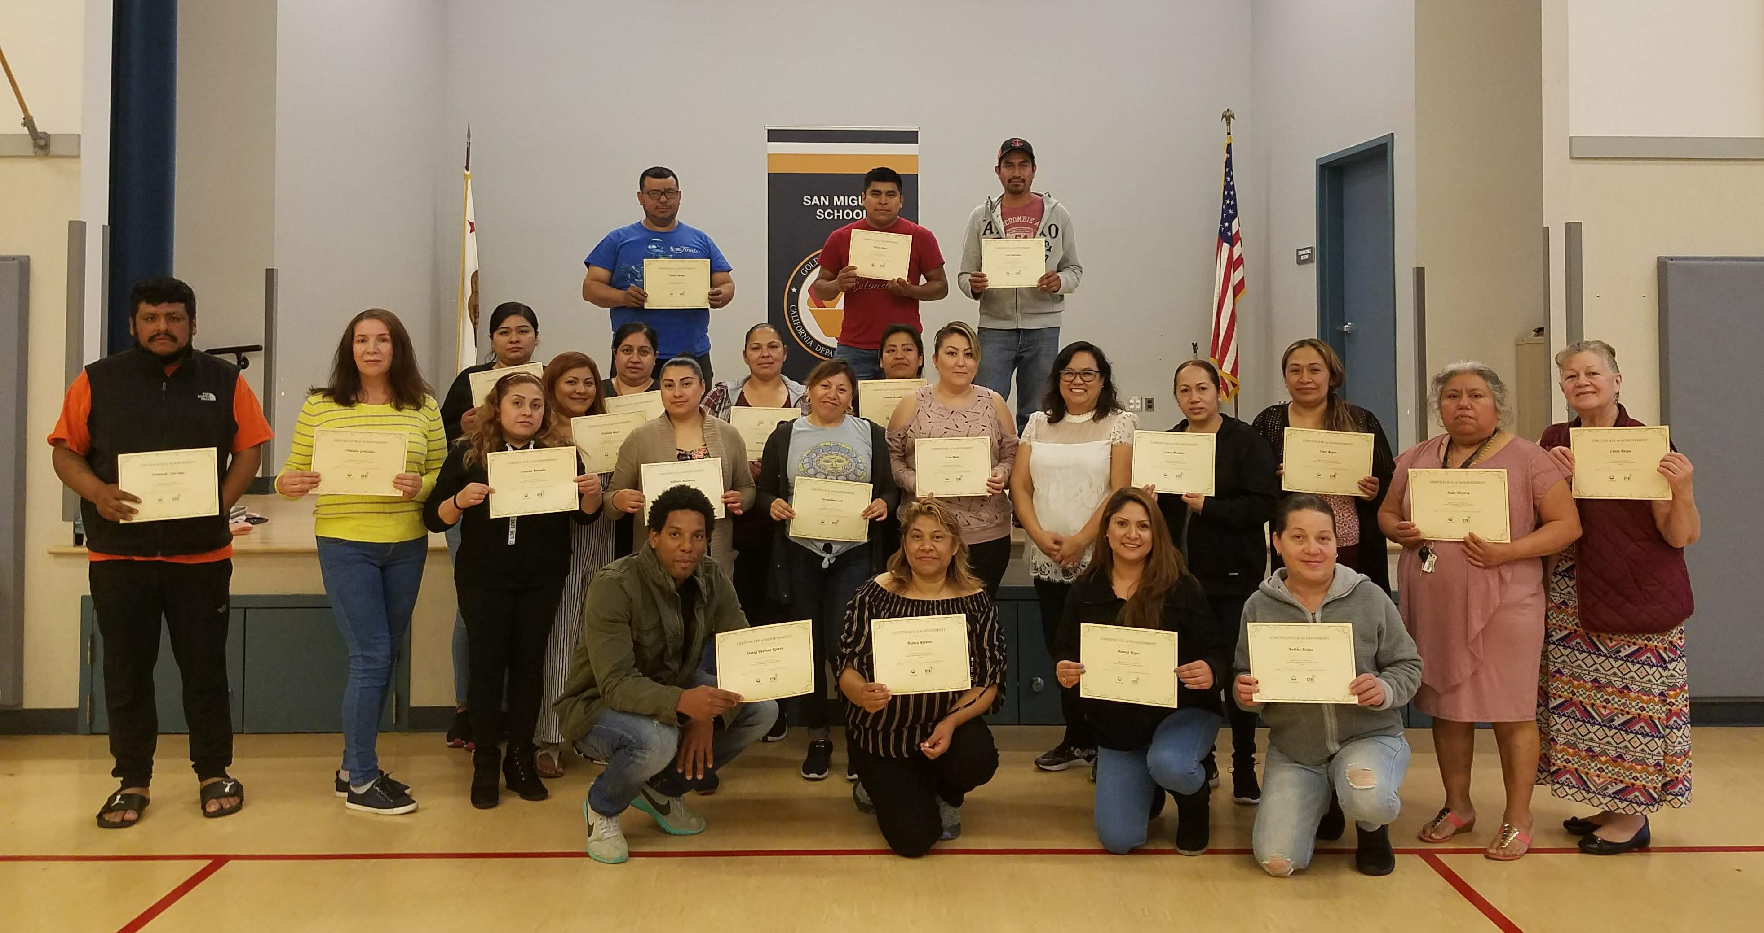
City of Sunnyvale - Latino Digital Literacy-San Miguel Elementary School
Thank you for your participation in the CASF Adoption Account
Please email casf_adoption@cpuc.ca.gov with any questions regarding the application process.

