Slide 1

California Advanced Services Fund
Infrastructure application overview
Webinar
March 22, 2023

Slide 2
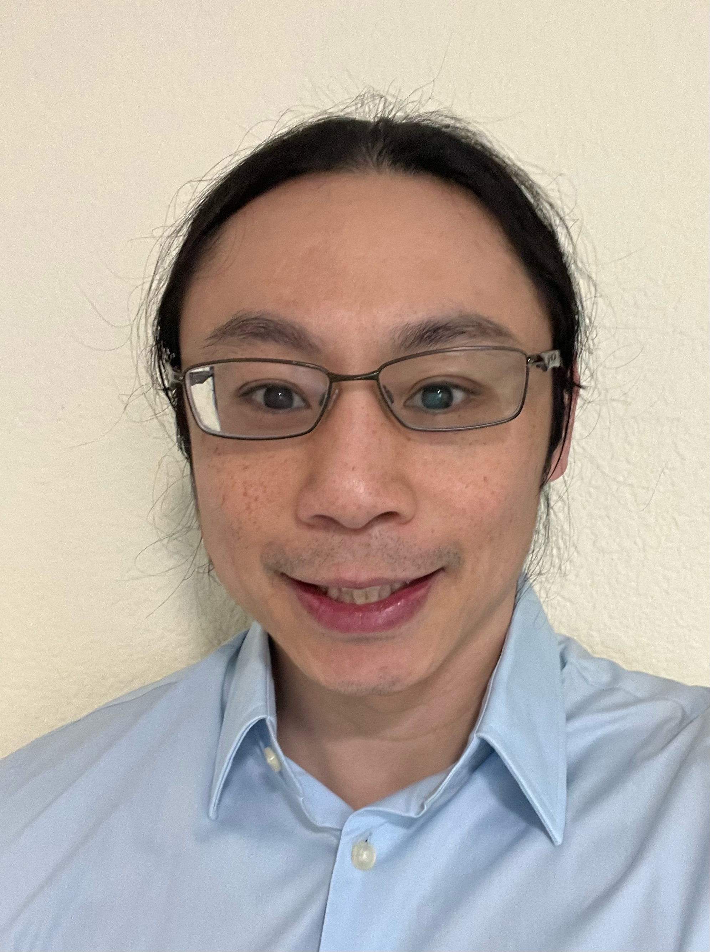
CASF Infrastructure Team
Heyward Daluz
Regulatory Analyst

Slide 3
Agenda
10:00-10:10 | Introduction, Welcome and CASF Program Updates Heyward Daluz, Regulatory Analyst
10:10-10:20 | Infrastructure Grant Account – Changes in Application Process (D.22-11-023) Louise Fischer, Program and Project Supervisor
10:20-10:30 | CASF Application Checklist Review Michael Goins, Senior Telco Engineer
10:30-10:50 | Changes to the Broadband Map and Broadband Map Demo Alex Abramson, Regulatory Analyst Michael Habeeb, Research Data Analyst
10:50-11:30 | Q&A Vincent Coppey, Regulatory Analyst
Submit questions to casf_workshop@cpuc.ca.gov

Slide 4
CASF Broadband Infrastructure Grant Account
Provides grants to eligible applicants to build and deploy broadband networks in underserved areas throughout the State of California. The programs' goal is to encourage deployment of high-quality advanced communications services to all Californians that will promote economic growth, job creation, and the substantial social benefits of advanced information and communications technologies.

Slide 5
CASF Broadband Infrastructure Grant Account
2022 Program Accomplishments
  Reimbursements to Grantees of $14.8 Million for 18 Projects
  Projects Completed in 2022
    13 projects in 8 counties
    Broadband facilities have been built to 11,476 previously-unserved households

Slide 6
CASF Broadband Infrastructure Grant Account
Planning for 2023 and Beyond
  Current Timelines
    Next application cycle anticipated deadline is – 4/1/20
Event | Date
Broadband Availability Map Published | March 31
CASF Infrastructure Account Application Deadline | May 1
Deadline for Staff to post Application Summaries and Maps to CPUC website and notify CASF Distribution List | May 15
Deadline for Challenge Submissions | June 5
Deadline for Application Approvals Under Ministerial Review | October 1
Deadline for Publishing Draft Resolutions Recommending Project Approval | December 31
    CASF Annual Workshop 4/10/2023

Slide 7
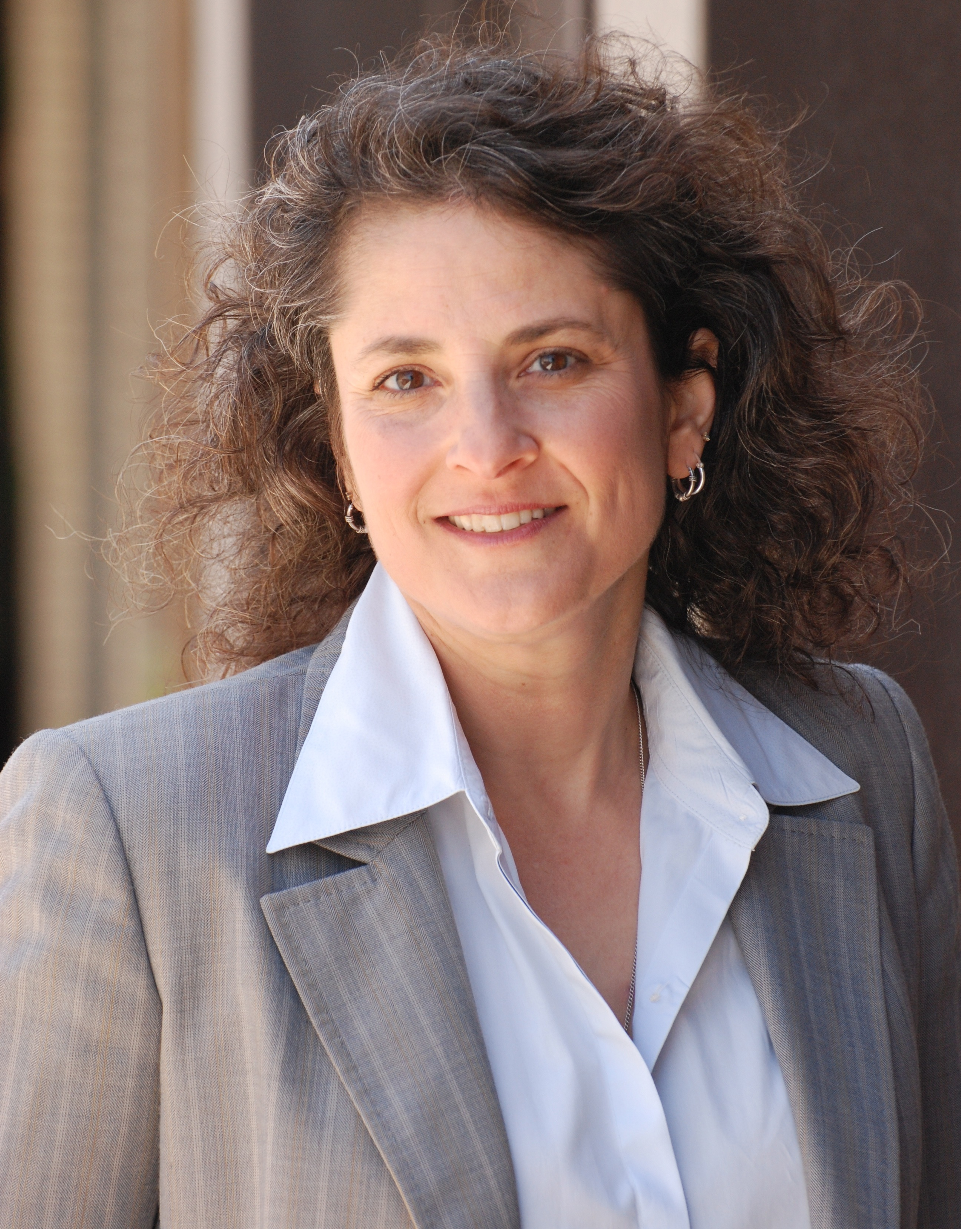
CASF Infrastructure Team
Louise Fischer
Program and Project Supervisor

Slide 8
Infrastructure Grant Account
Changes in Application Process (D.22-11-023)
Louise Fischer, Supervisor, CASF Infrastructure

Slide 9
Changes to CASF Infrastructure Program per Decision D.22-11-023
  Extends the CASF program to December 31, 2032
  New definition of ”unserved areas” vs census blocks
    25/3 mbps broadband standard; deployment minimum 100/20 mbps
  Ministerial Review Amounts increased
    $10 million to $25 million for total project
    $9,300 to $24,500 per HH for wireline projects
    $1,500 to $4,500 per HH for wireless projects
  Changes to Challenge Process
  Low-income plan changes
  Pricing plan guarantee changed from 2 years to 5 years
  Indirect/Administrative charges reduced from 15% to 10%

Slide 10
Legislative Changes related to Infrastructure CASF
  Extends the CASF program goal to December 31, 2032
  Extends the CASF surcharge
  Redefines “unserved area”
  Priority to areas with slow or no internet
  Serviceable locations
  Eliminates “indispensable middle-mile” language

Slide 11
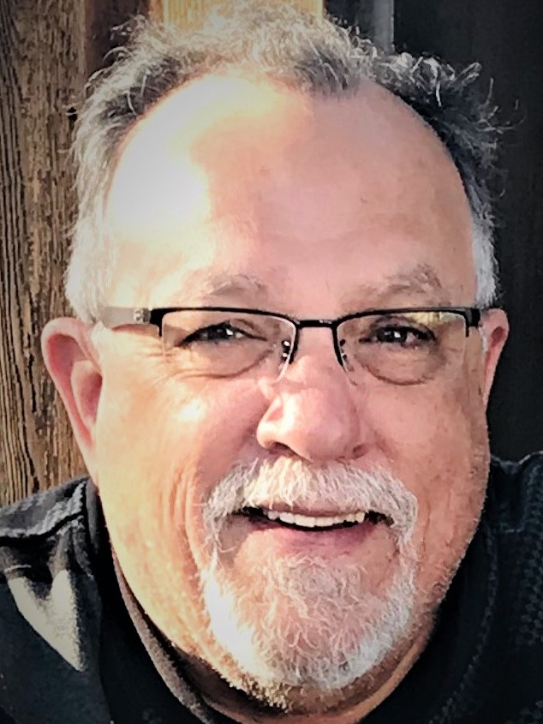

CASF Infrastructure Team
Mike Goins
Senior Telco Engineer

Slide 12
CASF Application Checklist review:
CASF Broadband Infrastructure Application Checklist
There are 20 items required for the CASF app. There is a checklist to keep track of these.
2) Applicants must submit checklist items using enumeration on Checklist.
3) As an example, the first Checklist Item we see is entitled Project Summary
File naming format: Item #_Name of Item_Service Provider Name_Project Name
Example: Item 1_Project Summary_South Bay Telcom_Smugglers Gulch
4) Continue to add info about item numbers on every filename – 01, 02, 03 etc.

Slide 13
CASF Application Checklist Review Continued:
Item 01- Project Summary: Applicants must provide enough information to enable stakeholders to comment or challenge the application.
Item 03 - Description of the Applicant’s Current Broadband Infrastructure: Applicants must provide a detailed description of your current broadband infrastructure and service within 5 miles of the proposed project.
Item 04 - Project Location Data: The geographic location of all serviceable locations, key network equipment and the boundary within the planned project area.
Item 08 - Proposed Project Expenditures: Use the template that is provided on the CASF Infrastructure Account webpage.

Slide 14
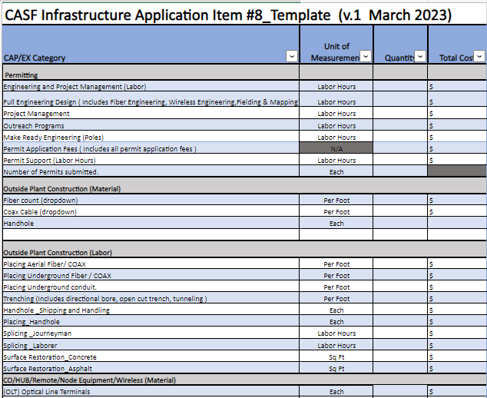
Proposed Project Expenditure Template
Click here to access the Proposed Project Expenditures Link

Slide 15
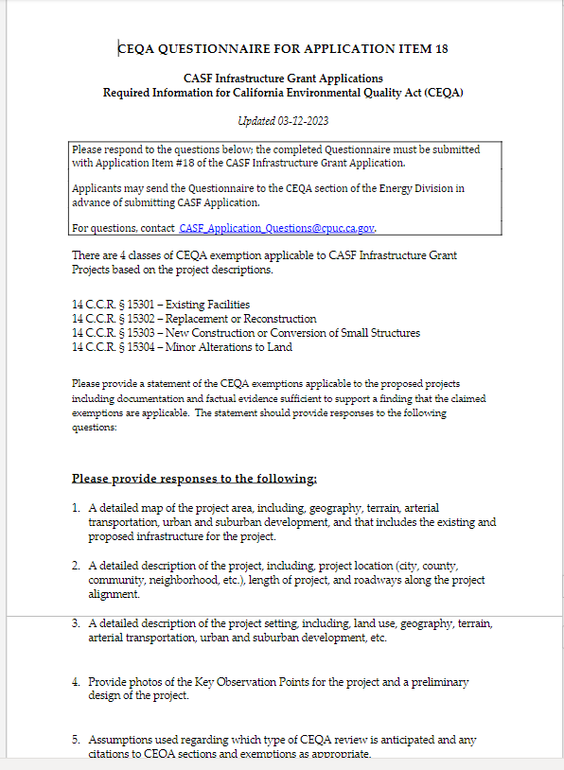
CEQA Questionnaire For Application Item 18 ​
CEQA Questionairre

Slide 16
Broadband Consortium Help
The CPUC provides grantees with a resource to answer specific questions you may have going forward.
The Broadband Consortium is your first level of support for CASF (California Advanced Services Fund) Applications.
This link will take you to the Broadband Consortia home page
This link to the Broadband Consortia Information with Active Grants can be used to locate your Consortia contact based on your geographic area.

Slide 17
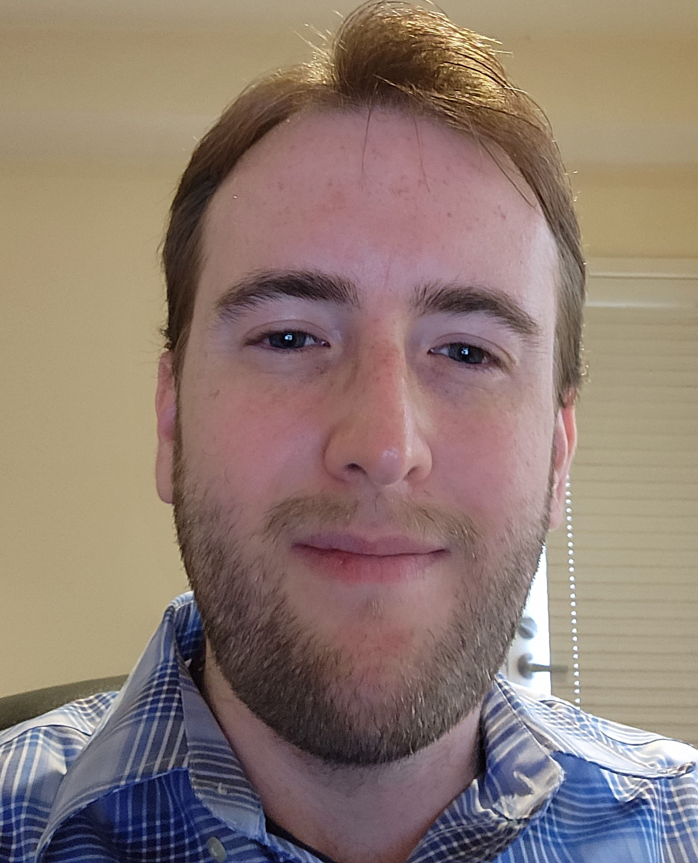
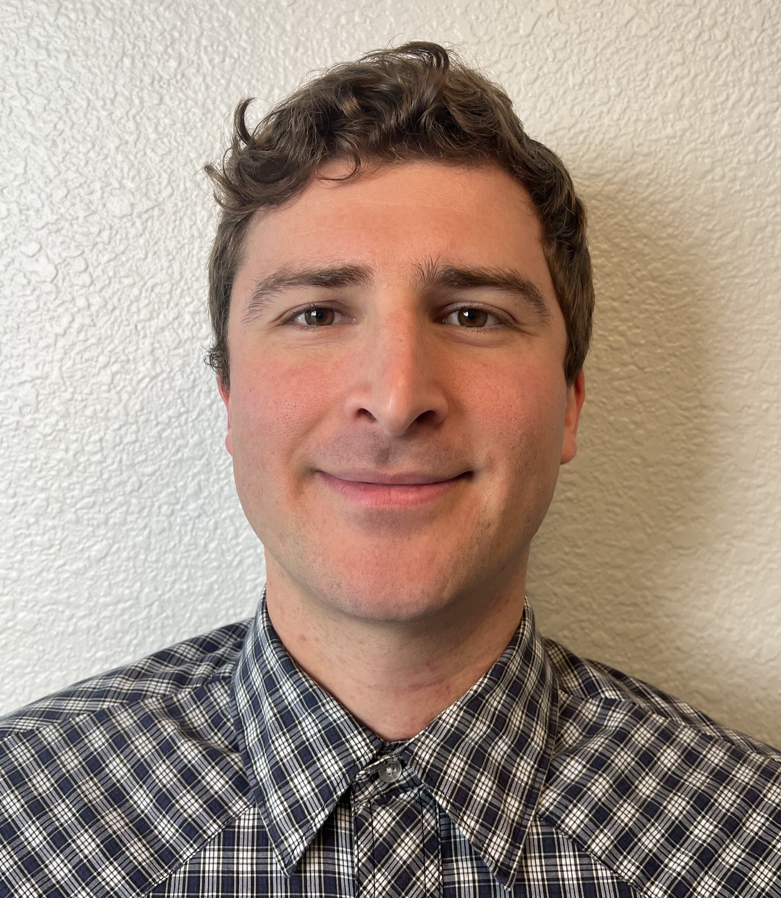
Broadband Mapping Group
Alex Abramson
Regulatory Analyst
Michael Habeeb
Research Data Analyst

Slide 18
Changes to the Broadband Map and Broadband Map Demo
Alex Abramson / Michael Habeeb

Slide 19
The Broadband Data Collection
Accomplishments in 2022
  Broadband Data Collection
    Collected data from 158 Broadband Providers
      154 Fixed Providers (Wireless, Wireline, and Wire-WISP)
      4 Mobile Providers
    Changes to the Annual Broadband Data Collection
      Revised requirements to collect
        Location-Specific and Shapefile or KML/Z Deployment Data
        Location-Specific Subscription data
      Utilized the FCC approved vendor for a Broadband Serviceable Location Fabric

Slide 20
Changes to come to the Broadband Map
Updates in 2022, Going into 2023
  Broadband Map: www.broadbandmap.ca.gov
    Data Layers:
      Served Status layers with ‘Served’ defined as at least 25/3 Mbps
        Unserved as between 25/3 and 10/1, Priority Unserved as less than 10/1
      New Broadband Adoption Layer by Census Block (Previously by Census Tract)
      New and Improved CASF Elegibility Layer showing Unserved, Priority Unserved Locations (Previously by Census Block)
    Look out for future updates to the Frequently Asked Questions page, the Public Feedback tool, and more!

Slide 21
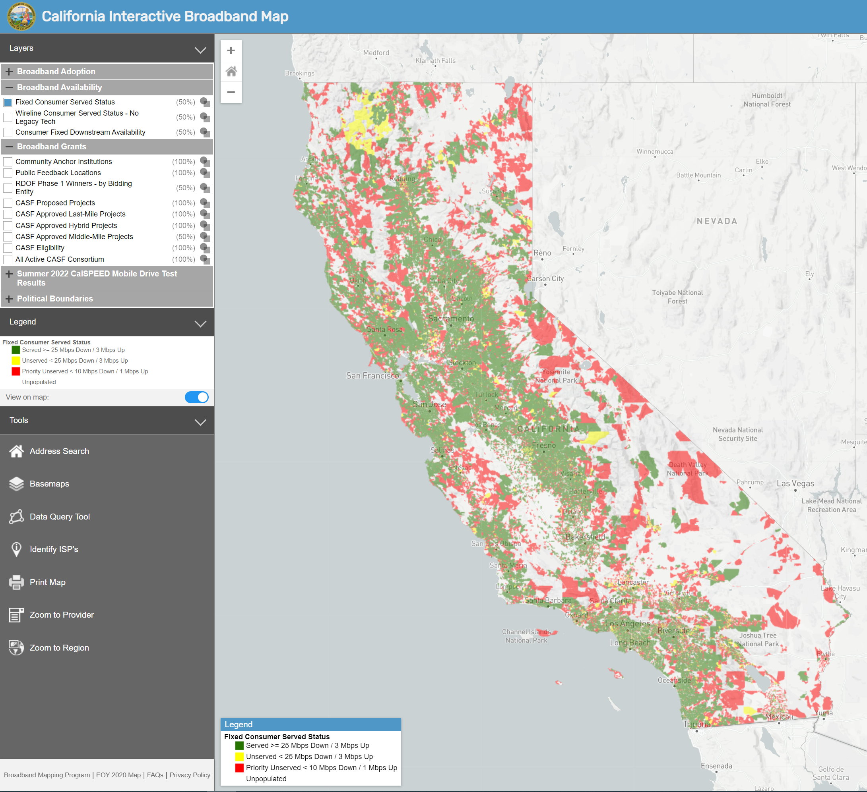
New Broadband Map Demo

Slide 22
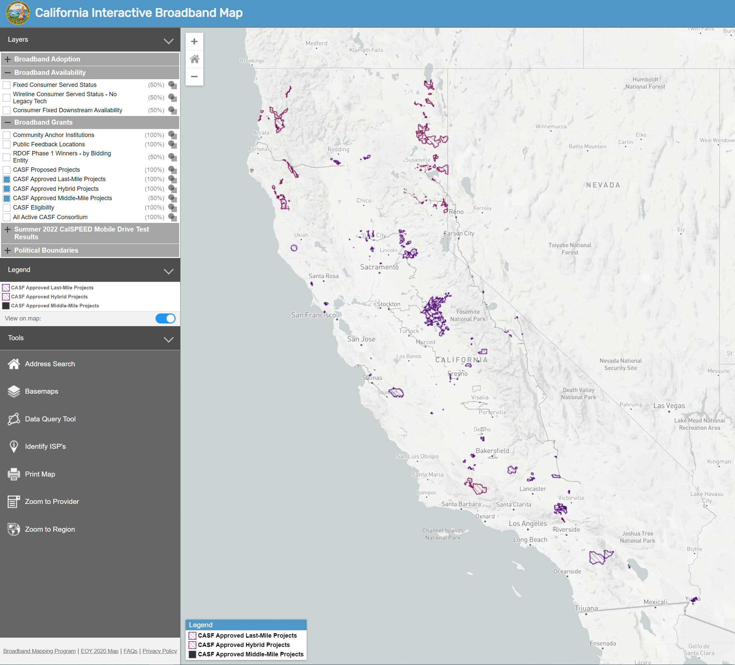
New Broadband Map Demo

Slide 23
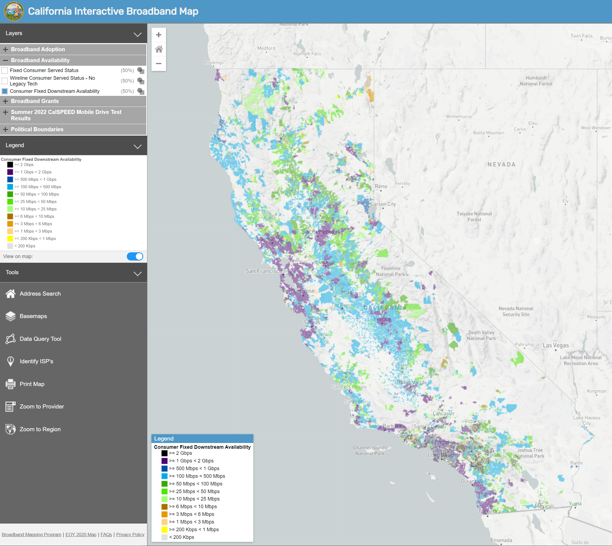
New Broadband Map Demo

Slide 24
Q&A
Questions:
Email to casf_workshop@cpuc.ca.gov

Slide 25
Contact Information
Application Questions: Contact Your Regional Consortia FIRST: Consortia Information
CASF Application Questions: CASF_Application_Questions@cpuc.ca.gov
Correspondence/Questions regarding approved projects: CASF_Infrastructure_Grant_Administrator@cpuc.ca.gov
Line Extension inquiries: CASFLineExtensionProgram@cpuc.ca.gov
CASF Webinar inquiries: CASF_Workshop@cpuc.ca.gov
Broadband Mapping inquiries: Broadbandmapping@cpuc.ca.gov
Notes:
Deadline extensions

Slide 26
Thank You!
(if we didn't respond to your question, we will respond through email)

