Slide 1
California LifeLine Third Party Administrator
Presentation to the Administrative Committee
September 19, 2023

Slide 2
Completed Initiatives
  On March 31, 2023, the TPA introduced a standalone IEH process for subscribers
3/31/2023 – 8/31/2023 statistics for the standalone IEH process
 | Created | Approved | Denied | Cancelled | Pending
Wireless | 58,163 | 37,371 | 13,231 | 4,310 | 2,908
Wireline | 128 | 79 | 24 | 14 | 11
Total | 58,291 | 37,793 | 13,255 | 4,324 | 2,919
For the completed processes:
Wireless – 73.4% approval
Wireline – 76.7% approval

Slide 3
Completed Initiatives
  June 30 – Improving the Program experience for subscribers who are trying to transfer their LifeLine benefits within 5 days of their anniversary dates but have renewal denial decisions stored
    Prior to the change such transfer requests triggered processing errors
    After the change the TPA system triggers the new enrollment process
    This change allows impacted subscribers to continue their engagement with Service Providers rather than requiring subscribers to wait until their anniversary dates. Because notification of renewal decisions are held until subscribers’ anniversary dates, the impacted subscribers are likely confused and frustrated that the Service Providers have to turn them away.
  July 12 – The TPA successfully completed a planned business continuity exercise which involved failing over to the secondary Azure region for a full workday
    All Program stakeholders benefit from proactive business continuity readiness exercises
  July 19 – Direct Application Process Sunset
    All wireless Service Providers have transitioned to SPIA for new enrollment application processing

Slide 4
Completed Initiatives
  July 27 – Delaying mailing renewal forms for ten (10) days
    Simultaneously encouraging online and over the phone renewal form completion allows the Program to save the California LifeLine Fund unnecessary mailing costs
  July 27 – Changing the day 0 and day 35 SMS text reminders for the renewal process from exposed PINs to hyperlinks with embedded PINs
    This change is part of the transition away from PINs for the renewal process
  July 27 – Adding electronic reminders (SMS & PROMs) for applicants and subscribers who have progressed to the soft denial stage due to nonresponse to initial forms
    Failure to respond to forms is the most frequent reason for Program denial

Slide 5
Completed Initiatives
TPA support of Service Providers for USAC’s Payment Quality Assurance (PQA) program
  USAC’s PQA program evaluates payments made to eligible telecommunications carriers (ETCs), commonly referred to as Service Providers, participating in the federal Lifeline program
  For the FY23 PQA evaluation of California LifeLine Service Providers, USAC opened 15 cases to evaluate
  When selected for participation in USAC’s Payment Quality Assurance Program, Service Providers are required to provide the requested documents and information within 10 business days. The materials requested can include:
    Subscriber lists
    Images of Lifeline enrollment forms and re-certification forms
    Images of qualifying eligibility documentation
    One-per-household worksheets
  To assist Service Providers, for the FY23 PQA, the TPA compiled the documentation requested by USAC
  On September 7, USAC notified the CPUC that its FY23 PQA Lifeline Assessment results have been finalized. The improper payment rate for CA is 0.22%. USAC’s Manager of Audit and Assurance Division characterized the California result as “great”

Slide 6
Upcoming Initiatives
The California LifeLine Customer Portal, Phase I – targeted for December 2023
Current LifeLine Website Functionality | Phase 1 of the Customer Portal
Source material for: Program Guidelines Fed and Cal benefits comparison Sample Forms SP Plans and “Comparison Tool” FAQ Instructions on how to appeal/file a complaint with CAB | Included
Provides interactive functions if utilizing a PIN pulled from SMS or sent paper application: Checking form status Submitting forms Document upload | PIN will be removed and replaced by customer accounts: Registered accounts will use email and passwords that can be reset Consumers choose how to verify their account (email, SMS text or phone call) instead of PIN Previous form completion and upload functionality will be the same but without PIN requirement

Slide 7
Upcoming Initiatives
The California LifeLine Customer Portal, Phase I – targeted for December 2023
Current LifeLine Website Functionality | Phase 1 of the Customer Portal
Supports 7 written languages | Included
Live chat support | Included
Web form to submit questions | Included
 | New - Collection of additional demographic data directly entered by portal users
 | New - Consumers gain web-based, self-help functionality over their account: Canceling pending transfers Self-initiated removal from program (instead of only SP notification) View font and language preferences. Service Providers will continue to submit changes to the TPA View current listed address View anniversary dates (for renewal)

Slide 8
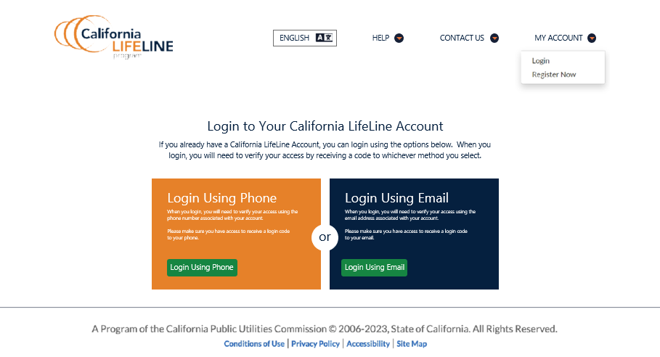
California LifeLine Customer Portal

Slide 9
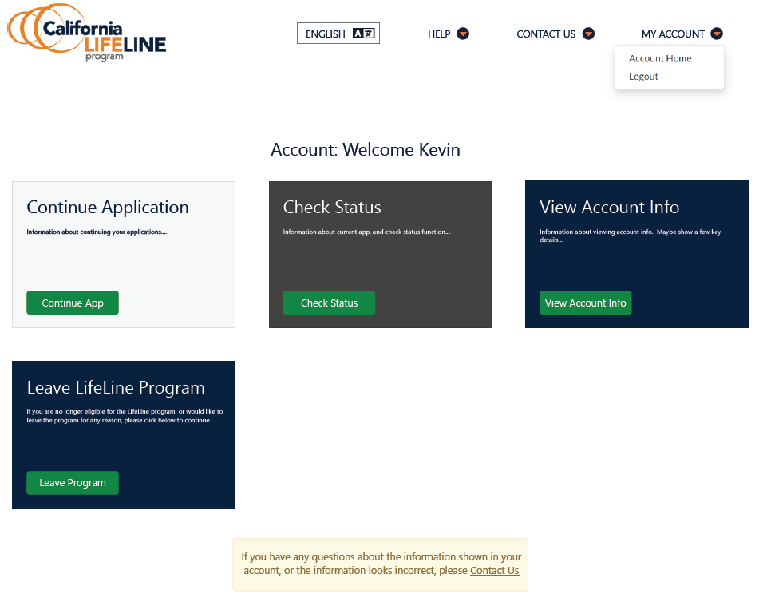
California LifeLine Customer Portal

Slide 10
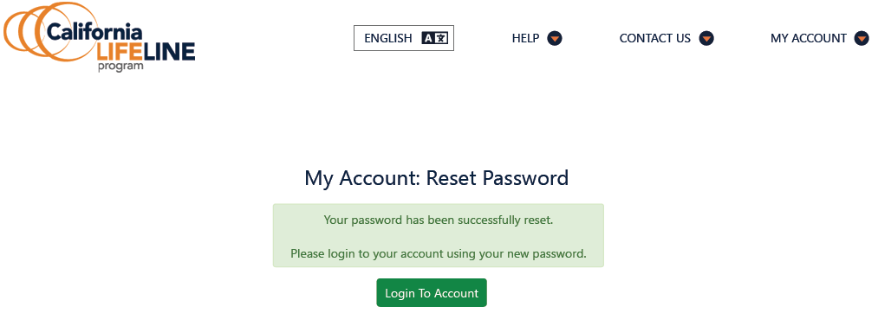
California LifeLine Customer Portal

Slide 11
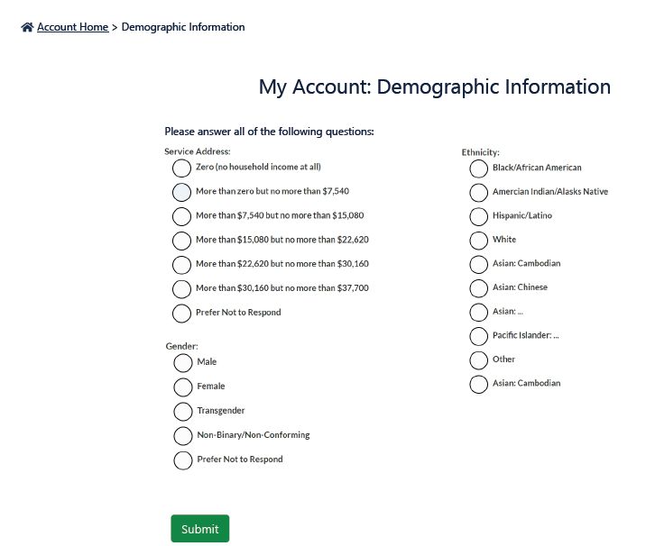
California LifeLine Customer Portal

Slide 12
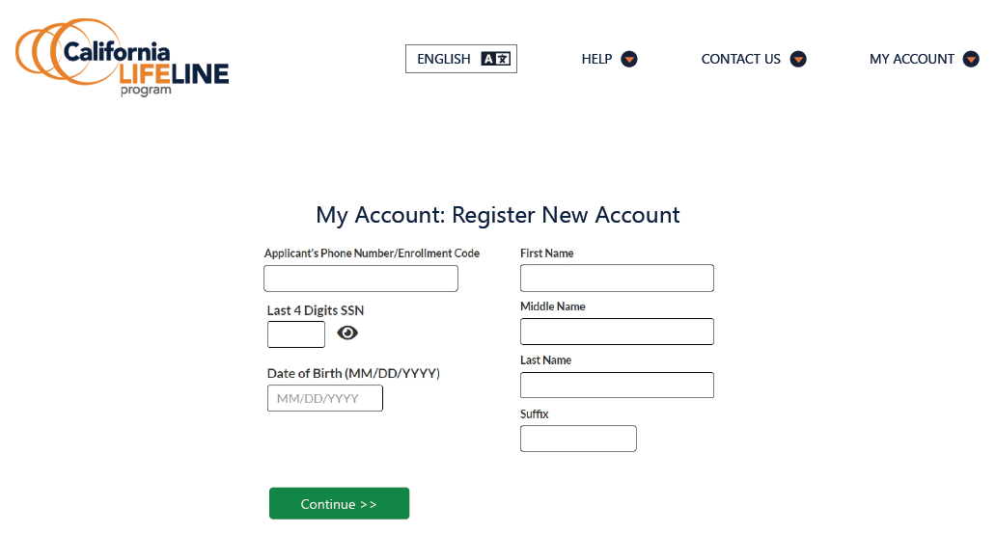
California LifeLine Customer Portal

Slide 13
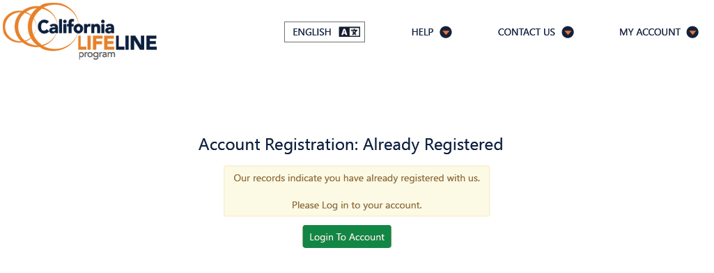
California LifeLine Customer Portal

Slide 14
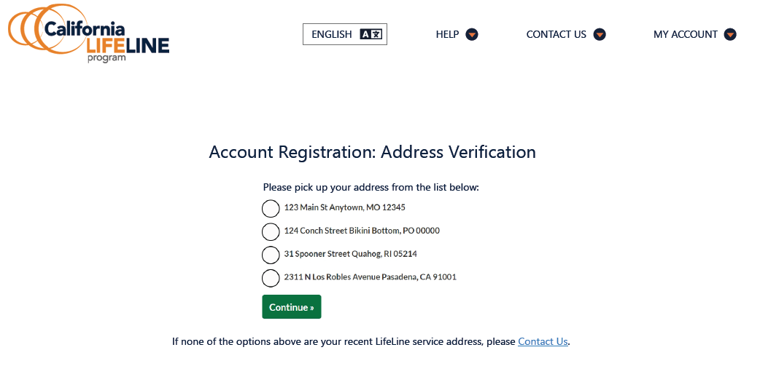
California LifeLine Customer Portal

Slide 15
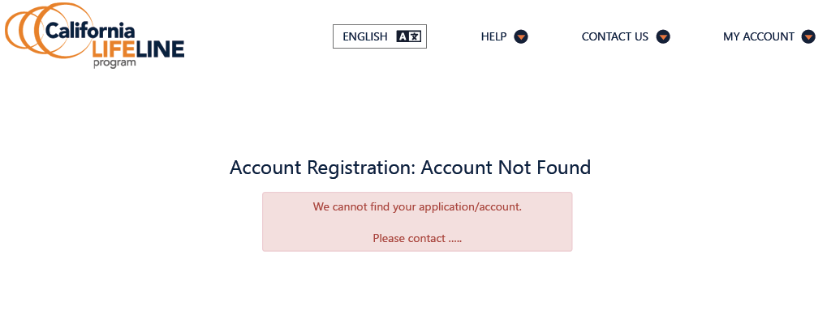
California LifeLine Customer Portal

Slide 16
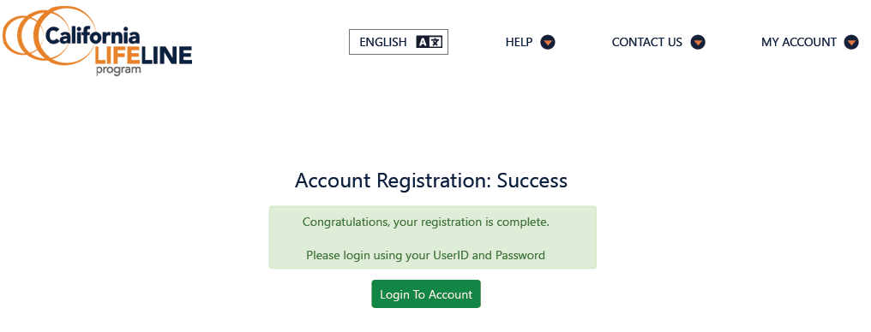
California LifeLine Customer Portal

Slide 17
Program and Operations Reports
Program Participation – Active LifeLine Subscribers
Wireless: Response & Approval Rates – All Form Types
Wireline: Response & Approval Rates – All Form Types
Top 5 Denial Reasons
Subscriber Count Trends for Largest Service Providers
Enrollment Eligibility Methods – Program versus Income
Enrollment Eligibility Methods – By Qualifying Program
Enrollment Application Volume By Received Channel
Renewal Form Volume By Received Channel
Renewal Rate
Standalone IEH Volume By Received Channel
Call Volumes – English & Spanish
Call Volumes – Other Supported Languages

Slide 18
Program Participation – Active LifeLine Subscribers
  Current: Total Number of Active LifeLine Subscribers as of September 1, 2023
  Wireless: 952,257
  Wireline: 160,590
  Total: 1,112,847
  June 2023 Administrative Committee Meeting: Total Number of Enrolled Subscribers as of June 1, 2023
  Wireless: 944,708
  Wireline: 165,056
  Total: 1,109,764

Slide 19
Wireless: Response & Approval Rates – All Form Types
Month Year | # Total | # Responded | % Responded | # Approved | % Approved | Qualified or Renewed %
Sep 2022 | 211,606 | 188,609 | 89.1% | 181,954 | 96.5% | 86.0%
Oct 2022 | 264,663 | 202,030 | 76.3% | 187,793 | 93.0% | 71.0%
Nov 2022 | 256,948 | 190,492 | 74.1% | 177,724 | 93.3% | 69.2%
Dec 2022 | 233,616 | 178,431 | 76.4% | 167,259 | 93.7% | 71.6%
Jan 2023 | 190,784 | 165,495 | 86.7% | 159,026 | 96.1% | 83.4%
Feb 2023 | 163,260 | 138,778 | 85.0% | 132,669 | 95.6% | 81.3%
Mar 2023 | 165,362 | 140,429 | 84.9% | 133,839 | 95.3% | 80.9%
Apr 2023 | 153,490 | 135,341 | 88.2% | 130,839 | 96.7% | 85.2%
May 2023 | 151,355 | 139,874 | 92.4% | 136,559 | 97.6% | 90.2%
Jun 2023 | 148,139 | 132,732 | 89.6% | 129,699 | 97.7% | 87.6%
Jul 2023 | 125,374 | 117,763 | 93.9% | 113,060 | 96.0% | 90.2%
Aug 2023 | 197,765 | 177,464 | 89.7% | 174,486 | 98.3% | 88.2%
Totals | 2,262,362 | 1,907,438 | 84.3% | 1,824,907 | 95.7% | 80.7%
% Responded: #Responded / #Total
% Approved = #Approved / #Responded
% Qualified or Renewed = #Approved / #Total

Slide 20
Wireline: Response & Approval Rates – All Form Types
Month Year | # Total | # Responded | % Responded | # Approved | % Approved | Qualified or Renewed %
Sep 2022 | 46,584 | 43,760 | 93.9% | 42,580 | 97.3% | 91.4%
Oct 2022 | 46,538 | 38,098 | 81.9% | 36,281 | 95.2% | 78.0%
Nov 2022 | 48,652 | 38,011 | 78.1% | 36,137 | 95.1% | 74.3%
Dec 2022 | 33,428 | 25,865 | 77.4% | 24,731 | 95.6% | 74.0%
Jan 2023 | 15,927 | 13,339 | 83.8% | 12,764 | 95.7% | 80.1%
Feb 2023 | 6,608 | 5,152 | 78.0% | 4,563 | 88.6% | 69.1%
Mar 2023 | 6,937 | 4,349 | 62.7% | 3,634 | 83.6% | 52.4%
Apr 2023 | 5,263 | 3,064 | 58.2% | 2,612 | 85.2% | 49.6%
May 2023 | 3,727 | 2,968 | 79.6% | 2,639 | 88.9% | 70.8%
Jun 2023 | 3,988 | 2,160 | 54.2% | 1,969 | 91.2% | 49.4%
Jul 2023 | 2,473 | 2,054 | 83.1% | 1,883 | 91.7% | 76.1%
Aug 2023 | 12,219 | 10,966 | 89.7% | 10,745 | 98.0% | 87.9%
Totals | 232,344 | 189,786 | 81.7% | 180,538 | 95.1% | 77.7%
% Responded: #Responded / #Total
% Approved = #Approved / #Responded
% Qualified or Renewed = #Approved / #Total

Slide 21
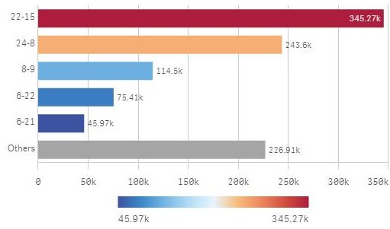
Top 5 Denial Reasons: September 2022 – August 2023
Denial Code | Type | Form | Description
22-15 | Correctible Denial | Renewal | Failure to return the renewal form by the due date
24-8 | Hard Denial | Renewal | Failure to return the renewal form by the due date
8-9 | Hard Denial | Application | Failure to return the application form by the due date
6-22 | Correctible Denial | Application | Documentation does not meet the eligibility guidelines.
6-21 | Correctible Denial | Application | Failure to return the application form by the due date

Slide 22
Top 5 Service Providers by Subscriber Counts
Service Provider | Sep 2022 | Oct 2022 | Nov 2022 | Dec 2022 | Jan 2023 | Feb 2023 | Mar 2023 | Apr 2023 | May 2023 | Jun 2023 | Jul 2023 | Aug 2023
Assurance Wireless (6664) | 399,796 | 410,576 | 406,284 | 394,592 | 380,309 | 347,740 | 356,082 | 347,965 | 341,155 | 333,270 | 303,709 | 299,309
Boomerang (262H) | 91,344 | 93,438 | 85,659 | 82,912 | 91,710 | 94,518 | 97,196 | 98,688 | 101,504 | 105,291 | 107,203 | 108,650
Pacific Bell (9740) | 178,779 | 176,724 | 170,916 | 163,476 | 159,460 | 159,834 | 160,507 | 159,823 | 158,963 | 157,943 | 156,814 | 155,621
TruConnect (4280) | 225,425 | 210,503 | 195,508 | 180,241 | 173,193 | 175,544 | 176,384 | 177,611 | 174,553 | 171,096 | 176,641 | 184,762
Tracfone (585B) | 155,633 | 171,232 | 175,069 | 170,590 | 165,911 | 163,210 | 157,143 | 160,295 | 166,360 | 174,760 | 179,603 | 190,846

Slide 23
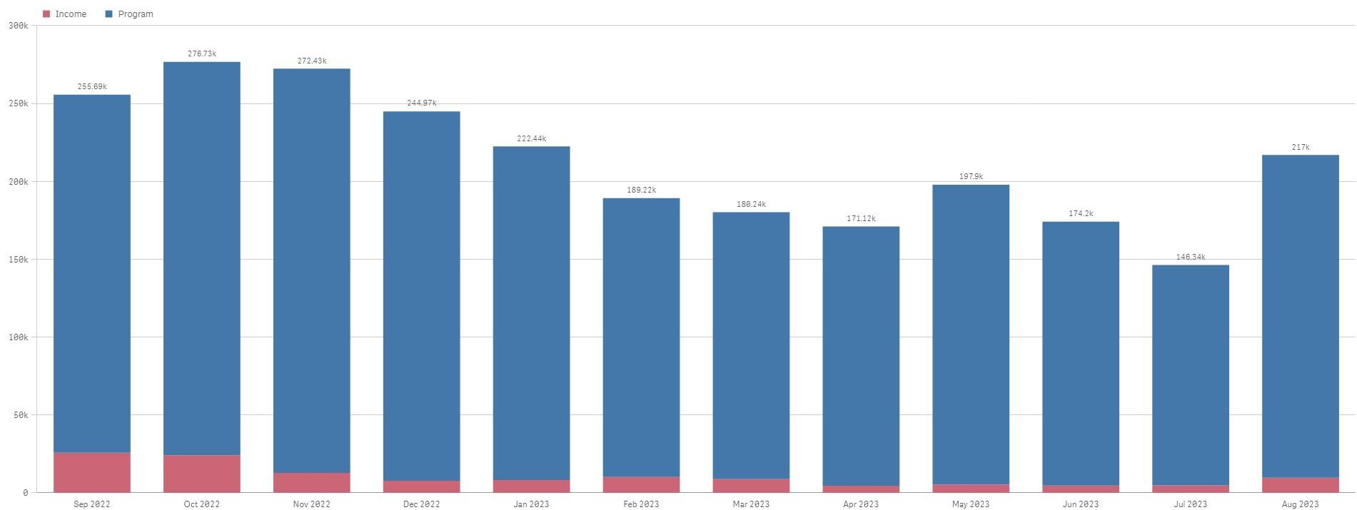
Enrollment Eligibility Methods – Program versus Income

Slide 24
Enrollment Eligibility Methods – By Qualifying Program

Slide 25
Enrollment Application Volume By Received Channel
September 2022 through August 2023
# Enrollment application forms received

Slide 26
Renewal Form Volume By Received Channel
September 2022 – August 2023
# Renewal forms received

Slide 27
Renewal Rate
September 2022 – August 2023
Outcomes have been recorded for all renewal processes started on and between 9/1/2022 and 6/7/2023
  Total renewal processes started: 831,762
  Total Hard Denials: 220,012
  Renewal Rate: 73.5%

Slide 28
Standalone IEH Volume By Received Channel
September 2022 – August 2023
  # IEH forms received
  Note: Standalone IEH process was deployed 3/31/2023

Slide 29
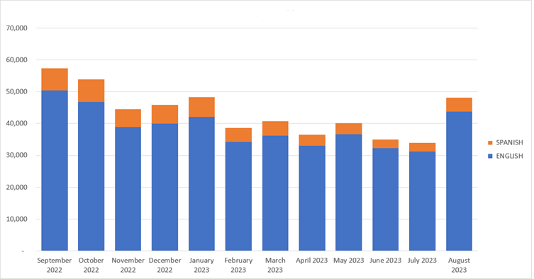
Monthly Inbound Call Volumes – English & Spanish
September 2022 through August 2023

Slide 30
Monthly Inbound Call Volumes – Other Languages
September 2022 through August 2023

