Slide 1
California LifeLine Third Party Administrator
Presentation to the ULTS Administrative Committee
March 20, 2025

Slide 2
Contents
Completed Initiatives
Upcoming Initiatives
Program Reports

Slide 3
Completed Initiatives
Added Wireless Rate Groups to Implement CPUC Administrative Letter #7
Administrative Letter #7 explains that wireless California LifeLine subscribers who are required to pay monthly fees for LifeLine service must be assigned to one of three new wireless rate groups:
  CAwireless0ormore - if the monthly out-of-pocket subscriber cost is $0.01 to $9.99
  CAwireless10ormore - if the monthly out-of-pocket subscriber cost is $10.00 to $19.99
  CAwireless20ormore - if the monthly out-of-pocket subscriber cost is $20.00 or more
Wireless California LifeLine subscribers who are not required to pay monthly fees for LifeLine service should be assigned to the CAWireless1000ormore rate group

Slide 4
Completed Initiatives
Continued Manual Automated Eligibility Verification System (AEVS) Checks to Confirm Applicants’ Medi-Cal Participation
Month | Medi-Cal Participation Confirmed | Medi-Cal Participation Not Confirmed | Percentage Confirmed
April 2024 * | 16,776 | 2,143 | 88.67%
May 2024 | 44,864 | 6,197 | 87.86%
June 2024 | 45,208 | 6,594 | 87.27%
July 2024 | 37,919 | 5,279 | 87.78%
August 2024 | 42,597 | 6,440 | 86.87%
September 2024 | 37,817 | 5,797 | 86.71%
October 2024 | 39,914 | 6,029 | 84.91%
November 2024 | 30,695 | 8,007 | 79.31%
December 2024 | 38,558 | 7,775 | 83.22%
January 2025 | 34,142 | 5,678 | 85.74%
February 2025 | 29,520 | 4,873 | 85.83%
*On 4/19/2024 manual AEVS checks started

Slide 5
Completed Initiatives
Temporarily Suspended Annual Renewal Processes for Subscribers with Service Addresses Located in Los Angeles & Ventura Counties
On Thursday, January 30, 2025, Commissioner Alice Reynolds issued a ruling suspending the Program’s annual renewal requirements for subscribers whose Service Addresses were in Los Angeles & Ventura Counties
Category | Action | Count
Renewal processes in progress with hard denial decisions rendered | Vacate the denial decisions, cancel the renewal processes, and adjust anniversary dates so new renewal processes start after 3/17 | 13,578
Renewal processes in progress with no decisions rendered | Cancel the renewal processes and adjust anniversary dates so new renewal processes start after 3/17 | 26,039
Renewal processes scheduled to start 1/31 through 3/17 | Anniversary dates adjusted so renewal processes start after 3/17 | 46,929

Slide 6
Completed Initiatives
2025 Federal Poverty Guidelines applicable to applicants and subscribers qualifying by income
On Friday, January 31st, the TPA’s system was updated with the 2025 federal income guidelines
Family Size | Annual Income | Monthly Income
1 | $21,128 | $1,761
2 | $28,553 | $2,379
3 | $35,978 | $2,998
4 | $43,403 | $3,617
Each additional Member | $7,425 | $619
The California income guidelines will be updated on June 1, 2025

Slide 7
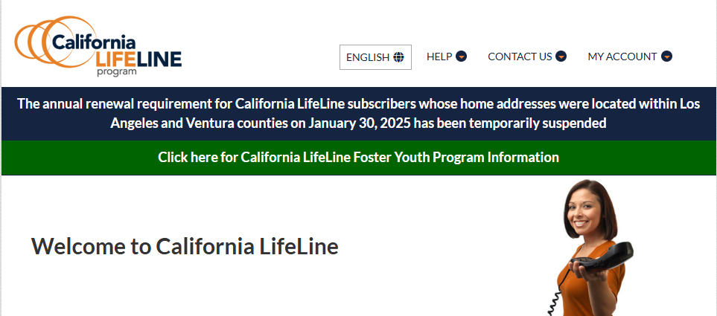
Completed Initiatives
Added a Public Website Banner Announcing the Temporary Renewal Process Suspension
On Friday, February 7th, a banner announcing the temporary renewal process suspension was added to the California LifeLine public website

Slide 8
Completed Initiatives
Collecting, tracking, and handling the demographics of Benefit Qualifying Persons (BQP)
An applicant can qualify for LifeLine because a member of their household, who is their child or a dependent, is currently enrolled in a qualifying assistance program. The household member is referred to as a Benefit Qualifying Person (BQP)
Today (Thursday, March 20th), the TPA’s system platform was updated to track and manage BQP demographic data

Slide 9
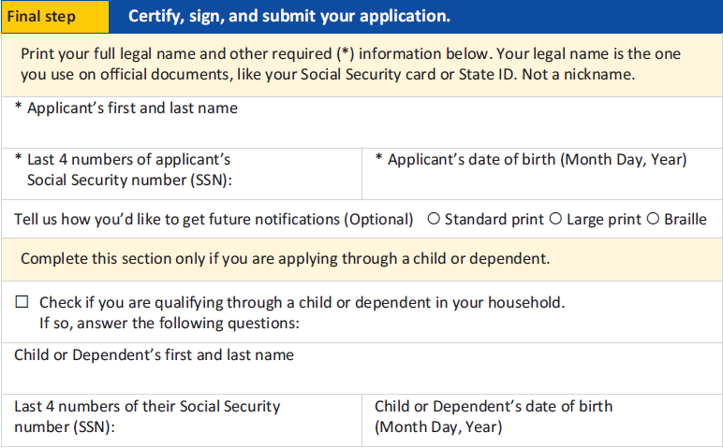
Completed Initiatives
Enrollment Application - Benefit Qualifying Person (BQP) Changes

Slide 10
Upcoming Initiatives
Acceptable Eligibility Documentation - CalFresh
Beginning Thursday, May 1, 2025, images of Golden State Advantage cards, the California EBT card, WILL NOT be acceptable proof of CalFresh participation
Beginning Thursday, May 1, 2025, the following documentation will be accepted by the TPA to demonstrate current CalFresh participation:
CalFresh Notices of Action which display issuance dates within the most recent seven (7) calendar days
CalFresh Notices of Approval which display issuance dates within the most recent seven (7) calendar days
CalFresh Verification of Benefits letters which display issuance dates within the most recent seven (7) calendar days

Slide 11
Upcoming Initiatives For Calendar Year 2025
Establishing an API connection with the Medi-Cal Eligibility Data System (MEDS) for confirming eligibility
Introducing an eligibility reverification process during the annual renewal for subscribers whose continuing eligibility is not determined by matching with external databases
Requiring wireless Service Providers to submit proof of consumer consent when initiating a LifeLine benefit transfer
Customer Portal 2.0
  Allow registered portal users to self-initiate enrollments, obtain eligibility determinations, and then select Service Providers and plans [emulating the USAC enrollment model]
  Allow registered portal users to change their service addresses, mail addresses, font preferences, and language preferences
Milestone dates for the foregoing initiatives are TBD

Slide 12
Program and Operations Reports
Program Participation – Active LifeLine Subscribers
Program Participation – Active LifeLine Subscribers - Trend
Active Subscribers – Top 5 Service Providers By Subscriber Count
Active Subscribers – Top 5 Service Providers by Subscriber Count and by Technology
Active Subscribers – By Funding Type – September 2024 through February 2025
Active Subscribers - Top 20 State Senate Districts
Active Subscribers - Top 20 State Assembly Districts
Active Subscribers – Top 20 Counties
Active Subscribers – Top 20 ZIP Codes
Active Subscribers – Written Language Preferences

Slide 13
Program and Operations Reports
Customer Portal – Registered Users
Customer Portal – Registered Users - Trend
Subscriber Reported Demographics – Household Income
Subscriber Reported Demographics – Gender
Subscriber Reported Demographics – Race
Subscriber Reported Demographics – Asian Ethnicity
Subscriber Reported Demographics – Pacific Islander Ethnicity
Response & Approval Rates – All Form Types – September 2024 through February 2025
Enrollment Application Volume by Received Channel – September 2024 through February 2025
Renewal Form Volume by Received Channel – September 2024 through February 2025
Enrollment Eligibility Methods – Program Versus Income
Enrollment Eligibility Methods – By Qualifying Program

Slide 14
Program and Operations Reports
Top 5 Denial Reasons – New Enrollment Applications – September 2024 through February 2025
Top 5 Denial Reasons – Renewal Forms – September 2024 through February 2025
Renewal Rate - Renewal Processes Starting 12/15/2023 through 12/12/2024
CalFresh Confirm Match Rates – Renewal Processes Starting 12/15/2023 through 12/12/2024
Standalone IEH Volume by Received Channel – September 2024 through February 2025
Call Center – Inbound Calls Handled – English & Spanish – September 2024 through February 2025
Call Center – Inbound Calls Handled – Other Supported Spoken Languages – September 2024 through February 2025
Call Center – Average Seconds to Answer (ASA) – September 2024 through February 2025
Call Center – Webchats Handled – September 2024 through February 2025
Call Center – Emails Handled – September 2024 through February 2025
Call Center – Forms Manually Processed – September 2024 through February 2025

Slide 15
Program Participation – Active LifeLine Subscribers
  Active LifeLine Subscribers - December 1, 2024
  Wireless: 1,597,640
  Wireline: 114,983
  Total: 1,712,623
3.29% decrease of total subscribers
  Active LifeLine Subscribers - March 1, 2025
  Wireless: 1,555,998
  Wireline: 100,282
  Total: 1,656,280

Slide 16
Program Participation – Active LifeLine Subscribers - Trend

Slide 17
Active Subscribers
Top 5 Service Providers By Subscriber Count
Service Provider | Active Subscribers
TruConnect | 674,942
TracFone dba SafeLink | 228,623
AirVoice Wireless dba AirTalk Wireless | 154,258
iWireless dba Access Wireless | 87,196
T-Mobile dba Assurance Wireless | 75,348

Slide 18
Active Subscribers
Top 5 Service Providers by Subscriber Count and by Technology
Wireless
Service Provider | Active Subscribers
TruConnect | 674,942
TracFone dba SafeLink | 228,623
AirVoice Wireless dba AirTalk Wireless | 154,258
iWireless dba Access Wireless | 87,196
T-Mobile dba Assurance Wireless | 75,348
Wireline
Service Provider | Active Subscribers
Pacific Bell dba AT&T California | 64,463
Frontier Communications dba Frontier CA | 15,314
Charter Communications dba Time Warner Cable | 7,055
Cox Communications | 4,173
ConnectTo Communications, Inc. | 2,177

Slide 19
Active Subscribers
By Funding Type
September 2024 through February 2025

Slide 20
Active Subscribers - Top 20 State Senate Districts
December 2024
State Senate District | Active Subscribers
18 | 85,918
14 | 78,312
28 | 73,409
16 | 72,806
35 | 72,044
29 | 67,576
23 | 61,847
26 | 60,047
33 | 59,299
22 | 58,264
8 | 56,323
31 | 55,671
39 | 52,786
19 | 50,013
34 | 47,935
20 | 47,781
1 | 46,254
7 | 44,491
11 | 43,982
5 | 41,407
March 2025
State Senate District | Active Subscribers
14 | 76,002
18 | 73,475
16 | 71,658
28 | 71,279
35 | 67,362
29 | 65,386
26 | 59,373
23 | 58,466
33 | 58,341
8 | 55,278
19 | 52,230
39 | 50,887
31 | 50,220
22 | 49,896
34 | 47,638
1 | 45,856
20 | 45,654
11 | 43,592
7 | 43,583
5 | 41,626

Slide 21
Active Subscribers - Top 20 State Assembly Districts
December 2024
State Assembly District | Active Subscribers
36 | 58,157
57 | 53,806
31 | 47,634
39 | 44,916
35 | 44,352
45 | 43,849
65 | 41,769
54 | 36,477
79 | 35,185
60 | 34,903
17 | 32,542
6 | 31,884
27 | 31,487
33 | 30,493
13 | 30,055
34 | 29,770
53 | 29,758
52 | 29,716
10 | 29,142
18 | 29,126
March 2025
State Assembly District | Active Subscribers
57 | 52,251
36 | 47,384
31 | 46,426
39 | 43,619
35 | 43,562
45 | 42,618
65 | 39,112
54 | 35,965
79 | 33,628
17 | 32,532
60 | 31,825
06 | 31,623
13 | 30,474
27 | 30,329
33 | 30,178
34 | 28,937
61 | 28,599
18 | 28,568
10 | 28,520
43 | 27,844

Slide 22
Active Subscribers - Top 20 Counties
December 2024
County | Active Subscribers
Los Angeles | 507,127
San Bernardino | 133,353
San Diego | 124,576
Riverside | 113,242
Orange | 96,154
Sacramento | 81,888
Fresno | 67,375
Kern | 64,597
Alameda | 54,714
Santa Clara | 42,738
San Francisco | 41,487
Imperial | 40,355
San Joaquin | 39,500
Contra Costa | 32,461
Stanislaus | 28,392
Tulare | 28,323
Ventura | 18,611
Merced | 17,378
Solano | 16,939
Monterey | 16,752
March 2025
County | Active Subscribers
Los Angeles | 483,014
San Bernardino | 130,202
San Diego | 114,618
Riverside | 108,906
Orange | 93,306
Sacramento | 80,190
Fresno | 65,707
Kern | 63,975
Alameda | 54,480
Santa Clara | 44,941
San Francisco | 41,457
San Joaquin | 39,897
Contra Costa | 32,629
Imperial | 31,591
Tulare | 28,397
Stanislaus | 28,261
Ventura | 19,671
Monterey | 17,322
Merced | 16,972
Solano | 15,881

Slide 23
Active Subscribers - Top 20 ZIP Codes
December 2024
ZIP Code | Active Subscribers
90044 | 11,901
92243 | 11,883
92231 | 11,835
92227 | 9,339
93535 | 9,134
93307 | 9,118
90003 | 8,953
90011 | 8,668
90059 | 8,550
91766 | 7,991
93550 | 7,668
92376 | 7,437
95823 | 7,421
92335 | 7,293
90805 | 7,178
92404 | 7,047
92410 | 6,975
92345 | 6,954
92553 | 6,902
90001 | 6,819
March 2025
ZIP Code | Active Subscribers
90044 | 11,204
92243 | 9,684
93535 | 9,315
90003 | 9,046
93307 | 8,938
90011 | 8,814
90805 | 7,778
92376 | 7,565
95823 | 7,536
93550 | 7,406
92227 | 7,174
92335 | 7,164
92410 | 7,033
92404 | 6,932
92345 | 6,895
90059 | 6,734
92231 | 6,407
92553 | 6,362
90037 | 6,247
92683 | 6,193

Slide 24
Active Subscribers – Written Language Preferences
December 2024
Language Code | Active Subscribers
English | 1,653,797
Spanish | 40,484
Chinese | 11,331
Vietnamese | 4,471
Korean | 1,966
Tagalog | 339
Japanese | 235
December 2024
Language Code | Active Subscribers
English | 1,601,032
Spanish | 39,217
Chinese | 10,084
Vietnamese | 3,796
Korean | 1,701
Tagalog | 286
Japanese | 162

Slide 25
Customer Portal – Registered Users
Metric | 12/02/2024 Counts | 03/02/2025 Counts
Registered Users | 170,479 | 200,159
Wireless Registered Users | 146,833 | 174,072
Wireline Registered Users | 23,646 | 26,087
At least one LifeLine form submitted via the Portal after registering | 74,468 | 85,193

Slide 26
Customer Portal – Registered Users - Trend

Slide 27
Subscriber Reported Demographics
Household Income
Household Income | December 2024 | March 2025 | % Change
0-9,999 | 75,361 | 91,062 | 20.83%
10,000 - 19,999 | 35,453 | 41,271 | 16.41%
20,000 - 29,999 | 18,712 | 21,350 | 14.10%
30,000 - 39,999 | 8,329 | 9,407 | 12.94%
40,000+ | 7,358 | 8,380 | 13.89%
Prefer Not To Respond | 25,143 | 29,687 | 18.07%

Slide 28
Subscriber Reported Demographics
Gender
Gender | December 2025 | March 2025 | % Change
Female | 86,644 | 102,304 | 18.07%
Male | 74,198 | 88,024 | 18.63%
Prefer Not To Respond | 8,470 | 9,623 | 13.61%
Nonbinary | 551 | 625 | 13.43%
Transgender | 493 | 581 | 17.85%

Slide 29
Subscriber Reported Demographics
Race
Race | December 2024 | March 2025 | % Change
Hispanic | 53,254 | 62,779 | 17.89%
White | 44,283 | 52,483 | 18.52%
Asian | 24,011 | 27,191 | 13.24%
Prefer Not To Respond | 19,218 | 23,120 | 20.30%
Black American | 18,868 | 22,416 | 18.80%
Other | 7,333 | 8,990 | 22.60%
American Indian | 2,379 | 2,963 | 24.55%
Pacific Islander | 1,010 | 1,215 | 20.30%

Slide 30
Subscriber Reported Demographics
Asian Ethnicity
Asian Ethnicity | August | December | % Change
Chinese | 5,183 | 8,303 | 60.20%
Vietnamese | 4,699 | 6,868 | 46.16%
Other Asian | 1,840 | 2,655 | 44.30%
Filipino | 1,608 | 2,208 | 37.31%
Indian | 1,004 | 1,527 | 50.09%
Korean | 696 | 980 | 40.80%
Cambodian | 463 | 659 | 42.33%
Japanese | 303 | 459 | 51.49%
Laotian | 245 | 325 | 32.65%
Prefer Not To Respond | 31 | 27 | -12.90%
Note: Registered users can change their responses. For example, the decrease of “Prefer Not To Respond” reflects users who changed their responses

Slide 31
Subscriber Reported Demographics
Pacific Islander Ethnicity
Pacific Islander Ethnicity | December 2024 | March 2025 | % Change
Other Pacific Islander | 541 | 652 | 20.52%
Native Hawaiian | 182 | 221 | 21.43%
Samoan | 182 | 213 | 17.03%
Guamanian | 105 | 129 | 22.86%

Slide 32
Response & Approval Rates – All Form Types
September 2024 through February 2025
Month | Total | Responded | % Responded | Approved | % Approved | % Qualified or Renewed
Sep 2024 | 385,339 | 340,839 | 88.5% | 269,629 | 79.1% | 70.0%
Oct 2024 | 423,328 | 377,924 | 89.3% | 299,968 | 79.4% | 70.9%
Nov 2024 | 392,508 | 342,030 | 87.1% | 269,357 | 78.8% | 68.6%
Dec 2024 | 380,783 | 335,730 | 88.2% | 263,680 | 78.5% | 69.2%
Jan 2025 | 372,206 | 330,613 | 88.8% | 262,523 | 79.4% | 70.5%
Feb 2025 | 272,762 | 244,018 | 89.5% | 192,227 | 78.8% | 70.5%
Totals | 2,226,926 | 1,971,154 | 88.5% | 1,557,384 | 79.0% | 69.9%
Responded / Total = % Responded
Approved / Responded = % Approved
Approved / Total - % Qualified or Renewed

Slide 33
Enrollment Application Volume by Received Channel
September 2024 through February 2025

Slide 34
Renewal Forms Submitted by Received Channel
September 2024 through February 2025
# Renewal forms received

Slide 35
Enrollment Eligibility Methods – Program Versus Income

Slide 36
Enrollment Eligibility Methods – By Qualifying Program
98.1% of subscribers qualified based on either CalFresh or Medi-Cal participation

Slide 37
Top 5 Denial Reasons – New Enrollment Applications
September 2024 through February 2025
Denial Code | Type | Description
8-9 | Hard Denial | Second chance application form not returned by the due date
6-22 | Correctible Denial | Documentation submitted does not meet eligibility guidelines
5-12 | Hard Denial | Active Phone Number & Service Start Date not received within 30 days of status code 53
5-16 | Hard Denial | IDV form not returned by the due date
8-10 | Hard Denial | Your form was returned as non-deliverable (a letter will not be generated for this reason).

Slide 38
Top 5 Denial Reasons – Renewal Forms
September 2024 through February 2025
Denial Code | Type | Description
22-15 | Soft Denial | Initial renewal form not returned by the due date
24-8 | Hard Denial | Second chance renewal form not returned by the due date
24-9 | Hard Denial | 2nd chance form returned undeliverable as addressed
21-13 | Hard Denial | IDV form not returned by the due date
22-17 | Correctible Denial | Did not initial the 1 per household certification

Slide 39
Renewal Rate
Renewal Processes Starting 12/15/2023 through 12/12/2024
  Total renewal processes started: 1,129,016
  Total Hard Denials: 270,686
  Renewal Rate: 76.02%
*Note: Final dispositions have been recorded for all renewal processes started for the selected period

Slide 40
CalFresh Confirm Match Rates
Renewal Processes Starting 12/15/2023 through 12/12/2024
  Day 0 – 56.11% [627,933 subscribers passed]
  Before issuing a hard denial for nonresponse – 6.38% [17,287 subscribers passed]

Slide 41
Standalone IEH Volume by Received Channel
September 2024 through February 2025

Slide 42
Call Center – Inbound Calls Handled
English & Spanish
September 2024 through February 2025

Slide 43
Call Center – Inbound Calls Handled
Other Supported Spoken Languages
September 2024 through February 2025
Language | Sep-24 | Oct-24 | Nov-24 | Dec-24 | Jan-25 | Feb-25
Cambodian | 12 | 4 | 5 | 7 | 6 | 9
Cantonese | 369 | 390 | 229 | 610 | 611 | 431
Hmong | 0 | 1 | 0 | 1 | 0 | 0
Japanese | 35 | 30 | 18 | 46 | 17 | 30
Korean | 112 | 137 | 131 | 229 | 202 | 148
Laotian | 9 | 4 | 5 | 12 | 9 | 18
Mandarin | 376 | 439 | 289 | 503 | 498 | 362
Vietnamese | 333 | 362 | 214 | 449 | 388 | 349
Total | 1,246 | 1,367 | 891 | 1,857 | 1,731 | 1,347

Slide 44
Call Center – Average Seconds to Answer (ASA)
September 2024 through February 2025

Slide 45
Call Center – Webchats Handled
September 2024 through February 2025

Slide 46
Call Center – Emails Handled
September 2024 through February 2025

Slide 47
Call Center – Forms Manually Processed
September 2024 through February 2025

Slide 48
Questions or Comments for the TPA
Please submit questions or comments for the TPA to TPA@CaliforniaLifeLine.com

