Slide 1
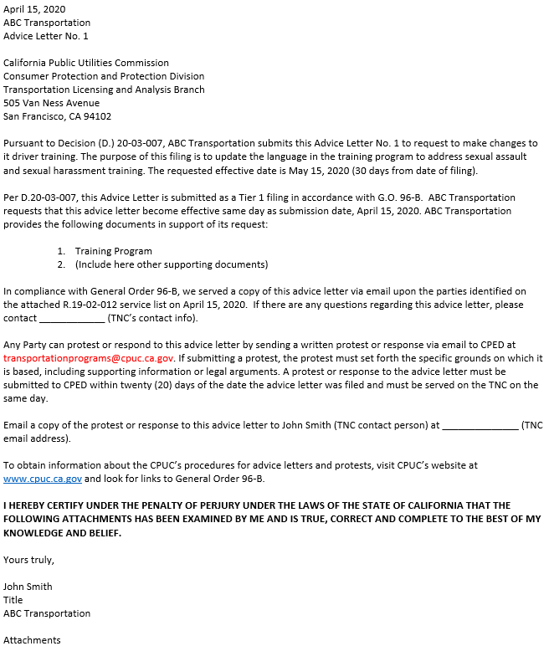
AL Cover Letter Sheet
An incomplete AL cover letter sheet may result in rejection of the AL filing
A. Date of submission
B. Brief description of the AL
C. CPUC authority (decisions, resolutions, GO, PU Codes, etc.)
D. Effective date
E. Date served on parties
F. Language about filing and serving the protest or response

