Slide 1
Long-Term Gas Planning Rulemaking How do we plan for a decarbonized future while ensuring energy reliability and protecting ratepayers?
October 15, 2021

Slide 2
Outline
R.20-01-007 Proceeding Overview
Track 2 Key Scoping Memo Issues
Environmental Justice Stakeholder Outreach
Questions

Slide 3
Long-Term Gas Planning Rulemaking
1A
System Reliability Standards
Establish minimum system requirements and ensure gas utilities consistently meet those standards and provide reliable gas service
1B
Market Structure and Regulations
Mitigate the risk that gas supply shortages pose to gas and electric reliability and prices
2
Long-Term Natural Gas Policy and Planning
Ensure safe, reliable, and affordable energy in a time of declining fossil gas throughput
Notes:
Mention that Track 1A and 1B are running concurrently.

Slide 4
Track 2
The Scoping Memo was issued on October 14 and includes questions related to the following issues:
Gas Infrastructure
Safety
Data
Process
Gas Revenues and Rate Design
Workforce Issues
Parties to the proceeding may comment on the Scoping Memo and suggest changes. Opening Comments are due November 2. Reply Comments are due November 12.

Slide 5
Gas Infrastructure
How should the CPUC determine the appropriate gas infrastructure portfolio for a decarbonizing future?
Transmission pipelines are similar to highways:
Carry large amounts of gas long distances at high pressure
Decommissioning impacts a large region
Distribution pipelines are similar to city streets
Carry smaller amounts of gas shorter distances at lower pressure
Decommissioning impacts a local area

Slide 6
Gas Infrastructure
Key issues:
Criteria for when aging pipelines should be repaired, replaced, or taken offline.
Priority for decommissioning distribution lines:
Community characteristics
Cost savings
Pipeline safety
Consideration of non-pipeline alternatives.
Infrastructure needs of customers who are likely to remain on the gas system the longest.
Workshops on these issues will be held on January 10 and 24, 2022.
A decision is expected in September 2022.
Notes:
Use Aldyl-A as an example for priority section

Slide 7
Safety
Gas utilities must comply with state and national regulations.
Key issues:
Should the Commission prioritize decommissioning infrastructure with costly safety requirements?
What should the process be for de-rating a transmission pipeline to a distribution pipeline?
A workshop on Safety, Data, and Process issues will be held in October 2022.
A decision on Track 2.2 is expected in mid-2023.

Slide 8
Data and Process
Consideration of changes to utility gas demand forecasting such as:
The type of data needed from utilities to assist decisionmakers and stakeholders in long-term gas system planning.
Should the gas utilities be required to submit a decarbonization plan with a 10-year outlook on a regular schedule?
Should policy decisions made in this proceeding be reevaluated over an established time interval or in the face of changing conditions?

Slide 9
Cost Allocation and Rate Design
Mitigation of affordability issues:
Should gas rate design and cost allocation methods be changed due to declining fossil gas throughput?
Consideration of new financial tools to balance costs between current and future ratepayers.
Cost Allocation, Rate Design, and Workforce issues will be addressed in Track 2.3, likely in 2023.

Slide 10
Workforce Issues
Consideration of potential negative impacts on gas industry workers from the transition away from gas.
Types of retraining that should be made available to gas utility employees to provide high road employment.
Ensuring that gas workers in disadvantaged or low-income communities have equitable access to retraining.

Slide 11
Proposed Engagement Plan
Compile
Stakeholder List
Initial ESJ
Group Meeting
Hold Community
Meetings
Post-Engagement
Evaluation
Early Intervenor
Discussions
Finalize Public
Engagement Strategy
Incorporate Public
Input in Record
Early Engagement
Formal Public Engagement

Slide 12
Where We Are Now
Compile
Stakeholder List
Initial ESJ
Group Meeting
Hold Community
Meetings
Post-Engagement
Evaluation
Early Intervenor
Discussions
Finalize Public
Engagement Strategy
Incorporate Public
Input in Record

Slide 13
Where We Are Now [2]
Stakeholder List
Early Intervenor Discussions
Over 70 organizations are expected to have an interest in the proceeding based on organizational goals, population or region represented, and/or interest in natural gas and related proceedings.
Includes statewide and regional ESJ organizations, past intervenors, thought leaders, environmental groups, and local governments.
Early discussions with intervenors and others with knowledge of the ESJ community in order to scope engagement strategy.

Slide 14
Initial ESJ Group Meeting
Discussion with statewide and regional ESJ groups.
Aim is to identify those interested in the proceeding and the best means to assist them and incorporate their views.
Intend to also get their views on community meetings and public engagement strategy for formal public engagement.

Slide 15
Proposed Engagement Plan
Compile
Stakeholder List
Initial ESJ
Group Meeting
Hold Community
Meetings
Post-Engagement
Evaluation
Early Intervenor
Discussions
Finalize Public
Engagement Strategy
Incorporate Public
Input in Record
Early Engagement
Formal Public Engagement

Slide 16
Questions?

Slide 17
Appendix Slide

Slide 18
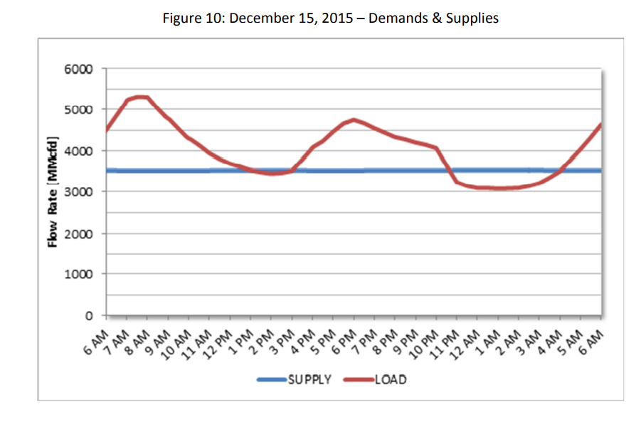
Background: Storage
Storage is like a bank account
Intraday demand $\sim$ checking
Pipelines deliver the same amount of gas every hour; storage helps meet changes in intraday demand
Seasonal demand $\sim$ savings
Allows gas to be bought in the spring and fall when it is cheaper and used in the summer and winter when it is more expensive
Emergency fund
Provides gas when supply is disrupted. Examples:
Winter Storm Uri
El Paso interstate pipeline outage

