Slide 1


SDG&E ACSDA Evaluation
DRMEC Results Summary, May 3, 2022

Slide 2
Agenda
Program overview
Ex post methodology overview
Ex post aggregate results
Ex ante aggregate results and enrollment forecast
Comparison of ex post vs ex ante between PY2020 and PY2021

Slide 3
Program Overview

Slide 4
Program overview
Commercial Thermostats
Residential Thermostats

Slide 5
Ex Post Methodology & Results

Slide 6
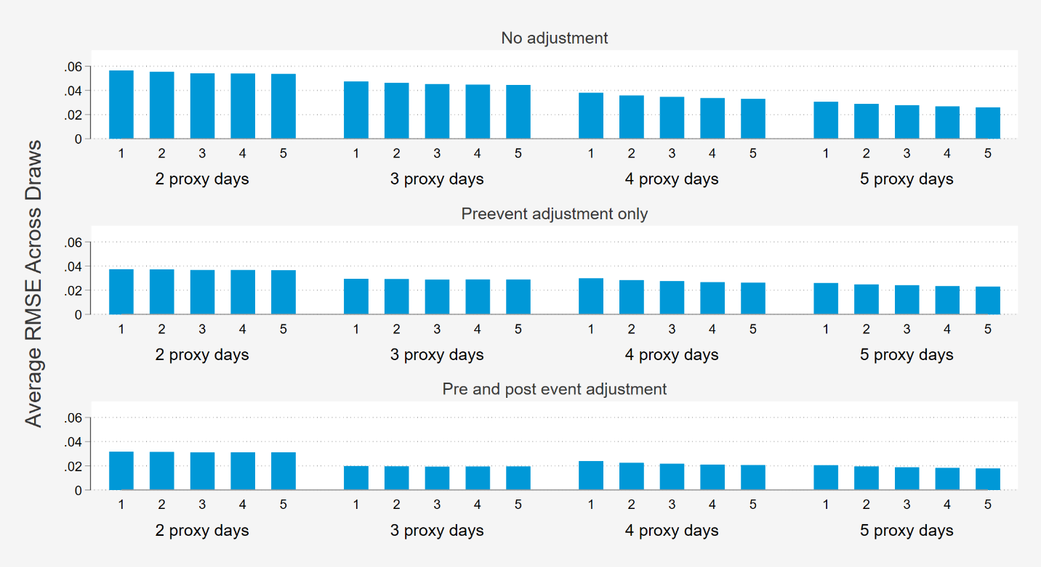
Ex Post Methodology (Commercial & Residential)
Out of Sample Process for Model Selection
Model Selection Results
1. Identify testing and training days
2. Define multiple models
3. Run each model using training data (leave out testing days)
4. Estimate out-of-sample bias and precision
5. Select the best performing model
Leave out every other day for testing
Number of proxy days ranging from two to five
Narrow to models with the least bias
6. Estimate loads during actual events using selected number of matched sites and proxy days
Inclusion of pre- or post-event adjustment parameters
Five control sites per participant site
Divide proxy days for each event into even and odd by Euclidian distance rank
Remove events
Five proxy days per event
Number of matches included from one to five
Control for event sampling bias
Bootstrap 20 random draws of 17 events to include in the calculations
Calculate average precision (RMSE) across draws
Pick the model with the best precision

Slide 7
Average event day reductions – All Thermostat Comparison
2021 Free Aggregate Reductions (MW)
2021 BYOT Aggregate Reductions (MW)
Pre-cooling
Y axis scale change from previous slide

Slide 8
Ex Post Aggregate Results: Residential
No Commercial Events in PY 21
ACSDA Residential Program Weekday Event Reductions (FREE)
ACSDA Residential Program Weekday Event Reductions (BYOT)
Used 9/9 event: only 6-8pm event with full population

Slide 9
Ex ante Methodology & Enrollment FOrecast

Slide 10
Ex ante methodology overview: PY 2021
Impacts
ACSDA: 2020
CPP-TD: 2020
ACSDA Res: 2020 & 2021 (weighted by enrollment of current participants)
PY 2021 site enrollment & device forecasts
TD enrollment model used for TD programs
Incorporates site retention & device connectivity
Assumptions based on PY 2021 analysis
Reference loads
Based on ex ante weather for ex ante analysis
Specification for each weather station used to enable granular forecast
Mensualized (change focused on May-Oct)
Ex Ante Forecast
&
Time Temp Matrix

Slide 11
Percent impacts

Slide 12
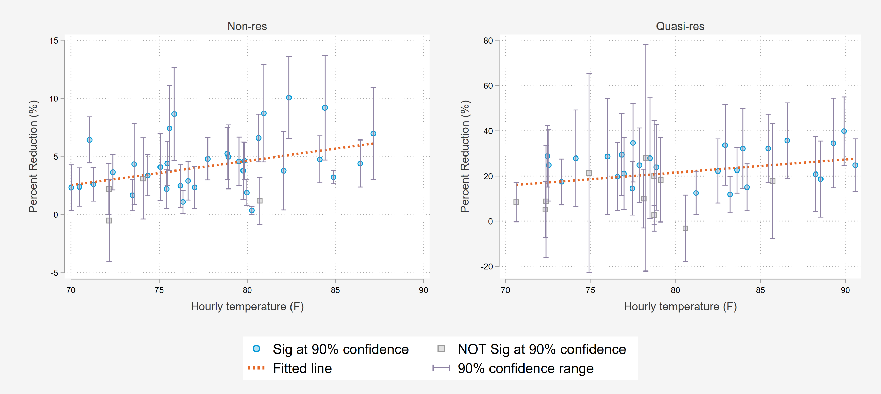
Commercial % impacts:
No PY 21 events, PY 20 events used to model ex ante impacts

Slide 13
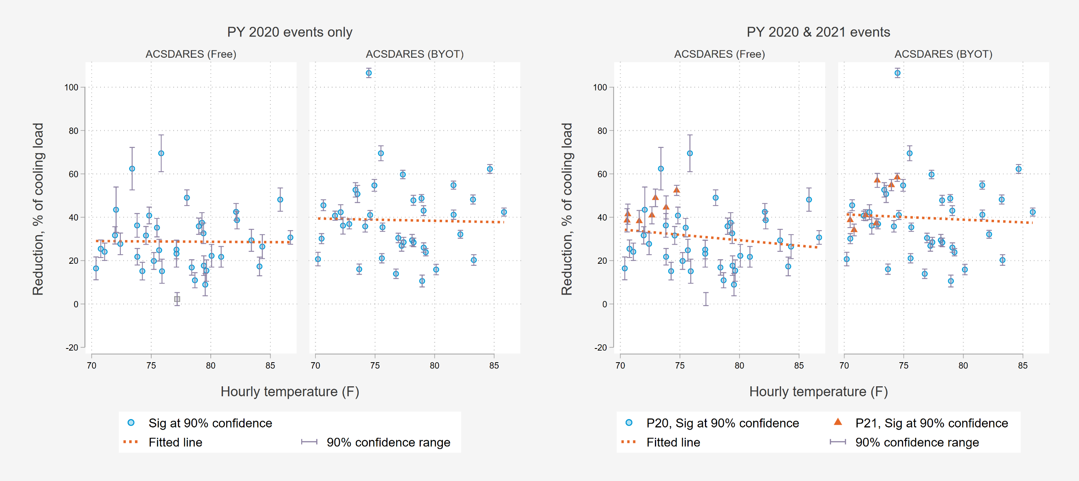
Residential % impacts: few PY 21 events, so ex ante model includes PY 20 events

Slide 14
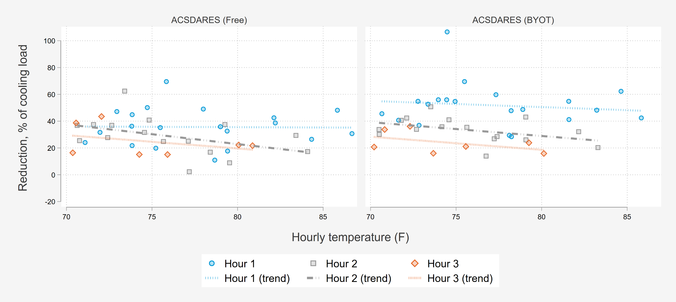
Residential % impacts:
Impacts decay in each subsequent event hour

Slide 15
Changes in ex ante % impacts relative to PY 2020
Percent impacts declined by ~10% on average but this varied by program
  TD Impacts are % of cooling
  Increases for CPP-D on TD
Overall ex ante impacts are weighted avg by segment
  Population changes even if the model doesn’t (e.g. PY20)
ACSDARES only program where model was updated (but still includes 2020)

Slide 16
Enrollment

Slide 17
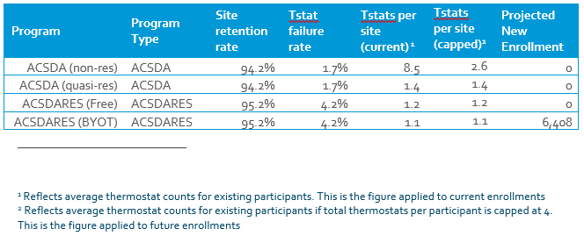
Enrollment forecasting model framework
Stock & flow model
Current enrollment (new vs returning)
Tstats per site
Tstat survival rate
Retention rate
Program growth targets
Using end of season enrollment as starting point
Forecast annual end of year enrollments
Separated site attrition from device disconnections
Annual counts by program, new vs returning

Slide 18
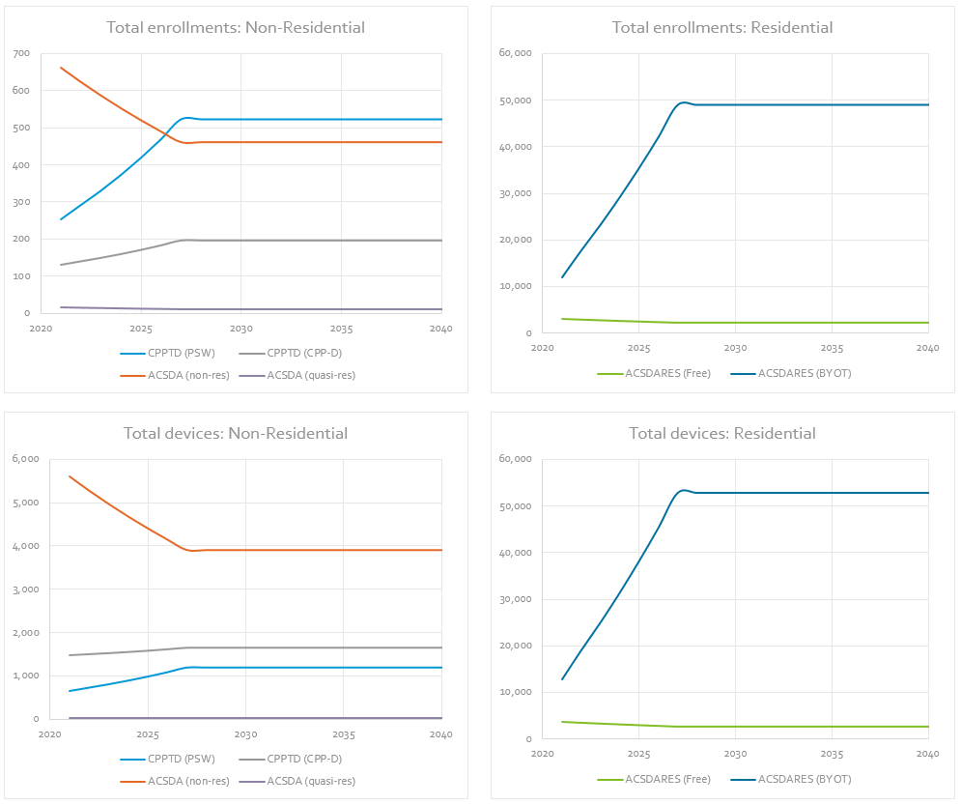
Enrollment Forecast model outputs
Annual counts by program, new vs returning
  Site retention
  New enrollments
Total vs connected devices
  Device connectivity over time
Year end forecast is linearly mensualized
Ex ante impacts per average connected device applied to connected device forecast
Site attrition
Res BYOT: +6.4k/yr
Assume enrollments flat after 2027

Slide 19
Overview: ex ante comparison to PY 2020

Slide 20
ACSDA commercial: 2021 Ex ante compared to 2020 Ex post
no PY 21 events
ACSDA Commercial Ex Ante-Ex Post Comparison
TD Program Forecast by Program
Result Type | Day Type and Period | Sites | Tstats connected | Load without DR (MW) | Load Reduction (MW) | % Reduction | Daily Max Temp (F)
Ex Post Avg. Weekday (PY2020 Results)** | Event Period (6pm to 8pm) | 941 | 3,543 | 15.17 | 0.44 | 2.9% | 85.6
 | Resource Adequacy Period (4 to 9pm) | 941 | 3,543 | 15.46 | 0.15 | 1.0% | 85.6
Ex ante SDG&E | 1-in-2 Weather August Peak (4 to 9pm) | 676 | 3,246 | 32.13 | 0.63 | 2.0% | 90.0
Ex ante CAISO | 1-in-2 Weather August Peak (4 to 9pm) | 676 | 3,246 | 33.03 | 0.64 | 1.9% | 89.8
*Table shows portfolio impacts. To avoid double counting, it excludes commercial thermostats and customers dually enrolled in other DR programs. **For comparability to ex ante, only includes events with average event temperature above 70F ***Ex ante site counts are lower due to exclusion of sites with no associated thermostat
Year | ACSDA |  | Total
 | Non-Res | Quasi-Res
2021 | 0.62 | 0.01 | 0.63
2022 | 0.59 | 0.01 | 0.60
2023 | 0.55 | 0.00 | 0.55
2024 | 0.51 | 0.00 | 0.51
2025 | 0.47 | 0.00 | 0.48
2026 | 0.44 | 0.00 | 0.44
2027 | 0.40 | 0.00 | 0.41
2028 | 0.39 | 0.00 | 0.39
2029 | 0.38 | 0.00 | 0.39
2030 | 0.38 | 0.00 | 0.38
2031 | 0.37 | 0.00 | 0.37
2032 | 0.36 | 0.00 | 0.37

Slide 21
ACSDA Residential: 2021 Ex ante compared to 2021 Ex post
ACSDA Residential Ex Ante-Ex Post Comparison
Forecast by Program
Result Type | Day Type and Period | Sites | Tstats connected | Load without DR (MW) | Load Reduction (MW) | % Reduction | Daily Max Temp (F)
Ex Post Avg. Weekday** | Event Period (6pm to 8pm) | 14,839 | 15,493 | 24.38 | 6.02 | 24.7% | 86.6
 | Resource Adequacy Period (4 to 9pm) | 14,839 | 15,493 | 24.77 | 0.98 | 4.0% | 86.6
Ex ante SDG&E | 1-in-2 Weather August Peak (4 to 9pm) | 15,041 | 13,037 | 25.45 | 2.81 | 11.1% | 89.9
Ex ante CAISO | 1-in-2 Weather August Peak (4 to 9pm) | 15,041 | 13,037 | 26.72 | 3.00 | 11.2% | 89.7
*Table shows portfolio impacts. To avoid double counting, it excludes commercial thermostats and customers dually enrolled in other DR programs. **For comparability to ex ante, only includes events with average event temperature above 70F ***Ex ante site counts are higher due to inclusion of new enrollments from October and November
Year | ACSDA - Residential |  | Total
 | Free | BYOT
2021 | 0.33 | 2.48 | 2.81
2022 | 0.31 | 3.22 | 3.53
2023 | 0.28 | 4.27 | 4.55
2024 | 0.26 | 5.31 | 5.57
2025 | 0.24 | 6.40 | 6.63
2026 | 0.21 | 7.52 | 7.74
2027 | 0.20 | 8.68 | 8.87
2028 | 0.18 | 8.81 | 9.00
2029 | 0.18 | 8.44 | 8.62
2030 | 0.17 | 8.09 | 8.25
2031 | 0.16 | 7.75 | 7.91
2032 | 0.16 | 7.42 | 7.57

Slide 22

Questions?
Alana Lemarchand
Partner & Principal
Demand Side Analytics
alana@demandsideanalytics.com
408.454.8158
Josh Bode
Partner & Principal
Demand Side Analytics
jbode@demandsideanalytics.com
415.786.0707

