Slide 1

Results of the Load Impact Evaluation for Leap’s 2021 Demand Response Program
Presented at the Demand Response Providers’
2022 Load Impact Protocol Final Report Workshop
hosted by the California Public Utilities Commission
May 18, 2022
Karen Herter, Ph.D.
Jenya Okuneva
Sam Borgeson, Ph.D.

Slide 2
Meters and Events in Leap’s 2021 Resource
Number of Meters
Load Type | PG&E | SCE | SDG&E | Total
Non-residential | 512 | 940 | 135 | 1587
Residential | 13,666 | 664 | XXX | 14332
Number of Events
Sector | Jan | Feb | Mar | Apr | May | Jun | Jul | Aug | Sep | Oct | Nov | Dec
Non-residential | 46 | 12 | 5 | 104 | 95 | 152 | 160 | 182 | 218 | 68 | 207 | 197
Residential | 0 | 0 | 0 | 0 | 0 | 4 | 5 | 20 | 83 | 7 | 13 | 43
Notes:
Some of the critical issues influencing this analysis include:
Leap’s resource is extraordinarily diverse. With twelve load types across two sectors, ranging in size from less than a kilowatt (kW) to tens of megawatts (MW) the heterogeneity of Leap’s DR resource requires separate approaches to load impact evaluation for subgroups within the participant population. For example, a model fit to a database with both residential AC and agricultural pumping will not converge.
Leap is growing quickly. Between December 2020 and December 2021, the number of residential meters in Leap’s DR programs nearly doubled, while the number of non-residential meters increased by more than 50%. Leap’s growth estimates imply that this level of growth will continue over the next few years at least.
Lack of non-participant data for control groups. Leap obtained participating meter data for the sixteen-thousand meters in their portfolio from their partners, but does not have access to the non-participant meter data held by utilities. Thus, load impact estimation for each meter (except for residential AC meters) relies on creating a baseline estimated from its own historical performance under similar conditions. The sole exception to this rule is the Residential AC analysis, which used the load data of participating meters not dispatched for a given event to create a control group for that event.
Lack of full resource events. 2021 saw several events labeled as “full resource” tests; however, these events were not truly full resource in the sense that each of the 16,000 meters participated in the same event, and for operational reasons, this is unlikely to ever occur. For this reason, the aggregate ex-post impacts of individual events are well below the full resource capacity.
California is a vast, geographically complex land area with countless microclimates. Related to the full resource discussion above, temperatures and geographic diversity limit the ability for a single number to accurately represent the full resource value. An event called on the entire state might yield maximum load impacts in some areas, but almost certainly not everywhere.

Slide 3
Data
Data | Description | Source
Partner customers | Partner ID, site ID, meter ID, enrollment date, site zip code and location, etc. | Leap
Meters | Hourly 2021 kWh values | Leap
Events | Date and timing of 2021 events | Leap
Enrollment | High, medium and low enrollment projections | Leap
Temperatures | Hourly temperature values linked to weather station using latitude and longitude | National Oceanographic and Atmospheric Administration (NOAA)
ZIP codes | Mapping of zip code to latitude and longitude | GeoNames database
Holidays | Off-peak weekdays | North American Electric Reliability Corp. (NERC) Holidays, July 2014
Weather profiles | Monthly 1-in-2 and 1-in-10 day profiles | Utilities and California ISO

Slide 4
Ex-post Analysis
What was the full resource potential for 2021?
Meter-specific baselines = N-of-10 or regression model with the lowest error for each meter
For each load type and month…
  Load impact estimates with RMSE* below 50% are used
  High-RMSE* estimates are replaced by the lowest load-impact result in the same season
Ex-ante analysis: What are the predicted load impacts for 2022-2032?
  Fit a mixed-effects model to temperature-dependent meter data (res AC, non-res HVAC)
  Forecast per-meter baselines for typical and extreme weather scenarios
  Forecast total demand resource for each load type from 2023 through 2032
How do results differ by sub-LAP and weather?
* RMSE = Root Mean Squared Error = the square root of the mean of all errors squared
Notes:
For each month of 2023-2032, the evaluation team estimated ex-ante load impacts for typical days (1-in-2) and peak days (1-in-10). To enable regression model convergence, meters were split into two subgroups according to monthly mean diurnal load shape – one group resembling a hill shape and the other a valley shape – and separate linear regression models were applied to each.
For each group, the model incorporates independent variables representing outdoor temperature, sub-LAP, year, and site characteristics. The resulting coefficients are used to predict future per-meter event impacts for the peak day of each month for two standard weather years, corresponding to conditions that are expected to lead to peak electric load in either one out of every two years (1-in-2), or one out of every ten years (1-in-10). Because there is a slight difference in the conditions that cause peak load for the CAISO and the IOUs, four sets of ex-ante load impacts are presented: CAISO 1-in-2, CAISO 1-in-10, IOU 1-in-2, and IOU 1-in-10.
For each month, load type, and sub-LAP, the model-predicted per-meter load impacts are then multiplied by the projected number of participants according to Leap’s low, medium, and high growth forecast values to project the aggregate load impact for the next three years. The ex-ante predictions are made for the first four hours of the 4-9 PM RA event window, referred to as the Qualifying Capacity window, or QC window.
The ex-ante analysis has the following steps:
Fit a mixed-effects model to temperature-dependent meter data. For each temperature-dependent load type and month, we quantify the relationship between the hourly meter data and available explanatory variables by developing a best-fit mixed-effects model. To improve model fit, Non-residential HVAC loads are divided into two groups according to diurnal load shape: those that are more bell shaped, and those that are more U- or V-shaped. Summer models are built with CDH and CDD weather variables, while winter models are built with HDH and HDD weather variables. The model specifications used in this analysis are provided below.
Forecast per-meter baseline load shapes for typical and extreme weather scenarios. For each temperature-dependent load type, the model coefficients from step 1 are used to predict hourly baseline loads and impacts as a function of temperature for the required CAISO and IOU peak temperature scenarios.
Forecast total DR resource for each load type from 2023 through 2032. For each temperature-dependent load type, predicted impacts are calculated as the product of the load impacts from Step 2 and Leap’s participation forecasts for each load type from 2023 through 2025. Impacts for load types that are not temperature dependent are calculated as the product of the 2021 ex-post per meter impacts and Leap’s participation forecasts for each load type from 2023 through 2025. Ex-ante forecasts beyond 2025 are held constant at 2025 values.
Note that ex-ante predictions presented in this report are based on temperature averages computed across meters in each load type, while values in the Ex-ante Table Generator are based on temperature averages that are computed across meters in each subLAP. This results in modest difference in results between the values presented here and those presented in the Table Generators.

Slide 5
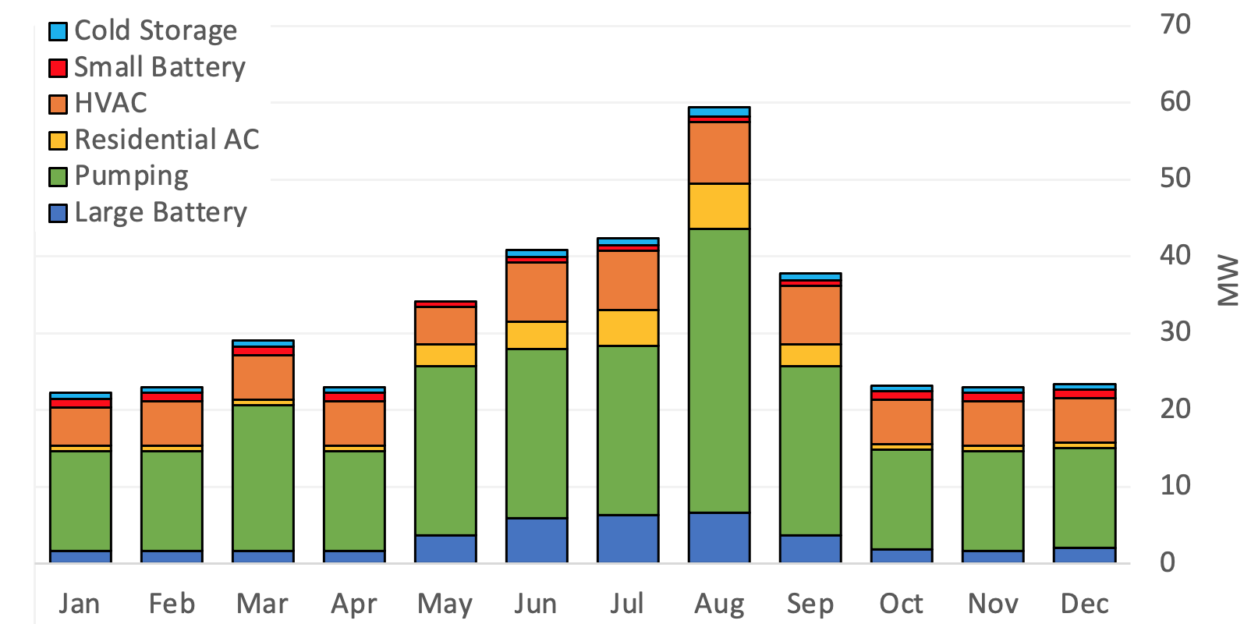
Full Resource Potential by Month

Slide 6
Ex-ante Analysis
What are the predicted load impacts for 2022-32?
Temperature-dependent loads: non-res HVAC, res AC
  Fit mixed-effects regression models to hourly loads
  Use coefficients to estimate per-meter loads and baselines by temperature scenario
    1-in-2 = Typical future weather scenario*
    1-in-10 = Extreme future weather scenario*
Non-temperature-dependent loads
  Assume per-meter load impacts do not change with the weather scenario
Use Leap’s enrollment forecasts to estimate the 2023-2025 resource
  By subLAP
  By load type
* The CAISO and utilities use different sets of future weather scenarios for a total of 4 scenarios
Notes:
For each month of 2023-2032, the evaluation team estimated ex-ante load impacts for typical days (1-in-2) and peak days (1-in-10). To enable regression model convergence, meters were split into two subgroups according to monthly mean diurnal load shape – one group resembling a hill shape and the other a valley shape – and separate linear regression models were applied to each.
For each group, the model incorporates independent variables representing outdoor temperature, sub-LAP, year, and site characteristics. The resulting coefficients are used to predict future per-meter event impacts for the peak day of each month for two standard weather years, corresponding to conditions that are expected to lead to peak electric load in either one out of every two years (1-in-2), or one out of every ten years (1-in-10). Because there is a slight difference in the conditions that cause peak load for the CAISO and the IOUs, four sets of ex-ante load impacts are presented: CAISO 1-in-2, CAISO 1-in-10, IOU 1-in-2, and IOU 1-in-10.
For each month, load type, and sub-LAP, the model-predicted per-meter load impacts are then multiplied by the projected number of participants according to Leap’s low, medium, and high growth forecast values to project the aggregate load impact for the next three years. The ex-ante predictions are made for the first four hours of the 4-9 PM RA event window, referred to as the Qualifying Capacity window, or QC window.
The ex-ante analysis has the following steps:
Fit a mixed-effects model to temperature-dependent meter data. For each temperature-dependent load type and month, we quantify the relationship between the hourly meter data and available explanatory variables by developing a best-fit mixed-effects model. To improve model fit, Non-residential HVAC loads are divided into two groups according to diurnal load shape: those that are more bell shaped, and those that are more U- or V-shaped. Summer models are built with CDH and CDD weather variables, while winter models are built with HDH and HDD weather variables. The model specifications used in this analysis are provided below.
Forecast per-meter baseline load shapes for typical and extreme weather scenarios. For each temperature-dependent load type, the model coefficients from step 1 are used to predict hourly baseline loads and impacts as a function of temperature for the required CAISO and IOU peak temperature scenarios.
Forecast total DR resource for each load type from 2023 through 2032. For each temperature-dependent load type, predicted impacts are calculated as the product of the load impacts from Step 2 and Leap’s participation forecasts for each load type from 2023 through 2025. Impacts for load types that are not temperature dependent are calculated as the product of the 2021 ex-post per meter impacts and Leap’s participation forecasts for each load type from 2023 through 2025. Ex-ante forecasts beyond 2025 are held constant at 2025 values.
Note that ex-ante predictions presented in this report are based on temperature averages computed across meters in each load type, while values in the Ex-ante Table Generator are based on temperature averages that are computed across meters in each subLAP. This results in modest difference in results between the values presented here and those presented in the Table Generators.

Slide 7
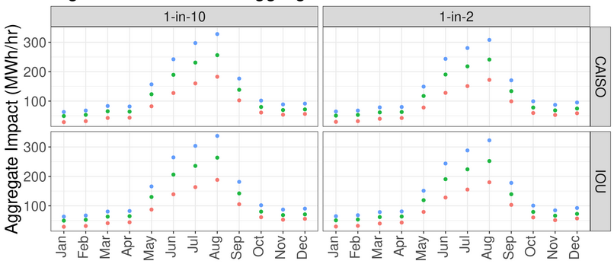
Ex-ante Results by Weather Profile
●2023 ● 2024 ● 2025-2032
Note: Estimates shown are based on Leap’s estimates for “moderate” participation growth

Slide 8
Ex-ante Results by SubLAP
Predicted IOU 1-in-2 August 2023-2032 QC by subLAP
Year(s) | PGCC | PGEB | PGF1 | PGFG | PGKN | PGNB | PGNP | PGP2 | PG SB | PGSF | PGSI | PGST | PGZP | SC EC | SC EN | SC EW | SCHD | SC NW | SD G1
2023 | 0.1 | 0.7 | 1.4 | 0.3 | 1.1 | 0.3 | 0.9 | 0.7 | 1.2 | 1.6 | 0.3 | 0.4 | 0.2 | 18 | 1.5 | 2.9 | 2.0 | 0.8 | 98
2024 | 0.2 | 0.9 | 1.8 | 0.3 | 1.4 | 0.4 | 1.1 | 0.9 | 1.5 | 2.1 | 0.4 | 0.5 | 0.2 | 22 | 1.9 | 3.6 | 2.5 | 1.0 | 146
2025-2032 | 0.2 | 1.2 | 2.2 | 0.4 | 1.8 | 0.5 | 1.4 | 1.1 | 2.0 | 2.6 | 0.5 | 0.7 | 0.3 | 28 | 2.4 | 4.6 | 3.1 | 1.2 | 185

Slide 9
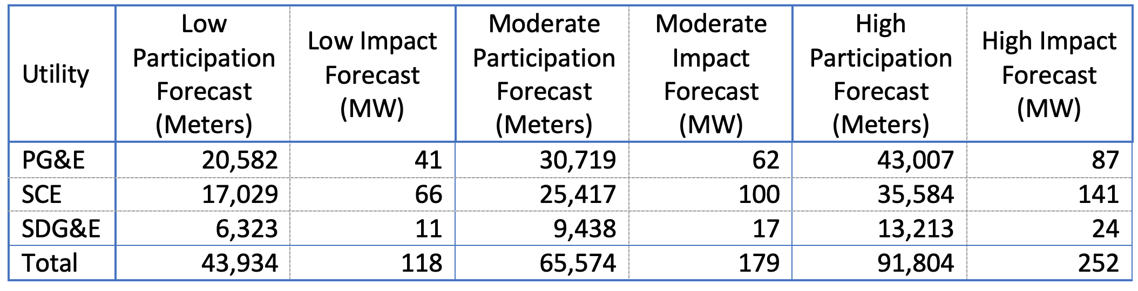
Leap’s 2023 Qualifying Capacity Values
IOU 1-in-2 Weather Conditions (August)

Slide 10
Recommendations
Program recommendations
  Expand efforts to understand which meters are not performing and why
  Develop educational materials to help low-performing partners improve their response
  Expand efforts to maximize performance during quarterly full resource tests
Protocol / evaluation recommendations
  Develop a standard protocol for estimating the “full” ex-post resource
    Different subsets of meters are dispatched for each event
  Develop a standard protocol for baseline methods
    At a minimum, protocols should require meter-specific baselines for heterogeneous loads
  Develop standard protocols for reducing error in load impact estimates

