Slide 1


Load Impact Evaluation:
PG&E’s SmartACTM Program
Xueting (Sherry) Wang
Corey Lott
Christensen Associates Energy Consulting
DRMEC Spring Workshop
May 3-4, 2022

Slide 2
Presentation Outline
Program Description
Ex-post Methodology
Ex-post Load Impacts
Ex-ante Methodology
Enrollment Forecast
Ex-ante Load Impacts
Recommendations

Slide 3
1. SmartACTM Program Description
Direct load control AC cycling program for residential customers
Participants receive one-time incentive, can opt-out of events
SmartAC integrated into CAISO wholesale market in PY2018
Events up to 6 hours per day (May – October)
Sub-LAP Events: all customers within a sub-LAP called
Serial Number Events: random sample of full territory
83,000 enrolled (May 2021), 8,000 dually enrolled SmartRate™
The CPUC approved swap out of all remaining one-way devices for two-way devices by 2024 (D.21-12-015)
Notes:
Customers either have a programmable communicating thermostat, one-way switch, or a two-way switch installed on their AC unit that allows PG&E to send a signal to their device to cycle the AC unit for 50% of the compressor run-time during each half-hour.
When SmartAC was integrated into CAISO wholesale market in 2018, sub-LAP events became a source of value to PG&E from CAISO market awards. Most events currently called for the program are sub-LAP events.
2 distinct types of events called:
1) Sub-LAP events (Sub-load Aggregation Point) call all customers within a called sub-LAP area.
Matched control group of non-SAC customers
2) Serial number events select customers from throughout service territory based on factory programmed serial number.
Works as a random sample so that SmartAC customers who are not called can serve as the control group
SmartAC customers not called for the event reside in other sub-LAPs
Rely on sub-LAP addressing after device installation, which is less reliable than factory programmed addressing.
CAISO market awards
System or local area emergencies for PG&E capacity
Limited testing for a maximum of 100 hours per summer

Slide 4
2. Ex-post Methodology
For sub-LAP events: matched control group + difference-in-differences
Two-Stages of Matching:
3-to-1 matching using all potential control customers
  Nearest neighbor matching on average monthly usage, weather station, CDD60, CARE, NEM, dwelling type, AC usage level, rate schedule
1-to-1 matching on selected controls from first stage
  Propensity score matching using interval load data for non-event day loads, CARE, NEM, dwelling type, and AC usage level
  Matches segmented by sub-LAP
  Two 24-hour average load profiles used for matching: hot days (top 10%) and a selection of cooler days (25th to 50th percentile)
For serial event on 7/9
  Sub-LAPs with double events – same method as sub-LAP events
  Serial event only sub-LAPs: withheld serial group 0 serves as control
Notes:
Don’t go into too much detail, same methodology as last 3 evaluations
Matched controls are as similar as possible to treatment customers in terms of their characteristics and hourly load profiles
Differences-in-differences further controls for remaining differences between treatment and control customers
PSM: Predict probability of customer being assigned treatment based on observable characteristics.
Find control and treatment that have similar predicted probabilities
Matching on propensity score guarantees a similar distribution across customer characteristics in the control group.
2-24 hour load profiles takes into account weather sensitivity of treatment and control
For sub-LAPs having serial event only:
Withheld serial group (group 0) serves as a randomly determined control group.
Use difference-in-differences and non-event days in regression to control for any remaining differences between treatment and control group
For sub-LAPs having both sub-LAP and serial events:
The method is the same as sub-LAP event load impacts estimation.

Slide 5
3. Ex-post Load Impacts: Events
Notes:
8 event days
2 event days are also SmartRate event days including the serial event day
Variation in hours called within same event for different sub-LAPs on 2 event days
Partial event hours on 7/9
For SmartAC-SmartRate dual events, we do not include dually enrolled customers in the number of called customers or the estimated load impacts
To prevent double counting as these customers’ load impacts are typically attributed to SmartRate program

Slide 6
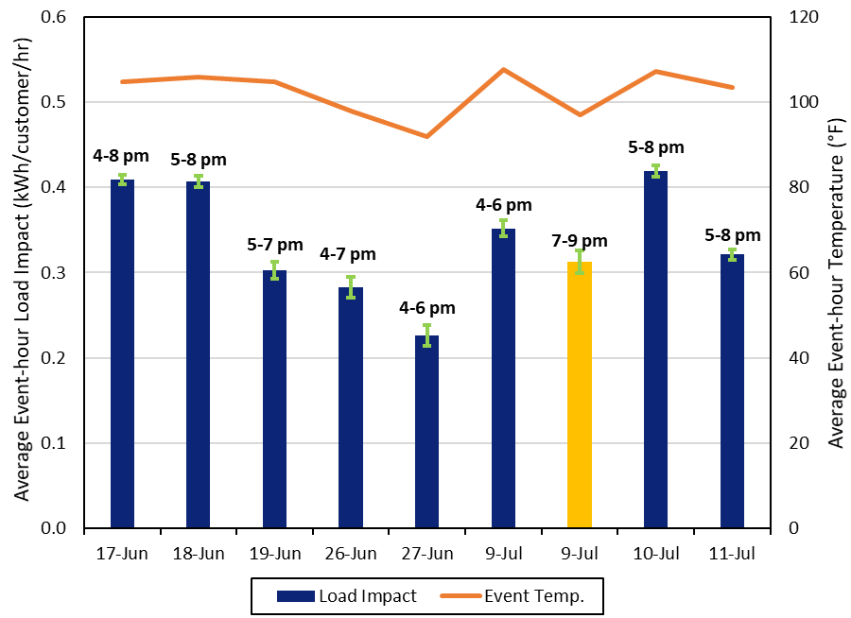
3. Ex-post Load Impacts
Average Event-Hour Load Impacts by Event
Overall: 0.23 - 0.42 kWh/customer/ hour
Drivers of variation: sub-LAPs called, event temperatures, hours of the day
Serial event load impact lower than previous years (low temperature for many sub-LAPs, late hours, 2 events in a row for 4 sub-LAPs)
Notes:
Results do not include partial event hours
Gold bar = serial group event
Blue bars = sub-LAP events
The green bands correspond to 80 percent confidence intervals around these estimates (i.e., the 10th and 90th percentile scenarios from the uncertainty-adjusted load impacts)
Lower load impacts correspond to cooler temperatures
The majority of events in 2021 were weekend events (6/19, 6/26, 6,27, 7/10, 7/11)
The sub-LAPs that were only called for a serial event on 7/9 had low temperatures
The sub-LAPs called for 2 events on 7/9 had high temperatures, but serial event was 4th and 5th hour of 5 consecutive hours of events
Late event hours are associated with temperature drop-offs

Slide 7
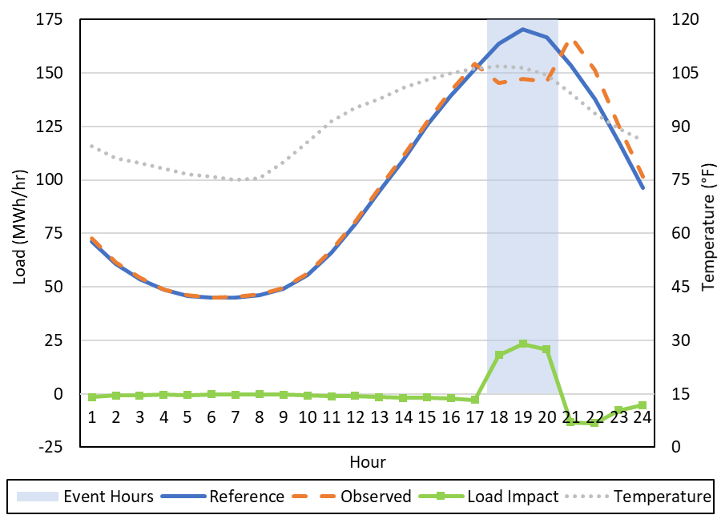
3. Ex-post Load Impacts
Hourly Load Impacts for sub-LAP event on June 18, 2021
51,053 customers called
5-8 p.m.
Peak of 23.4 MWh/hour during hour 2 of event (6-7 p.m.)
Average per-customer load impact 0.42 kWh/customer/hr
Notes:
Skip this slide if running low on time
Blue Line: Aggregate Hourly Reference loads
Orange Line: Aggregate Hourly Observed Load
Green: Line: Estimated Aggregate Hourly Load Impacts
Grey Line: Average Hourly Temperature
Reference Loads = Observed Load + Estimated Load Impact
Use treatments’ own loads to estimate what reference loads would have been
Post-event snapback peaks at 13.3 MWh/hour

Slide 8
3. Ex-post Load Impacts
PY2020 vs. PY2021
About 6,500 fewer customers were dispatched (Program attrition)
Comparable average load impact despite higher temperature (lower performance due to aging devices)
Average reference load is lower in PY2021 despite higher temperature (diminished shelter-in-place effect)
Comparable Load Impact
Higher Load Impact in 2021
Lower Load Impact in 2021
Notes:
Overall, comparable per-customer load impacts despite higher temperatures in 2021 reflects a continuing trend toward lower per-customer load impacts due to aging devices.
Worsening SmartAC™ program performance is consistent with the ex-post results comparisons in the last several evaluations, suggesting that aging devices continue to dampen load impacts.
Average event hour temperature is lower in PY2020, but the reference loads are higher due to the SIP orders from the pandemic. Since reference loads are lower in PY2021, we do not apply SIP adjustments to the ex-ante forecast in PY2021.
Green: Comparable load impacts in PY2020 and 2021
Blue: Higher load impact in PY2021
Pink: Lower load impact in PY2021

Slide 9
3. Ex-post Load Impacts
PY2020 Ex-Ante vs. PY2021 Ex-Post
Lower Load Impact and Higher Temperature in 2021
Higher Load Impact and Higher Temperature in 2021
Lower Load Impact and Lower Temperature in 2021
Limitations: ex-post are sub-LAP events while ex-ante forecast at LCA level
Most differences in per-customer load impacts explained by temperature differences
Notes:
We use LCA-level results from the appropriate peak month of the ex-ante forecast of PG&E 1-in-10 scenario from PY2020 and create average impacts for the LCAs associated with at least one sub-LAP called for the event.
The per-customer load impacts are roughly comparable with the forecast.
Blue highlight:
Several events had higher temperatures than the PG&E 1-in-10 scenarios (6/17, 6/18 and 7/10), so the per-customer load impacts were higher than forecasted.
Pink highlight:
Some ex-post load impacts are lower due to lower temperatures (6/26, 6/27)
Grey highlight:
On 6/19, 7/9, 7/11 the ex-post load impacts are slightly lower despite higher temperatures.

Slide 10
3. Ex-post Load Impacts: Device Type
Average Event-Hour Load Impacts by Device Type across Sub-LAP Events
Two-way devices have higher per customer and percent load impacts than one-way devices
Only 14 percent of SmartAC™ customers had two-way devices during PY2021
Swap-out of one-way devices in 2022-2023 will improve SmartAC™ program performance
Reference loads are higher for two-way device customers (previous device swap-outs targeted high AC users in hotter regions)
Notes:
Per-customer load impacts for two-way devices were nearly twice as high as one-way devices (0.59 compared to 0.34 kWh/customer/hour)
This is consistent with previous evaluations and shows the impact of aging one-way devices
The fact that only 14 percent of devices were two-way devices in 2021 means that over 60,000 one-way devices will need to be swapped out over the next two years
Thus far, PG&E has targeted customers with high levels of AC usage for device replacement, leading to the higher reference loads for two-way customers
As I will describe in the next slides, the ex-ante forecast accounts for a transition from one-way devices to two-way devices for SmartAC™ customers
We do not estimate separate ex-ante reference loads for one-way and two-way devices, because we do not expect the transition to all two-way devices to impact average customer reference loads
The ex-ante forecast does account for differences in load impacts between device types.

Slide 11
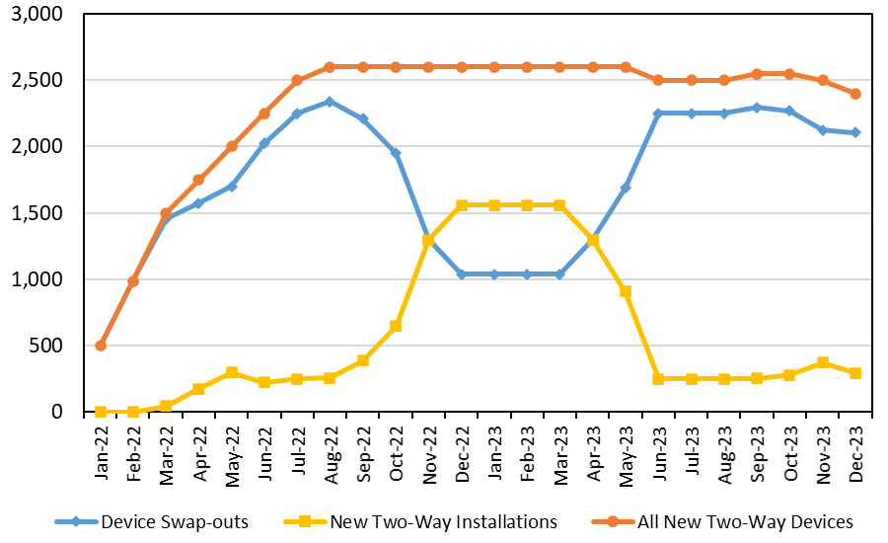
4. Ex-ante Methodology
Forecast methodology accounts for device swap-outs
  Ex-ante forecast incorporates device swap-outs (PG&E assumptions)
  Swap-outs completed by 2024
  Separate load impact estimates for one-way and two-way devices
  Increased marketing efforts to counteract annual program attrition
    10.6 percent attrition
    7,000 new customers
    Overall 1 percent increase
Notes:
PG&E will install approximately 2,600 two-way devices per month between summer 2022 and the end of 2023
PG&E will concentrate on new customer recruitment during the winter months and replacing existing one-way devices during the summer months

Slide 12
4. Ex-ante Methodology (2)
Per customer load impacts were developed separately for one-way and two-way devices using:
  Parameters obtained from regressions of per-customer load impacts as a function of weather, hour, sub-LAP and serial event indicator
  Ex-ante weather data and day-type characteristics (e.g., temperatures on a CAISO 1-in-2 August peak day)
Load impacts by device-type are combined based on the relative share of two-way devices reflected in the enrollment forecast from PG&E
Reference loads were developed for each month, sub-LAP, and enrollment segment (SmartAC-only and dually enrolled) using:
  Non-event days: Non-holiday weekdays
  Parameters obtained from regressions of per-customer hourly usage as a function of weather (CDD60) and load shape variables
  Ex-ante weather data and day-type characteristics
Notes:
Ex-ante load impacts simulate a sub-LAP event, same as 2020
Dually enrolled customers and smartAC only customers are assumed to have the same load impacts for one-way and two-way devices.
Load impact regression:
use level-load impacts instead of percent load impacts (used in previous evaluations)
interaction of mean17 and hr16-21
sublap indicators allow load impacts to vary by region
use load impacts from 2020 and 2021
serial events included, indicator variable
separate regression for one-way and two-way customer load impacts
post-event snapback as a percentage of load impacts during event hours
Reference load regression: hour day of week month interaction of cdd60 and hour interaction of Monday and hour interaction of Friday and hour (separate for smartAC only and dually enrolled)

Slide 13
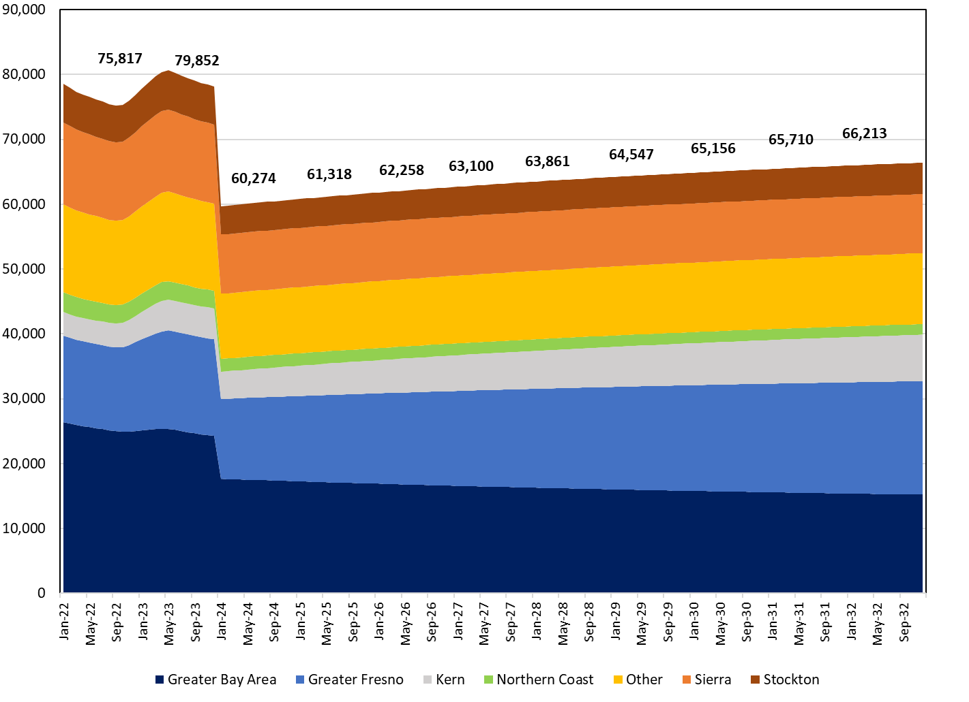
5. Enrollment Forecast
Enrollment Forecast by LCA (2022-2032)
Enrollments decline in 2022 and increase by the end of 2022 (increased marketing efforts)
Assume 20,000 customers with one-way devices will be de-enrolled in January 2024 (share of customers that do not consent to device swap-out)
Enrollments increase by 1 percent per year between 2024 and 2032.
Heterogeneity across LCAs (increases in Central Valley areas)
Notes:
The initial decline in enrollments in 2022 is driven by the time it takes for PG&E to ramp up device swap-outs, as previously shown
PG&E assumes that approximately 20,000 customers with one-way devices will not consent to a device swap-out. This assumption is based on past customer retention rates during device swap-outs
To mitigate some of this customer attrition, PG&E will offer a one-time incentive of $25 for customers to swap out their one-way device for a two-way device so long as they are enrolled at the time of the upgrade (D.21-12-015)
PG&E will keep the 20,000 customers in the program until 2024, at which point the one-way technology will no longer be supported
PG&E will concentrate marketing efforts in certain LCAs in the Central Valley region
Greater Bay Area and Northern Coast will have the biggest declines of over 40 percent between 2022 and 2032.
The largest increases in enrollments will occur in Greater Fresno and Kern with an increase of 32 percent and 96 percent between 2022 and 2032, respectively.
Moreover, dually enrolled customers, which are not depicted here, are expected to remain relatively constant over time aside from a large decline of over 30 percent in January 2024.

Slide 14
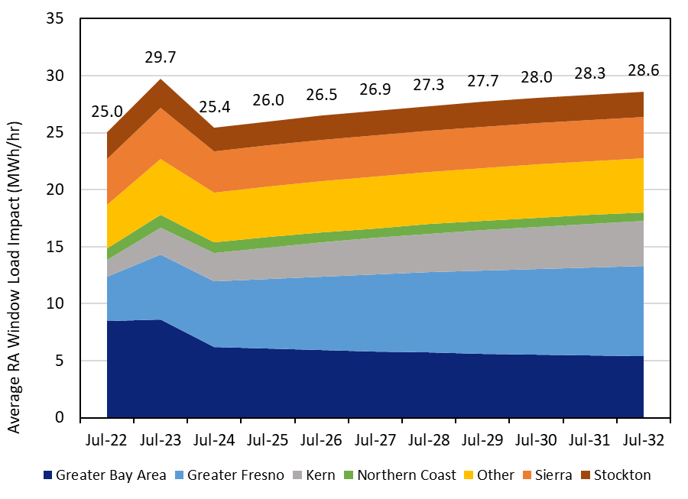
6. Ex-ante Load Impacts
Aggregate Load Impacts by LCA, Average Event Hour (4-9 p.m.)
PG&E 1-in-2 July Peak Scenario (2022-2032)
Aggregate load impacts increase from July 2022 to 2023 (4,000 additional customers, two-way devices)
Aggregate load impacts decrease from July 2023 to 2024 (20,000 customers de-enrolled)
Aggregate load impacts increase from 2024 to 2032 (increased marketing efforts)
Notes:
PG&E assumes that approximately 20,000 customers with one-way devices will not consent to a device swap-out. This assumption is based on past customer retention rates during device swap-outs.
To mitigate some of this customer attrition, PG&E will offer a one-time incentive of $25 for customers to swap out their one-way device for a two-way device so long as they are enrolled at the time of the upgrade (D.21-12-015).

Slide 15
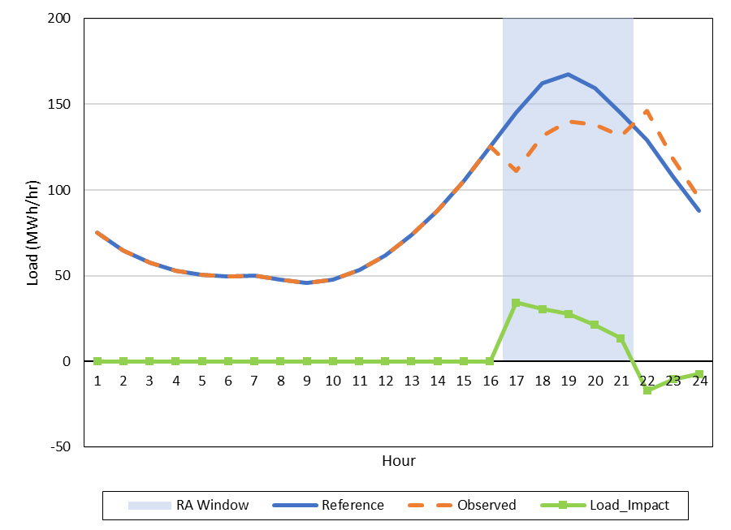
6. Ex-ante Load Impacts
2024 Aggregate Hourly Loads and Load Impacts for PG&E 1-in-2 July Peak Day: All SmartAC™ customers
Aggregate load impacts peak in the first hour of the resource adequacy (RA) window
Average RA window load impact: 25.4 MWh/hour
Percent Load Impact:
16% of reference load
Notes:
Skip if low on time
Use 2024 because device-swapout is completed.
We calculate post-event snapback as a percentage of load impacts during event hours
PY2021: Forecasted enrollment number in July 2024: 60,274
PY2020: Forecasted enrollment number in July 2024: 55,372

Slide 16
6. Ex-ante Load Impacts
PY2021 Ex-Post vs. PY2021 Ex-Ante
Compare ex-post load impacts with PG&E 1-in-10 scenario
Use ex-ante results for the eight sub-LAPs that were called for sub-LAP events in 2021
Higher per-customer load impacts in 2022 and 2024 due to device swap-outs and shift in customer composition to Central Valley
Notes:
We use the ex-ante results for the eight sub-LAPs that were called for sub-LAP events in 2021
Compares the ex-post load impacts from the sub-LAP events in 2021 by device type to the ex-ante load impact forecast for a July peak day with PG&E 1-in-10 weather conditions in 2022 and 2024
29 percent of devices will be two-way devices in July 2022 compared to 14 percent in 2021
The per-customer load impacts are higher in 2024 than the two-way customer ex-post load impacts due to a shift in program customer composition toward hotter sub-LAPs in the Central Valley that have higher per-customer load impacts
Per-customer reference loads are comparable to current customer mix in 2022, but are higher in 2024 reflecting the shift in customer composition toward Central Valley

Slide 17
6. Ex-ante Load Impacts
PY2020 vs. PY2021
Per-customer and percent load impacts are higher in PY2021 forecast due to device swap-outs and shifts of enrollments to hotter regions
Increased enrollments leads to higher aggregate load impacts in 2022 and 2024 compared to previous forecast
Notes:
PG&E 1-in-2 July Peak Day
The lower per-customer reference loads are indicative of diminished SIP effects observed in SmartAC™ customer loads in 2021 (2021 observed loads form the basis of the ex-ante reference loads)
Although SIP adjustments were made in the PY2020 forecast, observed loads have declined faster than the SIP adjustments assumed in PY2020 and are similar to pre-pandemic levels. As a result, PG&E has decided not to make further SIP adjustments in the PY2021 forecast.
The aggregate load impacts in PY2021 forecast are 38 percent higher in 2022 and 81 percent higher in 2024 that the PY2020 forecast
PG&E’s enrollment forecast shifting customer composition toward hotter LCAs, which explains the increase in per-customer reference loads between 2022 and 2024

Slide 18
7. Recommendations
Continue to have some system-wide or serial events called in isolation going forward for the purpose of load impact estimation
Dispatch events over a variety of temperatures to produce more robust forecast models
Notes:
Since the same sub-LAPs seem to receive CAISO market awards, other sub-LAPs have fewer events
System-wide events allow load impacts to be estimated for all sub-LAPs
A cleaner estimation can be done if the test event is not called in combination with other sub-LAP events on the same day
A wider variety of event temperatures will help to make in-sample forecasts. The ex-post event temperatures in the recent several evaluations exceed the temperatures in the weather scenarios

Slide 19
Questions?
Contact
Corey Lott: cjlott@caenergy.com
Sherry Wang: swang@caenergy.com
Dan Hansen: dghansen@caenergy.com
Christensen Associates Energy Consulting
Madison, Wisconsin
608-231-2266

