Slide 1


Load Impact Evaluation:
Base Interruptible Program
Mike Clark
Michael Vigdor
Dan Hansen
Christensen Associates Energy Consulting
DRMEC Spring Workshop
May 2022

Slide 2
Presentation Outline
Program Description
Ex-post Methodology
Ex-post Load Impacts
Ex-ante Methodology
Enrollment Forecast
Ex-ante Load Impacts

Slide 3
1. BIP Program Description
Emergency DR program for non-residential customers, events triggered by CAISO or local system emergencies
Customers receive a monthly capacity credit in exchange for a commitment to reduce energy consumption to their Firm Service Level (FSL)
  The FSL represents the customer’s minimal operational requirements
15, 20, or 30-minute notice of events
Failure to reduce load to the FSL can result in:
  excess energy charges,
  an increase in the FSL (& commensurate reduction in capacity credits),
  re-test events,
  or de-enrollment from the program
Program specifics vary by utility

Slide 4




2. Ex-post Methodology
Individual regressions were used to estimate BIP ex-post load impacts
This method was chosen for two reasons:
  Difficulty in finding adequate control-group customers
  Some customers have volatile loads, so even customers that match reasonably well on average may not have a comparable load on a specific day
Customer-specific specification search conducted to:
  Determine if each customer has a weather-sensitive load
  Find the best fitting weather and shape variables by groups defined by weather sensitivity and industry group

Slide 5
2. Ex-post Methodology (2)
BIP load impacts generally do not change significantly with temperatures because the biggest responders do not have weather-sensitive loads
However, there are weather-sensitive customers in BIP that cause the program reference load to change somewhat with temperatures
Separate weekday versus weekend regression specifications are used, when applicable
  In 2021, there were no weekend events called

Slide 6
3. Ex-post Load Impacts:
Events
Date | Day of Week | PG&E | SCE | SDG&E
6/17/2021 | Thursday |  |  | Temp. & Sys. Load 6:00 - 8:00 p.m.
7/9/2021 | Friday | Transmission Emergency 6:32 -8:32 p.m. | Reliability 5:50 – 8:53 p.m.
PG&E Event on 7/9/2021
  68 Customers were called one hour late to the PG&E event
  Around 7:30 p.m. start time

Slide 7
3. Ex-post Load Impacts:
Events (2)
Utility | Hours of Availability | Hours of Actual Use | No. of Available Dispatches | No. of Actual Dispatches
PG&E | 180 / year 6 / day | 2 | 10 / month 1 / day | 1
SCE | 180 / year 6 / day | 3.05 | 10 / month 1 / day | 1
SDG&E | 120 / year 4 / day | 2 | 10 / month | 1

Slide 8
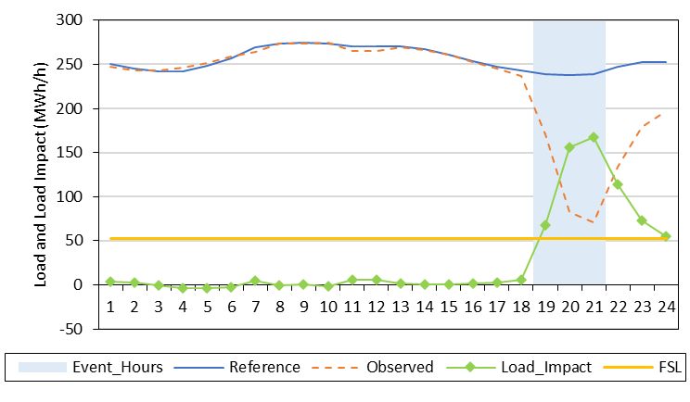
3. Ex-post Load Impacts:
PG&E July 9th Event Day
Event from 6:32 to 8:32 p.m.
310 customers enrolled
293 customers called
Ref. Load = 238 MW (239)
Load Impact = 155 MW (174)
% Load Impact = 65% (73%)
FSL = 53 MW (53)
FSL Achievement = 84% (94%)
Top 15 responders account for 60% of the total load impact
Notes:
There was only one event day in 2021
Impacts are summarized over the sole full event hour (HE 20)
( ) = Accounting for late notification (full effects described on next slide)

Slide 9
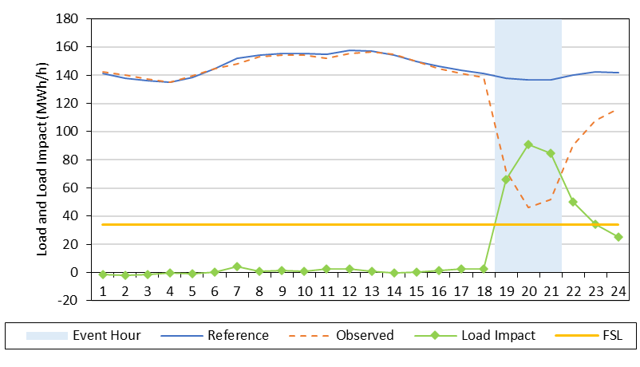
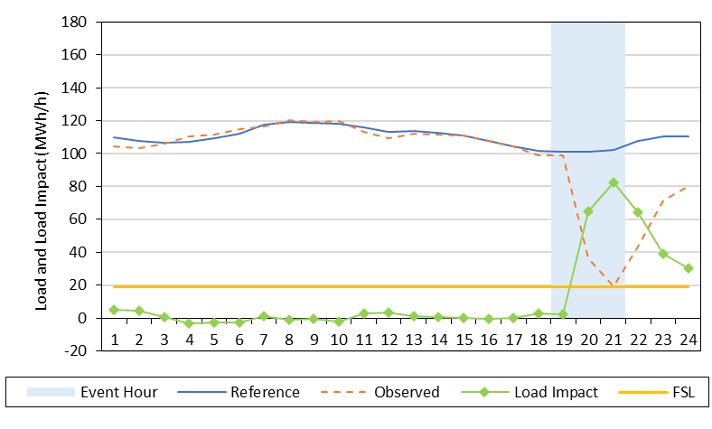
3. Ex-post Load Impacts:
PG&E Late Notification
Regular Notification
Late Notification
68 customers were called one hour late
Response from late notification customers begins almost exactly one hour late
We do not change any estimation of ex-post load impacts which leads to slightly lower results
= Used for Ex-Ante
= Ex-Post full hour
= Ex-Post partial hour

Slide 10
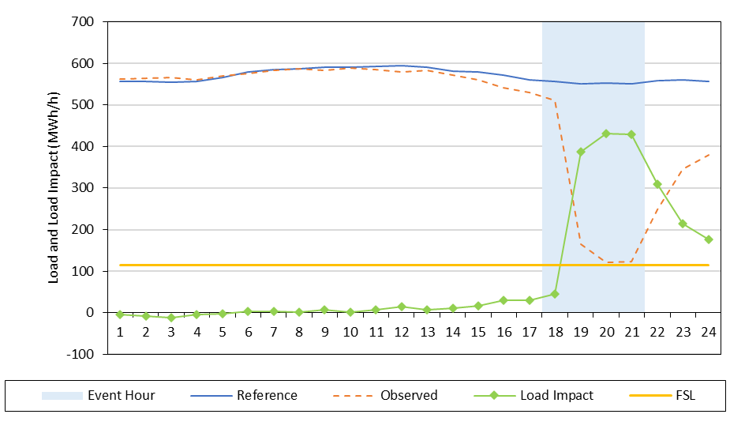
3. Ex-post Load Impacts:
SCE July 9th Event Day
Event from 5:50 to 8:53 p.m.
344 customers enrolled
344 customers called
Ref. Load = 551 MW
Load Impact = 409 MW
% Load Impact = 74%
FSL = 115 MW
FSL Achievement = 94%
Top 15 responders account for 54% of the total load impact
Notes:
There was only one event day in 2021
Impacts are summarized over full event hours (HE 19 and 20)

Slide 11
3. Ex-post Load Impacts:
SDG&E June 17th Day
SDG&E only had one customer called on the 2021 event day
Results are confidential to protect sensitive customer-level data
  This includes ex-ante forecasts which are built using 2021 ex-post results

Slide 12
4. Ex-ante Methodology
Customers who have left BIP are not included
Reference loads are simulated using the following:
  Customer-specific regressions to obtain effect of weather and time-period indicators on usage
  Ex-ante day types and weather conditions
  (e.g., August peak month day in a utility-specific 1-in-2 weather year)
  Biggest responders do not tend to have weather-sensitive loads
Ex-ante load impacts are based on the most recent full or test / M&E event day for which customer’s reference load was above their FSL, by customer

Slide 13
4. Ex-ante Methodology (2)
Each customer’s ex-ante load impact is set to its ex-post FSL achievement rate:
  Ex-post Achievement = Ex-post Load Impact / (Ref. – FSL)
  Ex-ante Impact = Ex-post Achievement x (Ref. – FSL)
Additional Details
Load impact is zero if FSL is above the reference load
Customers who have joined BIP are assigned the program-level FSL achievement rate (applied to their own reference loads and FSL, if available)
Load impacts display little to no relationship with weather conditions
Note: Example is provided for aggregate load; actual methodology is done at the per-customer level.

Slide 14
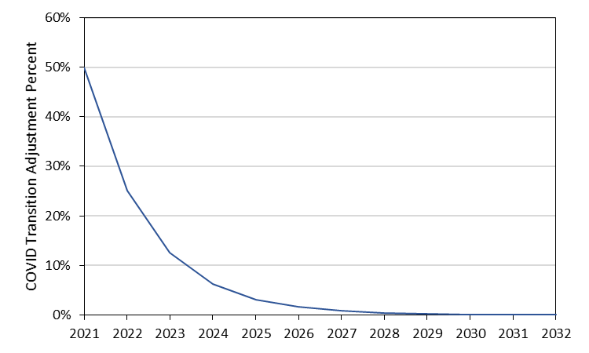
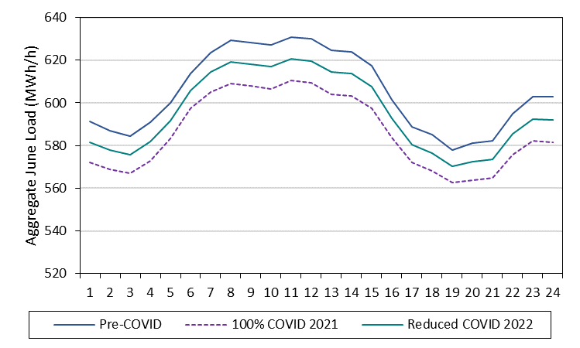
4. Ex-ante Methodology (3)
Reference loads are adjusted for COVID
  Estimate hourly per-customer COVID effects via regressions
  Make assumption regarding COVID transition period
  Apply per-customer COVID effect to reference loads based on the transition period
SCE COVID Transition Period
June Aggregate Loads
Reduced Load due to COVID
SCE: 17 MW
PG&E: 0.9 MW
SDG&E: 0 MW
COVID adjustment for SCE is 17 MW during the RA window

Slide 15
5. Enrollment Forecast
The table below shows August enrollment in each year of the forecast
  PG&E forecasts increased enrollment
  SCE forecasts flat enrollment
  SDG&E forecasts flat enrollment
Utility | 2022 | 2023 | 2024 | 2025 | 2026 | 2027 | 2028 | 2029 | 2030 | 2031 | 2032
PG&E | 268 | 278 | 286 | 297 | 305 | 313 | 322 | 333 | 343 | 351 | 360
SCE 15-min | 44 | 44 | 44 | 44 | 44 | 44 | 44 | 44 | 44 | 44 | 44
SCE 30-min | 297 | 297 | 297 | 297 | 297 | 297 | 297 | 297 | 297 | 297 | 297
SDG&E | 1 | 1 | 1 | 1 | 1 | 1 | 1 | 1 | 1 | 1 | 1

Slide 16
6. Ex-ante Load Impacts: by Year and Weather Scenario
Year | Weather | # SAIDs | Load Impact (MW) | Temp. (°F) | FSL (MW)
Aug. 2022 | PG&E 1-in-2 | 268 | 170 | 93 | 54
 | PG&E 1-in-10 |  | 170 | 96
Aug. 2032 | PG&E 1-in-2 | 360 | 227 | 93 | 72
 | PG&E 1-in-10 |  | 227 | 96
PG&E
Year | Weather | # SAIDs | Load Impact (MW) | Temp. (°F) | FSL (MW)
Aug. 2022 (25% COVID) | SCE 1-in-2 | 341 | 503 | 88 | 112
 | SCE 1-in-10 |  | 505 | 93
Aug. 2032 (0% COVID) | SCE 1-in-2 | 341 | 523 | 88 | 112
 | SCE 1-in-10 |  | 525 | 93
SCE

Slide 17
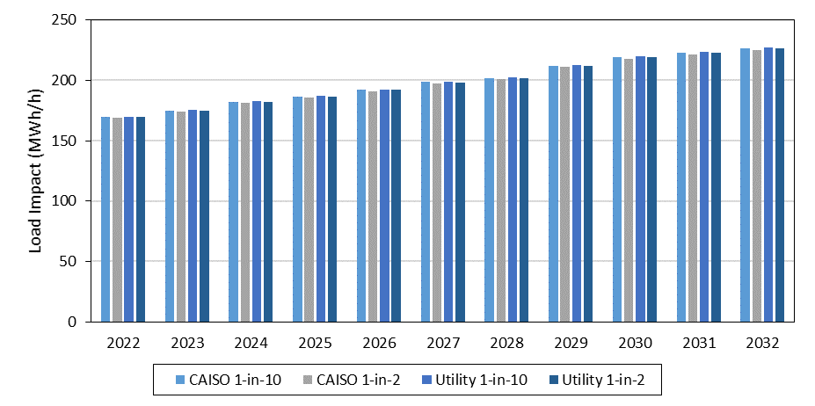
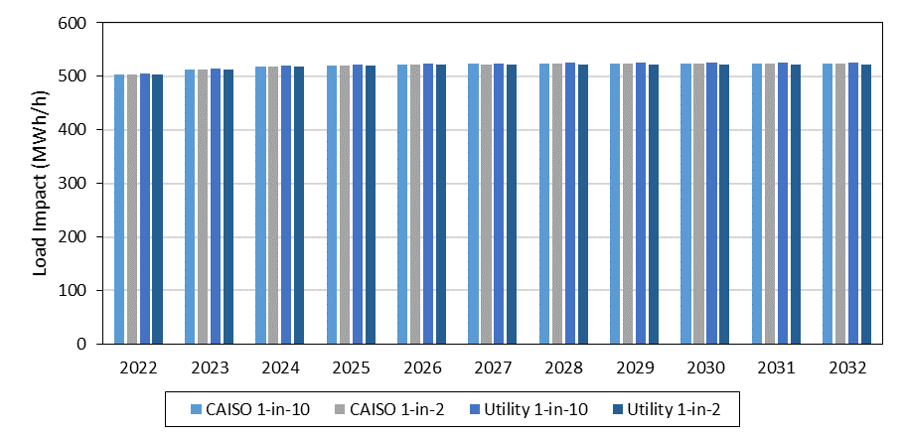
6. Ex-ante Load Impacts: by Year and Weather Scenario (2)
PG&E
SCE
Note: Aggregate load impacts above are for the month of August

Slide 18
6. Ex-ante Load Impacts:
PG&E Ex-post vs. Ex-ante
Ex-post / Ex-ante | Date / Scenario | # SAIDs | Reference Load (MW) | Load Impact (MW) | Temp. (°F) | FSL (MW) | FSL Achievement
Ex-post | July 9th Event | 293 | 238 | 155 | 96 | 53 | 84%
Ex-post | July 9th Event adjusted for late notification | 293 | 239 | 174 | 94 | 53 | 94%
Ex-ante | August 2022 Typical Event Day | 268 | 236 | 170 | 93 | 54 | 93%
Per-customer reference loads, load impacts, and FSL Achievement are higher in
ex-ante because of customers that remained on the program
Relaxing of COVID impact has a small, but nearly negligible positive impact on future reference loads
Total ex-ante LI and FSL Achievement is larger by assuming no late notifications, as there were in ex-post
Note: All ex-ante forecasts from this point forward reflect the utility-specific 1-in-2 peak day

Slide 19
6. Ex-ante Load Impacts:
PG&E, Previous vs. Current Typical Event Day 2022
When Created | # SAIDs | Aggregate |  |  | Per-customer
 |  | Reference Load (MW) | Load Impact (MW) | FSL (MW) | Reference Load (kW) | Load Impact (kW)
Following PY2020 (Previous) | 308 | 240 | 187 | 56 | 780 | 608
Following PY2021 (Current) | 268 | 236 | 170 | 54 | 881 | 633
Reference load and load impact decreased by 4 MW and 17 MW, respectively.
Factors include (arrows indicate direction of load impact):
  Enrollment forecast decreased by 40 customers
  Reference loads adjusted for COVID of remaining customers
  FSL decreased from 56 MW to 54 MW
  FSL Achievement Rate decreased from 102% to 94%
Per-customer reference load and load impacts higher
  COVID adjustment leads to higher reference loads
  Customers that remained are larger, on average.

Slide 20
6. Ex-ante Load Impacts:
SCE Ex-post vs. Ex-ante
Ex-post / Ex-ante | Date / Scenario | # SAIDs | Reference Load (MW) | Load Impact (MW) | Temp. (°F) | FSL (MW) | FSL Achievement
Ex-post | July 9th Event | 344 | 551 | 409 | 85 | 115 | 94%
Ex-ante | August 2022 Typical Event Day | 341 | 614 | 502 | 88 | 112 | 100%
Compositional Changes:
  Similar number of customers entering and leaving the program
  Customers who remained on the program are larger on average than those who left
Scaling leads to 8 MW of additional load impact
Relaxed COVID assumptions lead to 40 MW of additional load impact
Ex-ante per-customer reference loads and load impacts are higher than ex-post because July 9th had relatively low reference loads compared to similar days (about 15 MW lower in non-event hours)

Slide 21
6. Ex-ante Load Impacts:
SCE, Previous vs. Current Typical Event Day 2022
When Created | # SAIDs | Aggregate |  |  | Per-customer
 |  | Reference Load (MW) | Load Impact (MW) | FSL (MW) | Reference Load (kW) | Load Impact (kW)
Following PY2020 (Previous) | 359 | 653 | 510 | 112 | 1,818 | 1,421
Following PY2021 (Current) | 341 | 614 | 502 | 112 | 1,800 | 1,471
Reference load and load impact decreased by 39 MW and 8 MW, respectively.
Factors include (arrows indicate direction of load impact):
  Enrollment forecast decreased by 18 customers
  Similar COVID adjustment across years
  FSL remained at 112
  FSL Achievement Rate increased from 94% to 100%
Per-customer reference load and load impacts similar in size (slightly smaller)

Slide 22
Questions?
Contact
Mike Clark
Christensen Associates Energy Consulting
Madison, Wisconsin
  mtclark@CAEnergy.com
  (608) 216-7163
Michael Vigdor
Christensen Associates Energy Consulting
Madison, Wisconsin
  mjvigdor@CAEnergy.com
  (608) 231-2266

Slide 23
Load Impact Comparisons:
PG&E, previous Ex-post vs. current Ex-post
When Created | # SAIDs | Aggregate |  |  | Per-customer
 |  | Reference Load (MW) | Load Impact (MW) | FSL (MW) | Reference Load (kW) | Load Impact (kW)
Ex-Post, Previous | 494 | 294 | 202 | 76 | 595 | 408
Ex-Post, Current | 293 | 238 | 155 | 53 | 813 | 531
Ex-Post, Current Adjusted | 293 | 239 | 174 | 53 | 816 | 594
Reference load and load impact decreased by 56 MW and 57 MW, respectively.
Factors include (arrows indicate direction of load impact):
  Late notifications for 68 customers
  Fewer customers on the program
  FSL decreased from 76 MW to 53 MW
Per-customer reference load and load impacts higher
  COVID led to much smaller reference loads and impacts last year
  Customers that remained are larger, on average

Slide 24
Load Impact Comparisons:
PG&E, previous Ex-ante vs. current Ex-post
When Created | # SAIDs | Aggregate |  |  | Per-customer
 |  | Reference Load (MW) | Load Impact (MW) | FSL (MW) | Reference Load (kW) | Load Impact (kW)
Following PY2020 (Previous) | 308 | 234 | 183 | 56 | 761 | 593
Ex-Post, Current | 293 | 238 | 155 | 53 | 813 | 531
Ex-Post, Current Adjusted | 293 | 239 | 174 | 53 | 817 | 594
Reference load increased by 4 MW and load impact decreased by 28 MW.
Factors include (arrows indicate direction of load impact):
  Late notifications for 68 customers
  Fewer customers on the program
Per-customer reference load slightly higher, load impact lower
  Slightly larger customers called to the event on average
    17 non-called customers had lower usage than the program average
  Late notification customers decrease per customer load impact

Slide 25
Load Impact Comparisons:
SCE, previous Ex-post vs. current Ex-post
When Created | # SAIDs | Aggregate |  |  | Per-customer
 |  | Reference Load (MW) | Load Impact (MW) | FSL (MW) | Reference Load (kW) | Load Impact (kW)
Ex-Post, Previous | 469 | 640 | 484 | 105 | 1,366 | 1,032
Ex-Post, Current | 344 | 551 | 409 | 115 | 1,603 | 1,188
Reference load and load impact decreased by 89 MW and 75 MW, respectively.
Factors include (arrows indicate direction of load impact):
  Enrollment decreased by 125 customers
  FSL increased from 105 to 115
  FSL Achievement Rate increased from 94% to 100%
Per-customer reference load and load impacts increased
  Most customers who left were smaller on average

Slide 26
Load Impact Comparisons:
SCE, previous Ex-ante vs. current Ex-post
When Created | # SAIDs | Aggregate |  |  | Per-customer
 |  | Reference Load (MW) | Load Impact (MW) | FSL (MW) | Reference Load (kW) | Load Impact (kW)
Following PY2020 (Previous) | 351 | 627 | 488 | 109 | 1,786 | 1,391
Ex-Post, Current | 344 | 551 | 409 | 115 | 1,603 | 1,188
Reference load and load impact decreased by 79 MW and 76 MW, respectively.
Factors include (arrows indicate direction of load impact):
  Enrollment decreased by 15 customers
  Customers did not return to pre-COVID levels
  Unusually low event day reference loads
  FSL Achievement Rate increased from 94% to 100%
Per-customer reference load and load impacts lower

