Slide 1
Load Impact Protocols Simplification Workshop
Tuesday, August 8, 2023
1:30 p.m. – 5:00 p.m.

Slide 2
What Is this Workshop For and Why Now?
D.23-06-029 Conclusion of Law 17: “Energy Division should be authorized to pursue simplification of the current LIP requirements using a stakeholder process”
D.23-06-029, at 81: “Energy Division [staff are authorized]… to develop a proposal for Commission consideration… [and] establish a schedule for the process and the proposals.”
Notes:
Today, we are meeting in response to conclusion of law 17 from the June RA Decision D.23-06-029, which stated: “Energy Division should be authorized to pursue simplification of the current LIP requirements using a stakeholder process to develop a proposal for Commission consideration. Energy Division staff are authorized to establish a schedule for the process and the proposals.”

Slide 3
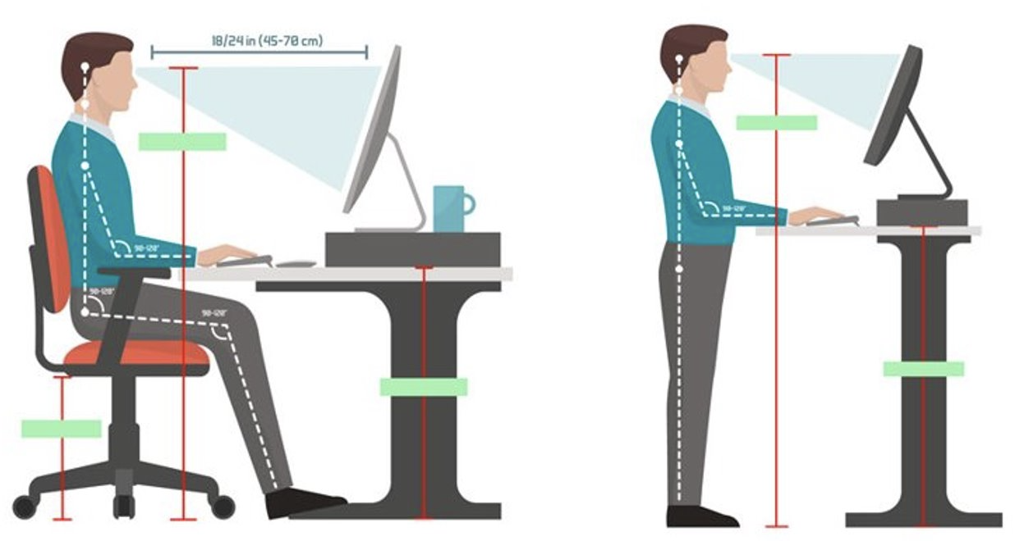
Logistics
Online and will be recorded
Today's presentations & recording will be uploaded onto DR Workshops website
https://www.cpuc.ca.gov/industries-and-topics/electrical-energy/electric-costs/demand-response-dr/demand-response-workshops
Host
  Andrew Magie (CPUC Staff)
Technical Support
  Jorge De Ocampo(CPUC IT) Jorge.DeOcampo@cpuc.ca.gov
Safety
  Note surroundings and emergency exits
  Ergonomic check
  Call 9-1-1 or use chat
Notes:
Some logistics before we begin

Slide 4
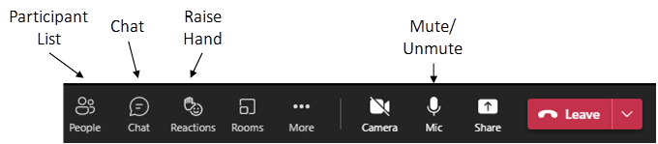
Logistics
Everyone is muted at the beginning of the workshop
To ask questions, please ‘raise your hand’ and unmute yourself when you have been called—you will have to do this each time you unmute.
  If you would rather type, use the “chat” function
Questions will be read aloud by staff; attendees may unmute to respond to the answer. (Reminder: Mute back!)

Slide 5
Ground Rules
Workshop is structured to allow the Stakeholders to present their ideas how to simplify the Load Impact Protocols processes and requirements
Keep questions friendly and respectful.
Please use chat feature only for questions or technical issues.
Do NOT start or respond to sidebar conversations in the Chat.
  You can send direct messages to people by right clicking on their name

Slide 6
Agenda
Welcome and Introductions | 1:30–1:40 p.m.
Load Impact Protocols Simplification Workshop
CPUC Energy Division | 1:40–1:55 p.m.
Q&A | 1:55–2:05 p.m.
2. OhmConnect & CEDMC | 2:05–2:50 p.m.
Q&A | 2:50–3:20 p.m.
10-Minute Break | 3:20–3:30 p.m.
3. SDG&E | 3:30–4:00 p.m.
Q&A | 4:00–4:15 p.m.
4. Enersponse | 4:15–4:25 p.m.
Q&A | 4:25–4:30 p.m.
5. Discussion/Q&A | 4:30–5:00 p.m.

Slide 7
Ongoing Issues with the Load Impact Protocols and Some Potential Solutions
Andrew Magie – Demand Response Section
Load Impact Protocols Simplification Workshop
August 8, 2023 | 1:30 – 5:00 PM

Slide 8

What are the Load Impact Protocols?
The Load Impact Protocols (LIPs) and the annual LIP filing requirements estimate ex-ante Qualifying Capacity (QC) and establish RA-eligible QC for DR resources.
  Adopted by D.08-04-050 (in 2008)
  D.19-06-026 started third party demand response providers’ LIP participation
  Designed for IOU DR programs
    Full program dispatches
    Control group data access
Notes:
So, what are the Load Impact Protocols?
The Load Impact Protocols (LIPs) and the LIP filing requirements estimate ex-ante Qualifying Capacity (QC) and establish RA-eligible QC for DR resources.
Established in 2008, all 27 protocols set a consistent method for measuring program performance across DR resources on ex-post basis and for forecasting anticipated performance (or available capacity) on ex-ante basis. Additionally, the resulting capacity estimates are used to analyze the cost-effectiveness of DR programs managed by the IOUs and for other CPUC activities such as the RA framework and long-term integrated resource planning.
The LIPs define the minimum data outputs needed to understand the impact of a DR resource and statistical measures to assist in determining the accuracy of these impact estimates. The LIPs allow flexibility on the part of the load impact evaluators to choose methodologies which are both feasible for and suitable to the type of DR activity or program being analyzed. The protocols allow the evaluators to define any additional purposes and needs of a particular evaluation beyond the minimum required data. To the extent appropriate, the protocols provide direction and guidance on what methods might be appropriate in different situations and raise issues that evaluators should consider when choosing their methods.
The protocols originally were designed with IOU DR programs in mind, as that was the only DR programs available in 2008. In 2016, D.16-06-045 gave third party demand response providers an exemption from the LIPs until 2019, where D.19-06-026 recognized the expiration of this exemption. Once the LIPs began to be applied to third party DRP portfolios, it has become increasingly clear how certain rigid requirements from the protocols themselves require superfluous and not useful data analysis and calculations in reference to the lack of control group data access the DRPs have and their CAISO market behavior.

Slide 9
General Issues with the LIPs
The LIPs are complex statistical analysis of ex post data to make ex ante projections. This analysis is oftentimes done by specialized evaluators/ consultant. The cost of contracting this work could be a burden on a DRP's finances.
  IOUs’ EM&V budgets are approved by the CPUC in DR Proceeding
The LIPs prescribe specific data requirements which are superfluous and not used by the CPUC/CEC in review of filings
The LIPS prescribe specific summary requirements which are not used by CPUC/CEC in review of filings
The timeline of the LIPs process (starting more than one year before the RA year) creates significant lag for rapidly growing DRPs and a barrier to develop new program designs or acquire participants

Slide 10
Protocol 2: Other Application for Load Impact Estimates
Protocol 2 calls out other potential applications for load impact estimates with additional requirements beyond RA QC. Some examples are:
  Forecasting DR resource impacts for operational dispatch by the CAISO;
  Ex post estimation of DR resource impacts for use in customer settlement; and
  Monthly reporting of progress towards DR resource goals.
These other applications are not utilized by CAISO or CPUC.

Slide 11
Protocols 6 & 20: Uncertainty Calculations
“Uncertainty” as value estimates in ex post and ex ante are convoluted and have questionable significance
  Protocol 6 requires “10th, 30th, 50th, 70th and 90th percentiles of the change in energy use in each hour, day and year… for each day-type and level of aggregation”
It is difficult to interpret uncertainty percentiles
  Are these estimating the “true” load reduction in ex post or “potential” load reduction in ex ante?
  Estimating statistical significance of load drop?
  Something else? Depends on evaluator
  Standard deviation or another variance variable may be more useful
Notes:
Uncertainty calculations at the 10th, 30th, 50th, 70th and 90th percentiles of the change in energy use in each hour, day and year… for each day-type and level of aggregation are required by protocol 6. These values in both the ex post and ex ante are convoluted and have questionable significance.
“Protocol 6 is designed to recognize the inherent uncertainty in impact estimates resulting both from the uncertainty in the estimation methods as well as uncertainty in underlying driving variables when ex ante estimation is required. “

Slide 12
Protocols 11-16: Non-Event Based Resources
Protocols 11-16 describe data and reporting requirements for non-event based resources, which third-party DRPs do not have. Because these requirements are not applicable, it should be stated these are not required for DR providers that do not have this resource type.

Slide 13
Superfluous Data Requirements
Protocol 5: “mean change in energy use per year… for the average across all participants and for the sum of all participants”
Protocol 8: “average event day over evaluation period”
Protocol 18 and 21: “mean change in energy use for the day shall also be estimated for each day type”
Protocol 19: “mean change in energy use per year shall be estimated… for the average… and for the sum of all participants… for each year over the forecast horizon”
Protocol 22: “information… shall be provided for each of the following day types…”
Notes:
Protocol 5 requires calculating “The mean change in energy use per year shall be reported for the average across all participants and for the sum of all participants on a DR resource option for each year over which the evaluation is conducted.” As DRP portfolios become increasingly diverse and IOU programs become technology agnostic, a mean value of participants is not very useful. It also ignores weather sensitivity that changes monthly throughout the year and the large size differences between customers in commercial and industrial portfolios.
Protocol 8 requires calculating the average event day. “An average event day is calculated as a day-weighted average of all event days. The number of event days that apply to each hour may vary for resource options that have variable length event periods.” DR portfolios that have regular small dispatches will artificially lower this average event value to make it meaningless, as there is no inherent reliability issue with dispatching DR resources in small quantities regularly. It also does not make sense to lower RA QC awards because of this bidding practice as long as the full resource is available during times of grid stress.
Protocol 18 requires calculating “The mean change in energy use per hour (kWh/hr) for each hour of the day shall be estimated for each day type and level of aggregation defined in Protocol 22. The mean change in energy use for the day shall also be estimated for each day type.” Protocol 21 also requires impact estimates by required day types. These day types should be changed to align with those required in recent RA decisions to be applicable for use in RA QC determinations.
Protocol 19 requires calculating “The mean change in energy use per month shall be estimated for non-event based resources and the mean change in energy use per year shall be estimated for both event and non-event based resources for the average across all participants and for the sum of all participants on a DR resource option for each year over the forecast horizon.” DRPs do not have non-event based resources, and calculating the mean change in energy use over the forecast horizon is not any more useful than protocol 5’s requirement of calculating for the current year.
Protocol 22 requires calculating typical event day, average weekday, and monthly system peak day in 1-in-2 and 1-in-10 weather scenarios. Typical event day is not a useful calculation for the same reason average event day is not useful. Monthly system peak day is not longer used by the Commission, as D.23-06-029 has redefined the required day type to “worst day” instead of “peak day.” Additionally, the CPUC only uses the 1-in-2 IOU weather scenarios for analysis and awards, and requiring 1-in-10 and CAISO weather scenario estimates quadruples the workload for evaluators calculating values that are unused. This protocol should only require worst day using 1-in-2 IOU weather scenarios to align with Commission policies and procedures.

Slide 14
Protocols 24-25: Inaccessible Data
Protocol 24: “The evaluation of a DR resource should identify correlations, synergies and overlaps across the set of DR resource options offered in a region or being proposed for a region. A judgmental determination of the impact of the magnitude of adjustment in program impacts should be made for all programs.”
  Requires access to customer data DRPs do not have: customer IOU/CCA electricity rate designs, control group, etc.
Protocol 25: details the requirements for using control groups and sampling methodologies.
Notes:
Protocol 24 requires the evaluator to identify “correlations, synergies and overlaps across the set of DR resource options offered in a region or being proposed for a region. A judgmental determination of the impact of the magnitude of adjustment in program impacts should be made for all programs.” This requires access to data the DRPs and their evaluators may not have. Whether a customer participates in a TOU rate or not may not be readily available, and expecting the DRP’s evaluator to calculate the load drop attributed to the TOU rate to distinguish it from the actual DRP’s events themselves likely requires a control group, and it will be duplicative of efforts by the IOUs in their non-event based LIP reports. This requirement puts a heightened time and financial burden on DRPs only to result in smaller QC estimates.
Protocol 25 details the requirements for using control groups and procedures to ensure sampling bias is minimized when sampling. Because the DRPs do not have access to non-DR participants, this protocol requires results using data that is inaccessible to the DRPs.

Slide 15
Protocol 26: Summary Requirements
Protocol 26 extensively details all the different sections of the report and what is required. Including—but not limited to:
  Cover
  Title Page
  Executive Summary
  Intro/Purpose
  Description of Resources
  Study Methodology
  Validity Assessment of the Study Findings
  Detailed Study Findings
  Recommendations
Notes:
Protocol 26 goes through how the final LIP report narrative will be built, and the executive summary to start each report is useful for a quick understanding of what will be covered in the report. However, this requirement has been interpreted to also be a full, separate, and additional executive summary of all LIP reports turned in by each IOU. This requirement is burdensome and duplicative and is seemingly only useful for casual public consumption of demand response programs. However, anecdotal experience with the LIPs has shown most stakeholders who review the reports outside of agency staff only look at the specific reports of the programs those stakeholders care about, and not the overall executive summaries of all IOU DR programs. Eliminating this overall executive summary requirement for the IOUs will lower the workload and hopefully the overall cost burden on ratepayers.

Slide 16
Questions?
Until 2:05 p.m.

Slide 17

10-min Stretch Break :)
Please be back at 3:20 p.m.
Image Source: iamthinks.blogspot.com​
https://www.showeet.com/19/06/2016/templates/title-slide-templates-for-powerpoint-and-keynote/

Slide 18
Discussion/Q&A
Until 5:00 p.m.

Slide 19

Thank you for attending today’s Load Impact Protocols Simplification Workshop.
Hosts’ contact:​
Andrew Magie – Andrew.Magie@cpuc.ca.gov
David Oliver – David.Oliver@cpuc.ca.gov

