Slide 1


CPower 2022
Load Impact Evaluation
May 10, 2023

Slide 2
Introduction: CPower
Leading energy management company that provides demand response and energy efficiency services to commercial, industrial, and institutional customers in North America
A subsidiary of LS Power, a power generation and transmission company with over 40 years of experience in the energy industry
Works with utilities to provide demand response services, which allows commercial and industrial customers to earn money for reducing their energy usage during times when the grid is under stress.
Provides energy efficiency solutions, including energy audits, retro-commissioning, and equipment upgrades, and facilitates energy procurement and management.

Slide 3
CPower Programs and Clients
Load Type | PGE CBP | PGE DRAM | SCE CBP | SCE RA | SDGE CBP | Total by Load Type
Battery | 2 | 11 | 2 |  |  | 15
HVAC | 272 | 36 | 279 | 112 | 66 | 765
HVAC + Lighting | 35 | 148 |  | 152 | 36 | 371
HVAC + Lighting + Refrigeration |  | 66 |  |  |  | 66
Refrigeration |  |  |  | 1 |  | 1
Water Pumping | 17 |  |  | 14 | 4 | 35
Total by Program | 326 | 261 | 281 | 279 | 106 | 1,253

Slide 4
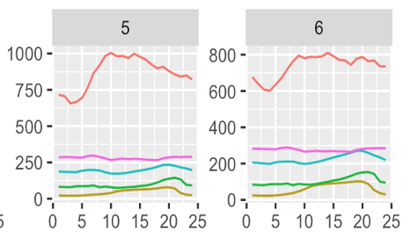
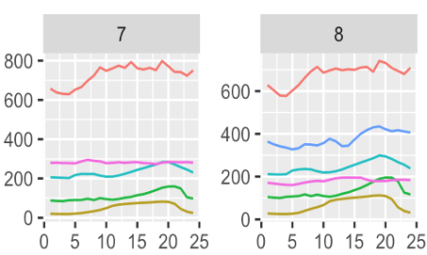
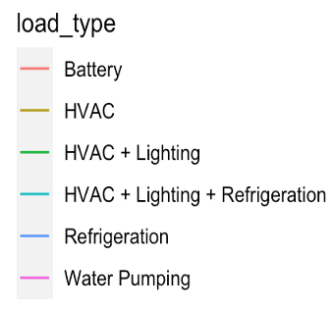
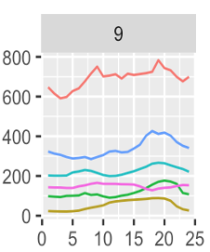
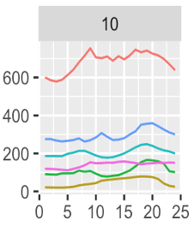
Average Diurnal Load Shapes
kW
May June July
August September October
kW

Slide 5
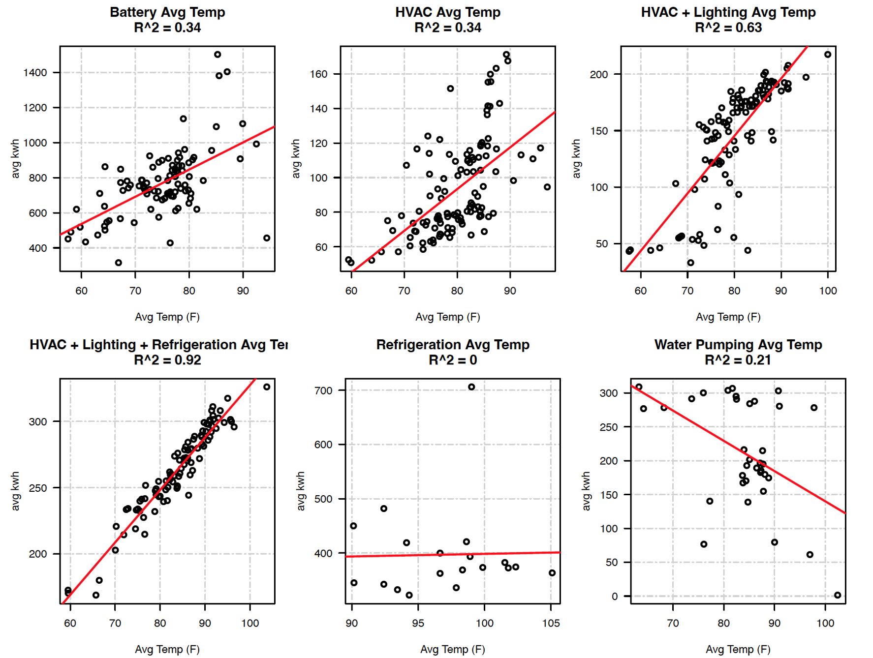
Temperature Sensitivity of Peak Loads
Battery
HVAC
HVAC +Lighting
Average Daily Peak Energy Use (kWh/h)
HVAC +Lighting + Refrigeration
Refrigeration
Water Pumping
Average Temperature (F)

Slide 6
2022 Event Hours
IOU | Program | Event Type | HE 17 | HE 18 | HE 19 | HE 20 | HE 21 | Program Total
PGE | CBP | Test | 0 | 1 | 8 | 7 | 4 | 20
PGE | CBP | ISO Dispatch | 13 | 19 | 20 | 11 | 6 | 69
PGE | DRAM | ISO Dispatch | 8 | 20 | 33 | 23 | 13 | 97
SCE | CBP | DA 1-6 Hour | 28 | 18 | 22 | 16 | 6 | 90
SCE | CBP | DO 1-6 Hour | 30 | 19 | 25 | 20 | 12 | 106
SCE | RA | ISO Dispatch | 7 | 10 | 12 | 2 | 2 | 33
SDGE | CBP | ISO Dispatch | 3 | 6 | 6 | 1 | 0 | 16
Hour Total |  |  | 89 | 93 | 126 | 80 | 43 | 431

Slide 7
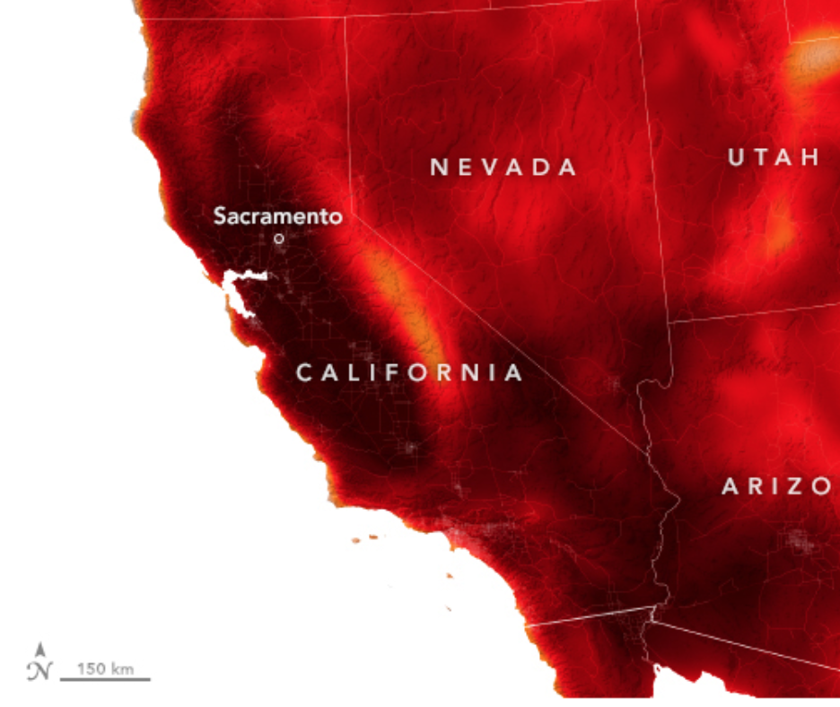

September 6, 2022 Heat Wave:
Load Relief provided by CPower Clients
Event Date (2022) | Mean Temp (F) | Baseline Load (MW) | Total Impact (MW) | Percent Impact (%)
09-01 | 86 | 178 | 33 | 18.8%
09-06 | 86 | 172 | 29 | 16.8%
09-07 | 89 | 171 | 31 | 18.3%
09-08 | 90 | 170 | 29 | 17.0%
(ºF)
86 95 104 113+
Source: NASA Earth Observatory

Slide 8
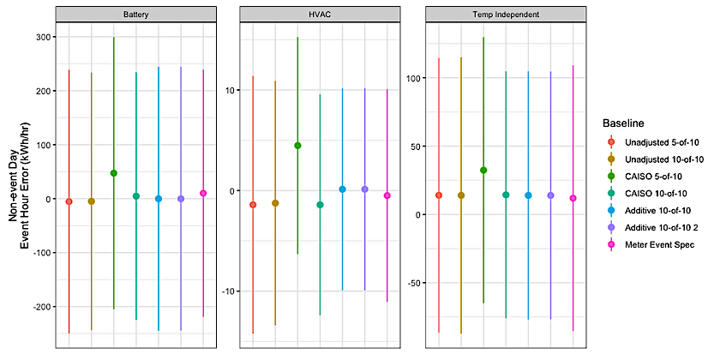
Bias and Error of Baselines
Battery
HVAC
Temperature
Independent
Fixed
Variable

Slide 9
Average Load Impact by Month
Month | Event Count | Mean Temp (F) | Meters in Analysis | Baseline Load (MW) | Total Impact (MW) | Percent Impact (%) | 90% Confidence Interval (MW)
May | 16 | 74 | 329 | 43 | 8.7 | 20.2% | (1.3, 16.2)
Jun | 32 | 85 | 641 | 103 | 15 | 14.2% | (2.5, 26.9)
Jul | 11 | 81 | 586 | 82 | 12 | 15.2% | (-1.0, 25.9)
Aug | 24 | 86 | 976 | 164 | 27.3 | 16.7% | (9.2, 45.4)
Sep | 20 | 91 | 1101 | 181 | 28.6 | 15.8% | (14.4, 42.7)
Oct | 4 | 83 | 142 | 9.6 | 1.4 | 14.0% | (-0.2, 2.9)

Slide 10
Average Load Impact by Load Type
Load Type | Event Count | Mean Temp (F) | Meters in Analysis | Baseline Load (MW) | Total Impact (MW) | Percent Impact (%) | 90% Confidence Interval (MW)
Battery | 32 | 76 | 15 | 11.1 | 1.5 | 13.1% | (0.8, 2.1)
HVAC | 107 | 88 | 1116 | 166.0 | 22.9 | 13.8% | (16.2, 29.5)
Pumping + Refrigeration | 14 | 90 | 33 | 6.0 | 4.8 | 81.3% | (3.7, 6.0)

Slide 11
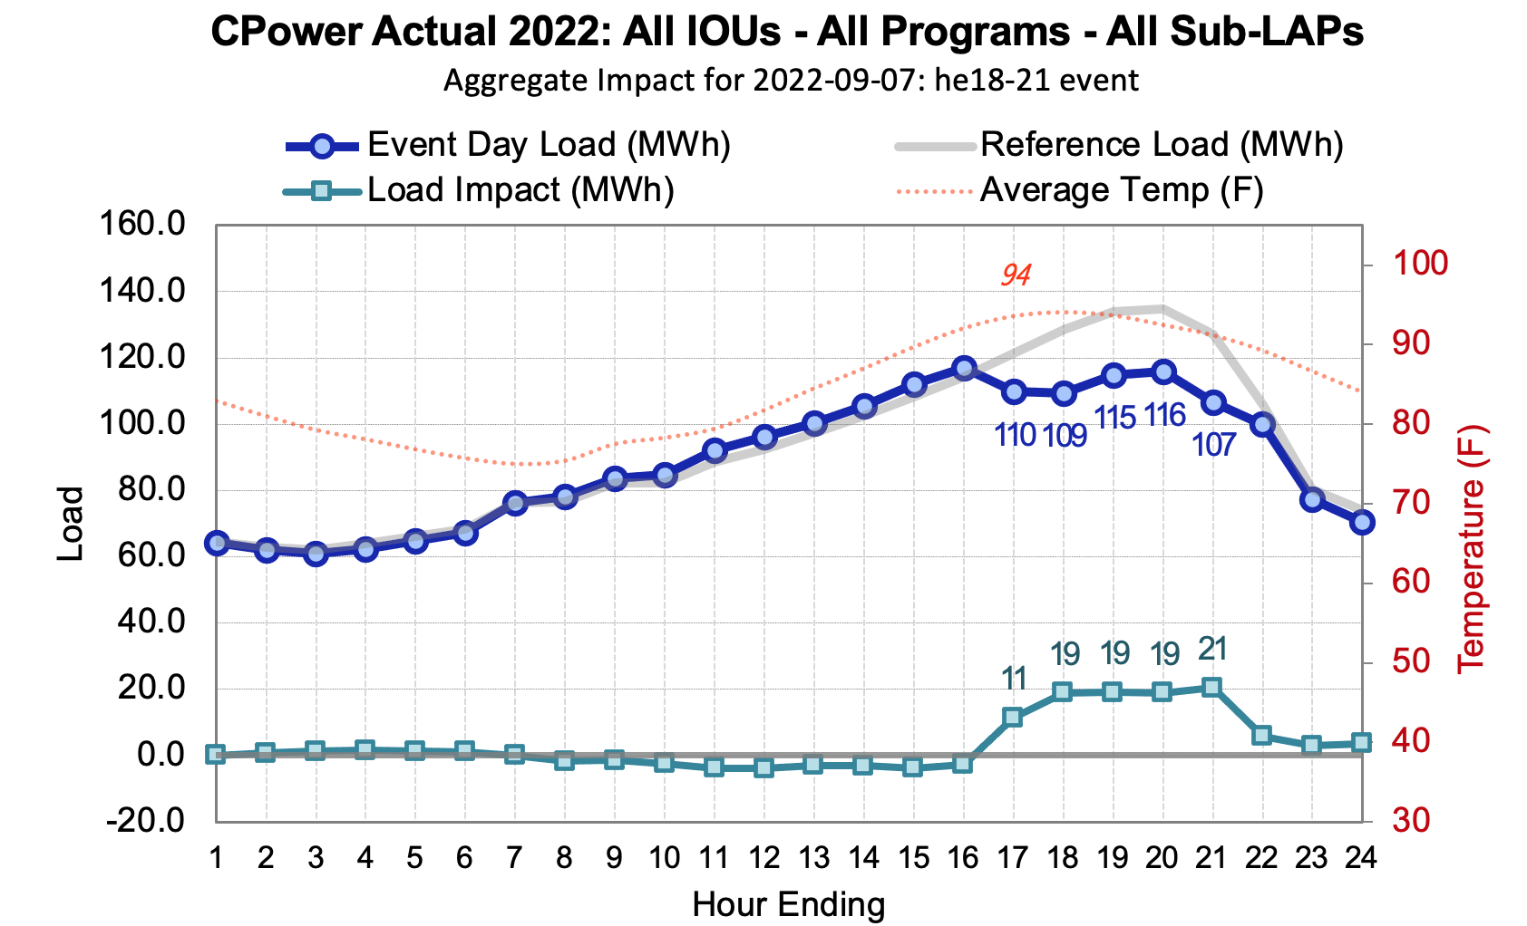
Example Ex-Post Results
Source: Herter Energy, CPower 2022 Ex-Post Table Generator

Slide 12
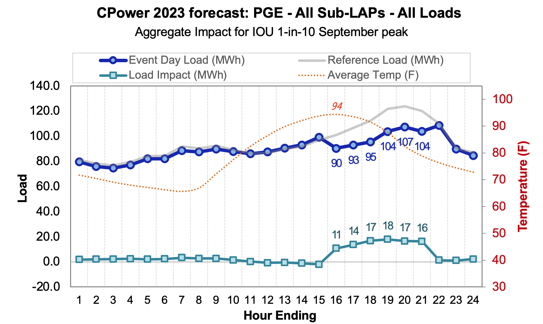
Example Ex-Ante Results
Source: Herter Energy, CPower 2022 Ex-Ante Table Generator

Slide 13
Final CPower 2024-2026 Forecast
Year | IOU 1-in-2 | ISO 1-in-2
2024 | 45.2 | 45.5
2025 | 50.7 | 51.0
2026 | 57.0 | 57.3

Slide 14
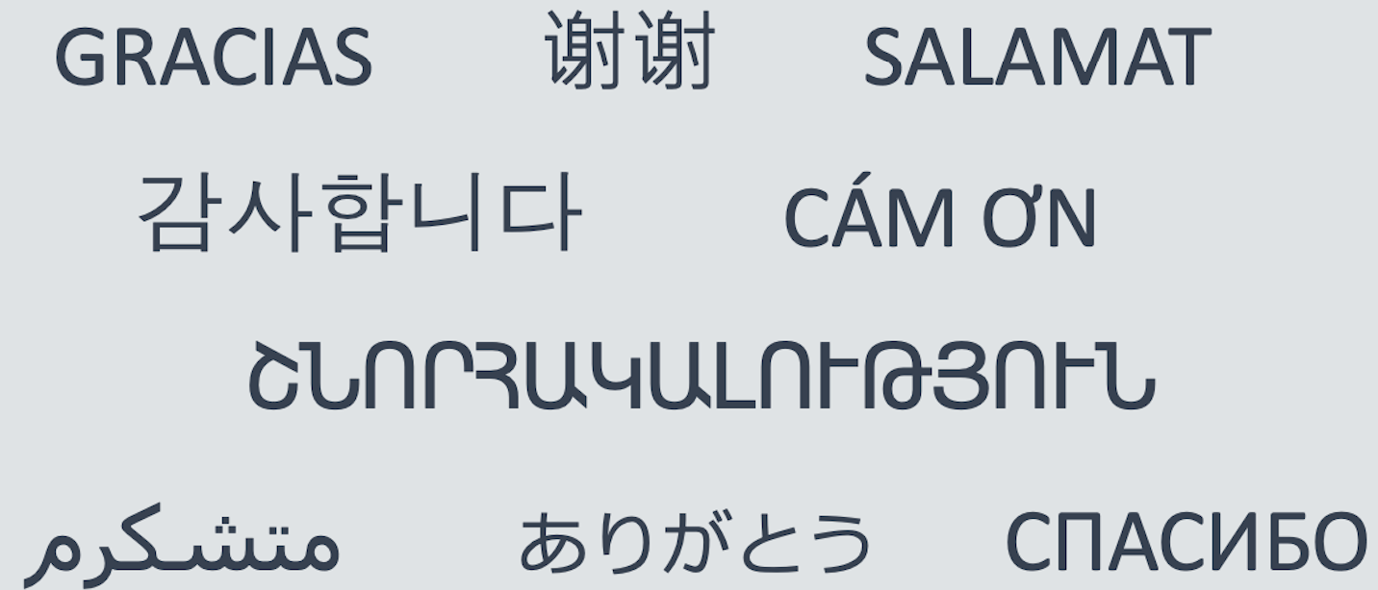
Thank you

