Slide 1

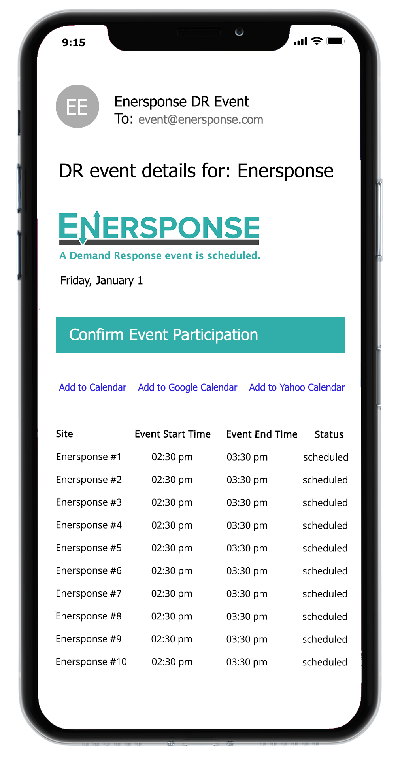
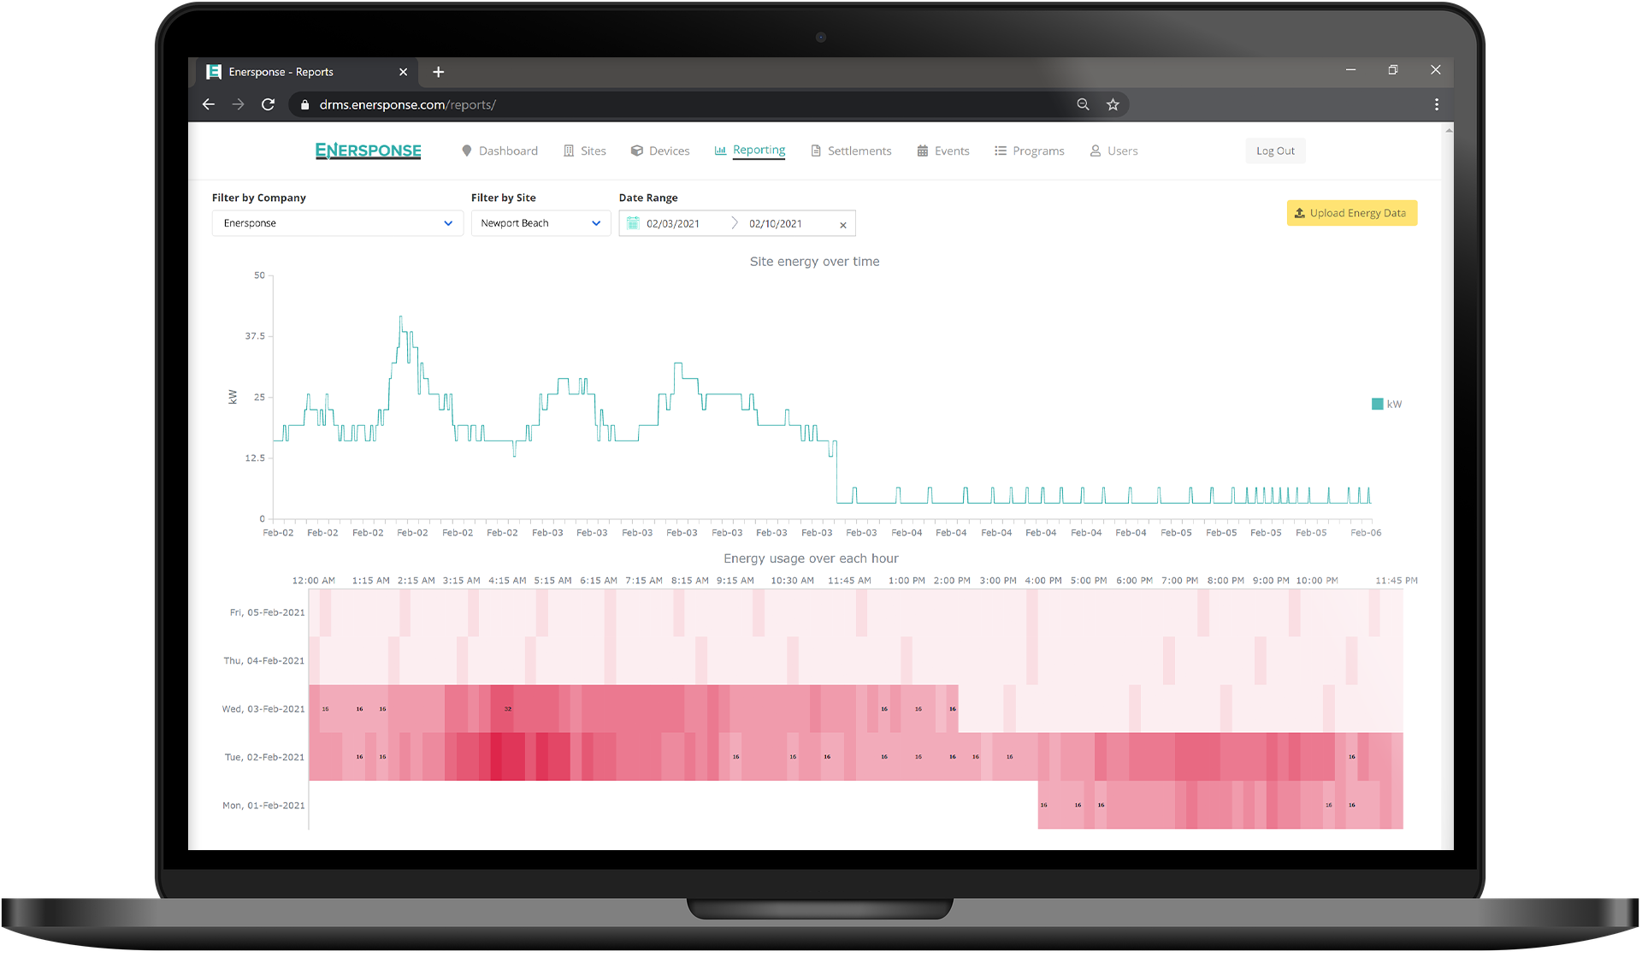
PY2022 Load Impact Protocols Workshop

Slide 2
PROGRAM BACKGROUND

Slide 3
About
Enersponse is a Demand Response Aggregator, and Auto-DR Integrator, managing nearly 18,000 commercial, industrial, agricultural and municipal water pumping locations across North America.
Enersponse manages customer participation by way of their DERMs platform, connecting to end-use customer controls via a library of software integrations, including custom API’s and OpenADR.
While some Enersponse customers are dispatched using traditional methods (email & sms/text notifications) most of their resources are direct-control.
Enersponse has been actively participating in various California Demand Response programs since 2015. The customer accounts included in this report have been actively managed by Enersponse in California demand response programs during 2022 program year.

Slide 4
EVENTS & DISPATCH
Event Day | Event Start | Event End | Duration | # Of Accts
6/23/2022 | 5:00 PM | 8:00 PM | 3 hrs. | 430
7/20/2022 | 5:00 PM | 8:00 PM | 3 hrs. | 453
7/28/2022 | 3:00 PM | 6:00 PM | 2 hrs. | 596
8/17/2022 | 5:00 PM | 8:00 PM | 3 hrs. | 647
8/24/2022 | 5:00 PM | 8:00 PM | 3 hrs. | 417
8/25/2022 | 4:00 PM | 8:00 PM | 4 hrs. | 417
9/6/2022 | 5:00 PM | 8:00 PM | 3 hrs. | 737
9/7/2022 | 4:00 PM | 8:00 PM | 4 hrs. | 700
9/8/2022 | 4:00 PM | 7:00 PM | 3 hrs. | 706
9/30/2022 | 4:00 PM | 8:00 PM | 4 hrs. | 614

Slide 5
EVENT PARTICIPATION BY LOAD TYPE
Event | HVAC | Pumping | Total
06/23/2022 5-8pm | 238 | 192 | 430
07/20/2022 5-8pm | 273 | 180 | 453
07/28/2022 3-6pm | 397 | 199 | 596
08/17/2022 5-8pm | 435 | 212 | 647
08/24/2022 5-8pm | 273 | 144 | 417
08/25/2022 4-8pm | 0 | 417 | 417
09/06/2022 5-8pm | 518 | 219 | 737
09/07/2022 4-8pm | 261 | 439 | 700
09/08/2022 4-7pm | 512 | 194 | 706
09/30/2022 4-8pm | 261 | 353 | 614

Slide 6
EX POST RESULTS

Slide 7
EX POST METHODOLOGY
Enersponse has elected to use performance results from its clients in California that have participated in the 2022 program year.
For the ex-post analysis, baseline loads were estimated using individual regression modeling. Different model configurations were tested for accuracy and bias to determine the best fit within building type groups. The best model was then estimated for each individual account within each building type group. Once the individual account baselines were calculated, the load impacts were calculated by subtracting the baseline loads in each hour from the actual load in that hour during the event.
Notes:
Accounts were grouped by end-use (HVAC & Pumping)
Models – Several model specifications were developed using variables such as hourly temperature, day of the week, and month.
Variable selection used the “leaps and bounds” algorithm (Stata vselect) to identify the best models.
This looks at five information criteria to identify the optimal model.
Mallows’s Cp,
Adj R²,
Akaike’s information criterion (AIC),
Akaike’s corrected information criterion (AIC_{c}), and
Bayesian information criterion (BIC)

Slide 8
COMBINED EX POST
Event | # Of Accts | Mean Reference Load (kW) | Mean Customer Impact (kW) | Relative Curtailment | Ave Event Hour Temp (ºF)
06/23/2022 5-8pm | 430 | 250.9 | 89.1 | 35.5% | 84.2
07/20/2022 5-8pm | 453 | 265.4 | 95.9 | 36.1% | 85.9
07/28/2022 3-6pm | 596 | 193.0 | 74.6 | 38.7% | 86.8
08/17/2022 5-8pm | 647 | 167.5 | 59.1 | 35.3% | 86.0
08/24/2022 5-8pm | 417 | 200.0 | 80.0 | 40.0% | 83.8
08/25/2022 4-8pm | 417 | 124.4 | 39.2 | 31.5% | 86.0
09/06/2022 5-8pm | 737 | 143.9 | 41.9 | 29.1% | 91.7
09/07/2022 4-8pm | 700 | 115.9 | 61.0 | 52.6% | 91.9
09/08/2022 4-7pm | 706 | 136.9 | 38.4 | 28.1% | 94.6
09/30/2022 4-8pm | 614 | 115.3 | 52.7 | 45.7% | 74.1
Notes:
This slide shows the aggregate ex-post results by event date.
Average impacts vary between 13 kW and 40 kW per account. This is mainly due to the end-use mix.
The number of accounts called during an event varies between 76 and 525.

Slide 9
AVERAGE IMPACTS – JUNE 23, 2022
Event Start Time: 17:00
Event End Time: 20:00
Notes:
This slide shows the average reference load, observed load and load impact for all hours for the August 30th event. This was a two hour event in which 409 accounts were called.

Slide 10
AVERAGE IMPACTS – SEPTEMBER 30, 2022
Event Start Time: 16:00
Event End Time: 20:00
Notes:
This slide shows the average reference load, observed load and load impact for all hours for the February 17th event. This was a four hour event in which 467 accounts were called.
In general, the baseline models appear to perform well in estimating the reference loads.

Slide 11
PUMPING IMPACTS – TYPICAL 2022 EVENT
Notes:
This slide shows the average reference load, observed load and load impact for all hours for the February 17th event. This was a four hour event in which 467 accounts were called.
In general, the baseline models appear to perform well in estimating the reference loads.

Slide 12
HVAC IMPACTS – TYPICAL 2022 EVENT
Notes:
This slide shows the average reference load, observed load and load impact for all hours for the February 17th event. This was a four hour event in which 467 accounts were called.
In general, the baseline models appear to perform well in estimating the reference loads.

Slide 13
EX-ANTE RESULTS

Slide 14
EX ANTE METHODOLOGY
The ex-ante load impacts were estimated for the DR resource for typical event days and monthly peak days from 2023 through 2033. The ex-ante analysis used a similar method as the ex-post.
Baseline loads and average hourly impacts were estimated using individual regression modeling. Different model configurations were tested for accuracy and bias to determine the best fit within building type groups. The best model was then estimated for each individual account within each building type group. Once the individual account models were estimated, the baselines and the load impacts were simulated based on the regression coefficients and the forecasted weather for the future events.
Notes:
The ex-ante impacts were estimated using the average percent load drop by end-use, LCA, and season from the ex-post analysis.
This was done because the impacts did not correlate with temperature for either the HVAC or the Pumping accounts. This is not surprising for the pumping accounts but it was unexpected for the HVAC accounts. The reason may be because the HVAC accounts were dominated by big box retail operations with significant refrigeration loads.

Slide 15
EX-POST IMPACTS vs TEMPERATURE
Notes:
This slide summarized the ex-ante impact estimators.
As you can see, the load drop for Pumping is much greater as a percentage of the reference load than HVAC regardless of the LCA or Season.

Slide 16
ENROLLMENT FORECATS (H/M/L)
Year | HVAC | Pumping | Total
2023 | 1,267 | 1,668 | 2,935
2024 | 1,622 | 2,135 | 3,757
2025 | 2,045 | 2,691 | 4,736
2026 | 2,534 | 3,336 | 5,870
2027 | 3,092 | 4,071 | 7,163
2028 | 3,710 | 4,884 | 8,594
2029 | 4,377 | 5,763 | 10,140
2030 | 5,078 | 6,685 | 11,763
2031 | 5,788 | 7,621 | 13,409
2032 | 6,482 | 8,537 | 15,019
2033 | 7,130 | 9,392 | 16,522
Notes:
James

Slide 17
EX-ANTE BY END-USE – AUGUST PEAK DAY2023
End-use | # Of Accounts | Mean Impact (kW) | Aggregate Impact (MW) | Percent Impact (%)
 |  |  |  | CAISO Peak |  | Utility Peak
 |  |  |  | 1-in-2 | 1-in-10 | 1-in-2 | 1-in-10
HVAC | 1,267 | 2.6 | 3.2 | 3.3% | 3.2% | 3.2% | 3.1%
Pumping | 1,668 | 53.6 | 89.3 | 31.1 | 31.0 | 31.1 | 31.0
Total | 2,935 | 31.5 | 92.6 | 24.0 | 23.7 | 23.9 | 23.7
Notes:
This slide summarizes the aggregate load impacts through out the forecast horizon.

Slide 18
EX-ANTE – PUMPING AUGUST PEAK DAY 2023
Notes:
This slide shows the estimated Pumping reference loads, actual loads, and impacts for an August event in 2022.

Slide 19
EX-ANTE – HVAC AUGUST PEAK DAY 2023
Notes:
This slide shows the estimated HVAC reference loads, actual loads, and impacts for an August event in 2022.
The ex-ante baseline model appears not to work particularly well for event period.

Slide 20
EX-ANTE BY LCA – AUGUST PEAK DAY 2023
LCA | # Of Accounts | Mean Impact (kW) | Aggregate Impact (MW) | Percent Impact (%)
 |  |  |  | CAISO Peak |  | Utility Peak
 |  |  |  | 1-in-2 | 1-in-10 | 1-in-2 | 1-in-10
Big Creek / Ventura | 435 | 32.2 | 14.0 | 21.5 | 21.3 | 21.5 | 21.3
LA Basin | 2,500 | 31.4 | 78.6 | 24.5 | 24.2 | 24.4 | 24.2
Total | 2,935 | 31.5 | 92.6 | 24.0 | 23.7 | 23.9 | 23.7
Notes:
This slide summarizes the aggregate load impacts through out the forecast horizon.

Slide 21
EX-ANTE TYPICAL EVENT IMPACT FORECAST
Year | HVAC (MW) | Pumping (MW) | Total (MW)
2023 | 3.2 | 89.3 | 92.6
2024 | 4.1 | 114.3 | 118.5
2025 | 5.2 | 144.1 | 149.3
2026 | 6.5 | 178.7 | 185.1
2027 | 7.9 | 218.0 | 225.9
2028 | 9.5 | 261.6 | 271.1
2029 | 11.1 | 308.7 | 319.8
2030 | 12.9 | 358.0 | 371.0
2031 | 14.7 | 408.1 | 422.9
2032 | 16.5 | 457.2 | 473.7
2033 | 18.2 | 502.9 | 521.1
Notes:
James

Slide 22
FUTURE RECOMMENDATIONS
It has been challenging to develop accurate and unbiased reference loads for customers with pumping loads. These customers tend to be irregular in their load levels and the timing of the changes in load are difficult to predict. However, in aggregate the individual regression baselines are reasonably accurate. Future evaluations will continue to seek to improve the estimation of the individual baselines.
Notes:
It has been a persistent challenge to estimate individual customer reference loads.
We will continue to work on improving this.

Slide 23
QUESTIONS
?

