Slide 1
SCE Summer Discount Plan PY 2024 Evaluation
DRMEC Presentation
May 12, 2025

Slide 2
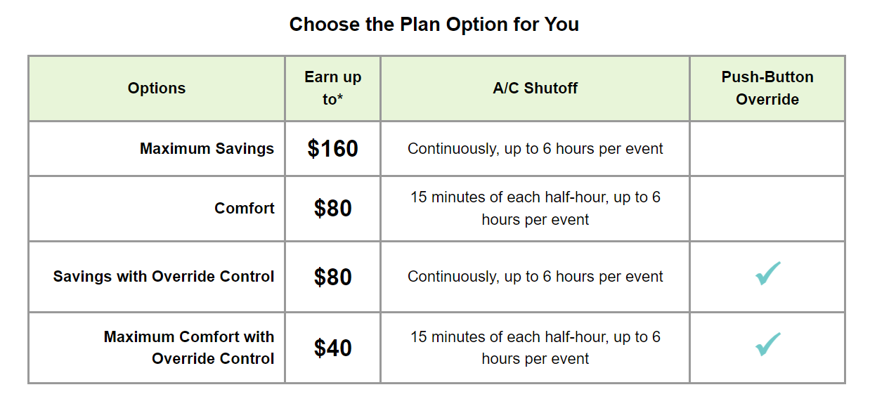
SDP Program Description
SDP operates through the installation of a remote-controlled device on the participant’s air conditioning unit. During events, this device turns off or cycles the A/C unit.
Events can be called year-round, though customers only receive bill credits for June through September participation.

Slide 3
The SDP program is an AC Cycling program, Where Events are dispatched by geographically defined regional subgroups
~82% of participants, tonnage, and devices are in 100% cycling
~52% of resources are in the SCE-Central SubLAP
~31% of SDP-R participants are low income (CARE or FERA)
Schools and religious organizations account for ~82% of SDP-C tonnage

Slide 4
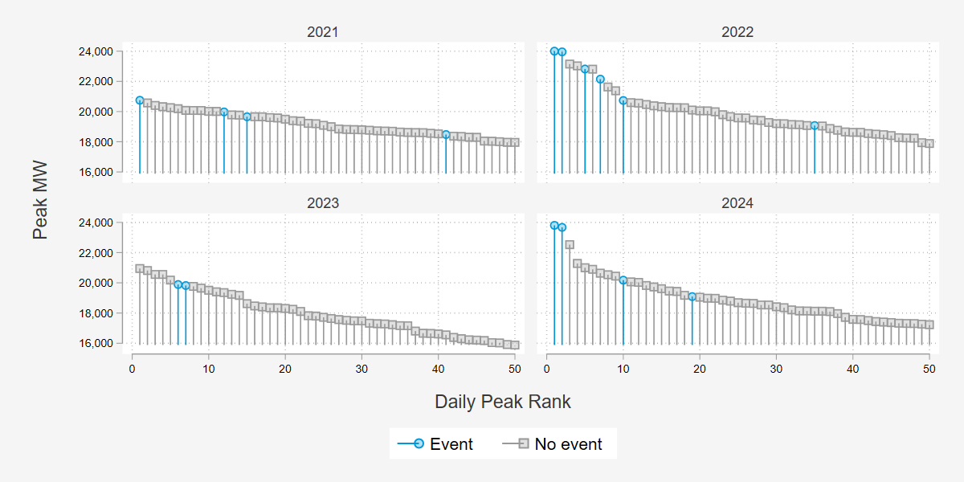
2024 System Peak loads were higher than Previous Years
2024 SCE Peak Days
1.) 9/6
2.) 9/5 ← CAISO Peak

Slide 5
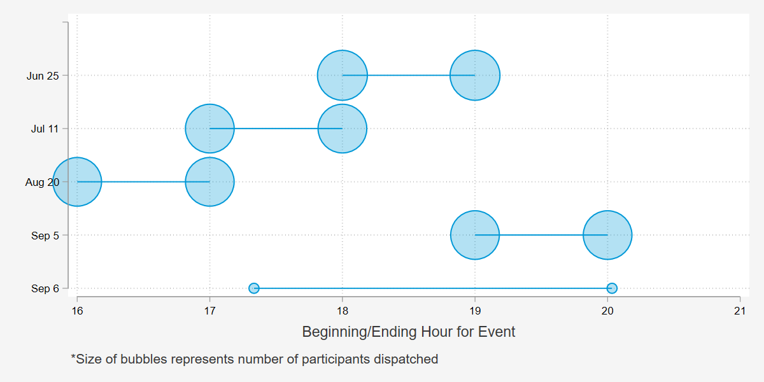
2024 had four large events and one Localized Dispatch
Full territory
Excluded C3
Localized dispatch

Slide 6
Methods Overview

Slide 7
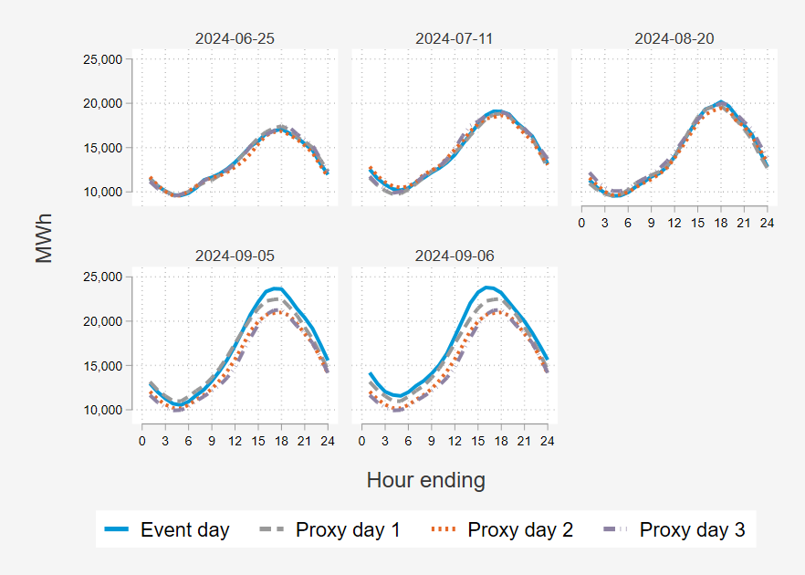
Estimating demand reductions delivered via 2024 operations
Proxy Day Selection
Three proxy days were selected for each event day based on SCE system load
Matched Controls
A single control customer was chosen for each participant based on individual load during proxy days
Regression Analysis
Difference-in-differences panel regression
Hourly event impacts estimated by subcategory and across all customers
Hard matching:
Propensity score matching with replacement
Commercial – Industry + Size
Residential – NEM, climate group, and size
For each event day, the corresponding proxy event day was used to net out differences between the treatment and control group that were not due to the intervention.

Slide 8
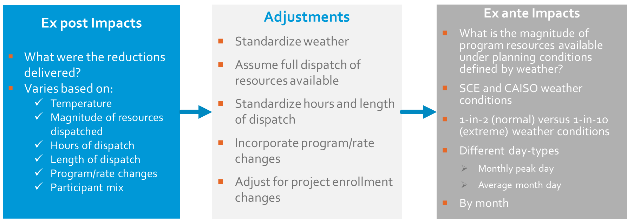
Quantifying the magnitude of reductions available during peaking conditions used for planning
Monthly Worst Day
Average Event Day

Slide 9
Residential Results

Slide 10
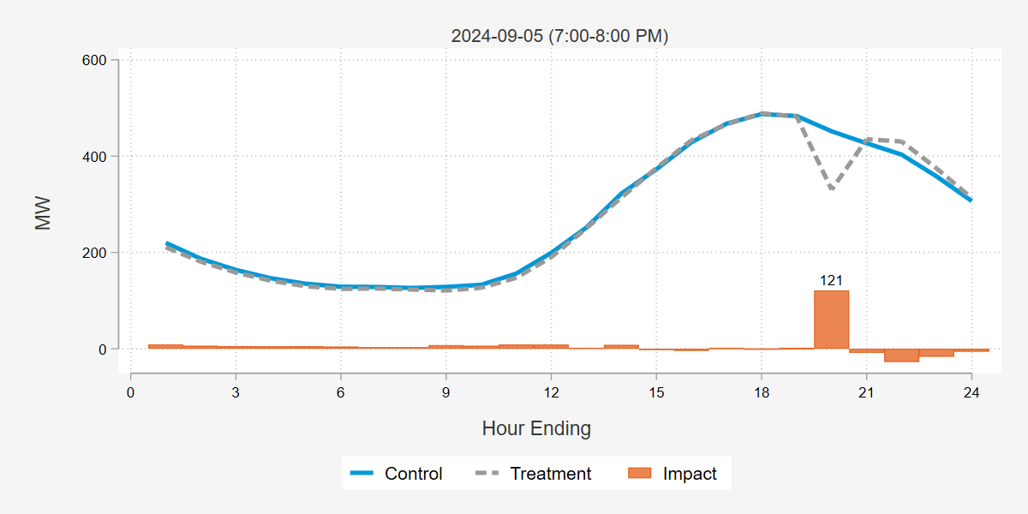
Residential Participants were able to Reduce Load by 121 MW During the Caiso peak day event and 88 mw on the average Event
This event did not dispatch C-3.
Resources dispatched are equal to per-customer, ex-ante estimates for August 1-in-2 events, which are scaled to the eligible population.
 |  |  |  |  | MW Metrics |  |  |  |  | Impact per … (kW)
Date | Load Control Groups | Event start | Event end | Accts | Ref Load | Obs Load | Impact | 90% LB | 90% UB | Acct | Device | Ton | % Impact | Weighted Temp (F)
6/25/2024 | Territory | 6:00 PM | 7:00 PM | 151,270 | 305 | 232 | 72 | 67 | 78 | 0.48 | 0.41 | 0.11 | 23.8% | 84.5
7/11/2024 | Excludes C-3 | 5:00 PM | 6:00 PM | 144,031 | 343 | 241 | 102 | 96 | 107 | 0.71 | 0.61 | 0.17 | 29.7% | 91.7
8/20/2024 | Excludes C-3 | 4:00 PM | 5:00 PM | 143,414 | 330 | 223 | 107 | 102 | 112 | 0.75 | 0.65 | 0.18 | 32.5% | 95.6
9/5/2024 | Excludes C-3 | 7:00 PM | 8:00 PM | 143,319 | 452 | 330 | 121 | 113 | 129 | 0.85 | 0.73 | 0.20 | 26.8% | 98.0
9/6/2024 | Localized | 5:13 PM | 8:02 PM | 5,681 | 22 | 18 | 5 | 4 | 6 | 0.84 | 0.64 | 0.18 | 21.3% | 105.5
Avg. Event | 5:00 PM – 7:00 PM |  |  | 150,762 | 330 | 242 | 88 | 85 | 91 | 0.59 | 0.50 | 0.14 | 26.8% | 88.1

Slide 11
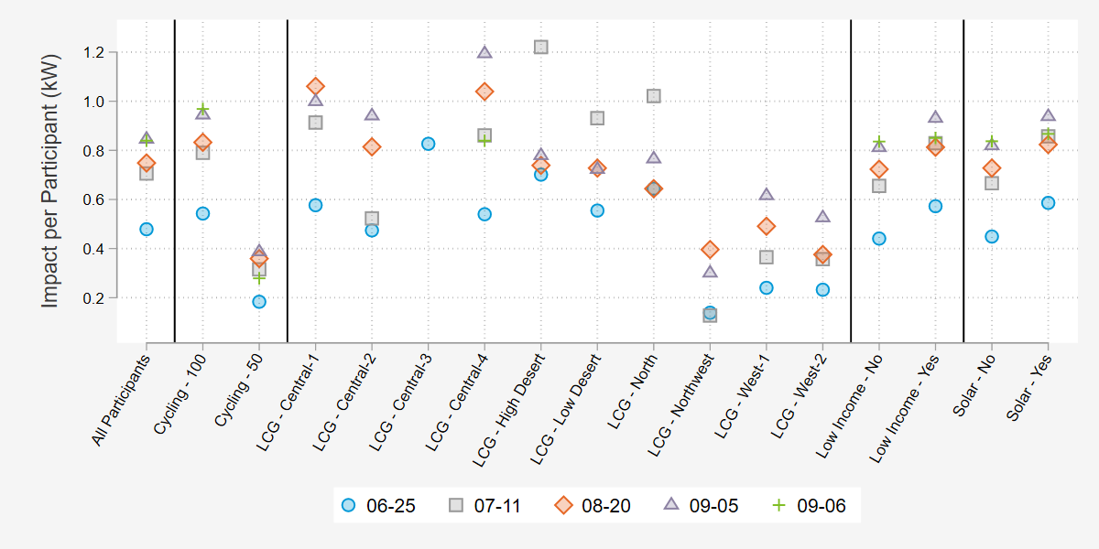
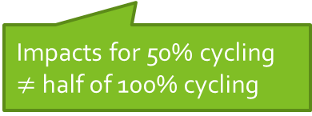
Average Residential Impacts by Date and Key Subcategories
Impacts for 50% cycling $≠$ half of 100% cycling

Slide 12
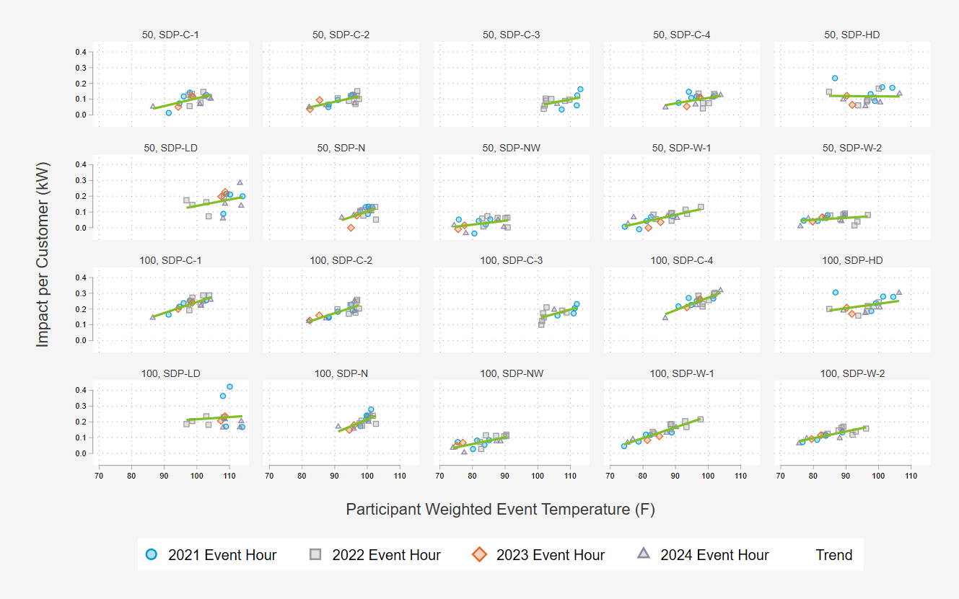
we used Per-Ton impacts from 2021-2024 to model reductions as function of temperature and hour
Population varies by load control group
Load control groups have different event history
At low end temperatures, impacts are flattened out to near zero impacts

Slide 13
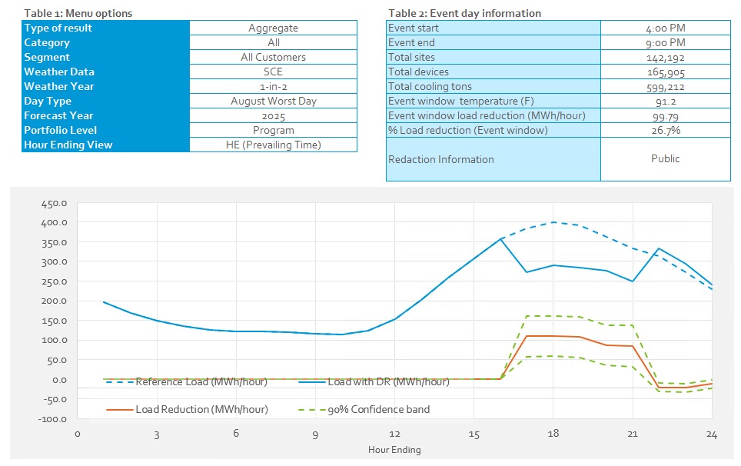
Ex-Ante impacts – Projected demand reductions under standardized weather conditions
Forecast Year 2025 Load Impacts on the 1-in-2 August Worst Day
August Worst Day Ex-Ante Aggregate Load Reductions
Forecast Year | Enrollment Forecast | SCE Weather | CAISO Weather
 |  | 1-in-2 | 1-in-2
2025 | 142,192 | 99.8 | 96.0
2026 | 133,216 | 93.5 | 90.0
2027 | 125,189 | 87.9 | 84.5
2028 | 118,009 | 82.8 | 79.7

Slide 14
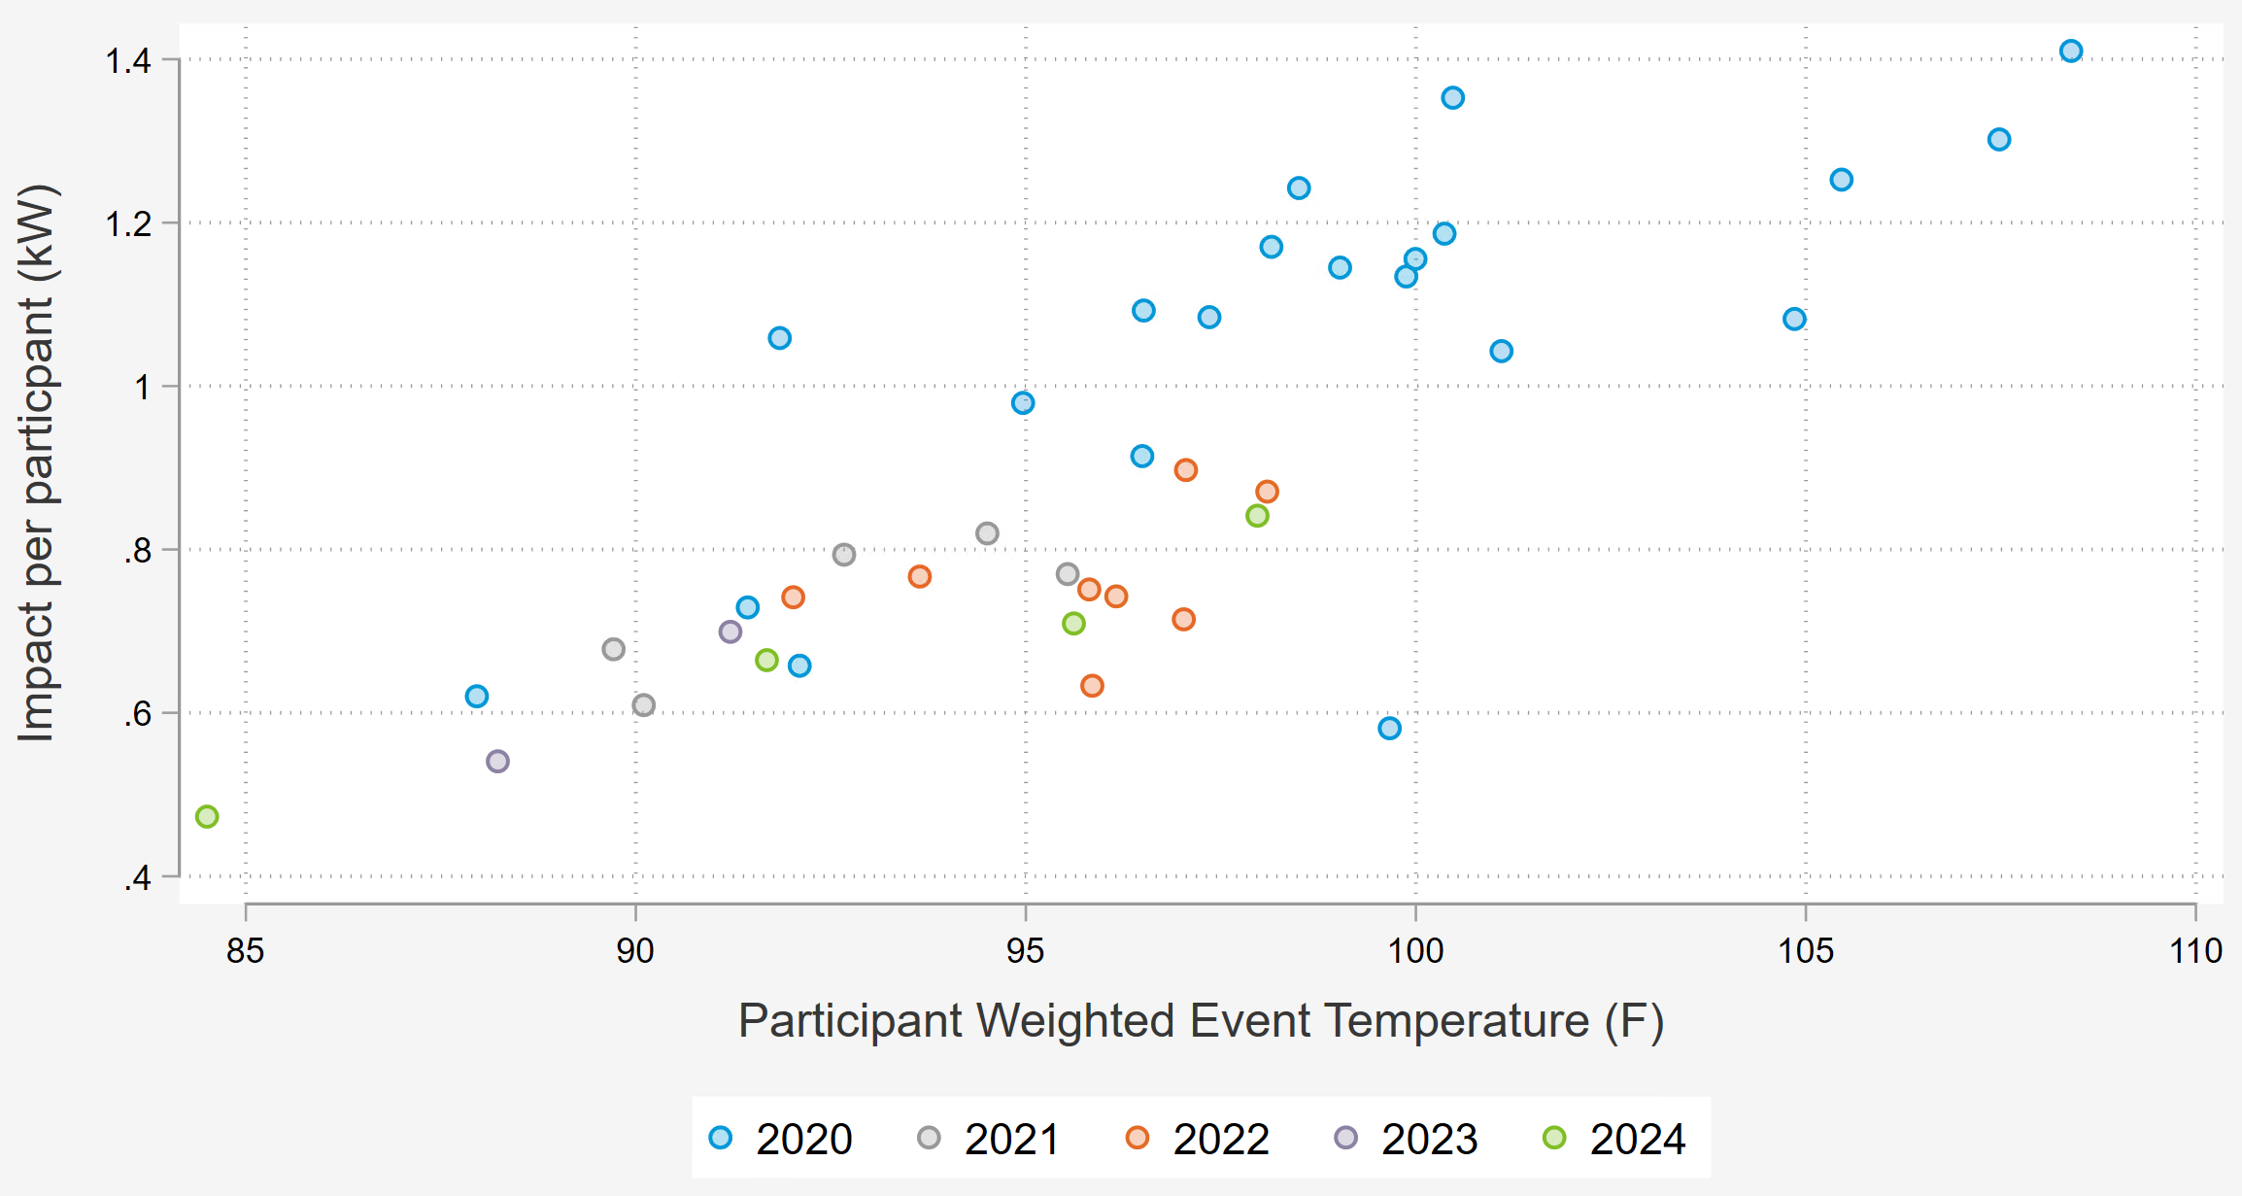
Residential Ex Ante impact Comparison
In this evaluation year, PY 2020 was not included in the ex-ante modelling
  Limited the data points for constructing the model
    A direct result of removing the 20-hour minimum after PY 2020
  Temperatures hotter than 100F are out-of-sample
  Temperatures between 95F and 100F had higher impact estimates in PY 2020 than subsequent years
Month | Vintage Year 2022 | Vintage Year 2023 | Vintage Year 2024
 | 1-in-2 | 1-in-2 | 1-in-2
June | 0.88 | 0.82 | 0.66
July | 0.96 | 0.89 | 0.70
August | 0.99 | 0.92 | 0.70
September | 1.00 | 0.93 | 0.73

Slide 15
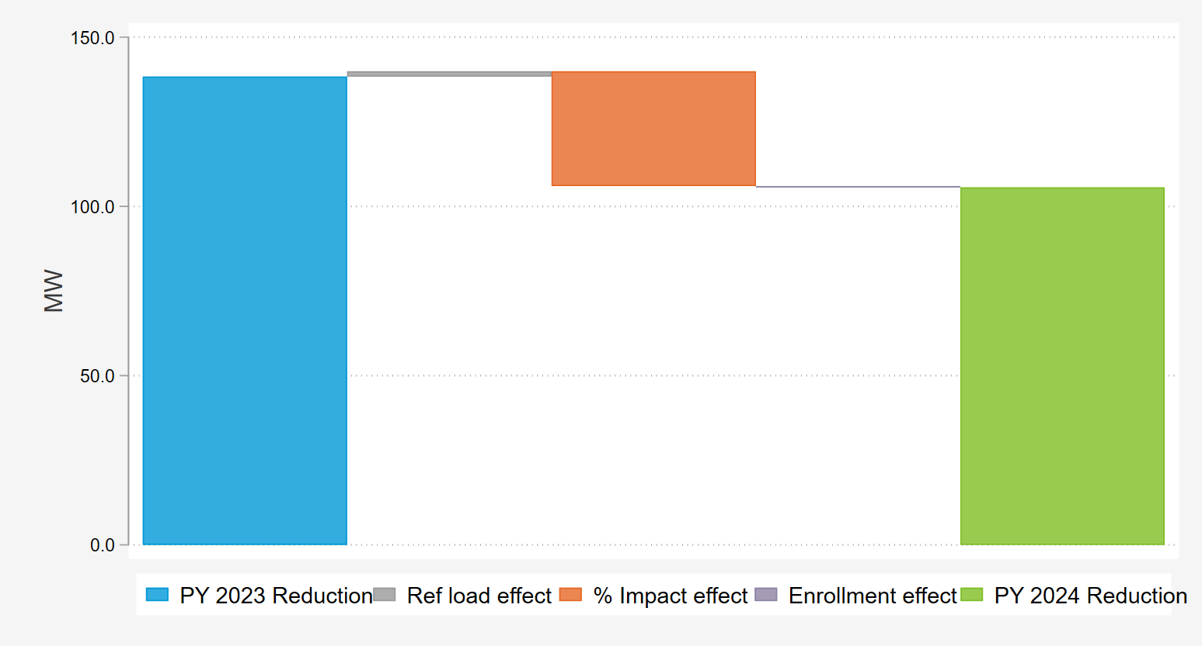
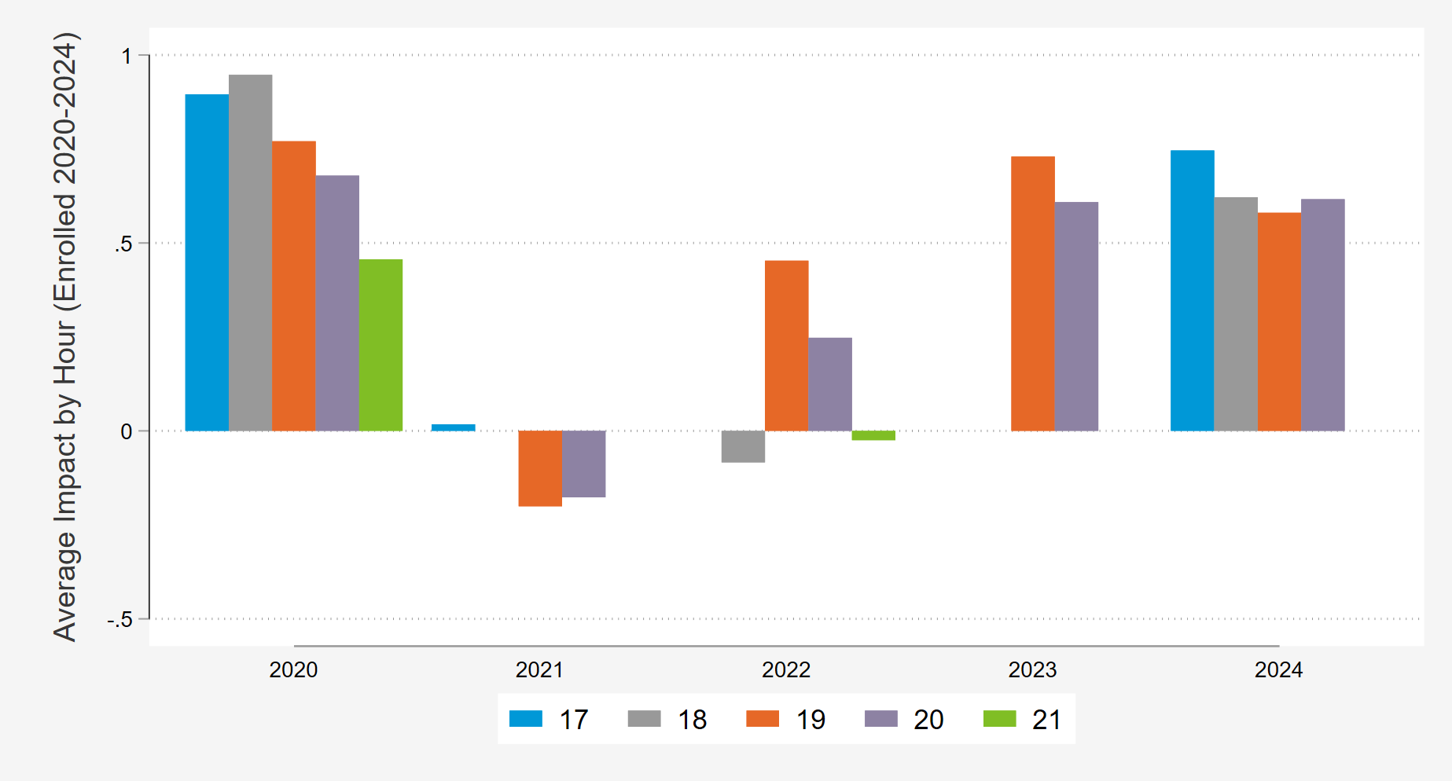
Adjustment in Ex Ante Primarily from the Change in Impacts
Comparison of August Ex-Ante
112,000 residential customers have been enrolled from the beginning of 2020 to the end of 2024
  The graph below shows the impacts by year for that set of participants
  Consistently enrolled participants experienced much smaller impacts in 2021/2022
  Impacts in 2023/2024 start to level out at a lower level than 2020
Isolates impacts for event hours cooler than 100F

Slide 16
Commercial Results

Slide 17
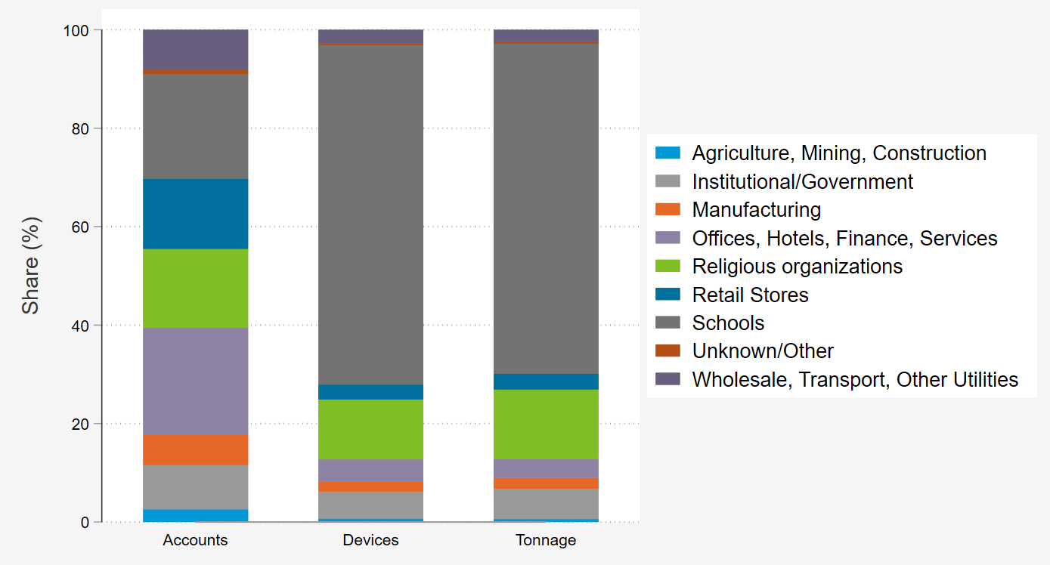
Most devices and AC tonnage are in schools and religious Organizations, Where loads vary based on Month, Day and time

Slide 18
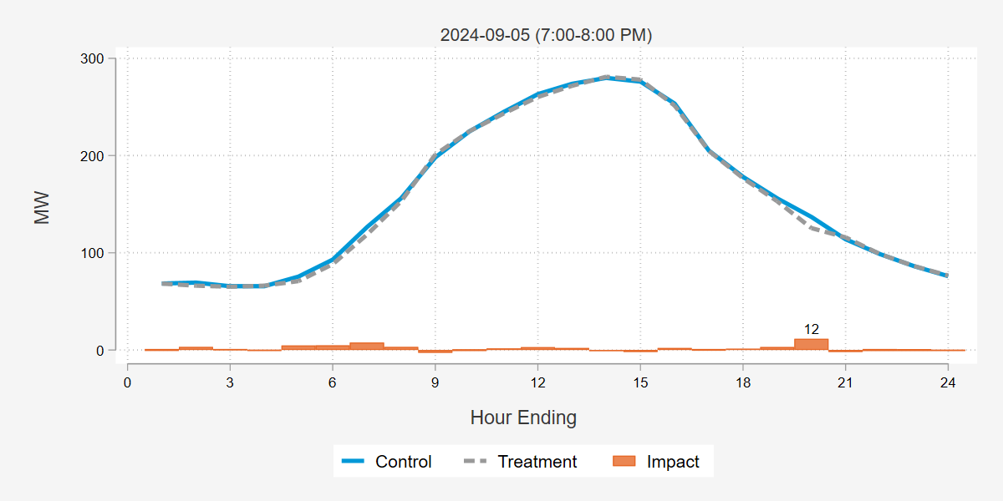
Commercial Participants were able to Reduce Load by 12 MW During the CAISO EVENT Day and 6 Mw on the average Event
This event did not dispatch C-3.
 |  |  |  |  | MW Metrics |  |  |  |  | Impact per … (kW)
Date | Load Control Groups | Event start | Event end | Accts | Ref Load | Obs Load | Impact | 90% LB | 90% UB | Acct | Device | Ton | % Impact | Weighted Temp (F)
6/25/2024 | Full Territory | 6:00 PM | 7:00 PM | 6,549 | 94 | 90 | 4 | 1 | 8 | 0.65 | 0.07 | 0.01 | 4.6% | 81.7
7/11/2024 | Excludes C-3 | 5:00 PM | 6:00 PM | 6,350 | 105 | 97 | 9 | 4 | 14 | 1.37 | 0.15 | 0.03 | 8.3% | 86.8
8/20/2024 | Excludes C-3 | 4:00 PM | 5:00 PM | 6,320 | 162 | 143 | 18 | 10 | 26 | 2.90 | 0.31 | 0.06 | 11.3% | 92.7
9/5/2024 | Excludes C-3 | 7:00 PM | 8:00 PM | 6,298 | 137 | 125 | 12 | -1 | 24 | 1.83 | 0.20 | 0.04 | 8.4% | 94.3
9/6/2024 | Localized | 5:13 PM | 8:02 PM | 119
Avg. Event | 5:00 PM – 7:00 PM |  |  | 6,469 | 99 | 93 | 6 | 2 | 10 | 0.93 | 0.10 | 0.02 | 6.1% | 84.2

Slide 19
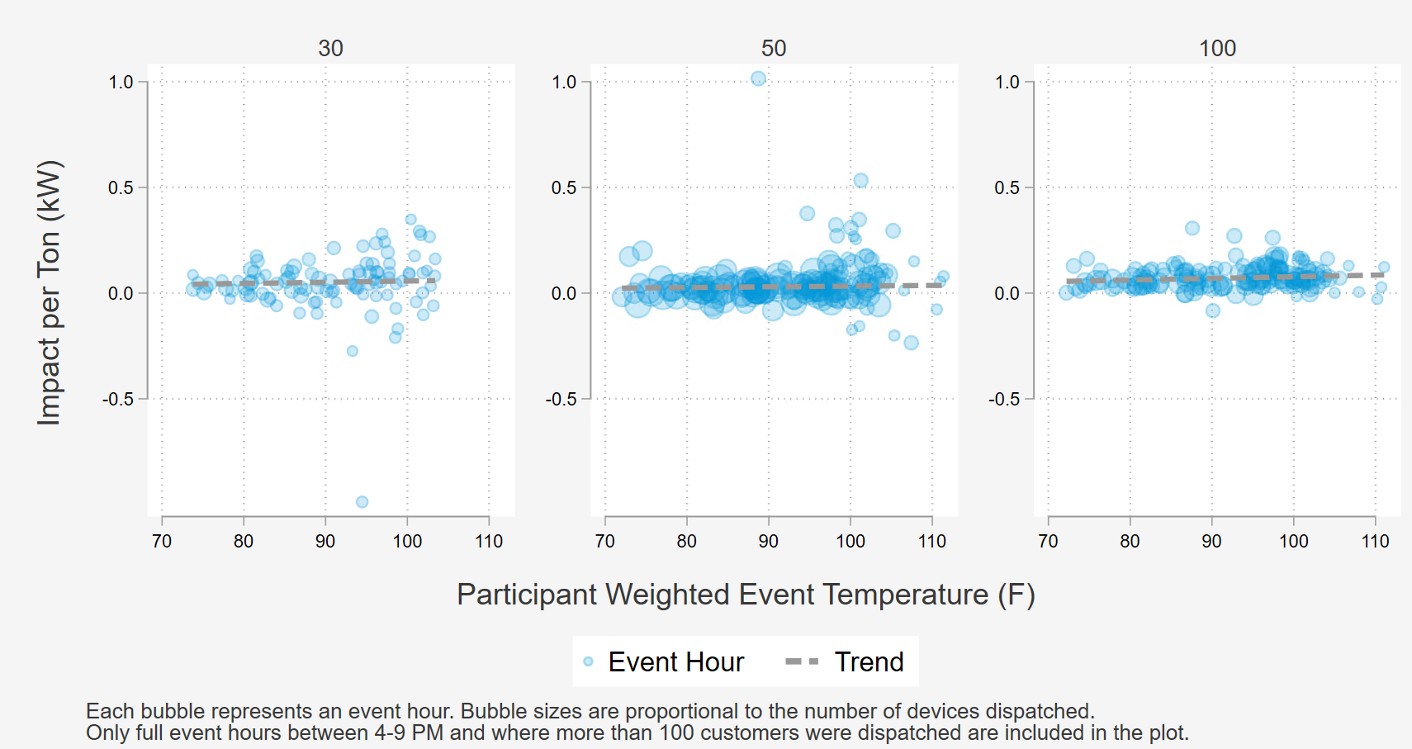
we used Per Ton impacts from 2021 - 2024 to model reductions as function of temperature and hour
Ex ante estimates used the relationship between weather and demand reductions from 2021-2024
Population varies by cycling strategy
  60% of devices are in the 100% cycling group, 35% and 5% for 50% cycling and 30% cycling respectively
At low temperatures, impacts are near zero

Slide 20
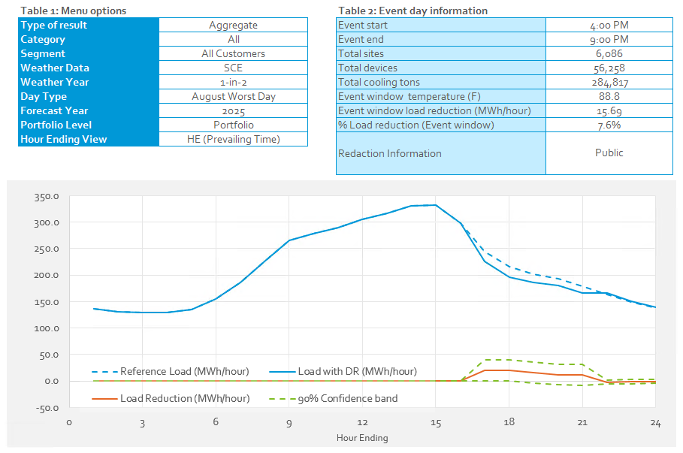
Ex-Ante impacts – Projected demand reductions under standardized weather conditions
Forecast Year 2025 Load Impacts on the 1-in-2 August Worst Day
August Worst Day Ex-Ante Aggregate Load Reductions
Forecast Year | Enrollment Forecast | Total Devices | SCE Weather | CAISO Weather
 |  |  | 1-in-2 | 1-in-2
2025 | 6,086 | 56,258 | 15.7 | 15.2
2026 | 5,719 | 52,865 | 14.7 | 14.3
2027 | 5,376 | 49,695 | 13.9 | 13.4
2028 | 5,055 | 46,727 | 13.0 | 12.6

Slide 21
Commercial Ex Ante impact Comparison
Commercial has not relied on 2020 for the past three years
Data Leveraged
  PY 2024
    Reference Loads: 2023 - 2024
    Impact Modelling: 2021 - 2024
  PY 2023
    Reference Loads: 2022 - 2023
    Impact Modelling: 2018, 2019, 2022, 2023
  PY 2022
    Reference Loads: 2022 - 2022
    Impact Modelling: 2018, 2019, 2022
Month | Vintage Year 2022 | Vintage Year 2023 | Vintage Year 2024
 | 1-in-2 | 1-in-2 | 1-in-2
June | 2.18 | 1.97 | 1.52
July | 2.30 | 2.15 | 1.63
August | 2.38 | 2.42 | 2.58
September | 2.48 | 2.82 | 2.78

Slide 22
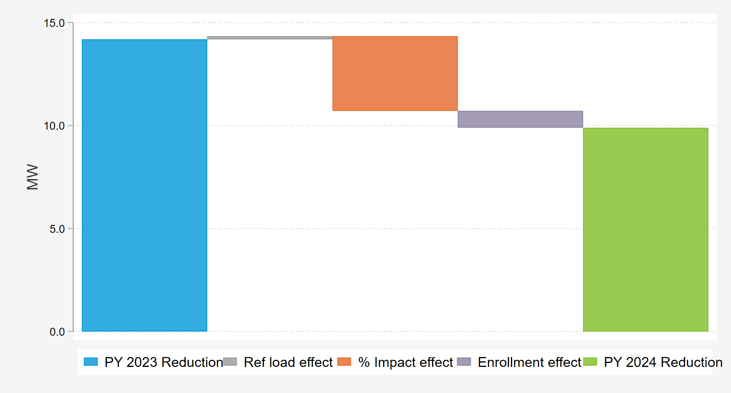
August/September Results Remain Similar While June/July Decrease
Comparison of July Ex-Ante
The impacts have become more sensitive to the seasonality of schools, which accounts for 67% of total commercial tonnage. The last couple years have had more June/July dispatches to model.

Slide 23
Discussion & Recommendations

Slide 24
Discussion
Recommendations
SDP has the capability to deliver large magnitudes of flexible loads at very fast ramp rates, delivering larger reductions when the weather is more extreme and resources are needed most.
The magnitude of SDP resources has been declining in recent years.
  Increased attrition has coincided with lower incentives and a higher number of events
  Possible “switch failure”
Implement more diverse events over the 2025 summer to cover a broader range of conditions
  Develop Test Event Plan for Summer 2025
    Dispatch events at a-bank/b-bank level, to gather data from a wide range of event types, tailored to various temperature brackets
    Introduce a two-hour limit for each event to prevent fatigue
Use Operational/Testing events to patch current holes in analysis for better understanding of program performance
  Combination of territory-wide actual and test events include each of the peak hour from 4–9 PM
  Ensure variability on the event duration, event start time, and weather conditions.

Slide 25

Questions?
Savannah Horner
Consultant
Demand Side Analytics
shorner@demandsideanalytics.com
Estefania Suarez
Quantitative Analyst
Demand Side Analytics
esuarez@demandsideanalytics.com

