Slide 1
Load Impact Evaluation of
GoodLeap California DR Resources
2026 Third-Party DRP LIP Workshop
May 11, 2026

Slide 2
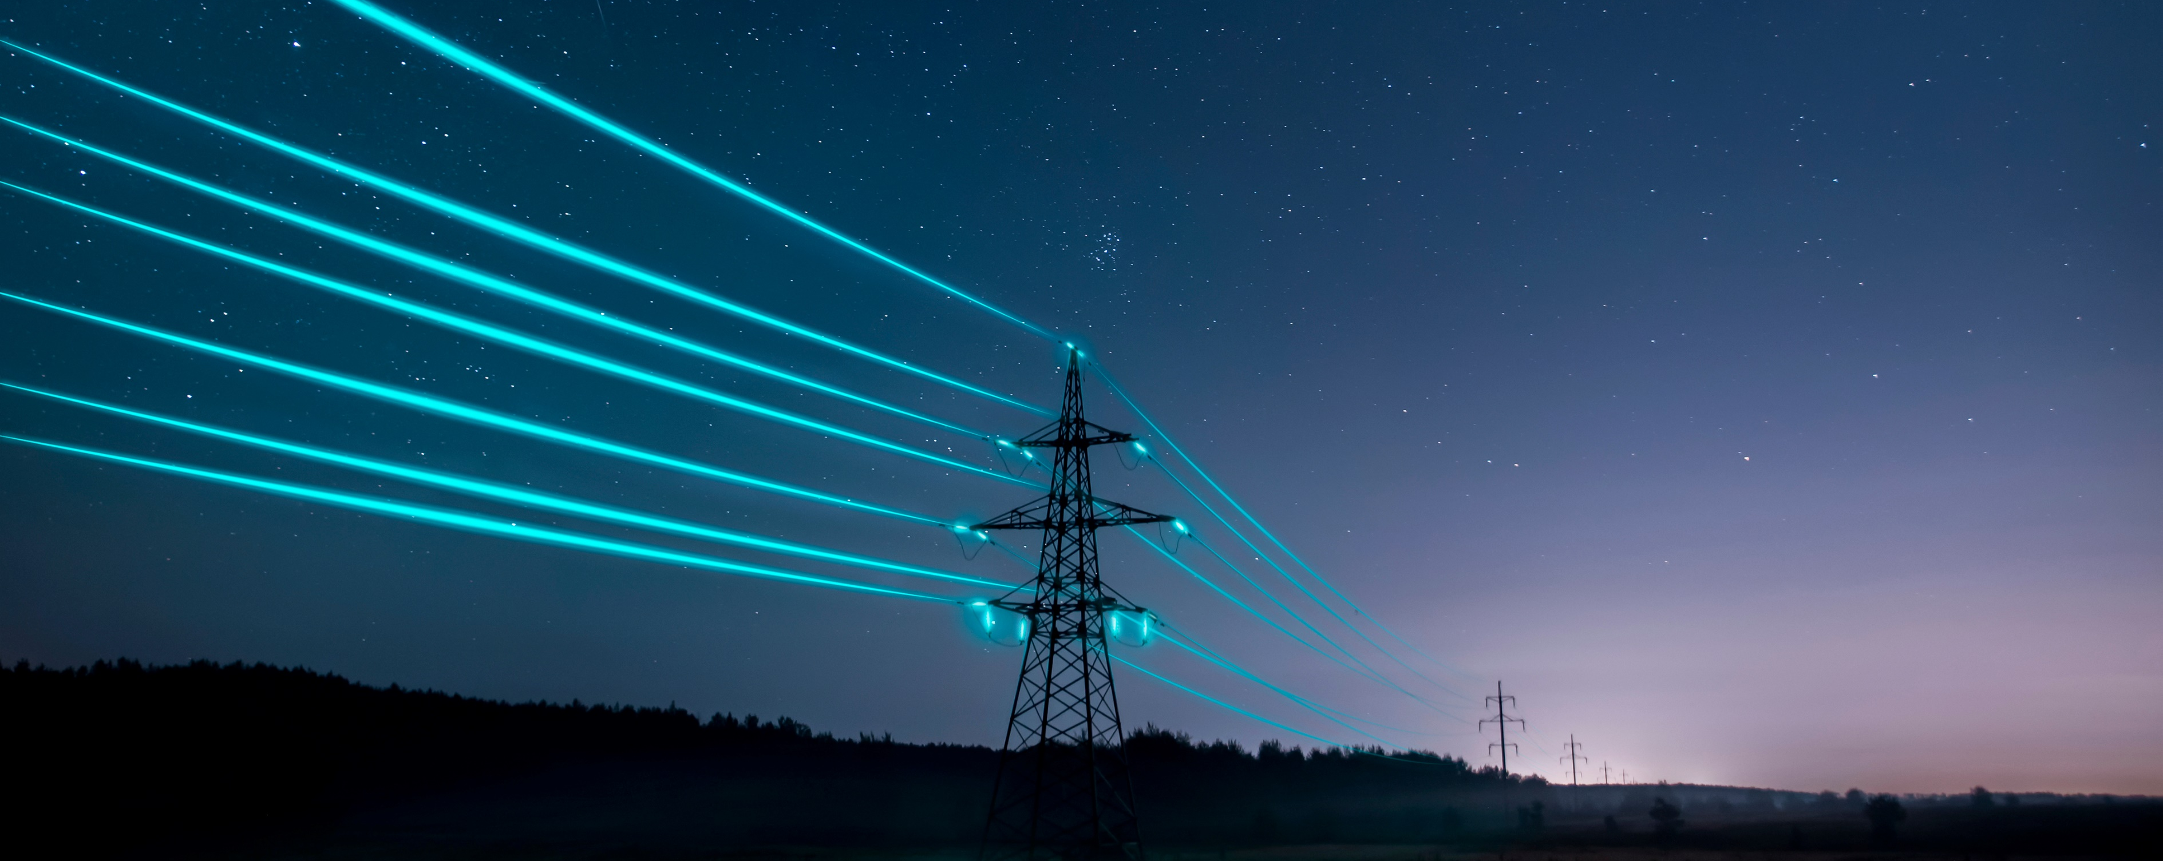
Presentation Overview
Key Research Questions and Findings
Participant Mix, Events, and System Conditions
Methodology
2025 Ex-Post Load Impacts
Ex-Ante Load Impacts for Planning

Slide 3
Key facts and performance Metrics
Customer Counts
3,500+ sites with 42 MWh of nameplate battery storage by the end of September 2025
Events
9 event days with 11 unique dispatch windows under DSGS
Growth
Site counts have increased by more than 12x from May 2025 to March 2026
21.9 MW
2025 Observed Load Reductions (Ex-Post)
21 MWh over two-hour events by the end of the season
NQC request for 2027
2025 Load Impacts for Planning Conditions (Ex-Ante)
18.3 MWh spread over 4-hour events

Slide 4
Participant Mix, Events, And System Conditions

Slide 5
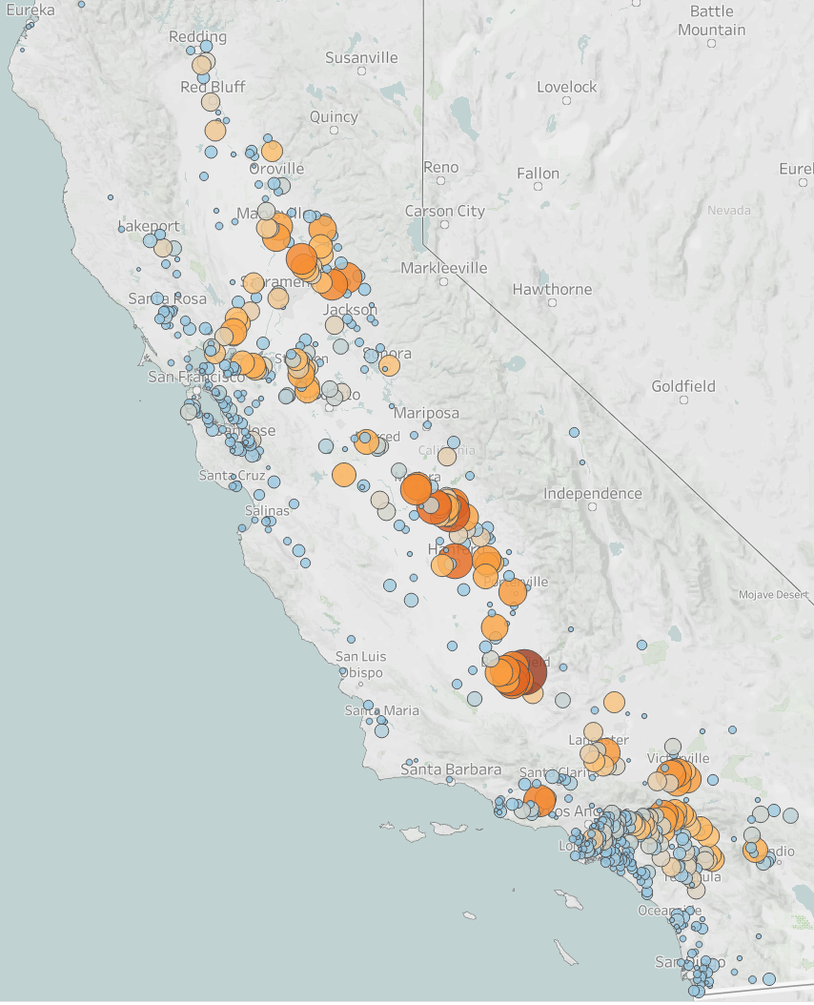
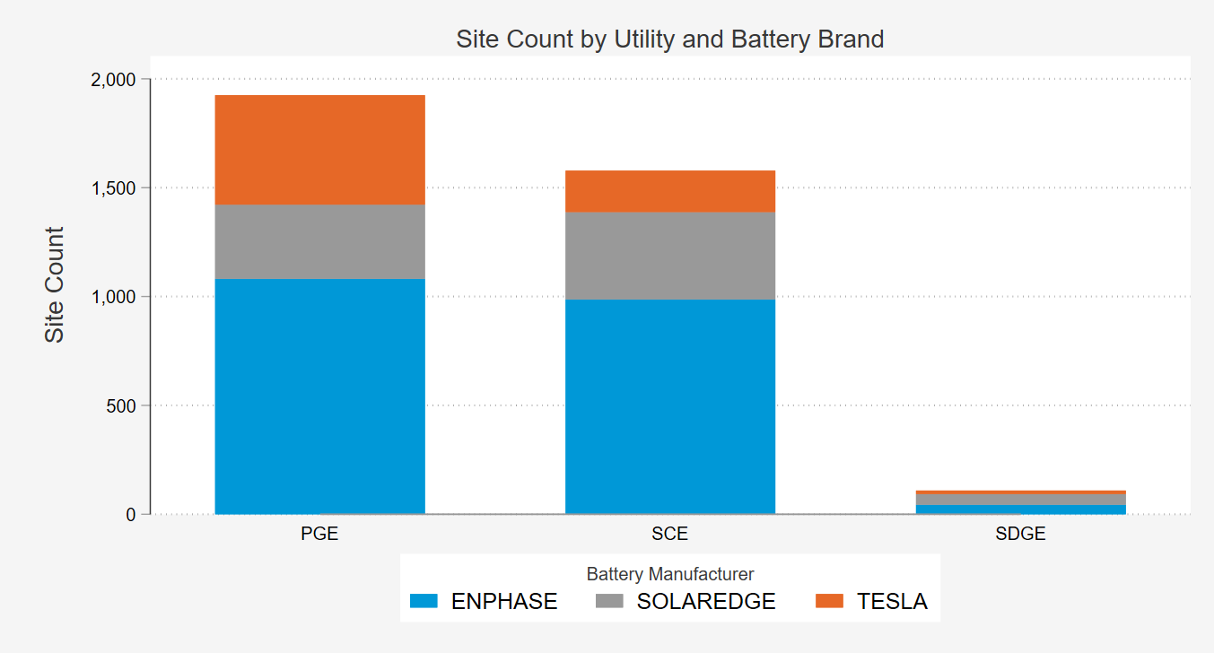
Goodleap’s Customer Mix is geographically diverse and reflects a wide array of market segments
Most participants were in PG&E’s territory and are enrolled with Enphase systems
GoodLeap had 3,500+ total enrollees by the end of September 2025
Bubbles are positioned at the centroid of a zip code
Bubble size and color are proportional to the nameplate energy storage (kWh)enrolled in the zip code

Slide 6
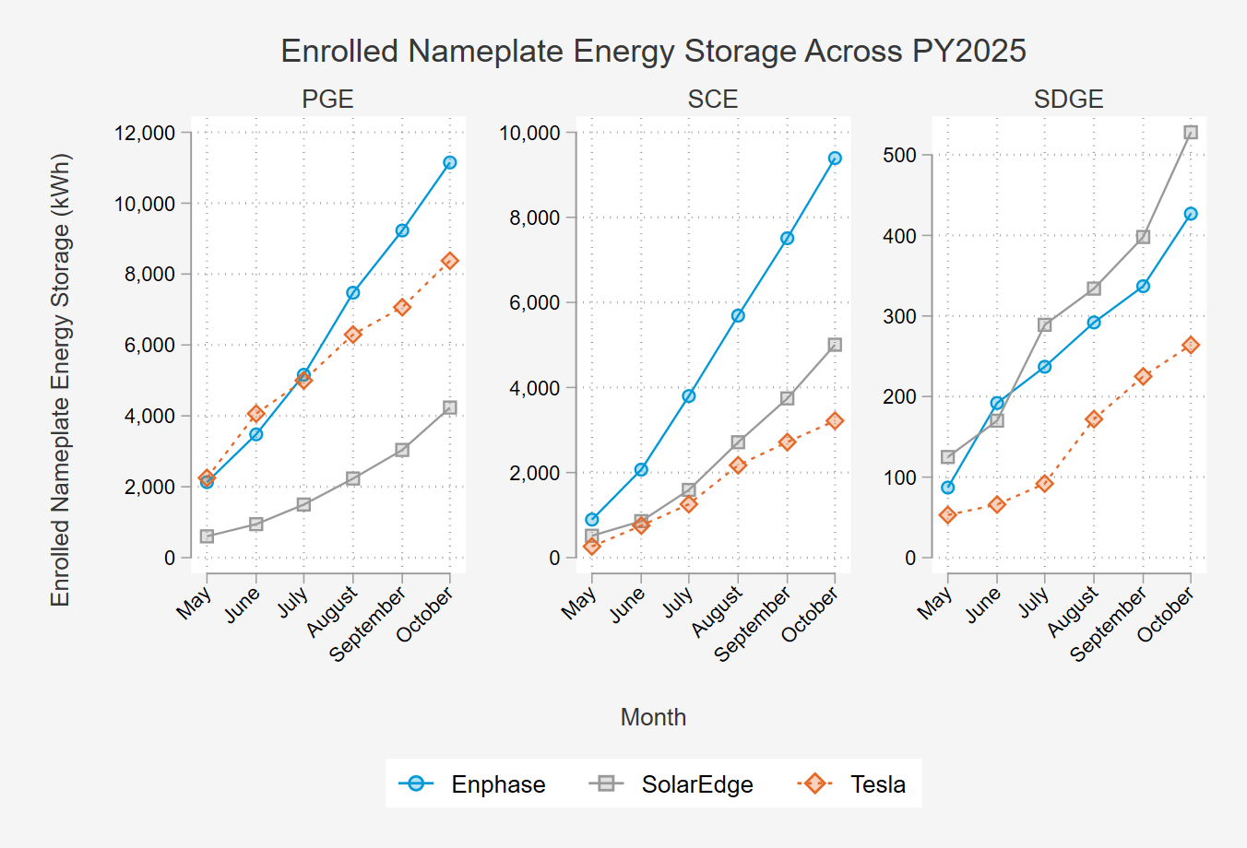
Enrollment grew substantially throughout PY2025 reaching 42 mWh of nameplate Energy by October
Individual customer counts reached over 3,500 customers by the end of September 2025
Number of participants doubled to over 7,400 customers by March 2026 (5 months)
The growth rate was over 680 customers per month from May 2025 to March 2026
By August 2027, over 19,000 sites are expected

Slide 7
DSA analyzed 11 unique events over 9 days in 2025
Events were called under a wide range of weather and system conditions.
All events were two hours and occurred during the evening peak window.
August 22 was the most critical day, with the highest system load and market prices.
Most events were called across all utilities
Three test events are included in the analysis:
  7/22
  8/22
  10/21
All metrics are reported as the hourly average across the event window

Slide 8
Methodology

Slide 9
Process for load impact evaluation
Ex post Impacts
What were the reductions delivered?
Varies based on:
  Weather conditions
  Magnitude of resources dispatched
  Hours of dispatch
  Length of dispatch
  Program/rate changes
  Participant mix
Adjustments
Standardize weather
Assume full dispatch of resources available
Standardize hours and length of dispatch
Incorporate program/rate changes
Adjust for project enrollment changes
Ex ante Impacts
What is the magnitude of program resources available under planning conditions defined by weather?
Utility and CAISO weather conditions
Produced for the system load worst day for each month
Slice-of-Day table for resource adequacy

Slide 10
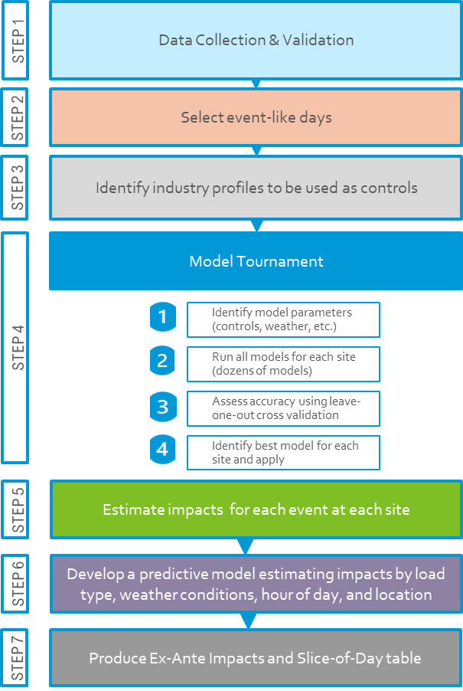
Methodology Overview
The ex-post impact estimation is centered around a model tournament to identify the best performing model for each site.
The ex-ante approach spreads out the typical event day change in SOC across a four-hour event window
Enrollment forecasts are based on the monthly growth observed from May 2025 to March 2026

Slide 11
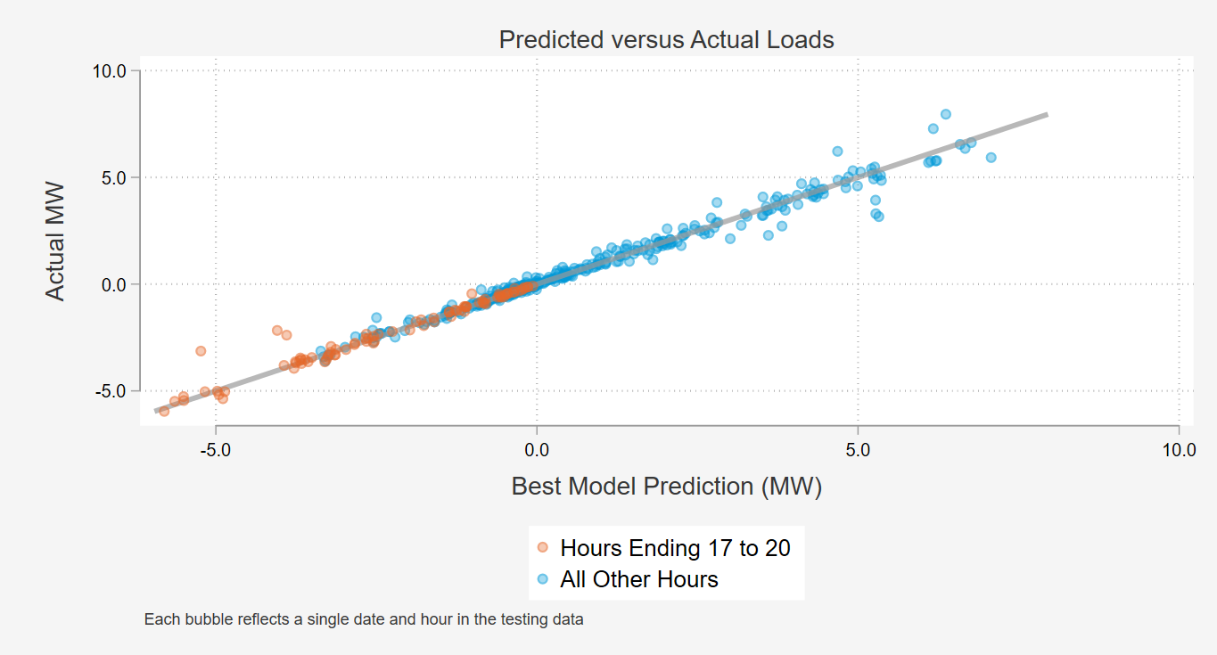
Using each site’s best performing model, baseline predictions on proxy days were very accurate, explaining approximately 93% of the variation in Peak hourly loads.
Total Predicted versus Actual Loads on Proxy Days Using Each Site’s Best Model:
Error Metrics for Per-Site Average Hourly Performance
(4:00 PM to 8:00 PM):
Model Number | Average Observed kWh | Average Predicted kWh | Average Error | RMSE | R Squared
Best Model | -1.024 | -1.048 | -0.024 | 0.155 | 93.0%
1 | -1.024 | -1.055 | -0.031 | 0.172 | 91.3%
2 | -1.024 | -1.046 | -0.022 | 0.154 | 93.0%
3 | -1.024 | -1.054 | -0.030 | 0.172 | 91.3%
4 | -1.024 | -1.052 | -0.027 | 0.159 | 92.6%
5 | -1.024 | -1.054 | -0.030 | 0.163 | 92.2%
6 | -1.024 | -1.051 | -0.027 | 0.157 | 92.8%
7 | -1.024 | -1.050 | -0.026 | 0.165 | 92.0%
8 | -1.024 | -1.053 | -0.028 | 0.157 | 92.8%

Slide 12
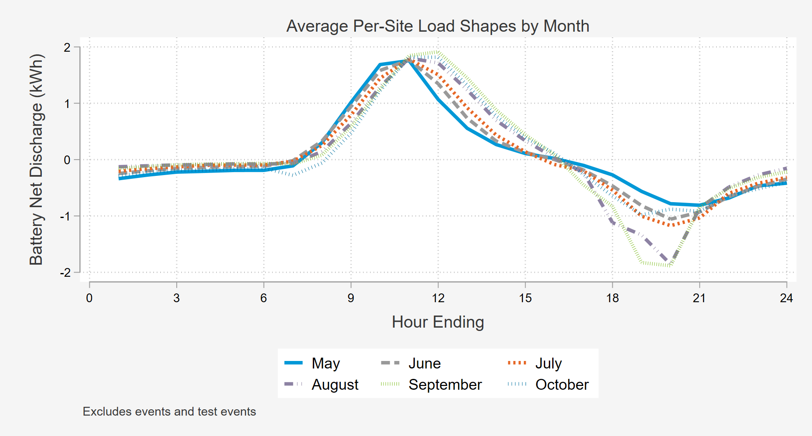
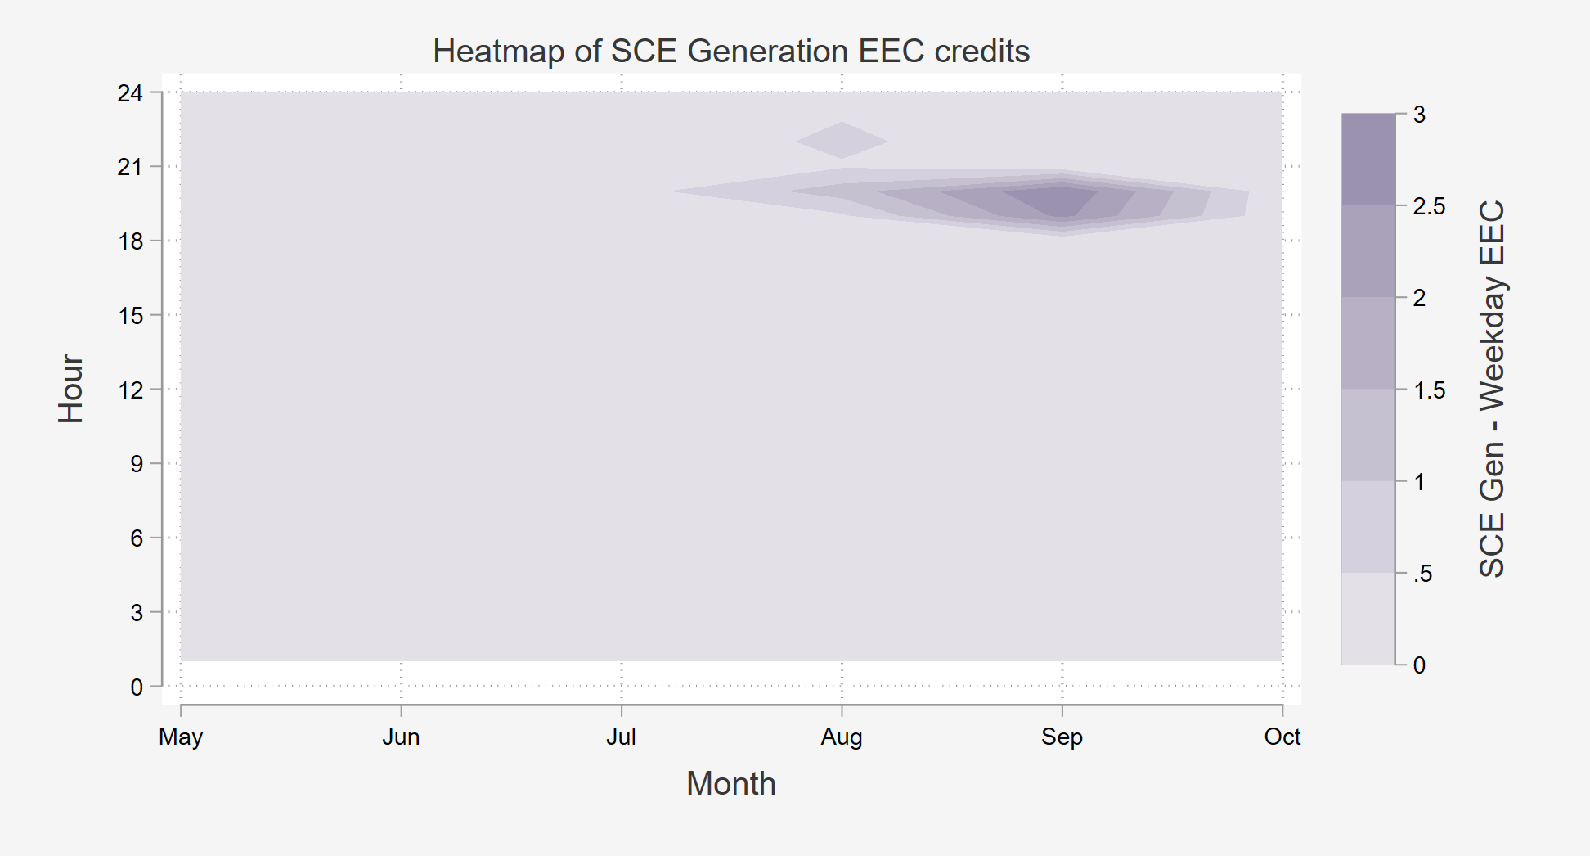
The impacts are incremental to battery output for the Net Billing Tariff
Energy Export Credits (EECs) are much greater during August and September, incentivizing the dispatch of batteries during peak periods
August and September have greater drawdowns during typical event hours
Month, day-of-week, and hourly dummy variables were included in all models to ensure that impacts are incremental to typical, rate-induced dispatch such as those from the Net Billing Tariff

Slide 13
2025 Ex-Post Load Impacts

Slide 14
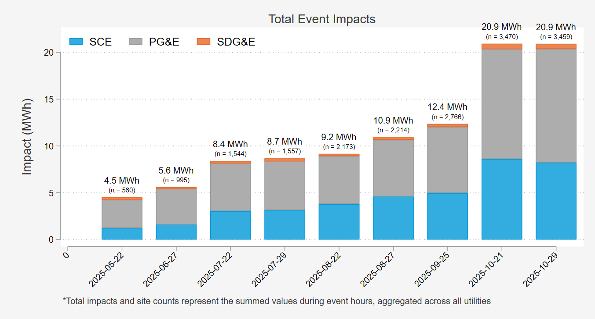
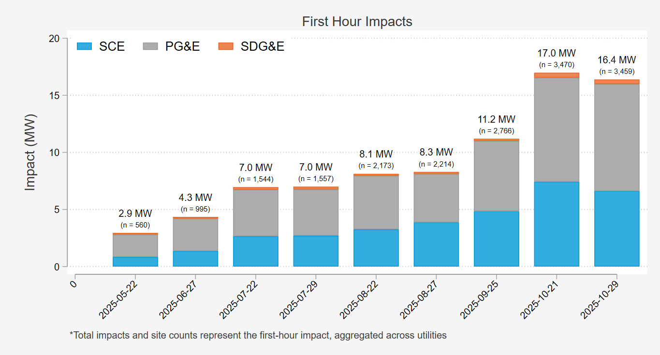
Impacts reached approximately 21 MWh by October and were largely driven by participation in PG&E’s territory
PG&E sites delivered the bulk of impacts across the two-hour events
First hour impacts were high across all events

Slide 15
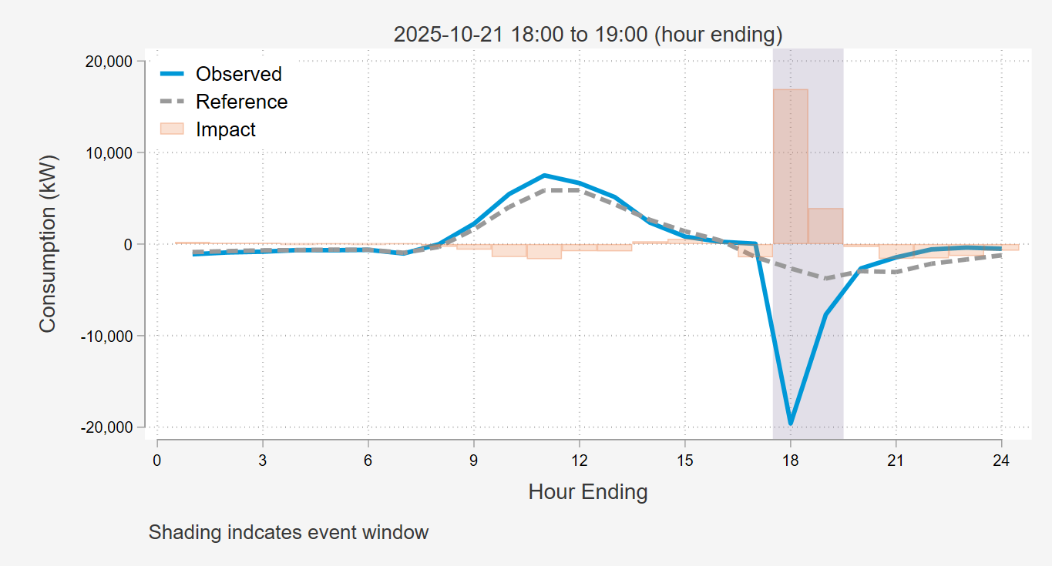
First hour Impacts Drove event performance for all events
On event days, batteries typically hold their charge until the event
There is a significant discharge during hour 1, diminishing in hour 2
After the event, there is still a small amount of battery discharge
The event with the largest participation during a single event window was 10/21 from 5-7PM.

Slide 16
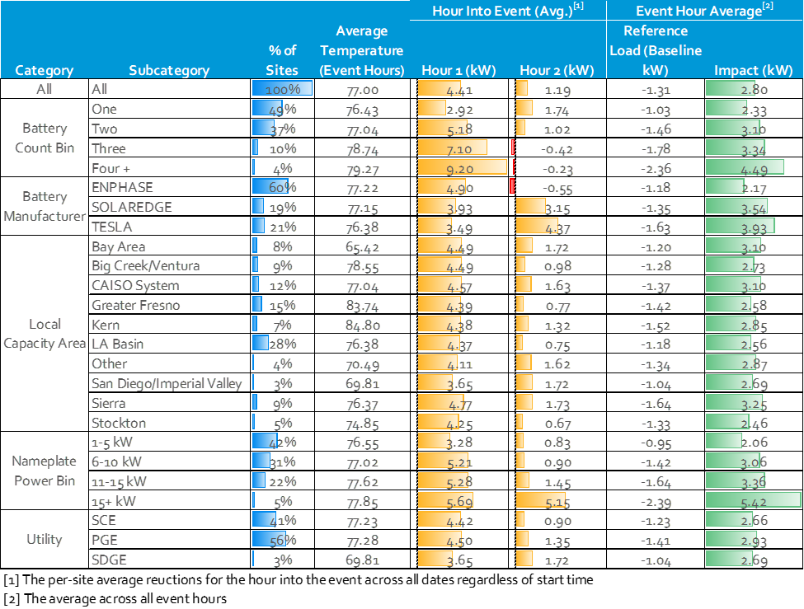
Detailed results by segment for average event

Slide 17
Ex-Ante Load Impacts For planning and Operations

Slide 18
Process for load impact evaluation
Ex post Impacts
What were the reductions delivered?
Varies based on:
  Weather conditions
  Magnitude of resources dispatched
  Hours of dispatch
  Length of dispatch
  Program/rate changes
  Participant mix
Adjustments
Standardize weather
Assume full dispatch of resources available
Standardize hours and length of dispatch
Incorporate program/rate changes
Adjust for project enrollment changes
Ex ante Impacts
What is the magnitude of program resources available under planning conditions defined by weather?
Utility and CAISO weather conditions
Produced for the system load worst day for each month
Slice-of-Day table for resource adequacy

Slide 19
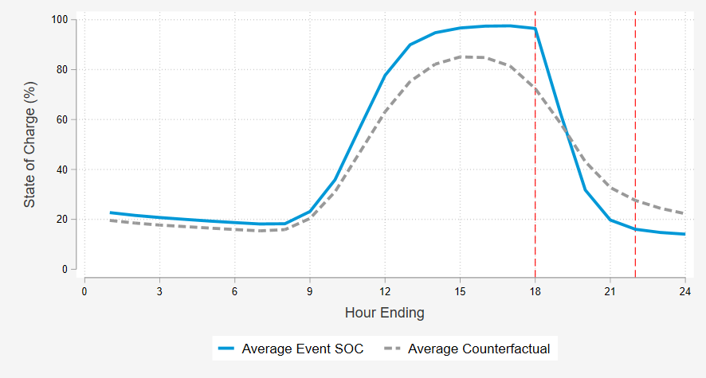

The ex-ante Modeling focused on the change in battery state of charge during events
Key issue:
To sustain impacts, the dispatch strategy must differ between 2-hour and 4-hour events
Example average SOC versus Modeled SOC for Events starting at 6:00 PM
What was done:
Estimate the battery state of charge on event and non-event days
Spread incremental reduction in state of charge over the 4-hour period in RA window
H-1
H+4
How do batteries provide incremental resources?
Ensure the battery is a near full state of charge at start of event, then draw the battery rapidly on event days.
Typically, batteries have greater than 20% reserve for backup power. During events, batteries are drawn down to 15%-20% state of charge.
Typically, batteries just offset whole home loads, but they can export back to the grid during time of high system demand.
$$SOC Impact=\left(SOC_{h−1, event }−SOC_{h+4, event}\right)−\left(SOC_{h−1, nonevent }−SOC_{h+4, nonevent}\right)$$

Slide 20
Battery capability for a 4 –hour Event
Predicted August 2027 Load Shapes (1-in-2 Utility Worst-Day)
kW

Slide 21
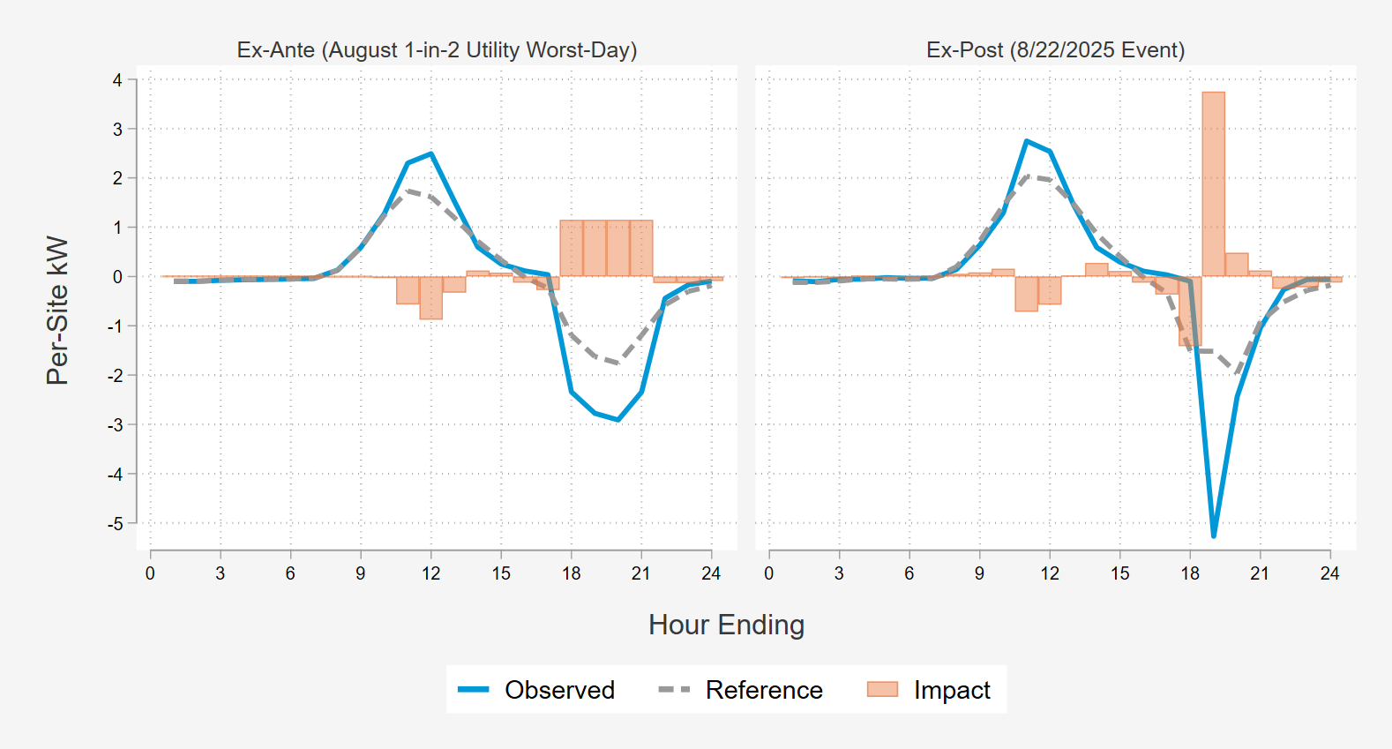
Comparison to Ex-Post load shapes
Load shapes prior to events are very similar between the ex-ante predictions and what was observed during 2025
Ex-post impacts have sharp, dramatic drops in load during the first hour
Batteries have the capability to flatten the load reductions, leading to consistent impacts across the RA window

Slide 22
Comparison to largest Ex-Post event
The impact estimated for August 2025 using the ex-ante model aligns with the event day when all resources were dispatched
  18.3 MWh (ex-ante) vs 21.0 MWh (ex-post)
The average impact per-hour is notably lower due to the duration of the events
  Ex-Ante predicts for a 4-hour event
  Ex-Post only saw 2-hour events
Day Type | # Dispatched | Event Hour Avg Temp | Avg Per-Customer Hourly Impact (kW) | Avg Per-Customer Total Impact (kWh) | Agg Total Impact (MWh)
Ex-Ante: 2025 October Worst Day 1-in-2 (4-hour event; 5:00 - 9:00PM) | 3,564 | 78.9 | 1.28 | 5.14 | 18.3
Ex-Post: 10/21/2025 (2-hour event; 5:00-7:00 PM) | 3,564 | 72.5 | 3.03 | 6.07 | 21.0

Slide 23
Forecasted Reductions: The NQC request for 2027 is 21.9 mW
August 1-in-2 Utility Worst-Day Conditions:
Year-Month | PGE |  |  | SCE |  |  | SDGE |  |  | Total
 | Sites | Avg. MW | MWh | Sites | Avg. MW | MWh | Sites | Avg. MW | MWh | Sites | Avg. MW | MWh
2025-08 (Base) | 1,265 | 1.5 | 5.9 | 938 | 1.1 | 4.3 | 74 | 0.1 | 0.3 | 2,277 | 2.6 | 10.5
2026-08 | 5,150 | 6.0 | 23.9 | 5,262 | 6.0 | 24.1 | 410 | 0.4 | 1.8 | 10,822 | 12.5 | 49.8
2027-08 (NQC Request) | 8,966 | 10.4 | 41.7 | 9,342 | 10.7 | 42.9 | 722 | 0.8 | 3.1 | 19,030 | 21.9 | 87.6
2028-08 | 12,782 | 14.9 | 59.4 | 13,422 | 15.4 | 61.6 | 1,034 | 1.1 | 4.4 | 27,238 | 31.4 | 125.4
The forecast assumes linear growth based on historical installations per month

Slide 24
2027 Load reduction capability under Slice-of-Day Framework
Summarizes the load reduction capability by month and hour for planning conditions

Slide 25
Key Findings

Slide 26
Key Analysis Findings
1 | Program enrollment grew substantially, expanding from 560 sites in May 2025 to over 7,400 sites by March 2026 | 5 | Under August 1-in-2 conditions, the portfolio delivers an average of 4.6 kWh per-site across four-hour events
2 | Impacts scaled with enrollment, reaching 21 MWh of load reductions for two-hour events by the late summer | 6 | Ex-post impacts were heavily concentrated in the first hour, reflecting dispatch without the requirement to distribute impacts
3 | Ex-ante modeling supports an NQC value of 21.9 MW | 7 | Segmented ex-post results show that impacts are generally consistent across the portfolio, with higher reductions from larger systems and hotter regions
4 | Ex-ante results indicate that battery discharge can effectively be shaped to sustain a four-hour event window | 8 | Event based impacts are incremental to NBT-driven behavior, with batteries delivering incremental reductions above typical behavior

Slide 27

Questions?
Josh Bode
Partner and Principal Consultant
Demand Side Analytics
jbode@demandsideanalytics.com
Parker Gauthier
Consultant
Demand Side Analytics
pgauthier@demandsideanalytics.com

