Slide 1


Renew Home 2025 LIP Evaluation
Presented at the Demand Response Providers’
PY2025 Load Impact Protocol Final Report Workshop
hosted by the California Public Utilities Commission
May 11, 2026
Co-authors:
Sam Borgeson
Phil Price

Slide 2
Spun off from Google’s Nest Renew team
Subsequently acquired OhmConnect
Renew Home currently operates two different resources
The “legacy” OhmConnect resource that offers residential customers a system of rewards to shift consumption away from “OhmHour” events
A new Renew Home VPP resource, consisting of homes with smart thermostats and operating since June 2025
  This is the source of Renew Home’s continuing DR capacity in California’s 3rd party DR market

Slide 3
Resource plans and implications
The new company will suspend operation of the OhmConnect “legacy resource”
  The legacy resource features hundreds of thousands of enrolled customers with heterogenous device ownership and dispatch logic
  Ex post performance was reported for PY2025 (report and table generator), but no ex ante forecast was made
Retained and newly recruited customers are part of the Renew Home “VPP resource” operated by the company since July 2025
  The VPP resource in formation has tens of thousands of customers primarily with HVAC loads dispatched via their smart thermostats
  PY2025 marks the first year of data availability from the VPP resource and the current LIP process will produce its first QC assignment

Slide 4
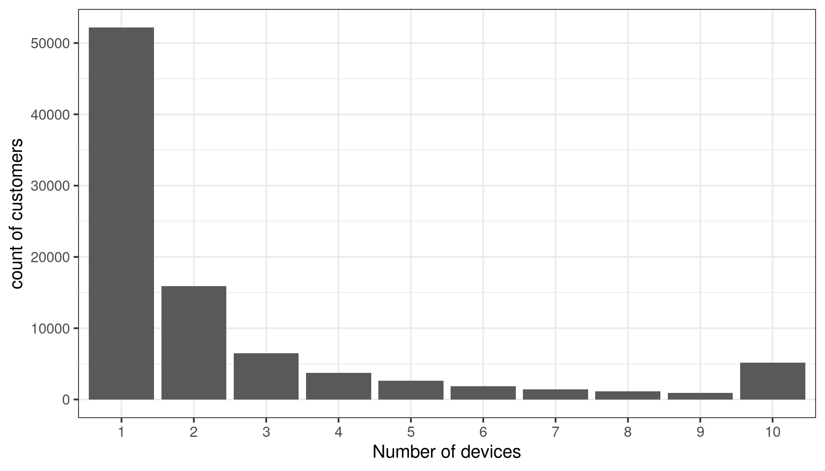
The VPP is a more homogeneous resource
VPP resource
  Thermostats, typically one-per-household
OhmConnect (legacy)
  Over 60% of customers have no device
  Of device customers, 1/3 are thermostat-only
  the remainder are mixed or other device types, primarily smart plugs
Legacy resource device counts per-participant

Slide 5
Ex post

Slide 6
Challenges of measurement
Whole-home consumption data with variable loads creates challenges:
  PV system generation is large and can be highly variable across baseline and event periods
  EV charging and home battery utilization can have large impacts on whole home consumption patterns
DR effects can be relatively modest per-household
Potentially biasing conditions lead to dispatch (event days not like baseline days)
The combined effect of these issues is low signal-to-noise ratio at the event level, for many events.

Slide 7
Methods and benefits of RCTs
Randomized Controlled Trials (RCTs) feature random selection of controls from the pool that is dispatched ensures that there is no systematic difference between the groups.
Control data comes from the locations and times the event is occurring
  Large confounding loads are randomly distributed across participants and controls
  Differences between day-to-day conditions and drivers of load patterns have significantly reduced influence

Slide 8
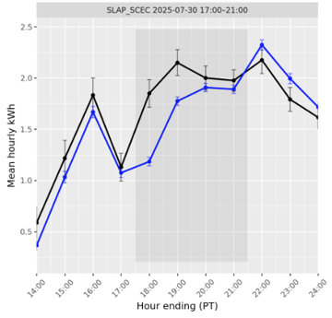
Example event with controls
The “simple” event impact is the difference between participant and control loads (without baseline and same-day adjustments)
Both participant and control averages contain uncertainties that carry into the impact estimate
Fewer participant/controls increase uncertainty, so there are limits to how precise we can be for small events or those with few controls
Participants are in blue and controls are in black.

Slide 9
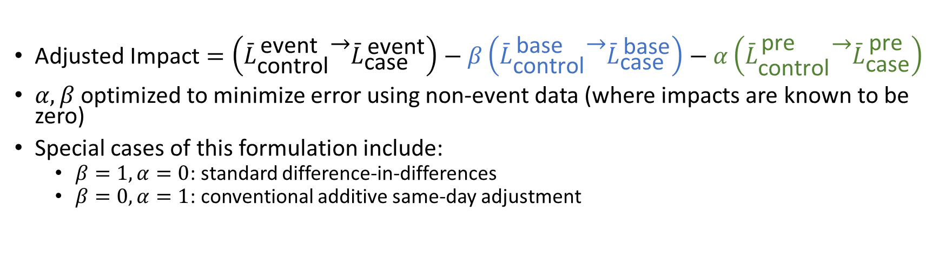
Estimating impact using randomized controls
Baselines remain useful – we utilize the difference in differences between controls and dispatched on baseline and event days. This is called a “difference-in-differences (DiD)” calculation
We also use a same day adjustment to true up loads during the pre-period prior to the event
Raw estimate (simple difference)
Baseline day adjustment (DiD)
Same day adjustment
$\text{Adjusted} \text{Impact}=\left({\overset{ˉ}{L}}_{\text{control}}^{ \text{event}} − {\overset{ˉ}{L}}_{\text{case}}^{ \text{event}}\right)−β\left({\overset{ˉ}{L}}_{\text{control}}^{ \text{base}} − {\overset{ˉ}{L}}_{\text{case}}^{ \text{base}}\right)−α\left({\overset{ˉ}{L}}_{\text{control}}^{ \text{pre}} − {\overset{ˉ}{L}}_{\text{case}}^{ \text{pre}}\right)$
$α, β$ optimized to minimize error using non-event data (where impacts are known to be zero)
Special cases of this formulation include:
  $β=1,α=0$: standard difference‑in‑differences
  $β=0,α=1$: conventional additive same‑day adjustment

Slide 10
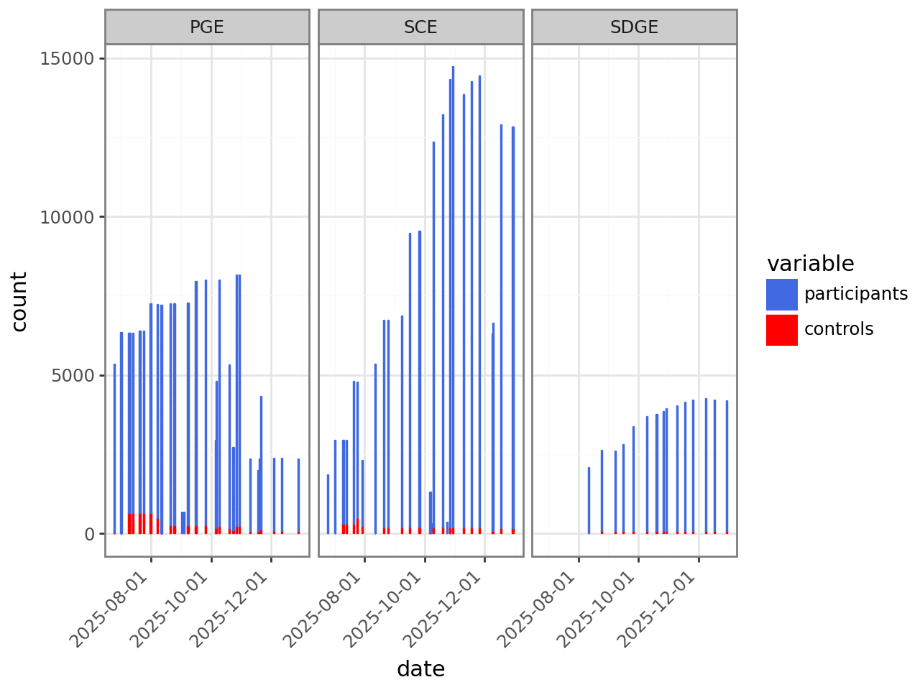
RCT based evaluation
Comparatively few controls are sufficient to produce estimates with reasonable error bands
The figure illustrates the proportion of controls (in red) to participants (in blue) in the data set used to evaluate each event for the VPP resource
A couple of events were “full dispatch” and lacked controls, and were evaluated via simple baselines

Slide 11
Caveats
Nothing is free – control customers must be withheld from events
Uncertainty remains in the estimates – it can be reduced by withholding more customers, but cannot be fully eliminated
  Smaller events have larger errors
While overall errors will be unbiased, individual events can be biased high or low
Better sources of device or sub-load data would improve estimates even further

Slide 12
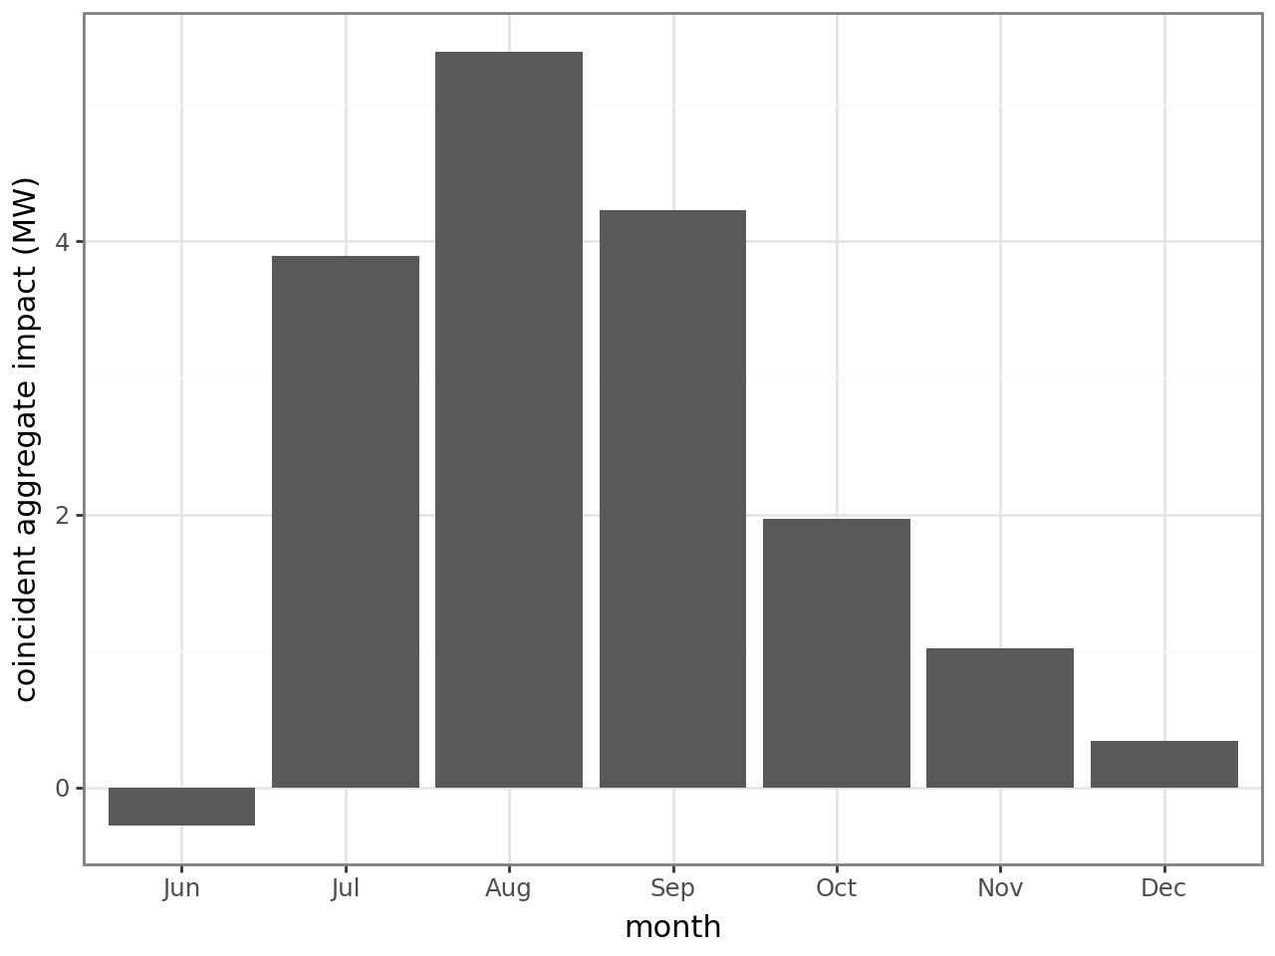
VPP monthly all participant aggregate impact
Event dispatch began in earnest in July, continuing through the end of the year
Since the resource is thermostat based, the capacity is seasonal
Holding participation constant, it scales with cooling loads

Slide 13
LEGACY OhmConnect ex post
The OhmConnect resource was also evaluated using ex post methods (for the last time)

Slide 14
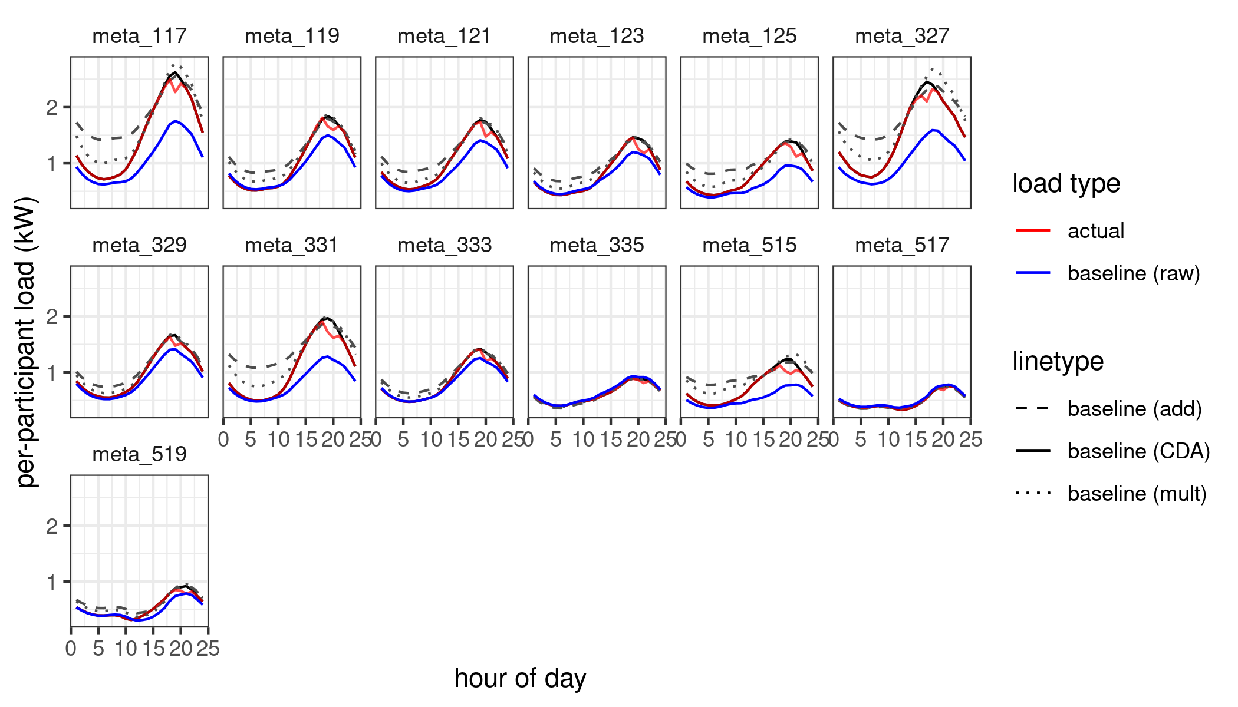
LEGACY: ex post methods
10 of 10 baselines
  Average of usage for the past 10 non-holiday weekdays
    Adaptive additive same day adjustments
  Aligns the baseline and event day data using the 2nd and 3rd hours before an event

Slide 15
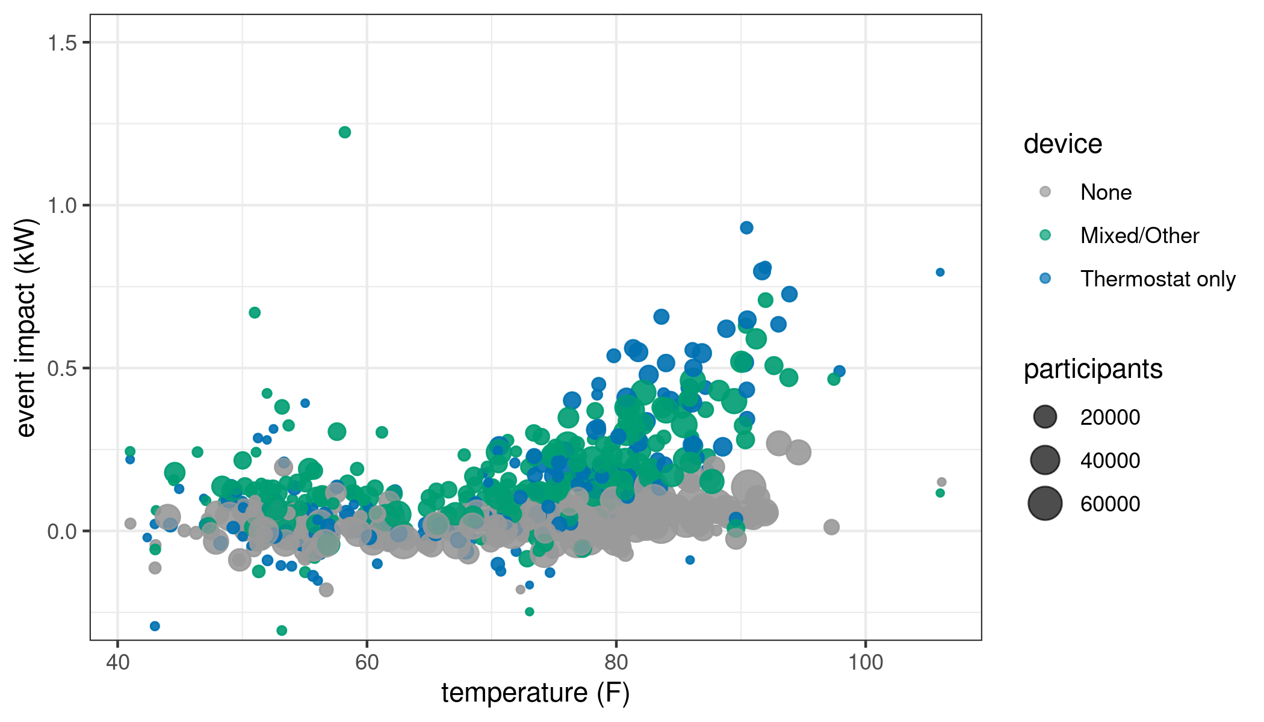
LEGACY ex post: patterns in impacts due to temperature and device category
The overall resource is clearly temperature responsive/dependent
Thermostat only customers are the most temperature responsive

Slide 16
Ex post summary
VPP resource
  RCTs produce higher quality ex post data
  Customers have substantially higher impacts in hotter weather, but there are differences across subLAPs in magnitude
  Customers in hotter subLAPs have higher average impacts than customers in cooler ones and events during hotter months produce greater impacts
  Data from July through December was sufficient to predict for a full year of conditions
OhmConnect Legacy
  customers with multiple/mixed devices out perform thermostat-only customers on average, but not at higher temperatures
  PY2025 legacy resource impacts consistent with prior years, after controlling for temperature

Slide 17
Ex ante

Slide 18
Ex ante methods
Ex Ante load forecasts are regression model predictions of the load impact that will be provided in future months in 1-in-2 weather conditions, based on fits of the temperature influence over per-customer ex post impacts
Fit using only the randomized controlled trial (RCT) events
  Estimated temperature-response relationships are grounded in impact estimates that are free of confounding factors
Ex post event data only span July-December, but that covers the range of expected annual temperature variability

Slide 19
Ex ante methods: models used
Two impact models are fit: a "high-temperature" model covering warm and hot conditions, and a "low-temperature" model covering cool and cold conditions
High temperature (cooling) model assumes piecewise linear temperature response, with knots at 65F and 75F (loads increasing at higher temperatures)
Low temperature (heating) model assumes a piecewise linear response, with knots at 70F and 60F (loads increasing at lower temperatures)
Separate coefficients for hours 1 and 2 are estimated for both the hot and normal sub-LAP groups. (reflecting the effects of pre-cooling in hour 1)

Slide 20
Ex ante methods: more details
Events with more participants yield more precise impact estimates: the model is fit using weighted least squares with weights proportional to the inverse variance of the per-event ex post impact estimate
Sub-LAPs are grouped into three categories for modeling purposes.
  Hot - inland PG&E and inland SCE territories (PGF1, PGKN, PGSI, PGZP, PGNC, SCEC, SCEN, SCLD)
  Cool - are the coastal and bay-area PG&E territories (PGCC, PGSF, PGHB)
  All remaining - including SDG&E and the remaining SCE territories - form the "normal" group.
Sub-LAP temperature-response coefficients are estimated using a form of regularization known as "ridge regression," in which the deviation of each sub-LAP's coefficient from its group mean (hot or normal) is pulled toward zero

Slide 21
Projected enrollment
Renew Home provided low, medium, and high enrollment forecasts, which were used to generate low, medium, and high aggregate impact forecasts
Renew Home forecasts substantial growth in enrollment for the “VPP resource,” which consists of smart thermostat owners
For purposes of ex ante, we ignore legacy OhmConnect customers, i.e. they will not be dispatched going forward

Slide 22
Per-customer predicted monthly load impact
Ex ante per-customer impacts are substantial but the average impact over a four-hour event is smaller than estimated from the previous reporting period (PY2024, based on “legacy” thermostat owners)
The impact for the first two hours of long events was higher than previously forecast, and this is reflected in high ex ante forecasts for hours 1 and 2…
… however the impact after hour 2 is not statistically distinguishable from zero, reducing the 4-hour event-average impact

Slide 23
Ex Ante aggregate forecast
Due to growing enrollment, aggregate capacity is predicted to increase over the coming years
All sub-LAPs are forecast to increase in enrollment by roughly the same factor. The low and high enrollment scenarios allow more variation in growth rates among sub-LAPs.
Greatest impacts are predicted for the afternoon through early evening
May through October are predicted to have larger impacts than cooler months

Slide 24
Questions?
sam@convergenceda.com

