Slide 1
Voltus - Load Impact Protocols
Third Party DRP LIP Workshop – May 11th, 2026
Confidential Information Excluded

Slide 2
Agenda
Voltus Load Impact Protocols Workshop
Voltus Background
Portfolio and Program Descriptions
Ex Post Methodology
Ex Post Load Impacts
Ex Ante Methodology
Ex Ante Load Impacts

Slide 3
Voltus Background

Slide 4

Background
Voltus History
Demand Response Provider across North America since 2016
Track record of successful DR programs
Entered PG&E CBP and PG&E BIP in 2019
Awarded DRAM capacity in PG&E and SCE territory from 2020 until program ended in 2024
Became scheduling coordinator in 2020 and currently providing RA to CCAs in California.
Actively engaged in the 3rd party CCA RA contracts, PG&E and SDG&E CBP, PG&E and SCE BIP, and PG&E and SCE DSGS (Option 2 and Option 3)

Slide 5
Importance of DR qc in light of dram sunset
Voltus DRAM MW are currently ‘stranded’ from providing supply-side RA
The DRAM program concluded in 2024, resulting in double-digit MW of Voltus’s DR contracts needing to be migrated to other similar day-ahead DR programs such as:
  Capacity Bidding Program
  CEC DSGS Option 2 Program
  CCA RA contracts via LIP
However, Voltus’s 2025 QC award was less than portfolio capabilities
  Resulted in our CCA RA program over-subscribed for 2025, and no DRAM customers could migrate to CCA RA; double-digit MW had to migrate away
  There is concern that sunsetting of DSGS may facilitate similar dynamics
Key Takeaway: in light of DRAM (and potentially DSGS) sunsetting, an increase in QC award is key to supplying additional supply-side RA to deliver least-cost, clean capacity resources and increased reliability

Slide 6
Voltus and Program Descriptions

Slide 7
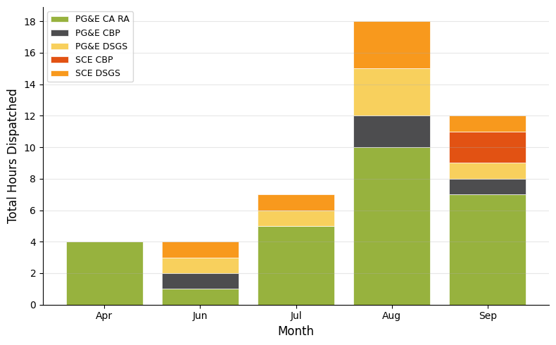
California DR Participation
PY 2025 Programs and Dispatches
 | PG&E CA RA | PG&E CBP | PG&E DSGS | SCE CBP | SCE DSGS
Num. of Voltus Event Days | 10 | 3 | 4 | 1 | 4
Num. of 1 to 2 Hour Dispatches | 9 | 3 | 3 | 1 | 3
Num. of Dispatches 3 Hours or Longer | 4 |  | 1 |  | 1
2025 Enrolled Facilities by IOU | 232 |  |  | 102
IOU | Participant Event Hours | Participant Event Hours
Program | HE 17 | HE 18 | HE 19 | HE 20 | HE 21
PG&E | 156 | 1,037 | 760 | 336 | 255
SCE | 72 | 206 | 74 | 96 | 22

Slide 8
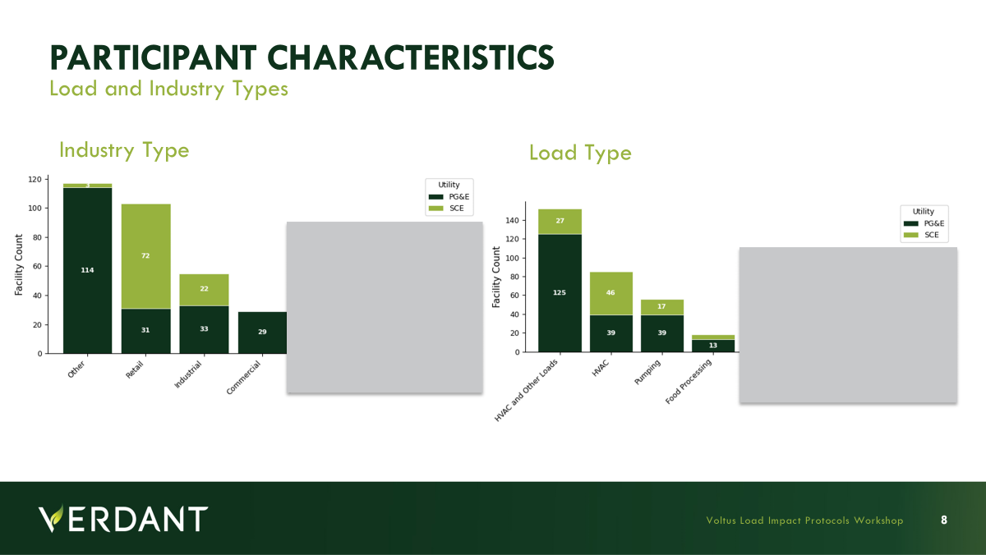
Load Type

Slide 9
Ex Post Methodology
And Impacts

Slide 10
Ex Post Methodology
Overview
Individual, hourly regression models were used to estimate ex post impacts.
Individual models were selected due to:
  Event variability
  Participant load variability
  Reporting granularity
Model selection based on tournament, where candidate models vary by:
  Weather sensitivity
  Season (summer, winter, shoulder)
Model selection based on fit (MAPE and CV RMSE) using a set of event like holdout days.

Slide 11
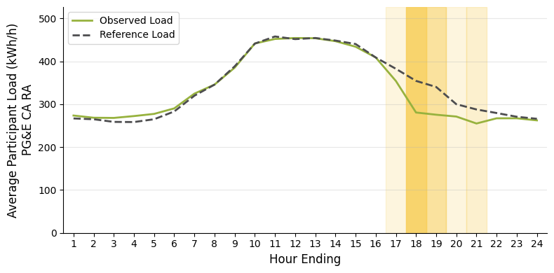
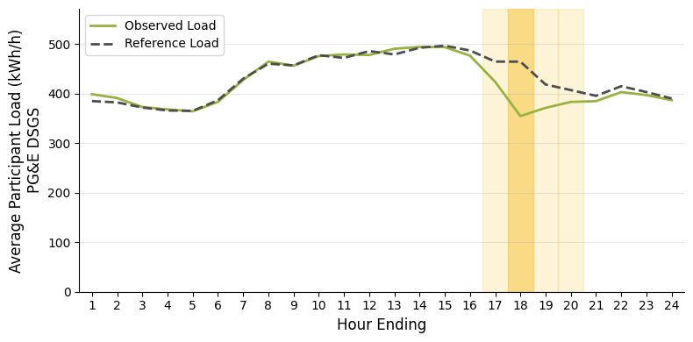
Ex Post Impacts
PG&E CCA RA and DSGS Average Event Day
Program | Avg. Number of Facilities | Mean Reference Load (kWh/h) | Avg. Facility Impact (kWh/h) | Pct. Load Reduction | Avg. Total Reduction MWh/h | Avg. Event Temperature (F)
PG&E CCA RA | 71.7 | 750.41 | 399 | 53 | 6 | 71.9
PG&E DSGS | 41.5 | 451.13 | 102.8 | 23 | 4.26 | 74.6
Note: PG&E CBP excluded on 15/15 reporting rule for confidentiality.

Slide 12
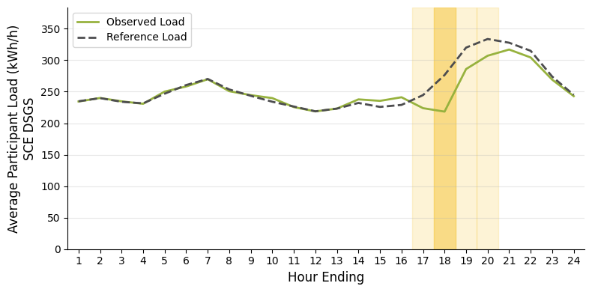
Ex Post Impacts
SCE DSGS Average Event Day
Program | Avg. Number of Facilities | Mean Reference Load (kWh/h) | Avg. Facility Impact (kWh/h) | Pct. Load Reduction | Avg. Total Reduction MWh/h | Avg. Event Temperature (F)
SCE DSGS | 69.5 | 273 | 65.8 | 24 | 4.56 | 74.7
Note: SCE CBP excluded on 15/15 reporting rule for confidentiality.

Slide 13
Ex Ante Methodology
And Impacts

Slide 14
Ex Ante Methodology
Overview
The ex ante methodology used adjusted ex post customer-specific regressions.
Step 1: Predicted per-customer weather-adjusted reference loads
Step 2: Estimate Ex Ante Impacts as a percent load reduction for each group of participants for each load type and SubLap combination
Step 3: Apply percent load reductions to reference loads, include degradation for events longer than estimated event hours
Step 4: SubLAP and Load Type hourly per capita impacts are applied to the participant enrollment forecast to calculate total ex ante MW
Total Participant Event Hours By IOU and Hour
Hour Ending | PG&E | SCE
HE 17 | 156 | 72
HE 18 | 1,037 | 206
HE 19 | 760 | 74
HE 20 | 336 | 96
HE 21 | 255 | 22

Slide 15
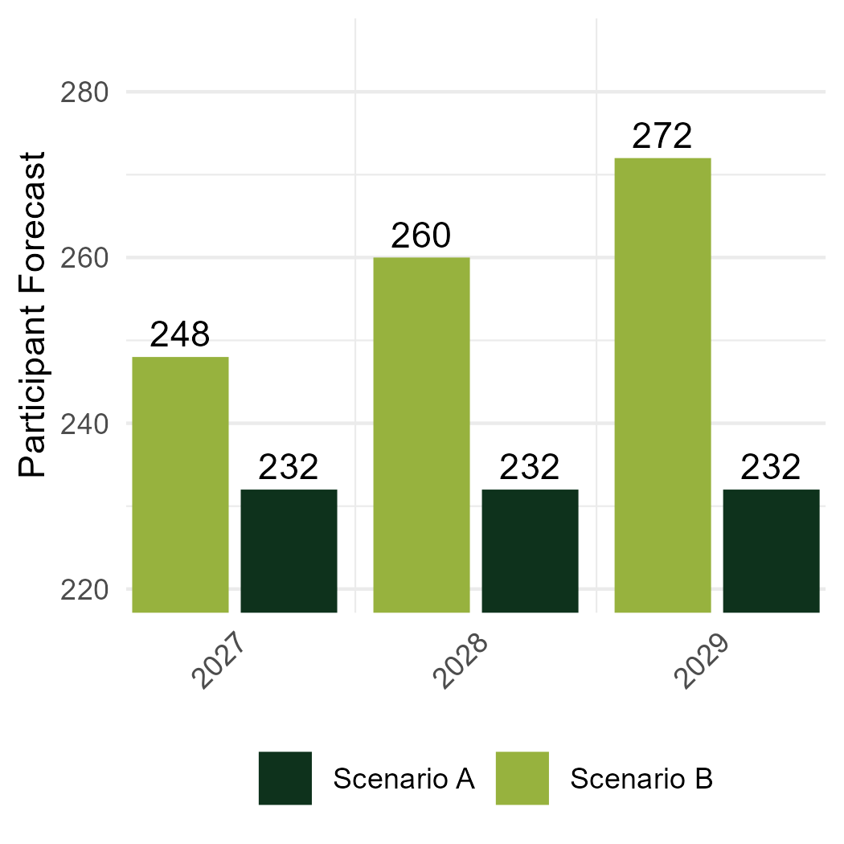
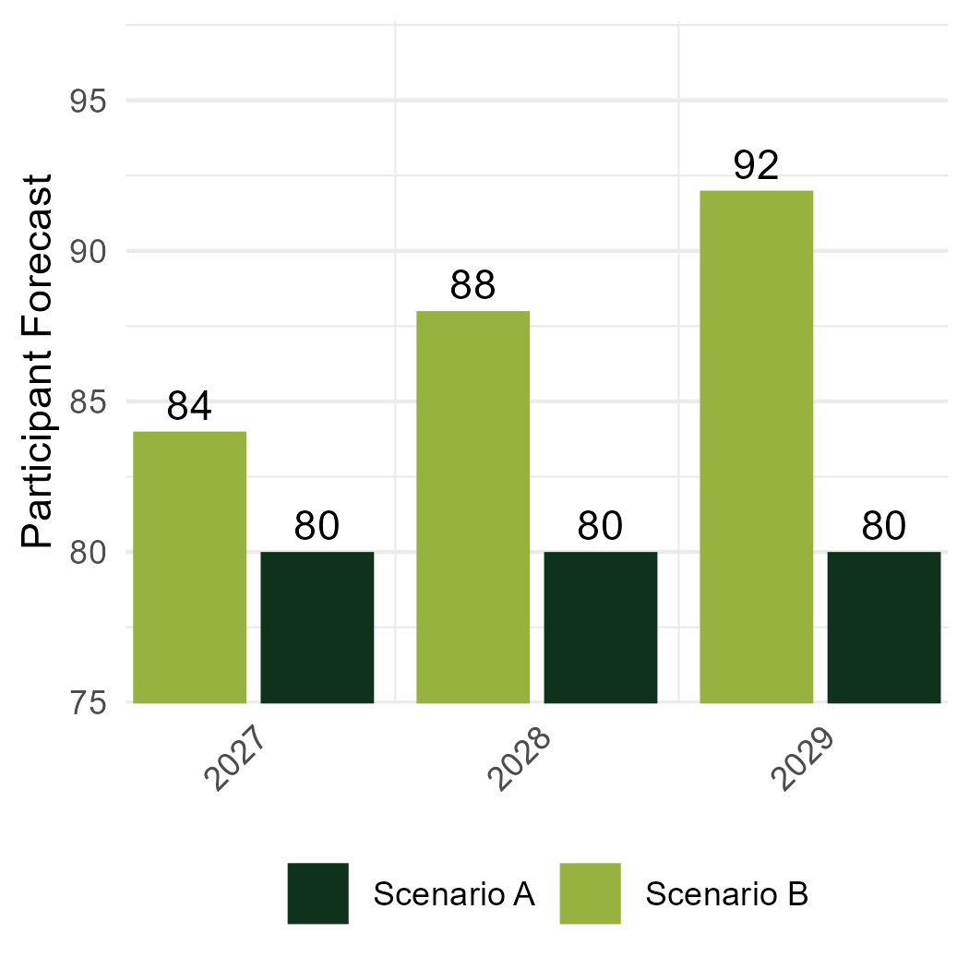
Ex Ante Forecasts
Participant Forecasts 2027 through 2029
Ex Ante forecasts were provided by a growth and maintenance scenario
Verdant allocated these forecasts to specific SubLAPs based on 2025 allocation
Voltus expects participant growth for both PG&E and SCE

Slide 16
Ex Ante Impacts
PY 2027 - 2029 Ex Ante Impact Estimates – August Monthly Worst Day
Utility and Year | Scenario A |  |  | Scenario B
 | Part. Forecast | CAISO 1-in-2 (MWh/h) | Utility 1-in-2 (MWh/h) | Part. Forecast | CAISO 1-in-2 (MWh/h) | Utility 1-in-2 (MWh/h)
PG&E
2026 | 232 | 38.2 | 35.3 | 236 | 38.9 | 35.9
2027 | 232 | 38.2 | 35.3 | 248 | 40.8 | 37.7
2028 | 232 | 38.2 | 35.3 | 260 | 42.8 | 39.5
2029 | 232 | 38.2 | 35.3 | 272 | 44.7 | 41.3
SCE
2026 | 80 | 6.2 | 6.2 | 80 | 6.2 | 6.2
2027 | 80 | 6.2 | 6.2 | 84 | 6.5 | 6.5
2028 | 80 | 6.2 | 6.2 | 88 | 6.7 | 6.7
2029 | 80 | 6.2 | 6.2 | 92 | 7.0 | 6.9

Slide 17
Ex Ante Impacts
PY 2027 Ex Ante Impact Estimates By Month: Utility Worst Day
Portfolio Average Hourly MW Reduction
Month | Scenario A |  | Scenario B
 | PG&E | SCE | PG&E | SCE
Jan. | 6.0 | 1.9 | 6.4 | 2.1
Feb. | 5.7 | 1.9 | 6.1 | 2.0
Mar. | 6.5 | 1.7 | 6.9 | 1.8
Apr. | 31.3 | 4.6 | 33.4 | 4.8
May | 32.1 | 5.3 | 34.3 | 5.5
Jun. | 22.1 | 4.0 | 23.7 | 4.1
Jul. | 31.8 | 5.5 | 33.9 | 5.7
Aug. | 35.3 | 6.2 | 37.7 | 6.5
Sep. | 43.8 | 6.7 | 46.8 | 6.9
Oct. | 46.5 | 6.8 | 49.6 | 7.0
Nov. | 7.8 | 2.2 | 8.3 | 2.4
Dec. | 6.3 | 2.0 | 6.7 | 2.1

Slide 18
Reconciliation
With Previous Ex Ante

Slide 19
Reconciliation
PY 2024 Vs PY 2025 Ex Ante Forecasts
IOU | Report Year | Participants | CAISO Monthly Worst Day (Month of August) | Utility Monthly Worst Day (Month of August)
 |  |  | 1-in-2 | 1-in-2
PG&E | PY 2025 (FY 2026) | 248 | 40.8 | 37.7
PG&E | PY 2024 (FY 2025) | 384 | 21.7 | 22.3
IOU | Report Year | Participants | CAISO Monthly Worst Day (Month of August) | Utility Monthly Worst Day (Month of August)
 |  |  | 1-in-2 | 1-in-2
SCE | PY 2025 (FY 2026) | 84 | 6.5 | 6.5
SCE | PY 2024 (FY 2025) | 191 | 9.0 | 10.3

Slide 20
Reconciliation
Causes for Difference
Differences between projections are driven by portfolio shifts that are confidential
  Resulted in substantially improved per capita performance
Updates to Ex Ante
  Enrollment scenarios based on growth from current portfolio enrollment and are more representative of the portfolio in future years due
  Minimized assumptions about portfolio shifts in enrollment scenarios

