Slide 1
Statewide (PG&E and SCE) BIP PY2025 Load impact Evaluation
IOU LIP Workshop - May 5, 2026

Slide 2
Agenda
PY2025 BIP Program Overview
Ex Post Evaluation Methodology
PY2025 Ex Post Results
Ex Ante Evaluation Methodology
Enrollment Forecasts
PY2026 – 2036 Ex Ante Results
Cross-year comparisons

Slide 3
py2025 BIP - Base Interruptible Program
Program Overview
Non-Residential Emergency Program (TOU-BIP)
Participants select their FSL (Firm Service Level) and must drop load to their FSL during called events. Customers must commit to reduce at least 15% of their maximum electrical demand (minimum of 100 kW) during each event.
Day-Of Notifications
15 or 30 minute notification options
May occur any time of any day
Year-Round Operation
One event per day (up to six hours)
Up to 10 events per calendar month
Up to 180 hours per calendar year
Compensation
Earn monthly incentive for commitment to reduce load
Penalties given for failure to reduce to FSL during an event
Notes:
Note that the FSL is somewhat similar to the ‘nomination’ component in other DR programs, but where nominations are typical an amount of load reduction one commits to (e.g., reducing load by 1MW regardless of current load) however, FSLs are a target amount of load to get to (e.g., regardless of current load, must reach a load of 100 kWh)

Slide 4
Program Enrollment
Industry Type | PG&E BIP Participants | SCE BIP Participants
Agriculture, Mining and Construction | 66 | 31
Manufacturing | 66 | 203
Office, Hotels, Finance, Services | 7 | 6
Retail Stores | 1 | 1
Schools | 0 | 1
Wholesale, Transport, and other Utilities | 53 | 69
Other/Unknown | 0 | 15
Total | 193 | 326
Program Option | PG&E BIP Participants | SCE BIP Participants
BIP15 | 5 | 49
BIP30 | 188 | 277

Slide 5
Event Information
IOU | Event Date | Program Options Deployed​ | Event Start and End Times | Event Duration (Hours) | Event Type​ | Customers Dispatched
PG&E | January 22nd | BIP30 | 3:00PM-5:00PM | 2 | Test Event | 6
 | February 12th | BIP30 | 3:00PM-5:00PM | 2 | Re-Test Event | 3
 | September 23rd | BIP15, BIP30 | 4:00PM-6:00PM | 2 | Test Event | 141
 | November 6th | BIP30 | 4:00PM-6:00PM | 2 | Re-test Event | 19
SCE | September 23rd | BIP15, BIP30 | 4:00PM-6:00PM | 2 | Test Event | 326
* Several historically well performing PG&E customers were not tested in any PY2025 event

Slide 6
PY2025 Ex-Post Analysis

Slide 7
Ex-Post Methodology Overview
Hourly Models, Customer-Specific Regression Approach
Participant Analysis
Perform data QC and weather sensitivity analysis
Proxy Day Selection
Select non-event days with event-like conditions to use for model testing
Model Selection
Select models based on proxy day prediction performance
Impact Estimation
Use selected models to estimate event day baselines and load impacts
1
2
3
4

Slide 8
Ex-Post Methodology Overview
Hourly Models, Customer-Specific Regression Approach
Participant Analysis
Perform data QC and weather sensitivity analysis
Model Selection
Select models based on proxy day prediction performance
Impact Estimation
Use selected models to estimate event day baselines and load impacts
Proxy Day Selection
Select non-event days with event-like conditions to use for model testing
Identify which customers should have temperature variables included in their candidate model sets
1
2
3
4

Slide 9
Ex-Post Methodology Overview
Hourly Models, Customer-Specific Regression Approach
Participant Analysis
Perform data QC and weather sensitivity analysis
Model Selection
Select models based on proxy day prediction performance
Impact Estimation
Use selected models to estimate event day baselines and load impacts
Proxy Day Selection
Select non-event days with event-like conditions to use for model testing
1
Select non-event non-holiday days based on a distance metric to event day temperatures
Select 12 weekdays and 6 weekend proxy days per season, per customer
2
3
4

Slide 10
Ex-Post Methodology Overview
Hourly Models, Customer-Specific Regression Approach
Iteratively hold out proxy days to predict load actual load on held out proxy day.
Select one model per customer per season per day type that:
Does not consistently generate significant event impact parameters on non-event
Has realistic coefficient magnitude and direction (e.x., weather coefficients should not be negative)
Minimizes bias and error
Participant Analysis
Perform data QC and weather sensitivity analysis
Model Selection
Select models based on proxy day prediction performance
Impact Estimation
Use selected models to estimate event day baselines and load impacts
Proxy Day Selection
Select non-event days with event-like conditions to use for model testing
1
2
3
4

Slide 11
Ex-Post Methodology Overview
Hourly Models, Customer-Specific Regression Approach
Participant Analysis
Perform data QC and weather sensitivity analysis
Model Selection
Select models based on proxy day prediction performance
Impact Estimation
Use selected models to estimate event day baselines and load impacts
Proxy Day Selection
Select non-event days with event-like conditions to use for model testing
1
2
3
4
Fit selected models for each hour and predict event day baselines

Slide 12
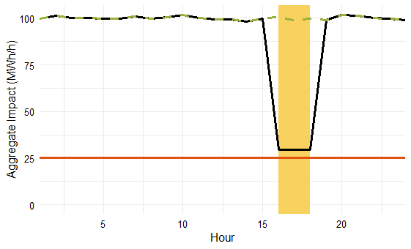
Firm Service Level (FSL) Achievement Rate
* Hypothetical event day, not representative
of any PY2025 events or forecasts
Baseline
Observed Impact
FSL Achievement
Rate
=
Impact at FSL
Observed
FSL
Baseline
Observed
FSL
Event window
FSL Achievement Rate = 100% if event load exactly reaches FSL
FSL Achievement Rate = 0% if event load does not differ from baseline
Notes:
One major output of our ex post analysis and a key input to the ex ante analysis is the FSL Achievement Rate

Slide 13
Ex-Post impacts Overview
PG&E Ex-Post Results are Confidential

Slide 14
Ex-Post impacts Overview
SCE
Event Date (2025) | Num. of Participants Dispatched | Aggregate (MWH/h) |  | Per Capita (kWh/h) |  | Percent Load Reduction (%) | FSL (MW) | FSL Achievement Rate (%)
 |  | Reference Load | Load Impact | Reference Load | Load Impact
September 23rd | 326 | 562.8 | 430.5 | 1,726.4 | 1,320.5 | 76% | 122.1 | 98%

Slide 15
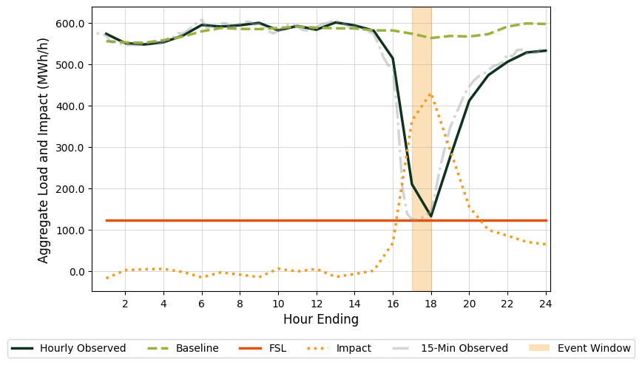
Ex-Post impacts
FSL Achievement Rate = 100% if event load exactly reaches FSL
FSL Achievement Rate = 0% if event load does not differ from baseline
SCE 9/23/2025 Event Day, Aggregate Load Shape
Number of dispatched customers: 326
Event Hours: HE 17-18
Aggregate Impact during event: 430.5 MWh/h
Average impact per customer during event: 1,320 kWh/h
FSL Achievement Rate: 98%
Pct. Load Impact: 76%

Slide 16
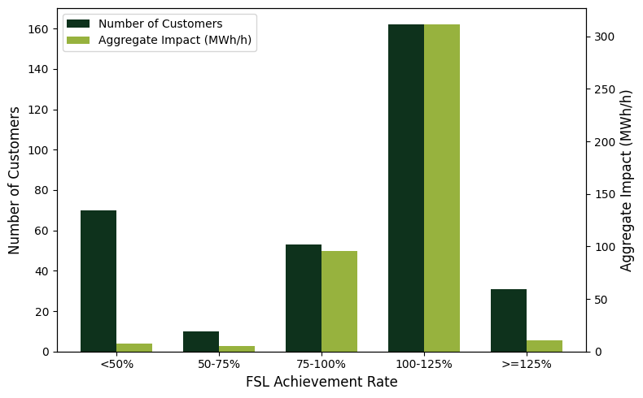
Distribution of FSL achievement rates
SCE 09/23/2025 event

Slide 17
PY2025 Ex-Ante Analysis

Slide 18
Ex-Ante Methodology Overview
Utilize Ex-Post models and FSL Achievement Rates
Develop Ex-Ante Drivers
Includes ex-ante weather scenario data and all assumed event day characteristics (including presumed event hours)
Estimate Ex-Ante Per Capita Reference Loads
Predict on the ex-ante drivers data using ex-post models when available
Estimate Ex-Ante Per Capita Impacts
Apply historic FSL achievement rates with forecast baselines and updated FSL values
Apply Ex-Ante Forecast
Roll together per capita impacts based on participant forecasts
1
2
3
4

Slide 19
Ex-Ante Methodology Overview
Utilize Ex-Post models and FSL Achievement Rates
Develop Ex-Ante Drivers
Includes ex-ante weather scenario data and all assumed event day characteristics (including presumed event hours)
Estimate Ex-Ante Per Capita Reference Loads
Predict on the ex-ante drivers data using ex-post models when available
Estimate Ex-Ante Per Capita Impacts
Apply historic FSL achievement rates with forecast baselines and updated FSL values
Apply Ex-Ante Forecast
Roll together per capita impacts based on participant forecasts
1
Assemble all data to use for baseline forecasting
Assume weekday, non-holiday event
2
3
4

Slide 20
Ex-Ante Methodology Overview
Utilize Ex-Post models and FSL Achievement Rates
Use ex-post models and ex-ante drivers to forecast weather adjusted ex-ante reference loads
Select additional models for new customers / for conditions where did not have an ex-post model
Validate reference loads by comparing to historic load shapes
Develop Ex-Ante Drivers
Includes ex-ante weather scenario data and all assumed event day characteristics (including presumed event hours)
Estimate Ex-Ante Per Capita Reference Loads
Predict on the ex-ante drivers data using ex-post models when available
Estimate Ex-Ante Per Capita Impacts
Apply historic FSL achievement rates with forecast baselines and updated FSL values
Apply Ex-Ante Forecast
Roll together per capita impacts based on participant forecasts
1
2
3
4

Slide 21
Ex-Ante Methodology Overview
Utilize Ex-Post models and FSL Achievement Rates
Compute typical FSL achievement rates, utilizing historical performance where relevant
Multiply FSL achievement rates by the expected impacts at full FSL achievement to estimate impacts for one hour before presumed event through end of day
Develop Ex-Ante Drivers
Includes ex-ante weather scenario data and all assumed event day characteristics (including presumed event hours)
Estimate Ex-Ante Per Capita Reference Loads
Predict on the ex-ante drivers data using ex-post models when available
Estimate Ex-Ante Per Capita Impacts
Apply historic FSL achievement rates with forecast baselines and updated FSL values
Apply Ex-Ante Forecast
Roll together per capita impacts based on participant forecasts
1
2
3
4

Slide 22
Ex-Ante Methodology Overview
Utilize Ex-Post models and FSL Achievement Rates
Develop Ex-Ante Drivers
Includes ex-ante weather scenario data and all assumed event day characteristics (including presumed event hours)
Estimate Ex-Ante Per Capita Reference Loads
Predict on the ex-ante drivers data using ex-post models when available
Estimate Ex-Ante Per Capita Impacts
Apply historic FSL achievement rates with forecast baselines and updated FSL values
Apply Ex-Ante Forecast
Roll together per capita impacts based on participant forecasts
1
Apply participant forecasts to estimated impacts
To compute portfolio-level impacts, FSL achievement rates are capped at 100% for customers dual enrolled in ELRP (through program sunset in 2027)
2
3
4

Slide 23
Ex-Ante Methodology
Event Assumptions
PG&E
SCE
4-Hour
Assumed Event Duration
4-Hour
6-Hour
Assumed Event Hours
First four hours of the RA Window
Includes 2027 Peak Hours
November through May:
HE 18-21
June through October:
HE 17-20
Consistent across year
Includes 2027 Peak Hours
Four Hour Event:
HE 18-21
Six Hour Event:
HE 17-22
Weather Scenarios Modeled
CAISO and Utility-specific weather scenarios
1-in-2 and 1-in-10
Monthly System Worst Day
CAISO and Utility-specific weather scenarios
1-in-2 and 1-in-10
Monthly System Worst Day
Notes:
Assumed weekday non-holiday

Slide 24
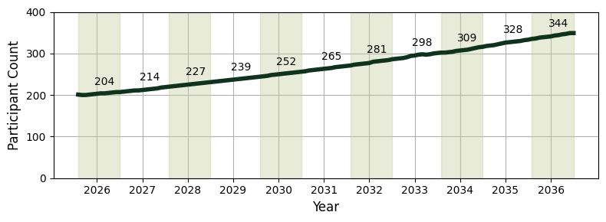
Enrollment Forecasts
PG&E
Does not differentiate between BIP15 and BIP30
Note: Participant counts are labeled for August of each year. Background color alternates by calendar year.
Notes:
We see that PG&E is anticipating a growth in participation through the forecast horizon due to increased marketing and outreach efforts

Slide 25
Ex-Ante Impacts Overview
PG&E August Monthly System Worst Day 2026 – Average over 4-hour event
Program
Weather Source | Weather Year | Event Dispatch (HE) | Number of Participants | Aggregate (MWh/h) |  | Per Capita (kWh/h) |  | Percent Load Reduction (%) | FSL (MWh/h) | FSL Achievement Rate (%)
 |  |  |  | Ref. Load | Load Impact | Ref. Load | Load Impact
CAISO | 1-in-10 | 17 - 20 | 204 | 217.3 | 168.3 | 1,065.0 | 825.0 | 77% | 58.2 | 106%
CAISO | 1-in-2 | 17 - 20 | 204 | 216.6 | 167.4 | 1,061.7 | 820.7 | 77% | 58.2 | 106%
Utility | 1-in-10 | 17 - 20 | 204 | 217.3 | 168.4 | 1,065.4 | 825.3 | 77% | 58.2 | 106%
Utility | 1-in-2 | 17 - 20 | 204 | 215.9 | 166.7 | 1,058.4 | 816.9 | 77% | 58.2 | 106%
Portfolio
Weather Source | Weather Year | Event Dispatch (HE) | Number of Participants | Aggregate (MWh/h) |  | Per Capita (kWh/h) |  | Percent Load Reduction (%) | FSL (MWh/h) | FSL Achievement Rate (%)
 |  |  |  | Ref. Load | Load Impact | Ref. Load | Load Impact
CAISO | 1-in-10 | 17 - 20 | 204 | 217.3 | 164.9 | 1,065.0 | 808.2 | 76% | 58.2 | 104%
CAISO | 1-in-2 | 17 - 20 | 204 | 216.6 | 164.2 | 1,061.7 | 804.8 | 76% | 58.2 | 104%
Utility | 1-in-10 | 17 - 20 | 204 | 217.3 | 165.0 | 1,065.4 | 809.0 | 76% | 58.2 | 104%
Utility | 1-in-2 | 17 - 20 | 204 | 215.9 | 163.5 | 1,058.4 | 801.5 | 76% | 58.2 | 104%

Slide 26
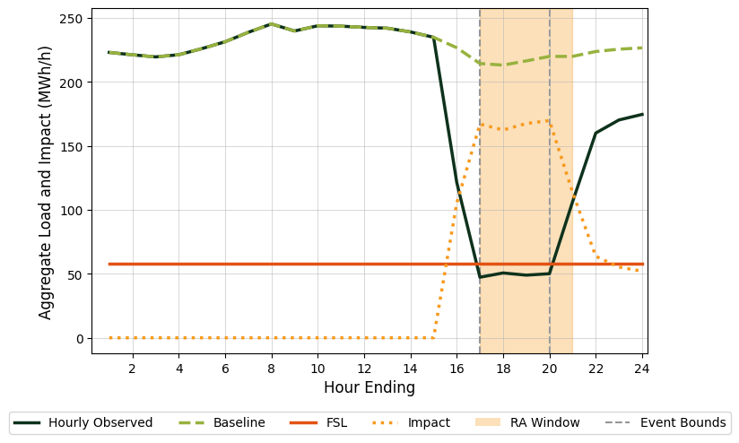
Ex-Ante Load Shape
PG&E Program-level August 1-in-2 Monthly System Worst Day, 2026

Slide 27
Ex-Ante Impacts Slice of Day Table
PG&E Program 1-in-2 System Worst Day 2026, Aggregate Hourly Impact (MWh/h)
Hour Ending | Jan. | Feb. | Mar. | Apr. | May | June | July | Aug. | Sept. | Oct. | Nov. | Dec.
16 | 0.0 | 0.0 | 0.0 | 0.0 | 0.0 | 108.1 | 104.5 | 105.3 | 106.4 | 103.1 | 0.0 | 0.0
17 | 92.1 | 98.3 | 94.7 | 110.2 | 111.2 | 167.9 | 164.8 | 167.0 | 171.8 | 163.1 | 98.3 | 90.2
18 | 167.6 | 176.5 | 164.2 | 186.6 | 182.4 | 164.6 | 159.7 | 162.4 | 171.8 | 160.3 | 177.5 | 167.8
19 | 161.5 | 171.9 | 163.8 | 186.4 | 186.4 | 167.7 | 163.9 | 167.4 | 178.2 | 160.1 | 172.4 | 165.3
20 | 159.0 | 169.6 | 165.4 | 189.8 | 190.4 | 171.0 | 166.9 | 169.8 | 177.3 | 154.0 | 171.0 | 164.5
21 | 157.9 | 167.5 | 163.2 | 189.1 | 190.6 | 112.6 | 113.2 | 113.6 | 113.9 | 102.7 | 170.8 | 163.8
22 | 112.4 | 118.5 | 115.8 | 123.8 | 124.9 | 67.2 | 65.0 | 63.7 | 65.0 | 59.7 | 116.8 | 112.0
23 | 65.5 | 69.9 | 65.8 | 70.4 | 70.2 | 58.7 | 56.9 | 55.3 | 56.0 | 51.7 | 65.1 | 64.3
24 | 57.5 | 59.7 | 56.9 | 60.0 | 61.1 | 55.5 | 52.9 | 52.0 | 51.8 | 47.7 | 56.2 | 53.8
Event hour in RA window
Non-event hour in RA window
Event Hour, 2027 CEC Peak Hour

Slide 28
Ex-Ante Impacts Slice of Day Table
PG&E Program 1-in-2 System Worst Day 2027, Aggregate Hourly Impact (MWh/h)
Hour Ending | Jan. | Feb. | Mar. | Apr. | May | June | July | Aug. | Sept. | Oct. | Nov. | Dec.
16 | 0.0 | 0.0 | 0.0 | 0.0 | 0.0 | 111.4 | 107.9 | 109.5 | 110.8 | 107.3 | 0.0 | 0.0
17 | 93.4 | 100.7 | 97.6 | 113.8 | 114.6 | 173.4 | 170.3 | 174.1 | 179.2 | 170.3 | 98.0 | 91.3
18 | 169.8 | 180.3 | 169.3 | 192.8 | 187.9 | 169.8 | 164.7 | 169.2 | 179.0 | 167.3 | 177.5 | 170.6
19 | 163.7 | 175.4 | 168.6 | 192.3 | 191.6 | 172.8 | 168.9 | 174.2 | 185.4 | 167.1 | 171.9 | 168.2
20 | 161.2 | 173.1 | 170.5 | 195.8 | 195.5 | 176.2 | 172.1 | 176.7 | 184.5 | 160.8 | 171.6 | 169.4
21 | 160.0 | 170.9 | 168.1 | 195.0 | 195.6 | 115.8 | 116.4 | 118.0 | 118.5 | 107.2 | 171.1 | 168.1
22 | 113.9 | 120.9 | 119.1 | 127.6 | 127.9 | 68.9 | 66.7 | 65.6 | 66.9 | 61.7 | 111.8 | 111.8
23 | 66.4 | 71.3 | 67.5 | 72.4 | 71.8 | 60.1 | 58.4 | 56.8 | 57.5 | 53.4 | 57.9 | 59.7
24 | 58.2 | 61.1 | 58.4 | 61.6 | 62.5 | 56.6 | 54.0 | 53.2 | 53.1 | 49.2 | 46.9 | 47.2
Event hour in RA window
Non-event hour in RA window
Event Hour, 2027 CEC Peak Hour

Slide 29
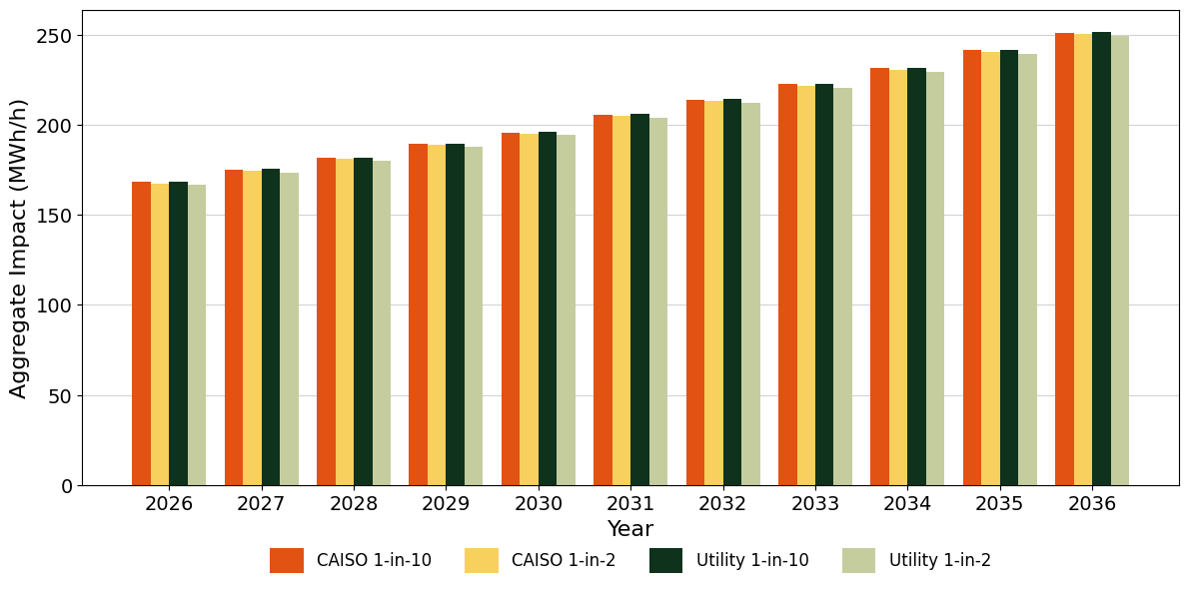
Ex-Ante Impacts Across the Forecast period
PG&E Program-level August Monthly System Worst Day
Min 166.7
Max 251.3

Slide 30
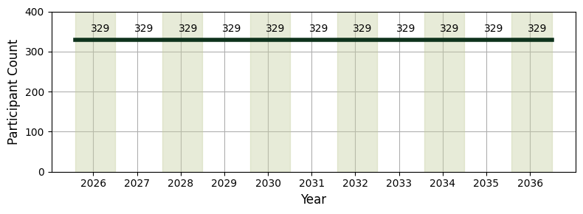
Enrollment Forecasts
SCE
Participant forecast is the same across all years.
  50 BIP15
  279 BIP30
Note: Participant counts are labeled for August of each year. Background color alternates by calendar year.

Slide 31
Ex-Ante Impacts Overview
SCE August Monthly System Worst Day 2026 – Average over 4-hour event
Program
Weather Source | Weather Year | Event Dispatch (HE) | Number of Participants | Aggregate (MWh/h) |  | Per Capita (kWh/h) |  | Percent Load Reduction (%) | FSL (MWh/h) | FSL Achievement Rate (%)
 |  |  |  | Ref. Load | Load Impact | Ref. Load | Load Impact
CAISO | 1-in-10 | 18 - 21 | 329 | 597.9 | 457.4 | 1,817.2 | 1,390.3 | 77% | 125.8 | 97%
CAISO | 1-in-2 | 18 - 21 | 329 | 596.4 | 456.1 | 1,812.9 | 1,386.4 | 76% | 125.8 | 97%
Utility | 1-in-10 | 18 - 21 | 329 | 597.7 | 457.3 | 1,816.8 | 1,389.8 | 76% | 125.8 | 97%
Utility | 1-in-2 | 18 - 21 | 329 | 597.3 | 456.9 | 1,815.4 | 1,388.7 | 76% | 125.8 | 97%
Portfolio
Weather Source | Weather Year | Event Dispatch (HE) | Number of Participants | Aggregate (MWh/h) |  | Per Capita (kWh/h) |  | Percent Load Reduction (%) | FSL (MWh/h) | FSL Achievement Rate (%)
 |  |  |  | Ref. Load | Load Impact | Ref. Load | Load Impact
CAISO | 1-in-10 | 18 - 21 | 329 | 597.9 | 453.9 | 1,817.2 | 1,379.5 | 76% | 125.8 | 96%
CAISO | 1-in-2 | 18 - 21 | 329 | 596.4 | 452.6 | 1,812.9 | 1,375.7 | 76% | 125.8 | 96%
Utility | 1-in-10 | 18 - 21 | 329 | 597.7 | 453.7 | 1,816.8 | 1,379.1 | 76% | 125.8 | 96%
Utility | 1-in-2 | 18 - 21 | 329 | 597.3 | 453.3 | 1,815.4 | 1,377.9 | 76% | 125.8 | 96%

Slide 32
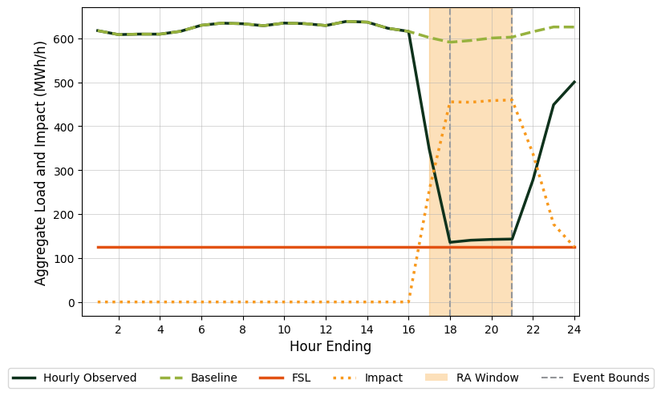
Ex-Ante Load Shape
SCE Program-level August 1-in-2 Monthly System Worst Day, 2026 through 2036

Slide 33
Ex-Ante Impacts Slice of Day Table
SCE Program 1-in-2 System Worst Day 2026 to 2036, Aggregate Hourly Impact (MWh/h)
Hour Ending | Jan. | Feb. | Mar. | Apr. | May | June | July | Aug. | Sept. | Oct. | Nov. | Dec.
16 | 0.0 | 0.0 | 0.0 | 0.0 | 0.0 | 0.0 | 0.0 | 0.0 | 0.0 | 0.0 | 0.0 | 0.0
17 | 229.2 | 238.2 | 261.6 | 242.5 | 258.1 | 254.9 | 258.1 | 254.5 | 254.6 | 263.7 | 239.7 | 212.8
18 | 420.2 | 434.5 | 473.9 | 448.5 | 468.8 | 464.3 | 468.9 | 455.3 | 459.5 | 470.4 | 433.5 | 385.7
19 | 414.0 | 431.6 | 473.8 | 448.6 | 466.4 | 460.7 | 466.2 | 454.4 | 458.5 | 470.5 | 424.5 | 380.8
20 | 412.6 | 430.0 | 466.5 | 452.4 | 470.7 | 461.4 | 471.0 | 458.2 | 457.3 | 470.6 | 419.2 | 378.4
21 | 412.9 | 433.3 | 470.0 | 459.9 | 474.0 | 466.8 | 474.0 | 459.6 | 459.0 | 471.6 | 421.1 | 380.2
22 | 298.2 | 313.6 | 333.1 | 331.4 | 336.2 | 334.1 | 343.1 | 337.9 | 337.6 | 342.1 | 308.6 | 285.9
23 | 158.4 | 169.4 | 163.1 | 169.0 | 174.9 | 174.8 | 177.5 | 176.9 | 174.4 | 182.0 | 164.0 | 154.9
24 | 109.1 | 116.8 | 112.3 | 118.1 | 123.6 | 125.4 | 125.7 | 125.1 | 121.3 | 129.4 | 113.7 | 105.3
Event hour in RA window
Non-event hour in RA window
Event Hour, 2027 CEC Peak Hour

Slide 34
Comparison of PY2025 and Prior Year results

Slide 35
Previous Versus Current Ex-Post
PG&E Ex-Post Results are confidential
Evaluation Year | Estimate Type | Number of Participants per Event | Aggregate (MWh/h) |  | Per Capita (kWh/h) |  | Percent Load Reduction (%) | FSL (MWh/h) | FSL Achievement Rate (%)
 |  |  | Ref. Load | Load Impact | Ref. Load | Load Impact
2022* | Sept. 6th | 258 | 203 | 149 | 787 | 577 | 73% | 51 | 98%
2023** | Avg. Event Day | 214 | 164 | 36 | 766 | 168 | 22% | 48 | 31%
2024 | Sept. 24th | 163 | 145 | 99 | 888 | 608 | 68% | 46 | 100%
2025 | Sept. 23rd | 141 | XXX | XXX | XXX | XXX | XXX | XXX | XXX
Reminder that PY2024 impacts showed an improvement relative to PY2022 impact levels for per capita impacts and FSL achievement rates
  PY2023 was only a single, 5-minute event
Aggregate impacts were lower in PY2024 than in PY2022 due to reduced program enrollment
Customers who were tested in the main September event in both PY2024 and PY2025 showed statistically indistinguishable event day impacts.
* 2022 Load Impact Evaluation of California Statewide Base Interruptible Programs (BIP) for Non-Residential Customers: Ex-post and Ex-ante Report
** 2023 Load Impact Evaluation of California Statewide Base Interruptible Programs (BIP) for Non-Residential Customers: Ex-post and Ex-ante Report

Slide 36
Previous Ex-Ante Versus Current Ex-Post
PG&E Ex-Post Results are confidential
Evaluation Year | Estimate Type | Number of Participants per Event | Aggregate* (MWh/h) |  | Per Capita* (kWh/h) |  | Percent Load Reduction (%) | FSL (MWh/h) | FSL Achievement Rate (%)
 |  |  | Ref. Load | Load Impact | Ref. Load | Load Impact
2024 | Ex-ante for 2025 | 173 | 187 | 132 | 1,079 | 765 | 71% | 55 | 101%
2025 | Ex-post Sept. 23rd | XXX | XXX | XXX | XXX | XXX | XXX | XXX | XXX
*Ex-ante estimates are based on program-level 1-in-2 utility-specific weather scenario
PY2025 ex-post impacts were lower than anticipated in the PY2024 forecast because several historically high performing customers were not re-tested in any PY2025 event

Slide 37
Previous Versus Current Ex-Ante
PG&E
Evaluation Year | Estimate Type | Number of Participants per Event | Aggregate* (MWh/h) |  | Per Capita* (kWh/h) |  | Percent Load Reduction (%) | FSL (MWh/h) | FSL Achievement Rate (%)
 |  |  | Ref. Load | Load Impact | Ref. Load | Load Impact
2024 | Ex-ante for 2026 | 182 | 194 | 138 | 1,068 | 760 | 71% | 57 | 100%
2025 | Ex-ante for 2026 | 204 | 216 | 167 | 1,058 | 817 | 77% | 58 | 106%
*Ex-ante estimates are based on program-level 1-in-2 utility-specific weather scenario
Aggregate impacts are forecasted to be 29 MW higher in PY2026 than previously anticipated
  The PY2025 participant forecasts include an increase in BIP enrollment for PY2026, based on observed enrollment patterns and increased marketing efforts.
Per capita impacts are forecast to be 57 kWh/h higher in PY2026 than previously anticipated
  This increase is largely driven by higher forecasted FSL achievement rates

Slide 38
Previous Versus Current Ex-Post
SCE
Evaluation Year | Estimate Type | Number of Participants per Event | Aggregate (MWh/h) |  | Per Capita (kWh/h) |  | Percent Load Reduction (%) | FSL (MWh/h) | FSL Achievement Rate (%)
 |  |  | Ref. Load | Load Impact | Ref. Load | Load Impact
2024 | Sept. 24th | 314 | 536 | 396 | 1,705 | 1,262 | 74% | 146 | 102%
2025 | Sept. 23rd | 326 | 563 | 430 | 1,726 | 1,320 | 76% | 122 | 98%
PY2025 aggregate impacts were 34 MWh/h higher than in PY2024
  The PY2025 event dispatched 12 more customers than the PY2024 event
Per capita load impacts in PY2025 were 58 kWh/h higher in PY2025 than in PY2024
  This difference is within 95% confidence intervals for these estimates
  While FSL achievement rates were lower in PY2025, FSL commitments were also substantially lower, leading to overall similar per capita impacts

Slide 39
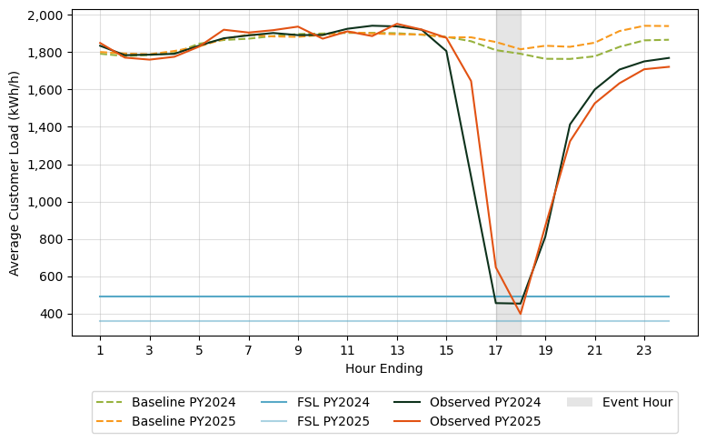
Previous Versus Current Ex-Post
SCE
Customers that were tested in the main test event in both PY2024 and PY2025 showed consistently strong performance on average

Slide 40
Previous Ex-Ante Versus Current Ex-Post
SCE
Evaluation Year | Estimate Type | Number of Participants per Event | Aggregate (MWh/h) |  | Per Capita (kWh/h) |  | Percent Load Reduction (%) | FSL (MWh/h) | FSL Achievement Rate (%)
 |  |  | Ref. Load | Load Impact | Ref. Load | Load Impact
2024 | Ex-ante for 2025 | 331 | 581 | 419 | 1,754 | 1,267 | 72% | 140 | 95%
2025 | Ex-post Sept. 23 | 326 | 563 | 430 | 1,726 | 1,320 | 76% | 122 | 98%
*Ex-ante estimates are based on program-level 1-in-2 utility-specific weather scenario
The 53 kWh/h difference between ex-ante and ex-post per capita load impacts is within the typical uncertainty range for these estimates.
The 11MW difference between the forecast and realized aggregate load impacts are also statistically indistinguishable.

Slide 41
Previous Versus Current Ex-Ante
SCE
Evaluation Year | Estimate Type | Number of Participants per Event | Aggregate (MWh/h) |  | Per Capita (kWh/h) |  | Percent Load Reduction (%) | FSL (MWh/h) | FSL Achievement Rate (%)
 |  |  | Ref. Load | Load Impact | Ref. Load | Load Impact
2024 | Ex-ante for 2026 | 331 | 581 | 419 | 1,754 | 1,267 | 72% | 140 | 95%
2025 | Ex-ante for 2026 | 329 | 597 | 457 | 1, 815 | 1,389 | 76% | 126 | 97%
*Ex-ante estimates are based on program-level 1-in-2 utility-specific weather scenario
Several factors contribute to the increase in forecasted impacts from PY2024 to PY2025.
  Higher Proportion of BIP15 Customers : The PY2025 forecast includes an additional two BIP15 customers relative to the PY2024 forecast. SCE BIP15 customers are expected to deliver significantly higher impacts than a typical BIP30 customer.
  Enrollment of New Large Customers/De-enrollment of Small Customers: At the end of PY2025, several new high baseline customers enrolled in the SCE BIP program, while several smaller baseline (and, thus, impact) customers de-enrolled.
  Commitments to Larger Load Reductions: The aggregate FSL for customers in the PY2025 forecast is 14MW lower than in the PY2024 forecast due to updated enrollments, de-enrollments, and FSL changes. This commitment to larger load reduction, in addition to the marginally higher forecast FSL achievement rate, is a major contributor to the increase in forecast impacts.

Slide 42
Final Takeaways
PG&E
SCE
Ex-Post
PY2025 ex-post load impacts are confidential.
All 326 active BIP customers were dispatched for a test event on September 23rd. On average these customers provided 430 MWh/h of load reductions during event hours with an FSL achievement rate of 98%.
PG&E’s BIP is anticipated to provide an average hourly load reduction of between 166.7 MWh/h to 168.3 MWh/h during a four-hour dispatch of all customers in August 2026.
SCE’s BIP is anticipated to provide an average hourly load reduction of between 456.1 MWh/h to 457.4 MWh/h during a four-hour dispatch of all customers in August 2026.
Ex-Ante
PY2025 forecast impacts for PY2026 exceed those from the PY2024 evaluation due to a combination of increased forecasted enrollment, lower average FSLs, and strong customer performance.
Aggregate impacts in PY2026 are forecast to increase somewhat relative to the PY2025 ex-post event. However, these differences are within the error bounds for these estimates.
Cross-Year
Comparisons

