Slide 1
SCE Summer Discount Plan PY 2025 Evaluation
DRMEC Presentation
May 6, 2026

Slide 2
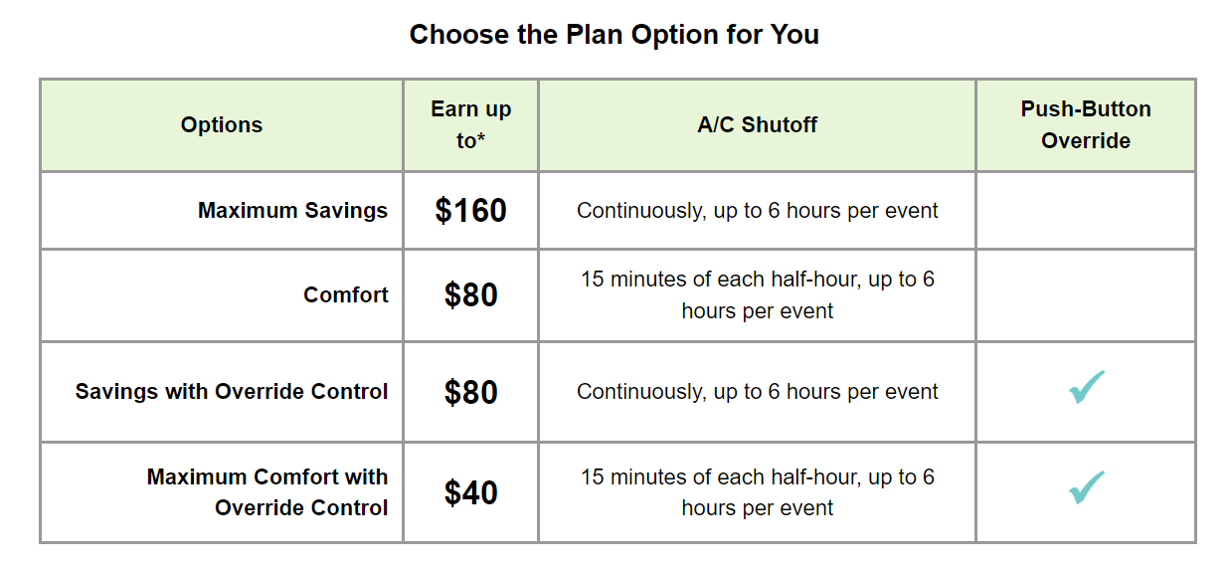
SDP Program Description
SDP operates through the installation of a remote-controlled device on the participant’s air conditioning unit. During events, this device turns off or cycles the A/C unit.
Events can be called year-round, though customers only receive bill credits for June through September participation.

Slide 3
The SDP program is an AC Cycling program, Where Events are dispatched by geographically defined regional subgroups
~82% of participants, tonnage, and devices are in 100% cycling
~51% of resources are in the SCE-Central SubLAP
~31% of SDP-R participants are low income (CARE or FERA)
Schools and religious organizations account for ~82% of SDP-C tonnage

Slide 4
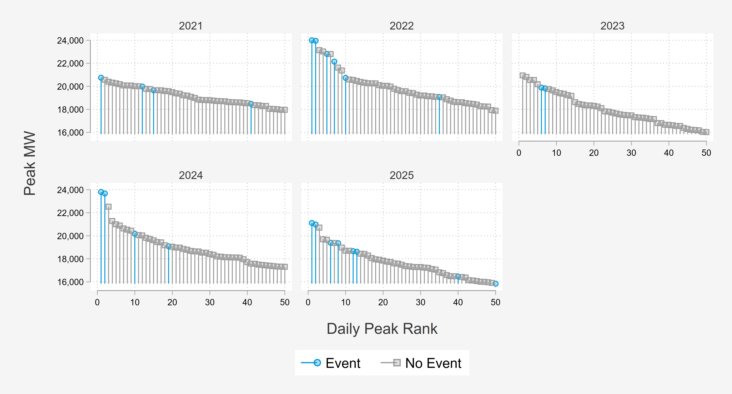
2025 System Peak loads were Lower than Previous Years
2025 SCE Peak Days
1.) 8/22
2.) 8/21 ← CAISO Peak

Slide 5
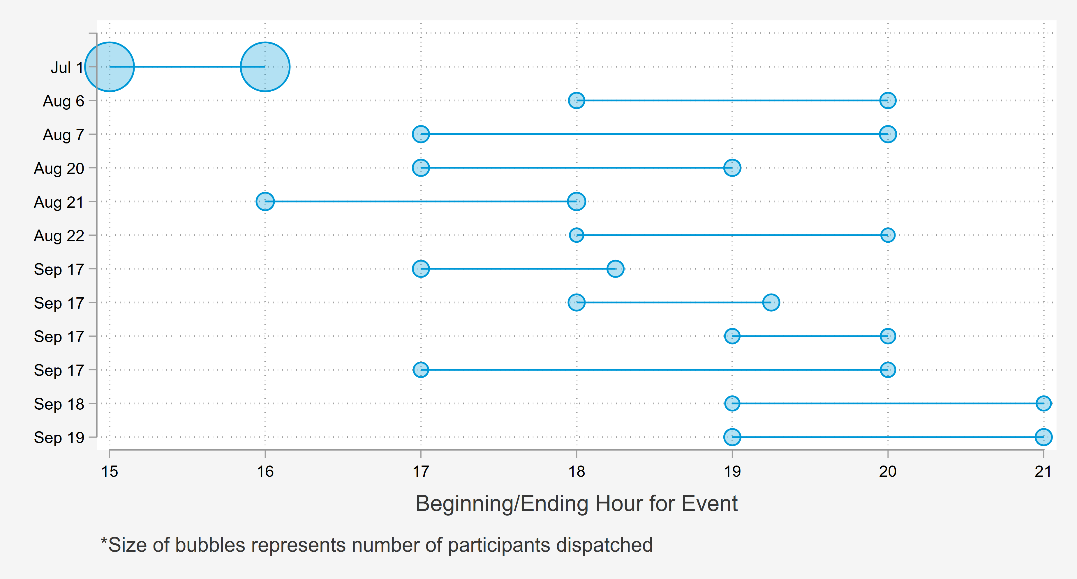
2025 had One Territory-wide event And The Remainder were Called as Part of A Distribution Testing Plan
Full Territory
Distribution Testing

Slide 6
Methods Overview

Slide 7
Estimating demand reductions delivered via 2025 operations
Proxy Day Selection
Three proxy days were selected for each event day
Matched Controls
A single control customer was chosen for each participant based on individual load during proxy days
Analysis
Difference-in-differences
Hard matching:
Commercial – Industry and Size
Residential – NEM, climate group, and size
Proxy event days are used to net out differences between the treatment and control group not due to the intervention
Residential – selected based on SCE system load
Commercial – selected based on dispatched customer loads
Residential – manual DiD
Commercial – panel regression (controls for effects outside of matches)

Slide 8
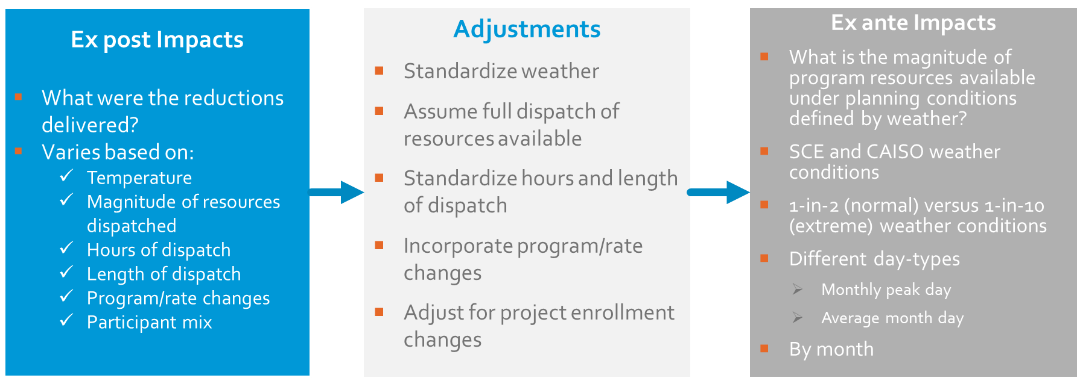
Quantifying the magnitude of reductions available during peaking conditions used for planning

Slide 9
Residential Results

Slide 10
Residential Event Summary
Event temperatures above 85F reduce load by 25% on average
  Cooler event days at the end of September showed lower impacts than events called under warmer conditions earlier in the season
Aggregate impacts were lower than previous years due to the distribution level events only dispatching ~10% of participants in each event

Slide 11
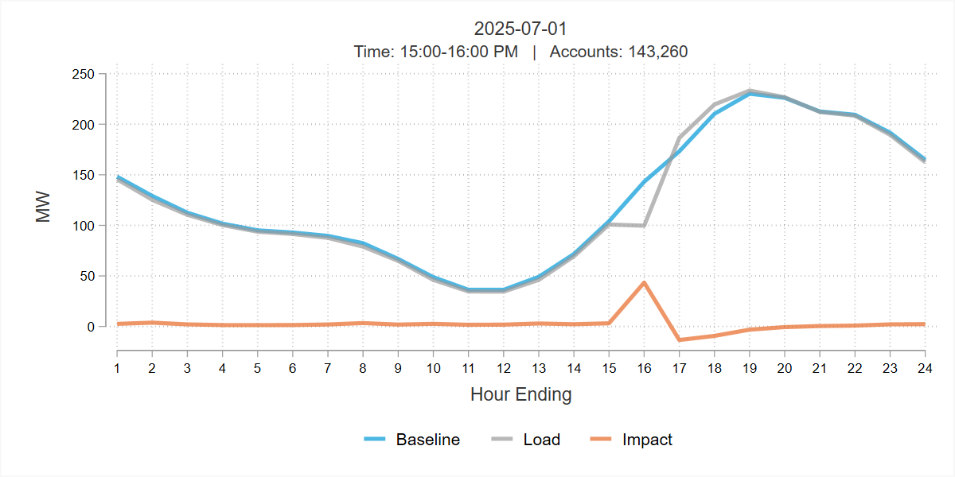
Territory Wide Event Day – July 1st
Event called for a single hour during load ramp
  Earliest event to be called in recent history (3-4pm)
Only PY2025 event where all participants were dispatched
0.30 kW per participant
Accounts | Reference Load (MWh/hour) | Load with DR (MWh/hour) | Energy Savings (MWh/hour) | % Change | Average Temperature (°F ) | Uncertainty Adjusted Impact - Percentiles |  |  | Standard Error | T-statistic
 | Accts |  |  |  |  | 5th | 50th | 95th | % Impact
143,260 | 143.16 | 99.71 | 43.45 | 30% | 84.6 | 42.37 | 43.45 | 44.52 | 0.66 | 66.25

Slide 12
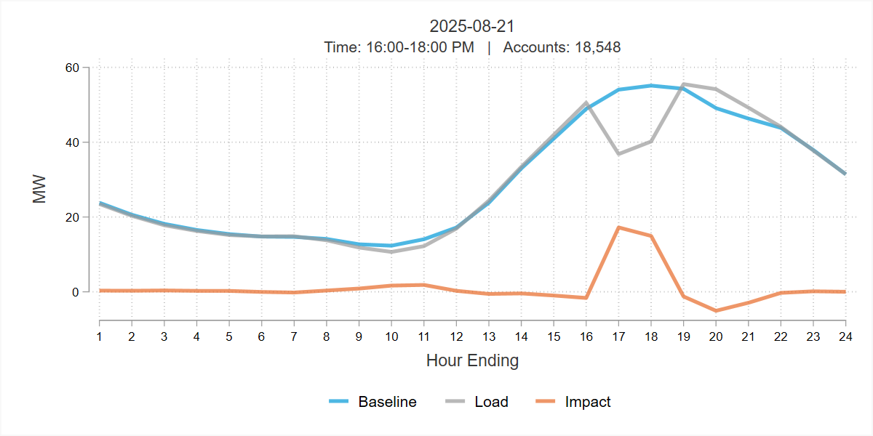
Warmest Event Day and the CAISO Peak day – August 21st
Dispatched the largest, single A-Bank
Percent impacts were similar to the territory-wide event (30%)
Per participant impacts (0.87 kW) are larger than the territory-wide event (0.30 kW)
Accounts | Reference Load (MWh/hour) | Load with DR (MWh/hour) | Energy Savings (MWh/hour) | % Change | Average Temperature (°F ) | Uncertainty Adjusted Impact - Percentiles |  |  | Standard Error | T-statistic
 | Accts |  |  |  |  | 5th | 50th | 95th | % Impact
18,548 | 54.59 | 38.51 | 16.08 | 29% | 97.2 | 15.53 | 16.08 | 16.63 | 0.33 | 48.47

Slide 13
Event Impacts Do Not decay As Duration Increases
September 17th dispatched four unique events
  Three 1-hour events
  One 3-hour event
Although four different groups of customers were dispatched, events delivered similar load reductions regardless of duration
  A/C cycling programs are agnostic of thermostat setpoints

Slide 14
Reference Load Modeling Is Based on Geography and Cycling
SCE 1-in-2 August System Peak Day by SubLAP
Regression Modeling
Separate model for each LCG + cycling strategy
  Limited to non-event weekdays
  Dependent variable is kWh
  Weather, hour, and day of week variables
The Central and Low Desert subLAPs have the highest loads

Slide 15
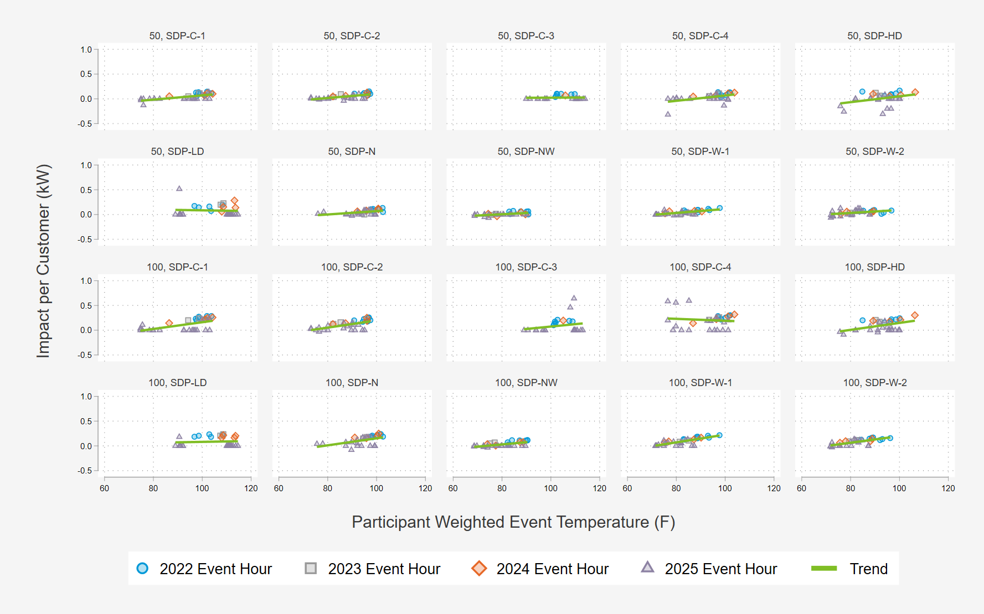
impacts from 2022-2025 Are Used to model reductions as a function of temperature and hour For Ex-Ante Predictions
Load control group and cycling strategy are the building blocks for impact modelling
  20 distinct segments
Load control groups have different event history
  Especially significant with the events called under the PY2025 distribution testing plan
At low temperatures, impacts are near zero impacts

Slide 16
Projected demand reductions under standard weather conditions
Forecast Year 2026 SCE August Worst Day Aggregate Load Reductions
August Worst Day Aggregate Load Reductions
Forecast Year | Enrollment Forecast | SCE Weather | CAISO Weather
 |  | 1-in-2 | 1-in-2
2026 | 137,212 | 107.4 | 95.0
2027 | 130,360 | 102.0 | 90.2
2028 | 124,147 | 97.2 | 85.9
2029 | 118,513 | 92.7 | 82.0

Slide 17
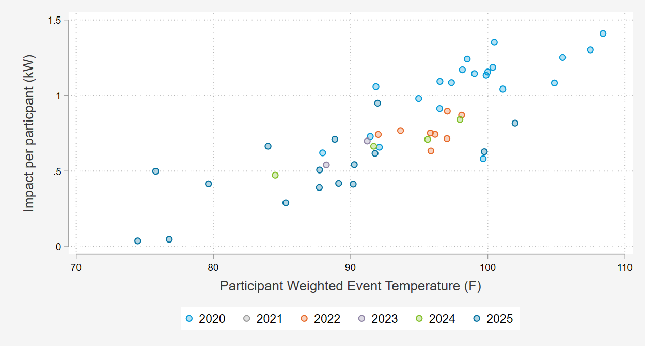
Residential Ex Ante impact Comparison
Vintage year 2023 are the only estimates that include the events from 2020
  Temperatures hotter than 100F are out-of-sample
Distribution level dispatches are included in vintage year 2025
  Increased the data points for constructing the model
    Although temperatures are lower in the 2025 data, the additional data still helps to fortify the weather trend we estimate in ex-ante
Month | Vintage Year 2023 | Vintage Year 2024 | Vintage Year 2025
 | 1-in-2 | 1-in-2 | 1-in-2
June | 0.82 | 0.66 | 0.62
July | 0.89 | 0.70 | 0.75
August | 0.92 | 0.70 | 0.78
September | 0.93 | 0.73 | 0.81

Slide 18
Commercial Results

Slide 19
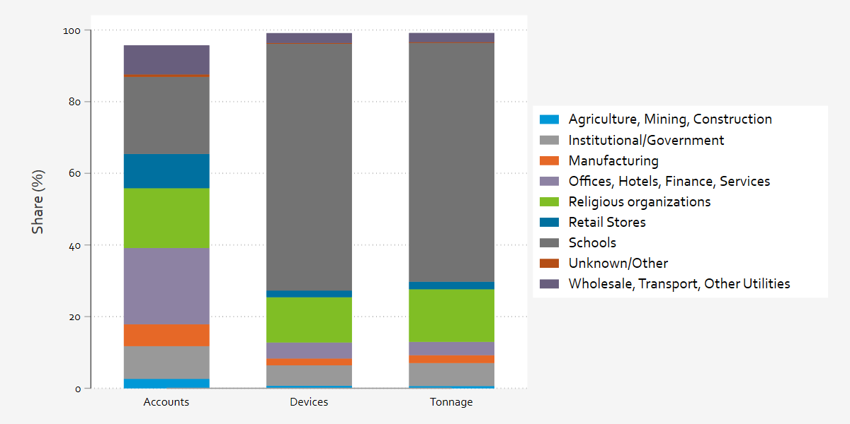
Most devices and AC tonnage are in schools and religious Organizations Where loads vary based on Month, Day, and time

Slide 20
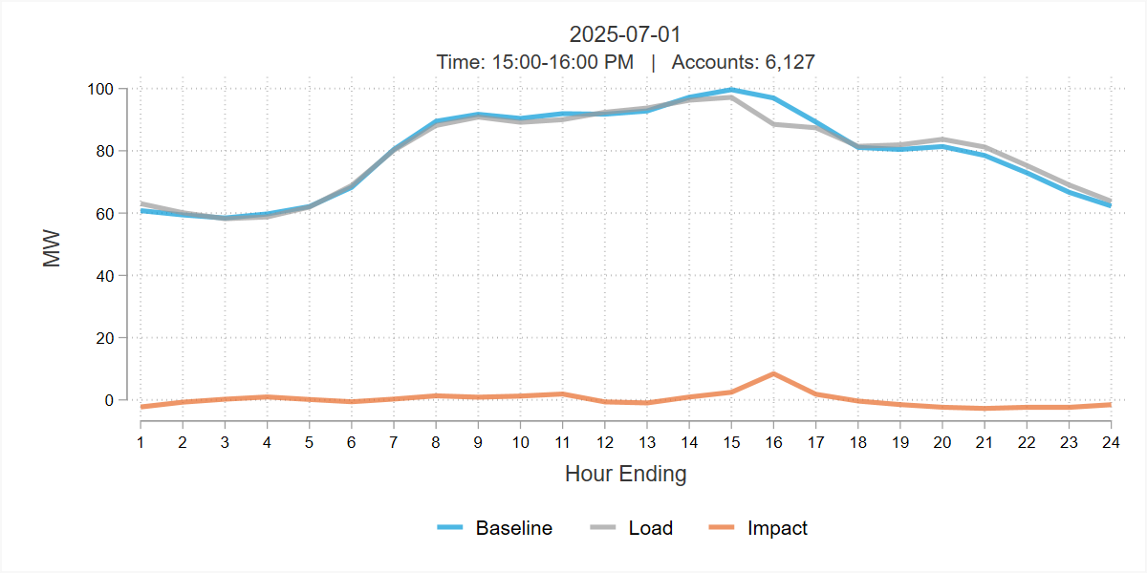
Territory Wide Event Day – July 1st
Event called for a single hour before loads begin to decline
  Earliest event to be called in recent history (3-4pm)
Only PY2025 event where all participants were dispatched
1.38 kW per participant
Accounts | Reference Load (MWh/hour) | Load with DR (MWh/hour) | Energy Savings (MWh/hour) | % Change | Average Temperature (°F ) | Uncertainty Adjusted Impact - Percentiles |  |  | Standard Error | T-statistic
 | Accts |  |  |  |  | 5th | 50th | 95th | % Impact
6,127 | 96.95 | 88.52 | 8.43 | 9% | 80.9 | 4.98 | 8.43 | 11.88 | 2.09 | 4.02

Slide 21
Reference Load Modeling Is Based on Geography and Cycling
SCE 1-in-2 August System Peak Day by Cycling Strategy
Regression Modeling
Separate model for each LCG + cycling strategy
  Limited to non-event weekdays
  Dependent variable is kWh
  Weather, hour, and day of week variables
Participants enrolled in 30% cycling have the highest loads

Slide 22
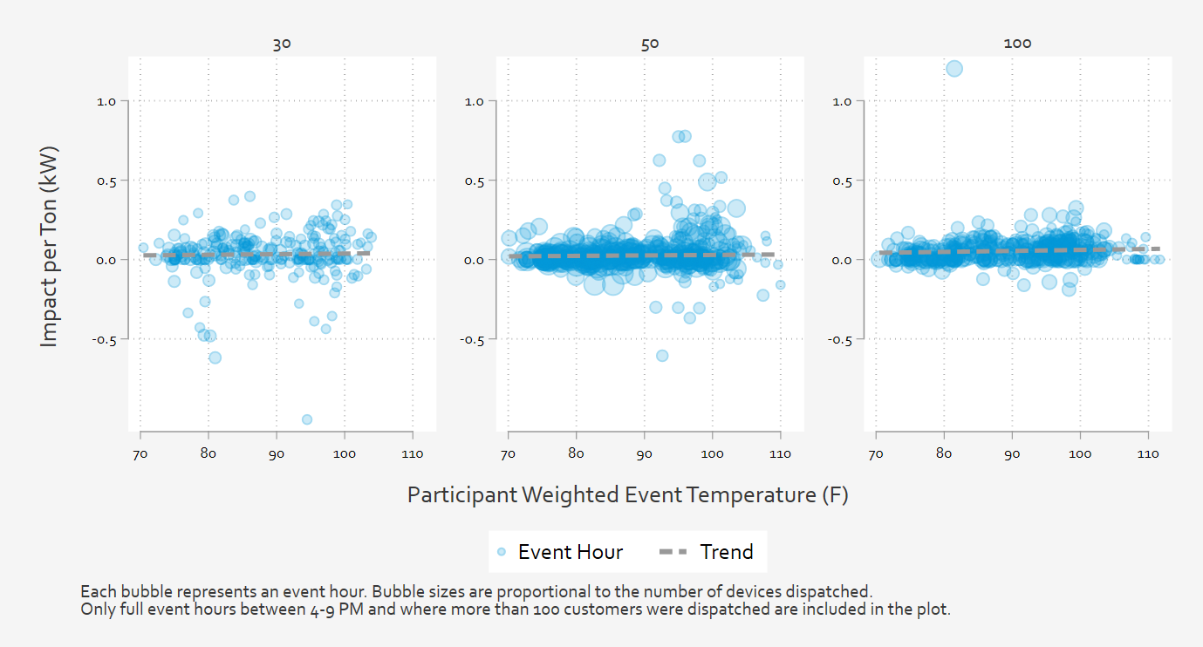
impacts from 2022-2025 Are Used to model reductions as a function of temperature and hour For Ex-Ante Predictions
Load control group and cycling strategy are the building blocks for impact modelling
  30 distinct segments
Population varies by cycling strategy
  60% of devices are in the 100% cycling group, 35% and 5% for 50% cycling and 30% cycling respectively

Slide 23
Projected demand reductions under standard weather conditions
Forecast Year 2026 SCE August Worst Day Aggregate Load Reductions
August Worst Day Aggregate Load Reductions
Forecast Year | Enrollment Forecast | Total Devices | SCE Weather | CAISO Weather
 |  |  | 1-in-2 | 1-in-2
2026 | 5,769 | 51,286 | 13.6 | 12.6
2027 | 5,427 | 48,249 | 12.8 | 11.8
2028 | 5,107 | 45,403 | 12.0 | 11.1
2029 | 4,807 | 42,737 | 11.3 | 10.5

Slide 24
Commercial Ex Ante impact Comparison
Data leveraged
  PY 2025 (2022-2025)
  PY 2024 (2021-2024)
  PY 2023 (2018, 2019, 2022, 2023)
Distribution level dispatches are included in vintage year 2025
  Increased the data points for constructing the model
  Additional data points below 85F to help inform trends at lower temperatures
Month | Vintage Year 2023 | Vintage Year 2024 | Vintage Year 2025
 | 1-in-2 | 1-in-2 | 1-in-2
June | 1.97 | 1.52 | 2.29
July | 2.15 | 1.63 | 2.72
August | 2.42 | 2.58 | 2.35
September | 2.82 | 2.78 | 2.61

Slide 25
Discussion & Recommendations

Slide 26
Discussion
Recommendations
Test Event Plan for Summer 2025:
  Strengthened confidence in granular dispatch for distribution level events
  Included a variety of event formats tailored to different temperature ranges, which increased understanding of future events/impacts
SDP has the capability to deliver large magnitudes of flexible loads at very fast ramp rates, delivering larger reductions when the weather is more extreme and resources are needed most.
The magnitude of SDP resources has been declining in recent years.
Continue to focus on granular event dispatch when applicable
  The two types of events are Operational/Testing and Load Control/Emergency
  Increasingly granular dispatches have a high potential to play in system reliability moving forward
Include "test" event operations to fully assess the load reduction capability
  To facilitate comparisons between ex post and ex ante results, we recommend at least one territory-wide event, ideally on the SCE system peak day or another day with high system loads

Slide 27

Questions?
Grayson Meckfessel
Senior Quantitative Analyst
Demand Side Analytics
gmeckfessel@demandsideanalytics.com
Patrik Karlovic
Consultant
Demand Side Analytics
pkarlovic@demandsideanalytics.com
Savannah Horner
Senior Consultant
Demand Side Analytics
shorner@demandsideanalytics.com

