Slide 1
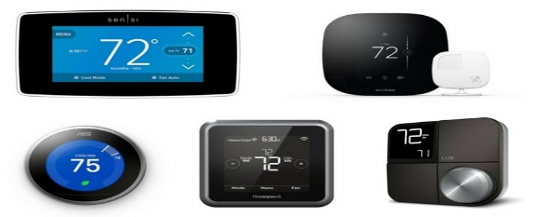
Southern California Edison
Smart Energy Program:
2025 Load Impact Evaluation
May 6, 2026

Slide 2
PY 2025 SEP Overview
Overview
Segmentation Variable | Segment Description | Participants
All Customers |  | 87,765
LCA | Big Creek/Ventura | 13,220
 | LA Basin | 71,736
 | Outside LA Basin | 2,809
Low Income | CARE | 22,459
 | Non-CARE | 65,306
NEM | NEM Customer | 33,466
 | Non-NEM Customer | 54,299
Size | Above Median (1.3 kW) | 44,507
 | Below Median (1.3 kW) | 43,258
Sub-lap | SCEC | 39,167
 | SCEN | 10,460
 | SCEW | 32,569
 | SCHD | 2,752
 | SCLD | 57
 | SCNW | 2,760
Tariff | Dynamic | 59,493
 | Flat | 28,272
Thermostats | 1 Thermostat | 74,416
 | 2 Thermostats | 11,833
 | 3+ Thermostats | 1,516
Zone | Remainder of System | 44,455
 | South Orange County | 13,301
 | South of Lugo | 30,009
SEP operates through temporary thermostat adjustments which reduce AC usage and lowers electric demand.
Events can be called year-round, though customers only receive bill credits for June through September participation.
SEP includes multiple vendors and smart thermostat manufacturers (OEMs)
All events in PY2025 were called as part of the distribution level testing initiative.
  A randomized subset of customers, about 10% of the total, was dispatched during each event.
  Events tended to be longer than in past years.

Slide 3
Ex-Post Analysis

Slide 4
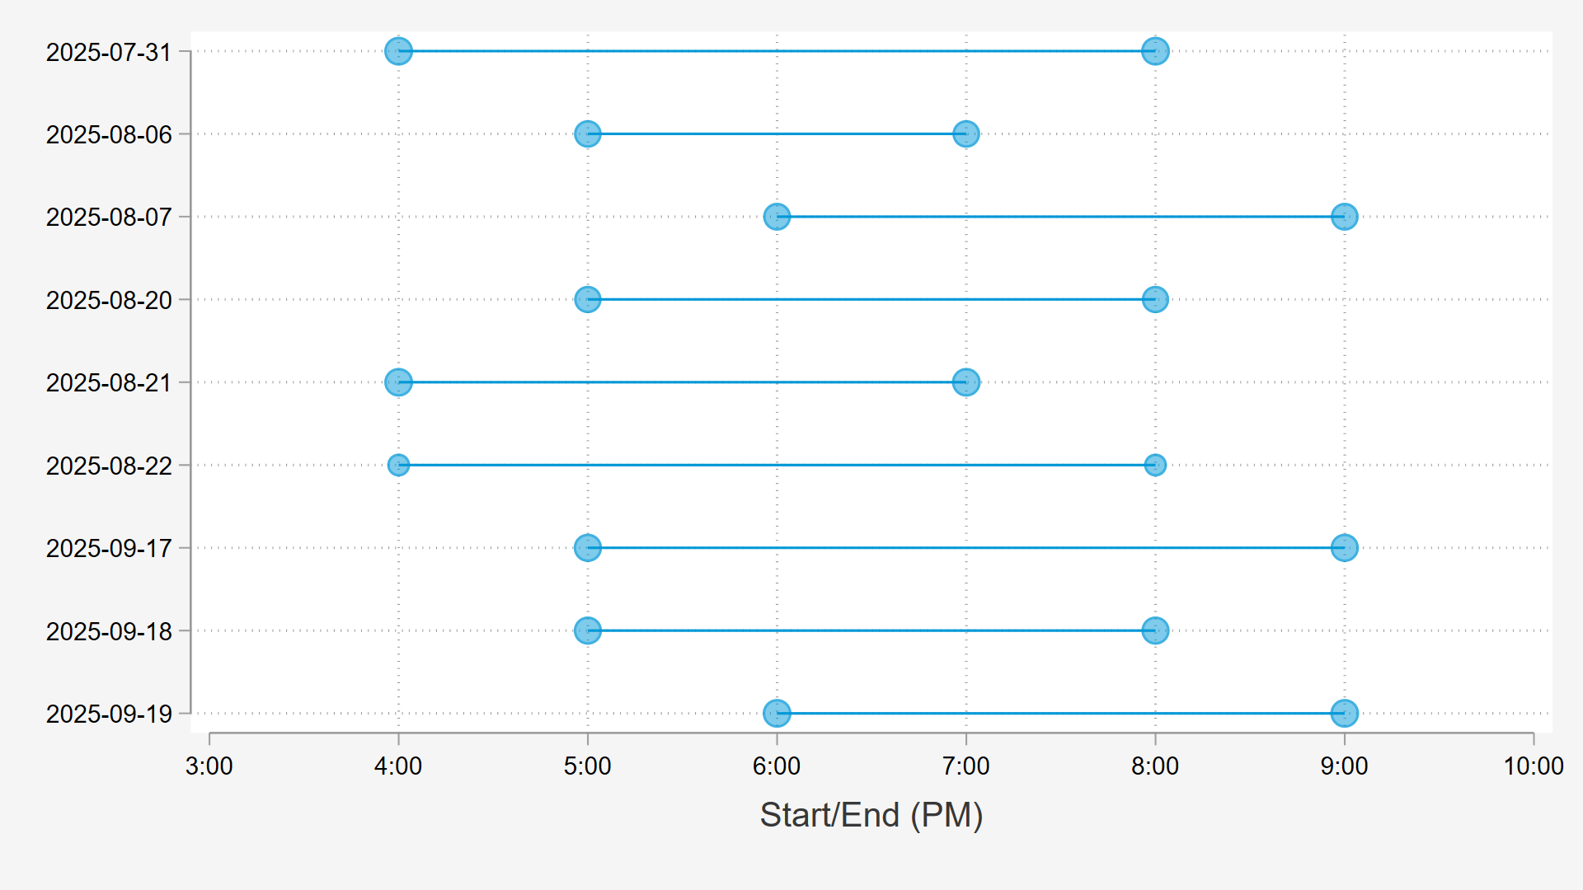
2025 SEP events were longer in duration than prior years and covered the entire RA window.

Slide 5
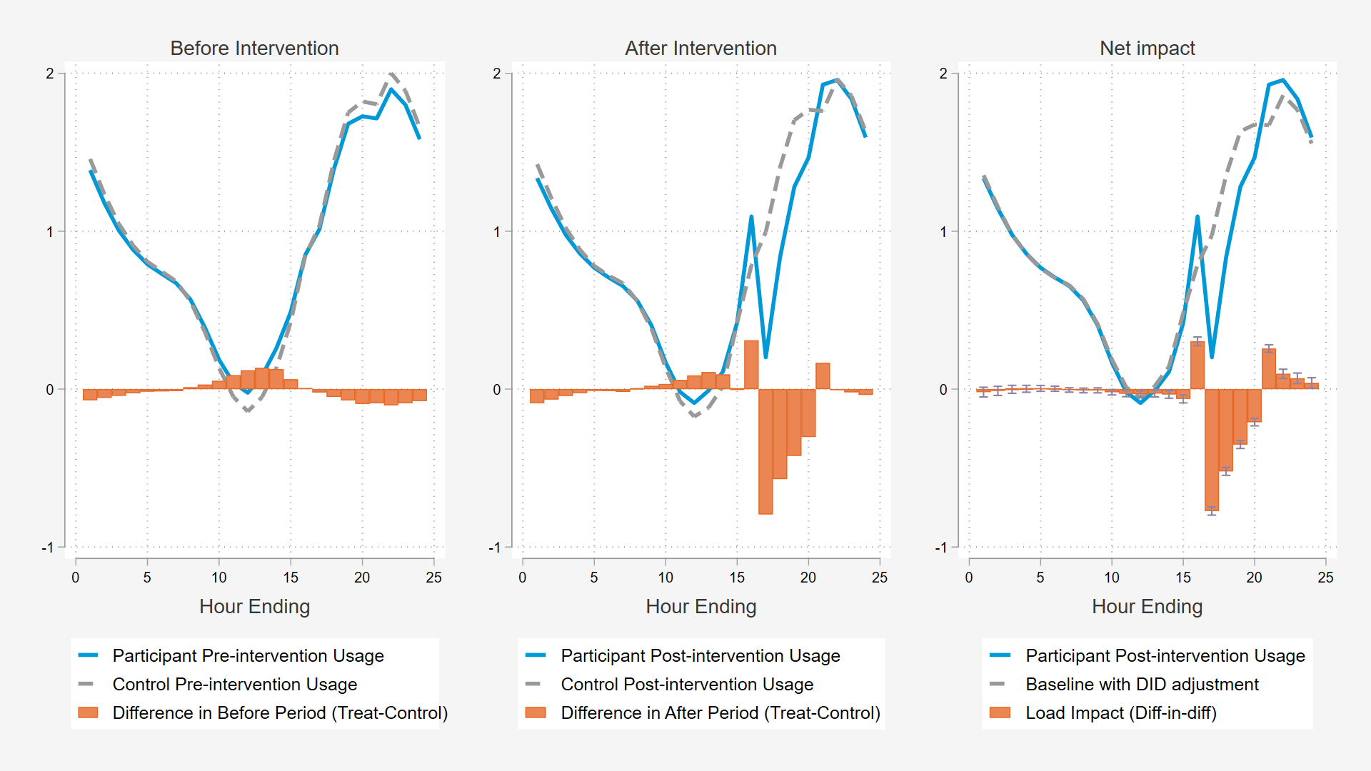
Ex Post Methodology –difference-in-Differences
Simple difference-in-differences model
  The differences in usage on similar, non-event days are removed from the reference load giving us our event-day baseline.
Proxy days, the non-event days used in modelling, are other hot days with similar characteristics to event days, but where no events were called.
Difference-in-Differences Analysis for July 31st Event

Slide 6
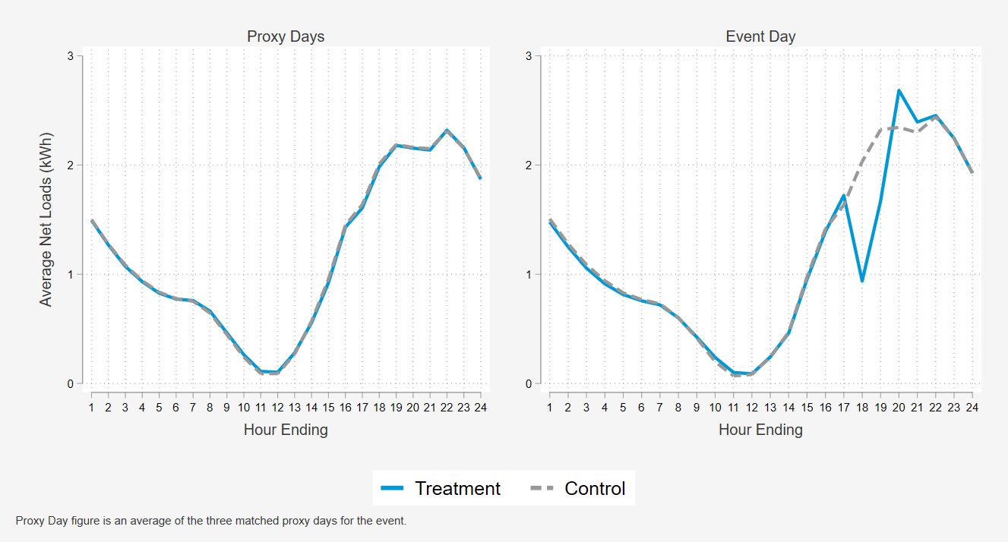
Using Non-dispatched Participants as controls
Randomized non-dispatched program participants provide an ideal control group for analyzing each event, controlling for unobservable characteristics better than a matched control group.
Observed loads on the proxy days for the August 6th event were nearly identical for the treatment and non-treatment (control) customers.
Observed Average Loads on August 6th and Matched Proxy Days

Slide 7
2025 Event Summary
Average impact in the first event hour was around 1 kW per customer.
  The average event day is constructed out of the two event days with an event window of 4-8pm.
  Cooler event days at the end of September showed lower impacts than events called under warmer conditions earlier in the season.
In aggregate, average hourly impacts ranged from 2 to 8 MW.
  Aggregate impacts were lower than previous years due to the distribution level events only dispatching ~10% of participants in each event.
  If the per-customer impacts from the average event day were assumed to hold for all participants enrolled in SEP at the end of the season, 87,765 customers, aggregate impacts in event hour 1 would have been 82 MW.
Event Date | Start Time | End Time | Participants | Average Event Temperature | Per Customer Reduction in Hour 1 (kW) | Per Customer Average Hourly Event Impact (kW) | Aggregate Average Hourly Event Impact (MW) | Aggregate Average Hourly Event Impact if All Enrolled Customers were Dispatched (MW)
7/31/2025 | 4:00 PM | 8:00 PM | 9,155 | 83.0 | 0.77 | 0.46 | 4.2 | 40.7
8/6/2025 | 5:00 PM | 7:00 PM | 8,366 | 89.2 | 1.07 | 0.86 | 7.2 | 75.3
8/7/2025 | 6:00 PM | 9:00 PM | 8,496 | 93.7 | 1.13 | 0.70 | 5.9 | 61.0
8/20/2025 | 5:00 PM | 8:00 PM | 8,163 | 87.9 | 0.97 | 0.58 | 4.7 | 50.7
8/21/2025 | 4:00 PM | 7:00 PM | 9,082 | 95.1 | 1.32 | 0.92 | 8.3 | 80.4
8/22/2025 | 4:00 PM | 8:00 PM | 5,409 | 86.8 | 1.19 | 0.70 | 3.8 | 61.4
9/17/2025 | 5:00 PM | 9:00 PM | 8,837 | 80.2 | 0.45 | 0.21 | 1.9 | 18.7
9/18/2025 | 5:00 PM | 8:00 PM | 8,751 | 77.3 | 0.62 | 0.44 | 3.8 | 38.4
9/19/2025 | 6:00 PM | 9:00 PM | 9,101 | 76.8 | 0.63 | 0.40 | 3.6 | 34.9
Average Event Day | 4:00 PM | 8:00 PM | 7,764 | 84.4 | 0.93 | 0.55 | 4.3 | 48.4

Slide 8
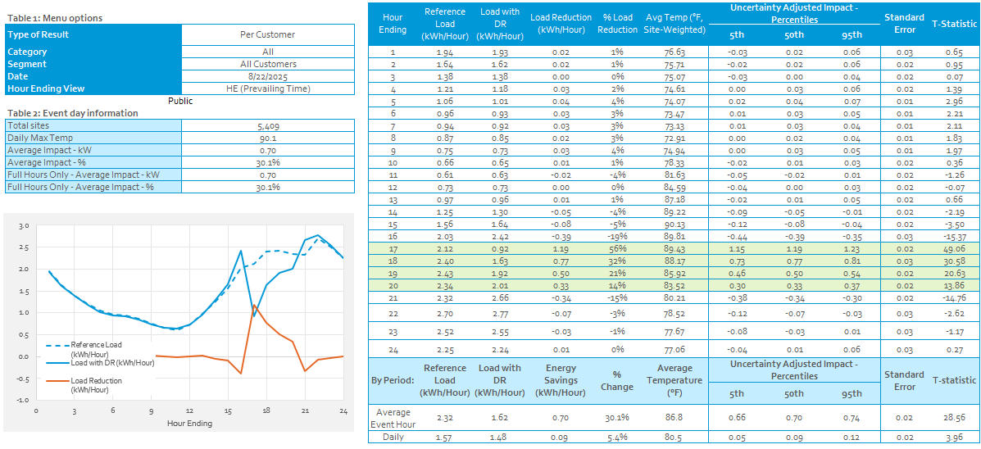
SCE System Peak Day – August 22nd
Event impacts in event hour 1 were higher than average at 1.19 kW per customers.
Only 5,409 customers were dispatched due to some to-be dispatched customers experiencing a PSPS event and being left out of the SEP event.
Not the warmest event day of the season, but generally strong impacts

Slide 9
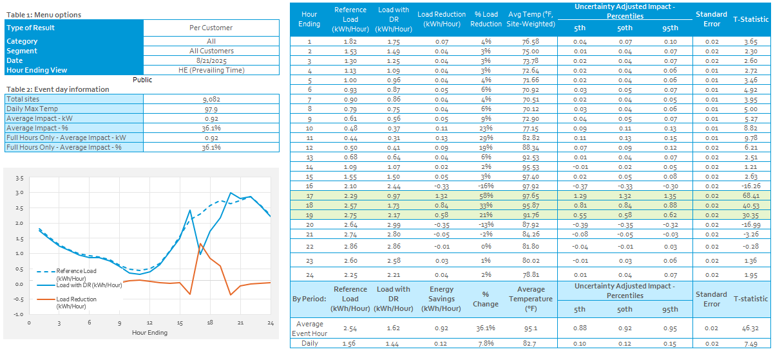
Warmest Event Day and the CAISO Peak day – August 21st

Slide 10
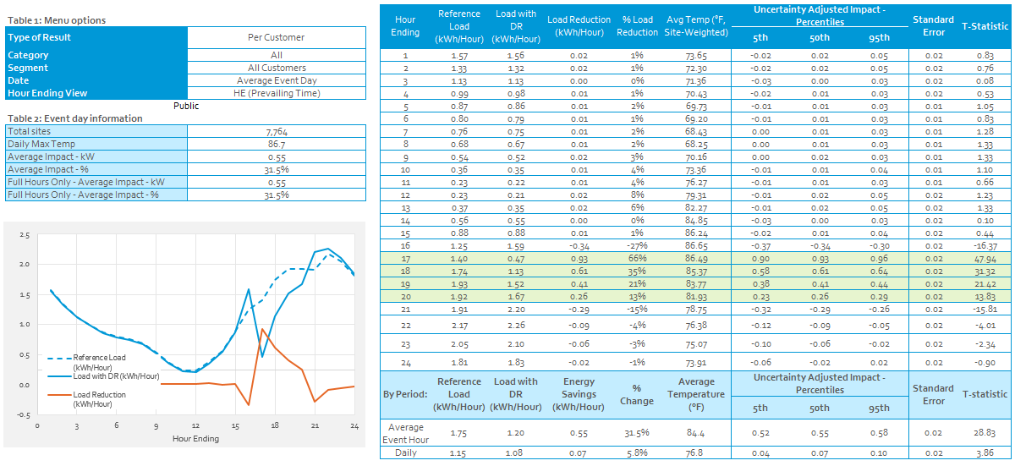
Average Event day 4-8PM
Average includes two event days
  7/31/2025
  8/22/2025
July event day was cooler than most events, while the August event was warmer than normal.
Per customer impact estimates are consistent with past years at ~0.9 kW in hour 1 and ~0.6 kW in hour 2

Slide 11
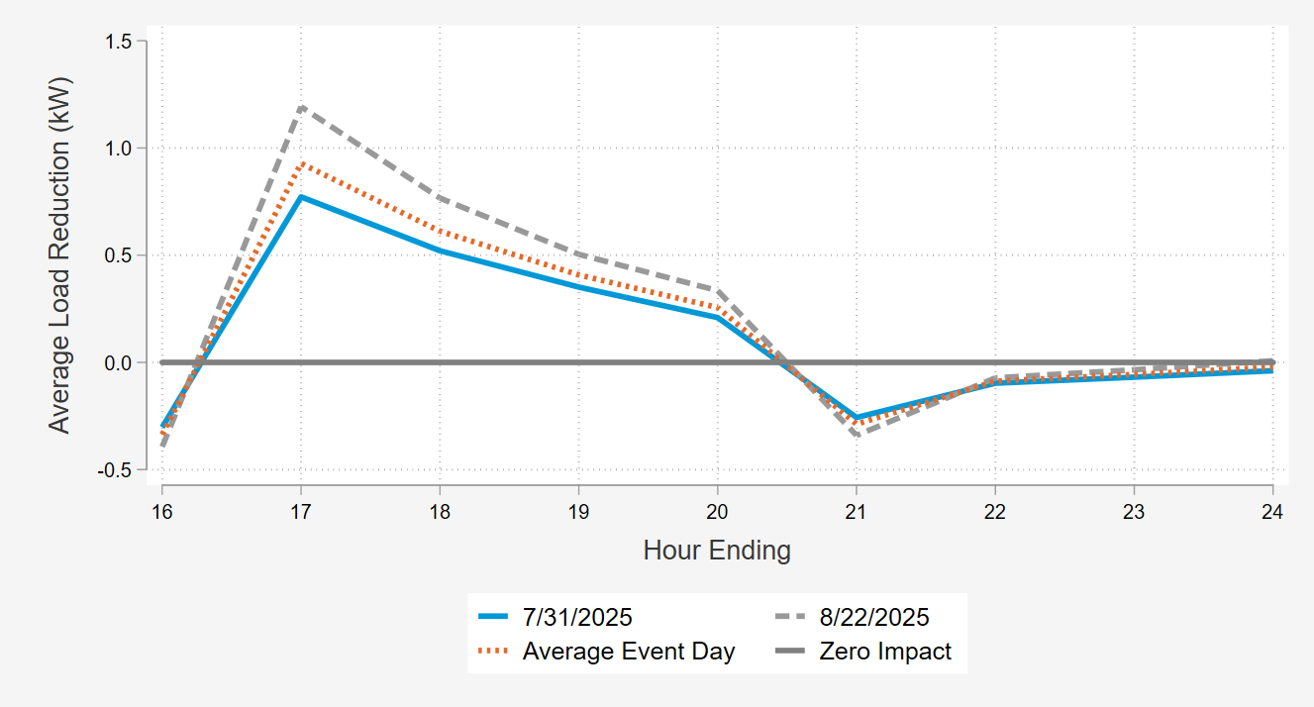
Event Impacts Are Largest During the first Hour of Dispatch and fade in subsequent hours
Pre-Cooling effects

Slide 12
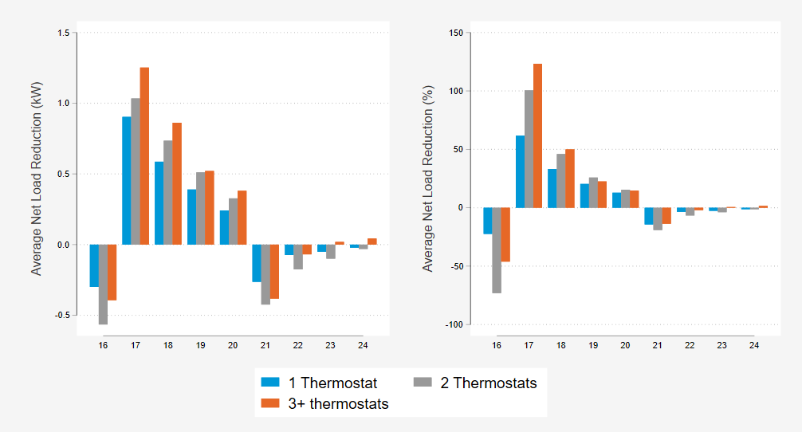
Number of Thermostats enrolled – Average Event day 4-8PM
Enrolled customers with more than one thermostat reduce more load than those with only one, but only by a small amount.
Events called earlier in the day when solar production is still high can lead to instances of net load reductions of more than 100% (3+ thermostats in hour ending 17)

Slide 13
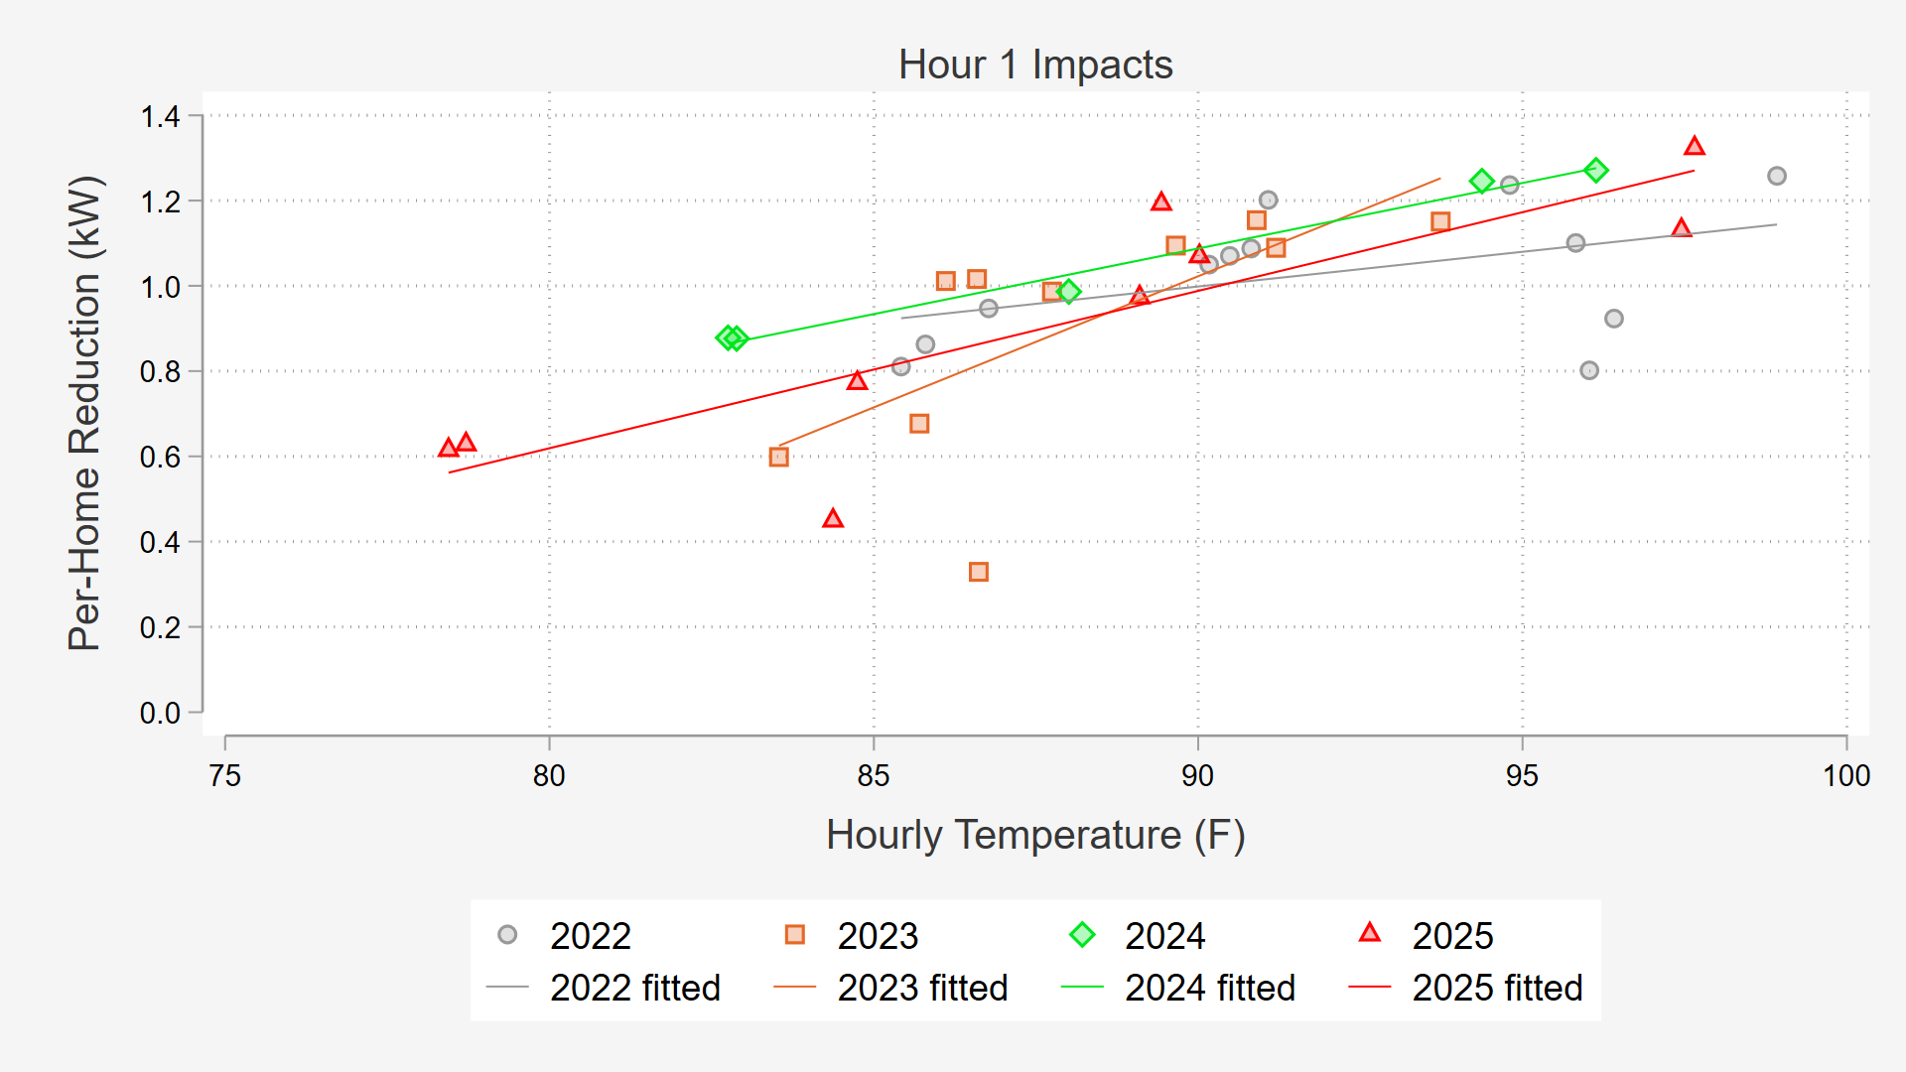
How does PY2025 compare to Prior Years?
Hour 1 impacts from 2025 events show similar impacts to prior years when considering event temperatures.
2025 events covered a wider range of temperatures than years past due to distribution level testing initiative.

Slide 14
2025 Ex-Post vs 2024 Ex-ante
7/31/2025 (4:00-8:00 PM) |  | Per-Customer Impact (kW)
Results | Event Hour Average Temp (F) | Hour 1 | Hour 2 | Hour 3 | Hour 4
SCE 1-in-2 July Monthly Worst Day (2024 Ex-Ante Predictions for 2025) | 91.6 | 1.20 | 0.66 | 0.41 | 0.35
Ex-Post | 83.0 | 0.77 | 0.52 | 0.35 | 0.21
8/21/2025 (4:00-7:00 PM) |  | Per-Customer Impact (kW)
Results | Event Hour Average Temp (F) | Hour 1 | Hour 2 | Hour 3 | Hour 4
SCE 1-in-10 August Monthly Worst Day (2024 Ex-Ante Predictions for 2025) | 94.6 | 1.27 | 0.69 | 0.45
Ex-Post | 95.1 | 1.32 | 0.84 | 0.58
9/19/2025 (6:00-9:00 PM) |  | Per-Customer Impact (kW)
Results | Event Hour Average Temp (F) | Hour 1 | Hour 2 | Hour 3 | Hour 4
SCE 1-in-2 September Monthly Worst Day (2024 Ex-Ante Predictions for 2025) | 93.8 | 1.24 | 0.67 | 0.44
SCE 1-in-2 November Monthly Worst Day (2024 Ex-Ante Predictions for 2025) | 81.9 | 0.58 | 0.43 | 0.16
Ex-Post | 76.8 | 0.63 | 0.30 | 0.26
These comparisons use the 4-9pm ex-ante predictions from the 2024 load impact evaluation
Events shown from July, August, and September
  Ex-ante events begin at 4pm, ex-post events from July and August start at 4pm, but the September event started at 6pm.
Event conditions for most 2025 events were not close to monthly worst day planning conditions due to a cool overall summer.
  However, the conditions during the August event were close to planning conditions and impacts were comparable to the forecast.

Slide 15
Ex-Ante Analysis

Slide 16
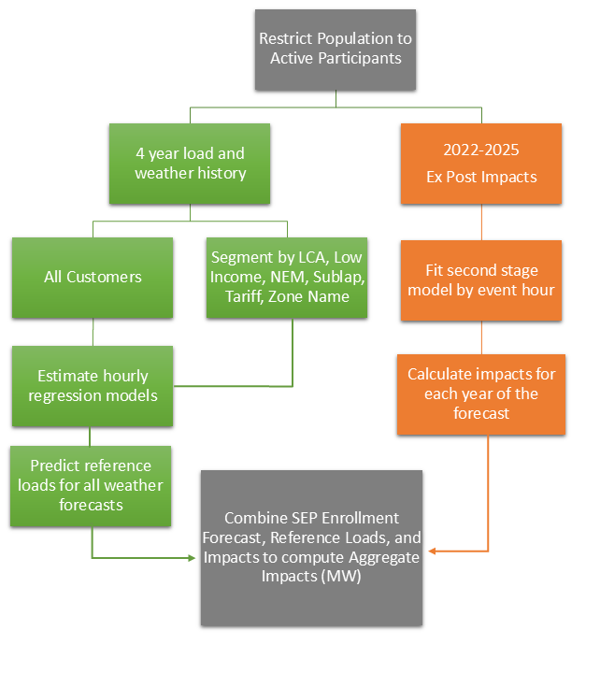
Ex Ante Estimation Process Diagram
We only include full event hours in the second stage model
Event hours affected by pre-cooling are included in the second stage model
High event temperatures help predict events under the more extreme ex-ante weather conditions
  Event temperatures for some events in 2025, August 7th and 21st, were very hot, which is helpful for modeling

Slide 17
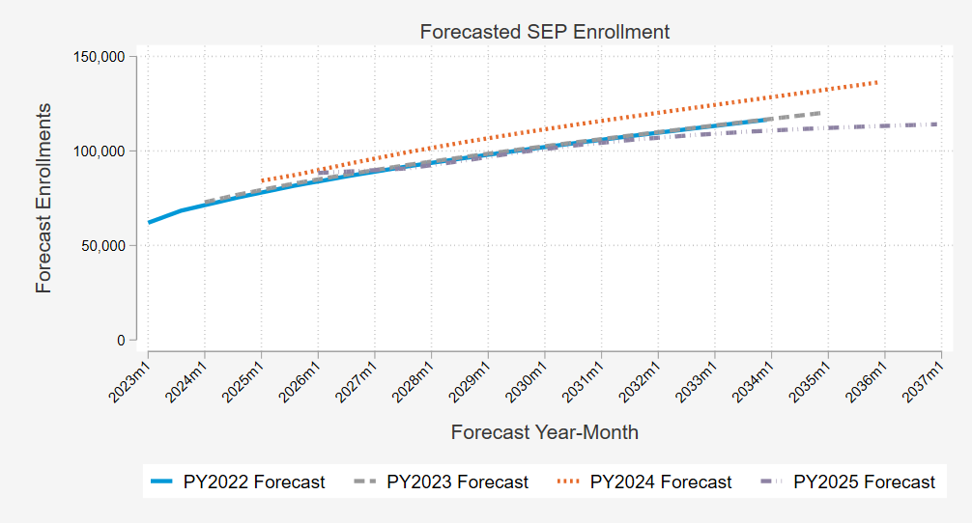
Enrollment Forecast
Forecast Notes
Comparison of 2025 Enrollment Forecast with Past Years
Used to convert average customer kW impacts to program MW capability
PY2025 enrollment forecast is lower than PY2024
  Current forecast is similar to 2022 and 2023 forecasts
  Enrollment in 2025 was in line with expectations from PY2024 forecast
We assume growth follows the distribution of enrollments at the end of summer 2025

Slide 18
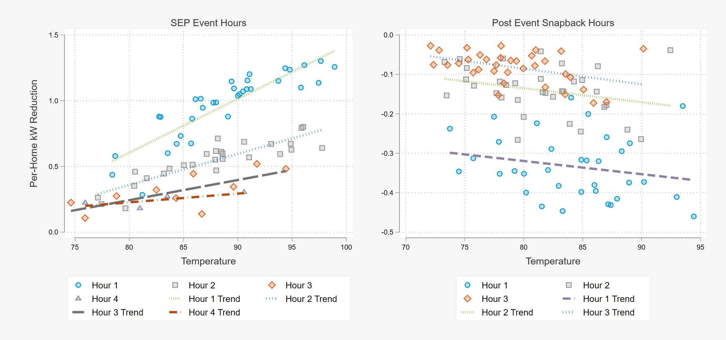
Approach to Second Stage Modeling of kW Impacts in 2025
Event hour is the most important predictor of impacts
2022 - 2025 impacts are used with more recent years having more weight
Impacts are modeled separately by climate zone group and SubLAP then aggregated to each subcategory
Due to event data limitations, we treat hour 5 as if it were an hour 4
  2022 – 2025 event data does not contain any 5-hour events

Slide 19
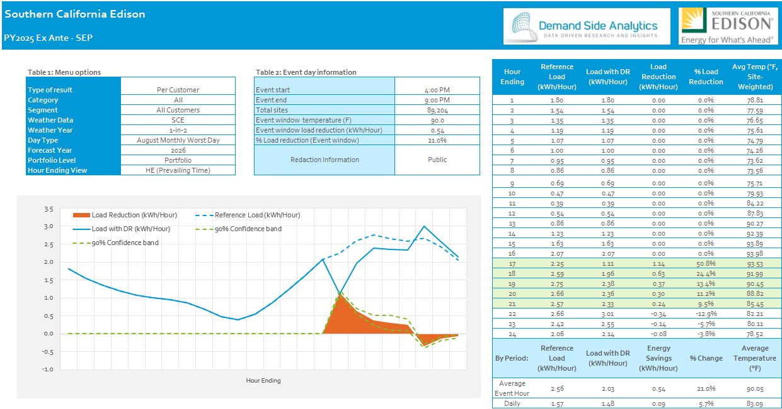
August 1-in-2 impact forecasts remain consistent
Per Customer SCE 1-in-2 August Monthly Worst Day 2026
Impacts are above 1 kW in the first hour and expected to reduce loads by more than 50%
Impacts decrease in each subsequent hour of dispatch, which is what we observe in all ex post events.

Slide 20
Comparison of PY2024 and PY2025 SCE 1-in-2 projections.
Average per-customer impacts over the RA window have decreased, especially in hours 4 and 5.
  Decrease in impacts for hours 4 and 5 is a result of increased data on event hour 4 from PY2025
Aggregate impacts are expected to be lower due to the decrease in the per-customer impacts and a lower enrollment forecast
Hour Ending | SCE 1-in-2 August Worst Day 2026
 | Per Customer Impact |  | Expected enrollment |  | Aggregate Impact
 | 2024 (kW) | 2025 (kW) | PY2024 | PY2025 | PY2024 | PY2025
17 | 1.17 | 1.14 | 93,514 | 89,204 | 109.6 | 102.1
18 | 0.63 | 0.63 | 93,514 | 89,204 | 59.3 | 56.4
19 | 0.40 | 0.37 | 93,514 | 89,204 | 37.3 | 33.0
20 | 0.37 | 0.30 | 93,514 | 89,204 | 34.2 | 26.5
21 | 0.30 | 0.24 | 93,514 | 89,204 | 27.9 | 21.8
RA Window Average | 0.57 | 0.54 | 93,514 | 89,204 | 53.7 | 47.9

Slide 21
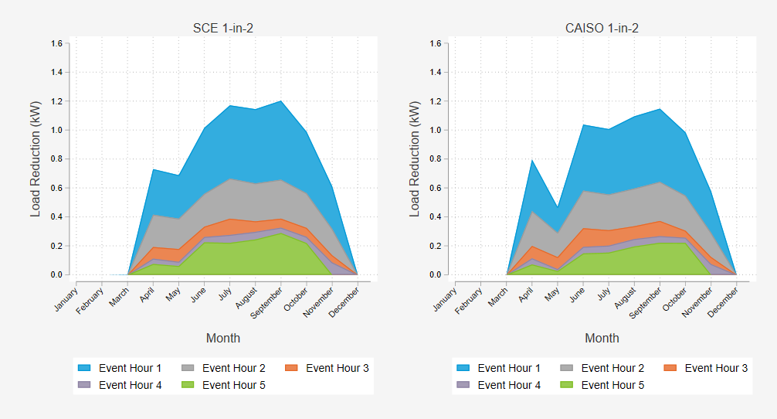
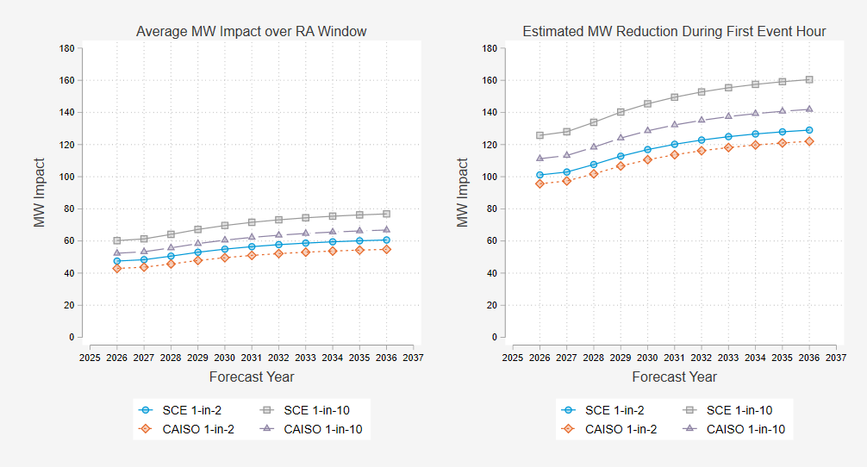
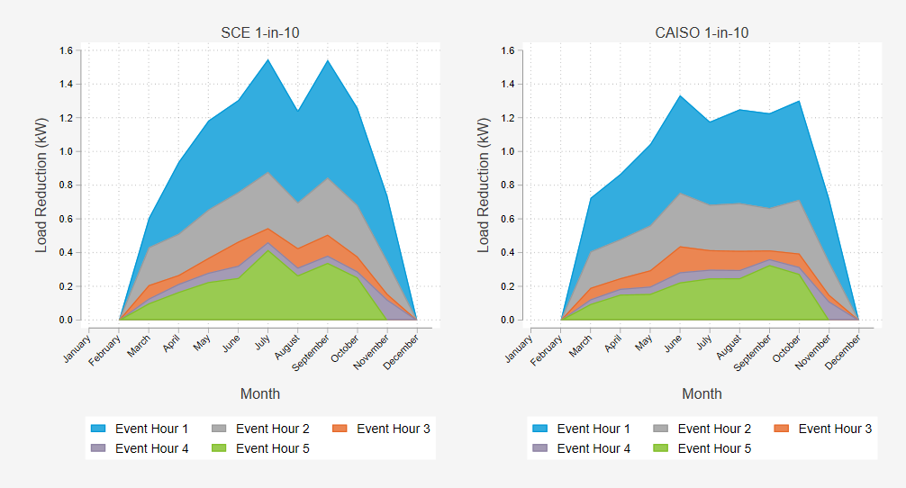
Ex Ante Impacts
Aggregate Impacts – Typical Event Day
Per Customer Impacts by Month
By 2036 SEP is expected to be a ~160 MW resource during the first hour of dispatch. ~80 MW average over RA window
Event impacts peak in warmer months but decline with each event hour in all months

Slide 22
Takeaways
The number one predictor of SEP load impacts is the position of an hour within an event.
  Largest during the first hour, in large part due to pre-cooling that took place prior to the event
The distribution level testing initiative caused events to be called for a much wider range of event conditions in PY 2025 providing more information on how the program performs at extreme high and low temperatures than in previous years.
The PY2025 ex-ante forecasts of impacts are generally lower than the PY2024 per-participant impacts for the same ex-ante weather conditions. We attribute this change to two key factors:
  Events in PY2025 were longer than in previous years meaning that we were able to fit separate ex-ante models for event hour 3 and event hours 4 and 5. Because smart thermostat event impacts decay in each event hour, impacts estimated for event hour 4 will usually be lower than event hour 3. Treating impacts in the final 2 hours of forecasted events in PY2024 as if they were like hour 3 likely overstated program capabilities in those hours.
  Observing a wider range of event conditions in PY2025 provided additional ex-post data for both cool and hot events which in turn provides more certainty for estimates of impacts at extreme ex ante conditions. The relationship between weather and event impacts was estimated to be slightly less steep, meaning that impacts are less weather sensitive, in the PY2025 analysis.

Slide 23

Questions?
Davis Farr
Consultant
Demand Side Analytics, LLC
dfarr@demandsideanalytics.com

