Slide 1
Statewide PY2025 CBP Load Impact Evaluation
2026 DRMEC Load Impact Workshop Day One
May 5, 2026

Slide 2
Agenda
PY2025 Capacity Bidding Program (CBP) Overview
Ex Post Analysis
  Methodology
  PY2025 Enrollment & Load Impact Results by IOU
  Comparison of ex post results
Ex Ante Analysis
  Methodology & Assumptions
  PY2026 – PY2036 Enrollment Forecasts & Load Impact Results by IOU
  Comparison of ex ante results
Final Takeaways

Slide 3
PY2025 Program Overview

Slide 4
Program Description by IOU
PG&E
SCE
SDG&E
Programs
Non-Residential Day-Ahead
Residential Day-Ahead
Non-Residential Day-Ahead
Residential Day-Ahead
Non-Residential Day-Ahead
Non-Residential Day-Of
Elect DA
Elect DO
Products
Elect DA
Elect DA
N/A
$200/MWh
$400/MWh
$600/MWh
Price Trigger Options
$200/MWh
$400/MWh
$600/MWh
Dispatch
May: 5pm-10pm
Jun-Oct: 4pm-9pm
May: 5pm-10pm
Jun-Oct: 4pm-9pm
May-Oct: 1pm-9pm
Eligible Dates
(non-holidays only)
May-Sep: Monday-Saturday
Oct: Monday-Friday
May-Sep: Monday-Saturday
Oct: Monday-Friday
May-Oct: Monday-Friday
Duration
1-4 hours
1-4 hours
2-4 hours
Notes:
Assumed weekday non-holiday

Slide 5
Program Description by IOU
PG&E
SCE
SDG&E
Consecutive Event Days
3 Days
N/A
3 Days
6 Days per Month
24 hours total
Event Limits
6 Days per Month
30 hours total
6 Days per Month
24 hours total
2 hours
Limit 1 per Month
Test Events
1-2 hours
Limit 1 per Month
1-2 hours
Limit 1 per Month
Limit 6 per year per SubLAP
Notes:
Assumed weekday non-holiday

Slide 6
Monthly Nominations
Nominated Customer Counts & Total Nominated MW Capacity
PY2025 Nominations – all DA (zero enrollment in SDG&E DO products)
SCE and SDG&E Enrollment – $600/MWh price options are the only subscribed
PG&E
SCE
SDG&E
Month | Number of Customers | Capacity (MW) | Number of Customers | Capacity (MW) | Number of Customers | Capacity (MW)
May | 546 | 31.4 | 461 | 10.6 | XX | XX.X
June | 591 | 36.7 | 497 | 11.7 | XX | XX.X
July | 655 | 39.9 | 500 | 12.4 | XX | XX.X
August | 689 | 40.8 | 518 | 12.7 | XX | XX.X
September | 690 | 38.8 | 527 | 12.9 | 28 | XX.X
October | 678 | 32.9 | 530 | 13.7 | 25 | XX.X

Slide 7
PY2025 Event Details
IOU | Event Details |  | Event Timing |  |  | Dispatch
 | Date | Type | Start | End | Duration | Customers | Capacity (MW)
PG&E | June 27th | Test Event | 7:00 PM | 8:00 PM | 1 hour | 576 | 35.5
 | August 21st | Test Event | 6:00 PM | 8:00 PM | 2 hours | 685 | 40.8
 | September 26th | Test Event | 6:00 PM | 7:00 PM | 1 hour | 83 | 3.9
SCE | July 30th | Test Event | 5:00 PM | 7:00 PM | 2 hours | 500 | 12.4
 | September 24th | Test Event | 7:00 PM | 9:00 PM | 2 hours | 527 | 12.9
SDG&E | August 22nd | Test Event | 6:00 PM | 8:00 PM | 2 hours | XXX | X.X
 | September 23rd | Test Event | 6:00 PM | 8:00 PM | 2 hours | 28 | X.X
SDG&E ex post and ex ante analyses are confidential and excluded from this presentation

Slide 8
PY2025 Ex Post Analysis

Slide 9
Ex Post Methodology
Step 2: Proxy Day Selection
Step 3: Model Selection
Step 4: Estimation of Impacts
Step 1: Participant Analysis
Step 1: Participant Analysis
Review all tracking and AMI data for completeness and usability
Identify weather-sensitive customers, to determine if temperature should be included in models
Step 2: Proxy Day Selection
Select non-holiday, non-event days that closely resemble each customer’s average event day temperature profile (based on a distance metric)
Select 5 weekdays and 3 weekend proxy days per customer for testing candidate models
Notes:
Distance metric used in proxy day selection: $Distance Metric=|({MaxTemp_RA_Window}_{avg event}−{MaxTemp_RA_Window}_{non− event})|+|({AvgDailyTemp}_{avg event}−{AvgDailyTemp}_{non− event})|$

Slide 10
Ex Post Methodology
Step 2: Proxy Day Selection
Step 3: Model Selection
Step 4: Estimation of Impacts
Step 1: Participant Analysis
Step 3: Model Selection
Predict load on the set of selected proxy days, holding out one proxy day at a time
Select candidate models to minimize bias and error (i.e., no significant event impact parameters for non-event days and realistic regressor coefficients)
Review and revise specific selected customer models due to high load heterogeneity
Step 4: Estimation of Impacts
Use selected models to predict event day baseline load to calculate per-customer impacts against observed load and aggregate

Slide 11
PG&E Ex Post Analysis

Slide 12
Program Enrollment by Industry Type
PG&E Non-Residential Elect DA
Industry Type | Under 20 kW (Small) | 20 kW to 199.99 kW (Medium) | 200 kW or Greater (Large) | Total
Agriculture, Mining and Construction | 19 | 227 | 88 | 334
Retail Stores | 10 | 96 | 205 | 311
Water, Wholesale, Transport, and other Utilities | 9 | 41 | 56 | 106
Office, Hotels, Finance, Services | 2 | 13 | 14 | 29
Schools | 1 | 17 | 9 | 27
Manufacturing | 1 | 2 | 18 | 21
Institutional/Government | 2 | -- | 2 | 4
Total | 44 | 396 | 392 | 832

Slide 13
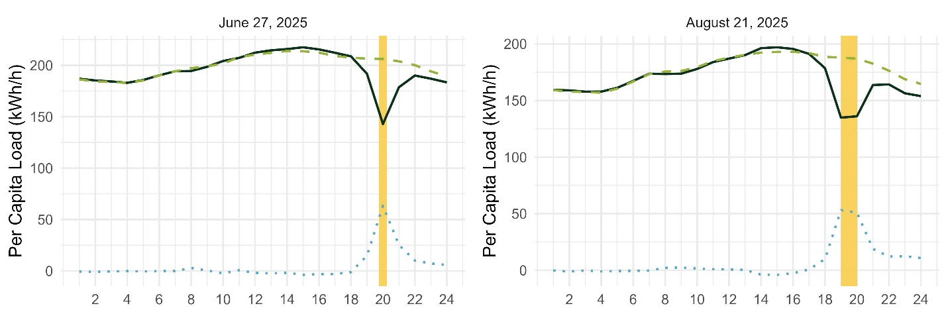
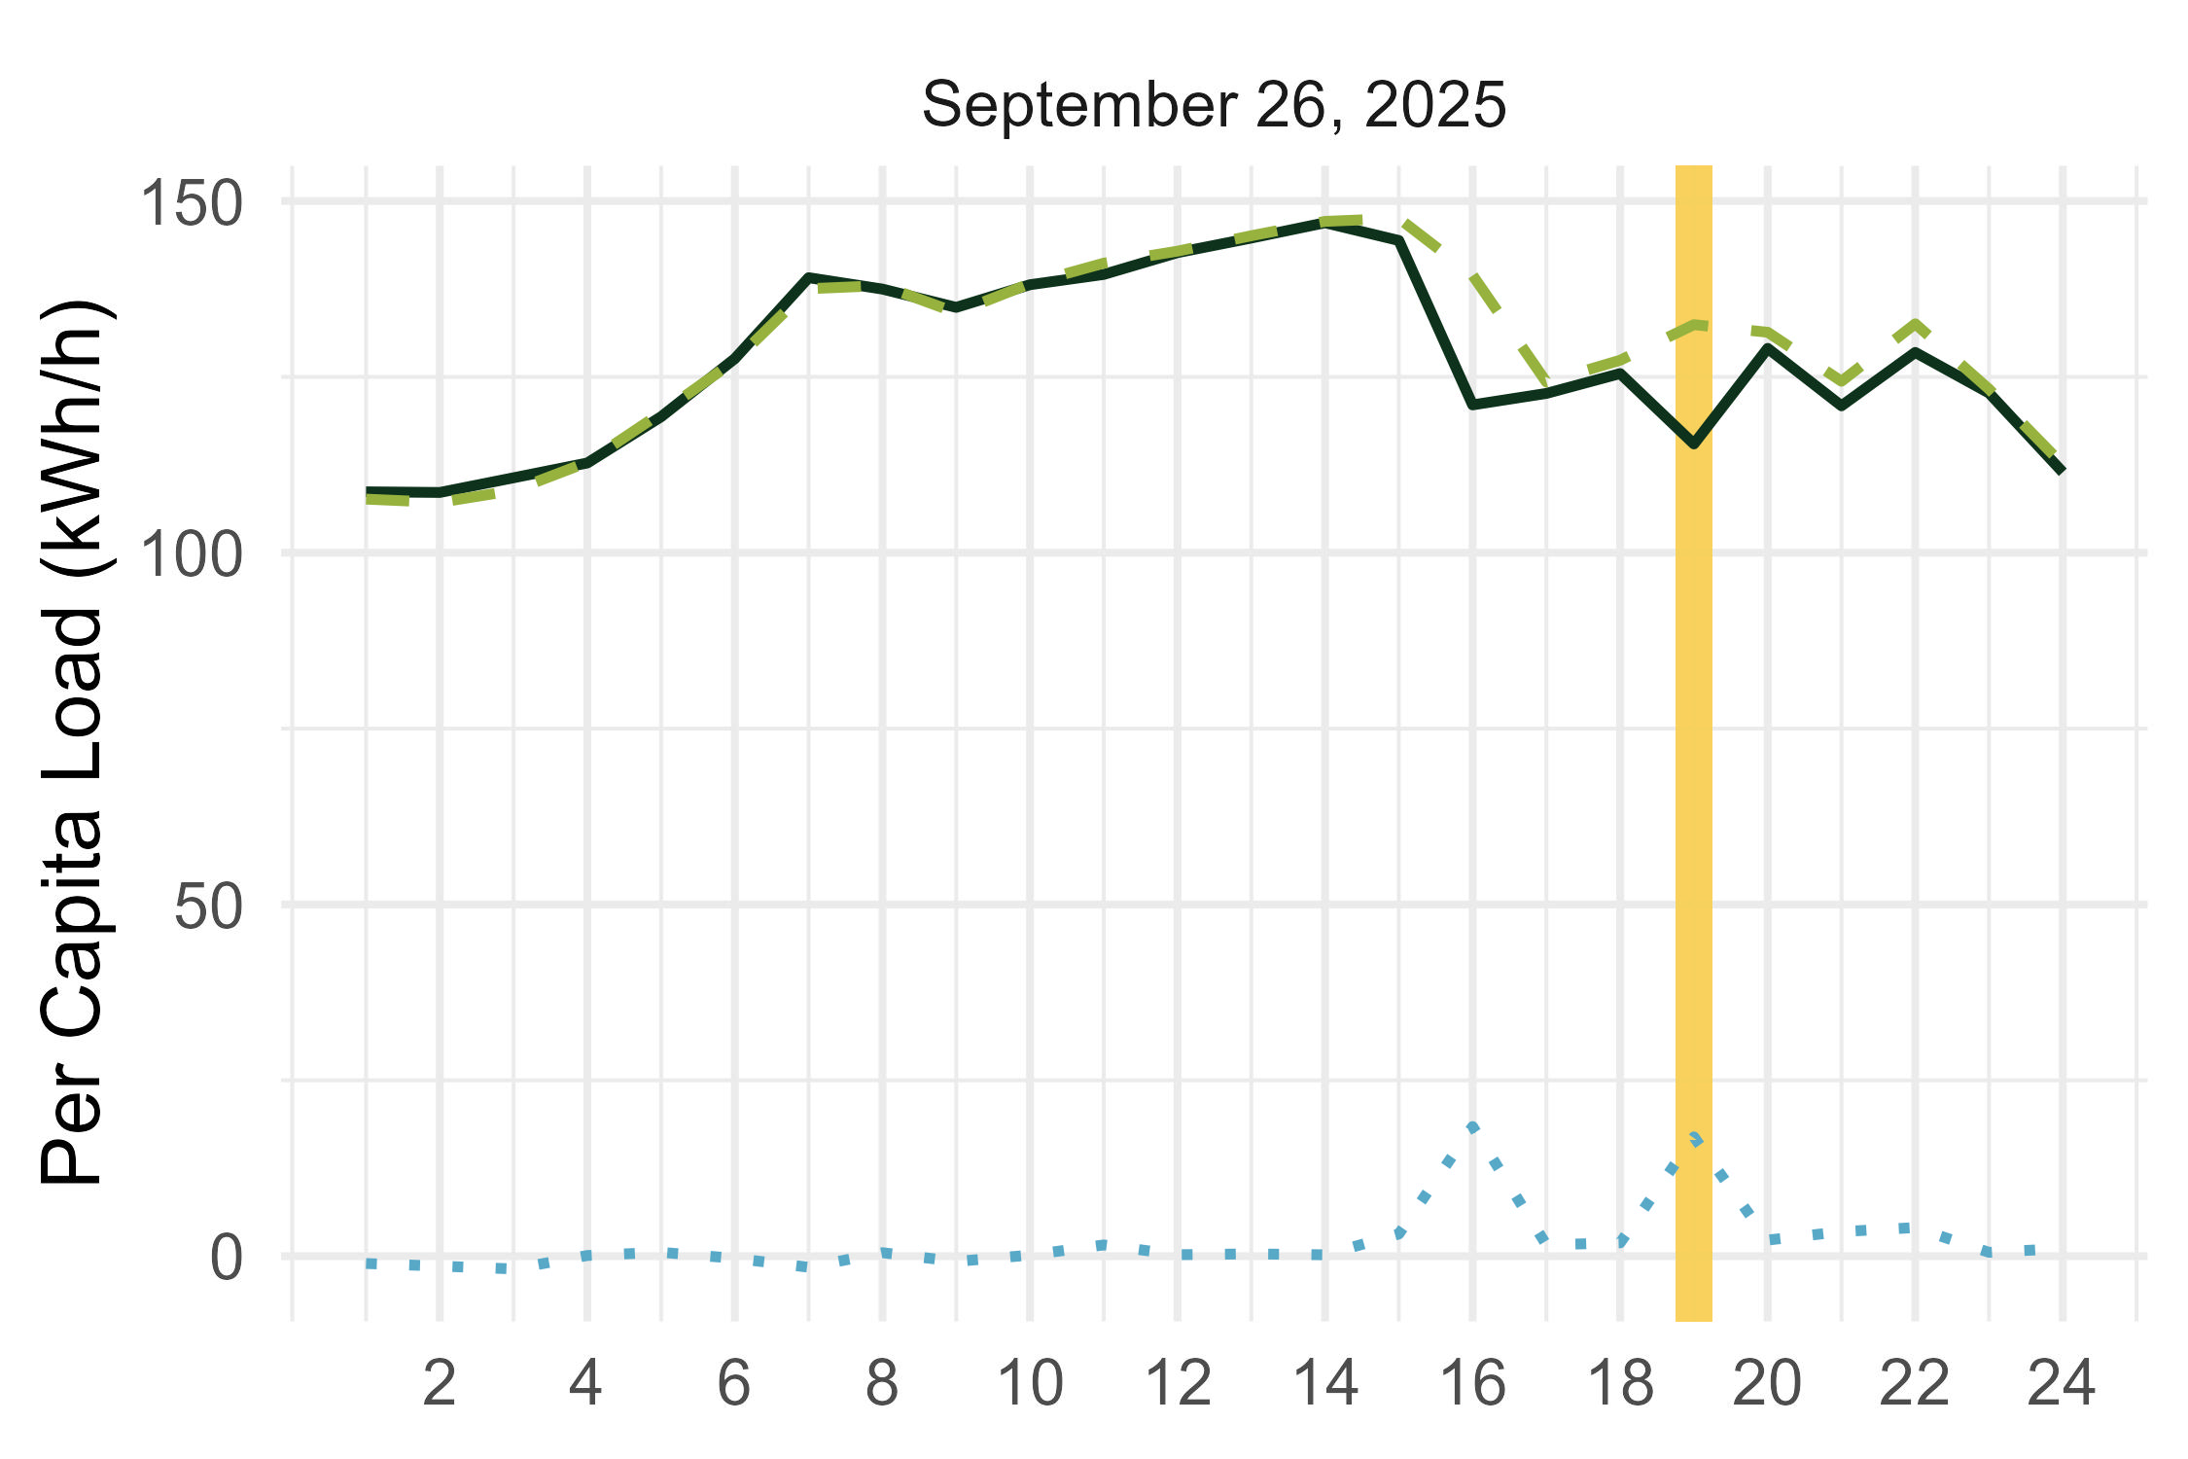
Ex Post Load Shapes
PG&E Non-Residential Elect DA

Slide 14
Ex Post Impacts
PG&E Non-Residential Elect DA
Event Date (2025) | Event Hours (HE) | Num. of Customers Dispatched | Aggregate (MWh/h) |  | Per Capita (kWh/h) |  | Percent Load Reduction (%) | Dispatch Delivery Perf. (%) | Temp (°F)
 |  |  | Ref. Load | Load Impact | Ref. Load | Load Impact
June 27th | 20 | 576 | 118.8 | 36.5 | 206.2 | 63.3 | 31% | 103% | 86
August 21st | 19-20 | 685 | 128.4 | 35.6 | 187.5 | 52.0 | 28% | 87% | 92
September 26th | 19 | 83 | 11.0 | 1.4 | 132.4 | 17.0 | 13% | 36% | 76
HE20 Avg. Impact | 20 | 630 | 123.4 | 35.7 | 195.7 | 56.6 | 29% | 94% | 88
No average event day; average HE20 (7pm-8pm) impacts for high-participation dates
Event 3 (September 26th) – re-test event for poor performers plus some new nominations

Slide 15
Historic Ex Post
PG&E Non-Residential Elect DA (PY2021 – PY2025)
Program Year* | Avg. Monthly Nominated Customers | Aggregate (MWh/h) |  |  | Per Capita (kWh/h) |  |  | Temp (°F)
 |  | Dispatched Capacity | Load Impact | % Del. | Ref. Load | Load Impact | % Load
2021 | 365 | 13.5 | 13.0 | 96% | 81.6 | 35.6 | 44% | 87
2022 | 475 | 31.3 | 28.0 | 89% | 150.9 | 58.9 | 39% | 96
2023 | 430 | 23.8 | 20.5 | 86% | 219.2 | 47.2 | 22% | 91
2024 | 270 | XX.X | XX.X | XX% | XX.X | XX.X | XX% | 92
2025* | 630 | 38.2 | 35.7 | 93% | 195.7 | 56.6 | 29% | 88
* Data represent the average event day except for 2025, which represents the average of HE20 during the June 27th & August 21st events

Slide 16
Comparison to PY2024 Ex Ante
PG&E Non-Residential Elect DA
Estimate for 2025 | Number of Customers | Aggregate (MWh/h) |  | Per Capita (kWh/h) |  | Percent Load Reduction (%) | Temp (°F)
 |  | Ref. Load | Load Impact | Ref. Load | Load Impact
PY2024 Ex Ante* | 431 | 123.9 | 40.8 | 287.5 | 94.6 | 33% | 97
PY2025 Ex Post (June 27th) | 576 | 118.8 | 36.5 | 206.2 | 63.3 | 31% | 86
PY2025 Ex Post (August 21st) | 685 | 128.4 | 35.6 | 187.5 | 52.0 | 28% | 92
HE20 Avg. Impact | 630 | 123.4 | 35.7 | 195.7 | 56.6 | 29% | 88
* PG&E 1-in-2 August System Worst Day Average
Higher enrollment in 2025 than was forecasted in PY2024
Lower average per capita reference loads and load impacts in 2025 compared to forecasted values from PY2024 result in lower realized load impacts (40.8 MWh/h forecasted compared to 35.6 – 36.5 MWh/h realized)

Slide 17
SCE Ex Post Analysis

Slide 18
Program Enrollment by Industry Type
SCE CBP-E Non-Residential
Industry Type | 50 kW or Under (Small) | 51 kW to 250 kW (Medium) | 250 kW or Greater (Large) | Total
Retail Stores | 19 | 187 | 180 | 386
Utilities | 25 | 91 | 27 | 143
Other/Unknown | 5 | 3 | 9 | 17
Total | 49 | 281 | 219 | 546
Notes:
“Other/Unknown” includes various service industries, institutional/government businesses, schools, and customers with no NAICS classification data

Slide 19
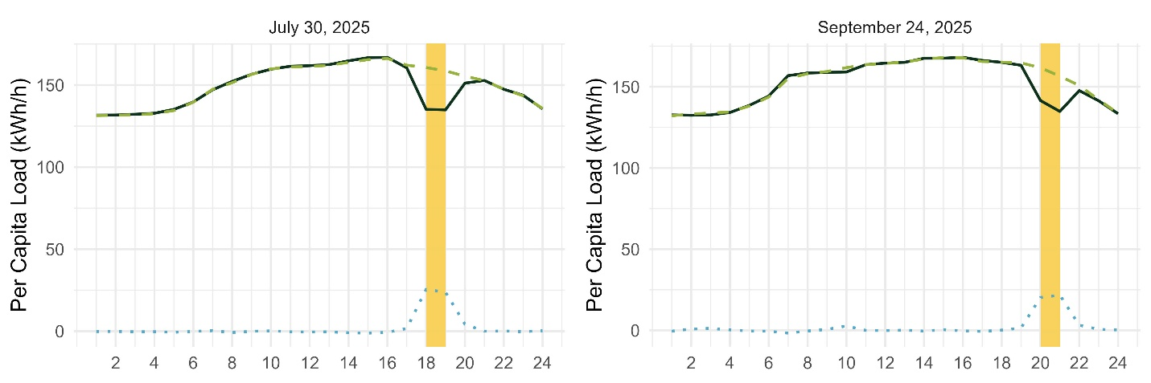
Ex Post Load Shapes
SCE CBP-E Non-Residential

Slide 20
Ex Post Impacts
SCE CBP-E Non-Residential
Event Date (2025) | Event Hours (HE) | Num. of Customers Dispatched | Aggregate (MWh/h) |  | Per Capita (kWh/h) |  | Percent Load Reduction (%) | Dispatch Delivery Perf. (%) | Temp (°F)
 |  |  | Ref. Load | Load Impact | Ref. Load | Load Impact
July 30th | 18-19 | 500 | 79.8 | 12.3 | 159.6 | 24.6 | 15% | 99% | 86
September 24th | 20-21 | 527 | 83.8 | 11.0 | 159.1 | 21.0 | 13% | 85% | 79
Avg. Impact | 18-21 | 514 | 81.9 | 11.7 | 159.4 | 22.7 | 14% | 92% | 82
No average event day; average impacts represent all four dispatched hours between events

Slide 21
Historic Ex Post
SCE CBP Non-Residential (PY2021 – PY2025)
Program Year* | Avg. Monthly Nominated Customers | Aggregate (MWh/h) |  |  | Per Capita (kWh/h) |  |  | Temp (°F)
 |  | Dispatched Capacity | Load Impact | % Del. | Ref. Load | Load Impact | % Load
2021 (Summer) | 312 | 7.6 | 4.0 | 53% | 81.1 | 12.8 | 16% | 82
2022 (Summer) | 83 | 0.9 | 1.1 | 117% | 78.8 | 12.8 | 16% | 84
2023 (Summer) | 1 | X.X | X.X | XX% | XX.X | XX.X | XX% | 95
2024 | 34 | 1.1 | 0.8 | 69% | 423.9 | 22.3 | 5% | 86
2025* | 514 | 12.7 | 11.7 | 92% | 159.4 | 22.7 | 14% | 82
* Data represent the average event day except for 2025, which represents the average of all event hours during both PY2025 events

Slide 22
Comparison to PY2024 Ex Ante
SCE CBP-E Non-Residential
Estimate for 2025 | Number of Customers | Aggregate (MWh/h) |  | Per Capita (kWh/h) |  | Percent Load Reduction (%) | Temp (°F)
 |  | Ref. Load | Load Impact | Ref. Load | Load Impact
PY2024 Ex Ante* | 495 | 86.8 | 10.9 | 175.3 | 22.0 | 13% | 86
July 30th Ex Post | 500 | 79.8 | 12.3 | 159.6 | 24.6 | 15% | 86
September 24th Ex Post | 527 | 83.8 | 11.0 | 159.1 | 21.0 | 13% | 85
Avg. Impact Ex Post | 514 | 81.8 | 11.7 | 159.4 | 22.8 | 14% | 86
* SCE 1-in-2 August System Worst Day Average
Higher average aggregate load impact in PY2025 (11.7 MWh/h) compared to PY2024 ex ante forecast of 2025 (10.9 MWh/h)
Differences are primarily driven by increased enrollment in the program as per-capita load impacts are roughly equivalent (22.8 kWh/h in the ex post vs. 22.0 kWh/h in the ex ante)

Slide 23
PY2025 Ex Ante Analysis

Slide 24
Ex Ante Methodology (Non-Residential)
Step 2: Estimate Per Capita Reference Loads
Step 3: Estimate Per Capita Impacts
Step 4: Apply Participant Forecasts
Step 1: Develop Ex Ante Drivers
Step 1: Develop Ex Ante Drivers
Develop the “drivers” data set containing all assumptions about event days under ex ante weather conditions, to be used in baseline forecasting
Assumes weekday, non-holiday events
Step 2: Estimate Per Capita Reference Loads
Use the ex post model specifications and ex ante drivers to predict weather-adjusted customer reference loads, and select additional models for those without an ex post model
Validate each customer’s weather-adjusted reference loads against their historic load shape

Slide 25
Ex Ante Methodology (Non-Residential)
Step 2: Estimate Per Capita Reference Loads
Step 3: Estimate Per Capita Impacts
Step 4: Apply Participant Forecasts
Step 1: Develop Ex Ante Drivers
Step 3: Estimate Per Capita Impacts
Impose ex post percent impacts onto the ex ante reference loads
Scale impacts according to differences in SubLAP, customer type, and size between the ex post and forecasted ex ante populations
Apply a de-rating factor (degradation of impacts due to participant fatigue) as appropriate
Step 4: Apply Participant Forecasts
Extrapolate per-capita impacts and reference loads onto forecasted enrollment to develop MW forecasts under each ex ante weather scenario

Slide 26
Ex Ante Methodology (Residential, SCE only)
Step 2: Apply Load Reductions
Step 3: Estimate Per Capita Impacts and Apply Forecasts
Step 1: Estimate the Ex Ante Reference Loads
Step 1: Estimate Ex Ante Reference Loads
Based on 2023 AMI data from SGIP participants likely to participate in DR (based on application dates)
Carried forward from the PY2024 LIP
Step 2: Apply Load Reductions
Verdant explored PY2025 residential CPP impacts from SGIP participants. Impacts vary by hour, but not weather and hour.
Hourly average event day ex post residential SGIP CPP impacts were used for ex ante per capita impacts
The same impacts are applied to all months May-Oct
Step 3: Apply Per Capita Impacts Forecasts
Scale per capita reference load and load impacts to the participant forecasts

Slide 27
PG&E Ex Ante Analysis

Slide 28
Ex Ante Assumptions
PG&E Elect DA
Load Reductions remain consistent between PY2025 and future years (as a % of reference load) and apply weather-sensitivity from the ex post load reductions
Program/Portfolio Impacts are identical (assumes zero dual-enrollment program days)
Four Hour Event Dispatch includes the first four hours of the RA window
Degradation Rates from PY2023 are applied to the third & fourth event hour
No Residential Participation across all forecasted program years (no enrollment since PY2023)

Slide 29
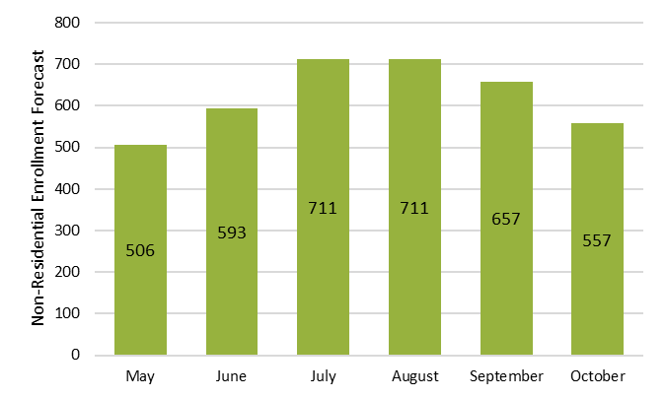
Ex Ante Enrollment Forecasts
PG&E Non-Residential Elect DA (2026 – 2036)
Enrollment assumed constant by month across all forecasted years 2026 – 2036
Ranges from 506 (May) to 711 (July/Aug.)

Slide 30
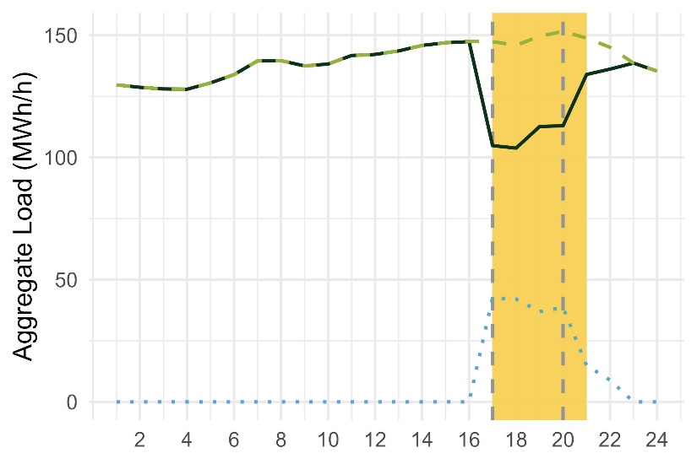
Ex Ante Load Shape
PG&E Non-Residential Elect DA (2026 – 2036)
System Worst Day Average Ex Ante Load Impacts (PG&E 1-in-2 August)

Slide 31
Ex Ante Impacts
PG&E Non-Residential Elect DA (2026 – 2036)
System Worst Day Average Ex Ante Load Impacts (August)
Weather Year | Weather Source | Event Hours (HE) | Num. of Customers | Aggregate (MWh/h) |  | Per Capita (kWh/h) |  | Percent Load Reduction (%) | Temp (°F)
 |  |  |  | Ref. Load | Load Impact | Ref. Load | Load Impact
1-in-2 | PG&E | 17-20 | 711 | 148.6 | 40.0 | 209.1 | 56.3 | 27% | 93.0
1-in-10 | PG&E | 17-20 | 711 | 150.4 | 40.4 | 211.6 | 56.8 | 27% | 98.4
1-in-2 | CAISO | 17-20 | 711 | 149.3 | 40.2 | 210.0 | 56.5 | 27% | 95.0
1-in-10 | CAISO | 17-20 | 711 | 149.7 | 40.2 | 210.5 | 56.6 | 27% | 95.8

Slide 32
Ex Ante Impacts
PG&E Non-Residential Elect DA (2026 – 2036)
System Worst Day Average Ex Ante Load Impacts (May – October)
Hour Ending | PG&E 1-in-2 System Worst Day (MWh/h) |  |  |  |  |  | PG&E 1-in-10 System Worst Day (MWh/h)
 | May | June | July | Aug. | Sept. | Oct. | May | June | July | Aug. | Sept. | Oct.
16 | 0.0 | 0.0 | 0.0 | 0.0 | 0.0 | 0.0 | 0.0 | 0.0 | 0.0 | 0.0 | 0.0 | 0.0
17 | 0.0 | 35.7 | 43.1 | 42.6 | 35.1 | 23.8 | 0.0 | 35.7 | 43.1 | 42.8 | 35.5 | 24.1
18 | 28.7 | 36.2 | 43.6 | 42.1 | 34.7 | 23.6 | 29.0 | 36.3 | 43.7 | 42.4 | 35.3 | 24.2
19 | 29.5 | 31.4 | 38.1 | 36.9 | 30.1 | 20.5 | 29.7 | 31.5 | 38.2 | 37.3 | 30.6 | 21.0
20 | 25.7 | 33.1 | 40.1 | 38.6 | 30.7 | 20.7 | 25.9 | 33.2 | 40.2 | 39.1 | 31.3 | 21.2
21 | 25.9 | 13.2 | 16.1 | 14.9 | 11.3 | 7.5 | 25.9 | 13.2 | 16.2 | 15.0 | 11.4 | 7.6
22 | 10.3 | 7.9 | 9.5 | 8.9 | 7.1 | 4.9 | 10.4 | 7.9 | 9.5 | 9.0 | 7.3 | 5.0
23 | 6.0 | 0.0 | 0.0 | 0.0 | 0.0 | 0.0 | 6.1 | 0.0 | 0.0 | 0.0 | 0.0 | 0.0
24 | 0.0 | 0.0 | 0.0 | 0.0 | 0.0 | 0.0 | 0.0 | 0.0 | 0.0 | 0.0 | 0.0 | 0.0
Event hour in RA window
Non-event hour in RA window
CEC Peak Hour (RA year 2027)
Notes:
Event hours in RA window (green) is inclusive of the Peak hour as projected by the CEC (blue)

Slide 33
Comparison of Ex Post & Ex Ante Backcast
PG&E Non-Residential Elect DA
System Worst Day Average Ex Ante Load Impacts (PG&E 1-in-2 August)
PY2025 Estimate | Number of Customers | Aggregate (MWh/h) |  | Per Capita (kWh/h) |  | Percent Load Reduction (%) | Temp (°F)
 |  | Ref. Load | Load Impact | Ref. Load | Load Impact
2025 Ex Ante Backcast | 692 | 124.1 | 32.4 | 179.4 | 46.8 | 26% | 92.5
June 27th Ex Post | 576 | 118.8 | 36.5 | 206.2 | 63.3 | 31% | 85.9
August 21st Ex Post | 685 | 128.4 | 35.6 | 187.5 | 52.0 | 28% | 91.5
Aggregate reference loads range from 118.8 – 128.4 MWh/h between the ex post results and the PY2025 ex ante backcast
Application of degradation rates for the third/fourth hour of ex ante impacts causes lower aggregate load impact (32.4 MWh/h) compared to ex post results (35.6 – 36.5 MWh/h)

Slide 34
Comparison of Ex Ante Impacts
PG&E Non-Residential Elect DA
System Worst Day Average Ex Ante Load Impacts (PG&E 1-in-2 August)
Program | Ex Ante Estimate for 2026 | Number of Customers | Aggregate (MWh/h) |  | Per Capita (kWh/h) |  | Percent Load Reduction (%) | Temp (°F)
 |  |  | Ref. Load | Load Impact | Ref. Load | Load Impact
Non-Res Elect DA | PY2024 Forecast | 431 | 123.9 | 40.8 | 287.5 | 94.6 | 33% | 96.8
 | PY2025 Forecast | 711 | 148.6 | 40.0 | 209.1 | 56.3 | 27% | 93.0
Substantial decrease in per-capita load impacts between PY2024 forecast (94.6 kWh/h) to PY2025 forecast (56.3 kWh/h) for PY2026 forecasted load impacts
Aggregate load impacts remain steady between forecasts (40.0 – 40.8 MWh/h)

Slide 35
SCE Ex Ante Analysis

Slide 36
Ex Ante Assumptions
SCE CBP-E
Hourly Impacts are extrapolated from the four hourly impacts between the two PY2025 events and applied to the corresponding dispatch hours in the ex ante
Customer Type Distribution reflects the composition of customers by SubLAP, industry type, and size, except for one large university customer which is assumed to be unique in future years
Program/Portfolio Impacts are identical (assumes zero dual-enrollment program days)
Four Hour Event Dispatch includes the last four hours of the RA window
Degradation Rates are not applied due to natural degradation observed between hours
Residential Impacts are based on the SGIP CPP ex post analysis, as SCE anticipates future residential participants will be comprised of SGIP battery storage participants
Notes:
Assumption of degradation rates will be revisited in future program years when the program has an event with a duration longer than two hours

Slide 37
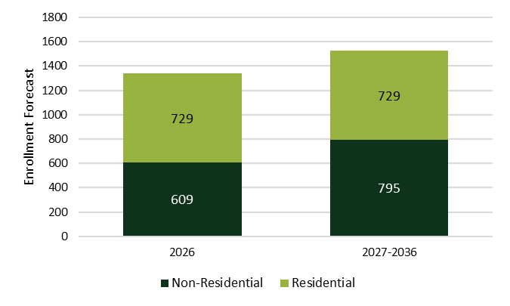
Ex Ante Enrollment Forecasts
SCE CBP-E (2026 – 2036)
Enrollment for August participation is applied to all months May-Oct within a given forecasted year
Non-Residential enrollment: 609 for 2026 and 795 for 2027 – 2036
Residential enrollment assumed constant for all years at 729

Slide 38
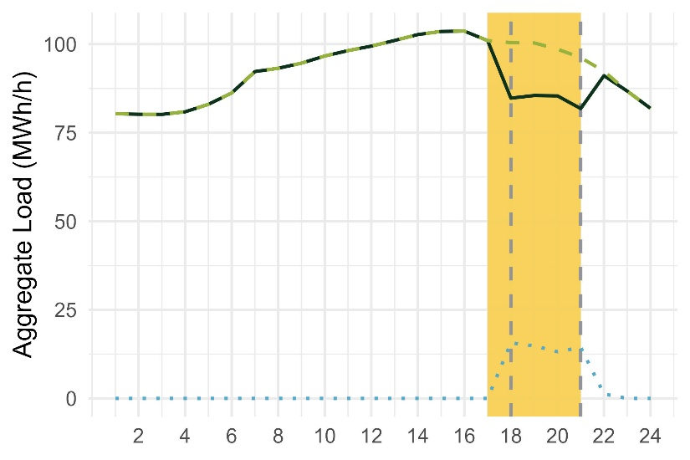
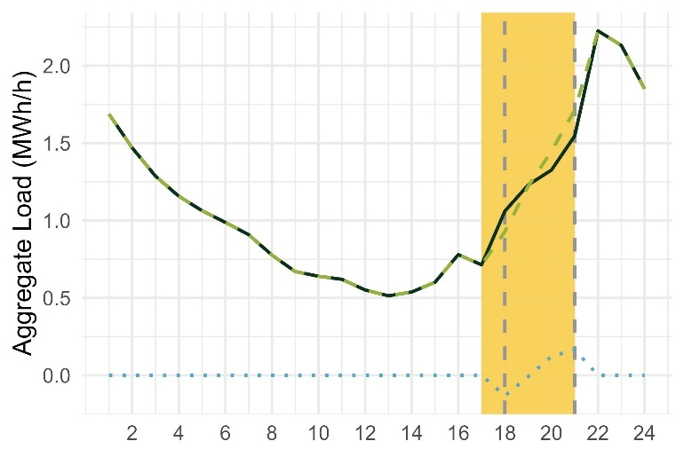
Ex Ante Load Shape
SCE CBP-E
System Worst Day Average Ex Ante Load Impacts (SCE 1-in-2 August)
Non-Residential (2026)
Residential (2026 – 2036)

Slide 39
Ex Ante Impacts Summary
SCE CBP-E Non-Residential (2026)
System Worst Day Average Ex Ante Load Impacts (August)
Weather Year | Weather Source | Event Hours (HE) | Num. of Customers | Aggregate (MWh/h) |  | Per Capita (kWh/h) |  | Percent Load Reduction (%) | Temp (°F)
 |  |  |  | Ref. Load | Load Impact | Ref. Load | Load Impact
1-in-2 | SCE | 18-21 | 609 | 98.9 | 14.5 | 162.4 | 23.8 | 15% | 90
1-in-10 | SCE | 18-21 | 609 | 99.5 | 14.6 | 163.4 | 24.1 | 15% | 93
1-in-2 | CAISO | 18-21 | 609 | 98.4 | 14.4 | 161.5 | 23.7 | 15% | 88
1-in-10 | CAISO | 18-21 | 609 | 99.4 | 14.6 | 163.2 | 24.0 | 15% | 92

Slide 40
Ex Ante Impacts Slice of Day
SCE CBP-E Non-Residential (2026)
System Worst Day Average Ex Ante Load Impacts (May – October)
Hour Ending | SCE 1-in-2 System Worst Day (MWh/h) |  |  |  |  |  | SCE 1-in-10 System Worst Day (MWh/h)
 | May | June | July | Aug. | Sept. | Oct. | May | June | July | Aug. | Sept. | Oct.
16 | 0.0 | 0.0 | 0.0 | 0.0 | 0.0 | 0.0 | 0.0 | 0.0 | 0.0 | 0.0 | 0.0 | 0.0
17 | 0.0 | 0.0 | 0.0 | 0.0 | 0.0 | 0.0 | 0.0 | 0.0 | 0.0 | 0.0 | 0.0 | 0.0
18 | 0.0 | 14.3 | 15.3 | 15.7 | 15.5 | 15.5 | 0.0 | 14.7 | 15.6 | 15.8 | 15.9 | 15.8
19 | 12.8 | 13.6 | 14.5 | 14.8 | 14.6 | 14.7 | 13.2 | 14.0 | 14.9 | 15.0 | 15.0 | 14.8
20 | 11.8 | 12.2 | 12.9 | 13.2 | 13.0 | 13.0 | 12.2 | 12.4 | 13.2 | 13.3 | 13.2 | 13.1
21 | 10.7 | 13.2 | 14.0 | 14.4 | 13.9 | 13.8 | 11.0 | 13.4 | 14.3 | 14.5 | 14.1 | 13.9
22 | 11.3 | 1.1 | 1.2 | 1.2 | 1.2 | 1.1 | 11.4 | 1.1 | 1.2 | 1.2 | 1.2 | 1.1
23 | 0.9 | 0.0 | 0.0 | 0.0 | 0.0 | 0.0 | 0.9 | 0.0 | 0.0 | 0.0 | 0.0 | 0.0
24 | 0.0 | 0.0 | 0.0 | 0.0 | 0.0 | 0.0 | 0.0 | 0.0 | 0.0 | 0.0 | 0.0 | 0.0
Event hour in RA window
Non-event hour in RA window
CEC Peak Hour (RA year 2027)
Notes:
Event hours in RA window (green) is inclusive of the Peak hour as projected by the CEC (blue)

Slide 41
Ex Ante Impacts Slice of Day
SCE CBP-E Non-Residential (2027 – 2036)
System Worst Day Average Ex Ante Load Impacts (May – October)
Hour Ending | SCE 1-in-2 System Worst Day (MWh/h) |  |  |  |  |  | SCE 1-in-10 System Worst Day (MWh/h)
 | May | June | July | Aug. | Sept. | Oct. | May | June | July | Aug. | Sept. | Oct.
16 | 0.0 | 0.0 | 0.0 | 0.0 | 0.0 | 0.0 | 0.0 | 0.0 | 0.0 | 0.0 | 0.0 | 0.0
17 | 0.0 | 0.0 | 0.0 | 0.0 | 0.0 | 0.0 | 0.0 | 0.0 | 0.0 | 0.0 | 0.0 | 0.0
18 | 0.0 | 18.6 | 19.9 | 20.4 | 20.2 | 20.2 | 0.0 | 19.2 | 20.4 | 20.6 | 20.7 | 20.6
19 | 16.6 | 17.7 | 19.0 | 19.3 | 19.1 | 19.1 | 17.2 | 18.2 | 19.4 | 19.6 | 19.5 | 19.3
20 | 15.4 | 15.9 | 16.8 | 17.1 | 16.9 | 16.9 | 15.9 | 16.2 | 17.2 | 17.2 | 17.1 | 17.1
21 | 13.9 | 17.2 | 18.3 | 18.7 | 18.1 | 18.0 | 14.3 | 17.4 | 18.6 | 18.8 | 18.3 | 18.1
22 | 14.7 | 1.5 | 1.6 | 1.6 | 1.5 | 1.4 | 14.9 | 1.5 | 1.6 | 1.6 | 1.5 | 1.4
23 | 1.2 | 0.0 | 0.0 | 0.0 | 0.0 | 0.0 | 1.2 | 0.0 | 0.0 | 0.0 | 0.0 | 0.0
24 | 0.0 | 0.0 | 0.0 | 0.0 | 0.0 | 0.0 | 0.0 | 0.0 | 0.0 | 0.0 | 0.0 | 0.0
Event hour in RA window
Non-event hour in RA window
CEC Peak Hour (RA year 2027)
Notes:
Event hours in RA window (green) is inclusive of the Peak hour as projected by the CEC (blue)

Slide 42
Ex Ante Impacts Summary
SCE CBP-E Residential (2026 – 2036)
System Worst Day Average Ex Ante Load Impacts (August)
Weather Year | Weather Source | Event Hours (HE) | Num. of Customers | Aggregate (MWh/h) |  | Per Capita (kWh/h) |  | Percent Load Reduction (%) | Temp (°F)
 |  |  |  | Ref. Load | Load Impact | Ref. Load | Load Impact
1-in-2 | SCE | 18-21 | 729 | 1.33 | 0.04 | 1.82 | 0.05 | 3% | 88
1-in-10 | SCE | 18-21 | 729 | 1.47 | 0.04 | 2.01 | 0.05 | 3% | 91
1-in-2 | CAISO | 18-21 | 729 | 1.20 | 0.04 | 1.65 | 0.05 | 3% | 85
1-in-10 | CAISO | 18-21 | 729 | 1.42 | 0.04 | 1.95 | 0.05 | 3% | 90

Slide 43
Ex Ante Impacts Slice of Day
SCE CBP-E Residential (2026 – 2036)
System Worst Day Average Ex Ante Load Impacts (May – October)
Hour Ending | SCE 1-in-2 System Worst Day (MWh/h) |  |  |  |  |  | SCE 1-in-10 System Worst Day (MWh/h)
 | May | June | July | Aug. | Sept. | Oct. | May | June | July | Aug. | Sept. | Oct.
16 | 0.00 | 0.00 | 0.00 | 0.00 | 0.00 | 0.00 | 0.00 | 0.00 | 0.00 | 0.00 | 0.00 | 0.00
17 | 0.00 | 0.00 | 0.00 | 0.00 | 0.00 | 0.00 | 0.00 | 0.00 | 0.00 | 0.00 | 0.00 | 0.00
18 | 0.00 | -0.13 | -0.13 | -0.13 | -0.13 | -0.13 | 0.00 | -0.13 | -0.13 | -0.13 | -0.13 | -0.13
19 | -0.13 | -0.01 | -0.01 | -0.01 | -0.01 | -0.01 | -0.13 | -0.01 | -0.01 | -0.01 | -0.01 | -0.01
20 | -0.01 | 0.12 | 0.12 | 0.12 | 0.12 | 0.12 | -0.01 | 0.12 | 0.12 | 0.12 | 0.12 | 0.12
21 | 0.12 | 0.17 | 0.17 | 0.17 | 0.17 | 0.17 | 0.12 | 0.17 | 0.17 | 0.17 | 0.17 | 0.17
22 | 0.17 | 0.00 | 0.00 | 0.00 | 0.00 | 0.00 | 0.17 | 0.00 | 0.00 | 0.00 | 0.00 | 0.00
23 | 0.00 | 0.00 | 0.00 | 0.00 | 0.00 | 0.00 | 0.00 | 0.00 | 0.00 | 0.00 | 0.00 | 0.00
24 | 0.00 | 0.00 | 0.00 | 0.00 | 0.00 | 0.00 | 0.00 | 0.00 | 0.00 | 0.00 | 0.00 | 0.00
Event hour in RA window
Non-event hour in RA window
CEC Peak Hour (RA year 2027)
Notes:
Event hours in RA window (green) is inclusive of the Peak hour as projected by the CEC (blue)

Slide 44
Comparison of Ex Post & Ex Ante Backcast
SCE CBP-E Non-Residential
System Worst Day Average Ex Ante Load Impacts (SCE 1-in-2 August)
PY2025 Estimate | Number of Customers | Aggregate (MWh/h) |  | Per Capita (kWh/h) |  | Percent Load Reduction (%) | Temp (°F)
 |  | Ref. Load | Load Impact | Ref. Load | Load Impact
2025 Ex Ante Backcast | 518 | 84.9 | 12.4 | 163.8 | 23.9 | 15% | 90
July 30th Ex Post | 500 | 79.8 | 12.3 | 159.6 | 24.6 | 15% | 86
September 24th Ex Post | 527 | 83.8 | 11.0 | 159.1 | 21.0 | 13% | 85
Avg. Impact Ex Post | 514 | 81.8 | 11.7 | 159.4 | 22.8 | 14% | 86
Aggregate per capita reference loads range from 159.1 – 159.6 kWh/h for the ex post event impacts compared to 163.8 kWh/h for the ex ante backcast for 2025
July 30th ex post load impacts at 12.3 MWh/h are comparable to ex ante backcast load impacts at 12.4 MWh/h

Slide 45
Comparison of Ex Ante Impacts
SCE CBP-E (2026)
System Worst Day Average Ex Ante Load Impacts (SCE 1-in-2 August)
Program | Ex Ante Estimate for 2026 | Number of Customers | Aggregate (MWh/h) |  | Per Capita (kWh/h) |  | Percent Load Reduction (%) | Temp (°F)
 |  |  | Ref. Load | Load Impact | Ref. Load | Load Impact
Non-Res CBP-E DA | PY2024 Forecast | 561 | 98.5 | 12.4 | 175.5 | 22.0 | 13% | 89.5
 | PY2025 Forecast | 609 | 98.9 | 14.5 | 162.4 | 23.8 | 15% | 90.1
Res CBP-E DA | PY2024 Forecast | 363 | 0.67 | 0.08 | 1.84 | 0.22 | 12% | 87.6
 | PY2025 Forecast | 729 | 1.33 | 0.04 | 1.82 | 0.05 | 2% | 87.7
Forecasted enrollment for 2026 is much higher in PY2025 than in PY2024 for both the residential and non-residential segments
Residential PY2024 ex ante was based on a subset of ELRP A.4 customers, whereas the PY2025 forecast is based on SGIP customers participating in CPP, resulting in lower impacts

Slide 46
Final Takeaways

Slide 47
Final Takeaways
PG&E
SCE
Ex Post
Non-residential Elect DA customers provided 35.7 MWh/h of load reductions on average during HE20 (includes 62% of all participant event hours).
Program enrollment substantially increased, with average nominations increasing from 1.1 MW and 38 customers in PY2024 to 12.4 MW and 506 customers in PY2025, the first year of CBP-E.
CBP-E customers delivered 11.7 MWh/h of load reductions on average between all event hours, equating to an average performance of 92%
Non-residential customers are anticipated to provide an average hourly load reduction between 40.0 MWh/h and 40.4 MWh/h during a four-hour dispatch in August 2026.
Non-residential customers are anticipated to provide between 14.4 MWh/h and 14.6 MWh/h of average load reduction during August 2026 four-hour dispatch.
Residential customers are anticipated to provide 0.04 MWh/h of average load reductions during August 2026 four-hour dispatch.
Ex Ante
PY2025 forecast impacts for 2026 align with those from the PY2024 evaluation, as higher enrollment and lower per capita reference loads for the PY2025 forecast balance out.
Non-residential impacts for 2026 have increased in PY2025, due to higher enrollment and higher per capita load impacts.
Residential impacts for 2026 have decreased due to changes in methodology, from 12% load reduction in PY2024 to 2% in PY2025.
Cross-Year
Comparisons

Slide 49
Historic Ex Post
PG&E Non-Residential Elect DA (PY2021 – PY2025)
Program Year | Avg. Monthly Nominated Capacity (MW) | Avg. Monthly Nominated Customers
2021 | 13.5 | 365
2022 | 31.3 | 475
2023 | XX.X | 430
2024 | 23.8 | 270
2025 | 36.8 | 642
Notes:
PY2025 average monthly nominated capacity and average monthly enrolled (nominated) customers are the largest to-date

Slide 50
Historic Ex Post
SCE CBP-E Non-Residential
Program Year | CBP Product | Avg. Monthly Nominated Capacity (MW) | Avg. Monthly Nominated Customers
2021 | CBP DA | 7.6 | 312
2022 |  | 0.9 | 83
2023 |  | X.X | 1
2024 |  | 1.1 | 38
2025 | CBP-E | 12.3 | 506
Notes:
PY2025 average monthly nominated capacity and average monthly enrolled (nominated) customers are the largest to-date

