Slide 1
Workshop on Dynamic rates and Real time Pricing
California Public Utilities Commission
October 15, 2019

Slide 2
Objectives for this Workshop
Objectives:
  Discuss existing dynamic rates and pilots offered by SDG&E and other jurisdictions.
  Provide parties an opportunity to share preliminary proposals regarding dynamic rate options.
  Explore implementation issues related to the feasibility and design of dynamic rates.
Expected Outcomes:
  All Party Workshop report to be filed by SDG&E that includes Summary of the presentations, proposals and discussions.
  Parties may file comments regarding the workshop and in response to SDG&E's workshop report.
  Intervenors may address the workshop and SDG&E’s workshop report in their testimonies.

Slide 3
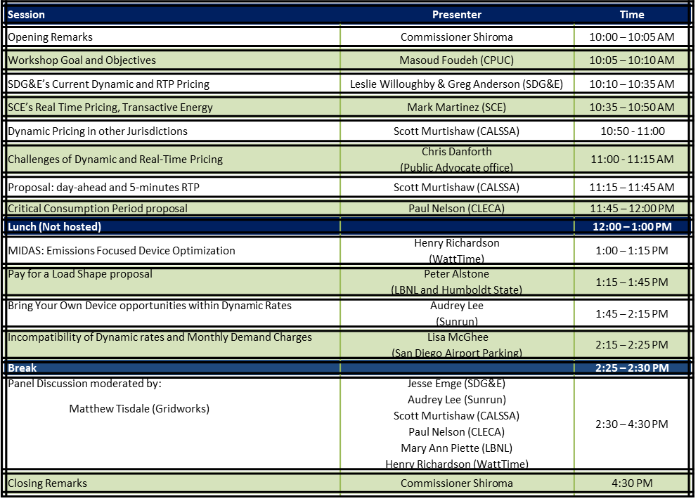
Workshop Agenda

