Slide 1
Real Time Pricing and Transactive Energy Rates
Reuben Behlihomji
Senior Manager – Modeling, Forecasting & Economic Analysis

Slide 2
Two-Part Real Time Pricing (RTP)

Slide 3
Two-Part RTP | Concept
Current RTP is template based where hourly prices are reflected in 7-day type pricing menus
  Temperature trigger
  Peak and ramp capacity allocated to day types based on expected capacity need
  Energy profiles reflect SCE’s marginal generation energy cost profile
Under a generation only 2-part RTP structure, usage (energy and demand) associated with generation charges is partitioned into a base amount and a RTP amount
  Delivery portion of the bill is considered to be entirely base usage
Base usage or Base Period Usage (BPU) is predetermined based on historical usage over a set period of time (i.e., prior 12-months, 3-year average, etc.)
  Likely to be seasonal and reflect the prevailing TOU periods
  BPU structure is currently used in SCE’s Schedule ME at the Port of Long Beach
Bill is rendered by charging OAT generation rates for all BPU kWh and kW
  Delivery portion is rendered by applying metered kWh and kW to the OAT delivery charges
Metered hourly kWh and kW above the baseline will be charged (or credited) at an Hourly Price

Slide 4
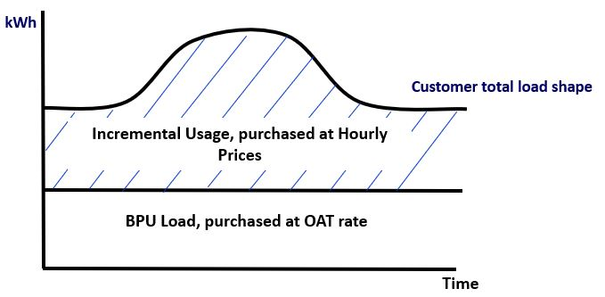
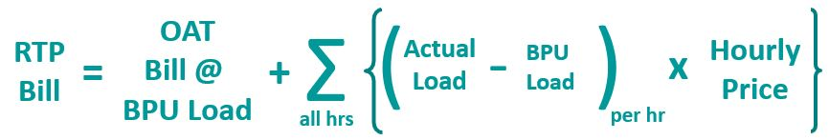
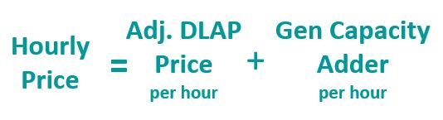
Two-Part RTP | Proposal (Illustrative)

Slide 5
Two-Part RTP | Hourly Price Determination
Two-Part RTP Hourly Prices is comprised of generation energy and capacity
  Capacity component reflects both peak and flex capacity costs
Hourly Capacity Adder will be triggered and valued based on an Implied Market Heat Rate (IMHR)
  IMHR = CAISO DLAP Price / SoCal Citygate Day Ahead Natural Gas Price
  Hourly Capacity Adder will be applied as an overlay to hourly energy prices in the 4-9pm period year round
  Daily IMHR determinants reflect the availability of peak and flex generation capacity
Hourly Energy Prices will use the actual CAISO Day Ahead Energy Market Price for SP15
A scaler will be applied to ensure revenue neutrality for the Two-Part RTP rate
  Applied to the hourly energy prices or capacity prices, or both
  Recovered as a flat adder in the BPU bill
  Combination of all of the above

Slide 6
Retail Automated Transactive Energy System (RATES)

Slide 7
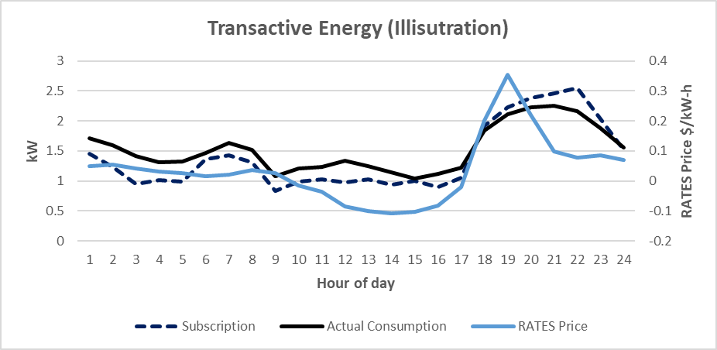
RATES | Concept
Subscribe at specific costs and quantity for each hourly interval
  Monthly Fixed Subscription Cost is calculated using the Customer’s SCE Tariff.
  The subscription is a forward contract at fixed monthly cost that stabilizes bills (cost to customer and revenue to suppliers).
RATES can automatically buy and sell at the same tender prices in each interval while maintaining customer comfort, etc.
Scarcity pricing used to recover more fixed (long-run marginal) cost when the delivery (in either direction) or generation system is more heavily loaded
Addresses
  Bill and revenue volatility
  Grid stability
  Recovery of both fixed and variable costs for all parties with settlement calculations
  Forward transactions support better operational planning

Slide 8
RATES | Price Components
CAISO Locational Marginal Price @ Transmission Interface
Generation Fixed Cost (Long-Run Marginal Cost) Recovery
  Energy Fixed Cost
  Flex Fixed Cost
Circuit Delivery Losses and Fixed Cost Recovery (Long-Run Marginal Cost) from Transmission Interface to Facility (can be facility specific)
Fixed costs such as metering, billing, public purpose included in subscription costs

Slide 9
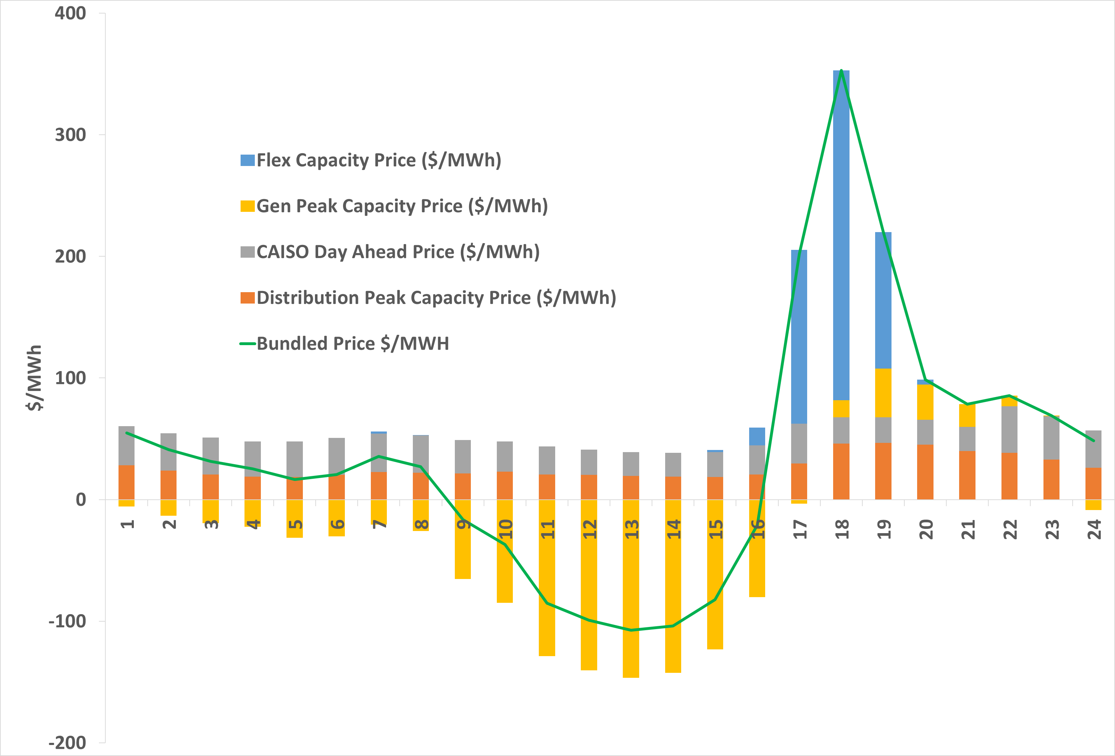
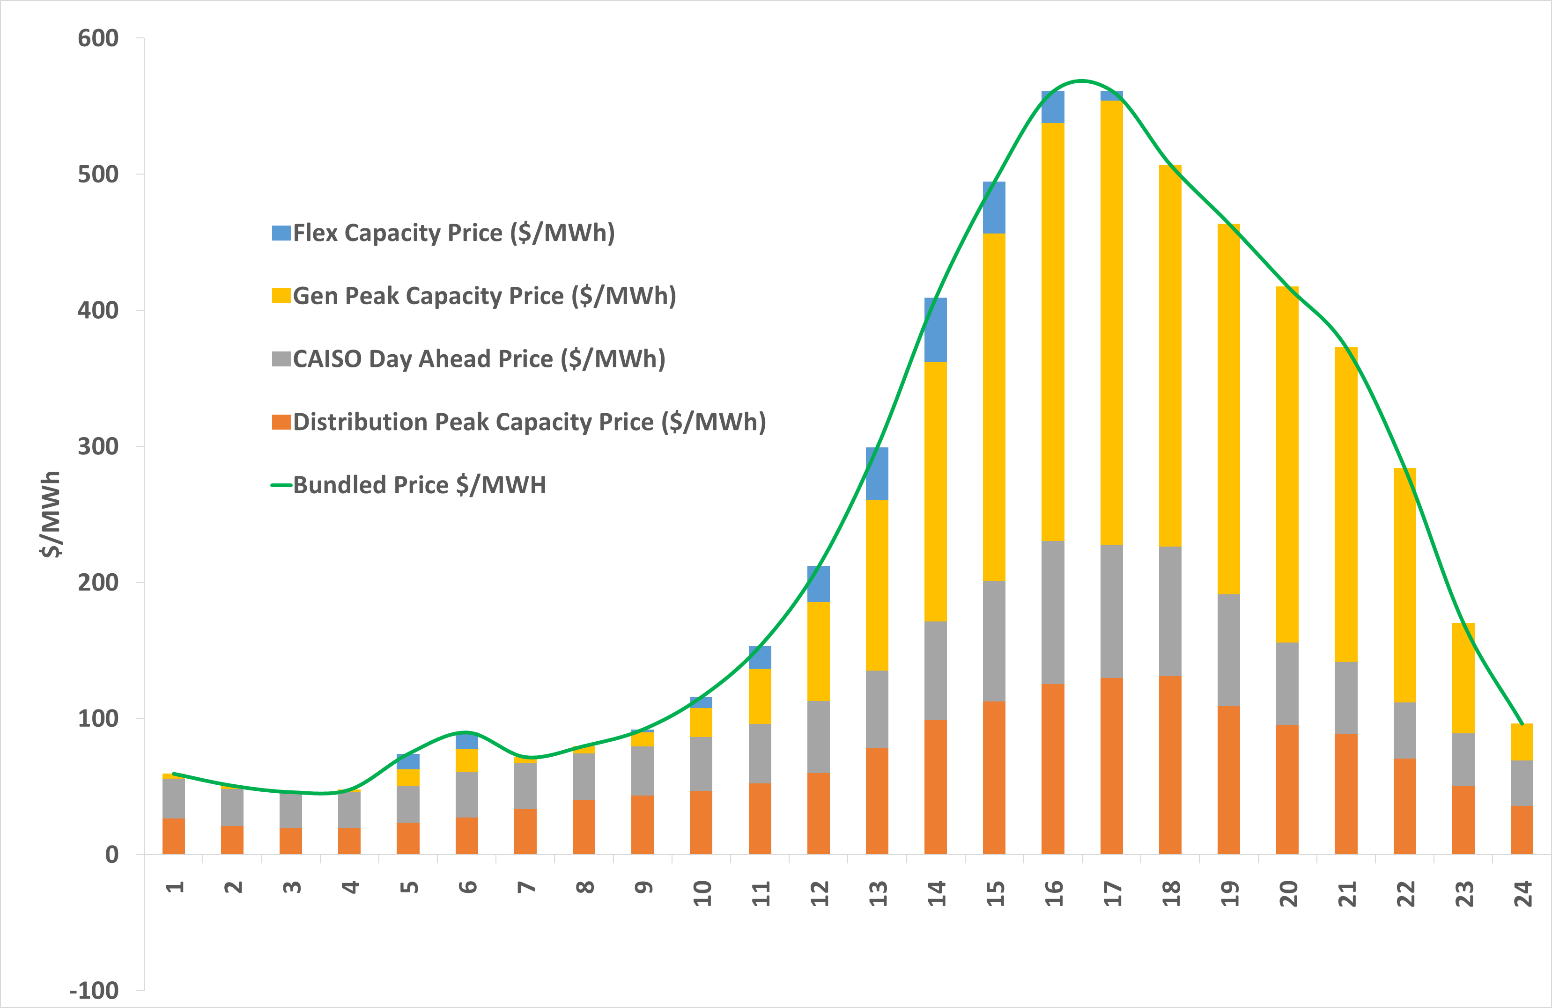
RATES | Transactive Hourly Prices
Typical Winter Day
Typical Summer Day

