Slide 1
Treatment of Demand Charge Rate Designs at SCE
Presenter
Robert Thomas – Manager of Pricing Design

Slide 2
Rate Restructuring Requires a Balanced Approach
SCE is committed to its Clean Power and Electrification Pathway as a means of achieving California’s Greenhouse Gas (GHG) reduction goals
  A review and restructuring of legacy rate designs is a key element in achieving these goals
Restructuring rates inevitably leads to redistribution of revenue recovery due to:
  Redefined cost basis (cost drivers)
  Reordering of structural benefiters
  Introduction of public policy driven rate designs
GHG reductions should be achieved through a cost effective approach that also considers the impacts in such areas as:
  Affordability
  Building electrification
  Non-participant equity

Slide 3
Principles of Rate Design
“Rates should provide clear, efficient, effective, informative, and cost effective market signals… should allow the utilities to serve as an agent of progress.”
Fairness
  Fairly apportion the cost of service among different customers (rates reflect cost causation)
  Avoid regressive rate structures/policies that favor participants over non-participants
Efficiency
  Promote the efficient use of energy (and competing products and services)
  Support economic efficiency – set prices to reflect marginal costs
Stability
  Minimize unexpected rate changes that may be adverse to existing customers
  Ensure revenues (and cash flow) are stable from year-to-year
Simplicity, understandability, public acceptability, and feasibility of application
SOURCE: EEI Publication, April 2013; Based on “Principles of Public Utility Rates” by James C. Bonbright, 1988

Slide 4
Recent Changes to SCE’s Legacy Rate Structures
- 2018 GRC Phase 2
SCE’s 2018 General Rate Case (GRC) Phase 2 modified the legacy non-coincident peak (NCP) demand charge
  Distribution costs recovered through NCP demand charge include incremental capacity, reliability, and O&M spending associated with distribution grid infrastructure
  Customer marginal costs are recovered through fixed charges and consist of meter, service drop, and final line transformer
2018 GRC Phase 2 rates reflect new system conditions and facilitate the integration of Distribution Energy Resources (DERs)
  Two part Grid and Peak distribution cost recovery structure
    Grid components facilitate bi-directional flow of energy expected with DER applications
      Ensure appropriate cost recovery for cost components that are not time- or peak- dependent
    Time-dependent Peak component is associated with capacity growth and a pricing signal to reduce peak load conditions

Slide 5
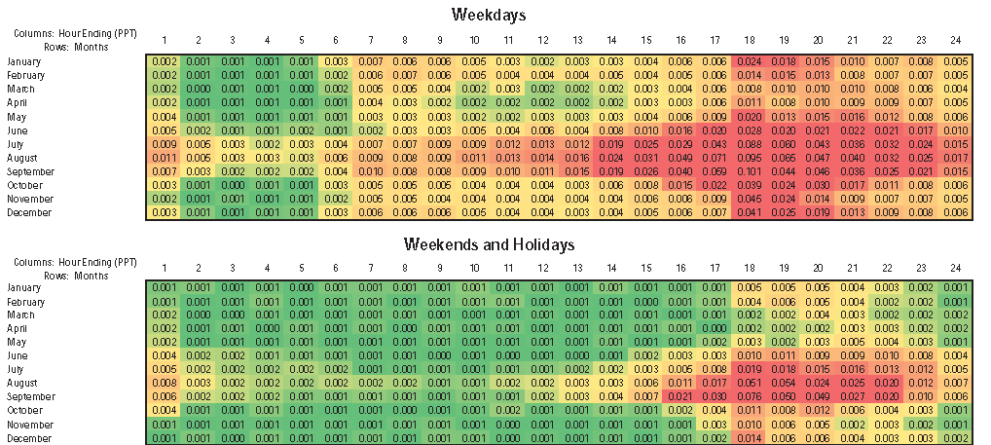
SCE 2024 Forecast Average Hourly Peak Component of Distribution Design Demand Marginal Costs ($/kWh)*
* Illustrative example

Slide 6
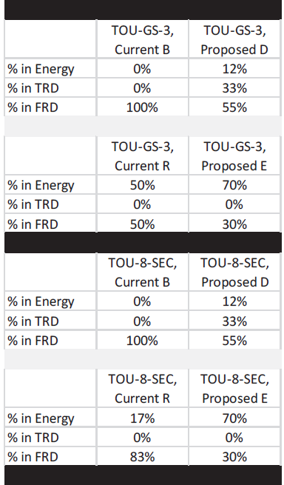
DER Rates Introduced in SCE’s 2018 GRC Phase 2
Distribution Revenue Recovery Comparison
SCE’s 2018 GRC Phase 2 introduced Option E (a DER technology rate)
  Option E further reduced the amount of revenue recovered through NCP demand charges
  Provides a rate choice to recognize changing customer preferences
Strikes a balance between:
  Customer choice
  Safeguards against revenue shifts
  Cost causation in rate design
  Equity across customer segments
Revenues recovered through NCP demand charge are associated with the provision of bi-directional access of the grid
  Time variant energy and demand charges to recover revenues associated with peak capacity

Slide 7
Recent Changes to SCE’s Legacy Rate Structure
- Transportation Electrification (TE) Charging Rates
Demand charge rate structures can result in higher average rates for low load factor early adopters
  Introduced a 5-year energy only introductory period
  Followed by a 5-year phase-in of demand charges
  End state TE rate structures envisioned to be consistent with Option E rate structure
Load Management Plays a Key Role in Overall Benefit
  Gradually phasing in demand charges will allow customers to gain knowledge and experience regarding demand charges and load management – still high on the Loading Order
Rate Simplicity and Customer Understandability
  Rate design that does not require radical billing system changes
  Rate design that accommodates customer transitions from discounted to regular rate structure without disruption
Rate equity provided by the transitory reduction in the policy driven benefit
  Demand charges gradually phased in to reflect the segment’s contribution to grid costs

Slide 8
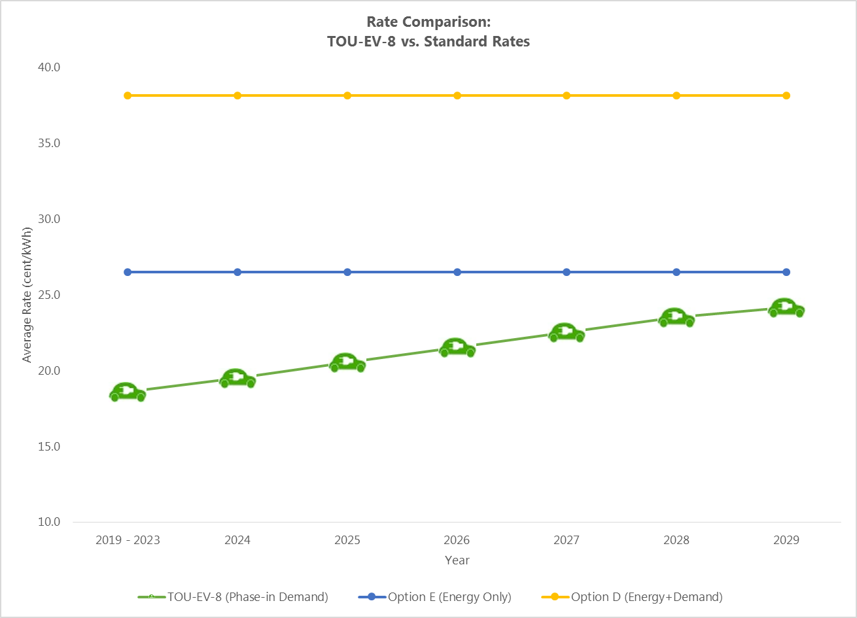
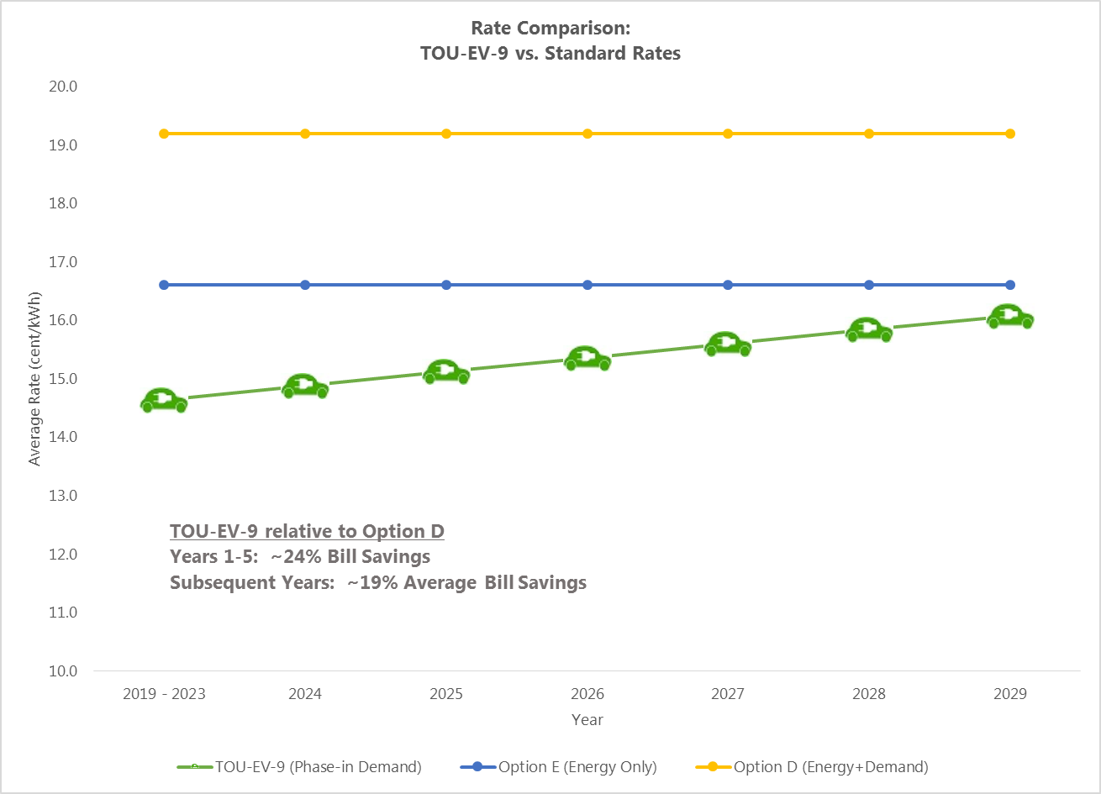
Average Rate Comparison
- Illustrative TOU-EV-8/-9 vs. Standard Rates
TE Rate Findings
TE bill comparison is based on the current population, a vast majority served on this rate are DC fast charging customers
Compared to Standard Option E, TOU-EV-8 provides about a 30% bill savings in the 5-year introductory period w/o demand charges, followed by an average bill savings of 17% in the subsequent years of the program.
Compared to Standard Option D, TOU-EV-9 provides about a 24% bill savings in the 5-year introductory period w/o demand charges, followed by an average bill savings of 19% in the subsequent years of the program.
Preliminary results with the daily demand charge rate indicate similar or greater differences to Options D & E
Preliminary Daily Demand Charge Rate
The Daily Demand Charge Option converts the NCP demand charge to a daily demand charge
  Retains time variant demand and energy charges associated with peak capacity
Further analysis is needed to determine if the revenue shift constitutes a cost shift given bi-directional DERs use the grid even when providing electricity to the grid

Slide 9
Conclusion
SCE has made considerable changes in NCP demand cost determination and rate design recognizing the benefits and costs associated with the changing energy landscape and new DER technologies
  Cost basis for the new rate structure must consider the bi-directional nature of DER technologies
Equity across customer segments and affordability must be considered when introducing non-legacy rate structures
  Introduction of a newly structured cost based rate can redistribute revenue recovery across customer segments
  Has the potential to create division between those who can afford the new technologies and those who cannot
Rate simplicity from a customer perspective and a billing system implementation perspective are critical to the successful adoption of non-legacy rate structures

