Slide 1
SEIA’s Perspective on Alternatives to Traditional Demand Charges
Tom Beach, Principal, Crossborder Energy
Consultant to SEIA
August 27, 2019

Slide 2
About SEIA
The Solar Energy Industries Association (SEIA®) is the driving force behind solar energy and is building a strong solar industry to power America through advocacy and education. As the national trade association of the U.S. solar energy industry, which now employs more than 250,000 Americans, we represent all organizations that promote, manufacture, install and support the development of solar energy. SEIA works with its 1,000 member companies to build jobs and diversity, champion the use of cost-competitive solar in America, remove market barriers and educate the public on the benefits of solar energy.

Slide 3
Commission Objectives
Peak load shifting and other grid support objectives
Cost causation principles in rate making
Reducing greenhouse gas emissions
Ensuring appropriate utility cost recovery
Enabling demand-side load management solutions
Objectives #2 and #4 are traditional rate design goals.
The others reflect today’s circumstances.

Slide 4
Then and Now
What is the same…
The cost of electricity is time-dependent.
What has changed…
Metering: monthly kWh/max kW to 15-minute TOU data
Rates are designed based on what can be measured.
Generation: baseload fossil / nuclear to time-varying renewables
Non-coincident demand charges strongly favor baseload customers.
An imperative to use time-varying clean energy efficiently
Today’s most valuable loads are flexible ones.
One-way monthly bill to two-way, near-real-time communications
Enables dynamic, more complex rates
In a word – data
Better data on the temporal and geographic diversity of loads

Slide 5
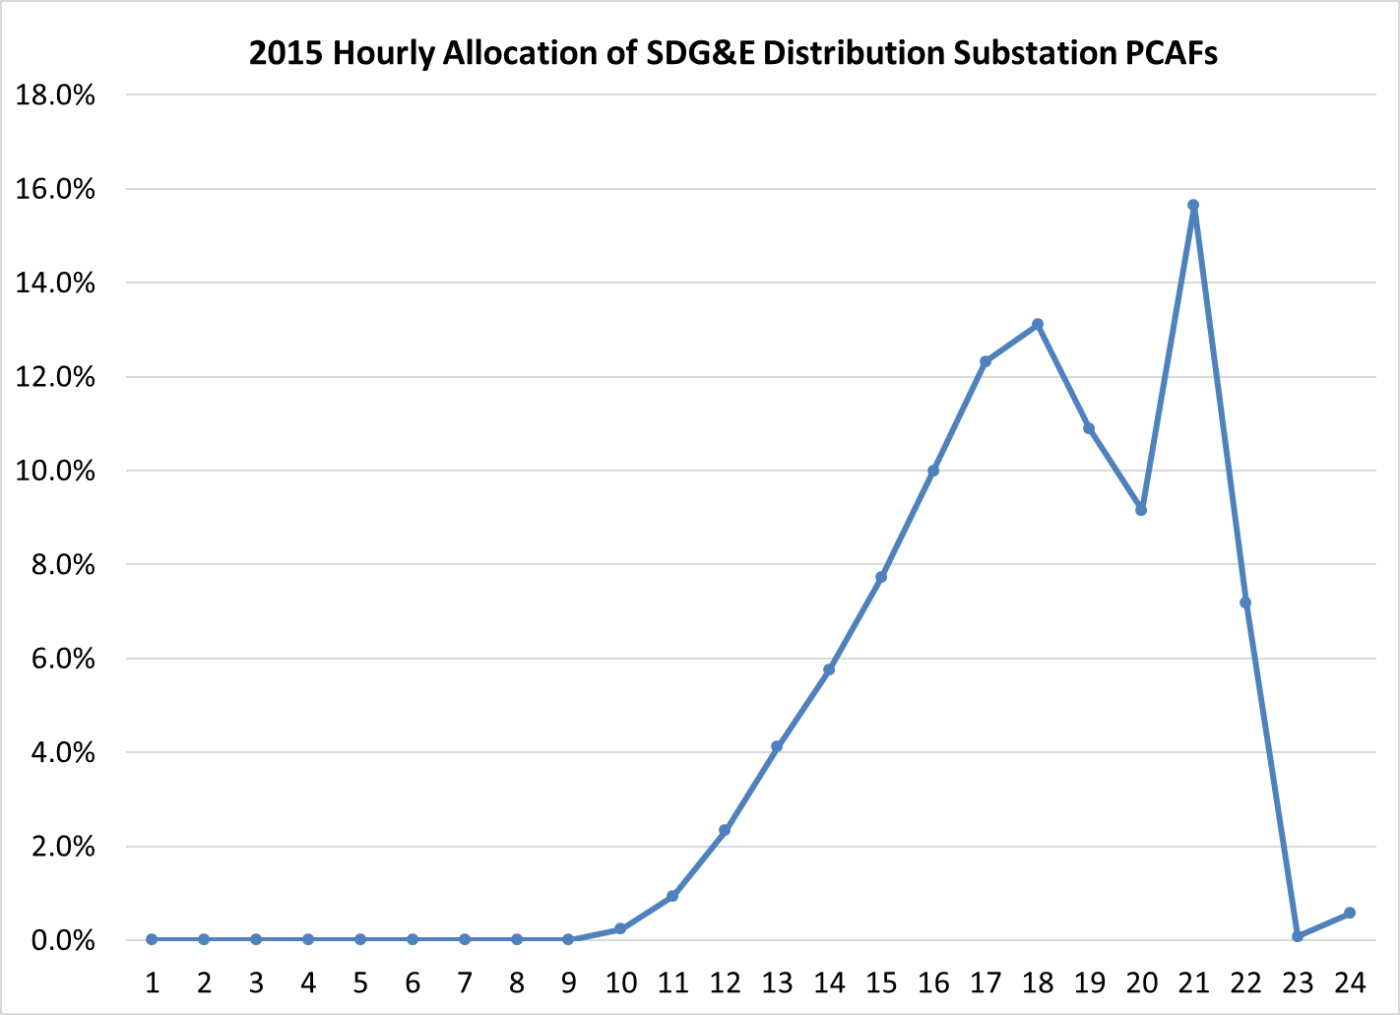
The Problems with Demand Charges, Part 1
Noncoincident, non-time-dependent demand charges
We have data on the time-dependent loads that drive distribution substation and circuit costs.
Demand charges based only on customer max demands, without a time element, discourage beneficial load shifts.

Slide 6
The Problems with Demand Charges, Part 2
Coincident, peak-related demand charges
Do consider the time element.
But may not best reflect load diversity….
TOU volumetric rates reduce average demand across the peak.
… or cost causation
Solar customers incur demand charges on cloudy, low-demand days.
A monthly demand charge does not incent daily actions.
Option S daily demand charge for storage cycling.
Monthly demand charges increase the risks and costs of customer actions and investments to reduce demand.

Slide 7
Evolution in SCE’s C&I Rates
Option A (circa 2005)
Generation demand charges replaced by volumetric TOU rates.
Optional rate available to all customers < 500 kW
TOU-8 Option A for permanent load shift technologies
Option R (2008) – similar to SDG&E’s DG-R (2007)
Option A plus reduced delivery demand charges
Solar customers only
Option E (2018) – replaces Options A and R
Reduced noncoincident and peak demand charges
4p-9p peak
Available to all customers (except 250 MW DER cap for TOU-8)
Option S (soon?) -- promotes daily storage cycling

Slide 8
Cost Shifts (to non-participating ratepayers)
Utility shareholders are protected by revenue decoupling.
Concern is cost shifts from multiple, optional rates (self-selection)
Important factors to consider:
Is the new rate option more cost-based?
TOU rates
Option R for solar customers
Does the new rate support beneficial technologies or behaviors?
Option S for daily storage cycling
Ways to mitigate cost shift concerns:
Tracking revenue changes
Caps on rate availability
Technology-based limits on eligibility
We need to experiment, with active Commission oversight.

Slide 9
Cost Shifts (to participating ratepayers)
Rates are changing rapidly (e.g. the TOU shift)
Customers’ long-term investments rely on stable rates.
Ways to mitigate cost shift concerns:
Gradualism
Grandfathering
SEIA appreciates the Commission’s and the utilities’ sensitivity to this issue.

Slide 10
SDG&E Demand Charge Studies
Studies: small fractions of T&D costs are peak-related.
35% for CAISO transmission
5% for distribution
Concerns:
Many types of T&D projects are linked to peak demand, even if a project’s primary reason is not to expand capacity.
Marginal distribution costs show peak loads drive investments.
Even fewer T&D investments are linked to individual customers’ noncoincident, non-time-related peak demands.
T&D costs not related to demand should be allocated to energy rates (e.g. fire hardening, meeting RPS requirements).

Slide 11
Peak-related Allocation of SDG&E Distribution Costs

Slide 12
SDG&E Demand Charge Issues for SEIA
Allocation of distribution costs
Noncoincident demand charges
Time-related demand charges
TOU or flat energy rates
Option S
Changes to Option R
Recommendation for the Commission’s position at FERC on SDG&E transmission rates

