Slide 1
2015 California Potential and Goals Study
DAWG Presentation
November 7, 2014

Slide 2
2015 California Potential and Goals Study
Content of Report
This presentation was prepared by Navigant Consulting, Inc. exclusively for the benefit and internal use of the California Public Utilities Commission and/or its affiliates or subsidiaries. No part of it may be circulated, quoted, or reproduced for distribution outside these organization(s) without prior written approval from Navigant Consulting, Inc. The work presented in this report represents our best efforts and judgments based on the information available at the time this report was prepared. Navigant Consulting, Inc. is not responsible for the reader’s use of, or reliance upon, the report, nor any decisions based on the report.
NAVIGANT CONSULTING, INC. MAKES NO REPRESENTATIONS OR WARRANTIES, EXPRESSED OR IMPLIED.
Readers of the report are advised that they assume all liabilities incurred by them, or third parties, as a result of their reliance on the report, or the data, information, findings and opinions contained in the report.
November 7, 2014
©2014 Navigant Consulting, Inc. All rights reserved. Navigant Consulting is not a certified public accounting firm and does not provide audit, attest, or public accounting services. See navigantconsulting.com/licensing for a complete listing of private investigator licenses. Investment banking, private placement, merger, acquisition and divestiture services offered through Navigant Capital Advisors, LLC., Member FINRA/SIPC.

Slide 3
2015 California Potential and Goals Study » Agenda
» Task Overview and Team Introduction
» Overview of Project Priorities and Schedule
» EM&V Results Integration
» Existing Baseline
» Codes and Standards, Behavior and Conservation, Financing
» Support AAEE and LTPP
»

Slide 4
2015 California Potential and Goals Study » Task Overview and Team Introduction
Four primary uses of the 2015 and Beyond Potential Study correspond to the four task descriptions that will be used throughout the project
Task 1 Potential and Goals Study Update
  Inform IOU goals
Task 2: Additional Achievable Energy Efficiency (AAEE) Savings Forecast
  Inform planning efforts of the CPUC, CEC, and CAISO
Task 3: Energy Efficiency Targets for Greenhouse Gas Reductions
  How can IOU programs and energy efficiency can help meet AB32 goals?
Task 4: Metrics to Support the Strategic Plan Update
  Support development of strategic plan by providing potential analysis

Slide 5
2015 California Potential and Goals Study » Task Overview and Team Introduction
Navigant Team Project Management Structure
Project Director
Advisors
Greg Wikler
Karin Corfee/Gary Cullen (Navigant)
Floyd Keneipp (Tierra)
Fred Coito (DNV GL)
David Wylie (ASWB)
Jennifer Mitchell-Jackson (ODC)
Quality Control Director
Jane Pater-Salmon
Project Manager
Amul Sathe
Activities
Task 1: Potential and Goals Study Update
Task 2: AAEE Savings Forecast
Task 3: EE Targets for GHG Reductions
Task 4: Metrics for Strategic Plan Update
Surya Swamy (Model Lead)
Michael Noreika (MICS Lead)
Matt O’Hare (AIMS Lead)
Navigant Team
Tierra Team
ASWB Team
Red Horse Team
DNV GL Team
ODC Team
Surya Swamy (Lead)
Navigant Team
Tierra Team
Matt Tanner (Lead)
Navigant Team
Red Horse Team
DNV GL Team
N. Reed Fry (Lead)
Navigant Team
Tierra Team
DNV GL Team
Crosscutting Support and Stakeholder Outreach & Management
  Samantha Piell

Slide 6
2015 California Potential and Goals Study » Agenda
» Task Overview and Team Introduction
» Overview of Project Priorities and Schedule
» EM&V Results Integration
» Existing Baseline
» Codes and Standards, Behavior and Conservation, Financing
» Support AAEE and LTPP
»

Slide 7
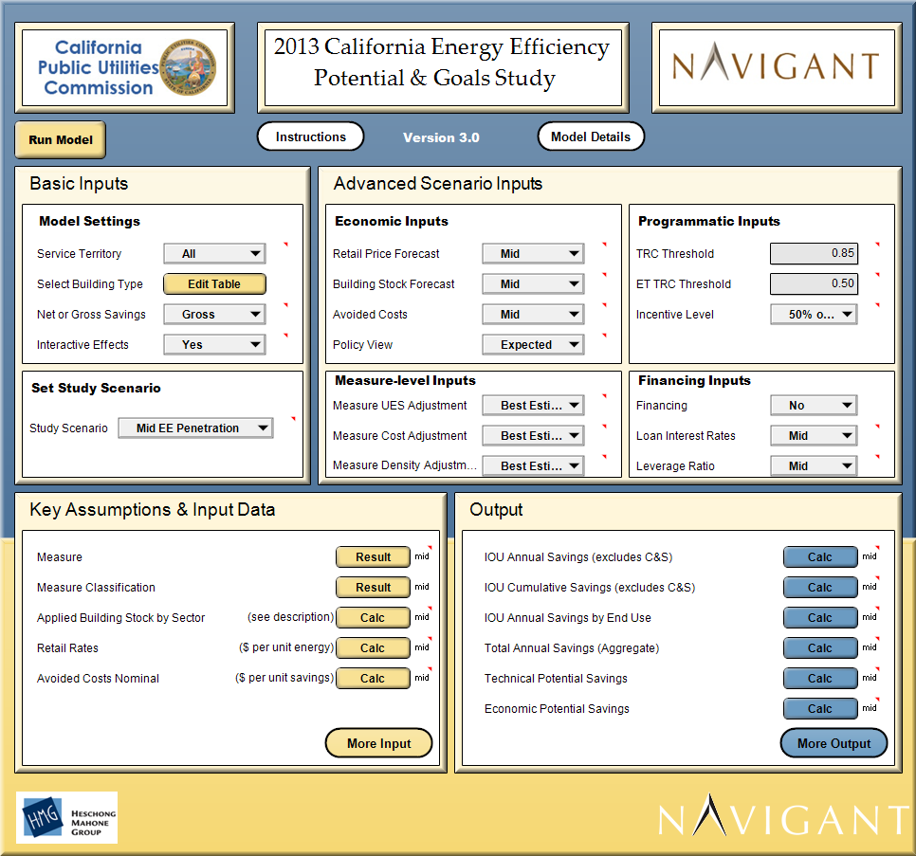
2015 California Potential and Goals Study » Overview of Project and Schedule
The Navigant team plans to maintain the core Analytica modeling platform from the 2013 study improving its operation and methodology.
All key features of the 2013 Model will remain:
  Bass diffusion adoption algorithms
  Scenario analysis
  Variable sensitivity analysis
  IOU, sector, end use, and measure level results
  Flexibility for users to run alternate scenarios
What we plan to improve:
  Added functionality and updated input data (details on next slide)
  Size of model and minimum RAM requirements
  Speed at which model loads and runs

Slide 8
2015 California Potential and Goals Study » Overview of Project and Schedule
Navigant’s will support the goals studies through 2018, we expect multiple “stages” of updating the study, each adding more to the last.
Stage 1: 2016 Goals Update
  Draft results/report: March 31, 2014
  Final results/report: May 2014
  Focus of Scope: Task 1
    Setting IOU goals for 2016
    Update 2013 model with new available data
Future Stages:
  Consider methodological updates to Task 1
  Task 2, 3, and 4
  Parallel work will occur but no deliverables will be scheduled until after March 2015
  Timeline: pending CPUC clarification

Slide 9
2015 California Potential and Goals Study » Overview of Project and Schedule
Given our short timeline, Stage 1 will be primarily a “data update” to the 2013 study.
Task | Topic Area | Priority | Forced Rank Priority | Key Activity
1 | MICS | High | 1 | Update Res/Com Measures with DEER and EM&V Data
1 | MICS | High | 2 | Consider existing conditions baseline - Res and Com
1 | AIMS | High | 3 | Consider existing conditions baseline - AIMS
1 | C&S | High | 4 | Update C&S savings analysis
1 | AIMS | High | 5 | Update Agricultural, Industrial, Mining, and Street-Lighting (AIMS)
1 | Strategic Plan | Medium | 6 | Incorporate Prop 39 and AB 758 as possible
1 | Whole Building | Medium | 7 | Update Whole Building Energy Efficiency data
1 | ET | Medium | 8 | Revisit Emerging Technologies (ET) data
1 | Model | Medium | 9 | Provided added detail in CFL result reporting
1 | Behavior | Low | 10 | Update Behavior and Conservation analysis with latest data
1 | Financing | Low | 11 | Update Financing analysis with latest data

Slide 10
2015 California Potential and Goals Study » Overview of Project and Schedule
Future updates will address items that are currently lower priority.
Task | Topic Area | Priority | Forced Rank Priority | Key Activity
4 | Strategic Plan | Medium | 12 | Support analysis for Strategic Plan
1 | ET | Medium | 13 | Add new ETs (up to 10)
3 | GHG | Low | 14 | Enable reporting of GHG savings
2 | AAEE | Low | 15 | Enable locational potential estimates
1 | MICS | Low | 16 | Consider embedded energy in water
1 | Global Inputs | Low | 17 | Saving potential in the residential market by building type and ownership status

Slide 11
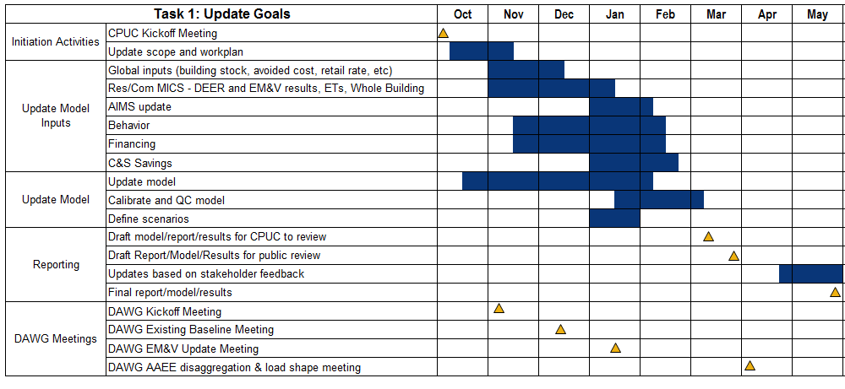
2015 California Potential and Goals Study » Overview of Project and Schedule
The near term schedule is compressed. Draft results to inform the 2016 goals will be available March 31.

Slide 12
2015 California Potential and Goals Study » Overview of Project and Schedule
The 2015 PG Model will produce results for different scenarios (to be used by different audiences)
Task 1 Potential and Goals Study Update
  The 2013 Study examined 3 scenarios; the “Mid Case” was used to inform the 2015 IOU goals
Task 2: Additional Achievable Energy Efficiency (AAEE) Savings Forecast
    Modified scenarios that also consider locational potential
Task 3: Energy Efficiency Targets for Greenhouse Gas Reductions.
  Feasible-stretch and maximum stretch scenario towards meeting AB32 goals
Task 4: Metrics to Support the Strategic Plan Update
  Scenario analysis as needed to support Plan update

Slide 13
2015 California Potential and Goals Study » Agenda
» Task Overview and Team Introduction
» Overview of Project Priorities and Schedule
» EM&V Results Integration
» Existing Baseline
» Codes and Standards, Behavior and Conservation, Financing
» Support AAEE and LTPP
»

Slide 14
2015 California Potential and Goals Study » EM&V Results Integration
Task 1 plans to update MICS with best available DEER, Ex Ante, and EM&V data.
The model is where DEER, work papers, impact evaluations, and market studies are combined to present a full picture of the measures and their market characteristics. Navigant will continue to refine measure inputs that are warehoused and documented in the online Measure Input Characterization System (MICS).
For the 2015 update, Navigant will update MICS with new data available from DEER, Ex Ante, and recent EM&V study results.
Given our short timeline, we need to establish a “cut-off” date for new data.

Slide 15
2015 California Potential and Goals Study » EM&V Results Integration
2010 -2012 EM&V results impact key aspects of the study.
Residential and Commercial measures:
  Unit Energy Savings
  Net to Gross Ratio
  Cost (if available)
  Measure saturation data from studies like CLASS, CSS, etc.
Model calibration data: 2010-12 gross program achievements
Codes and Standards savings (new data on code advocacy programs)
ISP for AIMS measures
Behavior and Financing

Slide 16
2015 California Potential and Goals Study » EM&V Results Integration
At a high level the integration of DEER, Ex Ante, and work papers is a three step process.

Slide 17
2015 California Potential and Goals Study » EM&V Results Integration
DEER is a fundamental input to the MICS.
DEER2008 and DEER2011 serve as the foundation for unit energy consumption and unit energy savings, respectively
  The databases were used in the previous 2013 PG Study and have already been integrated into the MICS
DEER2014 code update incorporated new C&S and weather files - updated most or all weather sensitive UES values
The DEER2015 Code Update will affect four measure types.
  Refrigerator/Freezer & Freezer
  Split and Packaged AC Equipment
  Water Heaters: Small Gas and Electric Storage, Small Gas and Electric Instantaneous
  Gas Furnaces (Weatherized)
DEER team is currently working on a 2016 comprehensive update
  Plan to incorporate 2010-12 EM&V results into DEER2016
  DEER2016 will not be available prior to our deadline of finalizing MICS for the Stage 1 update

Slide 18
2015 California Potential and Goals Study » EM&V Results Integration
The Navigant team will coordinate with the DEER team and simultaneously incorporate 2010-12 EM&V results into MICS.
Overall approach:
  Coordinate with the DEER team to prioritize “measures of concern” in the Residential and Commercial sector
    Those with large contributions to IOU program savings in the past
    Those that will be most affected by EM&V results
  Identify the types of changes that DEER would make for these measures
    Impact (Unit Energy Savings)
    Cost
    Net to Gross
  Adjust MICS data
    Impacts: calculate an adjustment factor for UES, apply adjustment factor to impact values from 2013 MICS
    Cost: replace old cost data with new cost data
    NTG: replace old NTG with new NTG
Other residential and commercial measure data updates
  Baseline measure saturation
  High efficiency measure saturation

Slide 19
2015 California Potential and Goals Study » Agenda
» Task Overview and Team Introduction
» Overview of Project Priorities and Schedule
» EM&V Results Integration
» Existing Baseline
» Codes and Standards, Behavior and Conservation, Financing
» Support AAEE and LTPP
»

Slide 20
2015 California Potential and Goals Study » Existing Baseline
Baseline energy use is a critical input to the PG model.
Term | Definition | Precedent
Code Baseline | Minimum level of efficiency required for new units that go into service | Set by the governing regulatory body or other industry standards
Existing Baseline | Level of efficiency of units going out of service (being replaced by new units) | Set by historical markets and is generally a mix of below and at code technologies
Key questions to be addressed:
  What are the applicable technologies most affected by this issue?
  What is the existing baseline for the applicable technologies in the study?
  What should the PG model use as the appropriate baseline?

Slide 21
2015 California Potential and Goals Study » Existing Baseline
The Navigant team will Work with the CPUC to develop methodology and research existing technology baseline.
Five step research process:
  Identify the measures, sectors, and end uses
  Describe the policy background that establishes the baseline
  Coordinate with CEC Title 24 and Title 20, and AB 758 staff to identify potential opportunities in existing buildings
  Coordinate with teams developing ex ante savings estimates (DEER, workpapers)
  Review and assess relevant data sources (e.g., market/saturation surveys, DEER, EM&V results, subject matter expert interviews, etc.)
Recommend most appropriate baseline framework
Incorporate baseline framework into PG model

Slide 22
2015 California Potential and Goals Study » Existing Baseline
Research will be completed early in 2015.
Action | Date Range
Submit memorandum to CPUC | Completed: September 30, 2014
Revise memorandum and submit revised memorandum to CPUC/CEC | Completed: October 28, 2014
Discuss issue, methodology and action plan with CPUC/CEC | Completed: November 5, 2014
Coordinate task working group with CPUC/CEC | November 2014
Begin data collection and research | November 2014
Submit draft findings report to PG stakeholders | TBD (dependent on CPUC prioritization regarding this topic)
Submit reviewed and revised findings report to CPUC
Incorporate findings into PG modeling framework

Slide 23
2015 California Potential and Goals Study » Agenda
» Task Overview and Team Introduction
» Overview of Project Priorities and Schedule
» EM&V Results Integration
» Existing Baseline
» Codes and Standards, Behavior and Conservation, Financing
» Support AAEE and LTPP
»

Slide 24
2015 California Potential and Goals Study » Codes and Standards, Behavior and Conservation, Financing
C&S savings analysis will be updated to better align with CPUC policy and incorporate EM&V data.
The general methodology used in the 2013 Study to examine the impacts of C&S will be used in the 2015 Study with several modifications.
Update calculation methodology for IOU estimated savings from C&S
  2013 study allowed “layering” savings from previous codes on top of savings from new codes. This is inconsistent with CPUC policy interpretation
  Navigant will work with the CPUC to update this methodology
Update input data for C&S analysis based on 2010-12 EM&V
The methodology of how C&S impacts IOU rebate programs will remain the same as the 2013 Study

Slide 25
2015 California Potential and Goals Study » Codes and Standards, Behavior and Conservation, Financing
Update Behavior and Conservation Analysis
In the 2013 Study, the Navigant team modeled behavioral program effects through an extensive research review across both the residential and commercial sectors
The methodology for calculating savings will remain unchanged for Stage 1.
Navigant team will update inputs based on the latest research and data.
In 2014, the CPUC commissioned a study by Opinion Dynamics Corporation (ODC) to assess the IOUs work on: 1) EE behavior pilots and programs; 2) smart meter / AMI assumed EE/DR pilots and activities; 3) the general state of the CA “behavior” service provider market; and 4) promising behavior pilots throughout the country

Slide 26

2015 California Potential and Goals Study » Codes and Standards, Behavior and Conservation, Financing
Update Financing Analysis
Leverage planned studies to gather California-specific
financing parameters
ODC is currently gathering California specific data that
can feed into the 2015 Model, including:
  Residential and non-residential financing market landscapes
  The need for, and willingness to participate in, financing programs
  The potential incremental effects of financing
The 2013 financing model relies on secondary data and expert interviews for key model inputs.
The Stage 1 update will use the same methodology and update input parameters based on new data and research.
  Additional research on sensitive model variables
  California financing market characteristics
  Additional research on other financing mechanisms

Slide 27
2015 California Potential and Goals Study » Agenda
» Task Overview and Team Introduction
» Overview of Project Priorities and Schedule
» EM&V Results Integration
» Existing Baseline
» Codes and Standards, Behavior and Conservation, Financing
» Support AAEE and LTPP
»

Slide 28
2015 California Potential and Goals Study » Support AAEE and LTPP
Navigant will work with the CEC to calculate Additional Achievable Energy Efficiency (AAEE) Savings for incorporation into the IEPR and LTPP Proceeding.
Share Task 1 scenario assumptions and results with the CEC and explore new scenarios based on locational requirements or policy drivers
Discuss the sensitivity of model results with the CEC
Work with the CEC to collaboratively set draft AAEE scenarios
Share draft scenario assumptions with the CPUC and DAWG
Refine scenario settings and run model to produce final AAEE results.

Slide 29
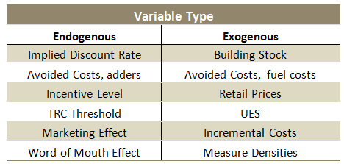
2015 California Potential and Goals Study » Support AAEE and LTPP
Navigant will use the 2015 model to refine how scenarios are defined such that endogenous variables are more aggressively explored.
Changes to bass diffusion parameter ranges from policy drivers (e.g. AB 758)
Changes to implied discount rate (iDR) from policy drivers (e.g. AB 1103)
Changes in avoided costs may be explored due to changes in environmental externality adders

Slide 30
Greg Wikler, Director-in-Charge
Navigant - Director
San Francisco, CA
(415) 399-2109
Greg.wikler@navigant.com
Amul Sathe, Project Manger
Navigant - Associate Director
San Francisco, CA
(415) 399-2180
Amul.sathe@navigant.com
Surya Swamy, Lead Modeler
Navigant – Managing Consultant
San Francisco, CA
(415) 356-7112
Surya.swamy@navigant.com
Michael Noreika, MICS Lead
Navigant - Managing Consultant
Seattle, WA
(206) 302-4016
Michael.Noreika@navigant.com
Sam Piell, Stakeholder Engagement
Navigant – Senior Consultant
San Francisco, CA
(415) 356-7160
Sam.piell@navigant.com

