Slide 1
2023 Proposed Preferred System Plan and 2024-25 Transmission Planning Portfolios Supplemental Criteria Pollutant Analysis
Energy Division Staff
November 2, 2023

Slide 2
Criteria pollutant analyses of the IRP PSP 25MMT Core cases for years 2026, 2030, and 2035

Slide 3
Background – criteria pollutants analysis
  Statute directs the Commission's IRP process to ensure that LSEs "minimize localized air pollutants and other greenhouse gas emissions, with early priority on disadvantaged communities "(PU Code 454.52 (a)(1)(H))
  Reports from SERVM studies were post-processed to produce criteria pollutant analyses for the CAISO area only as well as all of California. Analysis quantifies the quantity and breakdown of criteria pollutants within DACs (Disadvantaged Communities) and outside DACs.
  The following slides present these analyses for 2026, 2030, and 2035 with the 25 MMT Core cases paired with the 2022 IEPR electric demand forecast
    Refer to 2023 Proposed Preferred System Plan (PSP) Reliability and Emissions Analysis slides for further background on these cases, available here: PSP ruling-Reliability and emissions analysis-slides_2023-10-04-FINAL (ca.gov)
  Analysis steps using SERVM outputs
    Methods to estimate start NOx emissions and normal operation NOx emissions
    Data sources for estimating emission factors – Biomass emissions factors were updated this PSP cycle, given new information sourced from RPS contracts. The effect is to lower emissions from biomass, particularly NOx emissions.
    Methods to summarize results by resource type, study year, and DAC status

Slide 4
Background – Updated Criteria Pollutant Analysis
  Staff performed multiple updates to overall inputs and assumptions in 2023 inputs-assumptions-2022-2023_final_document_10052023.pdf (ca.gov). After publishing the Inputs and Assumptions document and issuing an initial analysis of Criteria Pollutants, staff identified the need to change emissions factors for biomass resources. Also staff identified a data error in tables contained in those slides.
  Staff performed updates to the emissions factors for biomass resources based on an analysis performed by Argonne National Lab and fixed the data errors in the charts contained in the original slides. Generation from biomass was incorrectly lower than the modeling results.
  The revised biomass emissions factors (below) were included in the Inputs and Assumptions document posted for the Resource Adequacy proceeding 527361341.PDF (ca.gov).
  Staff is updating analysis for the Core case only, as that was adopted as the IRP PSP in early 2024.
NOx, PM2.5 and SOx Emission factors for Biomass Only in g/kWh of Generation
Unit Category | NOx | PM2.5 | SOx | Units
BIOMASS/WOOD | 0.752 | 0.074 | 0.060 | g/kWh

Slide 5
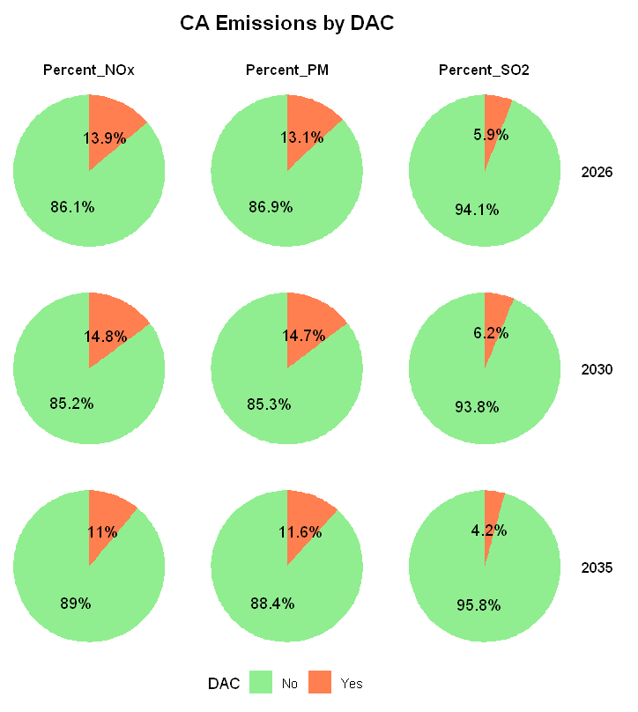
California-wide electric sector criteria pollutants (metric tons) by DAC – Core Case
In the Core case, in California, between 4% to15% of criteria pollutants emissions are in Disadvantaged Communities (DAC) and between 85% and 96% outside DACs. PM2.5 and NOx emissions are most likely to be in DAC areas and SO2 least likely.
Emissions In DAC | 2026 | 2030 | 2035
NOx | 13.9% | 14.8% | 11%
PM | 13.1% | 14.7% | 11.6%
SO2 | 5.9% | 6.2% | 4.2%
DACs contain about 25% of California’s population
In DAC: Emissions from generating units located in disadvantaged communities as defined by the California Environmental Protection Agency and in D.18-02-018 (even if the emissions may migrate beyond)
Not in DAC: Emissions from generating units not located in disadvantaged communities (even if emissions may migrate into such communities)

Slide 6
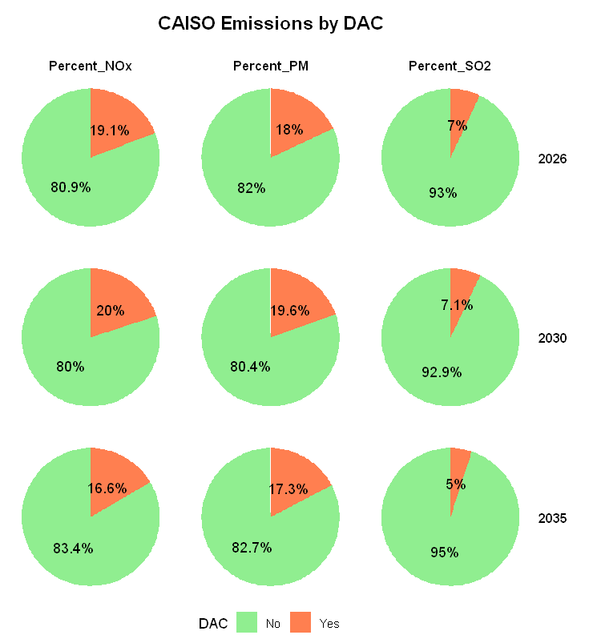
CAISO electric sector criteria pollutants (metric tons) by DAC – Core Case
In the Core case, in CAISO, between 5% to 20% of criteria pollutants emissions are in Disadvantaged Communities (DAC) and between 80% and 95% outside DACs. PM2.5 emissions are most likely to be in DAC areas and SO2 least likely.
Emissions In DAC | 2026 | 2030 | 2035
NOx | 19.1% | 20% | 16.6%
PM | 18% | 19.6% | 17.3%
SO2 | 7% | 7.1% | 5%
DACs contain about 25% of California’s population
In DAC: Emissions from generating units located in disadvantaged communities as defined by the California Environmental Protection Agency and in D.18-02-018 (even if the emissions may migrate beyond)
Not in DAC: Emissions from generating units not located in disadvantaged communities (even if emissions may migrate into such communities)

Slide 7
California Emissions by Unit Category – Core Case
California wide emissions shown for: biomass, CC (Combined Cycle), cogen (Cogeneration), CT (Combustion Turbine) and ICE (Internal Combustion Engine) for Core Studies
NOx emissions are higher for all units
Biomass and CC units have higher SO2 emissions

Slide 8
CAISO Emissions by Unit Category – Core Case
CAISO Thermal Generation - Core Cases
 | 2026 | 2030 | 2035
Biomass | 2,736 | 3,537 | 3,601 | GWh
CC | 59,867 | 34,307 | 32,244 | GWh
Cogen | 10,107 | 9,417 | 4,007 | GWh
CT | 2,494 | 700 | 1,323 | GWh
ICE | 110 | 54 | 69 | GWh
Geothermal | 16,756 | 22,755 | 25,616 | GWh
CAISO emissions shown for: biomass, CC, Cogen, CT and ICE for Core studies
NOx emissions are higher for all units
Biomass units have higher NOx and SO2 emissions, although their total generation is much lower than Cogen and CCs

Slide 9
California-wide capacity, energy, fuel burn, and criteria pollutants by unit category

Slide 10
2026 California-wide criteria pollutants by unit category - Core Case
2026 CA Core
Unit Category | Capacity (MW) | Generation (TWh) | Fuel_Burn (Million MMBTU) | Nox (Metric Tons) | PM25 (Metric Tons) | SO2 (Metric Tons)
BIOMASS/WOOD | 563 | 2.77 | 45.74 | 2,087.44 | 205.25 | 167.31
CC | 20,447 | 81.36 | 595.34 | 3,224.15 | 1,782.28 | 189.03
COGEN | 2,141 | 11.19 | 115.59 | 1,223.60 | 346.05 | 36.70
CT | 10,327 | 4.73 | 43.25 | 668.27 | 129.47 | 13.73
ICE | 309 | 0.15 | 1.41 | 38.10 | 6.39 | 0.45
STEAM | 186 | 0.12 | 1.32 | 8.24 | 4.48 | 0.42
Total | 33,972 | 100.32 | 802.65 | 7,249.79 | 2,473.92 | 407.64
Biomass listed above includes ONLY wood and biomass, excluding biogas for criteria pollutant calculations.
Biomass units have high emission intensities, emitting a large share of total criteria pollutants despite producing relatively small amounts of electricity
CC units have low emission intensity but still emit a significant share of total criteria pollutants since they produce large amounts of electricity

Slide 11
2030 California-wide criteria pollutants by unit category - Core Case
2030 CA Core
Unit Category | Capacity (MW) | Generation (TWh) | Fuel_Burn (Million MMBTU) | Nox (Metric Tons) | PM25 (Metric Tons) | SO2 (Metric Tons)
BIOMASS/WOOD | 734 | 3.55 | 58.51 | 2,671.47 | 262.67 | 214.12
CC | 20,758 | 48.78 | 353.37 | 2,044.11 | 1,057.90 | 112.20
COGEN | 2,141 | 10.10 | 107.95 | 1,104.84 | 323.16 | 34.27
CT | 10,327 | 1.67 | 15.87 | 363.20 | 47.51 | 5.04
ICE | 309 | 0.08 | 0.66 | 18.81 | 3.01 | 0.21
STEAM | 186 | 0.02 | 0.34 | 2.40 | 1.14 | 0.11
Total | 34,454 | 64.20 | 536.69 | 6,204.84 | 1,695.39 | 365.95

Slide 12
2035 California-wide criteria pollutants by unit category - Core Case
2035 CA Core
Unit Category | Capacity (MW) | Generation (TWh) | Fuel_Burn (Million MMBTU) | Nox (Metric Tons) | PM25 (Metric Tons) | SO2 (Metric Tons)
BIOMASS/WOOD | 733 | 3.63 | 59.87 | 2,730.12 | 268.44 | 218.82
CC | 20,692 | 47.93 | 350.43 | 2,015.22 | 1,049.07 | 111.27
COGEN | 1,064 | 4.59 | 45.02 | 504.38 | 134.77 | 14.29
CT | 10,327 | 2.79 | 27.23 | 542.91 | 81.53 | 8.65
ICE | 309 | 0.10 | 0.88 | 22.98 | 3.98 | 0.28
STEAM | 186 | 0.05 | 0.57 | 3.96 | 1.94 | 0.18
Total | 33,310 | 59.07 | 483.99 | 5,819.58 | 1,539.73 | 353.49

Slide 13
2030 California-wide criteria pollutants by unit category – 2021 PSP analysis for comparison
2030 CA (2021 PSP analysis)
Unit Category | Capacity (MW) | Generation (TWh) | Fuel_Burn (MMBTU) | NOx (Metric Tons) | PM2.5 (Metric Tons) | SO2 (Metric Tons)
Biomass/Wood | 615 | 4.40 | 53.40 | 4,667.10 | 1,735.90 | 667.70
CC | 20,483 | 54.40 | 400.00 | 1,437.10 | 1,196.00 | 112.70
Cogen | 1,933 | 9.90 | 75.30 | 1,075.70 | 224.20 | 23.80
CT | 10,450 | 7.60 | 78.00 | 454.30 | 231.50 | 22.00
ICE | 305 | 0.20 | 1.60 | 15.70 | 7.10 | 0.50
Steam | 272 | 0.10 | 1.10 | 5.20 | 3.70 | 0.40
Total | 34,057 | 76.60 | 609.40 | 7,655.10 | 3,398.40 | 827.10
Biomass followed by biogas units have highest emission intensities, emitting a large share of total criteria pollutants despite producing relatively small amounts of electricity
CC units have low emission intensity but still emit a significant share of total criteria pollutants since they produce large amounts of electricity

Slide 14
Comparison of 2030 study year from 2021 modeling and 2023 PSP modeling - Core Case
 | Capacity (MW) | Generation (TWh) | Fuel_Burn (Million MMBTU) | Nox (Metric Tons) | PM25 (Metric Tons) | SO2 (Metric Tons)
2021 PSP | 34,057 | 76.60 | 609.40 | 7,655.10 | 3,398.40 | 827.10
2023 PSP | 34,454 | 64.20 | 536.69 | 6,204.84 | 1,695.39 | 365.95
Decrease from 2021 PSP |  | 16.18% | 11.93% | 18.95% | 50.11% | 55.75%
Slight increase in thermal capacity in California in proposed 2023 PSP due to corrections and updates to the Anchor Data Set, showing more generation retained in LADWP generation and SMUD areas.
Overall decreases in criteria pollutants driven by 16% decrease in usage of thermal generators (12 TWh reduction in CC and CT generators and 0.77 TWh reduction in biomass).
Part of the PM2.5 and SO2 emission decrease driven by decrease in emissions factors used for biomass in the proposed 2023 PSP, as well as decrease in overall biomass generation.

Slide 15
Conclusions
CAISO criteria pollutant emissions decrease significantly between 2026 and 2035(Slide 9 to Slide 10).
Revised emissions factors for biomass generators contributed to a drop in per MWh emissions. Still, biomass is the largest emitter of SO2 now that steam and coal are no longer present in California. More attention to SO2 emissions from biomass generators appear to be warranted.
CC generators are the largest emitters overall in California of PM2.5. They are largest emitter of NOx in 2026, but in 2030 and 2035 biomass will be the largest NOx emitter which will be significant relative to their overall generation.
California-wide share of emissions which occur in DAC areas (ranging between 4% - 15%) are less than the proportion of the state’s population in DACs (approximately 25%).

