Slide 1
Resource Data Template
June 2026 Status and Updates
May 15, 2026

Slide 2
Logistics
Office Hours slides, recording, and all supporting material are available on the IRP Procurement Webpage:
Questions: We invite clarifying questions at the end of the meeting.
Please keep yourself muted throughout the presentation.
Please type your question in the chat or use the “raise your hand” to ask questions.
Please unmute yourself when Webex host will announce your name and ask your question.
Afterwards, please lower your hand.
For attendees joining by phone: You may either hold your question until the end and unmute to ask it or share it after office hours.
Note: This office hour is intended only for questions related to IRP-MTR June 1, 2026, filings, NOT FOR THE IRP BIENNIAL FILING due August 2026.

Slide 3
Agenda
Topic | Duration (minutes)
Introduction & Logistics | 5
Overview of IRP Procurement Orders and Filing Requirements | 5
RDT Guidance & Updates | 5
Key Features of RDT Sheets | 5
Summary of Changes to the RDT | 10
RDT Walk-Through | 15
Q&A and Feedback | 45
Notes:
The purpose of the meeting is Revised RDT walk thorugh

Slide 4
IRP Procurement Orders and Filing Requirements

Slide 5
IRP Procurement Orders and Compliance Review Schedule
Table 1. CPUC Procurement Orders (Applies to all CPUC-jurisdictional LSEs. No opt-outs allowed)
CPUC Orders | Total | 2023 | 2024 | 2025 | 2026 | 2027 | 2028 | 2030 | 2031 | 2032
D.21-06-035 | 11,500 MW NQC | 2,000 MW by Aug | 6,000 MW by Jun 1 | 1,500 MW¹ by Jun 1 | n/a² | n/a | 2,000 MW by Jun 1 | n/a | n/a | n/a
D.23-02-040 | 4,000 MW NQC | n/a | n/a | n/a | 2,000 MW by Jun 1 | 2,000 MW by Jun 1 | n/a | n/a | n/a | n/a
D.26-02-057 | 6,000 MW NQC | n/a | n/a | n/a | n/a | n/a | n/a | 2,000 MW by Jun 1 | 2,000 MW by Jun 1 | 2,000 MW by Jun 1
Cumulative Procurement Ordered | 21,500 MW NQC | 2,000 MW | 6,000 MW | 1,500 MW | 2,000 MW | 2,000 MW | 2,000 MW | 2,000 MW | 2,000 MW | 2,000 MW
Table 2. Timelines for CPUC Review of LSE Contracting
 | 2023 | 2024 | 2025 | 2026 | 2027 | 2028 | 2029 | 2030 | 2031 | 2032
CPUC Reviews LSE Compliance Filings | Feb 1, Aug 1, and Dec 1 | Jun 3 and Dec 2 | Jun 2 and Dec 1 | Jun 1 and Dec 1 | Jun 1 and Dec 1 | Jun 1 and Dec 1 | Jun 1 and Dec 3 | Jun 3 and Dec 2 | Jun 2 and Dec 1 | Jun 1 and Dec 1
(1) D.21-06-035 required 2,500 of the 9,000 MW NQC required between 2023-2025 be "Diablo-Canyon Replacement".
(2) D.21-06-035 required 2,000 MW NQC of Long-Lead Time Procurement by 2026, with an option to extend to 2028: 1,000 MW NQC of long-duration storage and 1,000 MW NQC of firm zero-emitting. D.23-02-040 automatically extends the procurement obligation to 2028. D.26-02-057 requires 6000 MW by 2032. 2000MW each by June 2030, 2031, and 2032.
Notes:
This slide here is just to give some context on the overall picture of IRP procurement
As I am sure folks here know, we now have 3 IRP procurement orders that cover from 2021-2028
Since the online date requirements are moving from Aug to June to get the proc on a little earlier for summer reliability, the compliance dates move as well

Slide 6
June 1, 2026 Filing Requirements
Filings Include:
  Public and Confidential RDT: RDT06.2026 released
  Supplemental Documents:
  1. Contracts
  2. Milestone documentation
  3. Engineering assessments as required
  Remediation Plan
  Relevant Documents
  User Guide: IRP Procurement Track
  Filing Requirement Overview: IRP Procurement Track
  Decision: D.21-06-035 D.23-02-040 D.26-02-057
  Resolution E-5426: 585357875.PDF
Notes:
Good morning – Anamik analyst in the IRP. Thank for providing the feedback we appreciate the time you all have taken to provide that. We have also received some feedback on the final materials yesterday and we will try to incorporate them as soon as possible. Today, we are going to cover what we are expecting from LSE for this filing and what LSEs should plan to include in the filing package. As most of you are aware but for the new ones, we expect LSEs to include public and confidential version of the RDT.
Mainly we are looking for three a pand c version , any supplemental and if there is a remediation plan, if the contracts are delayed or if there are specific details that LSEs are unable to capture in the RDT
These are the three things
Reminder to include
Number of tabs created for planning tab you don’t
Expectations : File name criteria
All 2023, 2024, and 2025 pursuant to D.21-06-035 procurement or bridge resources should be online, particularly related to the Diablo Canyon Replacement Requirement.
LSEs should have significant progress toward the remainder of their D.23-02-040 procurement obligations.
Clean Bullet and hyperlink to the decision. It is a huge challenge on our side can import it successfully it a small effort on LSE side we are covering just the RDT questions, but we want to the LSE to review that. Steve covering .

Slide 7
June 1, 2026 Filing Requirements
  File Naming Requirements:
  Use the LSE abbreviation from the “lse_names” sheet in the workbook
  Indicate “confidential” or “public”
  Include version number as v1, v2, etc.
  Increase version number each time you resubmit
  <LSE Abbreviation>_rdtv3_38mmt_<confidential/public>_v#
  Example: XYZ_rdtv3_38mmt_confidential_v1
Notes:
While you submit , Please name your RDT file, using the above naming convention. It is a huge challenge for us to import the RDT file and run it through the RECART if it doesnt come with proper naming convention, and then we have to manually correct them before start processing them. So prlese submit you’re your RDT file with correct naming convention.

Slide 8
RDT Guidance & Updates

Slide 9
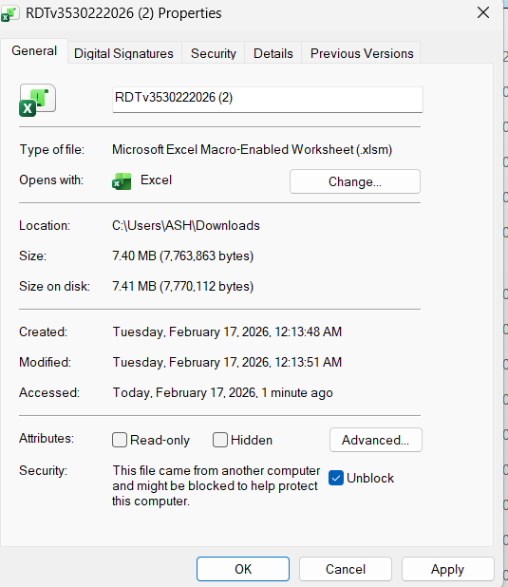
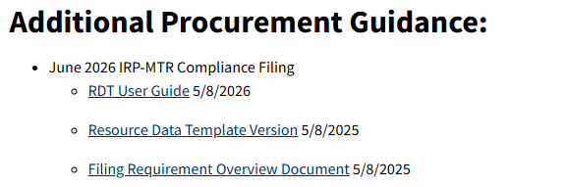
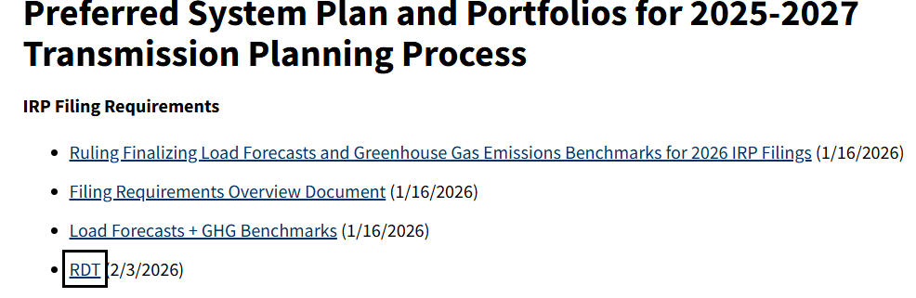
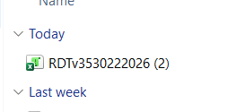

Key Features of RDT
  The RDT consists of 14 sheets. Not all sheets are required to be filled.
  LSEs fill sheets relevant to IRP Biennial Filing/IRP-MTR filing/Joint Filing.
The RDT uses Excel macros, which may be blocked by default when files are downloaded from the internet. To ensure the RDT works as intended, LSEs should follow these steps:
  Step 1
  Step 2 Step 3
Notes:
I am sure most of you have gotten a chance to look at the RDT before hand, We have programmed this functionallity withing the RDT. However in order to RDT to function properly the LSE are advised to follow the following step.

Slide 10

Key Features of RDT
  Use Correct naming convention :<LSE_Abbreviation>_rdtv3_8mmt_<confidential/public>_v#
  Do not forget to click "Enable Content" once prompted.
Select the appropriate filing that an LSE wish to use the RDT for, in order for the RDT to show relevant sheets required for the filing.
.
Notes:
Once you do that. Go to the certification tab and identify the submission type from the the drown list, in this case we will select MTR complaince filing from the list.

Slide 11
Key Features of RDT Sheets
Unique_Contracts Sheet
  The “unique_contracts” sheet is the only sheet in RDT for reporting the LSE’s existing and planned energy and capacity contracts.
  Please use separate rows for every contract reported.
  Hybrid contracts should be listed on separate rows, with a different row for each resource.
  New columns are added to include requirements of new MTR procurement D.26-02-057, as well as alternative complaince pathways with MA RA contracts
  MTR NQC Validation Tool Sheet
  LSEs are required to complete the MTR NQC Tool and Summary Sheet for every contract and for each tranche to which they intend to apply that contract.
  Contracts used to meet multiple compliance obligations should be listed on separate rows, with a different row for each compliance obligation targeted.
  Each bridge contract (long-term or short-term) should be entered in a separate row. If a bridge is used to bridge for two resources, use separate rows to identify the bridging NQC for each resource.
Notes:
Here some key features of the RDT sheets,
Unique contract sheet is the
While you do that please remember to use separate rows for hybrid contact. There has some feedback on not being able to find resource IDs for those contract. And resource tab is updated to include ll new Caiso Resource Id and LSE can look up those id using the drop down window. We are going to walk through them shortly.
The rules for filling MTR Summary tab are different in this tab fill the rows for each contract and each trance. If LSE intend to use contact in multiple tranches please identify the percentage capacity

Slide 12
Summary of Changes to the June 2026 RDT
Certification Form
1. Replace the current versioning system with date-based tracking
Unique_contracts Sheet
Capacity factor field
Engineering assessment field
Contract type and pricing fields
Tranche compliance fields for future years (to include new Procurement Order release D.26-02-057)
Alternative compliance pathway identification field
Notes:
Since RDT now has the ability to modify itself based on the filing type and can be used simultaneously for different filings as we just saw. Staff has gotten rid of the versioning system and now rely on date-based tracking to help LSEs identify correct RDT files.

Slide 13
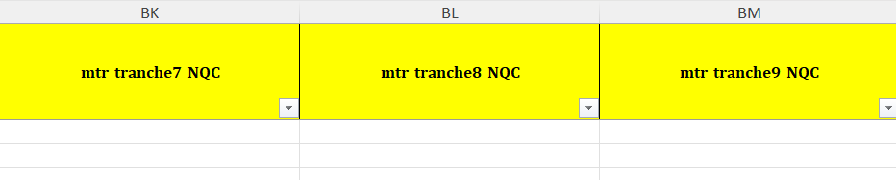
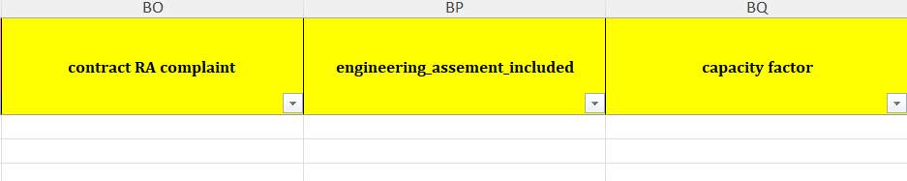
Unique Contracts Sheet
Tranche compliance fields for future years (Year 2030, 2031, 2032).
Capacity factor and engineering assessment field.
Resource Adequacy (RA) compliance identification field.
Notes:
Improved look up table if the g
which are more geographically isolated and have specific infrastructure requirements
eothermal project, and if you do not have equivalent geothermal resource id we don't see a lot of those projects and if you do not see that please rech out I and tell you the equivalent resource id.

Slide 14
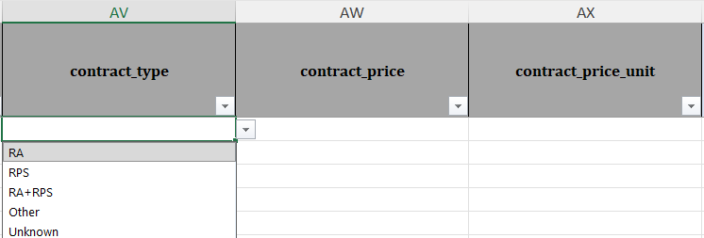
Unique Contracts Sheet
  Field to specify, contract type, contract price, and unit.

Slide 15
Avoiding Errors in RDT
Data Entry and Pasting
The “unique_contracts” sheet is the only sheet in RDT for reporting the LSE’s existing and planned energy and capacity contracts.
Hybrid contracts should be listed on separate rows, with a different row for each resource.
Avoid pasting values directly, as it can bypass data validation and create errors. When pasting is necessary, paste as values only.
Columns may change (added or removed) between RDT versions.
Complete all columns unless a field can be explicitly marked as not applicable.
Run macros after completing the “unique_contracts” sheet.
Notes:
Running the macros will catch many errors in will carry over to the validation tool.

Slide 16
Avoiding Errors in RDT
Unique_contracts Sheet
Do not delete rows from the “unique_contracts” tab -- this will cause errors in linked sheets.
Each contract row must include:
1. A unique “lse_contract_id” is required for every contract.
2. For hybrid contacts only show the contracted attributes and compliance targets relevant to resource type and Resource ID.
3. Hybrid resources with different Resource IDs may continue to use the same “lse_unique_contract_id”.
Columns including total and contracted nameplate capacity, resource mix, and storage depth should not be left empty.
Notes:
Coomon Errors In RDT

Slide 17
MTR ELCC Guidance Documents
2021
2021 Staff transmittal memo
  ELCCs for ‘23 (T1) and ‘24 (T2) compliance dates; ’25 (T3) + ‘26 (T4) compliance dates for contracts entered before 11/30/2022
  Direction on geothermal counting & other clarifications.
2021 Study for Mid-Term Reliability Procurement by E3 and Astrapé (2021 Study)
2023
June 2023 Staff Memo
  Addresses requirements in D.23-02-040 to provide final guidance on procurement adopted in that decision.
  Confirms that ELCC values issued in 2023 MTR Study are still effective.
  Clarifies which ELCCs stakeholders should use for OOS wind resources not explicitly mentioned in previous ELCC studies.
2023 Staff Transmittal Memo
  ELCCs for ’25 (T3) + ‘26 (T4) compliance dates for contracts entered after 11/30/2022.
  ELCCs for procurement adopted in D.23-02-040 – ’27 (T5) + ‘28 (T6).
  Directions for ELCCs for delayed contracts.
Incremental ELCC Study for Mid-Term Reliability Procurement (January 2023 Update)
FAQ Documents
2024 Staff Responses to Frequently Asked Questions on Mid-Term Reliability
2023 Staff Responses to Frequently Asked Questions on Mid-Term Reliability
General Q&A Responses to Frequently Asked Questions on Mid-Term Reliability issued on 5/22/2025, 6/17/2022, and 11/14/2022
Notes:
We have already reviewed in the previous RDT office hours we have already on our website and these aee also include here. If you still have any question please take some time to refer to the FAQs you may find your question being already answered. If there are any other question please feel free to reach out to us.
This slide is a resource– links to our studies and memos.
For 2021 – we have a study and transmittal memo. This is for tranche 1, tranche 2. As well as tranche 3 and 4 if contracts were entered before Nov 30 22.
For 2023 – I am going to go backward here
First we have the study updated Jan 2023
Then we have the staff memo proscribing ELCCs for tranche 3 and 4 contracts signed after Nov 30 22 as well tranches 5 and 6.
And finally the June memo, which was required by D.23 and confirms that the values or 5 and 6 are still effective and are not updated.
In general, the studies are good for understanding how we arrived at the ELCC values we did whereas the memos summarize values briefly and provide more compliance direction.

Slide 18
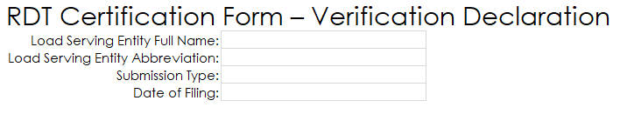
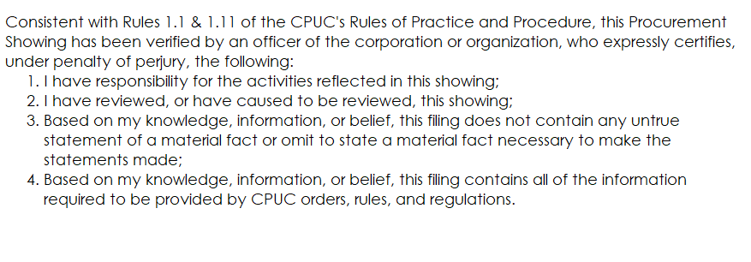
Certification Form - Do Not Forget to Complete!
This Form is used to verify the accuracy, reduce data errors and inconsistencies in procurement volumes that LSEs are reporting for their MTR compliance.
LSE must nominate a person/persons verifying and certifying that information provided for MTR compliance.

Slide 19
RDT Example Walkthrough
Notes:
In this walk though Iwe are going to demonstarte how to download and save the RDT in order to use the new functionality added to it as well as we will look at the new coloumns.

Slide 20
Q&A and Feedback

