Slide 1
2022 RA Guide and Templates Workshop
August 5, 2021
10:00 a.m. – 12:00 p.m.

Slide 2
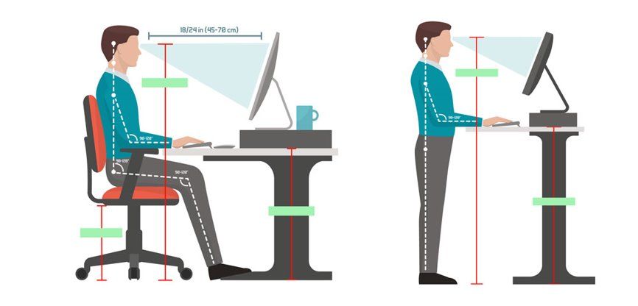
Logistics
Online only​
  Audio through computer or phone
  Toll-free 855-282-6330 or 415-655-0002 Access code: 146 026 1889
Type password : 2022RA
Hosts (Energy Division Staff)​
  Lily Chow
  Jaime Rose Gannon
  The workshop is being recorded
Safety
  Note surroundings and emergency exits
  Ergonomic check

Slide 3
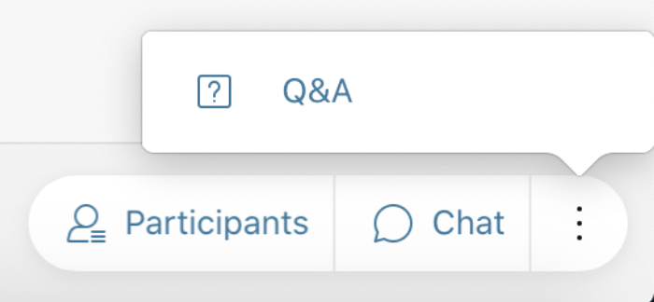

Workshop Logistics
All attendees have been muted
Panelist that are presenting have been identified and will be identified as panelist when their issue/topic is being addressed
To ask questions please use the Q&A function (send "To All Panelists") or raise your hand
Questions will be read aloud by staff; attendees may be unmuted to respond to the answer. (Reminder: Mute back!)
Mute/ Unmute
Participant List
Chat
Audio Options
On the bottom right of screen: click "3 dots" for Q&A

Slide 4
Ground Rules
Workshop is structured to facilitate understanding of the 2022 RA compliance process.
Keep comments friendly and respectful.
Please use Q&A feature only for questions, or technical issues.
Do NOT start or respond to sidebar conversations in the Chat.

Slide 5
Agenda
10:00 am – 10:15 am – Introduction and Overview of Agenda
          Today’s Objective
          To discuss and clarify CPE implementation for 2022 Year Ahead process
          To demonstrate new features of the RA templates and guide for 2022 compliance year
10:15 am – 11:00 am – Central Procurement Entity Implementation
Overview of CPE and changes to local RA requirement for 2023 and 2024 – D.20-06-002 and D.20-12-006
CPE and LSE Showing for 2023 and 2024
CAM Credits for System and Flexible Capacity from the CPE procurement
Questions
11:00 am – 11:25 am - 2022 RA Guide
CPE Implementation
Other Modifications to the RA Guide
11:25 am – 11:50 pm - General Demonstration of RA templates
  Revised Local and Flexible Template
      Changes to the Local and Flexible template - CPE
      Practice entering resource into template for both Local and Flexible compliance
      Practice verifying compliance
      Go through advisory monthly flexible tables
  Month Ahead Load Forecast Template
    Demonstration of entering load migration
    Demonstration of how the load migration values flow into the RA System
  System Template
Changes to the System template
Practice entering load and resource information for both System and Flexible compliance, including CAM/RMR
Practice verifying compliance
11:50 pm – 12:00 pm Wrap Up and Next Steps
  Informal comments due on August 13, 2021
  Finalize Guide and Templates September 2021
  Overview of Year Ahead allocation and compliance schedule

Slide 6
Central Procurement Entity Implementation
D.20-06-002
  OP 2: Pacific Gas and Electric Company and Southern California Edison Company shall serve as the central procurement entities for their respective distribution service areas for the multi-year local Resource Adequacy (RA) program beginning for the 2023 RA compliance year.
  OP 3: The hybrid central procurement framework for local resources is adopted for Pacific Gas and Electric Company (PG&E) and Southern California Edison’s (SCE) distribution service areas. Load serving entities in PG&E’s and SCE’s distribution service areas will no longer receive a local allocation beginning for the 2023 Resource Adequacy compliance year.

Slide 7
2022 Year Ahead RA Timeline
April-May 2021:
  The CAISO files draft and final LCR one- and five-year ahead studies. LCR studies will include any CAISO-approved transmission upgrades from the Transmission Planning Process (TPP) LCR study.
  LSEs in SCE and PG&E TAC areas commit to CPE to show self-procured local resources in RA filing for 2023 and 2024.
  Parties file comments on draft and final LCR studies.
June 2021:
  The Commission adopts multi-year local RA requirements for the 2022-2024 compliance years as part of its June decision.
  CPE receives total jurisdictional share of multi-year local RA requirements for 2022-2024 compliance years.
July 2021:
  For the SCE and PG&E TAC areas, LSEs receive initial RA allocations, including CAM credits and system, flexible, and local requirements for 2022 (but are not allocated local requirements for 2023 and 2024).
  For SDG&E TAC area, LSEs receive initial RA allocations (system, flexible, local requirements) and CAM credits.

Slide 8
2022 Year Ahead RA Timeline
Late September 2021: CPE and LSEs that voluntarily committed local resources to the CPE make local RA showing to the Commission and the CAISO.
Late September/early October 2021: For PG&E and SCE’s TAC areas, LSEs are allocated final CAM credits (based on coincident peak load shares) for any system and flexible capacity that was procured by the CPE during the local RA procurement process or by CAISO through its RMR process.
End of October 2021: LSEs in the SDG&E TAC make system, flexible, and 3-year local RA showing. CAISO determines necessary backstop procurement. LSEs in PG&E and SCE TACs make local showing only for 2022, as well as 2022 year ahead system and flexible showings.

Slide 9
Central Procurement Entity Implementation
For the 2022 Year Ahead Compliance Process
  LSEs will receive local requirements for 2022
  LSEs will not receive local requirements for 2023 and 2024 in PG&E and SCE’s TAC area
  The CPE will receive local requirement for 2023 and 2024 in PG&E and SCE’s TAC area
  LSEs in SDG&E’s TAC area will receive local requirements for 2023 and 2024

Slide 10
Central Procurement Entity Implementation
LSEs may self-show local resources in PG&E and SCE’s TAC area for 2023 and 2024.
CPE and LSEs that voluntarily committed local resources to the CPE make local showing to CPUC and CAISO on September 30, 2021
LSEs will receive CAM credits for system and flexible capacity from the CPE procurement in 2023 and 2024 by October 15, 2021. This credit will be updated in July 2022 for the 2023 initial YA allocation.

Slide 11
Central Procurement Entity Implementation
D.20-12-006 – LCR Reduction Compensation Mechanism
  OP 3: California Community Choice Association’s Option 2 local capacity requirements (LCR) reduction compensation mechanism (RCM) is adopted to apply to new preferred resources and new energy storage resources, including utility-owned generation, with modifications, as follows:
  (a) The central procurement entity (CPE) may accept or reject the shown local resource if more cost-effective resources are available.
  (b) The CPE shall apply all of the methodology and criteria set forth in Ordering Paragraph 14 of Decision (D.) 20-06-002 to shown resources in the same way the methodology and criteria are applied to bid resources.
  (c) If selected, the load-serving entity (LSE) shall be paid up to the showing price without annual adjustment for effectiveness. The showing price shall not exceed the pre-determined local price, which is calculated as follows:
    Year 1: Use the weighted average price from the last four quarters of Energy Division Power Charge Indifference Adjustment (PCIA) responses for both system and local RA; subtract system Resource Adequacy (RA) price from local RA price.
    Subsequent Years: Use the weighted average price from the last four quarters of Energy Division PCIA responses for system RA and the most recent weighted average price reported in the CPE solicitation results (prior year’s results) for local RA price; subtract system RA price from local RA price.

Slide 12
LCR Reduction Compensation Mechanism
Prices for Year 1 has been posted on the RA Compliance webpage at:
  https://www.cpuc.ca.gov/industries-and-topics/electrical-energy/electric-power-procurement/resource-adequacy-homepage/resource-adequacy-compliance-materials

Slide 13
2022 RA Guide
Added Ordering Paragraphs from D.21-06-029
Added CPE section
Changed MCC bucket table
Changed DR PRM adder to 9%
Added new ED verification process for imports
Added new rules on Penalty section
Deleted “Sellers Choice Contract” section
Changed dates to 2022

Slide 14
2022 Local/Flexible Template
CPE and LSEs use the same template
Added three columns “CPE Product Type”, “LSE for Self Show”, and “Scheduling Coordinator for Self Show” to 2023 and 2024 physical resources tab
  CPE will select “Existing CAM” or “Procured” for product type, LSEs that show local resources will select “Self Shown” or “Self Shown LCR RCM”
  LSEs showing local resources to meet San Diego/IV local requirements do not need to use these three columns
Added “Third Party DR” column to 2024 physical resources tab
Changed 2024 Summary tab to account for Third Party DR

Slide 15
2022 System Template
Changed MCC bucket percentages on the Year Ahead Summary and Month Ahead Summary tab
Changed PRM adder for DR to 9% in the Year Ahead Summary and Month Ahead Summary tab
Added System RMR for Year Ahead Summary tab
Currently we are allocating IRP resources as a credit to show on the Physical Resources tab to account for all local, system, and flexible credits. The IOUs are showing the entire resource. We will take comments on if there are other ways of allocating IRP credits.

Slide 16
2022 Multiyear Capacity Documentation Summary
For LSEs that show local resources in 2023 and 2024 in the San Diego/IV local area

Slide 17
Upcoming 2021 RA Compliance Timeline
Comments on 2022 Draft RA Guide and Templates due August 13, 2021
Final 2022 YA Load Forecast due August 16, 2021
LSEs receive 2022 final YA allocations the week of September 20, 2021
Finalize 2022 RA Guide and Templates the week of September 20, 2021
CPE and LSEs make local showing to CPUC and CAISO due September 30, 2021
LSEs receive CAM credits for system and flexible capacity procured by the CPE for 2023 and 2024 by October 15, 2021
LSEs file 2022 YA RA filings due November 1, 2021*

Slide 18

Thank you for attending 2022 RA Guide and Templates workshop.
Feedback welcome.
Hosts contact:​
Lily Chow- lily.chow@cpuc.ca.gov​
Jaime Gannon – jaimerose.gannon@cpuc.ca.gov​

