Slide 1
Slice-of-Day Office Hours
Energy Division
August 16, 2024

Slide 2
Agenda
SOD Implementation Timeline
CEC Load Forecast Presentation
Exceedance Values Update
Stakeholders' Topics of Interest
  Data Availability (Showing Template V32, Allocations, MRD, Exceedance Values)
  State-of-Charge and Flexible Compliance Logic
  Unspecified Import Contracts
  Showing Collocated and Hybrid Resources
  Template Feedback
Additional Questions

Slide 3
Slice-of-Day Implementation Timeline
Recent Program Milestones and Upcoming Dates:
LSE Initial Load Forecasts Submitted to CEC & CPUC | April 15, 2024
LSE Revised Load Forecasts Submitted to CEC & CPUC | May 13, 2024
Draft RA Guide and Local & Flex Template sent to LSEs | July 29, 2024
Initial 2025 Year-Ahead RA Allocations Sent to LSEs | July 31, 2024
LSE Final Load Forecasts Submitted to CEC & CPUC | August 12, 2024
Draft Master Resource Database (MRD) posted; Comment Period Open | August 23, 2024* Comment Period Open Aug 23 – Sep 2, 2024
2025 Final MRD Published | September 11, 2024*
Final 2025 Year-Ahead Allocations and V32 of Template Sent to LSEs | September 19, 2024*
Additional SOD Office Hours | September 12, 2024 October 11, 2024
*Future dates may be subject to change due to external data availability

Slide 4
Slice-of-Day Implementation Timeline
Upcoming Compliance Due Dates through 2024:
RA Compliance Filing | Due Date
SOD Test Year – September Month-Ahead Filing | September 1, 2024
Final 2025 Year-Ahead System RA Showing | October 31, 2024
Final 2025 Flexible and Three-Year Local (for LSEs in SDG&E TAC area only) RA Showing | October 31, 2024
January Month-Ahead Showing | November 17, 2024
February Month-Ahead Showing | December 18, 2024

Slide 5
2025 YA Filings: SOD System, Local, and Flexible
Two separate filings are required for 2025 Year-Ahead Compliance:
System YA Showing
  Use the SOD Showing Tool
  All LSEs are required to make a System YA Showing for May - September
Local and Flexible YA Showing
  Use the Local and Flexible RA template
  All LSEs are required to demonstrate compliance with the Flexible RAR for all 12 months of 2025
  LSEs in SDG&E’s distribution service area are required to demonstrate Local RAR for all 12 months of 2025, 2026, and 2027
Note: Month-Ahead filings will require one filing, using the SOD Showing Tool.

Slide 6
CEC Load Forecast Presentation
(Lynn Marshall to present)

Slide 7
Exceedance Value Update
Adjusted for Daylight Savings Time (DST)
  Identified all Pacific Daylight Time (PDT) hours and moved forward one hour to normalize to Pacific Standard Time (PST)
Removed 2017 data
  Original in-state data had a seventh year
  The decision requires the last six years
Ran solver until convergence
  Altered source data to make solver run faster
  Ran solver until convergence
  Minimal changes in this step

Slide 8
Exceedance Value Update

Slide 9
Exceedance Value Update

Slide 10
Stakeholders' Topics of Interest

Slide 11
Data Availability Timeline
  Updated exceedance values – currently posted on RA History webpage
    https://www.cpuc.ca.gov/industries-and-topics/electrical-energy/electric-power-procurement/resource-adequacy-homepage/resource-adequacy-history
  2025 Master Resource Database –
    Draft: August 23, 2024
    Comment Period: August 23, 2024 – September 2, 2024
    Final: September 11th*
  Showing Template V32 for YA & MA compliance – September 19th
  Allocations based on CEC final load forecast – September 19th
* Dates may be subject to change due to external data availability

Slide 12
Storage Excess Capacity Test
CPASC seeks to confirm that V32 of template will address issues raised regarding the excess capacity test
  Showing Template V32 modifies filtering that excluded EO capacity in the excess capacity test
  This issue affected grid-charging storage resources paired with energy-only renewable resources (DRACKR_2_DSUBT3 and MSTANG_2_MTGBT1 are currently the only matching resources in the MRD) and, by excluding the energy-only renewable capacity, results in an overly constrained Excess Capacity Test when these resources are shown

Slide 13
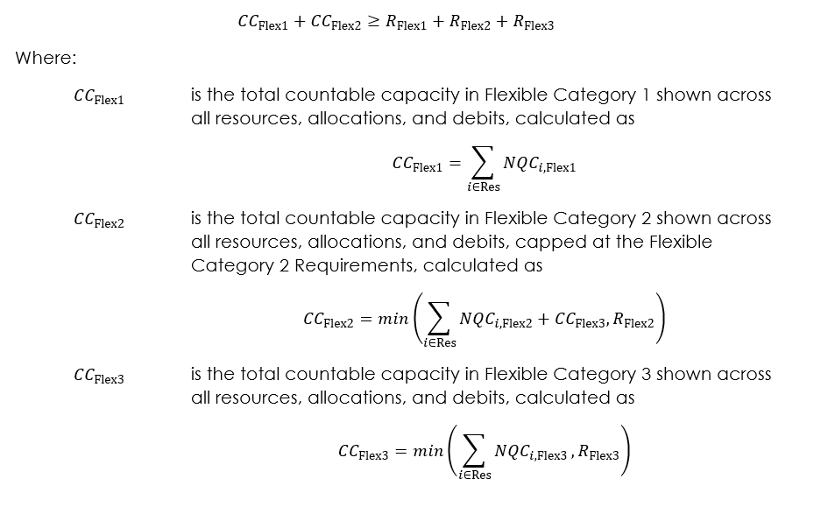
Flexible Compliance Logic
CPASC is seeking confirmation that the compliance logic used in the SOD Template is consistent with the framework used in the current RA program.
User Guide V32 Flexible Compliance Equation​

Slide 14
Unspecified Import Contracts
CPASC ask, Unspecified import RA contracts signed before SOD implementation likely tie delivery profiles to MCC buckets (a set number of hours within a window of time), as opposed to a specific set of hours. For such contracts to be compliant with SOD rules, do LSEs need to amend the delivery profile so that it lists a specific set of hours?
Appendix A of D. 23-04-010:
Non-resource-specific imports will count based on the contract value, subject to the requirement that resources be at least four hours in duration.
For import resources under the SOD framework, a non-resource-specific import will count towards the RA requirements, provided that:
    (a) The contract is an energy contract with no economic curtailment provisions.
    (b) The energy must self-schedule (or in the alternative, bid in at a level between negative $150/MWh and $0/MWh) into the CAISO day-ahead and real-time markets at least during the Availability Assessment Hours every Monday-Saturday excluding NERC holidays throughout the RA compliance month.
    (c) The energy must be delivered to the LSE in accordance with the governing contract.

Slide 15
Showing Collocated and Hybrid Resources
PG&E requests that the Energy Division provide more details about State of Charge requirements with regard to claiming co-located storage resources in the Slice of Day Showing template. There is no statutory language regarding batteries ability to charge from the Grid and be shown individually as part of a compliance showing. PG&E was unable to identify a requirement for Load Serving Entities (LSEs) to have contracts for both components of co-located resources (storage and solar) to be able to show the full NQC of a co-located storage resource.
AReM requests a walk-through example for how to model a collocated storage + solar resource in two cases: 1) an LSE has contracted for portions of both the storage and solar and 2) an LSE has only contracted for the storage? Additionally, please clarify if it's different for hybrid vs collocated.
AReM asks, how does the template account for collocated and hybrid storage resources with energy-only solar attached? Based on the last RA decision, energy-only charging capacity should be allocated based on charging capacity under contract, correct? Is this in the template automatically?

Slide 16
Showing Collocated and Hybrid Resources
Excerpt from Section 4.7.3 of D.24-06-004
"Paired storage resources will be characterized on the Master Resource Database (MRD) as either charging exclusively from paired resources or allowing grid charging. An energy-only (EO) resource is eligible to count towards the storage charging sufficiency requirement if the EO resource is charging exclusively paired storage, regardless of whether the paired storage is able to charge from the grid. The charging capacity of the renewable resource will be capped at the amount that can be used to charge the paired storage and the storage will be capped at the interconnection limit. Paired components will be shown as separate assets on the MRD and load-serving entities’ showings, and the total of the components must not exceed the interconnection amount in any hour."

Slide 17
Showing Collocated and Hybrid Resources
Excerpt from Section 4.7.3 of D.24-06-004
“SCE also seeks clarification as to whether the off-taker of co-located storage resources must have off-take rights for the EO resources to allow counting towards charging sufficiency of the storage in SOD filings, but SCE acknowledges that this issue requires further development. For early implementation, therefore, SCE proposes that starting in 2025, energy sufficiency from EO resources be prorated to all paired storage resources based on the NQC of the storage resources.
The Commission finds this to be reasonable as it allows the energy sufficiency benefit of the EO components to remain bundled with the storage components, while allowing for further discussion among stakeholders.
As such, beginning with the 2025 compliance year, and on an interim basis, energy sufficiency from EO resources will be prorated to all paired storage resources based on the NQC of the storage resources. For a more permanent solution, the issue of off-taking rights for EO resources should be considered in a later track of this proceeding."

Slide 18
Template Feedback
Feedback has been received and is being consider
Suggestion:
Round to 2 decimal places in Requirements and Allocations
Revert to manual calculations in Validation Tab is improve processing time
Documentation on Allocations and provide breakdown of CAM Bucket components
  e.g., total Other CAM Allocation = X CPE MW + Y Diablo MW + Z non-storage IOU CAM MW

Slide 19
Additional Comments or Questions?

Slide 20

Resource Adequacy Homepage

