Slide 1
Resource Adequacy 2026 Year-Ahead Load Forecast Process
CPUC Workshop on Slice of Day Implementation
Lynn Marshall
July 30, 2025

Slide 2
RA 2026 Load Forecast Process
Reference Forecast
Use of IEPR Forecast Tables
Development of CPUC Reference Forecast
2. Review of Forecast Adjustment Process
Submitted Forecast
LSE-Specific Adjustments
Transmission & UFE Losses
Coincidence Adjustment
Load Credits
LSE Type Pro-Rata
Pro-Rata Adjustment
Final Adjusted Forecast

Slide 3
Reference Forecast Development
The reference forecast is drawn from the 2025 IEPR Planning Scenario. The worst day framework of SOD means the forecast for the 24 hours on the day of the monthly CAISO system peak.
The forecast used is drawn from the Hourly Forecast Forms adopted in the 2024 Integrated Energy Policy Report proceeding:
CED 2024 Peak Forecast
The LSE and BAA Tables are not adopted or used for RA forecasts.
Form 1.1c, Electricity Deliveries to End Users by Agency, disaggregates the CEC energy forecast by sector to LSEs based on 2023 LSE sales, LSE sector mix, and known expansion plans.
Form 1.1c includes allocations of data center load to LSEs based on data available at that time, but in the RA 2026 forecasts, data center load was not specifically allocated to individual LSEs.

Slide 4
Reference Forecast Development
The SCE and PGE TAC areas must be disaggregated by jurisdiction type:
CEC receives historical hourly loads and year-ahead RA forecasts from all LSEs in CAISO. The POU load forecast estimate is based on analysis of aggregate POU loads on past system peak days, adjusting for expected POU load growth.
The non-pumping POU load share of CAISO hourly loads is estimated from 2022-2024 system peak days.
CEC forecasts POU pumping load separately in its hourly forecast.
CPUC load=(TAC forecast-CEC forecast of pumping)*(1-POU share of CAISO load excluding pumping)
CPUC-authorized adjustments for the CPUC-jurisdictional reference forecast are applied:
IFOM storage temporarily credited to load
CPP load impacts provided by CPUC

Slide 5
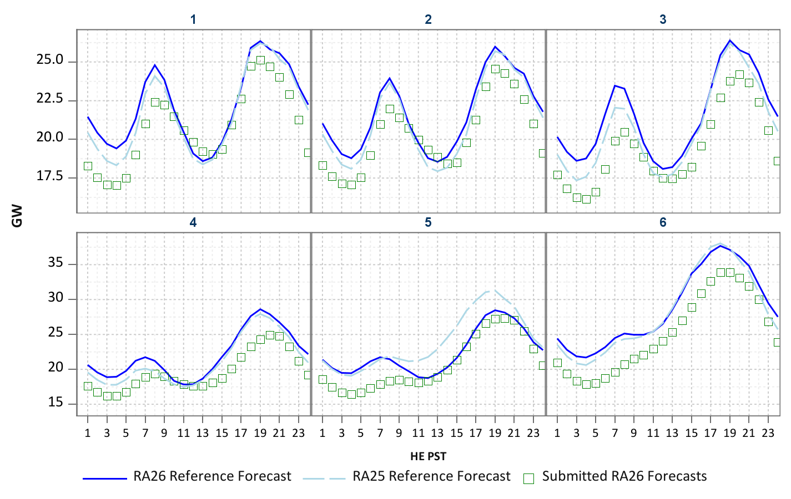
Submitted versus Reference Forecast Jan.-June 2026

Slide 6
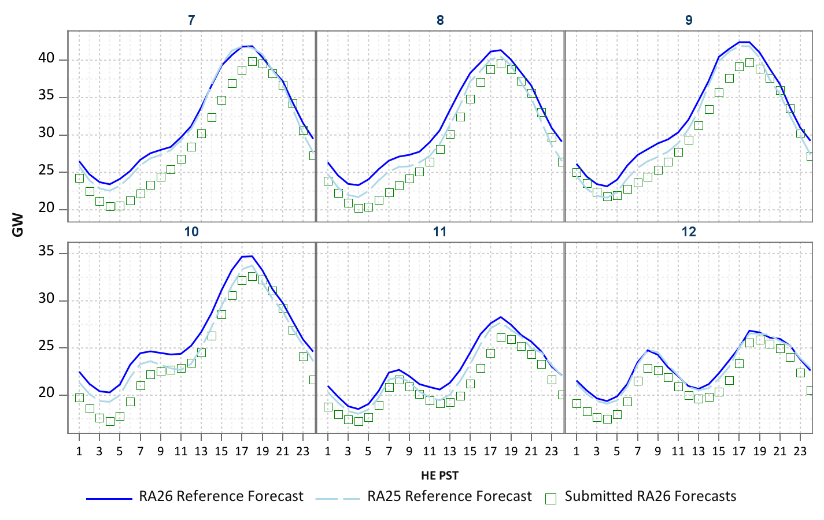
Submitted versus Reference Forecast July-Dec. 2026

Slide 7
LSE-Specific Adjustments
The LSE-Specific adjustment column in the LSE forecast tables may include up to 3 elements:
Load modifier adjustments
Adjustments to mpeak and energy
Hour-specific adjustments
1. Load Modifier Adjustments:
The RA 2026 forecast instructions included explanation of allowable load modifiers:
Load modification must be daily, consistent, predictable and verifiable.
Programs that trigger load only during predetermined system conditions and/or are integrated into the CAISO market and are therefore eligible for RA valuation should not be included in the demand forecast.
The expanded dynamic pricing pilots are funded by distribution rates for the benefit of all LSEs, so allocation of load impacts to individual LSEs would conflict with CPUC D.24-01-032.
If included programs do not meet these criteria, they were removed from the forecast.
Other forecast assumptions and forecast results are reviewed for reasonableness and overall consistency with IEPR forecast.

Slide 8
2. Adjustments to Monthly Peak and Energy
The submitted monthly peak and energy forecast is compared to a CEC benchmark:
CEC estimates a noncoincident monthly peak demand and peak-day energy benchmark for each LSE to evaluate need for LSE-specific adjustments.
Median peak-to-energy ratio and peak day energy is calculated from top 5 noncoincident peak days.
CCA summer months are based on weather normalized peak estimates using last 3 years load data and local weather stations.
ESP’s energy and peak are estimated based on the most recent DASR reports (April 2025)
Noncoincident monthly peak day peak-to-energy ratios are calculated from recorded load data and applied to the latest reported DASR annual sales
CEC also considers specific information provided on expected customer load migration.
Default adjustment to the LSE forecast is to within 5% of the estimated benchmark.
A curve-fitting formula is applied to fit LSE’s submitted load shape to the target noncoincident monthly peak and energy:
a=(Target Peak-Target MWH/24)/(Form1Peak-Form1 MWH/24) ;
b=(Target MWh /24*Form1_Peak-TargetPeak*Form1 MWH/24)/(Form1Peak-Form1 MWH/24)
Transformed Hourly MW=a*Submitted Hourly MW + b ;
.

Slide 9
3. Hour-Specific Adjustments
Additional hourly adjustments were calculated by comparing the adjusted forecast to estimated LSE load profiles on high load days.
Recorded hourly loads on the LSE’s high load days were normalized to the adjusted peak and energy from the previous step.
Profiles were calculated using 2022-2024 loads, adjusted for load migration.
This hourly profile is compared to the LSE’s transformed hourly profile from Step 1.
If the Step1 hourly forecast deviates from the benchmark by more than 5% in a given hour, a default adjustment of 5% is calculated and flagged for review.
IOU Hourly Adjustments :
IOU service areas forecasts are compared to CPUC reference forecast.
The benchmark for IOUs is the estimate bundled share of the jurisdiction reference forecast.
CEC estimated the bundled share of load from historic data for comparison to IOU’s forecast of bundled share.

Slide 10
Transmission & UFE Losses
Transmission loss factors were decided in a past RA decision to be 2.5%
PG&E is also adjusted by .5% for unaccounted for energy.
For SOD, transmission losses were added during the CAISO-defined Availability Assessment Hours for 2025:

Slide 11
Coincidence Adjustment
First an estimate of total monthly coincidence is calculated as in the past. This is a measure of total diversity within a month and is not hour-specific:
Total Coincidence Factor (CF) =LSE load during high system load hours/LSE monthly peak.
Default statistic =Median CF during top 3 system peak days in each month.
Submitted forecasts already include within-day coincidence, but not across-month.
Embedded coincidence = forecast at system peak hour/monthly peak forecast
Residual CF=Total CF – coincidence embedded in LSE forecast, including LSE-specific adjustments.
If this value is negative, indicates need for further LSE-specific adjustments.
Hourly coincidence factor =
Minimum(1,1+Total CF – embedded CF in adjusted LSE forecast )
This is applied to the sum of the submitted forecast, LSE-specific adjustments, and losses.

Slide 12
Load Credits
Load credits are designated by CPUC decisions and include:
LSE load ratio share of incremental PGC funded program impacts in the CEC forecast, net of impacts included in LSE’s submitted forecast.
Credit for SCE IFOM storage discharge in non-summer months; credit is negative in off-peak hours to account for charging.
Eligible LMDR approved by CPUC. (CPP)

Slide 13
LSE Type Pro-Rata
After applying the LSE-specific and coincidence adjustments, significant differences between adjusted load and the reference forecast remained, both positive and negative, most notably (but not only) during solar production hours.
In different hours/seasons, the shortfall is driven by different sectors or LSE groups.
Applying the resulting pro-rata adjustments would in many cases produce inappropriate load shapes for LSEs.
ESPs would frequently be given an atypical shape.
Total direct access forecasts sometimes would exceed the cap on DA load.

Slide 14
LSE Type Reference Forecast
Staff constructed separate reference forecasts for Direct Access and non-Direct Access load and implemented an intermediate pro-rata step to within 5% of the LSE Type reference forecast.
DA reference is estimated using aggregated ESP loads, 2022 – 2024 to calculate a system peak day load profile.
Load profiles are normalized to current level of aggregate DA loads.
The IOU/CCA reference is the CPUC reference forecast minus the DA Reference.

Slide 15
April – June LSE Type Reference Forecasts (All TACs)
IOU/CCA hourly load forecasts influenced heavily by assumptions about BTM PV forecast assumptions and weather-sensitive load.
Complete reference forecasts by TAC are included in the RA Forecast Summary tables on the RA compliance page.

Slide 16
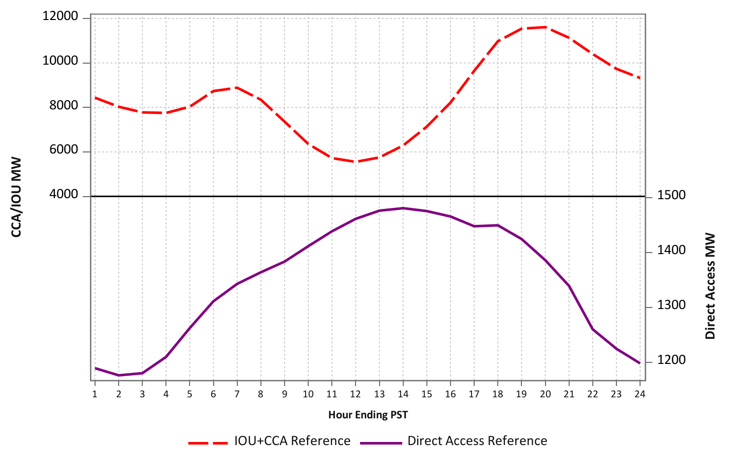
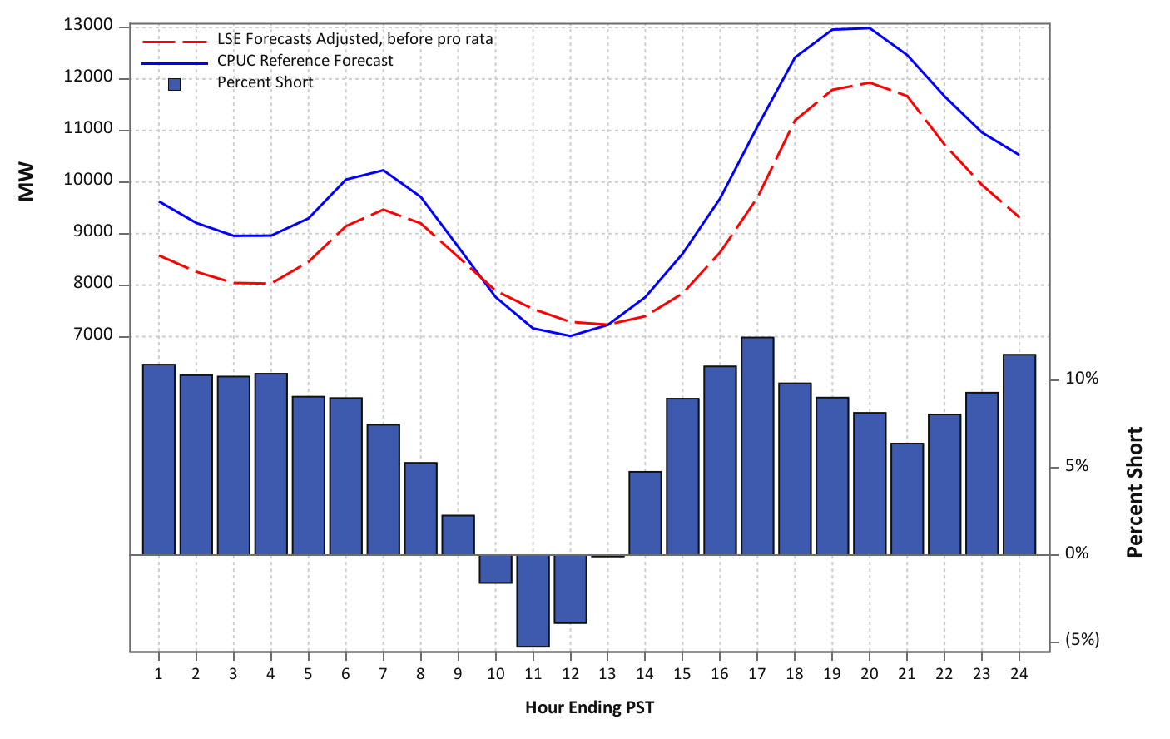
Example: April PG&E without Type Pro-Rata Step
Under the one-step pro rata method, all LSEs would have a negative adjustments in hours 10-12, and as much as 10%-plus increase other hours.
ESP loads would be reduced mid-day but aggregate ESP loads could exceed the DA cap in afternoon hours.
\.

Slide 17
LSE Type Pro – Rata Percents April PGE Example
But aggregate ESP forecasts are actually below the DA reference forecast in mid day hours, so with the LSE Type Pro-Rata step, ESP forecasts are adjusted up mid-day while CCA & IOUs are adjusted down.
Applying the LSE type pro-rata step better allocates shortfalls to the appropriate group
The final pro-rata adjustments are reduced to about 5% for all LSEs.

Slide 18
Final Pro-Rata
Final step is pro-rata to within 1% of 2024 IEPR Planning Scenario 1-in-2 hourly forecast for the day of the monthly system peak day, by TAC.

Slide 19
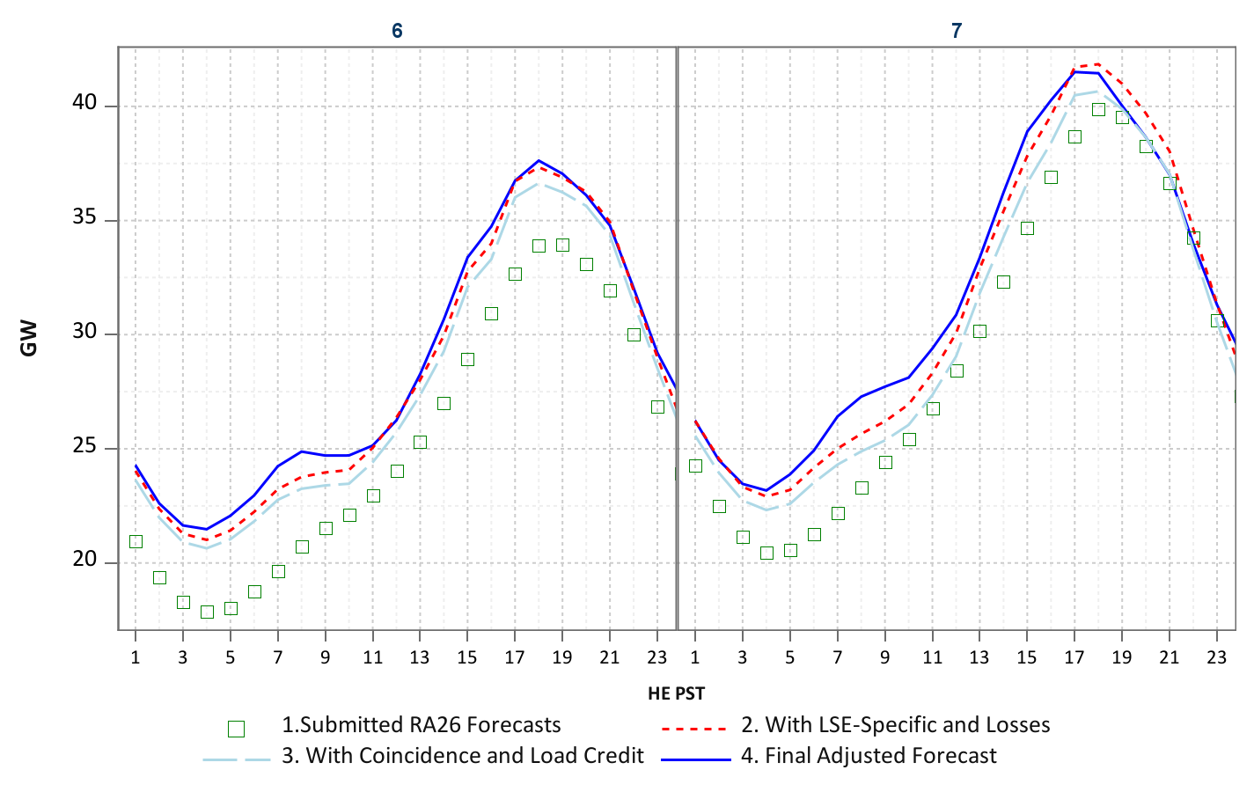
Aggregate Adjusted Forecasts by Step June and July

Slide 20
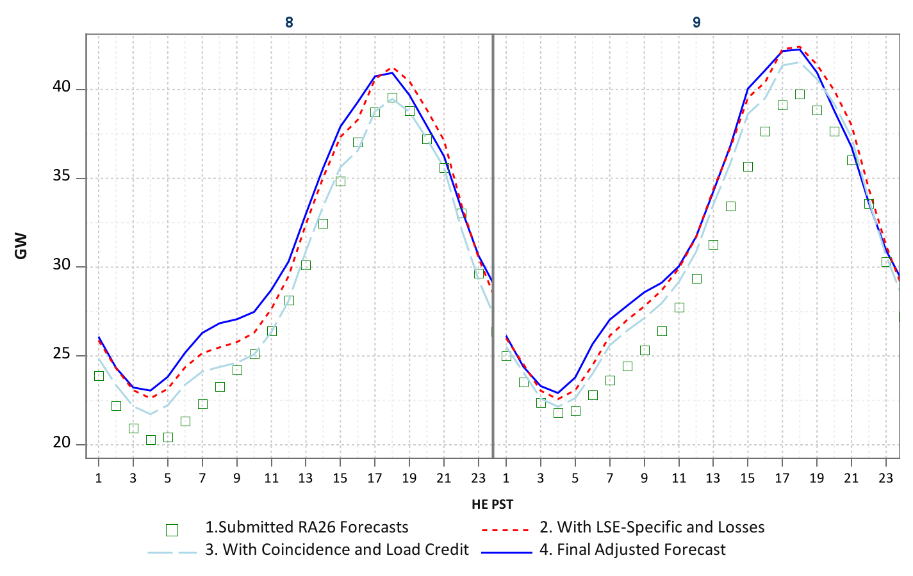
Aggregate Adjusted Forecasts by Step August and September

Slide 21
Conclusion
CEC will distribute final forecast to LSEs in early September:
Final hourly and monthly coincident peak forecasts
Month Ahead Load Migration template
Summary tables are posted on CPUC RA Compliance website.
Please contact CEC staff if you would like to discuss specifics of your forecast or did not receive your forecast report:
rafiling@energy.ca.gov
Questions?

Slide 22
Thank You!

