Slide 1
Slice-of-Day Implementation Workshop
Energy Division
July 30, 2025

Slide 2
Agenda
CEC 2026 RA Slice of Day Load Forecast Process
SOD Implementation Updates, from D.24-12-003 and D.25-06-048
Q3 Off Peak Imports
CPE Modifications
2-Hour Battery Showings in SOD Template
Hybrid NQC Counting Changes
Year-Ahead Local, Flex RA, and CPE Reporting Template Update
Stakeholder Questions and Discussion

Slide 3


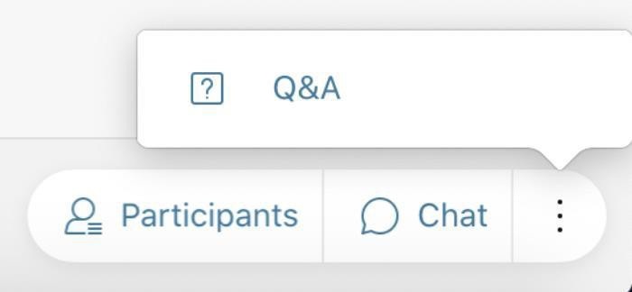

Logistics
All attendees have been muted.
To ask questions, please "raise your hand"
can ask your question.
and a moderator/presenter will unmute you so you
If you would rather type, use the Q + A function and send to "all panelists". Q + A questions will be read aloud by moderators/presenters; attendees may be unmuted to respond to the answer verbally.
*Reminder: Please press mute when done speaking
Please silence and remove all AI-generated conversations and notifications to avoid cluttering the
chat and Q & A forums
Use chat only for webinar logistics questions and not substantive comments or questions.
Q + A: on the bottom right of
Mute/ Unmute
Participant List Chat Audio Options
screen, click "3 dots"
California Public Utilities Commission
1

Slide 4
CEC 2026 RA Slice of Day Load Forecast

Slide 5
SOD Implementation Updates

Slide 6
Off-Peak Imports
D.25-06-048 extends the off-peak import counting rule adopted in D.24-06-004, which allows LSEs to count off-peak imports towards RA requirements, to apply to Q3 of 2025 and Q3 of 2026.
LSEs may count off-peak import energy that is not available during the AAH window towards meeting its RA requirements, regardless of whether the import is paired with the on-peak import on a specific branch group, so long as the off-peak import energy adheres to the other existing import requirements and provides ED with proof demonstrating:
The availability of import allocation rights, and
If there is an associated on-peak import on the branch group, to avoid over and under accounting of import allocation right availability.

Slide 7
Load Migration Update
D.25-06-048 modifies the mid-year load migration update timeline to align with the mid-year revised allocation timeline. The mid-February load migration update would cover June to December load migration rather than May to December load migration.

Slide 8
CPE Modifications
Elimination of Voluntary Self-Show Option
OP 3 of D.24-12-003 eliminates the option for Load Serving Entities (LSEs) to voluntarily self-show (for no compensation) their capacity under contract with the local CPEs.
Instead, OP 4 authorizes Energy Division to issue a data request collecting LSEs’ information on their local RA capacity contracts. Once collected, the Energy Division will aggregate, anonymize, and provide this information to CPEs to inform their annual solicitation and procurement processes.
OP 15 of D.25-06-048 incorporates the reporting requirements into the annual RA compliance filings due October 31. The data request is incorporated in the Local, Flexible RA, and CPE Data Reporting Template.

Slide 9
CPE Allocations
2027 Compliance Year Allocations Locked In
OP 5 of D.24-12-003 locks in 2027 compliance year allocations a year in advance (2025) so that LSEs can have earlier certainty on their requirements and more time to conduct their own procurements.
The CPE procurement process is as follows:
Local CPE procurement conducted by October 31, 2025, for compliance year 2027 will be considered “locked”. In 2026, the CPEs will no longer procure local requirements for compliance year 2027, as allocated in 2025.
In 2026, the CPEs will only procure for the incremental changes between what was provided in 2025 and the CAISO’s updated Local Capacity Technical study for compliance year 2027. Any incremental procurement conducted by the CPE will be allocated to the LSEs in accordance with the annual CPE and LSE allocation timelines in August and mid-September.

Slide 10
2-Hour Battery Showings in SOD Template
According to the Appendix of D.23-04-010
"Energy storage resources will be assigned value based on Pmax, restricted to daily
resource capabilities (e.g., maximum daily run hours, maximum continuous energy, and
storage efficiency). Excess capacity must be shown to cover battery capacity with
efficiency losses" (emphasis added).
NQC Calculation
NQC for a 2-hour resource is max continuous energy (MWh) divided by 4.
E.g., SANBRN_2_ESABT1 is 100 MW resource with 200 max continuous MWh. The NQC is therefore 50 MW
This calculation is performed by the CAISO
SOD Template
In the SOD template, the resource is permitted to discharge up to Pmax until it has discharged 100% of its MWh
E.g., SANBRN_2_ESABT1 may discharge 100 MWh for 2 hours

Slide 11
Hybrid NQC Counting Updates
In the 2026 Compliance Year, default NQC for hybrid components will be similar to co-located resources, as the NQC haircut will come fully from paired VERs.
2025 Counting Methods
When the additive NQC of hybrid components exceeds Point of Interconnection (POI), the NQC was pro-rated by component size at peak hour, with default haircut given to both components in high solar QC months like July
2026 Adjustment
Default haircut is given to VER, like co-located resources
For all non-EO hybrid components, 0.1 is the minimum QC given
In Both Cases
Parties could/can request changes and must provide contractual evidence
These default NQC valuations do not affect hourly values in the showing tool.
Rationale
Less reactive to peak hour changes
Counting methodology is simpler
Party feedback
Coordination with CAISO
Treats paired resources more consistently

Slide 12
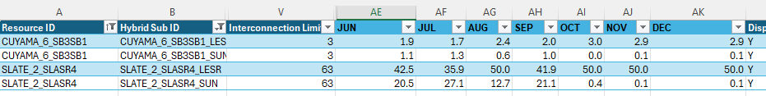
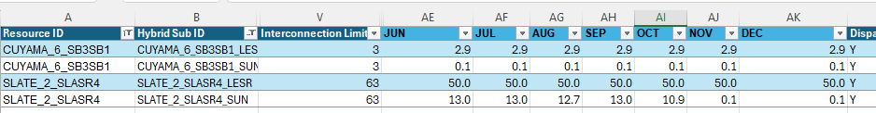
Hybrid Example
2025 MRD Proration
Summer months (besides August due to later peak hours) have proration based on addition of solar NQC and storage NQC
2026 MRD Flat Haircut
The difference between the storage component and the POI is the max NQC for the VER
For resources where the POI = storage max NQC, VER NQC = 0.1

Slide 13
Year-Ahead RA Filing Templates

Slide 14
2026 YA Filings: SOD System, Local, and Flexible
Similar to 2025 YA Showings, two separate filing templates are required for 2026 Year-Ahead Compliance:
System YA Showing
Use the SOD Showing Tool
All LSEs are required to make a System YA Showing using the SOD Showing Tool for May - September
Local and Flexible YA Showing; CPE Data Collection
Use the Local, Flexible RA and CPE Data Reporting Template
All LSEs are required to demonstrate compliance with the Flexible RAR for all 12 months of 2026
LSEs in SDG&E’s TAC are required to demonstrate Local RAR for all 12 months of 2026, 2027, and 2028
LSEs in the PG&E and SCE TAC complete the CPE Data Collection worksheet. All LSEs use CPE Data Collection tab to list RA resources not shown on supply plan.

Slide 15
YA Local, Flex RA and CPE Data Reporting Template
Draft 2026 Year-Ahead Local, Flex RA and CPE Data Reporting Template distributed 7/28/25, this is an update to the Local/Flex RA Template used for 2025 year-ahead filings
Consolidated Showing and Compliance tabs
Added tab for CPE Data Collection
LSE Allocations worksheet and process for adding requirements & allocations to the Template are unchanged
Summary of changes:
Consolidated compliance Summary tabs; one tab each for multi-year Local and year-ahead Flex
Consolidated multi-year Local Resources showing tabs
Added CPE Data Collection tab
Removed Additional Local Resources tab; included field in CPE Data Collection tab to collect information on additional local resources
Removed fields (T&D Loss Factors, LSE Contract with RMR unit, Scheduling Coordinator for Self-Show, Third Party DR, Name of Attestation File, Justification Requirement D.22-03-034)

Slide 16
Local, Flex RA and CPE Data Reporting Template Demo
Instructions for completing the Template are included on the Instructions tab, as well as in the 2026 RA Filing Guide
Only LSEs with Local RAR in San Diego-IV complete Local Resources tab
All LSEs complete Flexible Resources tab
All LSEs use CPE Data Collection tab to list local RA resources not shown on supply plan (Committed RA Capacity column; select "No")
LSEs serving load in PG&E or SCE TAC complete CPE Data Collection tab pursuant to D.24-12-003
Local Compliance Summary and Flexible Compliance Summary compare LSE requirements to resource showings; LSEs do not need to enter information on these tabs
Template Walkthrough by Energy Division Staff

Slide 17
Upcoming 2026 RA Compliance Dates
Aug 4, 2025 | Comments and requests for modifications on 2026 NQC List due to CAISO
Aug 11, 2025 | Informal Comments on Draft 2026 RA Compliance Materials Due
Aug 11, 2025 | Final date to file revised load forecasts for 2026
Aug 19, 2025 | CPEs make local showing for 2026, 2027, and 2028 for PG&E and SCE Local Areas.
Aug 29, 2025 | LSEs receive updated CPE CAM allocations
Sept 19, 2025 | CPE Annual Compliance Report filed by PG&E-CPE + SCE-CPE
Sept 22, 2025 | LSEs receive revised 2026 RA Requirements and Allocations
Oct 31, 2025 | 2026 YA Filings Due. LSEs in the SDG&E TAC make system, flexible, and three-year local RA showing; LSEs in PG&E and SCE TACs make year-ahead system and flexible showings

Slide 18
Additional Comments or Questions?

Slide 19

Resource Adequacy Homepage

