Slide 1
Customer Data Access Interconnection Discussion Forum March 10, 2020

Slide 2
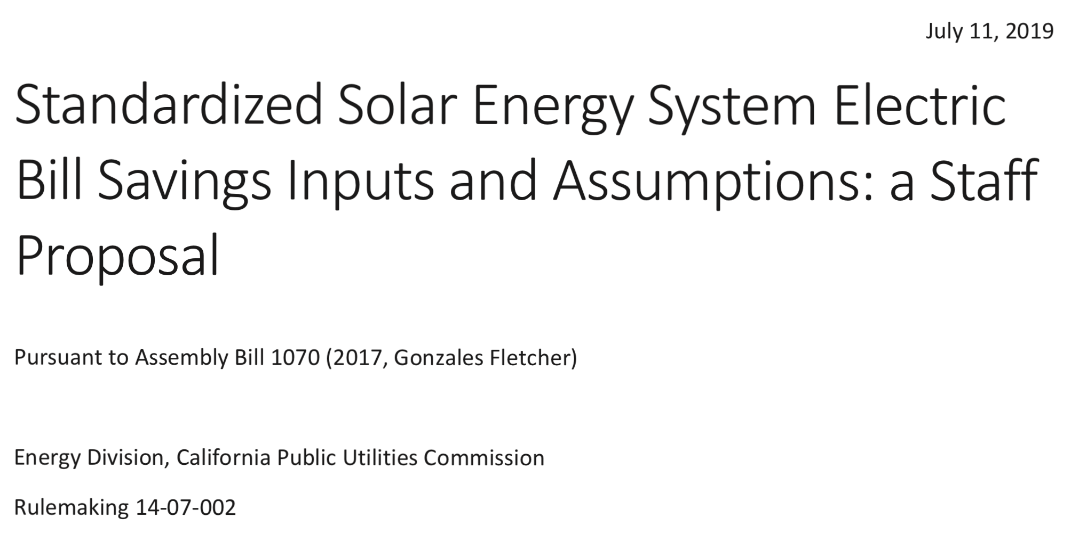
Customer Data Access
CPUC staff has proposed to require all solar providers to use interval data in savings estimates
CALSSA supports this requirement, but only if a more reasonable data access option becomes available

Slide 3
Customer Data Access
Three options for third parties to obtain data:
Build an API for ongoing data acquisition
Get the customer to download and send
Send an email and wait 2-4 weeks
There should be an option for a one-time download after obtaining customer authorization

Slide 4
Data Access Problems
Building an API is a high barrier of entry and is unnecessary outside of demand response programs
Many customers do not have sufficient computer skills to access their own data
A four week delay in sending data by email is not acceptable customer service
SCE representatives frequently refuse to provide data even when customer has given authorization
Web portals are often out of service
Downloaded data is often full of errors
Call center employees do not understand the rules or process
Metatags on .xml files change frequently. Available time periods are not consistent.

Slide 5
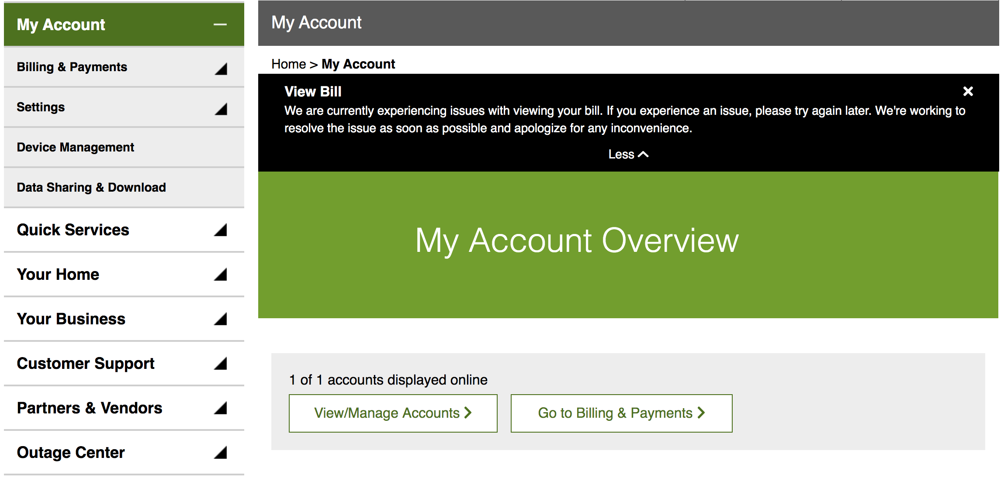
SCE Data Not Available

Slide 6
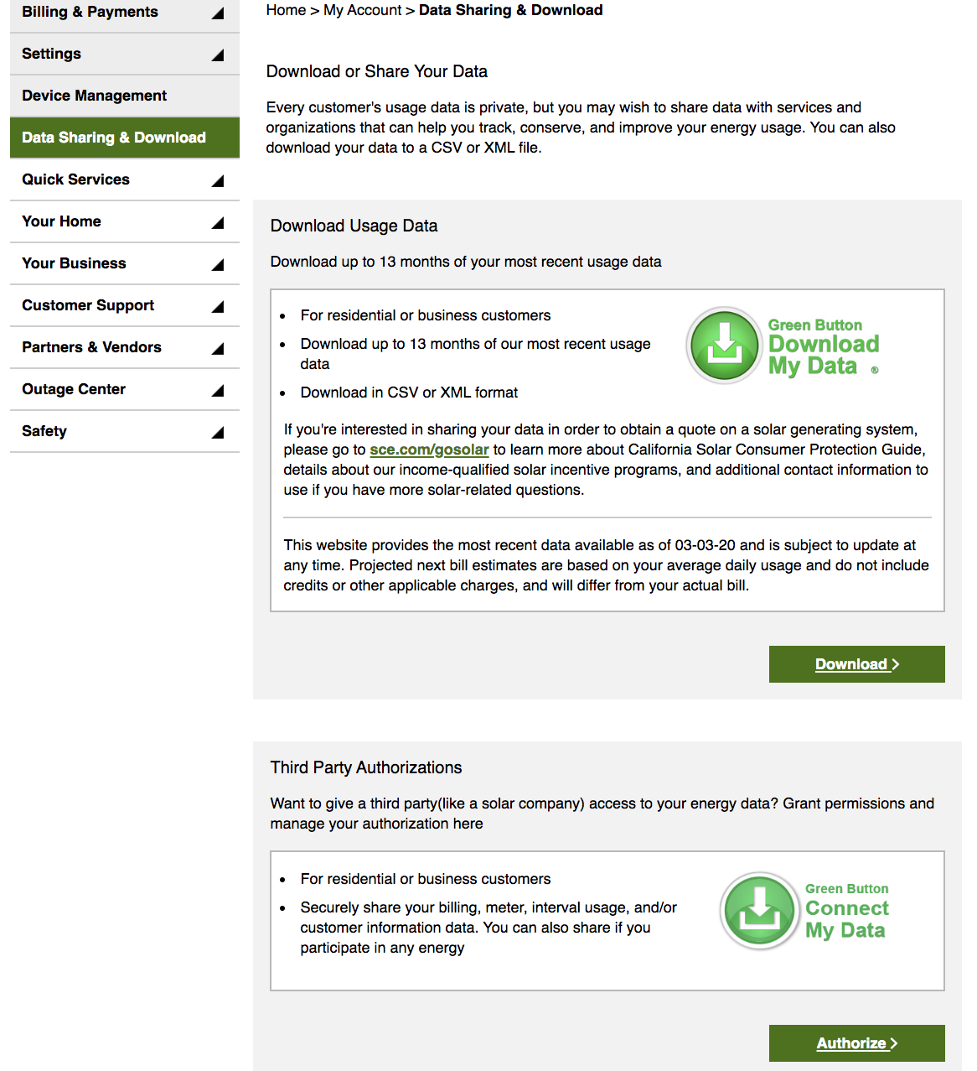
SCE Website Data Access Options

Slide 7
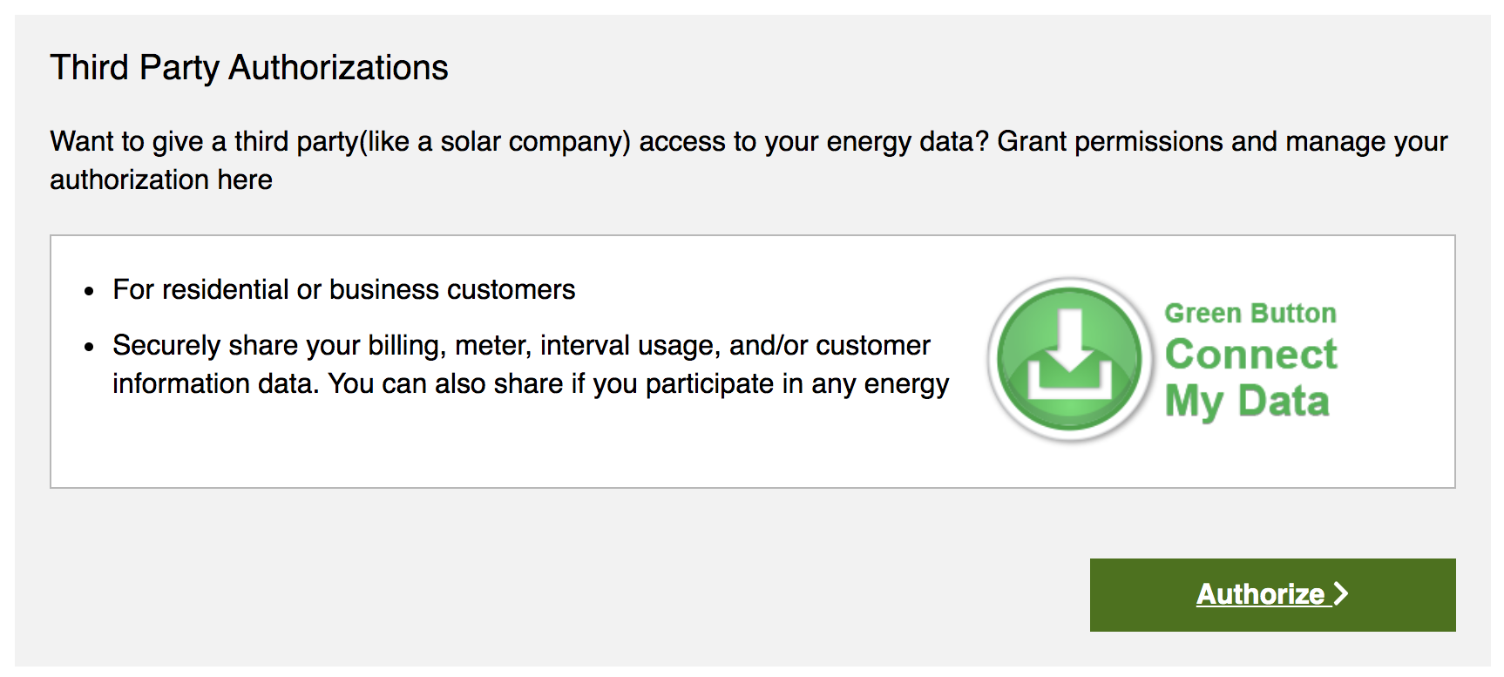
SCE Website Data Access Options

Slide 8
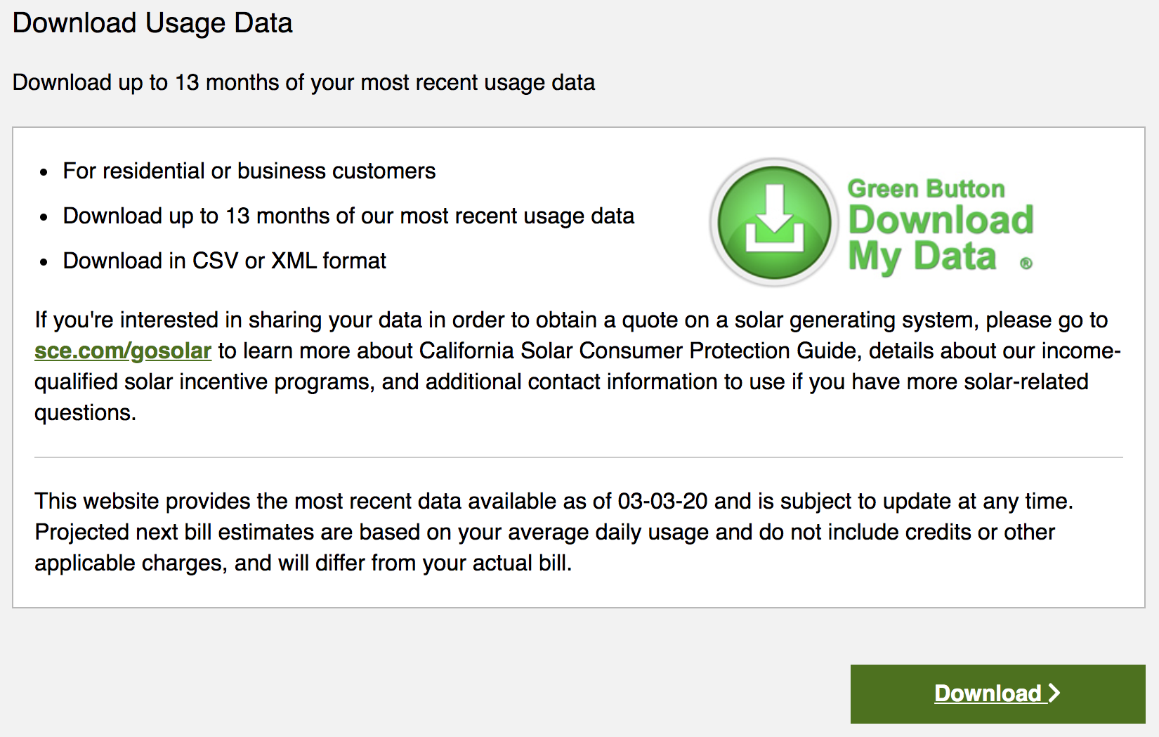
SCE Website Data Access Options

Slide 9
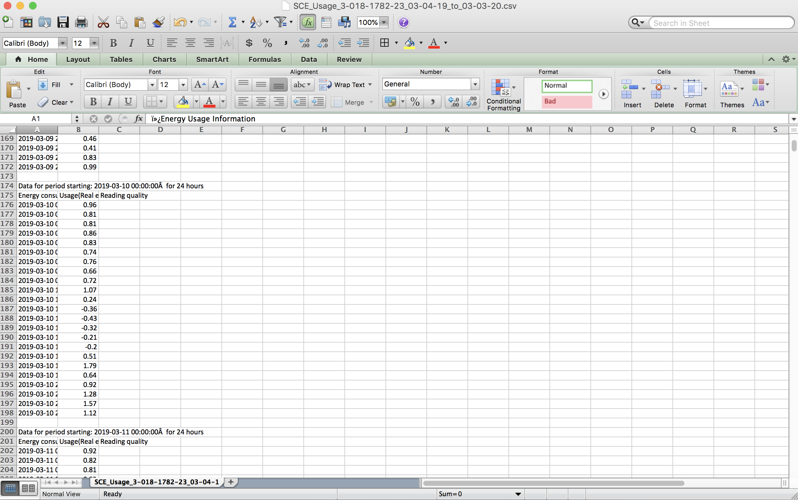
SCE Data Format

Slide 10
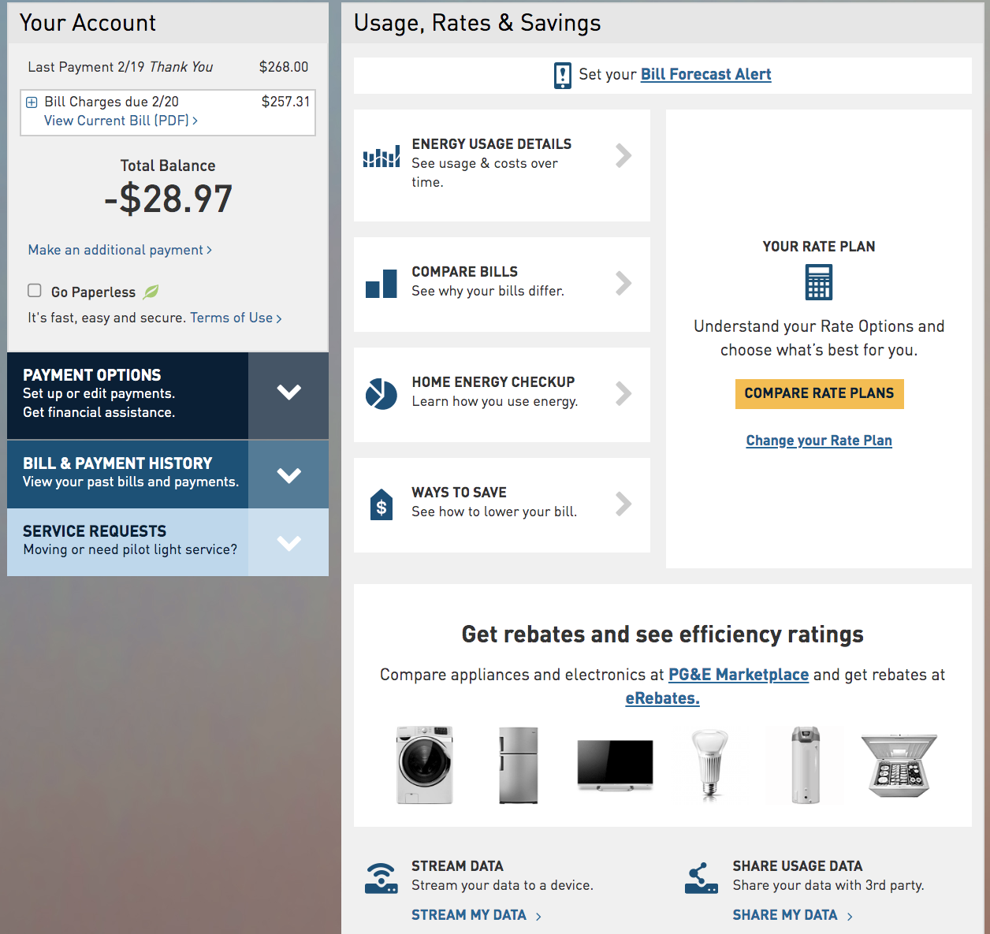
PG&E Website Data Access Options

Slide 11
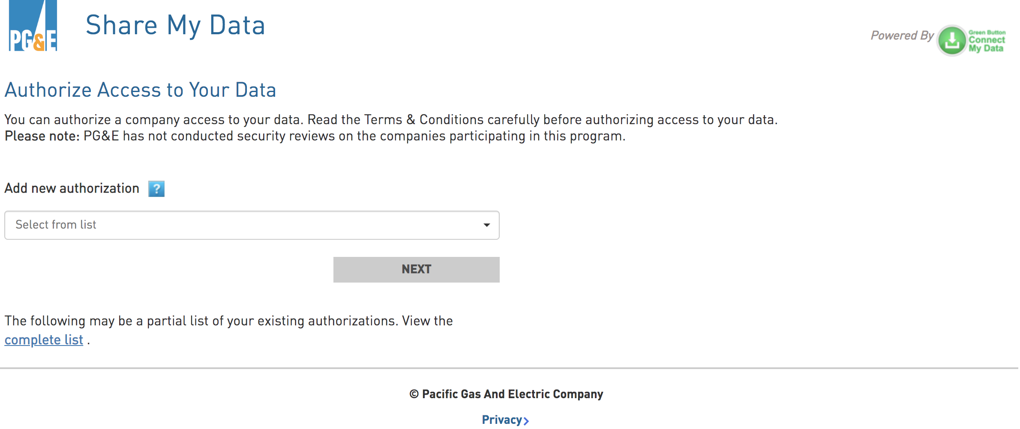
PG&E Website Data Access Options

Slide 12
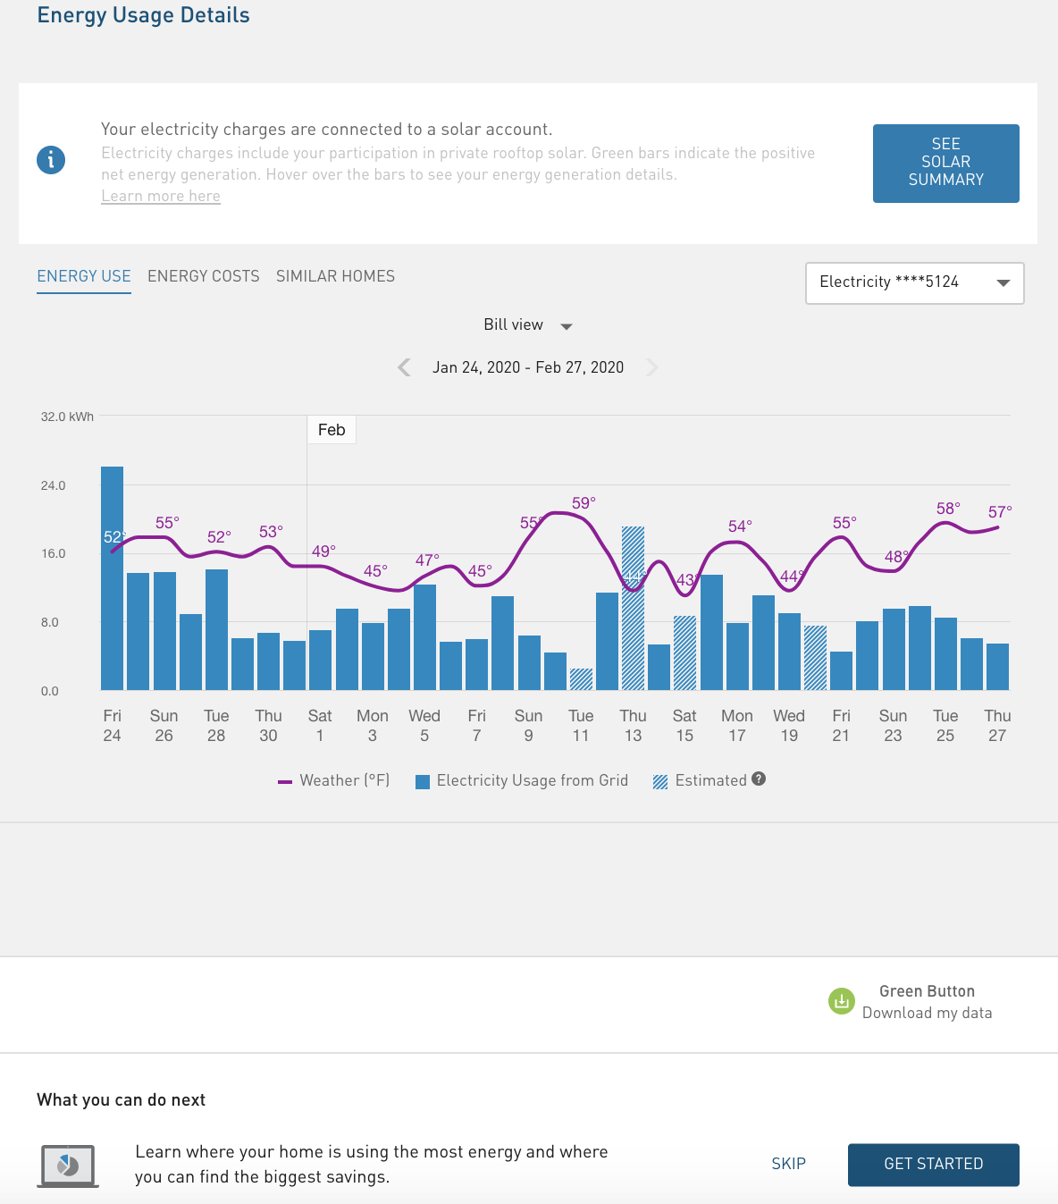
PG&E Website Data Access Options

Slide 13
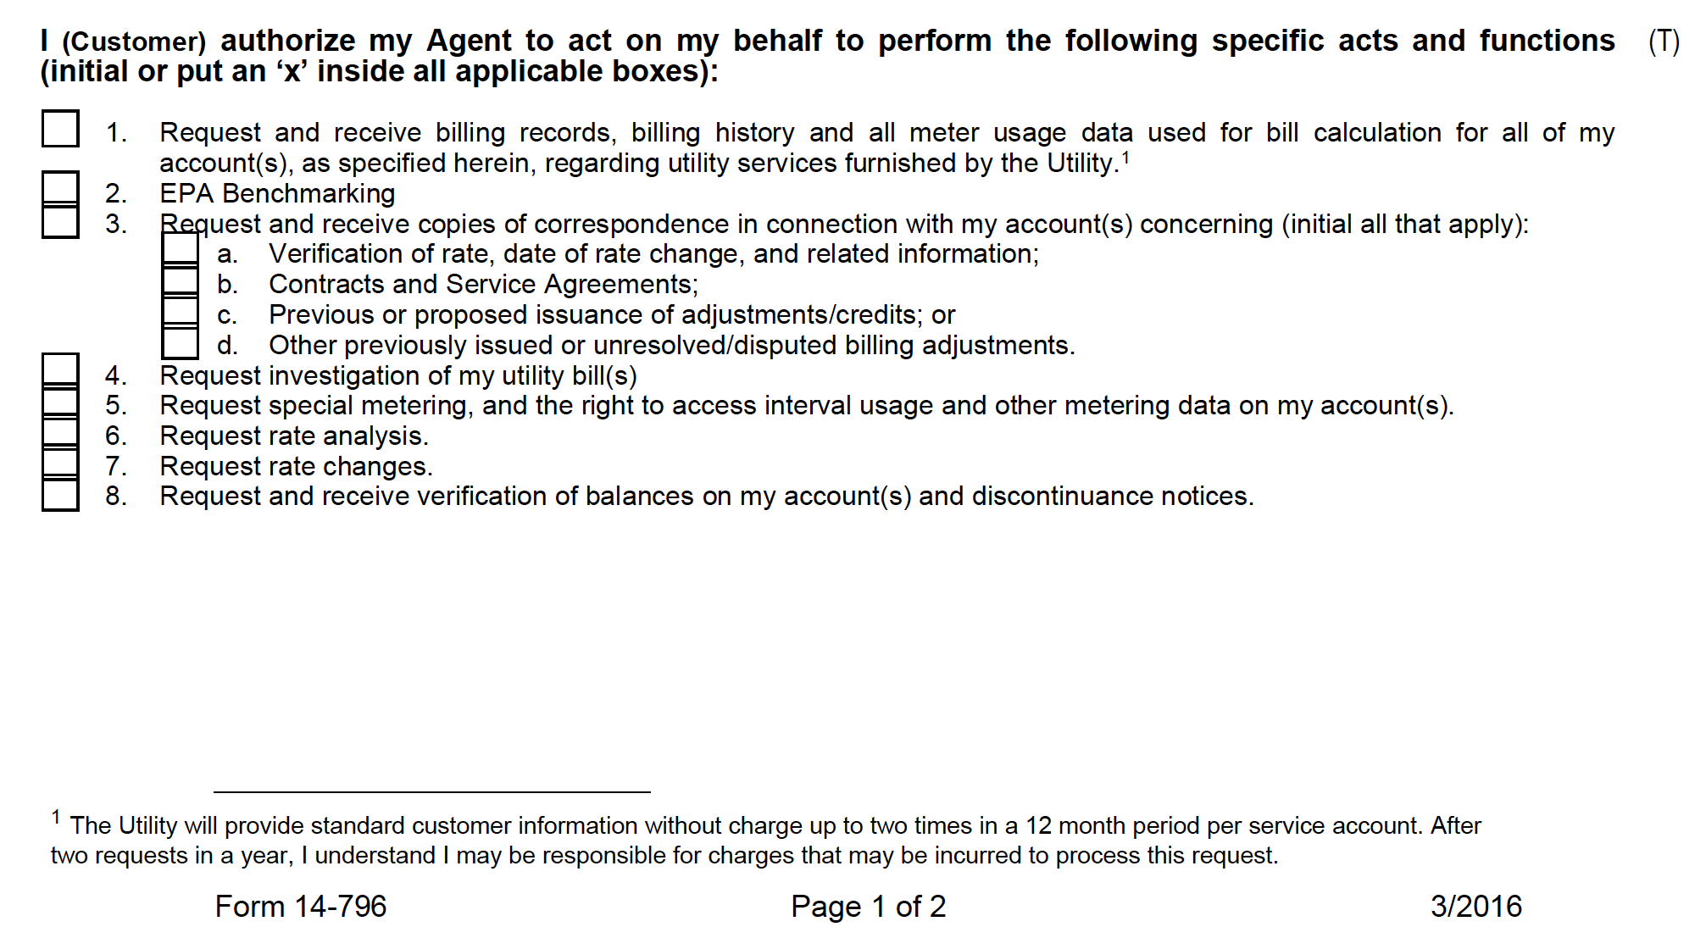
Customer Information Service Request (CISR) - Charge for Data

Slide 14
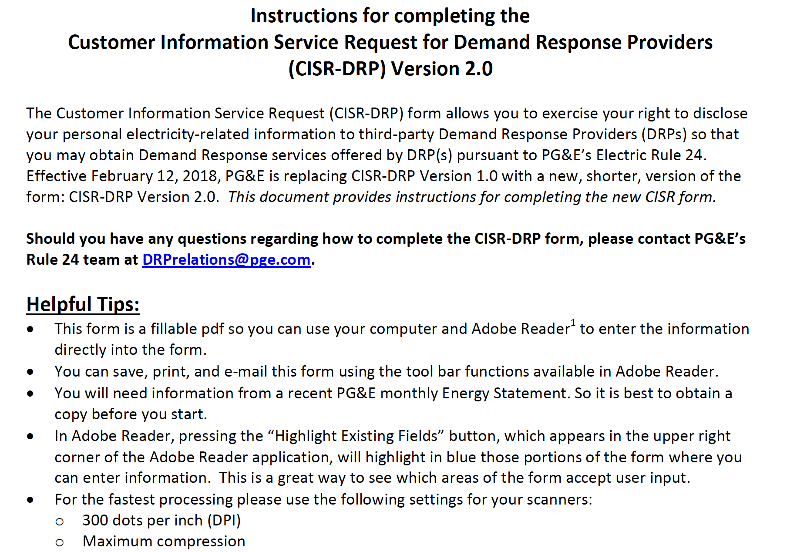
PG&E CISR Form Is Specific to Demand Response Providers

Slide 15
Primary Recommendation
Allow third parties to use “Download My Data” or equivalent function if they receive customer authorization
Utilities should recognize they could have one thousand authorized vendors if using interval data is required for solar providers

Slide 16
Future IDF Topics
Telemetry
Power control systems
Dispute escalation pathway
Lists of approved devices
Rate selection for SGIP eligibility

Slide 17
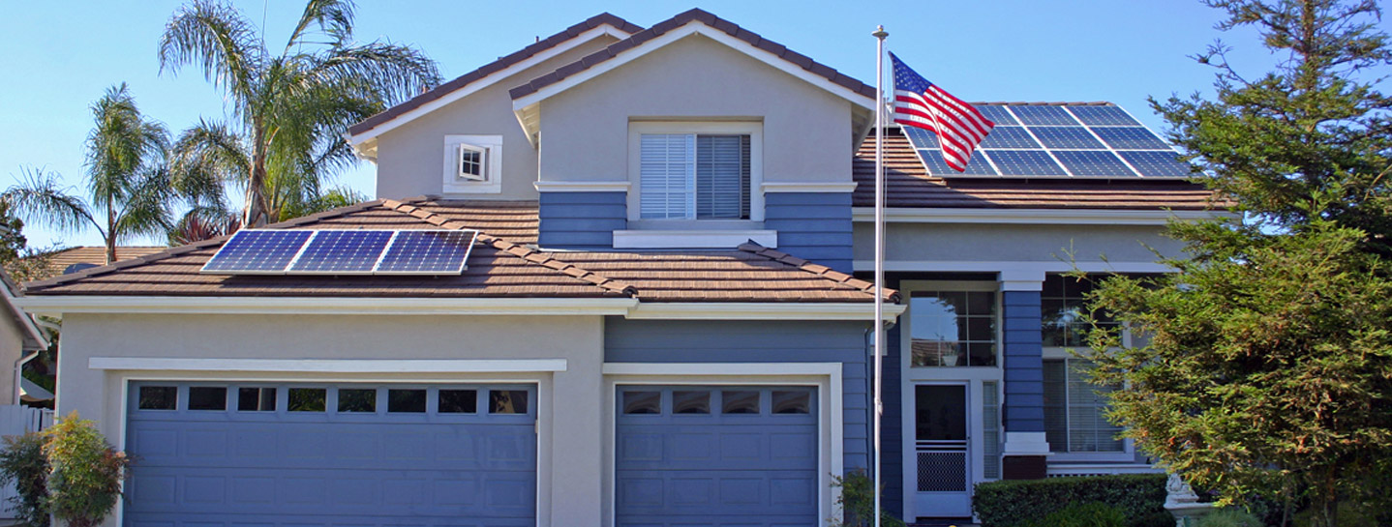
Thank You!
Brad Heavner
Policy Director
California Solar & Storage Association
brad@calssa.org

