Slide 1
Service Planning Requests Interconnection Discussion Forum June 24, 2020

Slide 2
A. Submit Requests to Service Planning
Service planning delays are a significant cause of customer frustration
Routing service planning requests through the interconnection review team cases delay

Slide 3
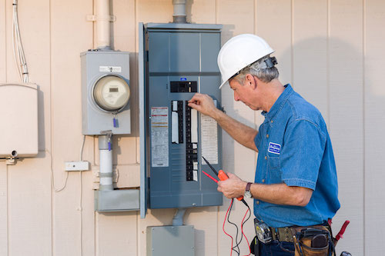
A. Types of Work to Request Directly
Main panel upgrades
Line side taps
Exploratory shutdowns
Interconnection shutdowns

Slide 4
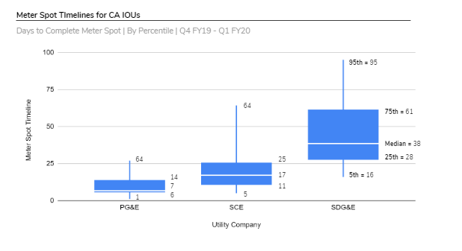
A. IOU Timelines
PG&E previously allowed customers to make service planning requests directly to a central service planning entity. Under that process, they provided the best customer service.

Slide 5
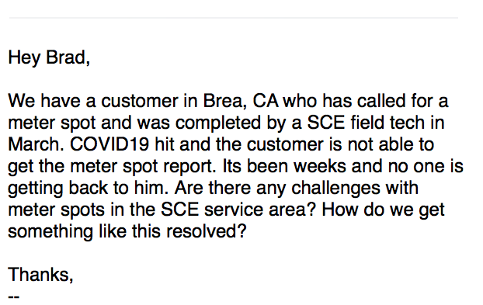
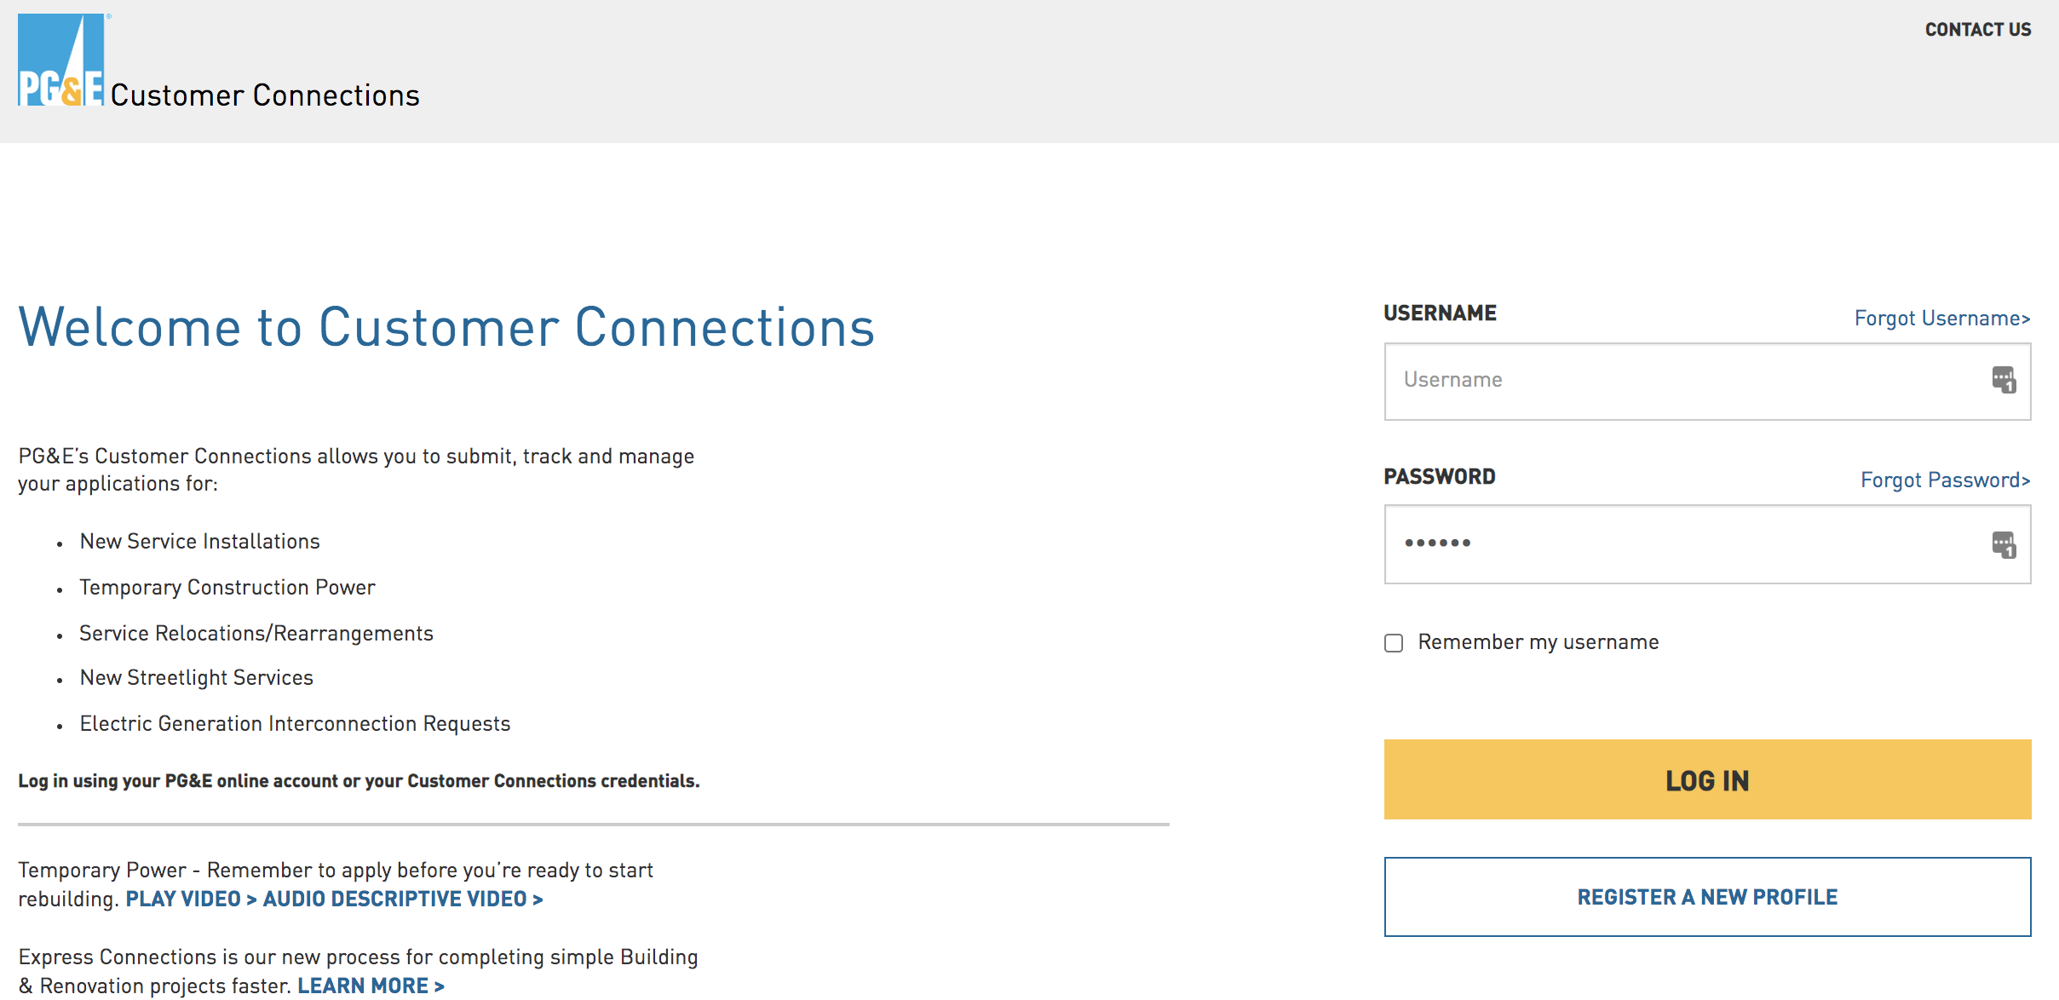
B. Standardized Request Process
Service planning requests should be managed centrally
Use one portal or phone number for the service territory

Slide 6
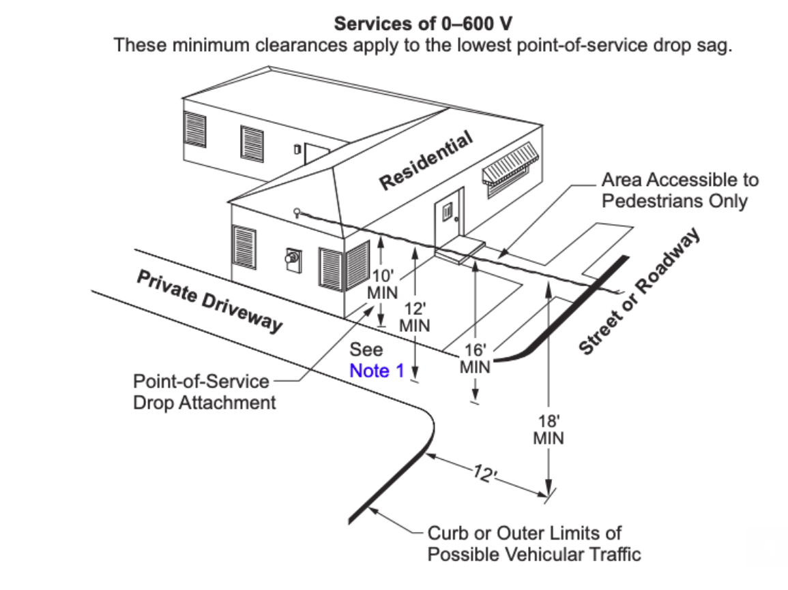
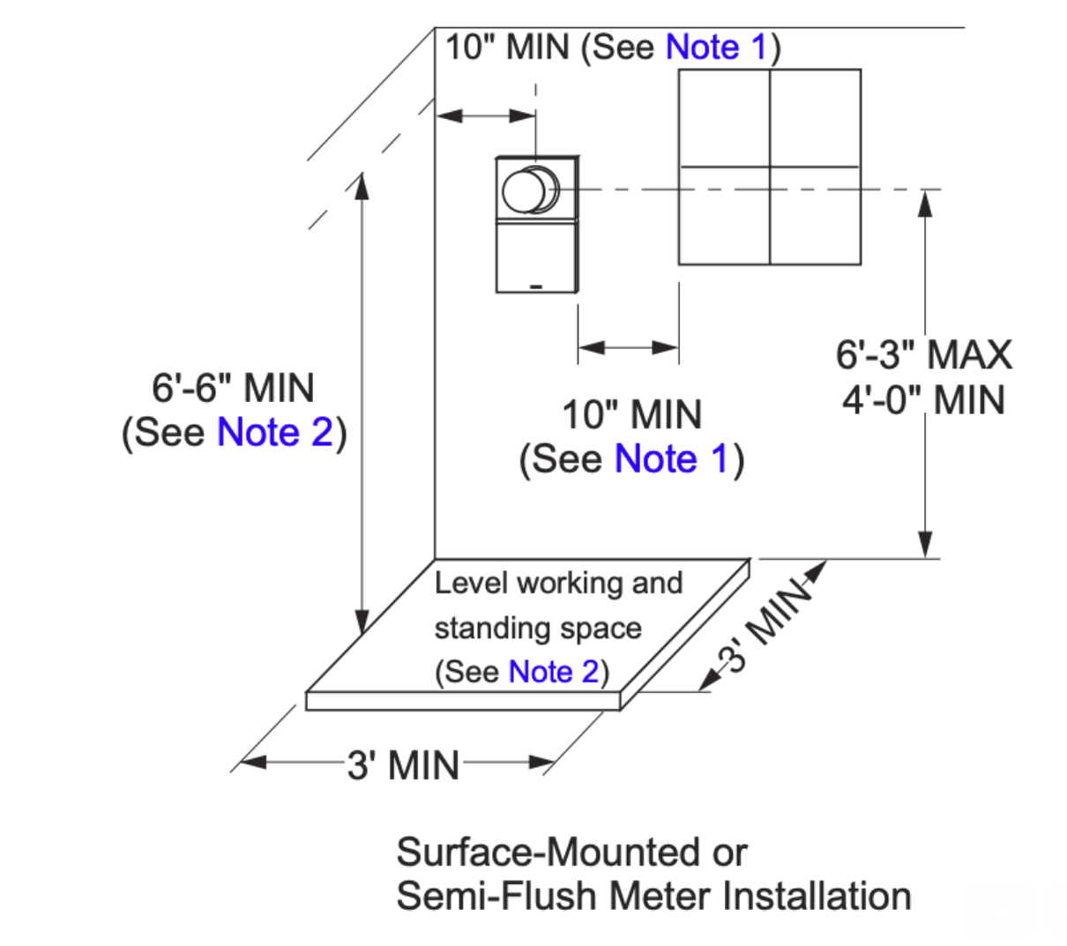
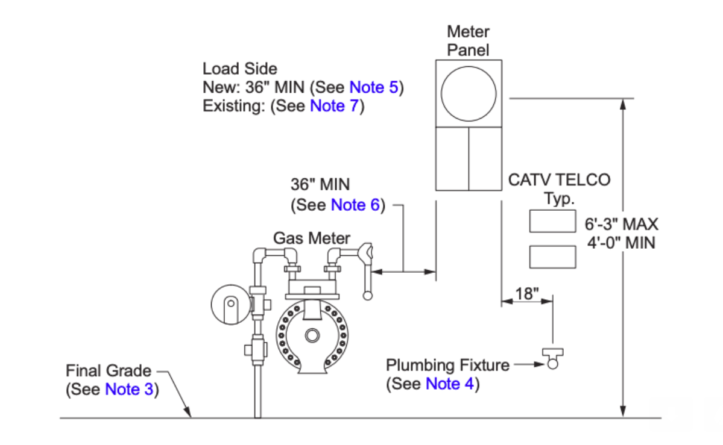
C. Meter Spot by Photo Review

Slide 7
D. Meter Collar Adapters
Used on < 5% of new residential solar projects
Limited impact due to cost and product limitations dictated by utilities.
The hardware costs <$100. Installed cost is $340-$1300.
Tesla is developing a ‘Backup Switch’ to be compatible with ESS that should be available this year. Other companies such as ConnectDER, Brooks Utility Products, Marwell Corp, and GenerLink could provide additional products.

Slide 8
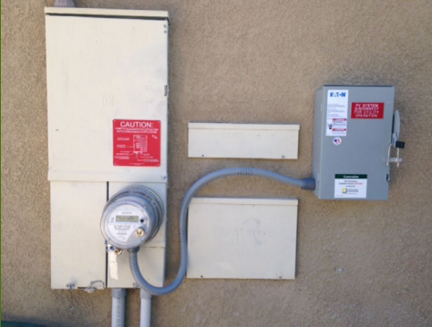
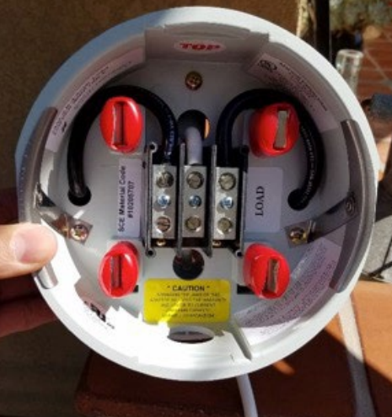
D. Meter Collar Adapters Can use the existing meter socket to streamline interconnections but utility efforts have had limited success
Product Capability | Implementation Under Present Rules
Avoids main panel upgrades and other high cost installation methods | Used on < 5% of new residential solar projects & << 1% of ESS
Same certification and specs as existing meter socket Simple installation can be completed by contractor | Utility requirement that only they can install Utility maintains ownership and bills customer
Low retail cost and plug and play installation | $343 - $1,326 fee charged depending on Utility
Multiple manufacturers & meter collar configurations to be compatible with any PV or ESS | 1 or 2 collars per utility Restricted PV compatibility Not compatible with ESS for whole home backup

Slide 9
D. Meter Socket Adapters in CA
 | SDG&E | SCE | PG&E
Cost | $1,326 | $343 | $1,038
Product Compatibility | PV only or DC coupled storage with UL PCS certification | PV only | PV only
Compatibility Limitations | Certain overhead service panels Certain GE panels 60A max PV | Any overhead service panel 60A max PV | Max 125A panel (60% of customers have a larger panel) Any underground service panel 60A max PV
Timeline | 2 weeks | 2-3 weeks | 2-3 weeks
Touch Points with Utility | paperwork installation notification | paperwork schedule install day of install | paperwork schedule install day of install

Slide 10
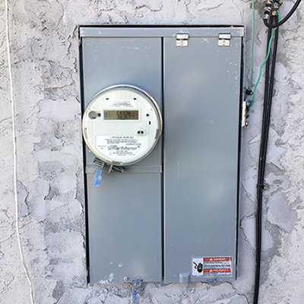
D. Benefits of a Backup Switch
With the combined meter/load center combination units that are common in California, it is difficult to install a disconnect or intercept the load with a backup power source.
Solutions are possible that do not involve substantial rewiring or a main panel upgrade.

Slide 11
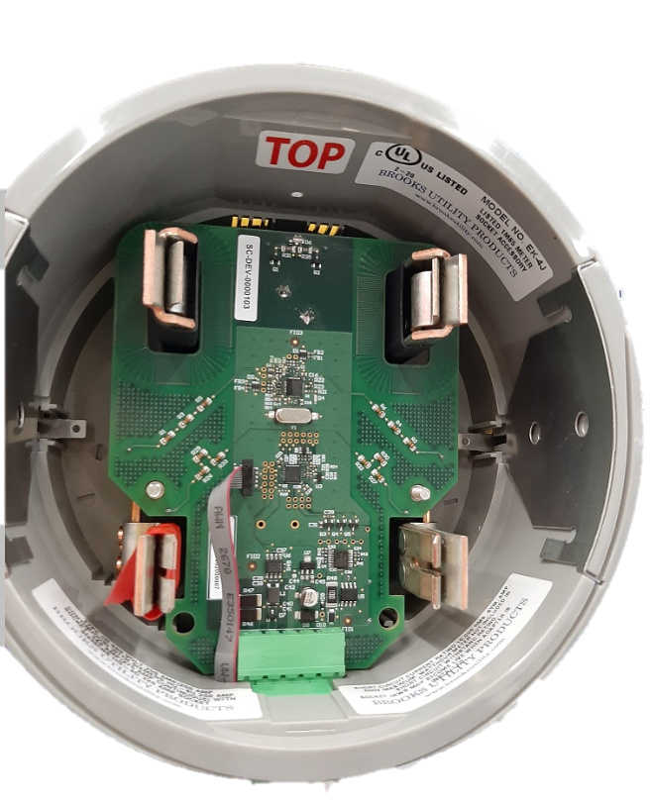
Tesla Backup Switch
A meter collar that islands the whole home from the grid
The biggest single-change potential for customer cost savings
Not a means for electrically connecting a generation source
Not a line side tap
The Backup Switch contains:
A latching relay to disconnect the home from the grid so that it can be backed up safely
Sensing equipment so that we can safely operate the relay and backup power sources
Intelligence and communication to ensure safe operation
Will have all applicable safety certifications.
It will be certified under the same UL Standard as the meter socket
Switch underneath

Slide 12
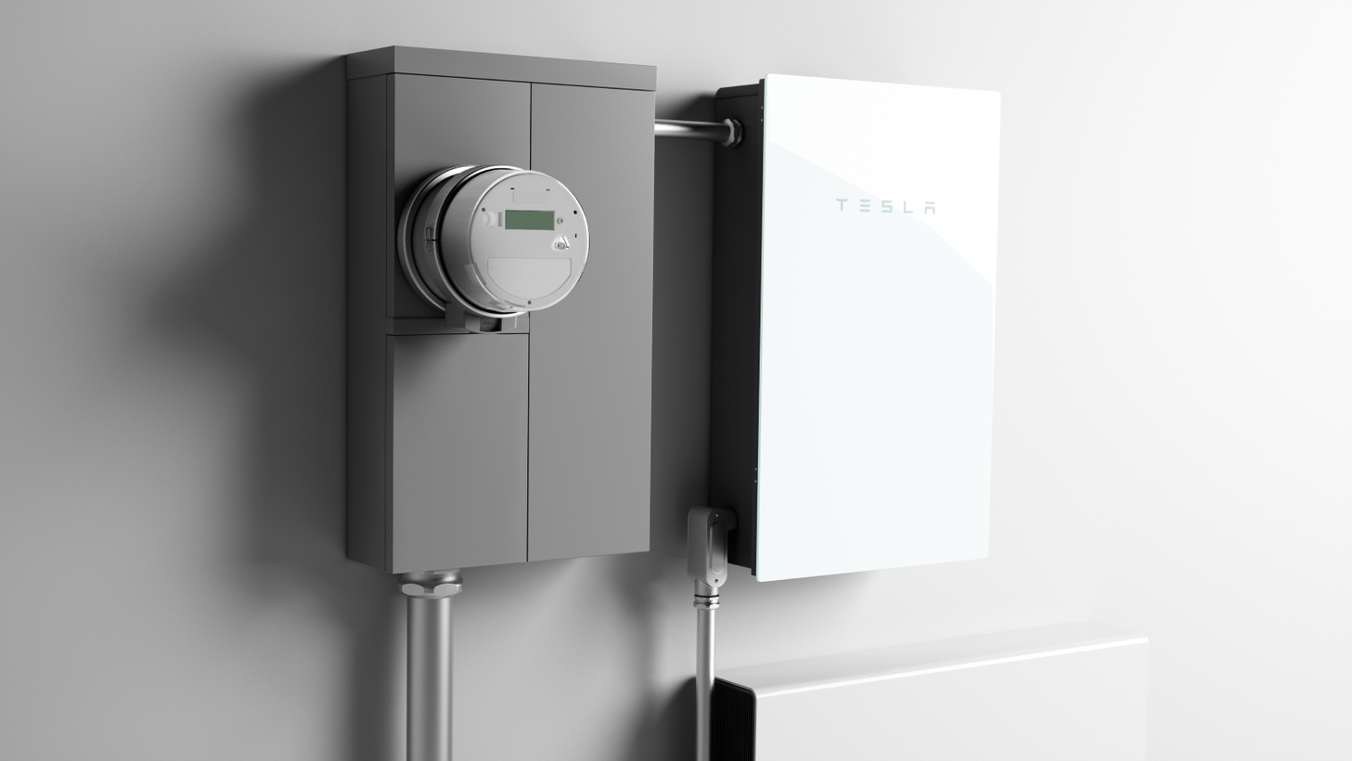
Tesla Backup Switch enables low cost whole home backup for any ESS

Slide 13
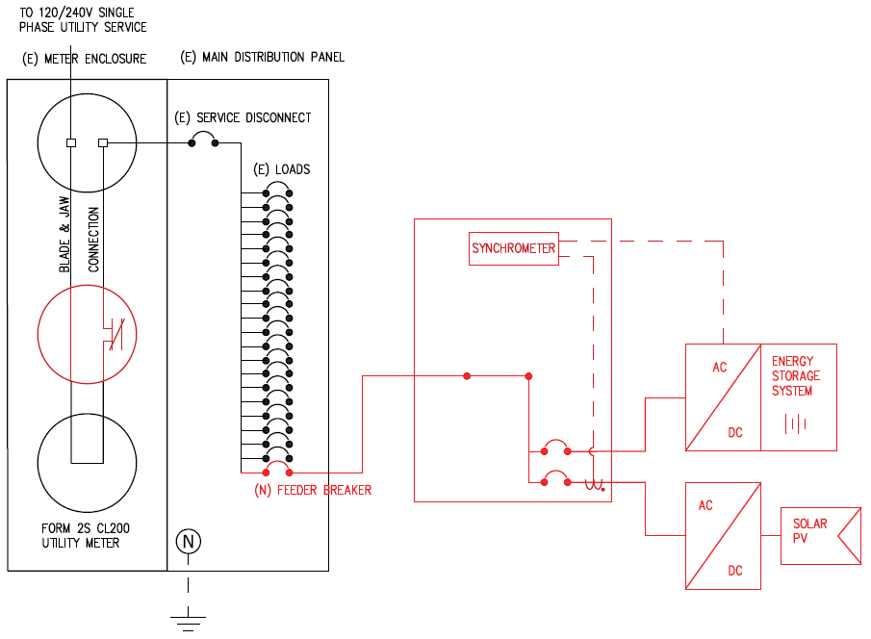
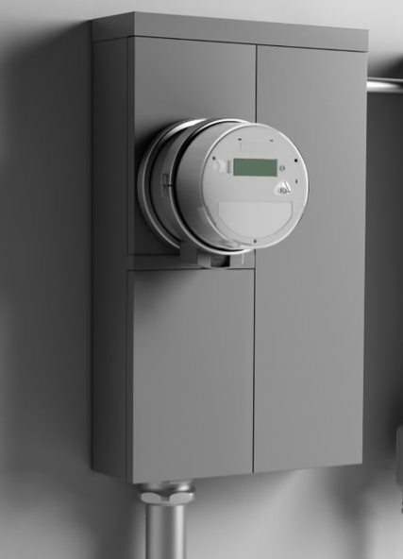
Benefits to the utility
Simplifies battery interconnection requests
Example of Backup Switch interconnection request drawing
Powerwall
Backup
Gateway 2
Contactor
Backup Switch
Notes:
Tesla proposes introducing a socket adapter between the meter and existing meter/main combination panel that solves for load relocation while reducing the time , cost and complexity of installs
In cases where the meter and main panel are separate the MSA reduces main power wire routing complexities.
*Make sure it looks clear that we’re not doing anything different / new / scary

Slide 14
Benefits to the Utility, CPUC, & ratepayers
Uniform, faster installation method
Streamline interconnection requests
Easy to understand for Utility field employees or emergency personnel
Discourage unsafe installation methods (modifying panels)
Provide a better interconnection option for PSPS-impacted customers looking for resiliency from ESS
Saves customers $1,200 - $5,000 per installation, making the tech more accessible
Reduced storage installation cost extends the SGIP Equity Resiliency budget by 11% by reducing the overall installed system cost.
Saves 5 hours of on-site installation labor time, meaning faster deployment to customers who need it
Mitigate possible points of failures due to ~60 fewer wire terminations
Notes:
removed “​​Open access to aggregate telemetry data for pilot installations & Prepares utilities for Grid Services / Virtual Power Plant Programs ”

Slide 15
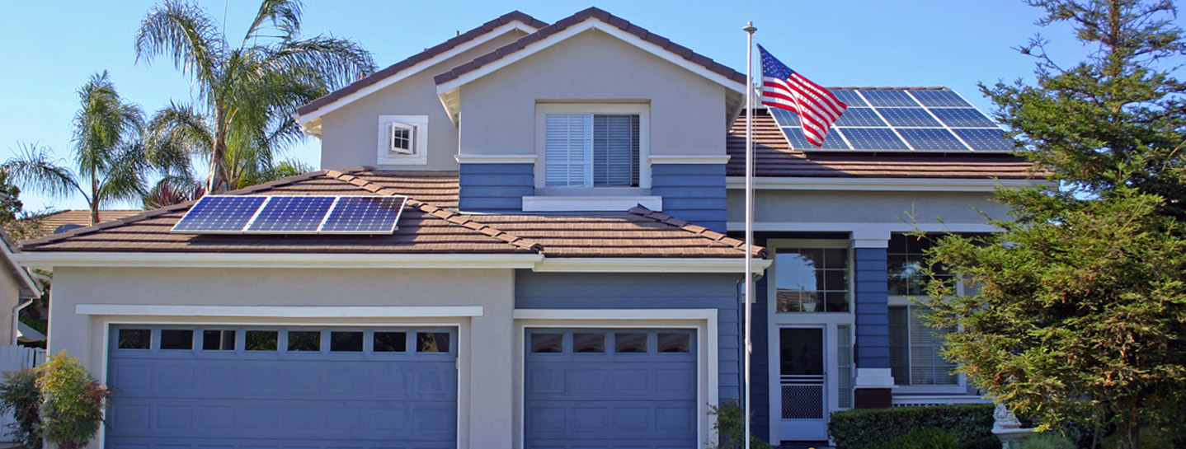
Thank You!
Brad Heavner
Policy Director
California Solar & Storage Association
brad@calssa.org

Slide 16
Appendix

Slide 17
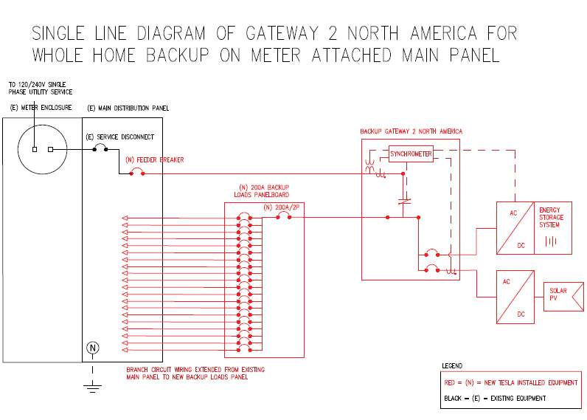
Current Powerwall Install – Single Line Diagram
20+ loads relocated to a new panel
Powerwall
Backup
Gateway
Contactor
Relay
Backed-up Home Loads
Notes:
Backup Gateway need to be near meter, since it is the disconnect point

Slide 18
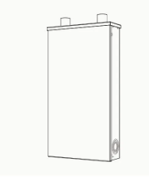
Backup Switch Installation $ Savings
$1,200 - $5,000 savings per install
Powerwall
Supporting
Hardware & Installation
Incentive level to cover 100% of installed ESS cost
Total Cost
Today
$10,800
$6,500
+
$4,300
$0.80/Wh
w/ Backup
Switch
$9,600
$6,500
+
$3,100
$0.71/Wh

Slide 19
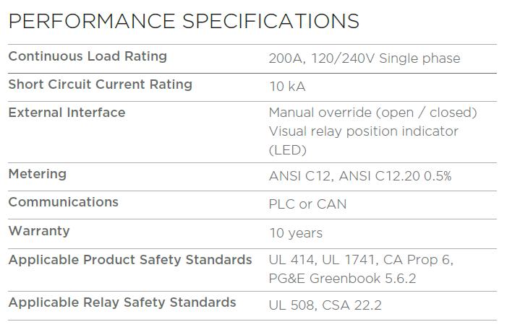
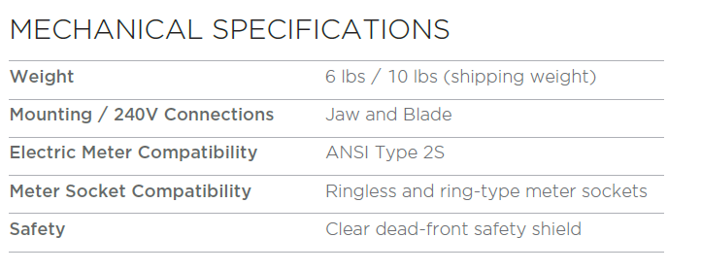
Datasheet (Preliminary)

