Slide 1
Pilot on Expedited Interconnection for Non-Export Storage Facilities
Interconnection Discussion Forum
Q4 2019

Slide 2
Recap PG&E Goal for Pilot
Goal: Attempt to speed up interconnection for stand-alone energy storage
  Define the Population
    Sizing
    Point of Common Coupling
    Non-export protection requirements
    No Variance from Greenbook
  Improve the Application Process
    Utilized the new ACE-IT portal to improve and simplify the application process across multiple portfolios of projects
As stated in our Advice Letter 4941-E-A:
"A key feature is PG&E’s plan to expand its online interconnection application process and incorporate a modular front-end architecture that only requires interconnection applicants to complete modules relative to their particular generation technology and associated program. As these planned improvements are rolled out in the platform, applicants for Rule 21 projects including non-exporting storage are anticipated to see shorter and shorter interconnection timelines."

Slide 3
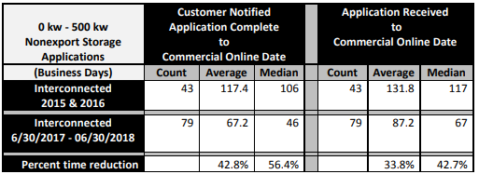
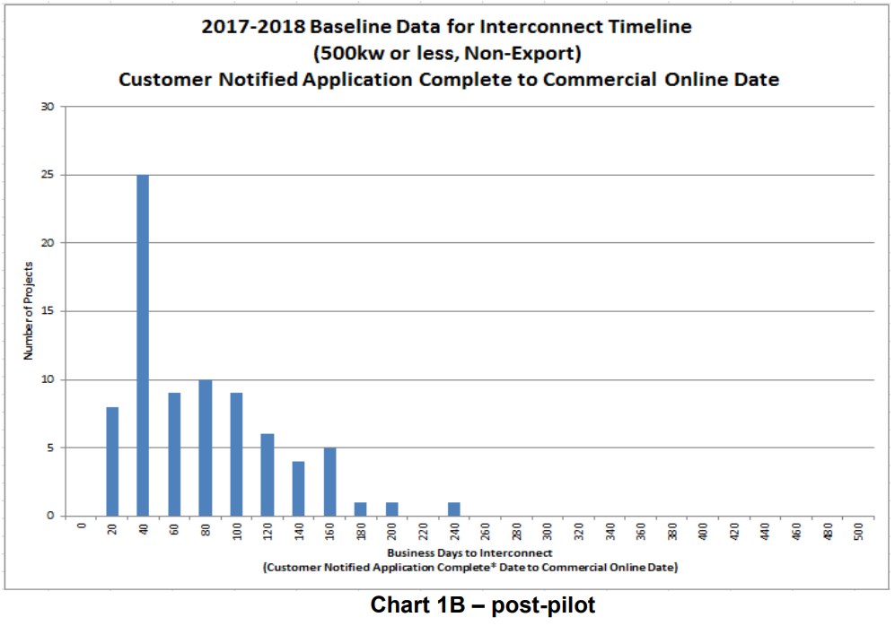
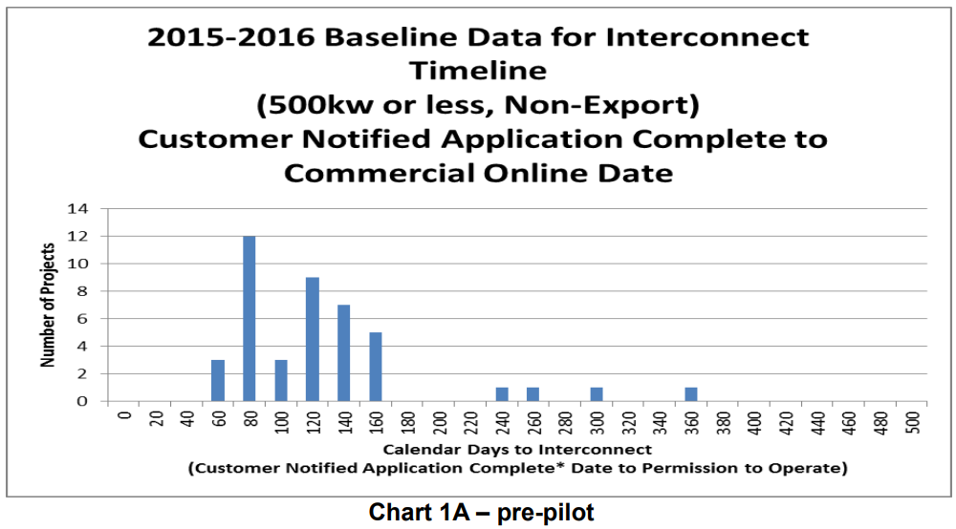
Recap Pilot Result
June 30, 2017 – June 30, 2018
PG&E Advice Letter at end of pilot: https://www.pge.com/tariffs/assets/pdf/adviceletter/ELEC_5371-E.pdf

Slide 4
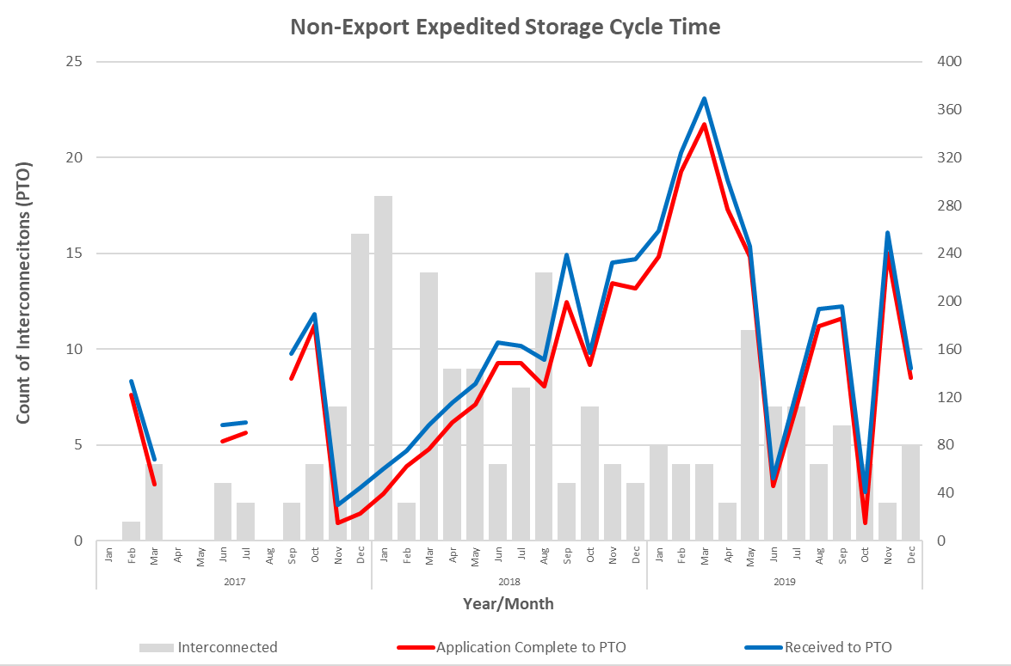
Cycle Time Last 3 Years
Pilot duration
Cycle Time (BD)

Slide 5
Key Takeaways
Expedited process is no longer necessary
No changes to fees needed at this time
PG&E supports working with industry stakeholders to implement high-impact process improvements and simplifications to improve cycle times

Slide 6
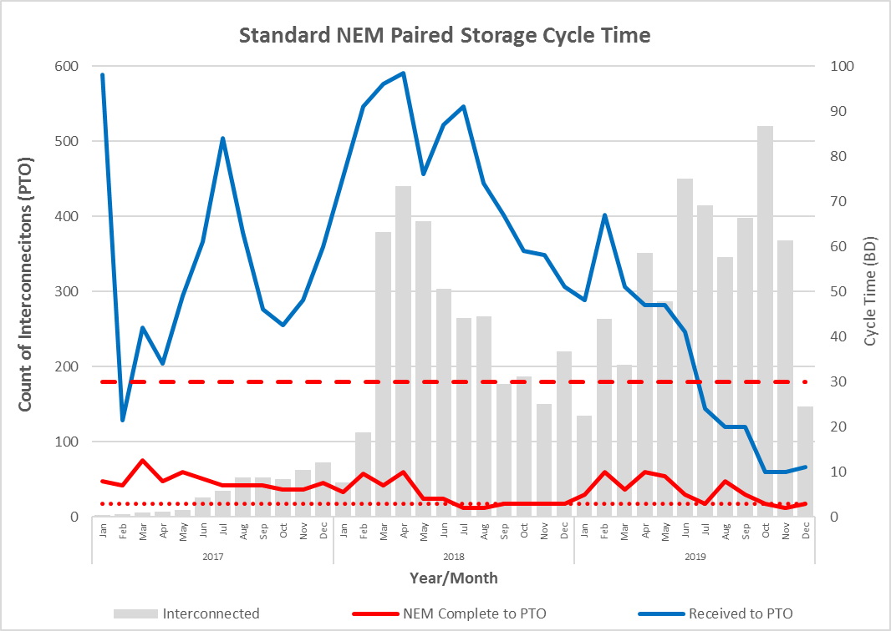
NEM Paired Storage Improvements

