Slide 1
Rule 21 Non-Exporting and Backup Overview

Slide 2
Overview – Non-Export, Backup and Inadvertent Export Options
Summary Overview of Existing Options (Non-Export, Backup and Inadvertent Export) and Common Configurations
Upcoming 2020 Activities
Questions

Slide 3
Overview – Non-Export, Backup and Inadvertent Export Options
Non Exporting Projects Overview
  SCE customers that operate generation systems for customer’s use only and do not export power for sales to SCE’s electric grid are referred to as “non-export” (or “non-exporting” generators. Non-export projects include all generating facilities to be operated by, or, for a customer to serve part or all of its electric energy requirements that would otherwise be provided by SCE, including “distributed generation”, “cogeneration”, “emergency”, “backup” and standby generation.
  - Backup Systems are non-exporting generators used by customers to serve part or all of their electrical needs during a power outage. While customers operating in backup systems under either momentary parallel or isolated mode are not obligated to enter into an interconnection agreement with SCE, notice still needs to be provided to SCE in accordance with California Health and Safety Code 119085(b)
  - Inadvertent Export – These systems are optimally sized to meet the customers’ peak demand. These systems have generator controls to ensure export of electrical power to SCE’s electric system is minimized. The event of exporting uncompensated power for less than 60 seconds is referred to as Inadvertent Export
Non-Exporting Projects Generally Provide for Expedited Reviews
  Looking to 2020, SCE looks to engage in additional customer outreach and a project configuration overview is provided to assist with 2020 planning and education

Slide 4
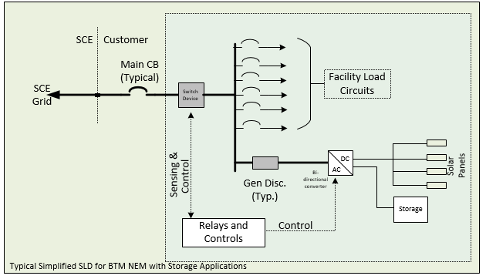
Rule 21 NEM Solar With Paired Storage
Tariff/Option: NEM + Paired Storage
Typical Study Process: Fast Track [Initial Review]
Typical Upgrades: Transformer and secondary conductors
Interconnection Equipment:
  UL CRD control systems with 10 seconds or less Open Loop Response (>10KW storage facilities). Other Alternatives ( Non-export relay, NGO meter) are available for generally take longer to implement
  Storage Sized to 150% of solar maximum storage capacity

Slide 5
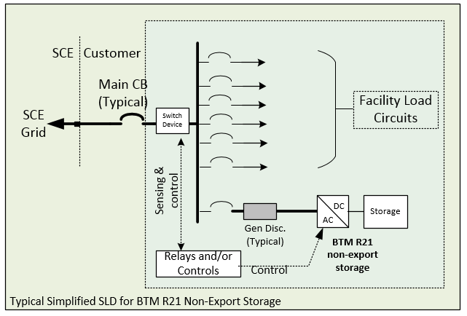
Rule 21 Non-Export Options (Storage)
Tariff/Option: Rule 21 Non-Export Option
Typical Study Process: Fast Track [Initial Review]
Typical Upgrades: Telemetry for large projects ≥ 1MW
Interconnection Equipment:
  Installation of relays for monitoring and control or
  UL CRD control systems with 2 seconds or less Open Loop Response (export)
    When UL CRD is used, Only UL 1741/SA Inverter based Technology are part of the generating facility
  UL CRD control systems with up to 30 seconds Open Loop Response (inadvertent export)
    When UL CRD is used, Only UL 1741/SA Inverter based Technology are part of the generating facility

Slide 6
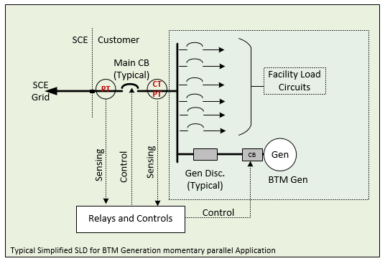
Rule 21: Momentary Parallel Operation
Tariff/Option: Rule 21 Momentary Operation Option
Typical Study Process: Momentary (<1second) Closed Transition Evaluation
Typical Upgrades: None
Interconnection Equipment:
  Relaying and control logic

Slide 7
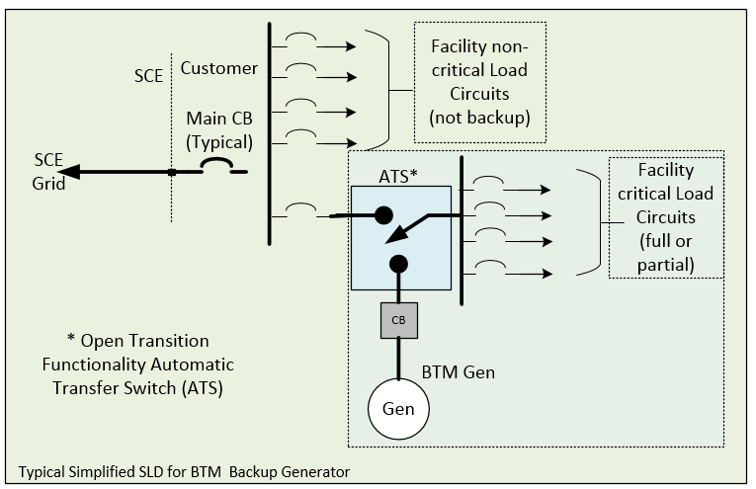
Rule 21:Isolated Operation (Backup)
Tariff/Option: Rule 21 Isolated Operation Option
Typical Study Process: Open Transition Review
Typical Upgrades: None
Interconnection Equipment:
  Open Transition Switch

Slide 8
Non-Exporting Review
                Questions??

