Slide 1
PV-Paired Storage Projects
Single Line Diagrams
Interconnection Discussion Forum
December 2019

Slide 2
Overview
Current process
Process improvements
Implementation proposals

Slide 3
Existing Practices – PV-Paired Storage
PG&E | SCE | SDG&E
Template diagram employed for standard NEM Custom diagram submitted for NEM-ST, NEM-MT, NEMA, and Expanded NEM | No template diagram for any scenario All projects require custom diagram be submitted | Template diagram employed for standard NEM Custom diagram submitted for NEM-ST, NEM-MT, NEMA, and Expanded NEM

Slide 4
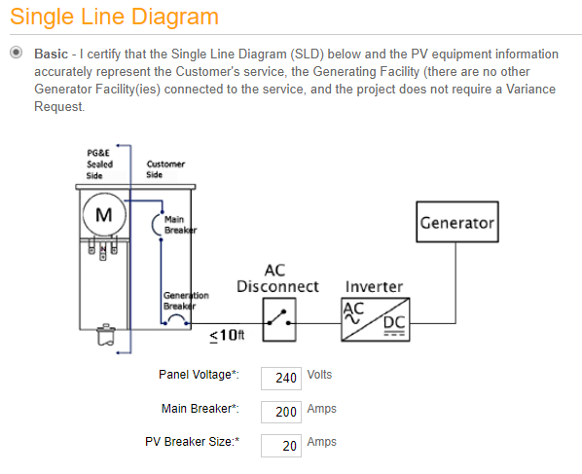
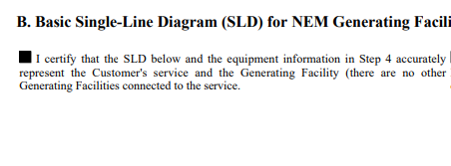
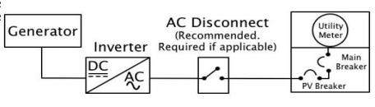
Standard NEM Template Diagrams
PG&E
SDG&E

Slide 5
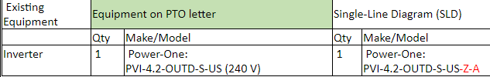
Process Improvements
Reduce deficiency rate
Existing equipment confirmed in application portal and existing utility records
Improved review timelines – batteries online quicker

Slide 6
Implementation Proposals
Templates by scenario
  AC / DC coupled
  Uninterruptible power supply
  Standby generators
Templates by contractor or CSLB Number
Templates within sizing threshold (up to 30 kW)
Custom diagrams can still be submitted when necessary

Slide 7
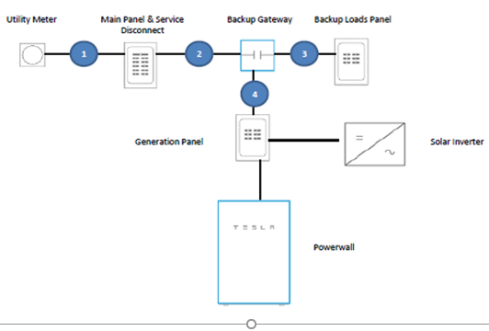
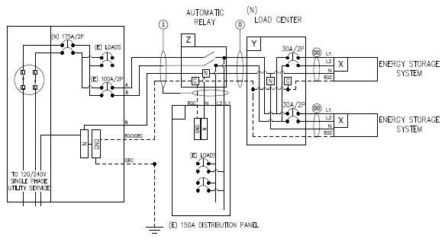
Sample Template Diagrams
Retrofit (Existing PV) AC Coupled
Standalone (No PV) AC Coupled

Slide 8
Energy Storage Site Inspections
Interconnection Discussion Forum
December 2019

Slide 9
Inspection Process
Occurs at utility’s discretion
Common when AC disconnect(s) included
Requires additional coordination between customer, contractor and utility

Slide 10
Proposed Alternatives
Photos provided in place of duplicate inspections
Final building inspection record satisfies utility inspection
Acknowledge UL certified equipment
Visit site after storage device is operational

Slide 11
Benefits to Removing Utility Inspection
Removes timeline for additional inspection to occur – quicker PTO
Improves customer experience – protected from shutoffs sooner

Slide 12
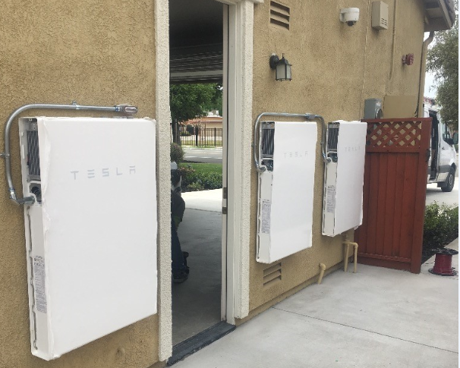
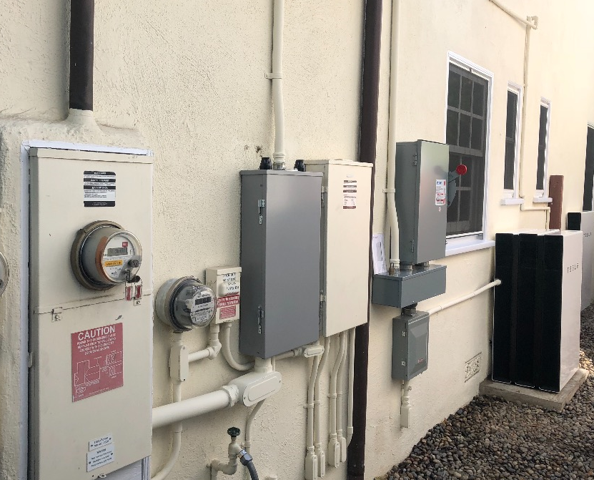
Sample Inspection Photos

