Slide 1
Power Control System Listing
Interconnection Discussion Forum
October 14, 2020

Slide 2
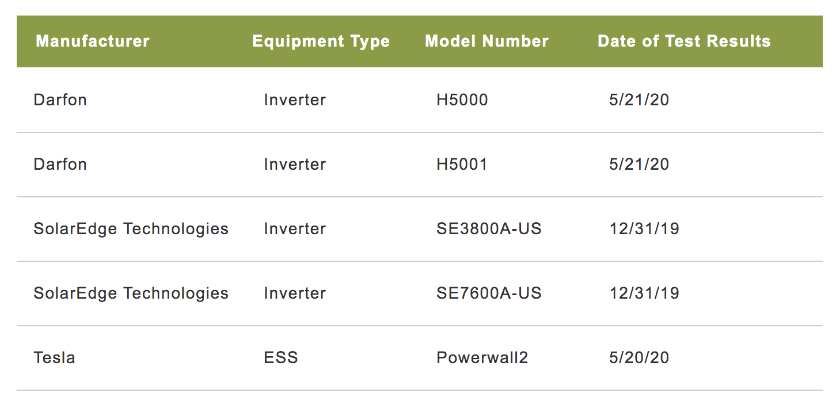
List of Tested Equipment
Sonnen ECO5, ECO10, ECOLX10, EXOLX22 also through testing
calssa.org/powercontrolsystems

Slide 3
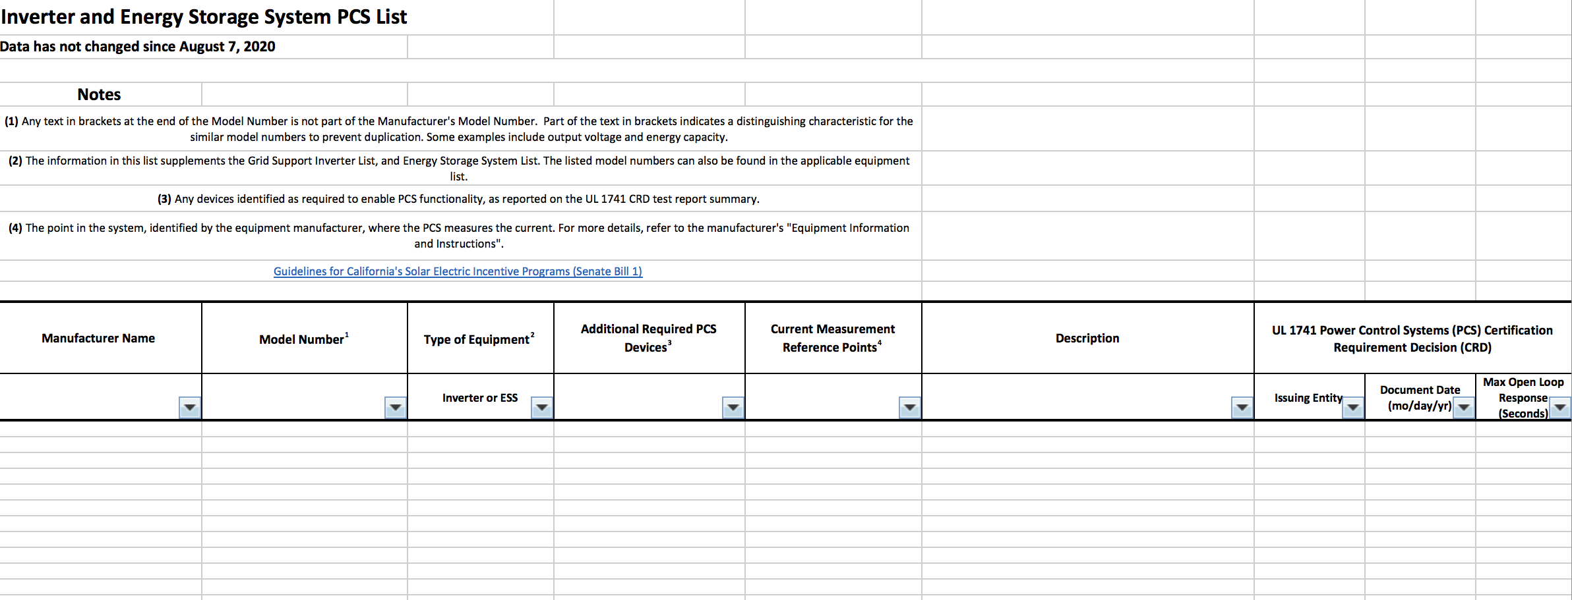
List of CEC Certified Equipment

Slide 4
Outstanding Questions
Clarity on installation requirements?
Is definition of ESS correct?
Can all system configurations that are allowed by the CRD achieve testing and certification?
Can we learn from any shortcomings of early test results?
IOUs have approved some equipment based on test results. Will this continue pending CEC listing?

Slide 5
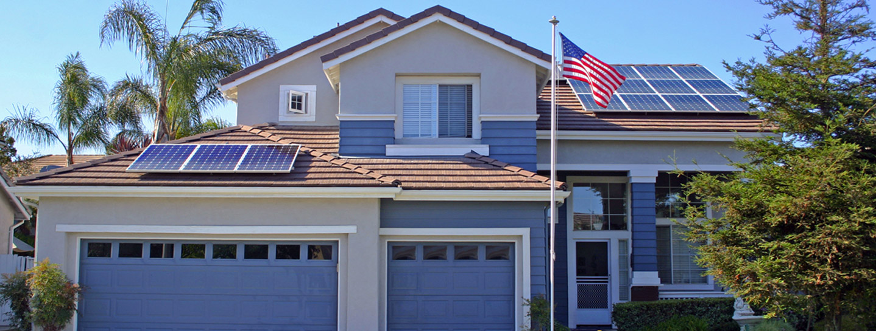
Thank You!
Brad Heavner
Policy Director
California Solar & Storage Association
brad@calssa.org

