Slide 1
Limited Generation Profiles (LGP)
Workshop #1 per Resolution E-5230
February 1, 2023
12:00 PM -- 4:00 PM PST
Workshop will Commence at 12:00 P.M. PST
11:30 A.M. - 12:00 P.M. – Presenters’ Roll-Call
Please keep yourself muted when not speaking and do NOT put the call on hold. If muted by the leader, press *6 to unmute.

Slide 2
Limited Generation Profiles (LGP)
Workshop #1 per Resolution E-5230
February 1, 2023
12:00 PM -- 4:00 PM PST
Please keep yourself muted when not speaking and do NOT put the call on hold. If muted by the leader, press *6 to unmute.

Slide 3
Workshop Logistics & Announcements
Safety reminder.
  Make a note of your surroundings and exit routes.
  Reach out if you need help, either during the call or to an attendee
Workshop Logistics:
  This meeting is being recorded; recording and materials will be posted in the CPUC Rule 21 LGP Web Page.
  Workshop participants are encouraged to ask questions during the presentation; a dedicated Q&A time slot has also been scheduled after each presentation
  Please keep yourself muted when not speaking and do NOT put the call on hold. To speak, unmute yourself from the button at the lower part of your screen and identify yourself before speaking
  If calling in by phone, use the mute button on your handset and unmute yourself to speak. If muted by the host, press *6 to unmute. To raise your hand press *3
  If you were forwarded the invite and did not receive it directly from Energy Division, and would like to be added to the workshop distribution list, please email Jose Aliaga-Caro (jose.aliaga-caro@cpuc.ca.gov)
    Future Workshop invites will include participants from the previous workshop
Please keep yourself muted when not speaking and do NOT put the call on hold. If muted by the leader, press *6 to unmute.

Slide 4
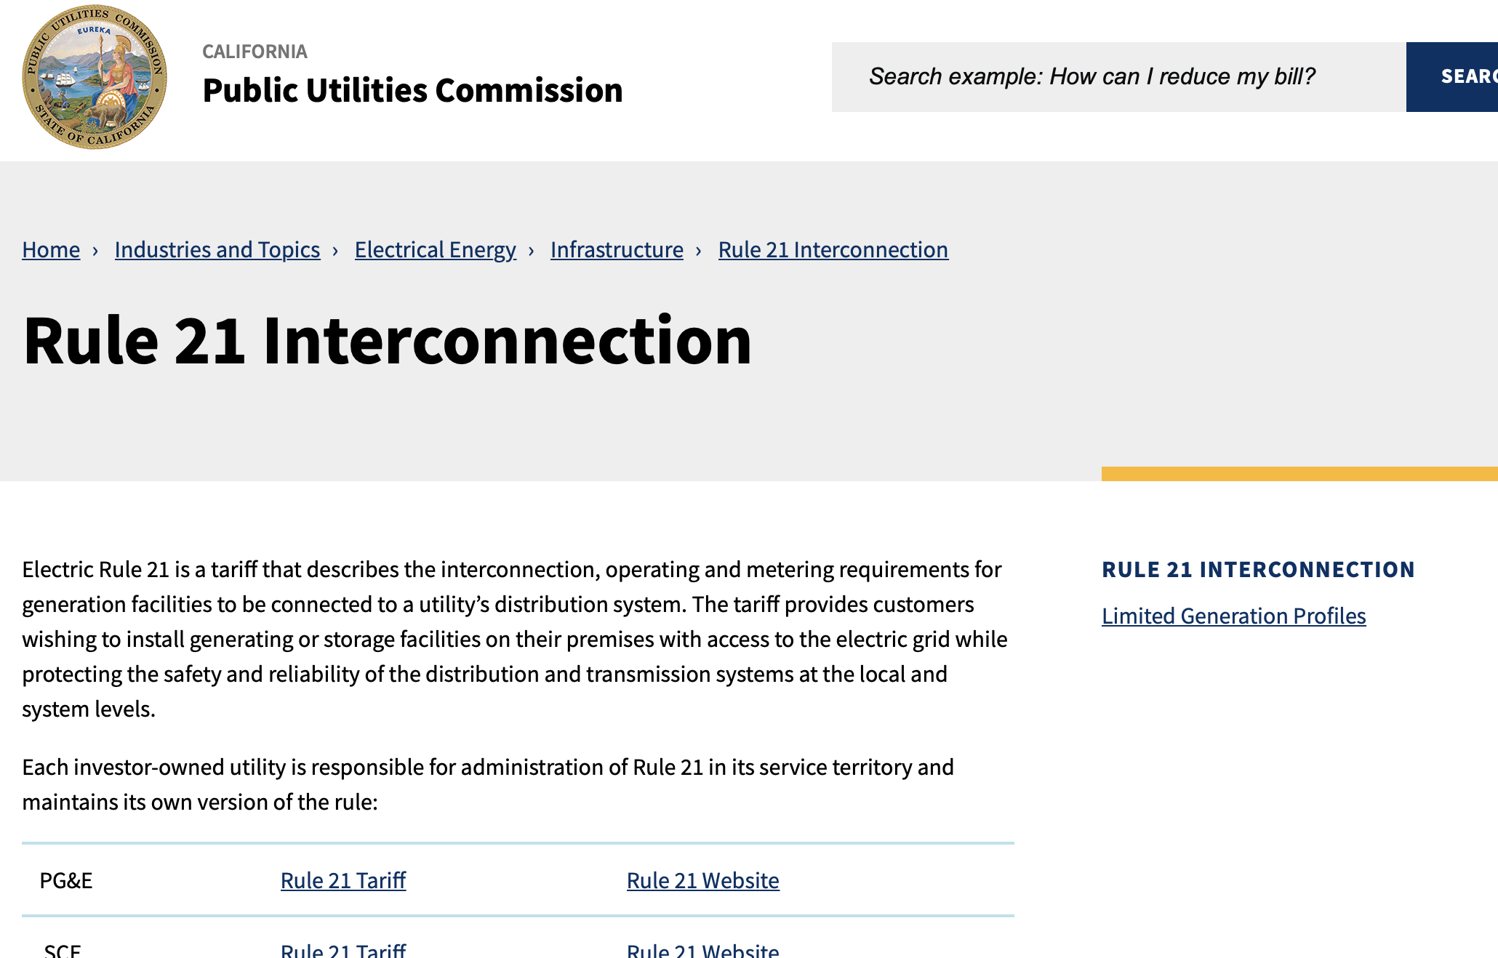
Rule 21 Web Page: Limited Generation Profiles
Main Page: https://www.cpuc.ca.gov/rule21/
Workshop recording and materials will be posted in the Rule 21 Limited Generation Profiles Web Page
Please keep yourself muted when not speaking and do NOT put the call on hold. If muted by the leader, press *6 to unmute.

Slide 5
Agenda
Please keep yourself muted when not speaking and do NOT put the call on hold. If muted by the leader, press *6 to unmute.

Slide 6
Background: Resolution E-5230 (Issued 12/09/22)
Identified Topics Needing Discussion:
  Section B / Issue 1: Quarterly Reports: Re-affirm AMI process + Tariff Language
  Section B / Issue 2: Use of Gross Nameplate Rating (including sections of Resolution Section C)
  Section C: Overview of Proposals--Including technical requirements, ”monthly" scheduling (Seem Topic F), Nameplate capacity (Topic B.2); Alignment of language (See Topic D); and Incorporate all topics in Resolution E-5230
  Section D: Alignment of Language
  Section E: Implementation of Limited Generation Profiles Using Current Smart Inverter Functions
  Section F: Implementing more than 12 LGP Values per year—Definition of Monthly Profiles and 288-hour requirement
Please keep yourself muted when not speaking and do NOT put the call on hold. If muted by the leader, press *6 to unmute.

Slide 7
Meetings per Resolution E-5230 (Issued 12/09/22)
Discussions to resolve Limited Generation Profiles (LGP) (per OP 15 and 51 of D.20-09-035)
  Workshop 1: February 2, 2023; Noon – 4:00 p.m.; via WebEx
    Section E: Implementation of Limited Generation Profiles Using Current Smart Inverter Functions
    Section F: Scheduling and Implementing More Than 12 LGP Values Per Year
  Workshop 2: February 21, 2023; 9:00 a.m. – 4:00 p.m.; via WebEx
  Workshop 3: March 14, 2023; 9:00 a.m. – 4:00 p.m.; via WebEx
  Workshop 4: TBD (if needed); March 28, 2023 (tentative)
  Tier 3 Advice Letters: Due by May 1, 2023
SIWG Preparation Meetings:
  January 19, 2023: Section F: Scheduling and Implementing More Than 12 LGP Values Per Year
  February 2, 2023: Section B, Issues 1 and 2
  February 16, 2023
  March 2, 2023
  March 16, 2023
  March 30, 2023: TBD (if needed)

Slide 8
Workshops and SIWG Topics per Resolution E-5230 (Issued 12/09/22)

Slide 9
Resolution E-5230: Section E. Implementation of Limited Generation Profiles Using Current Smart Inverter Functions -- The Large IOUs are directed to discuss the possibility and challenges with implementing the LGP-option before standards are approved.
Based on the record for Issue 9, there is general agreement that the technology needed to implement the LGP-option already exists and can be implemented before scheduling standards are approved.
The Decision does consider utilization of LGP prior to the approval of the standards.
In discussing the implementation of Limited Generation Profile the Working Group Two Report states “The Working Group generally agreed that the technology needed for a DER facility to implement a scheduled generation profile is already available [emphasis added] ....” and the need to “[u]pdate the interconnection procedures to allow customers which have certified Phase III inverters to use Phase III Function 3 (Limit Maximum Real Power Mode) in order to limit maximum power output based on seasons of the year.”
To expedite the use of available hosting capacity it is prudent, therefore, for the Large IOUs to discuss any challenges to implement Issue 9 and Proposal A-B 3 using current smart inverter settings
The Large IOUs shall elaborate on challenges and concerns as stated in the Working Group Reports and discuss and propose solutions. The Large IOUs shall determine which functional elements are already present in commercially available inverters, and which are not, to establish LGP functionality prior to the approval of standards.
Should implementation of Issue 9 and Proposal A-B 3 be feasible before approval of standards, the Large IOUs shall outline a clear process and the requirements, including technical, to be considered in the implementation of the LGP option. The Large IOUs shall also establish a mechanism for validating proposed profiles. If the implementation of this mechanism is not feasible, the Large IOUs shall clearly articulate the reasons.

Slide 10
Resolution E-5230: Section F. Implementing More Than 12 LGP Values Per Year—Definition of Monthly Profiles and 288-hour Requirement
In adopting a modified version of the Large IOUs’ counter proposal, the Decision modified the proposal such that the “frequency of changes is expanded to monthly limits to align with the Integration Capacity Analysis.” The Decision, however, did not specify that the monthly profile was limited to only one value. The Decision addressed the frequency of change and did not restrict the number of values within a month to be only one.
Large IOUs are therefore directed to discuss the 288-hour format and how it may allow for more than one value per month. Given that the Working Group Two Report was filed October 31, 2018, four years from the current date, we expect there is now more information and experience available to the Large IOUs to allow this. The Large IOUs shall discuss their learnings and best practices in the workshops and propose how implementation of more than one value per month may be accomplished to better take advantage of the available capacity on a circuit to accomplish the goals of Issue 9.

Slide 11
Next Steps
E-mail Energy Division any topics that need addressing in ALs and 2nd Workshop by February 8, 2023.

Slide 12
Background: OP 15 and 51Requirements of D.20-09-035
OP 15: The counter proposal from ... [the Large IOUs] to resolve Issue 9 is adopted with modification. ... Within six months of issuance of this decision, Utilities shall submit a Tier 3 Advice Letter providing recommendations (as applicable) regarding the standard review, certification requirements, and interconnection processes necessary for implementation of the proposal. Within 60 days of adoption of a certification scheme for the Limited Generation Profile, Utilities shall modify the Rule 21 Interconnection Application Process to allow a distributed energy resources customer to include a Limited Generation Profile with their application, require the customer to enable generation profile limiting functionality, and allow Utilities opportunity to alter the profile if safety and reliability concerns warrant it. Retroactive alterations to generation profiles shall not reduce generation to below a pre-defined static level, i.e., the lowest Integrated Capacity Analysis – Static Grid typical profile value identified at the time of the Interconnection Application. As part of the proposal, Utilities shall: i) allow customers to utilize a smart inverter’s ability to increase its output on a monthly basis; and ii) use a 10 percent buffer, which shall be revisited....
OP 51: A modified Proposal A-B 3 is adopted but shall not be implemented until nine months after technical specifications standards, and a certification scheme for a Limited Generation Profile have been approved by the standards approving bodies. Within 90 days of such approval, ... [the Large IOUs] shall [seek] ... to modify their Rule 21 tariffs to allow an inverter approved for non- export and limited export to be set using different maximum export value settings at different times of the year, when meeting the qualifications for either Proposal A-B 13 or A-B 2.4 ... Within six months of issuance of this decision, Utilities shall submit a Tier 3 Advice Letter providing recommendations (as applicable) regarding the standard review, certification requirements, and interconnection processes necessary for implementation of the proposal. The discussions and Tier 3 Advice Letter required in this ordering paragraph may be combined with those required in Ordering Paragraph 15.
Please keep yourself muted when not speaking and do NOT put the call on hold. If muted by the leader, press *6 to unmute.

Slide 13
Background: Issue 9 and A-B 3 of D.20-09-035
Issue 9 looks at the conditions of operations the Commission should adopt to allow distributed energy resources to perform within existing hosting capacity constraints and avoid triggering [distribution grid] upgrades... The purpose of resolving Issue 9... is to utilize the Integration Capacity Analysis data to allow modern inverters, storage, and other technologies to confidently respond to grid conditions while ensuring safety and reliability.
This proposal [A-B 3] would allow an inverter approved for non-export and limited-export to be set using different maximum export value settings at different times of the year and at the discretion of the utility until a future scheduling standard is released. Proposal A-B 3 would require the inverter to meet the qualifications for non-export or limited- export under Proposal A-B 1 or A-B 2..
Please keep yourself muted when not speaking and do NOT put the call on hold. If muted by the leader, press *6 to unmute.

Slide 14
Questions?

Slide 15


