Slide 1
Limited Generation Profiles (LGP)
Workshop #4 per Resolution E-5230
April 7, 2023
8:00 AM -- 2:00 PM PST
Workshop will Commence at 8:00 A.M. PST
Please keep yourself muted when not speaking and do NOT put the call on hold. If muted by the leader, press *6 to unmute.

Slide 2
Workshop Logistics & Announcements
Safety reminder.
  Make a note of your surroundings and exit routes.
  Reach out if you need help, either during the call or to an attendee
Workshop Logistics:
  This meeting is being recorded; recording and materials will be posted in the CPUC Rule 21 LGP Web Page.
  Workshop participants are encouraged to ask questions during the presentation; a dedicated Q&A time slot has also been scheduled after each presentation
  Please keep discussion to items in scope of Resolution E-5230 – We have limited time and a full agenda.
  Please keep yourself muted when not speaking and do NOT put the call on hold. To speak, unmute yourself from the button at the lower part of your screen and identify yourself before speaking
  If calling in by phone, use the mute button on your handset and unmute yourself to speak. If muted by the host, press *6 to unmute. To raise your hand press *3
Please keep yourself muted when not speaking and do NOT put the call on hold. If muted by the leader, press *6 to unmute.

Slide 3
Meetings per Resolution E-5230 (Issued 12/09/22)
Workshops to resolve Limited Generation Profiles (LGP) (per OP 15 and 51 of D.20-09-035)
  Workshop 1: February 2, 2023; Noon – 4:00 p.m.; via WebEx
  Workshop 2: February 21, 2023; 9:00 a.m. – 4:00 p.m.; via WebEx
  Workshop 3: March 14, 2023; 9:00 a.m. – 4:00 p.m.; via WebEx
  Workshop 4: April 7, 2023 ; 8:00 a.m. – 2:00 p.m.; via WebEx
  Tier 3 Advice Letters: Due by May 1, 2023
SIWG Meetings:
  January 19, 2023: Section F
  February 2, 2023: Section B, Issues 1 and 2
  February 16, 2023: Section E and Section C
  March 2, 2023: Section F
  March 16, 2023: Section E
  March 30, 2023: Section E
Please keep yourself muted when not speaking and do NOT put the call on hold. If muted by the leader, press *6 to unmute.

Slide 4
Agenda
Please keep yourself muted when not speaking and do NOT put the call on hold. If muted by the leader, press *6 to unmute.

Slide 5
Background: Resolution E-5230 (Issued 12/09/22)
Identified Topics Needing Discussion:
  Section B / Issue 1: Quarterly Reports: Re-affirm AMI process + Tariff Language
  Section B / Issue 2: Use of Gross Nameplate Rating (including sections of Resolution Section C)
  Section C: Overview of Proposals--Including technical requirements, ”monthly" scheduling (Seem Topic F), Nameplate capacity (Topic B.2); Alignment of language (See Topic D); and Incorporate all topics in Resolution E-5230
  Section D: Alignment of Language
  Section E: Implementation of Limited Generation Profiles Using Current Smart Inverter Functions
  Section F: Implementing more than 12 LGP Values per year—Definition of Monthly Profiles and 288-hour requirement
Please keep yourself muted when not speaking and do NOT put the call on hold. If muted by the leader, press *6 to unmute.

Slide 6
Next Steps
Energy Division Contacts:
  Jose.Aliaga-Caro@cpuc.ca.gov
  Justin.Regnier@cpuc.ca.gov
Please keep yourself muted when not speaking and do NOT put the call on hold. If muted by the leader, press *6 to unmute.

Slide 7
Background Slides
Please keep yourself muted when not speaking and do NOT put the call on hold. If muted by the leader, press *6 to unmute.

Slide 8
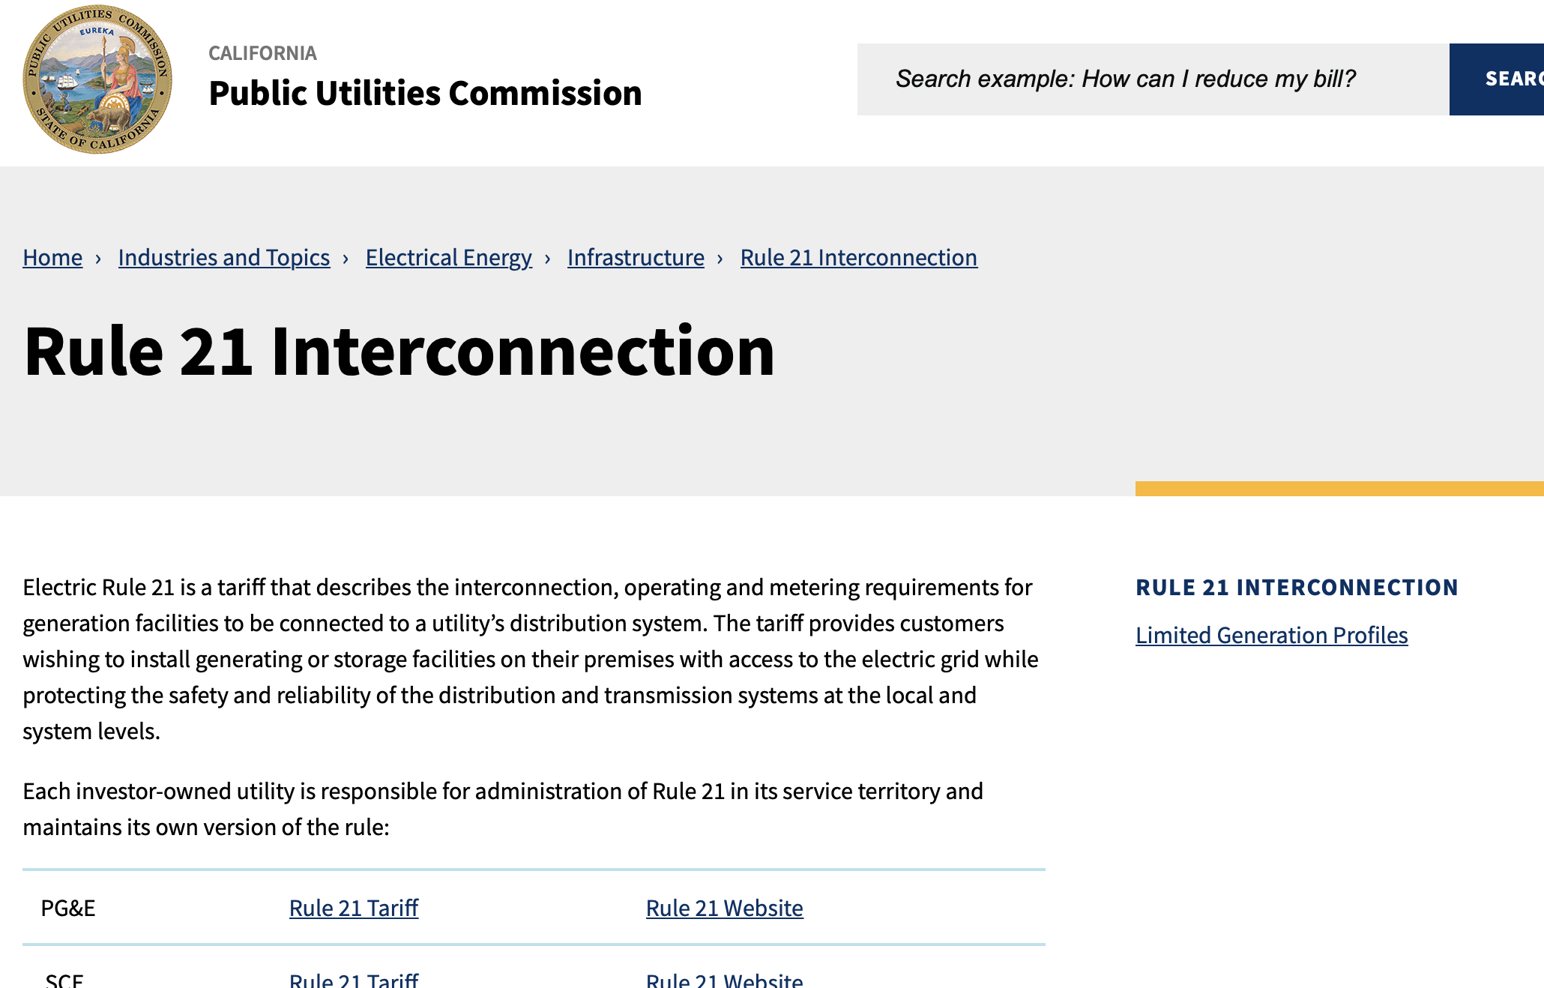
Rule 21 Web Page: Limited Generation Profiles
Main Page: https://www.cpuc.ca.gov/rule21/
Workshop recording and materials will be posted in the Rule 21 Limited Generation Profiles Web Page
Please keep yourself muted when not speaking and do NOT put the call on hold. If muted by the leader, press *6 to unmute.

Slide 9
Resolution E-5230 (Discussion Section B.1): Quarterly reporting is not required. The Large IOUs are directed to to finalize details and tariff language of the alternative process discussed in the LGP Workshop #2 per Resolution E-5211 held on November 29, 2022.
Workshop discussions per Resolution E-5211, however, have resolved this issue. As presented during the November 29, 2022 workshop, the Large IOUs shall utilize Advanced Metering Infrastructure (AMI) data for projects with a nameplate of less than 1 MW and telemetry for LGP projects with a nameplate over 1 MW as telemetry is already a requirement per the current Rule 21 for projects sized above 1 MW. The Large IOUs are therefore directed to finalize details and tariff language during the workshops ordered in this Resolution and include it in the subsequent ALs.

Slide 10
Resolution E-5230 (Discussion Section B.2): Further discussions are needed to justify the use of gross nameplate for the Rule 21 screens.
Should the Large IOUs continue to propose the use of gross nameplate rating for screens D, I, J and K, the Large IOUs are directed to discuss these concerns further during the workshops directed herein and in the subsequent ALs. This discussion should provide further information on the similarities and differences between the proposals in question and articulate the concerns and most likely outcomes for utilizing the limited export value adopted in Proposals A-B 1 and A-B 2 for A-B 3 and Issue 9.
The discussions shall also include the Supplemental Review screens (Screens N, O and P). In the November 10, 2022 SIWG meeting the Large IOUs presented that “Screen M, N, O and some aspects of P will be studied using LGP. The exact Rule 21 language should be discussed with stakeholders. The additional LGP language should build on recent changes to Screen M which supports Nameplate and Typical PV profile interconnection applications.” Discussions in the November 29, 2022 workshop though implied that parties had an unclear understanding of how the screens would be studied and thus discussions are still warranted. We direct the Large IOUs to discuss tariff language modifications during the workshops and to provide more information on which aspects of Screen P will be studied using the LGP value and which will not, if this is the case. In the November 10, 2022 SIWG meeting, the Large IOUs also state that Screens F, G, and H will be evaluated on nameplate rating. The Large IOUs note that “Screens A-E are also not included in ICA calculation. The evaluation is not based on nameplate rating but will depend on aspects of each screen.”33 As it is still in unclear how screens D, I, J, and K will be studied, discussions regarding these screens should continue within the workshop discussions.
The discussions should refer to how the Decision adopts Proposal A-B 3 and how the Working Group Three Report states the screens should be applied…
Please keep yourself muted when not speaking and do NOT put the call on hold. If muted by the leader, press *6 to unmute.

Slide 11
Resolution E-5230: Section C. Proposals submitted in PG&E AL 6141-E, SCE AL 4455-E, and SDG&E AL 3721-E.
Within these proposals, the Large IOUs have included review and certification requirements, as required by the Decision. The Large IOUs have largely complied with OP 15 and 51. We find, however, there are topics that need further clarification before we can approve them. The Large IOUs are directed to discuss these topics in the workshops.
Large IOUs shall discuss any updates to the proposals that their subsequent experiences indicate may be warranted. The Large IOUs shall also differentiate between “export power” and “output power” and make clear that the LGP option is intended to manage the amount of export power to the electric grid and not output power that may be consumed on-site. The Large IOUs are directed to go over the proposal to address any questions stakeholders may have and determine whether each step is appropriate and complete. Approval in this Resolution of any step within the process outlined in the Large IOUs’ proposals should not be interpreted to mean that those steps are not amendable if there is reason to do so based on workshop discussions. The steps shall be updated if needed to add any additional clarity required or incorporate new learnings. Any changes to the steps in the process must be justified.

Slide 12
Resolution E-5230: Section E. Implementation of Limited Generation Profiles Using Current Smart Inverter Functions -- The Large IOUs are directed to discuss the possibility and challenges with implementing the LGP-option before standards are approved.
Based on the record for Issue 9, there is general agreement that the technology needed to implement the LGP-option already exists and can be implemented before scheduling standards are approved.
The Decision does consider utilization of LGP prior to the approval of the standards.
In discussing the implementation of Limited Generation Profile the Working Group Two Report states “The Working Group generally agreed that the technology needed for a DER facility to implement a scheduled generation profile is already available [emphasis added] ....” and the need to “[u]pdate the interconnection procedures to allow customers which have certified Phase III inverters to use Phase III Function 3 (Limit Maximum Real Power Mode) in order to limit maximum power output based on seasons of the year.”
To expedite the use of available hosting capacity it is prudent, therefore, for the Large IOUs to discuss any challenges to implement Issue 9 and Proposal A-B 3 using current smart inverter settings
The Large IOUs shall elaborate on challenges and concerns as stated in the Working Group Reports and discuss and propose solutions. The Large IOUs shall determine which functional elements are already present in commercially available inverters, and which are not, to establish LGP functionality prior to the approval of standards.
Should implementation of Issue 9 and Proposal A-B 3 be feasible before approval of standards, the Large IOUs shall outline a clear process and the requirements, including technical, to be considered in the implementation of the LGP option. The Large IOUs shall also establish a mechanism for validating proposed profiles. If the implementation of this mechanism is not feasible, the Large IOUs shall clearly articulate the reasons.
Please keep yourself muted when not speaking and do NOT put the call on hold. If muted by the leader, press *6 to unmute.

Slide 13
Resolution E-5230: Section F. Implementing More Than 12 LGP Values Per Year—Definition of Monthly Profiles and 288-hour Requirement
In adopting a modified version of the Large IOUs’ counter proposal, the Decision modified the proposal such that the “frequency of changes is expanded to monthly limits to align with the Integration Capacity Analysis.” The Decision, however, did not specify that the monthly profile was limited to only one value. The Decision addressed the frequency of change and did not restrict the number of values within a month to be only one.
Large IOUs are therefore directed to discuss the 288-hour format and how it may allow for more than one value per month. Given that the Working Group Two Report was filed October 31, 2018, four years from the current date, we expect there is now more information and experience available to the Large IOUs to allow this. The Large IOUs shall discuss their learnings and best practices in the workshops and propose how implementation of more than one value per month may be accomplished to better take advantage of the available capacity on a circuit to accomplish the goals of Issue 9.
Please keep yourself muted when not speaking and do NOT put the call on hold. If muted by the leader, press *6 to unmute.

Slide 14
Background: OP 15 and 51 Requirements of D.20-09-035
OP 15: The counter proposal from ... [the Large IOUs] to resolve Issue 9 is adopted with modification. ... Within six months of issuance of this decision, Utilities shall submit a Tier 3 Advice Letter providing recommendations (as applicable) regarding the standard review, certification requirements, and interconnection processes necessary for implementation of the proposal. Within 60 days of adoption of a certification scheme for the Limited Generation Profile, Utilities shall modify the Rule 21 Interconnection Application Process to allow a distributed energy resources customer to include a Limited Generation Profile with their application, require the customer to enable generation profile limiting functionality, and allow Utilities opportunity to alter the profile if safety and reliability concerns warrant it. Retroactive alterations to generation profiles shall not reduce generation to below a pre-defined static level, i.e., the lowest Integrated Capacity Analysis – Static Grid typical profile value identified at the time of the Interconnection Application. As part of the proposal, Utilities shall: i) allow customers to utilize a smart inverter’s ability to increase its output on a monthly basis; and ii) use a 10 percent buffer, which shall be revisited....
OP 51: A modified Proposal A-B 3 is adopted but shall not be implemented until nine months after technical specifications standards, and a certification scheme for a Limited Generation Profile have been approved by the standards approving bodies. Within 90 days of such approval, ... [the Large IOUs] shall [seek] ... to modify their Rule 21 tariffs to allow an inverter approved for non- export and limited export to be set using different maximum export value settings at different times of the year, when meeting the qualifications for either Proposal A-B 13 or A-B 2.4 ... Within six months of issuance of this decision, Utilities shall submit a Tier 3 Advice Letter providing recommendations (as applicable) regarding the standard review, certification requirements, and interconnection processes necessary for implementation of the proposal. The discussions and Tier 3 Advice Letter required in this ordering paragraph may be combined with those required in Ordering Paragraph 15.
Please keep yourself muted when not speaking and do NOT put the call on hold. If muted by the leader, press *6 to unmute.

Slide 15
Background: Issue 9 and A-B 3 of D.20-09-035
Issue 9 looks at the conditions of operations the Commission should adopt to allow distributed energy resources to perform within existing hosting capacity constraints and avoid triggering [distribution grid] upgrades... The purpose of resolving Issue 9... is to utilize the Integration Capacity Analysis data to allow modern inverters, storage, and other technologies to confidently respond to grid conditions while ensuring safety and reliability.
This proposal [A-B 3] would allow an inverter approved for non-export and limited-export to be set using different maximum export value settings at different times of the year and at the discretion of the utility until a future scheduling standard is released. Proposal A-B 3 would require the inverter to meet the qualifications for non-export or limited- export under Proposal A-B 1 or A-B 2..
Please keep yourself muted when not speaking and do NOT put the call on hold. If muted by the leader, press *6 to unmute.

Slide 16
Questions?

Slide 17


